Slide 1

AMNESTY INTERNATIONAL

Slide 2

Taking Meaningful Action
In this workshop we will explore:
Theorists and a learning framework
Opportunities and challenges regarding student action
Examples of student-led action
Planning activity based on the Amnesty ‘Write for Rights’ Campaign
Ideas for how to reflect and evaluate
Opportunities for action with Amnesty International
‘Human rights are inscribed in the hearts of people; they were there long before lawmakers drafted their first proclamation.’
Mary Robinson

Slide 3
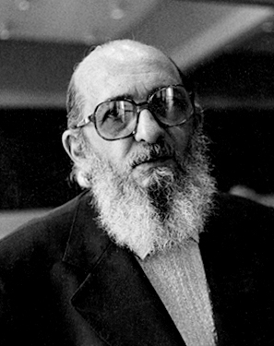
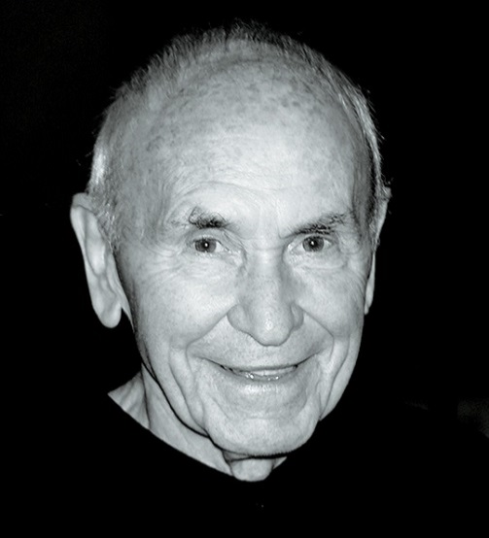
Paulo Freire
Critical Thinking: People can make things happen rather than accept what happens to them. The aim to encourage active participation in social and political life and challenge apathy, indoctrination, and prejudice.
Conscientisation: Critical consciousness is a form of emancipatory learning – the focus is on root causes rather than symptoms in order to challenge oppressive systems.
Praxis: Reflection and action leading to change. Education is part of a process of transformation linked to affirmative collective action.
“It is a farce to affirm that men are people and thus should be free, yet to do nothing tangible to make this affirmation a reality.”
Jack Mezirow
Learning process: Changes to habits of mind and points of view. Can include a ‘disorientating dilemma’ or critical thinking opportunities that allow us to step outside of our habitual perspectives.
Transformative learning: About a change to a way of knowing, therefore it is an epistemological change and not just change in behaviour or accumulation of more knowledge.
Action: Action shouldn't just happen at the end of learning; action and learning are inseparable.
“Transformations may be epochal – sudden major reorientations in habit of mind…– or cumulative, a progressive sequence of insights resulting in changes in point of view”

Slide 4
Learning &
Connection
Issues, stories, me and the world
Action
How will we achieve the change we want?
Reflection
What was the impact of our actions? How did we grow and change?

Slide 5
Action in Schools
Awareness Raising & Peer-Learning Creative | Sports & Events
Environmental | Research and Surveys
Lobbying & Political | Public Speaking & Debates
Community & Volunteering | Online & Social Media
Fundraising | Creative Action
Petitions & Letter-writing | Solidarity Action
Sports & Events | Protests & Vigils
What is already happening in your schools?
What are the curriculum links?
Where are the gaps? What are the challenges?

Slide 6
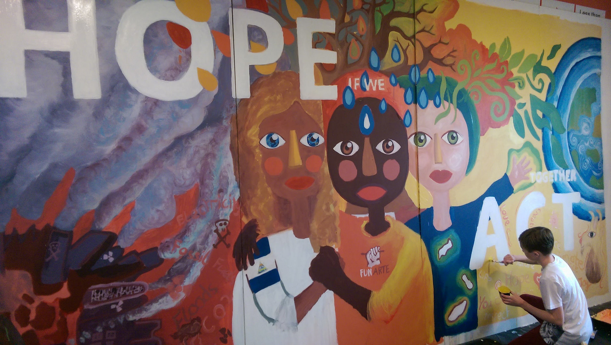
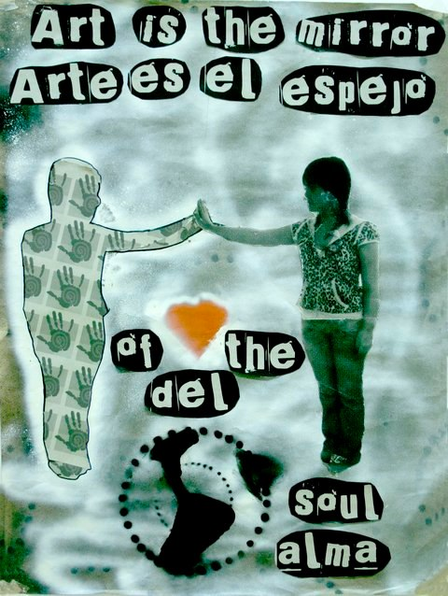
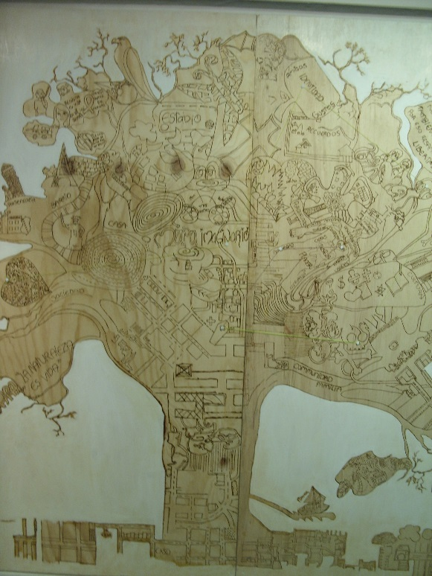
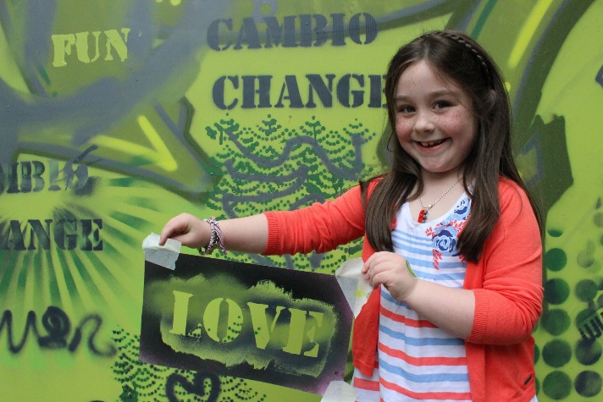
Creative Action
Notes:
Mayfield Arts Centre Cork: http://www.mayfieldarts.ie/ (poster and girl with stencil)
Centro Colombo Americano community arts programme in Medellin Colombia – The tree is created using pyrography tools on wood, and is a collaborative piece documenting the neighbourhood of young people in order to map identify and experiences
Climate Change Mural with 6th classes in schools in Skerries – There is Hope if we Act Together - https://developmenteducation.ie/feature/hope-act-together-climate-justice-mural-skerries/

Slide 7
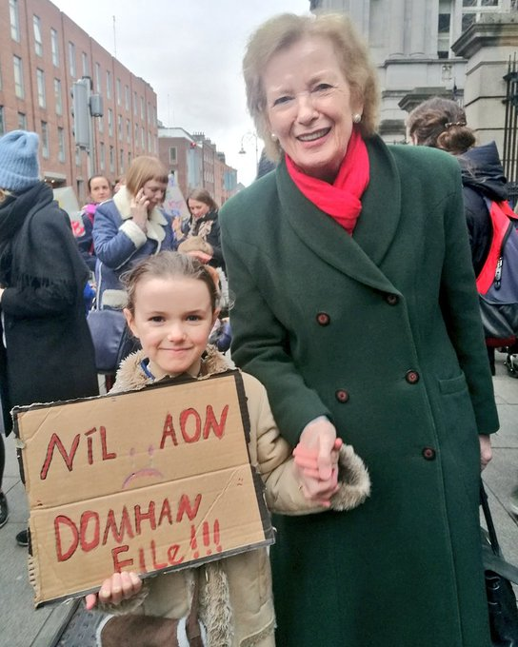
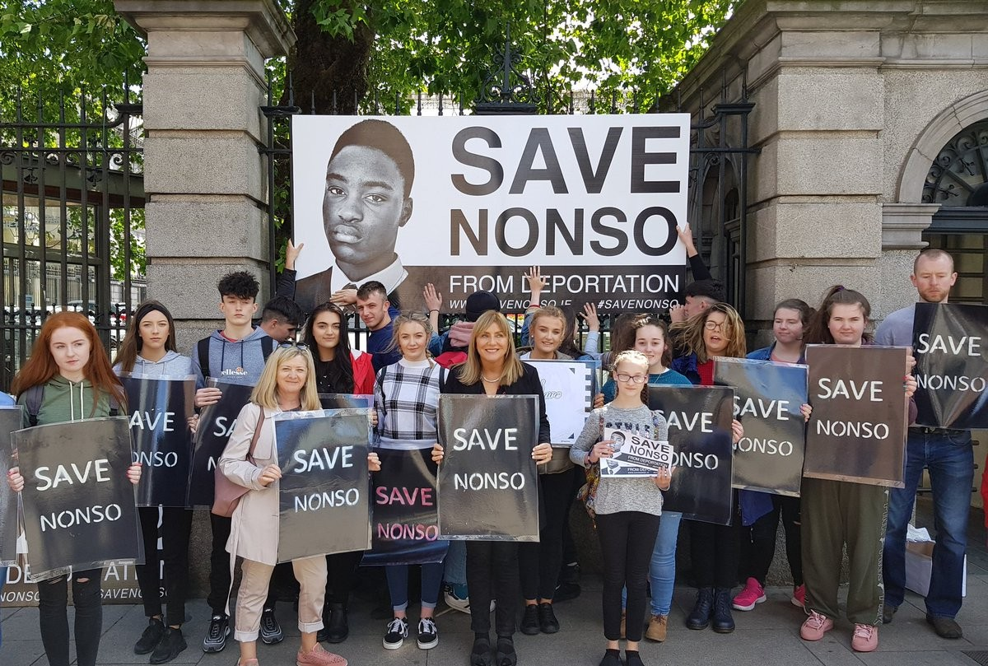
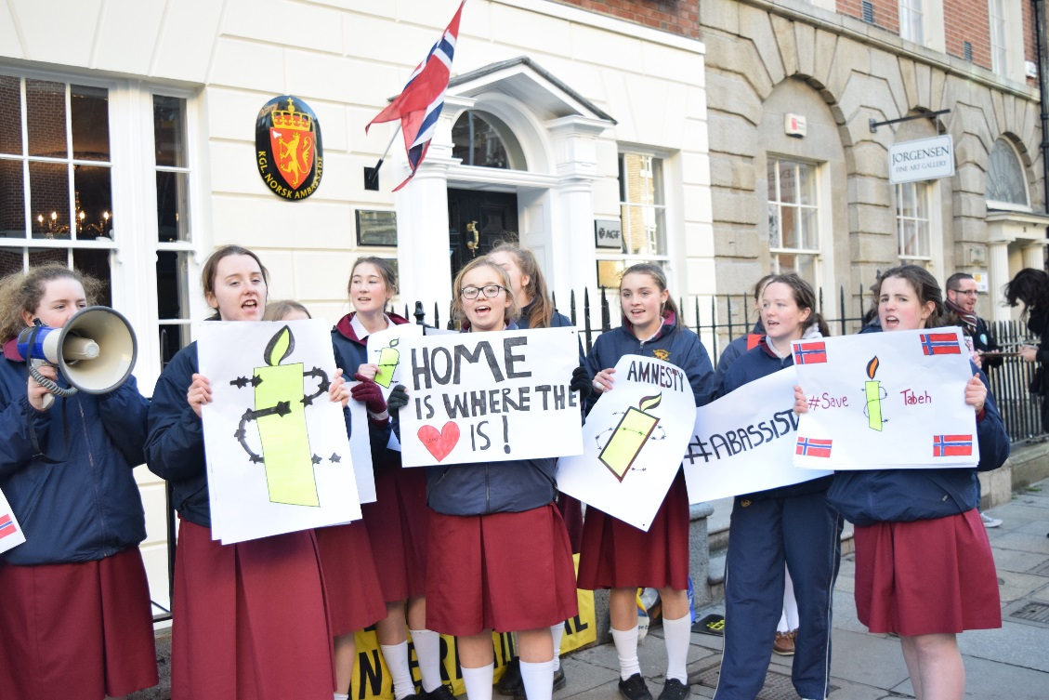
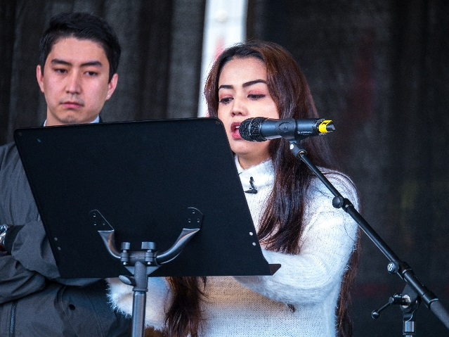
Political and Protest Action
Notes:
Loreto on the Green Students protesting at the Norwegian Embassy 15th December 2017 to stop deportations of people like the 18 year old Taibeh Abbasi and others to danger in Afghanistan - https://www.amnesty.ie/urgent-stop-taibehs-deportation-now/
Climate Case Irealnd family protest at the Dail
Save Nonso campaign – students lead a campaign to stop the deportation of their friend, a 16 year old boy and his family originally from Nigeria

Slide 8
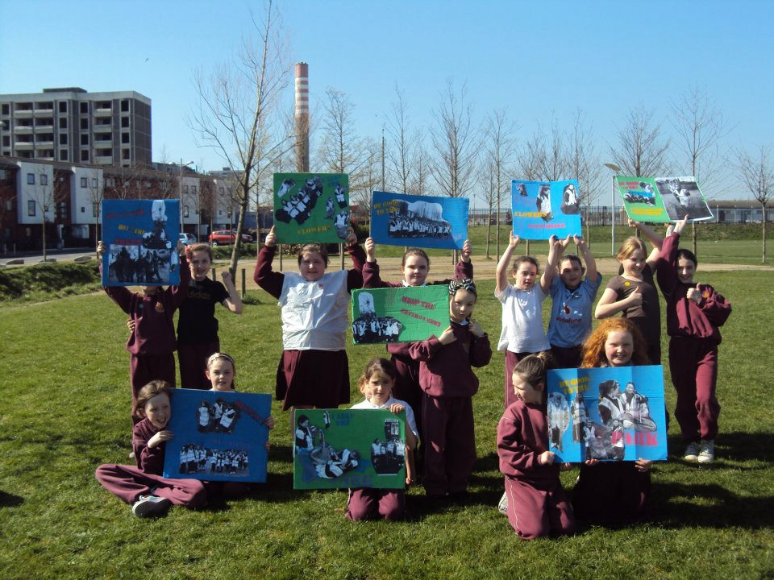
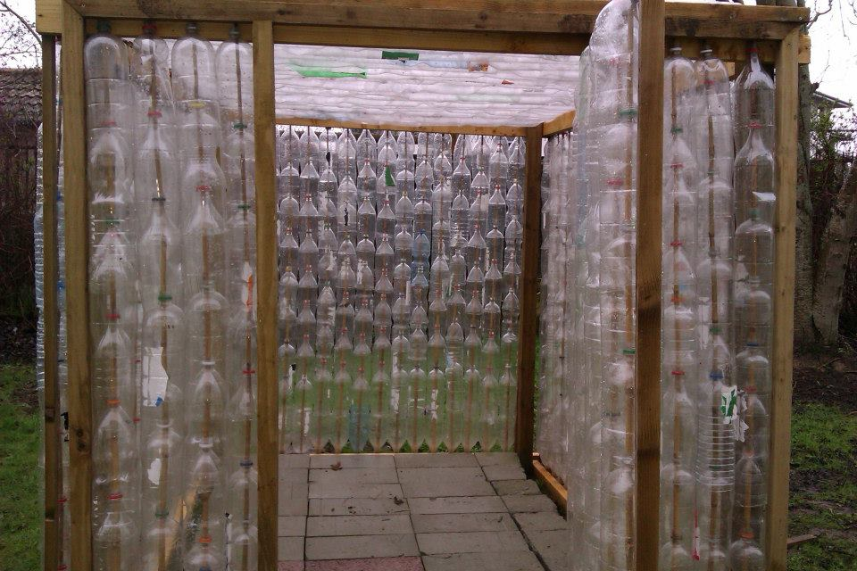

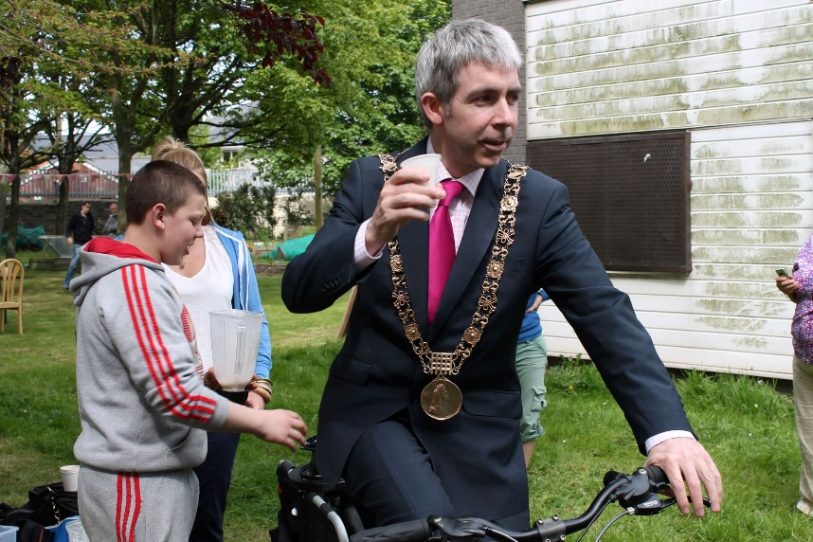
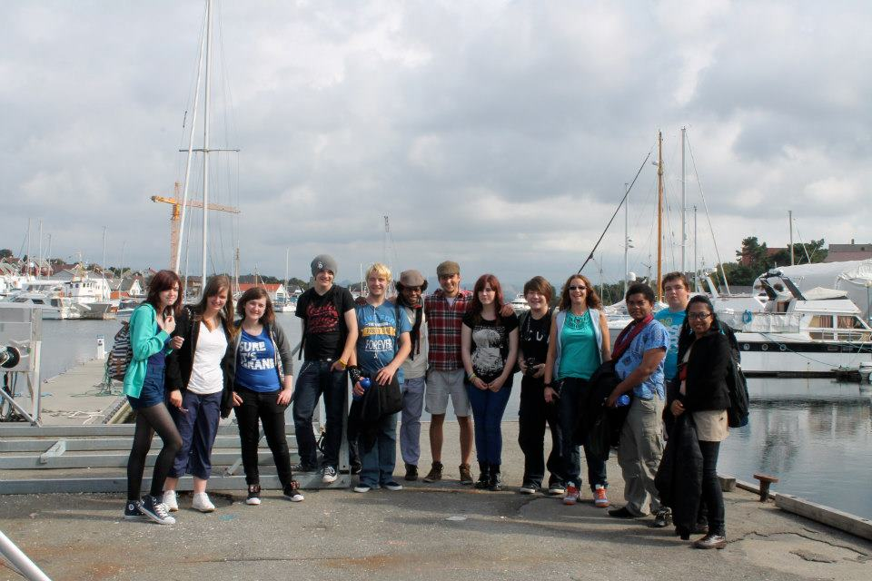
Community & Environmental Action
Notes:
Community action and environmental projects with Global Action Plan in Ballymun: http://globalactionplan.ie/

Slide 9
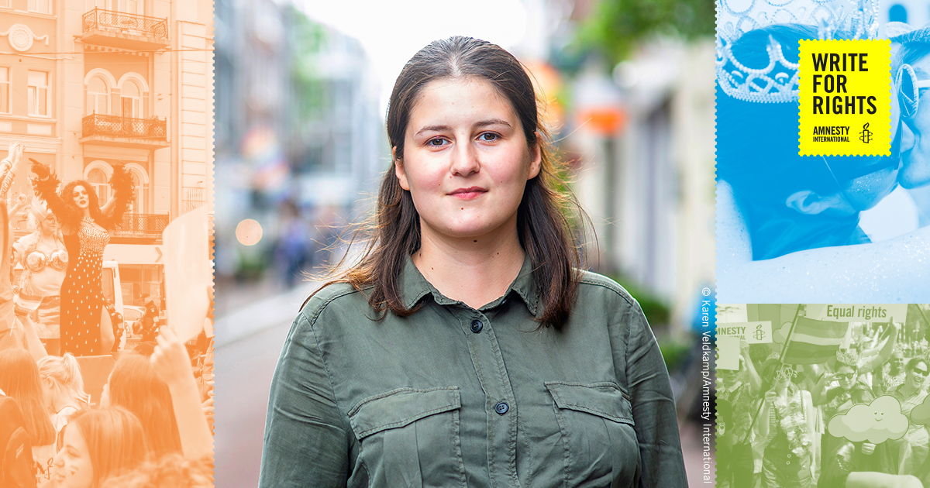
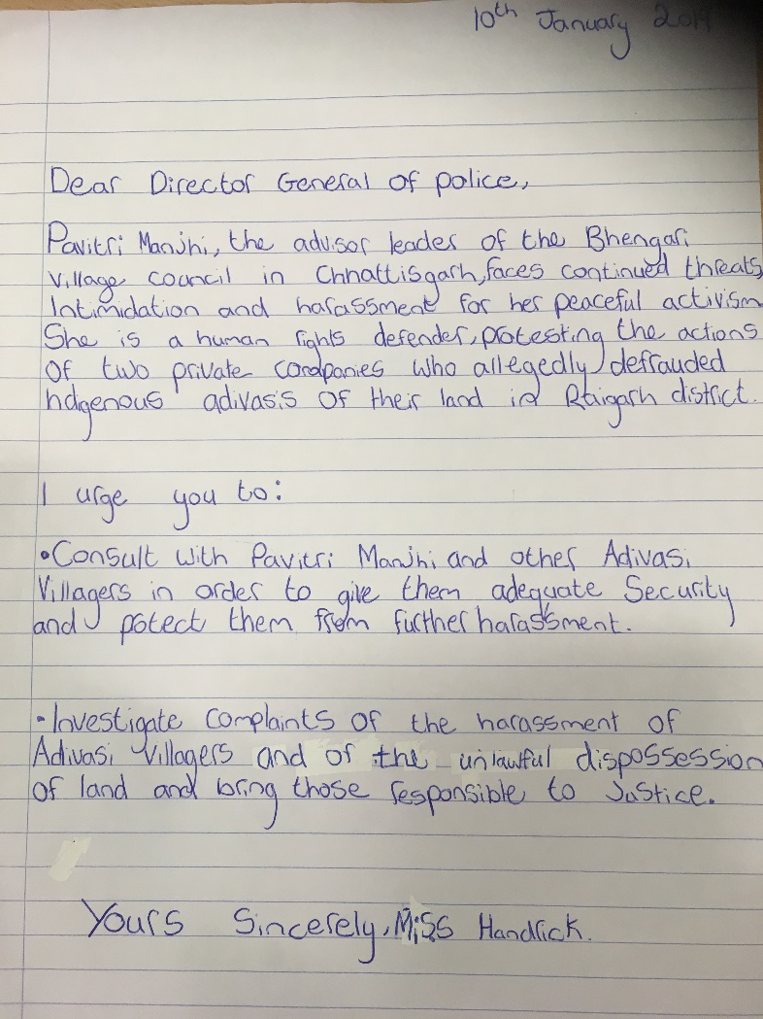
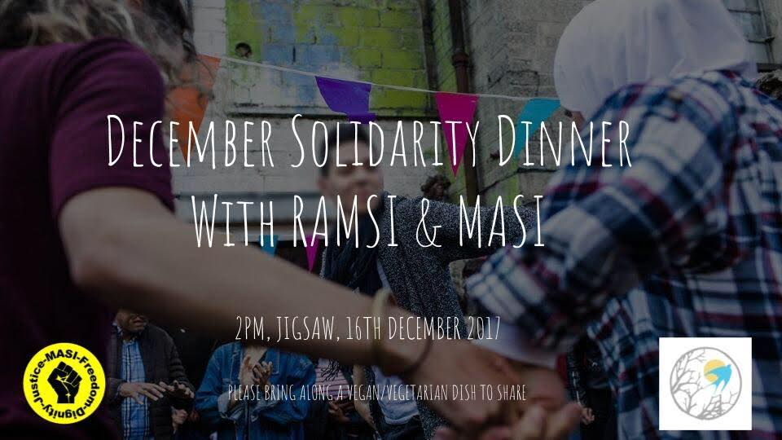
Solidarity Action
‘Stories of Refugee, Stories of Welcome’ Schools Programme
Notes:
Amnesty International project facilitated by people who are asylum-seekers/refugees and living in DP in schools (funded by WWGS)
Writing letters directly to Human Rights Defenders (e.g. Vitalina Koval who defends LGBTI rights pictured) as part of Write for Rights
Refugee and Migrant Solidarity Ireland – Solidarity Dinners in Dublin

Slide 10

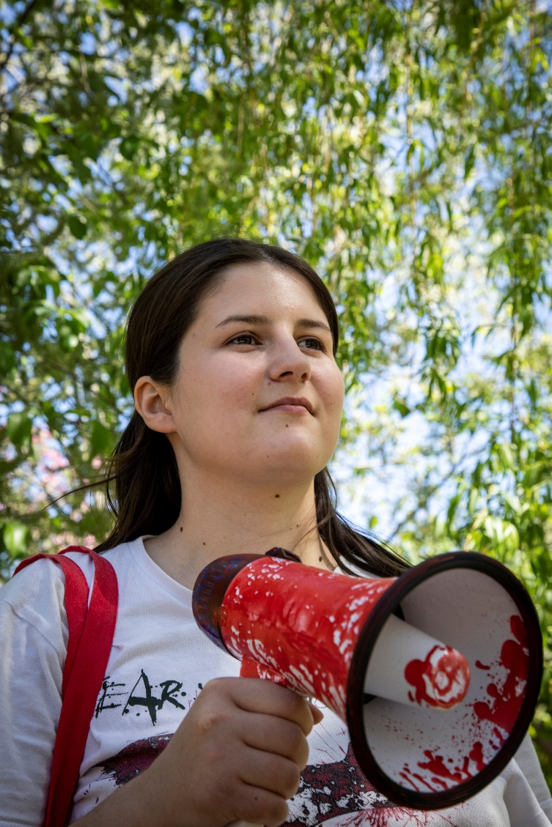
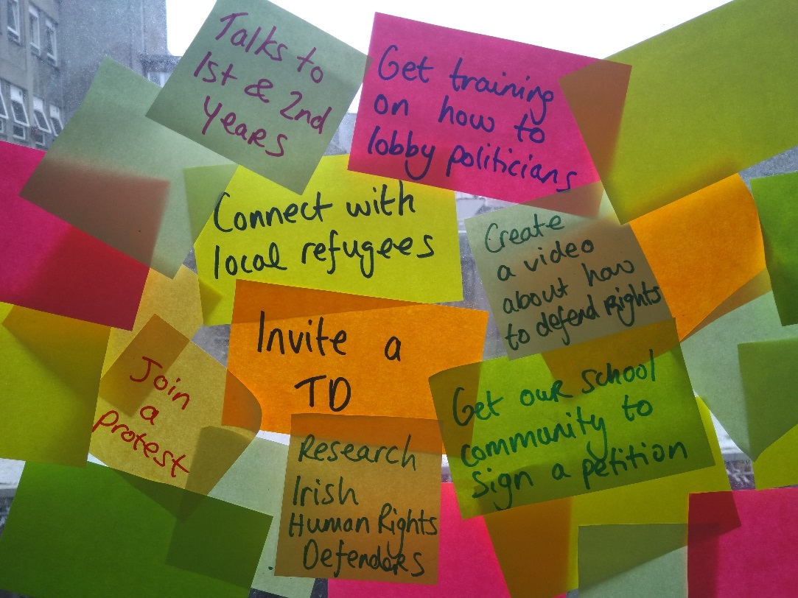
Human Rights Defenders (HRDs) are empowered, safe and supported, alongside thousands who are inspired to act with them against injustice.
Vitalina Koval
LGBTI+ Activist in the
Ukraine
Brainstorm for Action Activity!

Slide 11
Reflection & Evaluation
Plan & Start
Act & Reflect
End & Reflect
SAT – modified to suit the action project
Timeline - to place ourselves back in the process
Questions:
What worked well?
What was challenging? What would we do differently next time?
What skills did we gain?
How did this activity help to achieve to change we wanted?
How did we monitor our activity?
E.g. number of petitions, comments of people we engaged, responses from politicians, number of likes and shares on social media, number of people attending an event etc. )

Slide 12
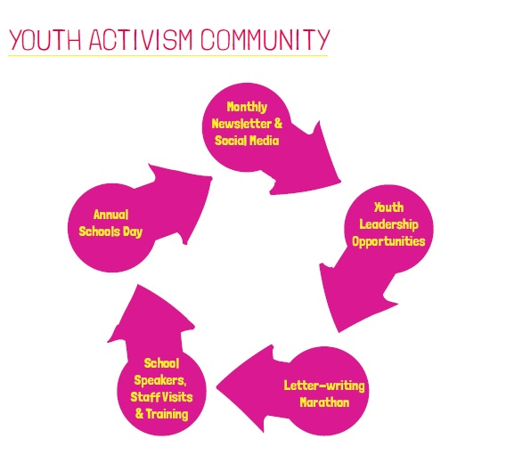

Twitter: @amnestyouth Instagram: actamnesty
Facebook: @youthamnestyireland

Slide 13
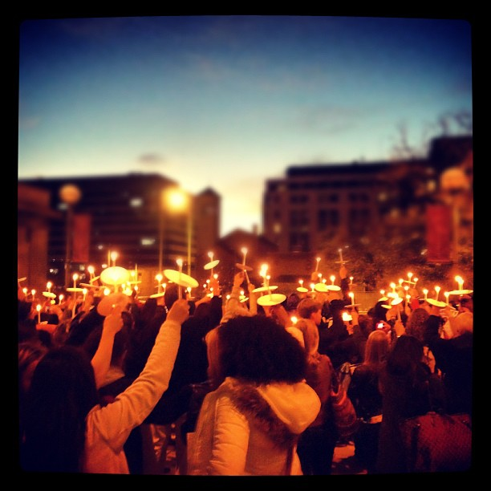
Create change together
Notes:
Tools
The checklists and tools from the HRCA booklet
Dochas Guidelines

