Slide 1

National Teacher Conference 2019
#WWGSTT2019
WiFi:

Slide 2
Agenda
Time | Activity
9.45 | Introduction to the day
10.15-11.50 | Global Café –Idea Exchange
12.00-1.00 | Workshop 1 (various room)
1.00-1.45 | Lunch
1.45-2.15 | Resource Fair
2.15-3.15 | Workshop 2 (various room)
3.15-3.45 | Evaluation and Close

Slide 3
Why are we here?
Upcoming key dates for your diary
A look back at the year so far
WWGS Supports

Slide 4



Slide 5


Slide 6
Key dates for your diary!
Global Passport Award : Apply Online by Feb 28th
2) Irish Language Event: Global Citizenship Education March 29th Galmont Hotel Galway
3)Annual Student Confernece: April 4th - Croke Park
4) Funding Call for Schools → 2019-2020 School Year
Opens: April 8th Closes: May 10th
Online Application
5) Final Report on this years project: May 10th

Slide 7

Next webinar: February 14th 4.30pm
Focus: Global Passport Award

Slide 8
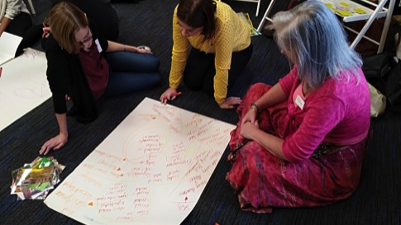
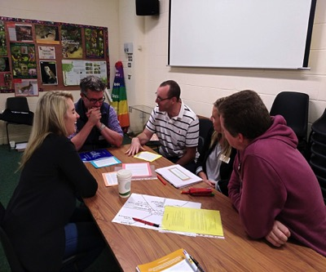
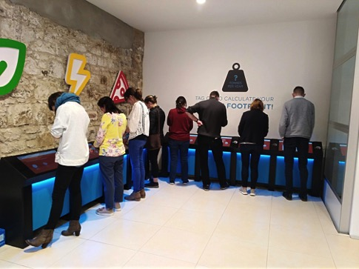
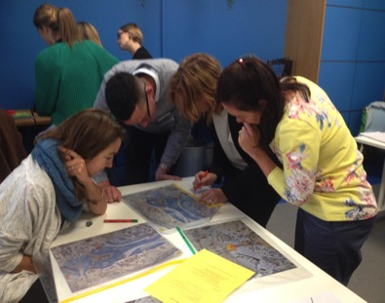
Regional Teacher Training Sept & Oct 2018

Slide 9
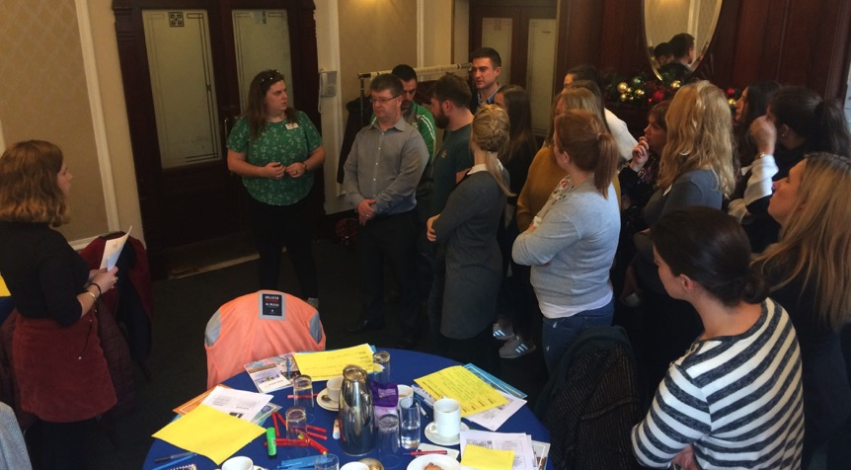
Global School Partnership Training

Slide 10

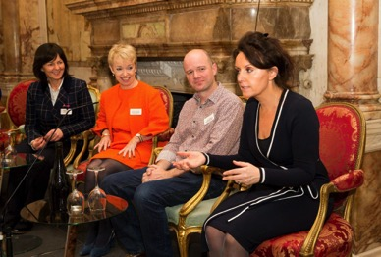

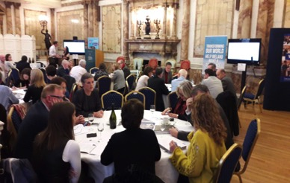
Symposium for School Management on Global Citizenship Education November 15th 2018

Slide 11
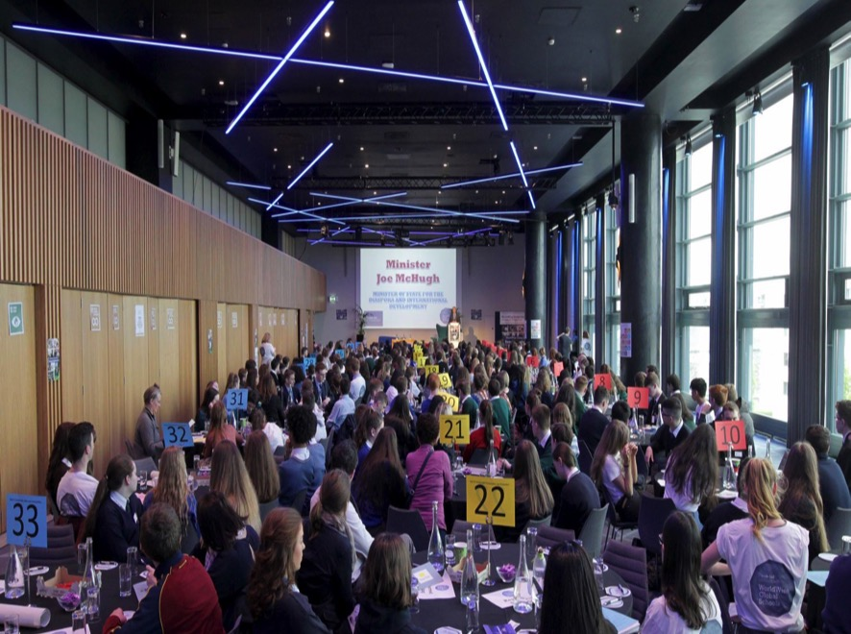
Croke Park April 4th 2019
4 students and 1-2 teachers

Slide 12
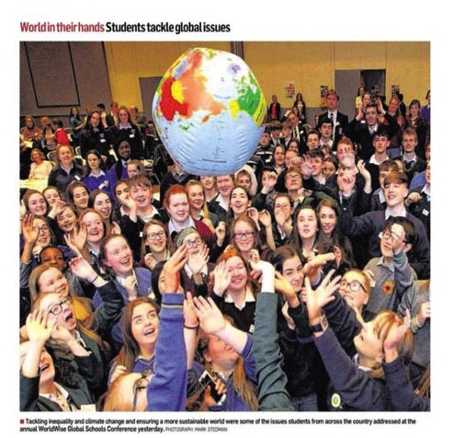
4 students and 1-2 teachers
Call for student performances/student panel
You will be asked to display your projects-take a stand/poster presentation
We will be in touch soon with registration link and more details
Croke Park April 4th 2019
Few points to note:

Slide 13


WWGS School Grant Funding: Budget Check-Up
Check your budget online
Contact your Education Officer for guidance and support
Keep a record of spending
Speak to other teachers about their plans

Slide 14













Large community of NGOs involved in Post-Primary GCE in Ireland
Resource fair after lunch
1.45-2.15pm

Slide 15



GCE and the Curriculum

Slide 16

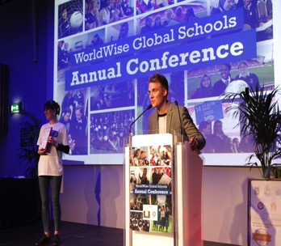
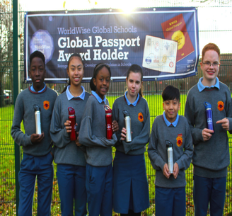


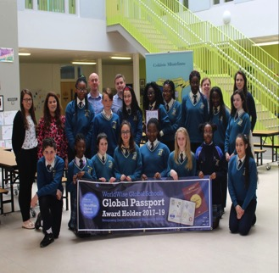

Global Passport Award
Apply by Feb 28th 2019

Slide 17



WWGS on Social Media
@WorldWiseGlobalSchools
@WorldWise_Irl
http://www.worldwiseschools.ie
#WWGSTT2019

Slide 18
Session 1
Global Café
Idea Exchange
10.15-11.50

Slide 19
Session 2
Workshops
12.00-1.00

Slide 20
Session 3
NGO Resource Fair
1.30-2.15

Slide 21
Session 4
Workshops
2.15-3.15

Slide 22
Session 5
SAT-Self Assessment Tool (Teacher Survey)
Expense Claims
3.15-3.45

Slide 23
Key dates for your diary!
Global Passport Award : Apply Online by Feb 28th
2) Irish Language Event: Global Citizenship Education March 29th Galmont Hotel Galway
3)Annual Student Confernece: April 4th - Croke Park
4) Funding Call for Schools → 2019-2020 School Year
Opens: April 8th Closes: May 10th
Online Application
5) Final Report on this years project: May 10th

Slide 24
Global Passport Award
Apply by Feb 28th 2019

Slide 25
4 students and 1-2 teachers
Call for student performances/student panel
You will be asked to display your projects-take a stand/poster presentation
We will be in touch soon with registration link and more details
Croke Park April 4th 2019
Few points to note:

Slide 26


Slide 27
4 Rotations: 20 minutes
Part 1 – Overview of GCE Activity by table host (5mins)
Part 2 – Questions from teachers (5mins)
Part 3 – Sharing Experience (5mins)
Part 4 – Capturing ideas and future plans (5mins)
On the table cloth-activity & name
Wildcard & Coffee!

Slide 28

https://www.youtube.com/watch?v=M2dhD9zR6hk

