Slide 1


Climate Change, Climate Action
Meaghan Carmody
Head of Mobilisation at Friends of the Earth
Mobilisation Coordinator for the Stop Climate Chaos Coalition
meaghan@foe.ie

Slide 2
Climate Change Outburst Relay!
Get into groups of 4.
Take a flip chart sheet
Get in a line
When I say go, the first person writes a word associated with climate change, beginning with A. The next person writes one beginning with B, and so on.
Write as fast as possible but legibly, and the group that gets the farthest wins!
Your teammates can help you!

Slide 3
Find your match!
On the floor are _____ slips of paper (should be the same as the number of people)
Take one and find your match
Some could be questions, others are statements
  If a question or answer, find your match
  If a statement, find the person with the same statement
When you find your match, talk about:
  What this information means to you. Did it surprise you?
  What you think your students would think of it
Feedback briefly in the circle

Slide 4
Stand up, sit down!
I am concerned about climate change
I feel equipped to help my students feel confident enough to act on climate change
I have completed an educational session with my students on climate change

Slide 5

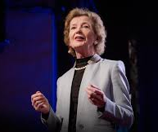
Climate Justice
Dirty Energy is at the Root of Climate Justice

Slide 6
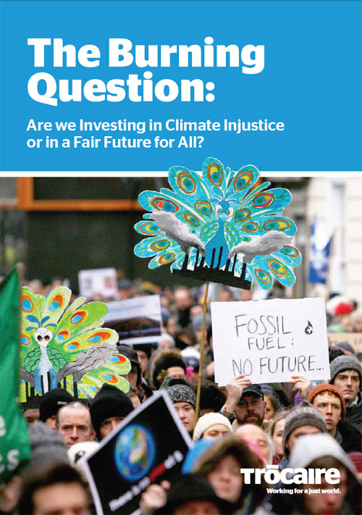
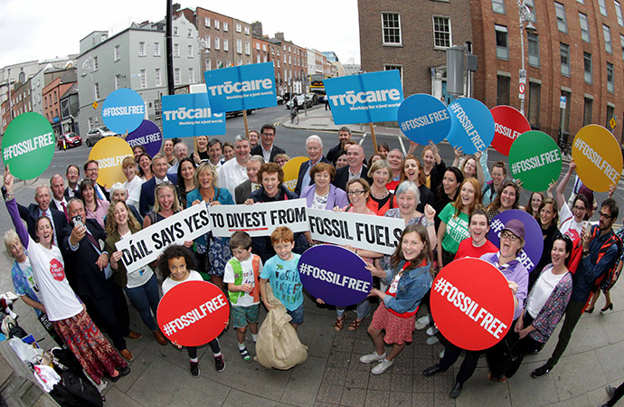
https://www.youtube.com/watch?v=HcsXm1UI0fs

Slide 7
Causes and effects
Split into 4 groups
Two groups focus on causes, two on effects
Write one cause and one effect per post it
Causes on green post its
Effects on yellow

Slide 8
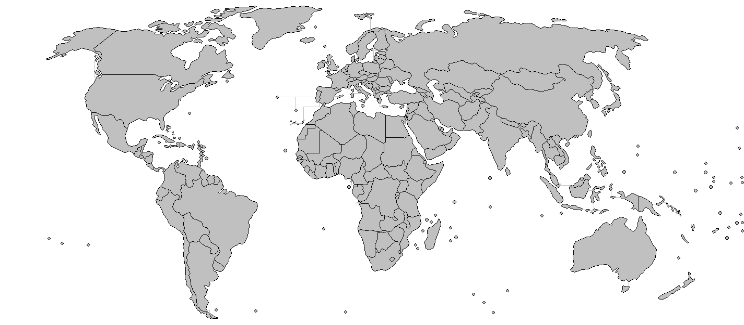

Slide 9
Role play in pairs
Scenario 1:
  Person A lives in Honduras, and worked with Berta Caceres who was killed for our efforts in 2016.
  Person B works Dutch development bank FMO, one of the backers of the Agua Zarca dam on the Gualcarque river which Caceres was resisting.
Scenario 2:
  Person A works in the Petroleum Affairs Division of the Irish government.
  Person B is part of a community resisting a new gas terminal in Kerry.
Scenario 3:
  Person A works for ExxonMobil.
  Person B lost their home in Typhoon Haiyan I 2013, and the insurance company will no longer insure them as they are living in a ‘high-risk’ area.

Slide 10
Any reflections?

Slide 11
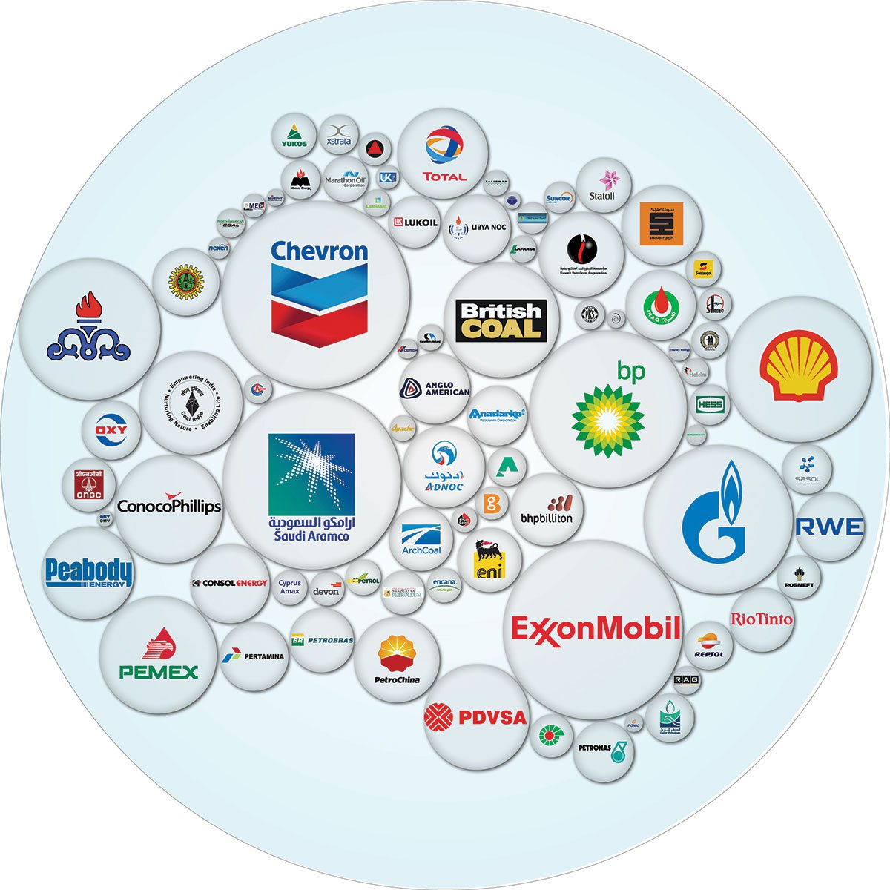

Slide 12
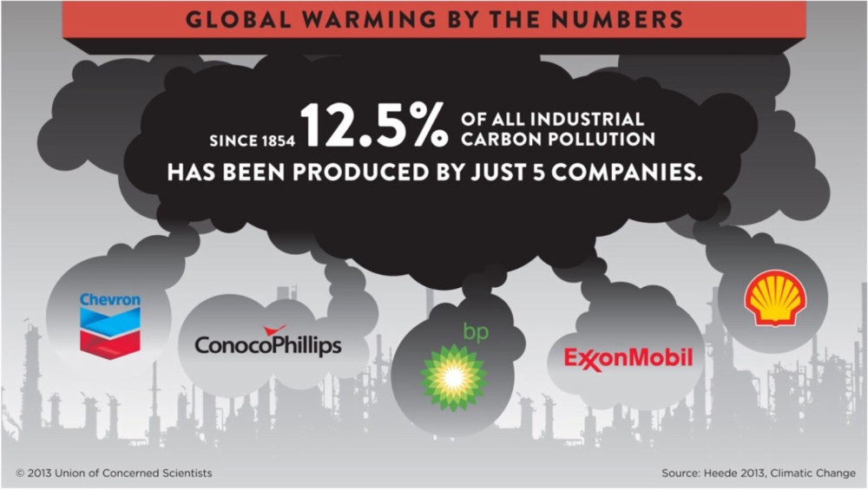

Slide 13
Historical Responsibility
Rank these countries in terms of their carbon dioxide emissions per capita:
Afghanistan
United Arab Emirates
Australia
Burundi
China
United Kingdom
Honduras
Haiti
Ireland

Slide 14
Afghanistan | 0.299444991 | 7
United Arab Emirates | 23.30202251 | 1
Australia | 15.37013776 | 2
Burundi | 0.044485376 | 9
China | 7.543907641 | 3
United Kingdom | 6.49744049 | 5
Honduras | 1.07522179 | 6
Haiti | 0.270538586 | 8
Ireland | 7.313939808 | 4
Source: https://data.worldbank.org/indicator/EN.ATM.CO2E.PC

Slide 15
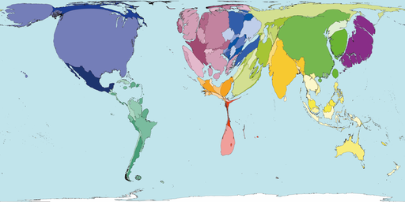
What does this image represent?
Territory size shows the proportion of carbon dioxide emissions in 2000 that were directly from that country.
Notes:
Climate change as a political issue – what does this represent? It represents the historical responsibility the countries of the world have for the climate change we ar experiencing.
Questions: Which countries are the most polluting?
Which countries do you think are suffering the most from the impacts of climate change?

Slide 16
Ireland’s track record on climate action
Ireland has the third highest greenhouse gas emissions per person among the EU28 (2016, source Eurostat)
Ireland has the eighth highest greenhouse gas emissions per person among the OCED 35 (2014, WRI CAIT)
Ireland is one of only two EU countries that are projected to overshoot their 2013-2020 GHG emissions target (2017, EEA).
The latest projections from Ireland’s EPA is that on current trends, Ireland’s emissions will still be 13% above 1990 levels in 2030 (2018, EPA).
In the 2018 Climate Performance Index from Germanwatch ranked Ireland as the worst climate performer in the European Union, 49th out of 57 countries ranked overall.
The Climate Action Network Europe report Off Target, published on 18th June 2018, ranks Ireland second worst in Europe for climate action, ahead only of Poland.

Slide 17
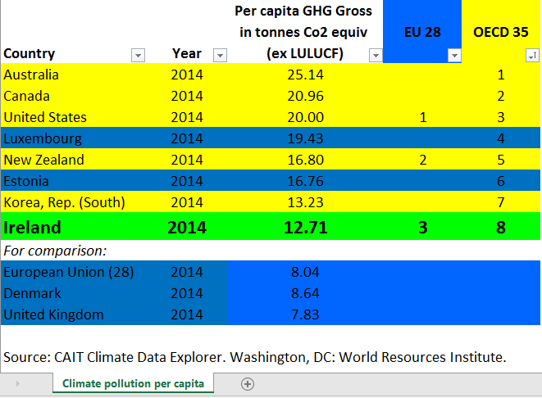

Slide 18
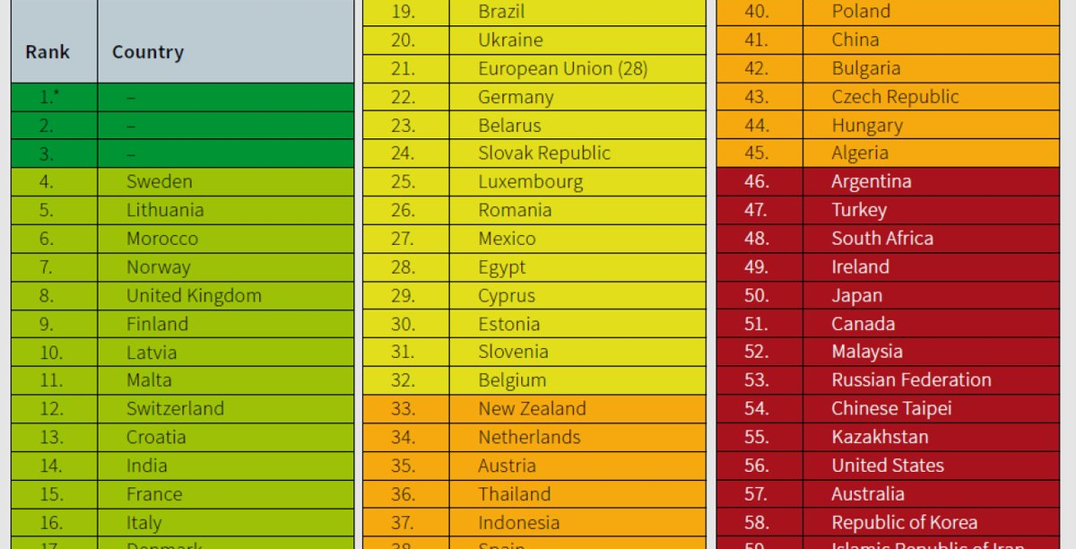

Slide 19
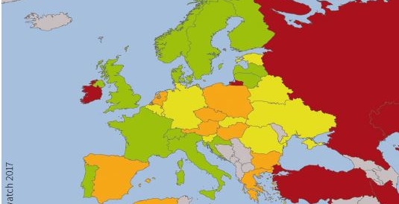

Slide 20
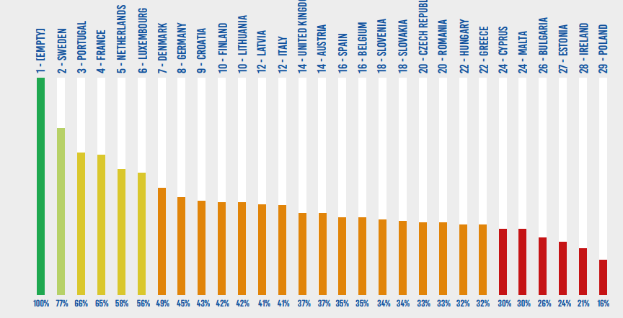

Slide 21
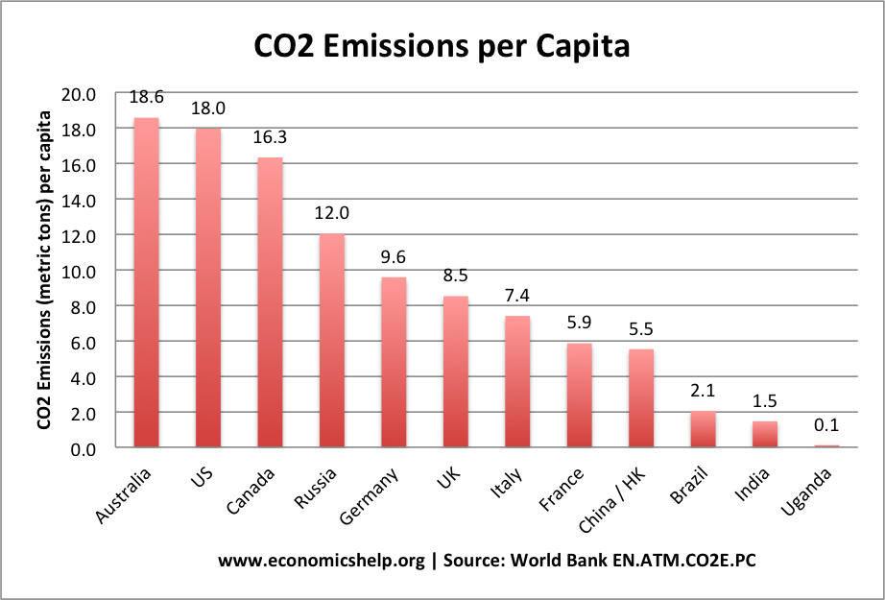

Slide 22
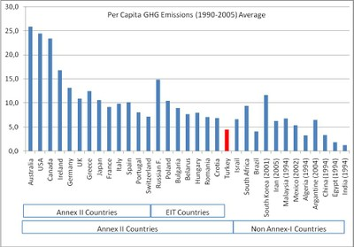

Slide 23
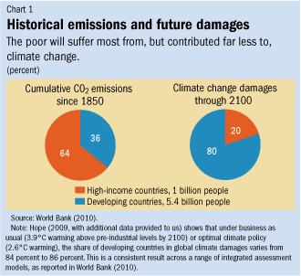

Slide 24
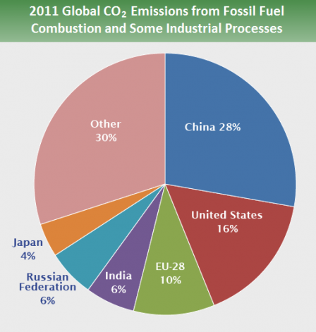

Slide 25
Spectrum Cross
Near board
Action is more easy to do
Fundraising for solar panels
Divesting from fossil fuels
Children suing
the government
4. School strikes
X
Near wall closest to door
Action is less effective
Near wall farthest from door
Action is more effective
X
Near window
Action is more difficult to do

Slide 26
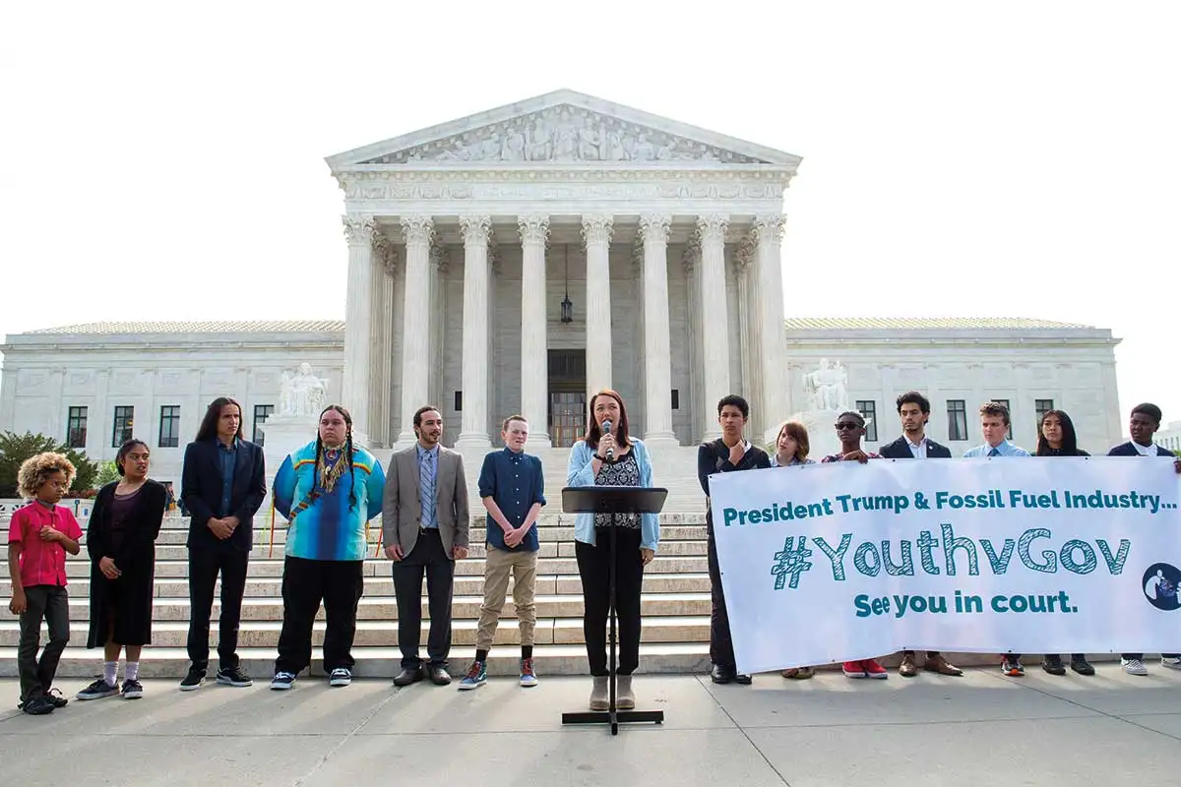
Children and teens suing their governments over lack of adequate action to prevent catastrophic climate change

Slide 27


Slide 28
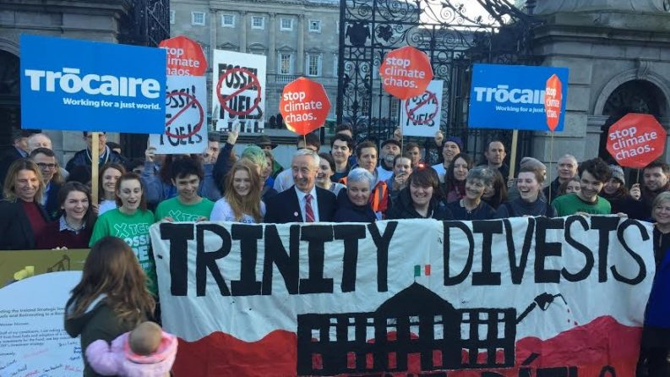

Slide 29
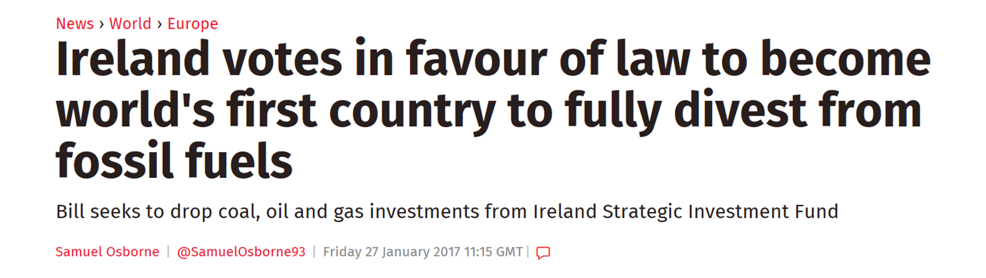

Slide 30
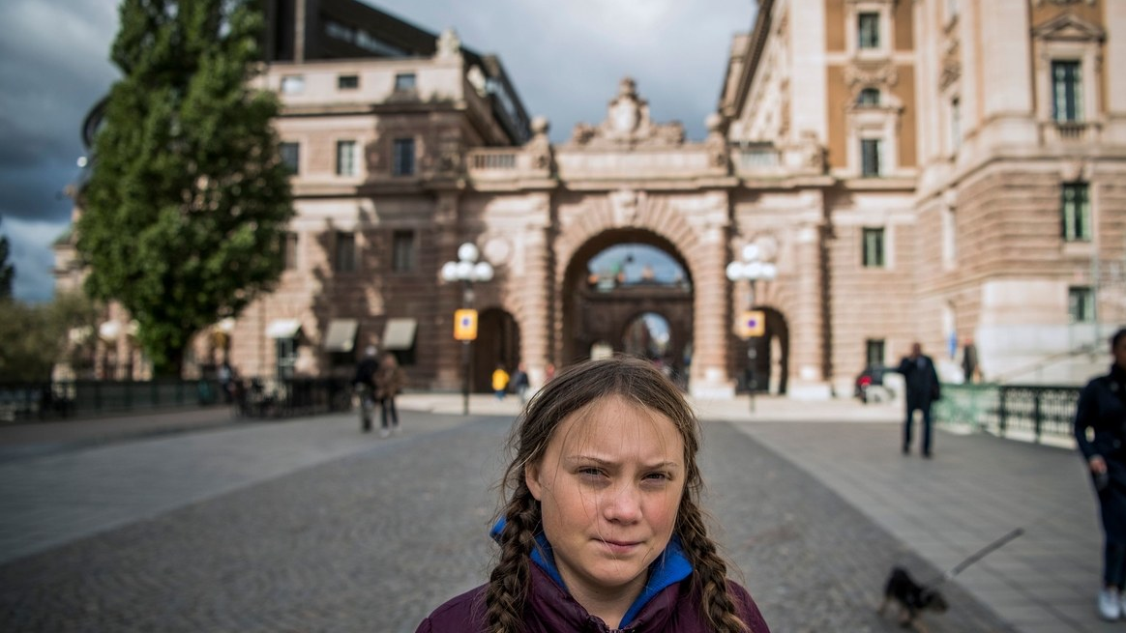
“I’ve learnt that you are never too small to make a difference.” – Greta Thunberg, 16

Slide 31
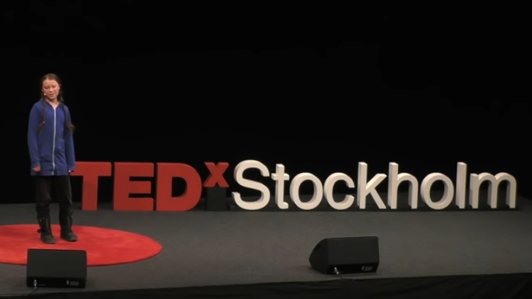
School strike for climate - save the world by changing the rules | Greta Thunberg | TEDxStockholm

Slide 32
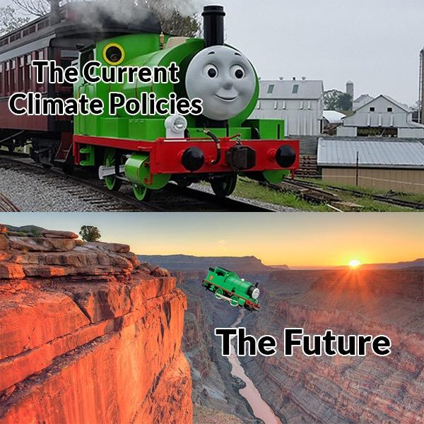

Young people have skills that can be used in the climate justice movement

Slide 33
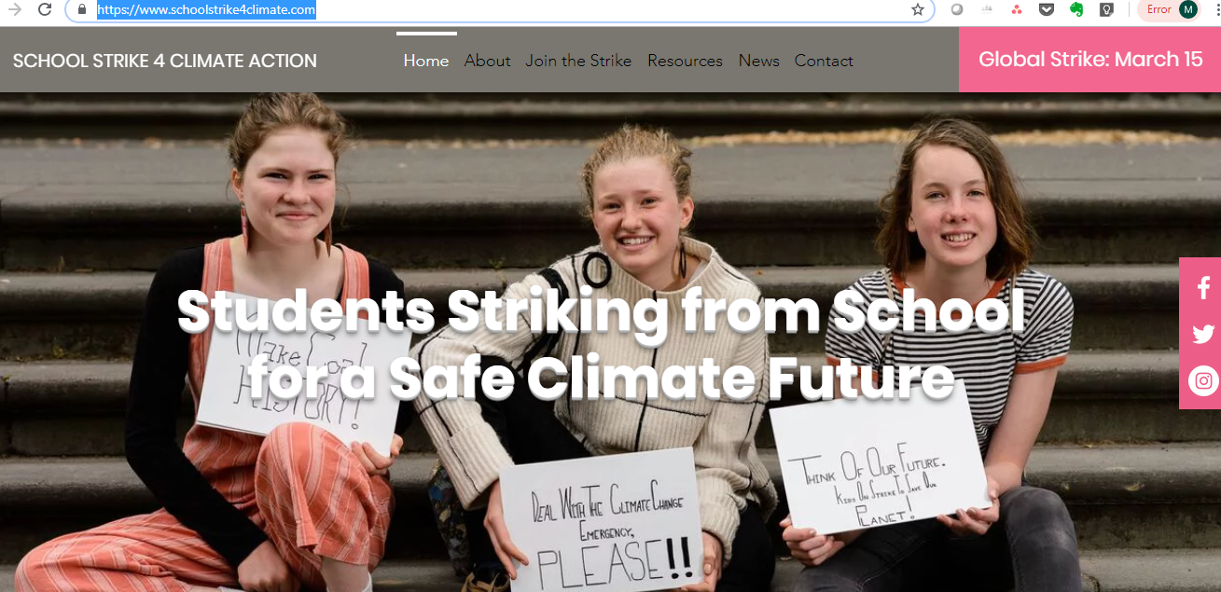

Facebook: join the group
Twitter: @StrikeClimate
Instagram: @climatestrike

Slide 34
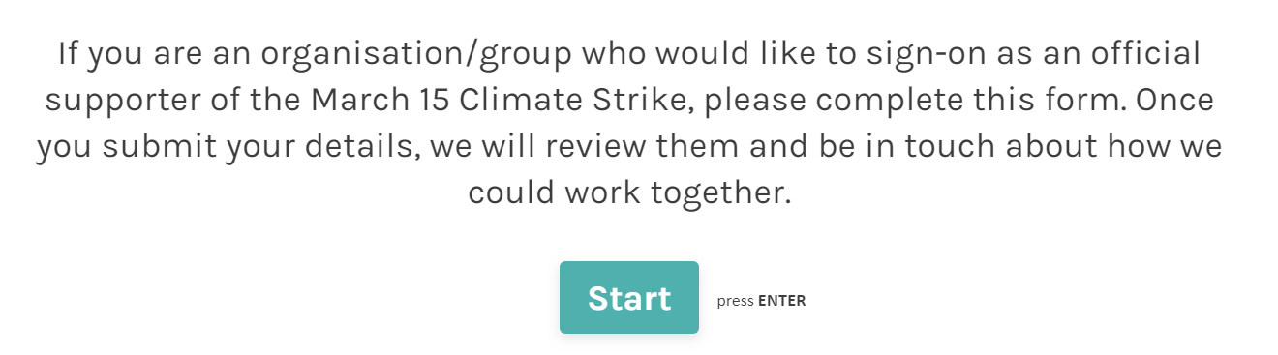

Slide 35
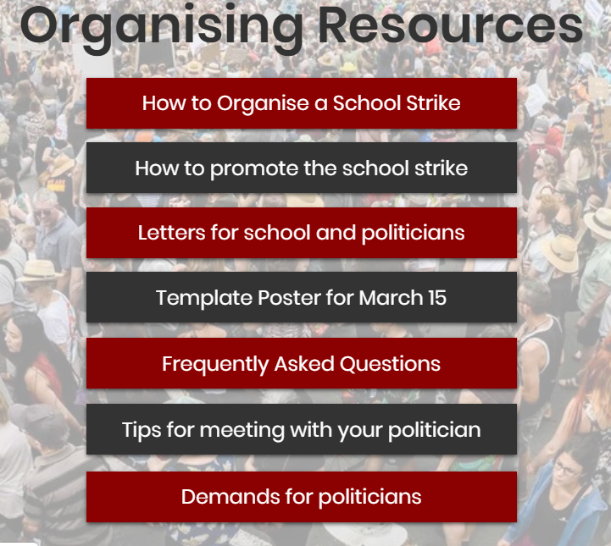

Slide 36
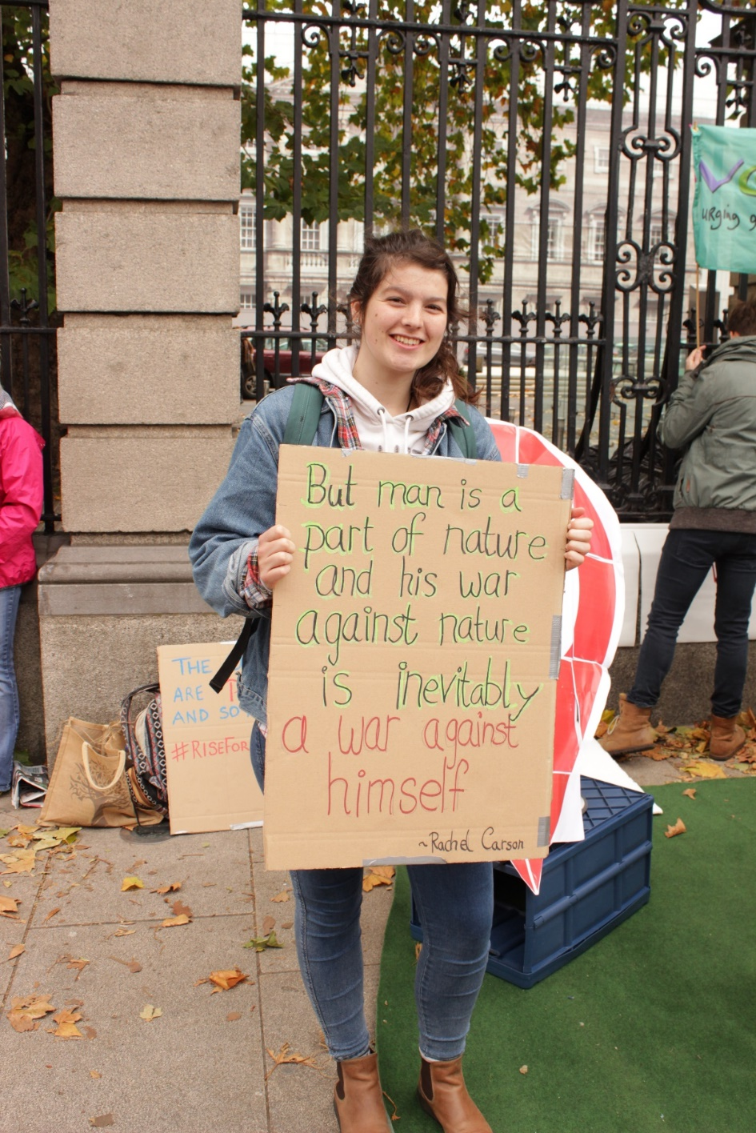
Hannah Fitzpatrick – Young Friends of the Earth

Slide 37
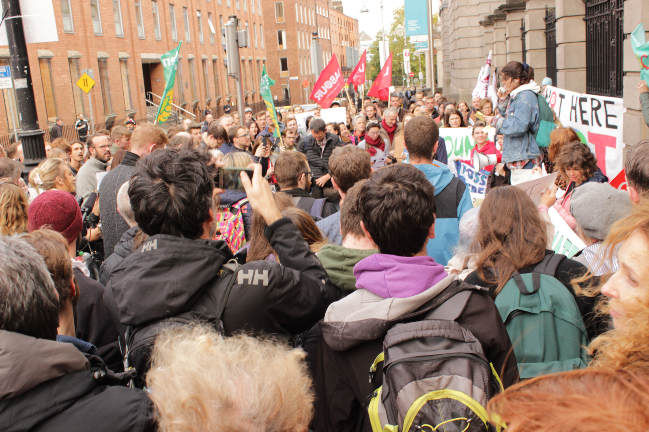
https://www.irishtimes.com/news/environment/climate-change-protest-in-dublin-we-want-change-and-we-want-it-now-1.3665755

Slide 38
Thank you!
meaghan@foe.ie
Friends of the Earth Ireland

