Slide 1



Presentation by Eukaria O’Grady (DP) to
WWGS Conference 11th Nov 2020
E-mail: deputy@limericketss.ie

Slide 2



LETTS Theme and Context for
WWGS and Global Citizenship Education
Initiative 2019 to 2020

Slide 3

LETTS WWGS and Global Citizenship Education : School and Community
Context: City/Suburban school with wide catchment and diversity of students
Relate to SDG 13 Goal
Junior Cycle Framework : Key Skills
Project Based Learning (PBL) initiative
Ethos – Community and Democracy

Slide 4
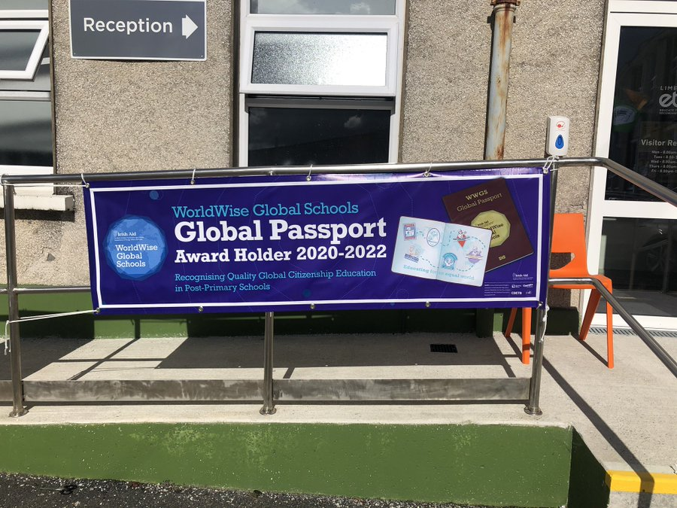

LETTS WWGS and Global Citizenship Education: How Managed in our school?
Agenda item on weekly staff update
Agenda item on board of management and parent council meetings, and staff meetings
Regular meeting with WWGS teacher representative : Norma Lowney and management – cover provided.
Part of other school initiative i.e. school show, green schools, Project Based Learning (PBL)
Mix of students and classes i.e CSPE, art and Music
Liaising and integrating with our Greens School Committee

Slide 5
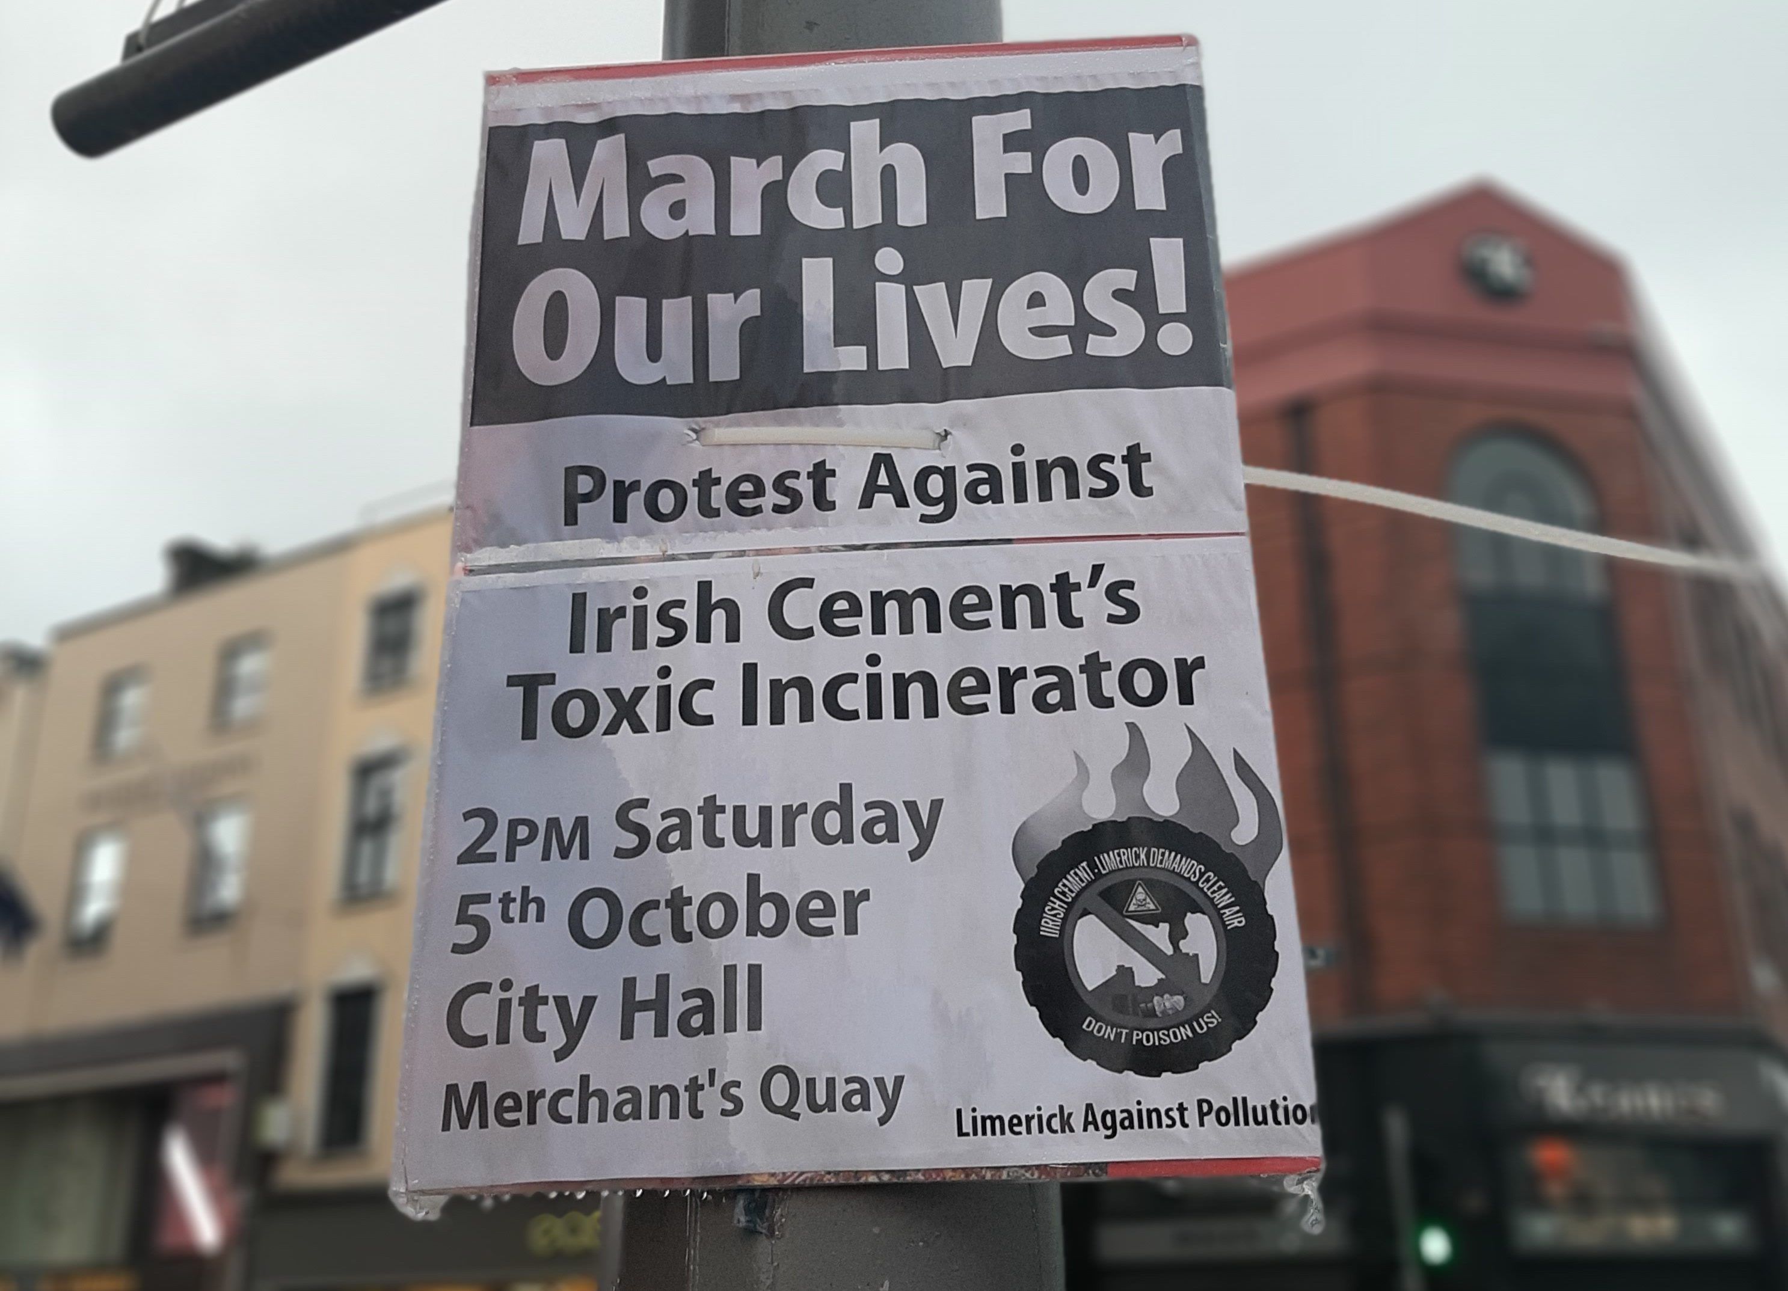
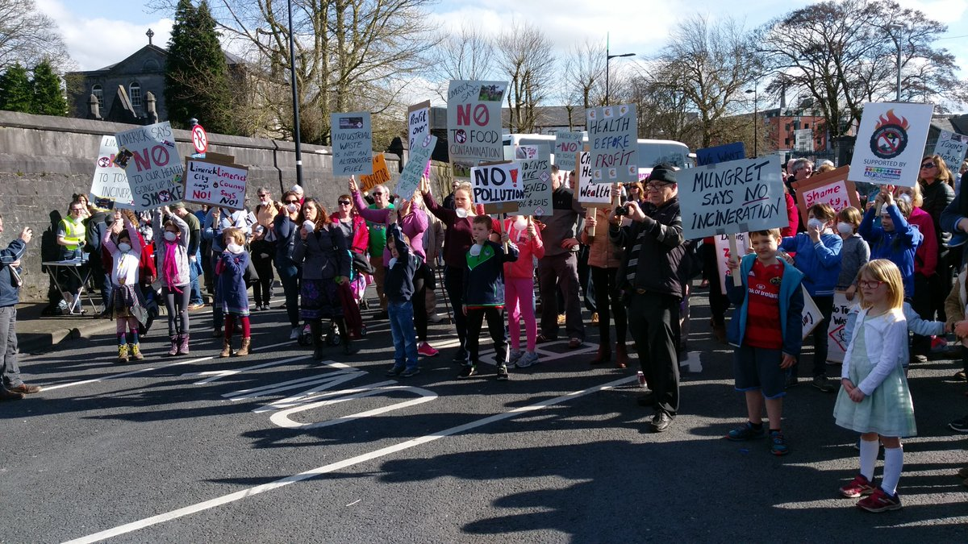
LETTS Theme and Context for
WWGS and Global Citizenship Education:
Climate Strike & Limerick Against Pollution

Slide 6
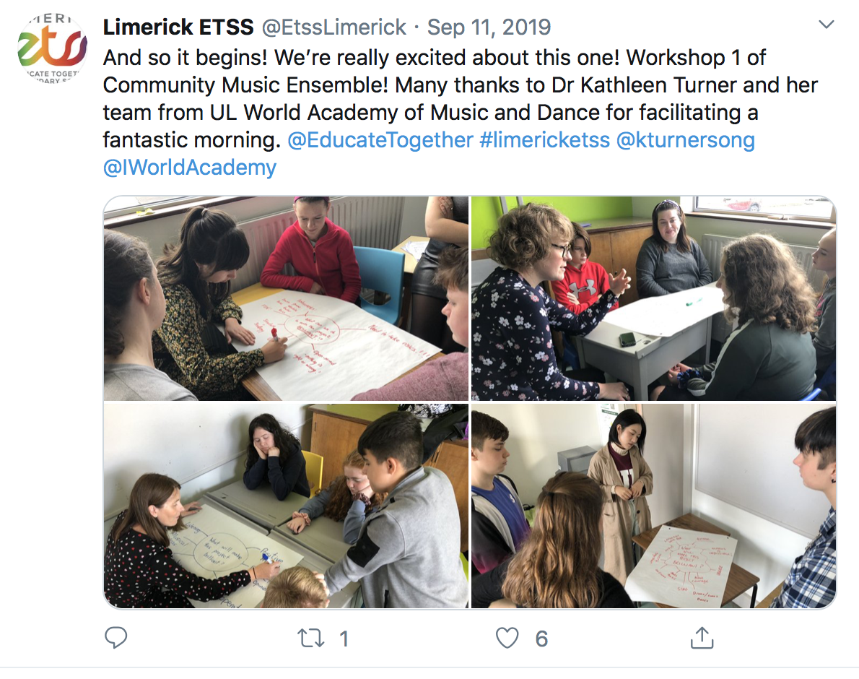
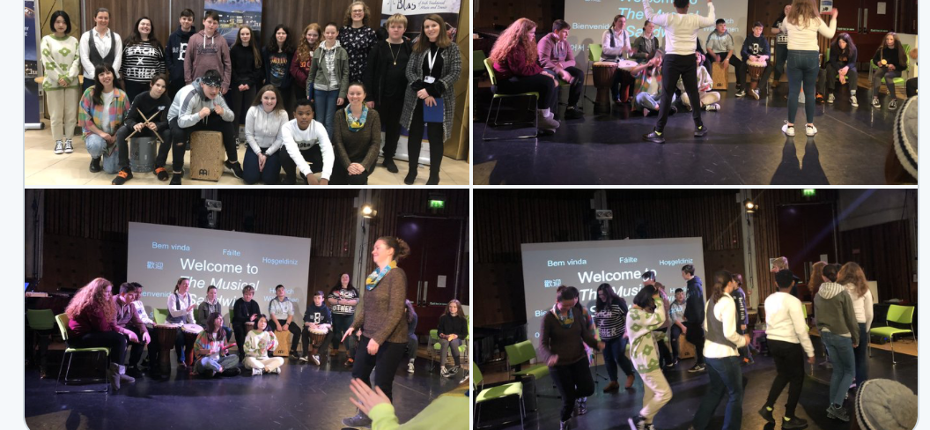
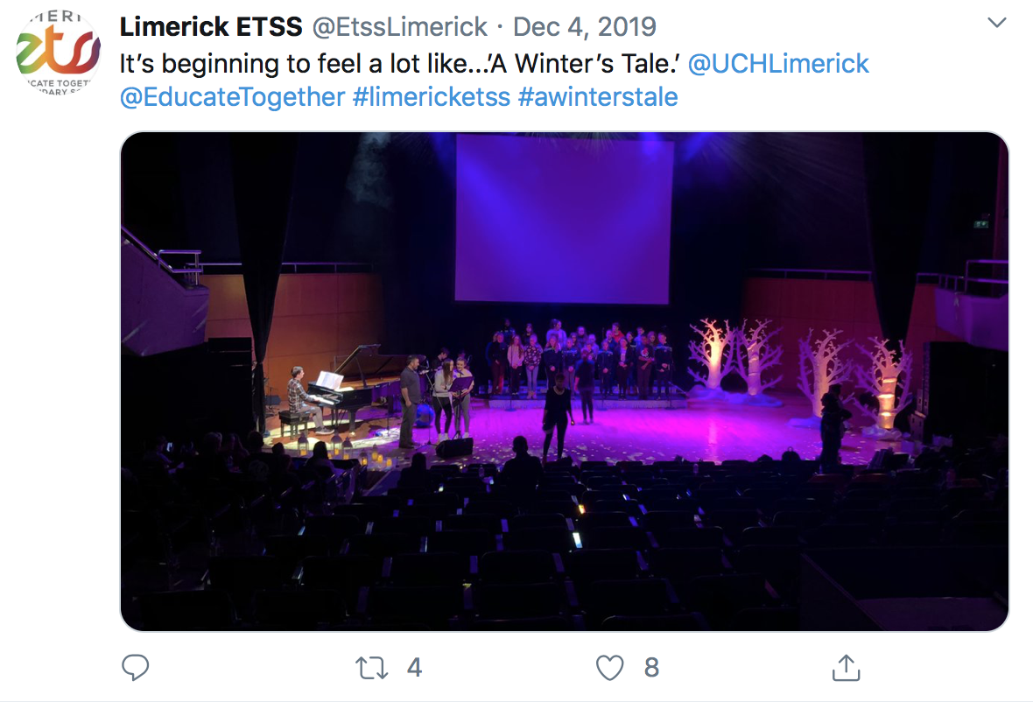
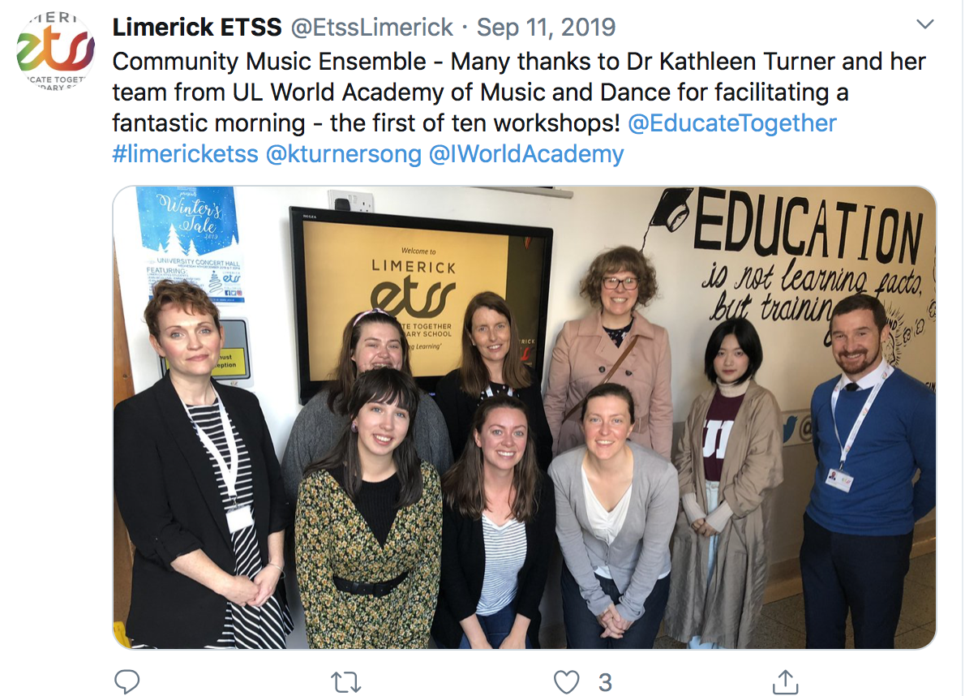
LETTS Theme and Context for
WWGS and Global Citizenship Education:
A Winter’s Tale – A Concert for Climate Change
Irish World Academy & School Anthem

Slide 7
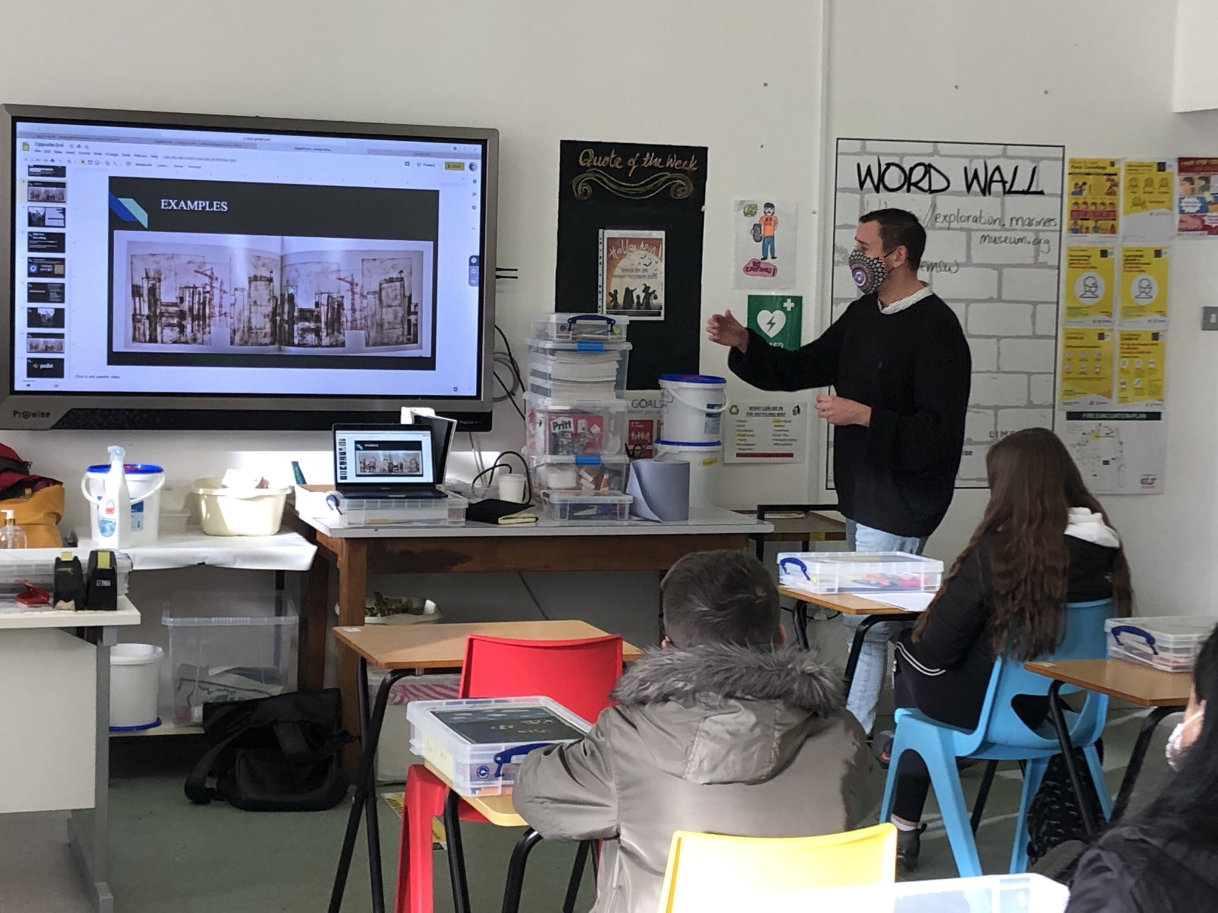
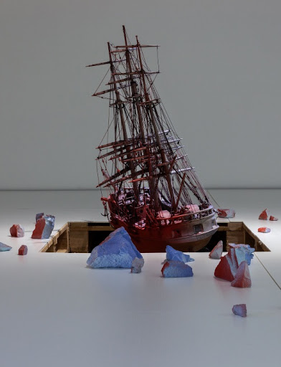
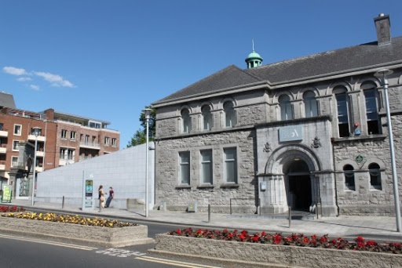
LETTS Theme and Context for
WWGS and Global Citizenship Education:
Limerick City Art Gallery

Slide 8
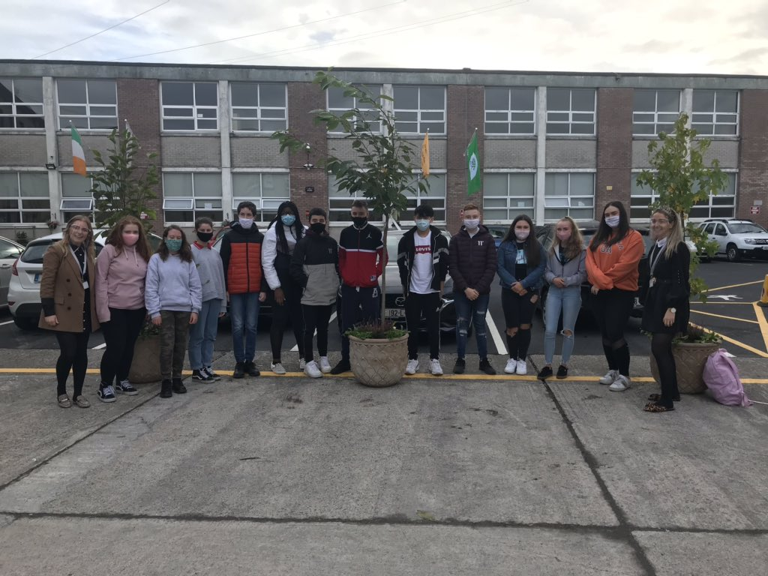
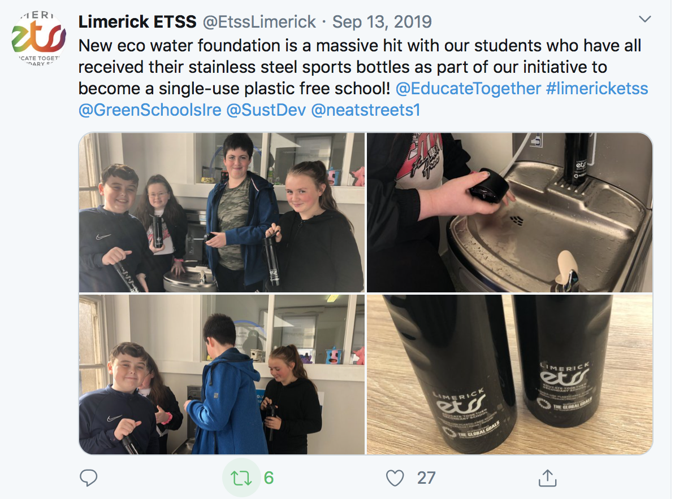
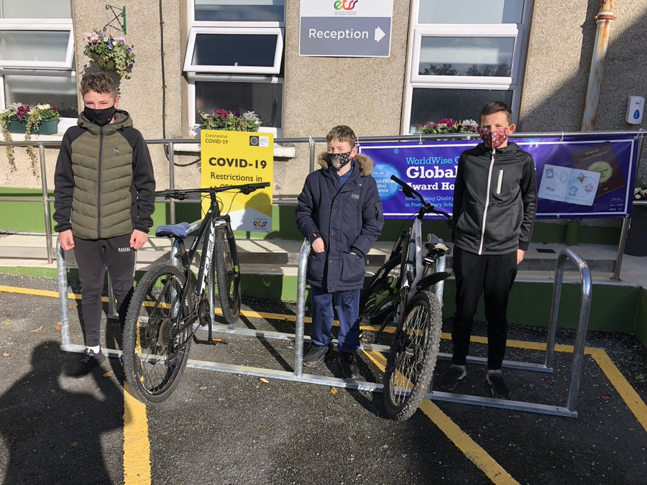
LETTS Theme and Context for
WWGS and Global Citizenship Education:
LETSS Green Schools’ Committee

Slide 9
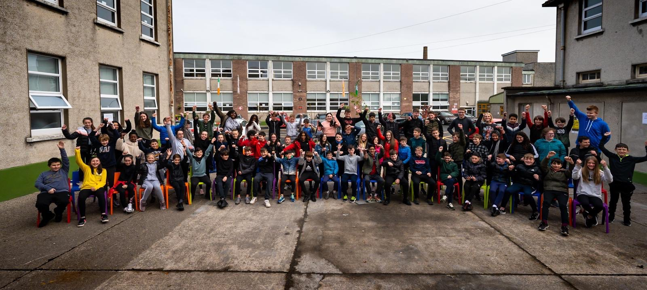
LETTS Theme and Context for
WWGS and Global Citizenship Education:
20/21 ‘Better Together Theme’

