Slide 1


Development Education
Holy Family Community School, Rathcoole Co. Dublin
Derek Maher – Deputy Principal & Founder of the Development Education Department (d.maher@hfcs.ie)

Slide 2

Our Programme
Trust, Respect, Awareness, Inclusion & Leadership

Slide 3

Timeline:
Humble Beginnings
Formal TY Classes
Cross-Curricular
1st Year Induction
Diverse Curricular Team

Slide 4
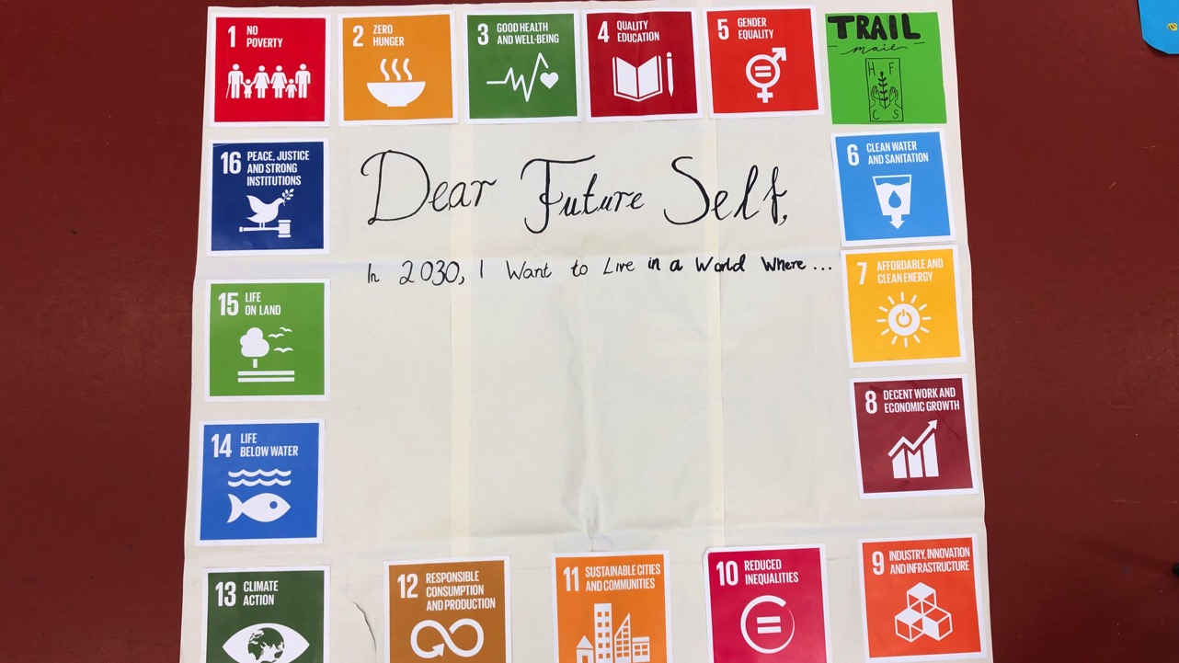
Exploring the SDGs with our Community

Slide 5
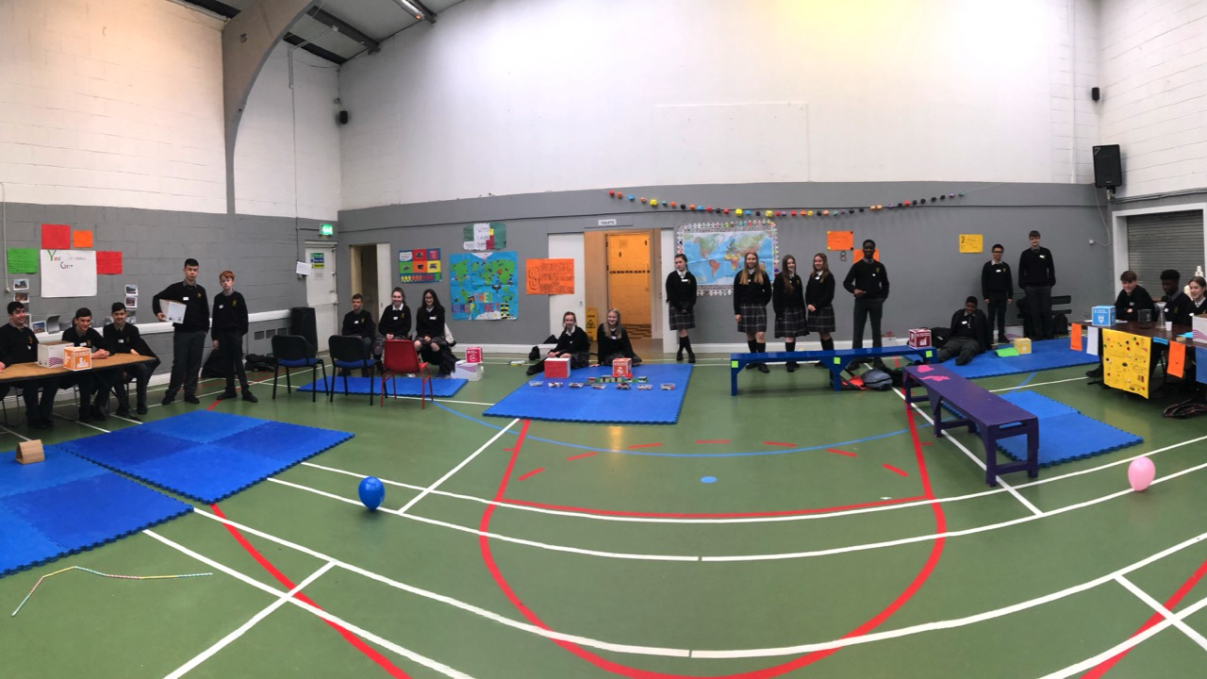
Student Leadership

Slide 6
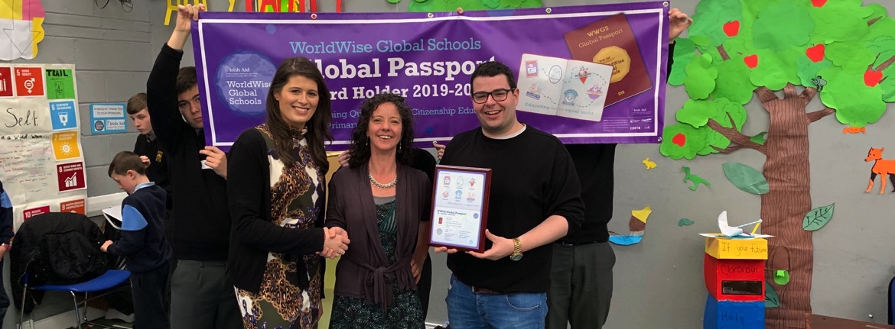
Triple Award Winners, Fair Trade School, EU Ambassador School, Green School

Slide 7
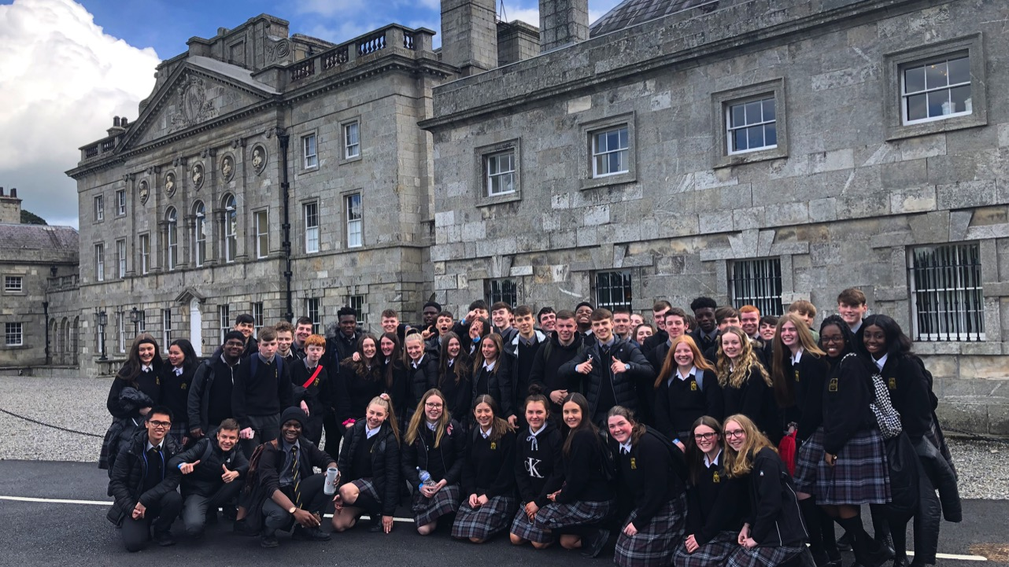
Cool Planet

Slide 8
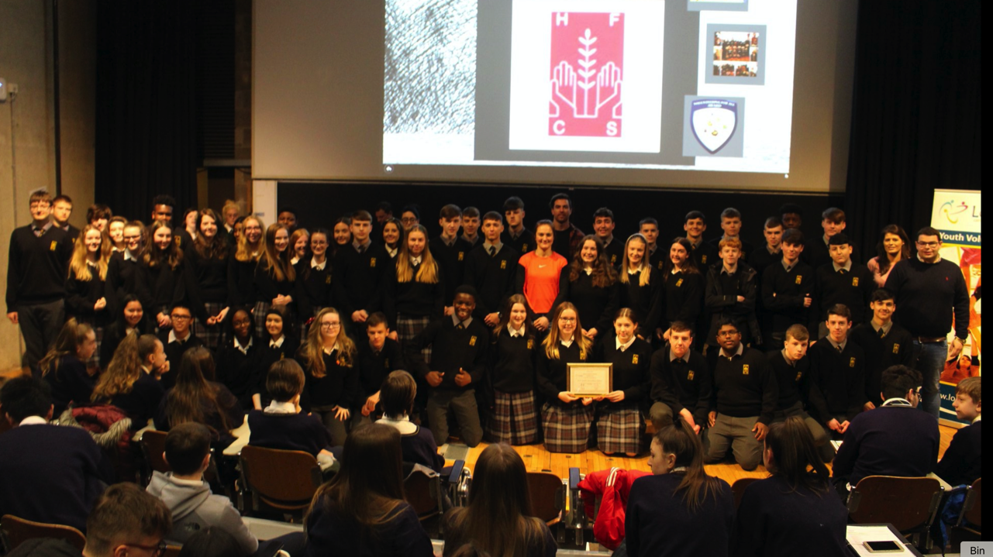
Student Activism

Slide 9
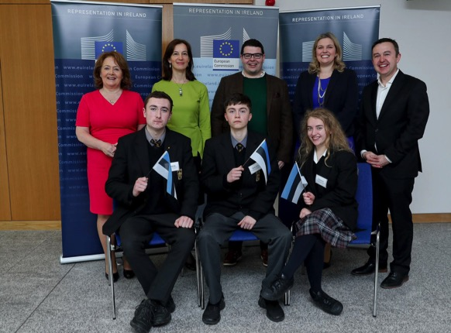
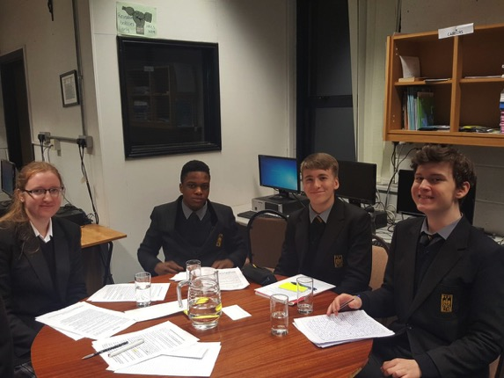
EU Model Parliament & Debating

Slide 10
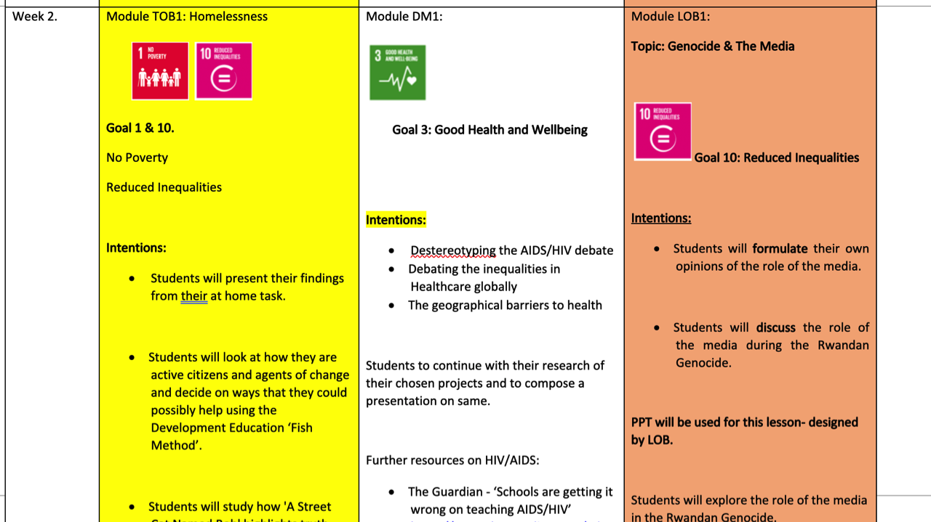
Planning

Slide 11

Funding

Slide 12

The Team
Teide, Lauren, Michael, Barry, Niamh. All the Staff and Students at Holy Family CS.

Slide 13
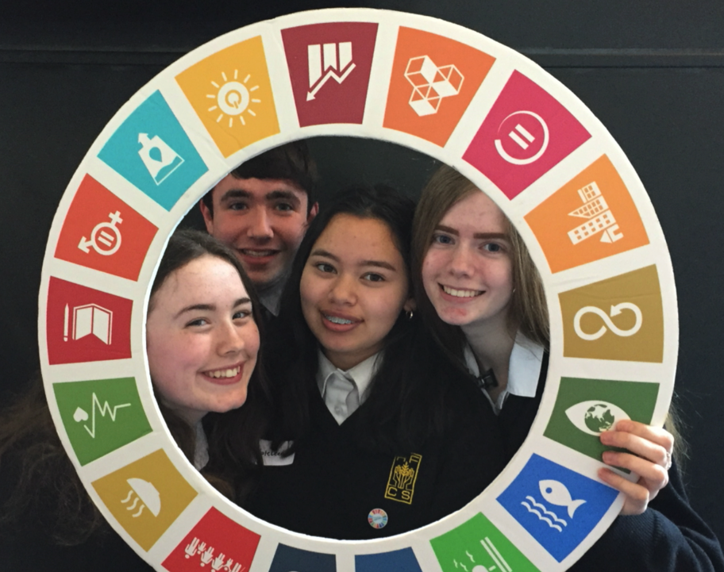
Agents of Change

Slide 14





Thanks to our Trustees and WWGS

Slide 15

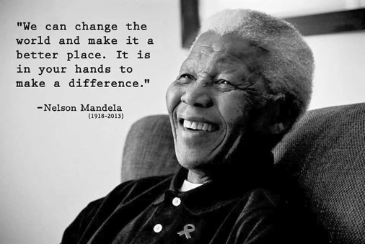
Questions/Comments?

