Slide 1
Global Citizenship Education in Kishoge CC
Delivered through our Ethical Education programme

Slide 2

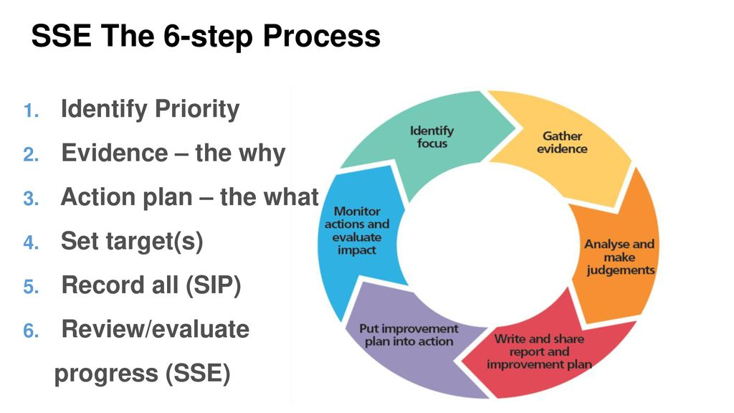
Management support for GCE in KCC
Robust Structure:
  Deputy Principal acts as co-ordinator of Ethical Ed/GCE inc. the SDGs.
  Ethical Ed committee of six – teacher responsible for each year group.
  Committee meets three times per year.
  Tutor team (35 staff delivering Ethical Education lessons) meet termly.
  GCE on principal’s report.
Integration of GCE into planning:
  Department and class planning templates include GCE space.
  On agenda at Subject Dept. meetings
CPD:
  SSE review of GCE/Ethical Education
  Whole staff CPD with Marelle Rice, in-house support and material from Stephen Farley in Trócaire (4x2hour sessions – inc. TeachMeet).
  Facilitation/encouragement of strong staff presence
  GCE on staff meeting agenda
Commitment of financial support:
  WWGS grant.

Slide 3

Ethical education teaches students…. ???
Ethical education is a moral/character education programme which teaches students to make considered, informed decisions about how they act as a member of society.
The foundations of Educate Together are also the foundations of the Ethical Ed curriculum and classroom
Learner-Centred | Democratically Run | Multidenominational | Co-educational

Slide 4

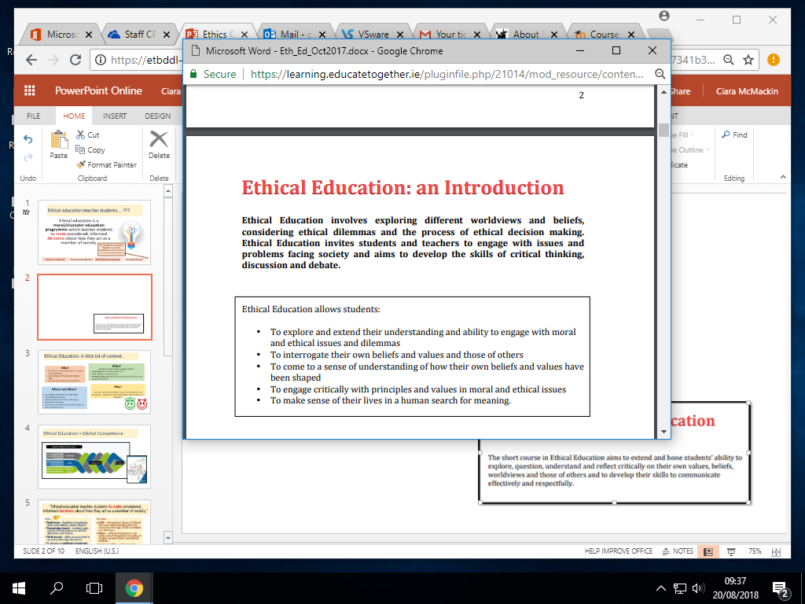
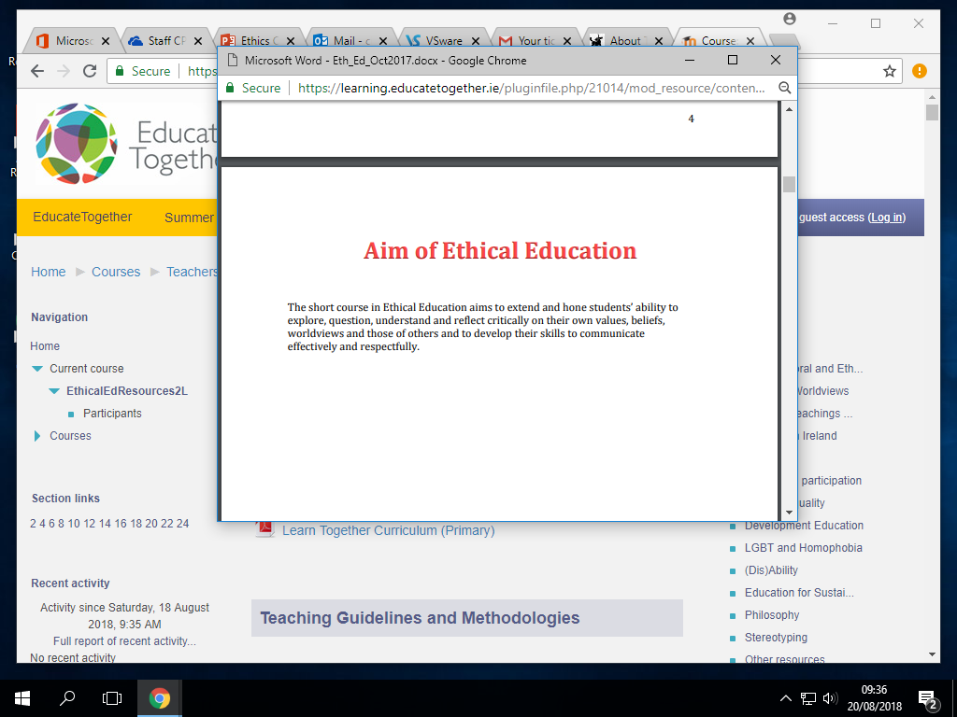

Slide 5


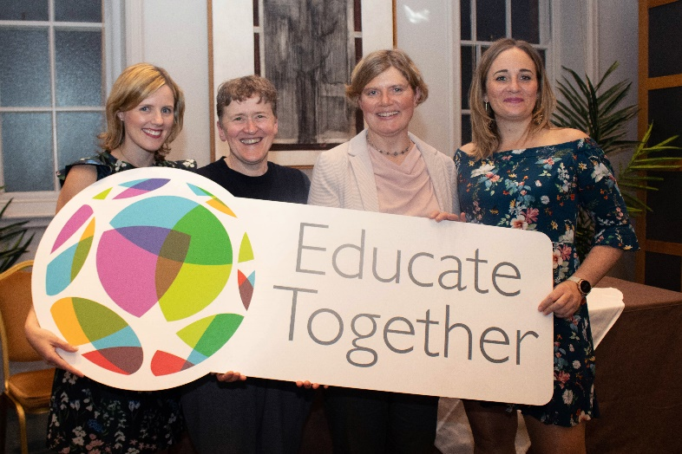
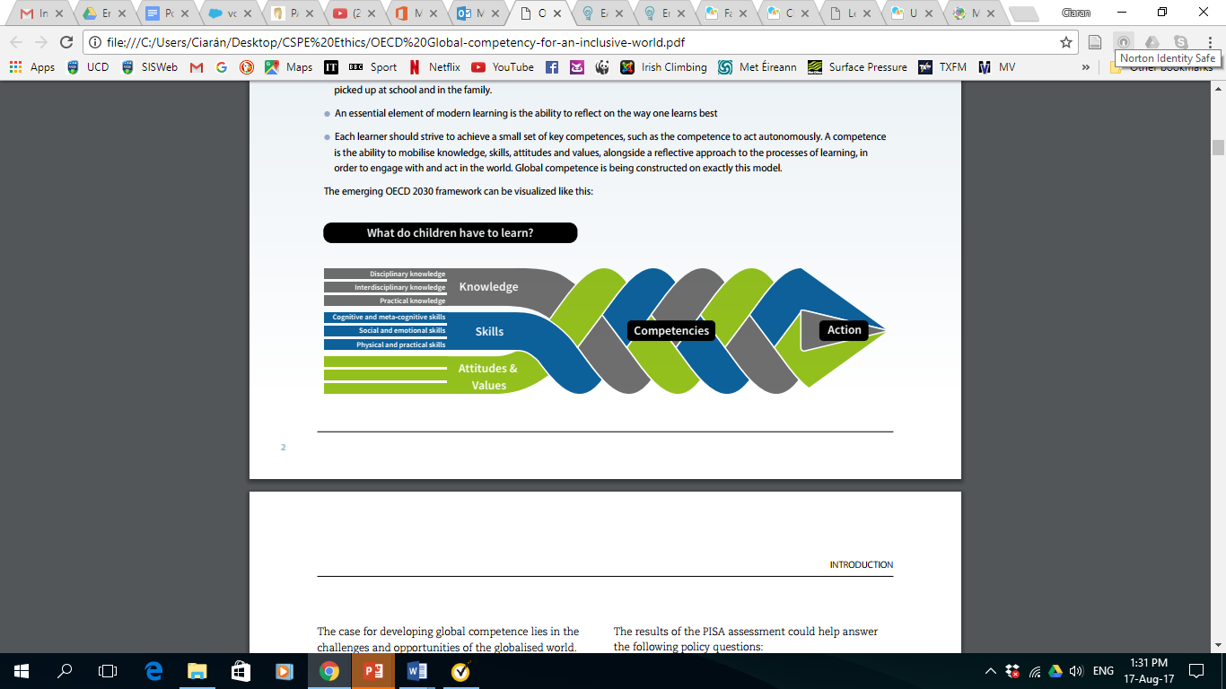
Ethical Education: A little bit of context..
Who?
ALL OF US! - Ethical Education is a whole school approach
Laura Dooley & The Educate Together National Office Team
Ciara, Niall, Hannah, Liam, Michael, Aoife and Patricia
What?
Ethical Education classes engage students':
knowledge (about ethical questions)
skills (debate, critical thinking)
attitudes and values (where do they come from and are we happy with them?)

Slide 6

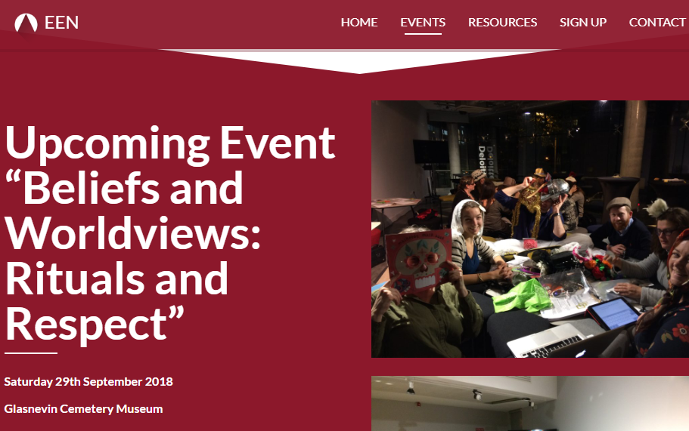
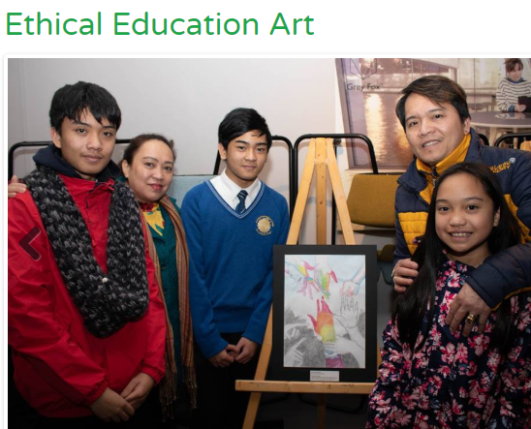
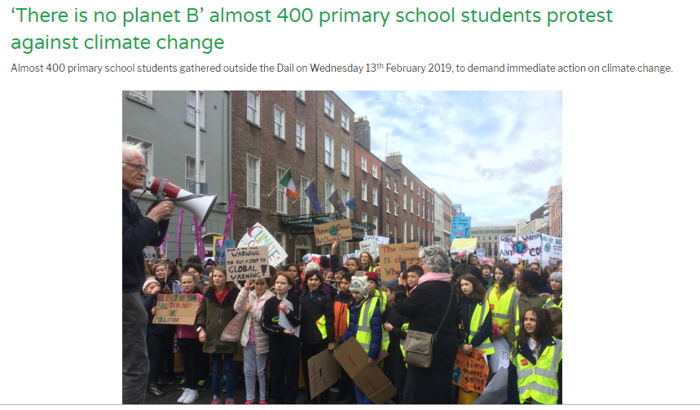
Ethical Education: A little bit of context..
Where and When?
ALL SCHOOL ACTIVITIES, ALL THE TIME!
1hr of Ethical Ed per wk
Ethical questions and skills in all lessons
Department Meetings
CPD with the EEN (Ethical Education Network) - three events per year.
Why?
...because character education helps us decide HOW to use our genius – whether to build sustainable energy solutions or bombs!?

Slide 7
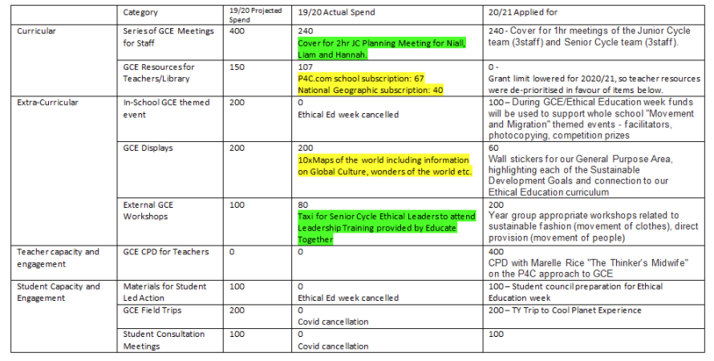
Financial support for GCE

Slide 8
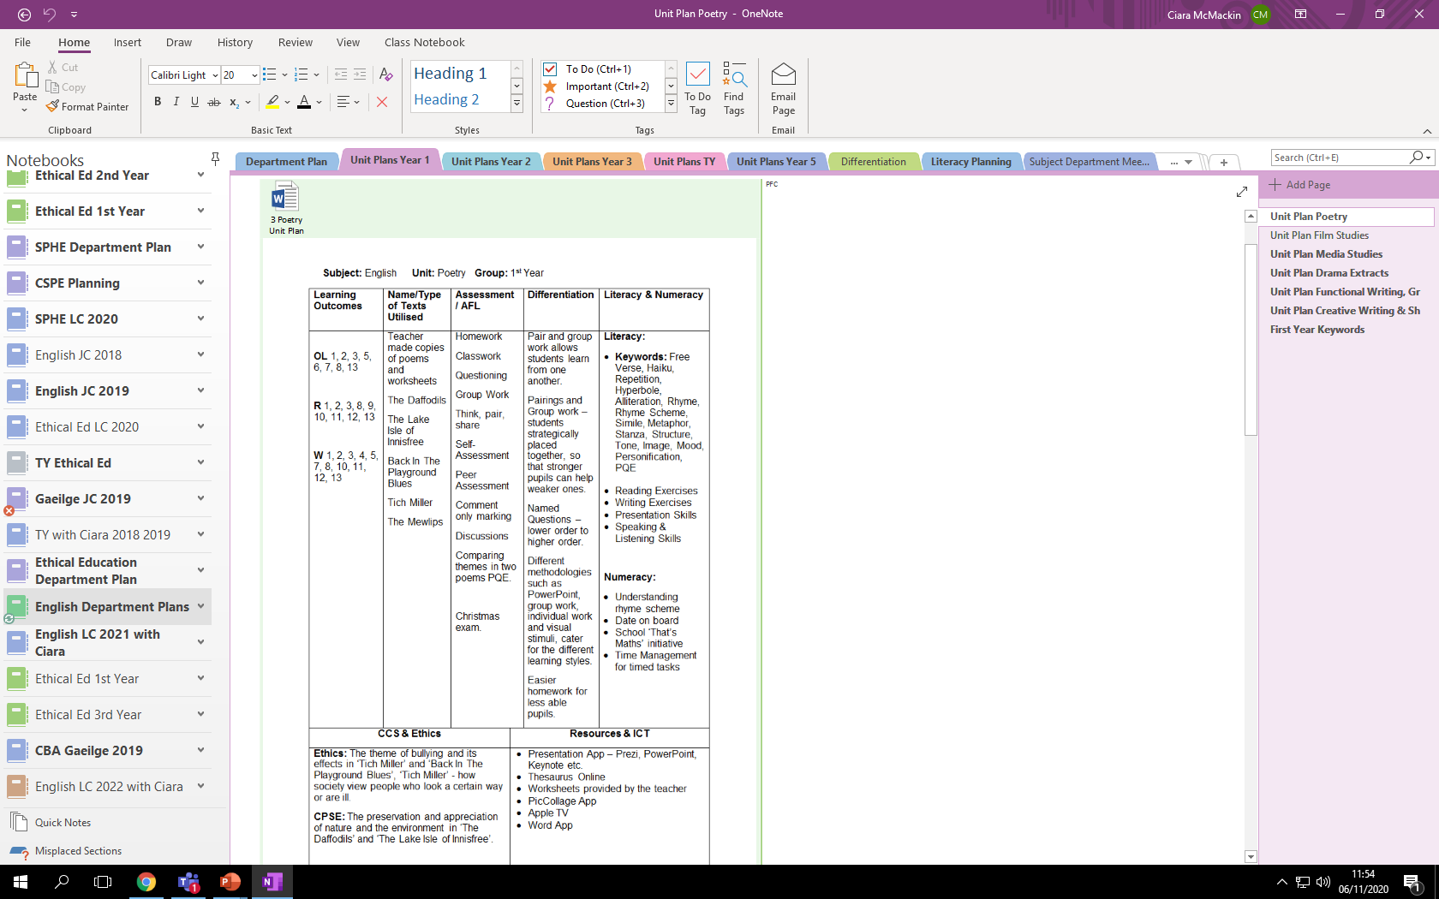
GCE in Kishoge Planning..

Slide 9
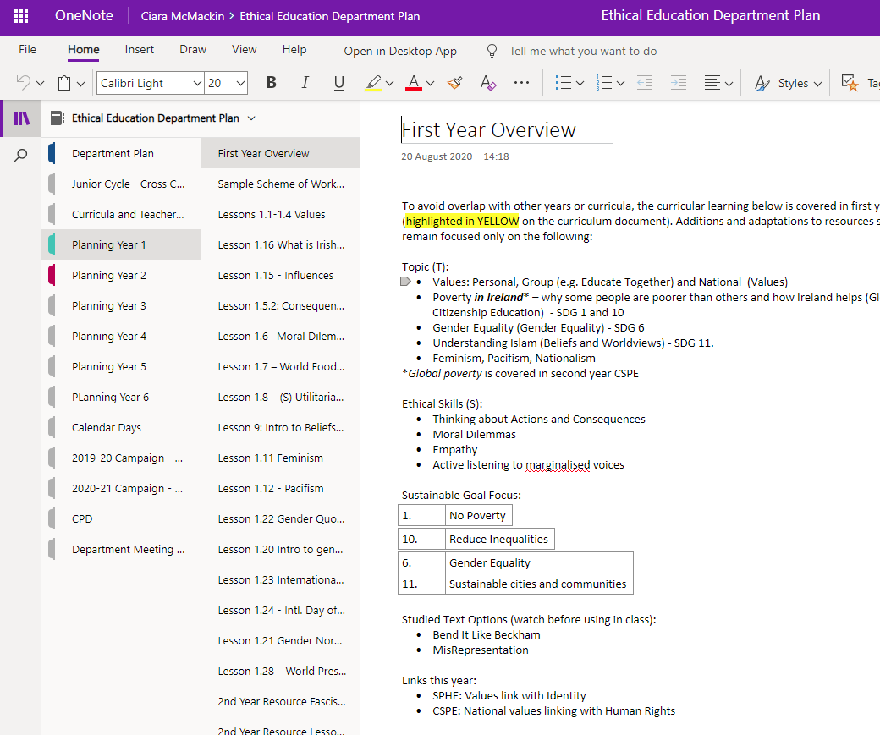
GCE in Kishoge Planning..

Slide 10
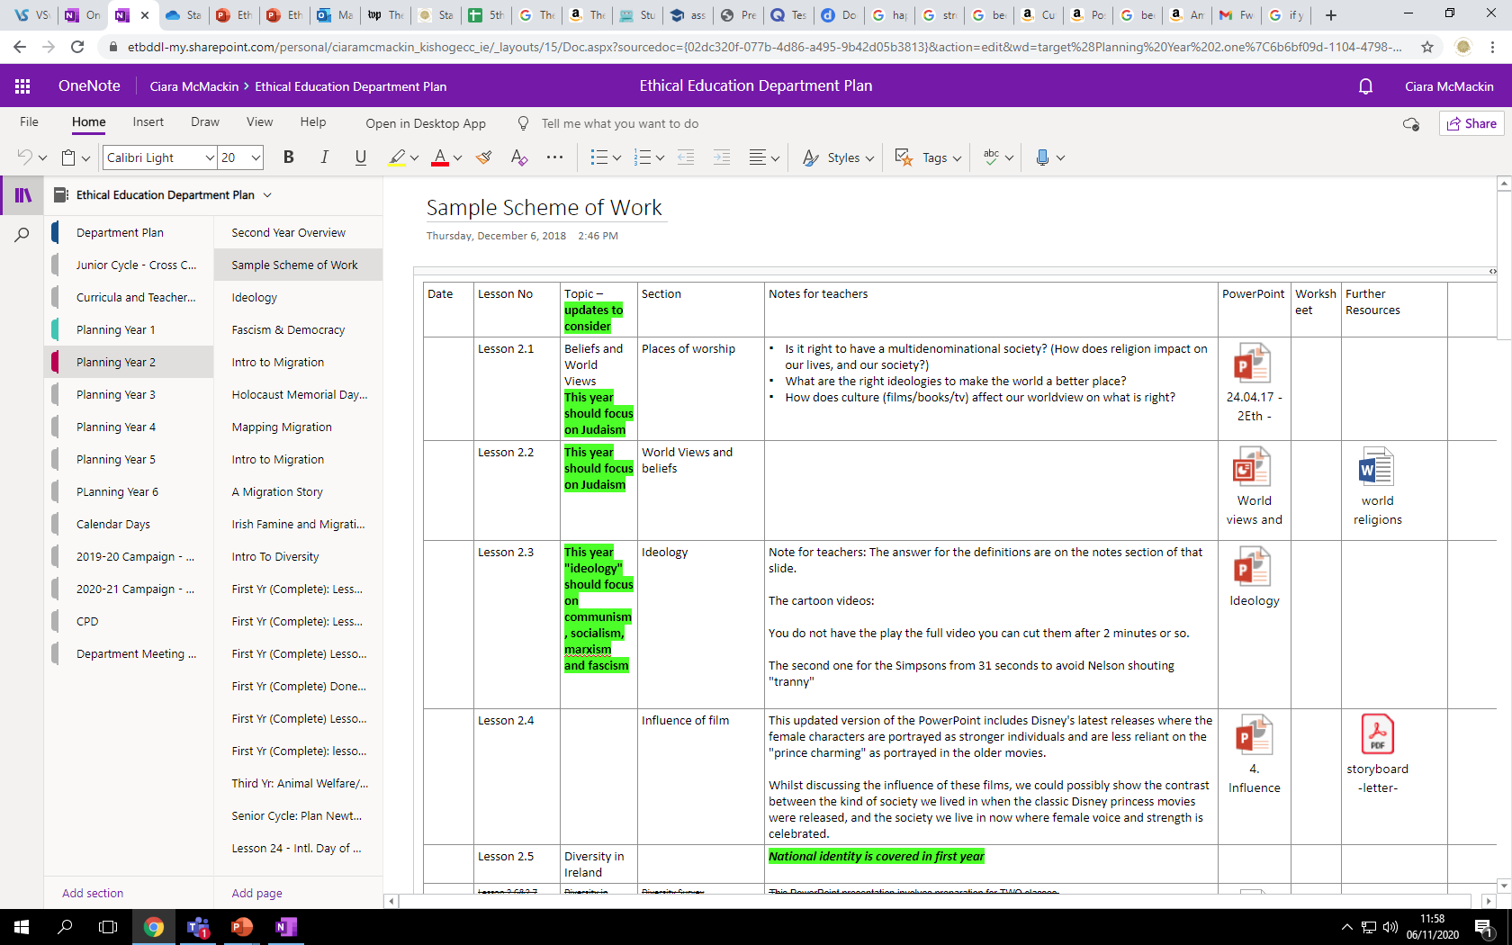
GCE in Kishoge Planning..

Slide 11
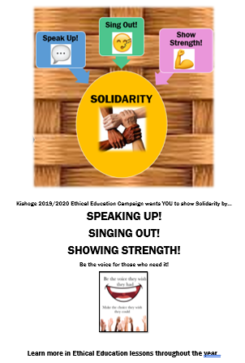
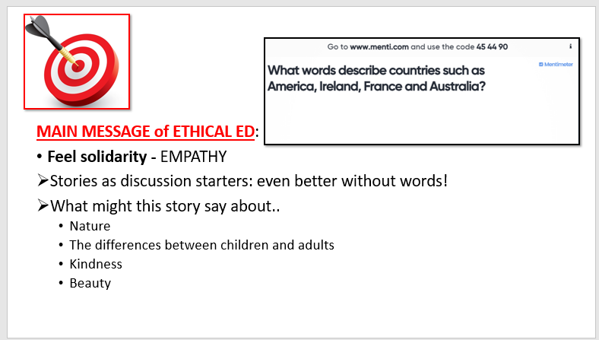
Solidarity not charity
KCC Annual GCE Campaign: 2019/20
Term | Focus
1.1 | Solidarity through Music – whole school lesson
1.2 | Solidarity through writing – Amnesty Campaign
1.3 | Solidarity through Film – speaker Caoimhe Butterly
1.4 | Solidarity through Art
Including staff CPD, weekly lessons, cross curricular focus, marketing throughout school

Slide 12


KCC Annual GCE Campaign: 2019/20
and
Products
National
People
International

Slide 13
2. Explain the 2020/21 Eth Ed Campaign to our students – and contribute personally to it!
and
Whole School Events
Resources from external groups: MASI
Competitions: Creative Competition
Whole School Lessons
Launch Lesson
Mincéirí in Ireland
Cross Curricular Coordination
Maths Week
History and Geography projects
Eth Ed Week!
Student Council Diversity Day
Treasure Hunt
Visibility Posters and Transfers
Project Showcase
Each Year will complete a monthly project
Fast Fashion from source to shop
Products
National
People
International

