Slide 1


Slide 2
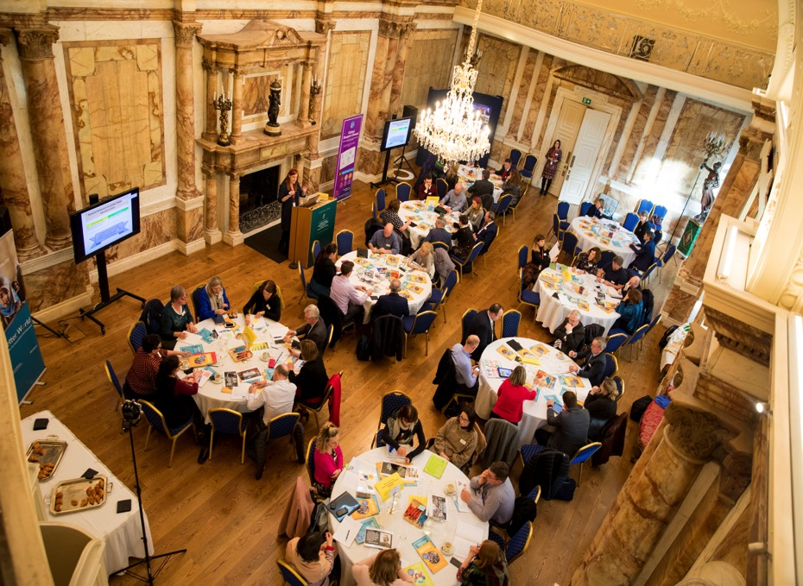

Slide 3



Housekeeping
Put on Speaker View
To mute and un-mute
Turn your camera on
Please use the chat function

Slide 4

Agenda
9.30 Opening Address: Colm Brophy TD, Minister of State for Overseas Aid and the Diaspora
9.40 Global Passport Award ceremony
9.50 Introduction: Aishling McGrath, Director of Worldwise Global Schools
10.00 Global Café: Principals share their school’s GCE programmes
– Breakout rooms
10.50 Recommendations from WWGS Participating Teachers
10.55 Next Steps! Playing an active role in my school vis a vis GCE
- Breakout rooms
11.25 Closing remarks: Áine Doody, Head of Global Ctizenship, Irish Aid,
Department of Foreign Affairs
11.30 Evaluation & Close

Slide 5


Áine Doody,
Head of Development Education/ Global Citizenship,
Irish Aid, Department of Foreign Affairs

Slide 6
Colm Brophy, TD
Minister of State for Overseas Development and Diaspora

Slide 7

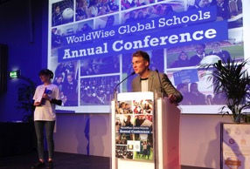
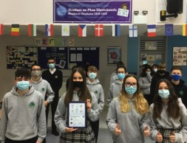


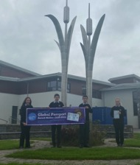


WWGS Global Passport Award
Recognises & Rewards Quality
Global Citizenship Education

Slide 8
Aishling McGrath
Director, WorldWise Global Schools

Slide 9

Global Citizenship Education
Symposium for School Leadership and Management
To gain a better understanding of Global Citizenship Education (GCE) and how it can be implemented in schools
To understand how GCE can align to schools culture and ethos
To reflect on how GCE can help foster the vision and ethos of our own school
To engage in peer learning on GCE
Adapting GCE learning needs and student wellbeing in the wake of COVID-19

Slide 10
Outcome 1: An increased spread and number of post-primary schools accessing quality Global Citizenship Education (GCE)
Outcome 2: Quality standards and good practice approaches to GCE promoted and implemented in post-primary schools
Outcome 3: Increased awareness and sustainable impact of the WorldWise Global Schools Programme within the formal education sector and development education/GCE sector
About WWGS
Established 2013
Ireland’s Global Citizenship Education programme for post-primary schools.
Capacity Building and Support
Schools
School Clusters
NGOs
School Networks

Slide 11





Aims of the WWGS Programme
Notes:
The WWGS programme aims to:
familiarise learners with the concepts of interdependence, development, globalisation and sustainability
enable teachers to move learners from a charity mentality to a social justice mentality
community of practice that stretches across regions and continents. An informal and flexible network that can share experience and resources
stimulate critical thinking about global issues, both at a whole school and learner level help schools promote greater awareness and understanding of global justice issues.

Slide 12
What is Global Citizenship Education?
“an educational process aimed at increasing awareness and understanding of the rapidly changing, interdependent and unequal world in which we live”
By challenging stereotypes and encouraging independent thinking, GCE helps students critically explore the root causes of global justice issues and how they link with our everyday lives
GCE inspires solidarity by supporting people to realise their full rights, responsibilities and potential as global citizens in order to take meaningful action for a just and sustainable world

Slide 13
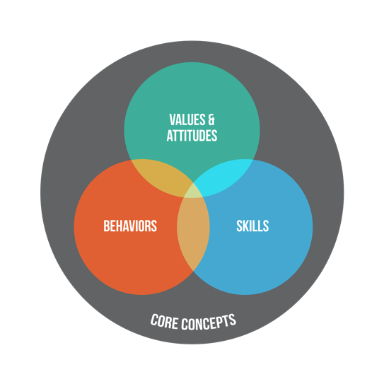
What is Global Citizenship Education?
Global Citizenship Education (GCE) is a framing paradigm which encapsulates how education can develop the knowledge, skills, values and attitudes learners need for securing a world which is more just, peaceful, tolerant, inclusive, secure and sustainable.

Slide 14
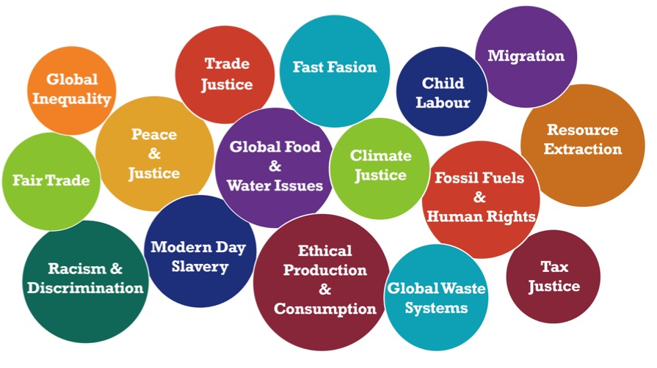
Global Citizenship Education Themes

Slide 15
Personal Reflection on Global Citizenship Education (GCE)
Me (as school leader) | My student(s)
Where does my interest in GCE come from? Why do I care? | Why is GCE of value to my students?
We invite you to add some of your thoughts to the chat

Slide 16
Questions for reflection
How can GCE foster the vision and ethos of your school?
How can GCE be adapted to the current context and in the wake of COVID-19?
Is GCE closely aligned to you own schools vision, mission, ethos and culture?
Is your school enabling global citizens and agents for change?
What conditions are needed for GCE to be successfully implemented in schools and how can we sustain GCE in the long term?
What are the opportunities at school level for GCE?

Slide 17
Agents for change –World Shapers
Maastricht Declaration on Global Education in Europe (2002). “Global Education is education that opens people's eyes and minds to the realities of the world, and awakens them to bring about a world of greater justice, equity and human rights for all.
“I have always held empathetic opinions on all the matters discussed during developmental education, this course has only further solidified those opinions and helped me take action against the injustices..”
“Whilst participating in the Global Justice activities in class this year, I learned many things about global inequalities around the world. I learned about why and how these injustices are happening as well as how I can actively try and make a difference no matter how small.”
“now that I have a lot more knowledge of what is going on in the world and why these things happen it makes me want to look into it more and it also makes me want to try and improve these problems and make a difference myself or even push people around me to make a difference..”
Students participating in the WWGS programme 2019-2020
Notes:
Cultivating young leaders who are active in change

Slide 18
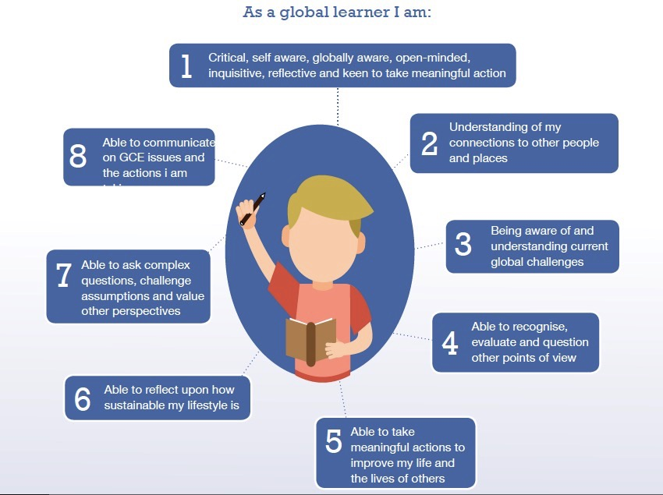

Slide 19
Leading GCE in post-primary schools
Need for a holistic approach which includes school leadership in embedding GCE, this is acknowledged as important (Toland, 2006)
Supportive school leadership and management is critical for those teachers who are delivering GCE
GCE may percolate across all curriculum areas and extra-curricular activities but is it included in your staff planning days?
  Question for reflection: How formalised is GCE in your school?

Slide 20
Leading GCE in post-primary schools
‘the art of leadership lies in the balancing of the different interests’ (Bottery 2013).
WWGS acknowledges the complexity of the school eco-system, but this offers a useful lens to examine how GCE can complement other interests and initiatives in schools
Recent literature on GCE often focuses on students, teachers and the curriculum with leadership only noted tangentially. However, literature on school leadership highlights the importance of leaders being driven by a moral purpose, but this literature rarely interact with GCE literature.
  Question for reflection: What is your moral purpose as school leader?

Slide 21
Leading GCE in post-primary schools
While it is possible to create a curriculum for global citizenship, the scope is wider than a single subject and indeed wider than the curriculum itself. Ideally, GCE becomes part of the ethos of a learning environment, influencing senior management decisions, teacher practices and relationships between educational institutions and communities. (UNESCO, 2014)
Education authorities and senior management, including principals, must also be open to educators working in what may be a new role – as an ‘enabler’ or ‘facilitator’, rather than a ‘doer’ for children – and in process-centred learning. This will require additional training to promote transformative behaviours and beliefs among learners, and self-assessments among educators of their own assumptions and practices. This includes in- and pre-service training on participatory and transformative pedagogical practices. (UNESCO, 2014)

Slide 22

Three questions:
- Is Global Citizenship Education whole-school appropriate?
- Who and what affects school culture and ethos?
- What supports need to be in place?

Slide 23






A framework for GCE in schools

Slide 24












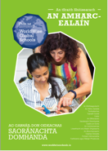


GCE and the Curriculum
Available in Irish
Notes:
WWGS Provide subject specific resources to support teachers integrate GCE into their subject areas.
Go to the ”Tools” section of our website to download these.

Slide 25


GCE and the current context

Slide 26

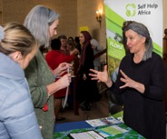
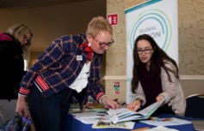
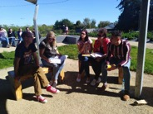
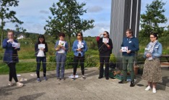
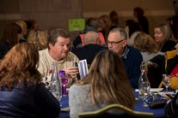
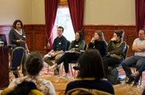
Teacher Capacity and Engagement
National and Regional Teacher Training
Format:
Online participatory workshops
WWGS Inputs
Inputs from teachers
Peer Learning
Workshops
Resource Fair
Evaluation
Some topics explored:
Teaching controversial issues
Active teaching & learning methodologies
The Global Goals
WWGS 6-Step programme
Developing a school policy on GCE
Taking meaningful action

Slide 27
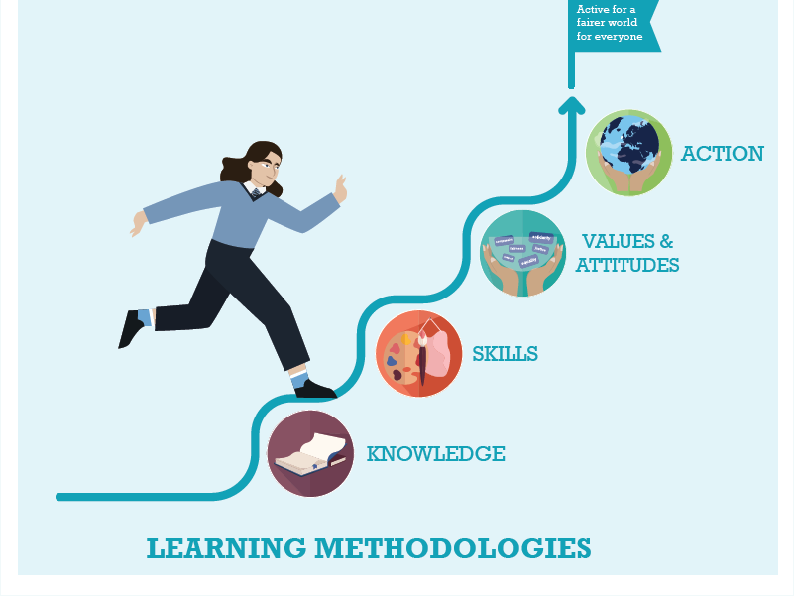




Slide 28
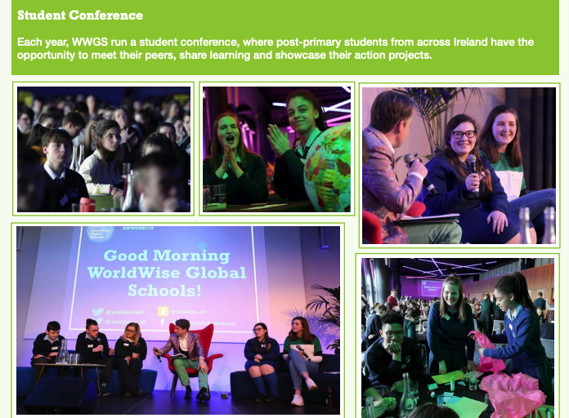

Slide 29
Questions for reflection
How can GCE foster the vision and ethos of your school?
How can GCE be adapted to the current context and in the wake of COVID-19?
Is GCE closely aligned to you own schools vision, mission, ethos and culture?
Is your school enabling global citizens and agents for change?
What conditions are needed for GCE to be successfully implemented in schools and how can we sustain GCE in the long term?
What are the opportunities at school level for GCE?

Slide 30
Global Citizenship Education
Symposium for School Leadership and Management
To gain a better understanding of Global Citizenship Education (GCE) and how it can be implemented in schools
To understand how GCE can align to schools culture and ethos
To reflect on how GCE can help foster the vision and ethos of our own school
To engage in peer learning on GCE
Adapting GCE learning needs and student wellbeing in the wake of COVID-19

Slide 31


Global Café

Slide 32

Global Café
Room 1:
Holy Family Community School,
Derek Maher
Implementing anti-racism work in the school and how teacher capacity can pay off in this area
Room 2:
Kishoge Community College,
Ciara McMackin
Taking an enquiry based learning approach to GCE, and creating space and time for teachers to build their capacity in GCE and Ethical Education.
. Room 7:
Limerick Educate Together Secondary School,
Eukaria O’Grady
Engaging students in community based campaigns and utilizing
The Arts to explore global justice issues
Room 3:
Belmayne Secondary School,
Ashling Kenevey
Experience of how they hit the ground running with GCE in a new school!
Room 6:
Cashel Community School,
Principal John Gallagher
Utilizing a GCE approach to develop Citizenship within school community and nurture responsible young adults; and supporting staff to achieve this
Room 4:
Loreto Secondary School Clonmel,
Anne McGrath
How they have built up Global Citizenship Education in their school to become a Special Award Passport holder; and how they have adapted their range of activities to the new school climate.
Room 5:
Colaiste Bhaile Clair, Galway,
Claire Whyte
Claire will talk of the team of teachers working together in a cross curricular way with the Global Goals.

Slide 33
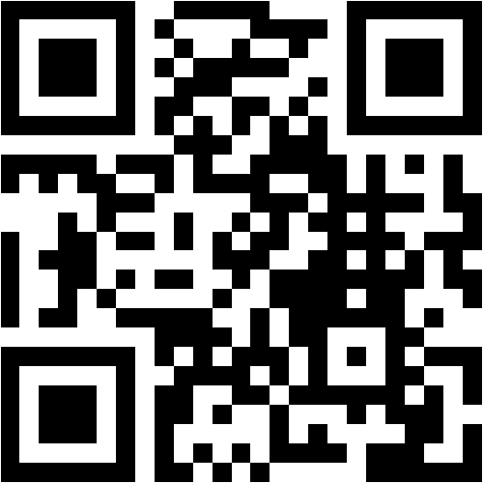
Global Café Mentimeter
What inequality highlighted by the pandemic would you like to see addressed in the world?
https://www.menti.com/59bv96i2qz

Slide 34

Reflection

Slide 35
Teacher Recommendations
Kathleen Beatty,
WWGS Teacher Advisory Group

Slide 36
Teacher Recommendations
WWGS Teacher Advisory Group
To help with secondary schools’ Global Citizenship Education (GCE) programme, school management could:
Recognise the importance of GCE to students and teachers in all aspects of school life not just as part of a module or a subject.
Take a systematic approach to GCE, where it is integrated into schemes of work and subject planning.
Build GCE into the school from the start of student’s school life; building knowledge and understanding in Junior Cycle, ready for further knowledge, building it in to all TY subjects and ready to take
meaningful action in TY and further developing critical
thinking and questioning on global issues in Senior Cycle.

Slide 37
Teacher Recommendations
WWGS Teacher Advisory Group
To help with secondary schools’ Global Citizenship Education (GCE) programme, school management could:
4. Give sufficient and protected time and space to teachers to plan collaboratively across subject areas for a cross curricular GCE programme.
5. Make GCE a standing item on the agenda at staff and board of management meetings.
6. Give the GCE lead teacher a post of responsibility for GCE and allow them time to plan and coordinate.
7. Give the students sufficient time to plan their GCE in curricular
and extra-curricular settings.

Slide 38
Teacher Recommendations
To help with secondary schools’ Global Citizenship Education (GCE) programme, school management could:
8. Facilitate students and teachers to develop related school policies on GCE, human rights and sustainability for example.
9. Involve and inform Board Of Management members and parents about GCE in the school.
10. Address issues with accessing WWGS grant funding in ETB schools.
Teachers would like to thank school management
for their support and for taking the time to
attend the symposium today.

Slide 39



Next Steps
Key Questions:
As a member of school management, what role do I play in supporting this ‘stamp’?
What can I put in place when I go back to my school to support my school's Global Citizenship Education journey?
LINK: https://docs.google.com/document/d/1KbiUSK-SoWaZLGrDMYv_-iPgfnV7UPHsECRkP9y_sbY/edit?usp=sharing
Room 1: Curricular (Facilitator Anne Payne)
Room 2: Extra-curricular (Facilitator Michael Doorly)
Room 3: Teacher Capacity (Facilitator Lizzy Noone)
Room 4: Student Capacity (Facilitator Laura Cahill)
Room 5: School Leadership and Policies (Facilitator Aishling McGrath)
Room 6: Community Engagement (Facilitator Rita Walsh)

Slide 40
Closing Remarks
Áine Doody,
Head of Development Education/ Global Citizenship,
Irish Aid, Department of Foreign Affairs

Slide 41
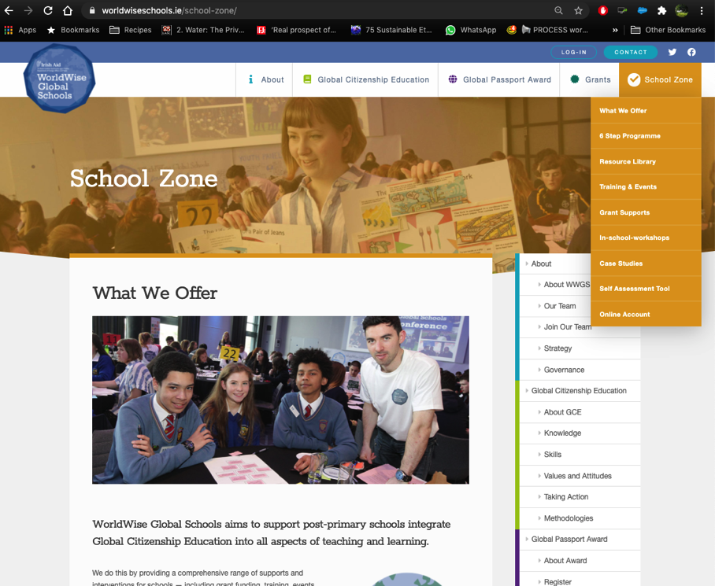

Slide 42
Questions for reflection
How can GCE foster the vision and ethos of your school?
How can GCE be adapted to the current context and in the wake of COVID-19?
Is GCE closely aligned to you own schools vision, mission, ethos and culture?
Is your school enabling global citizens and agents for change?
What conditions are needed for GCE to be successfully implemented in schools and how can we sustain GCE in the long term?
What are the opportunities at school level for GCE?

Slide 43
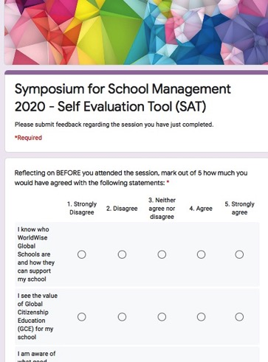
Evaluation
Please complete the following evaluation on today’s session
https://forms.gle/RdUrSEzXf5QNjzGc7

Slide 44



Thank you!
Questions???

