Slide 1


Wellbeing and Health
WWGS Thematic Online Training Series
SINÉAD HAYES, DUBLIN
LIZZY NOONE, DUBLIN
Notes:
Welcome
- Introduce ourselves
Type in your name and the name of your school in the chat! Also change your name on your Zoom to your first name
Invite people to use the chat

Slide 2
Housekeeping
To mute and un-mute
Turn your camera on
Please use the chat function

Slide 3

Hopes & Fears
- What do you HOPE to get out of todays session?
- Any FEAR about todays session?

Slide 4

Session Plan
Outcomes for the session
An Introduction to the justice issues around ‘Wellbeing and Health’
Katie Martin & Katie Lynch, Development Perspectives
Break & Reflection
An overview of the Wellbeing Framework
What it is and how to integrate GCE using the framework
Wellbeing and Health: from Knowledge to Action
WWGS 6 Step Programme
Reflection and Next Steps
Notes:
Todays session will be broken into 3 key areas:
Read through slide

Slide 5

Session Outcomes
A greater understanding of Wellbeing as a global justice issue
How the wellbeing framework and GCE can be complimentary
Resources to support this work
Practical next steps
Opportunity to reflect and network with others
Notes:
Todays session will be broken into 3 key areas:
Read through slide

Slide 6
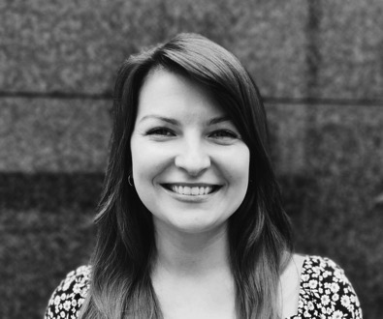

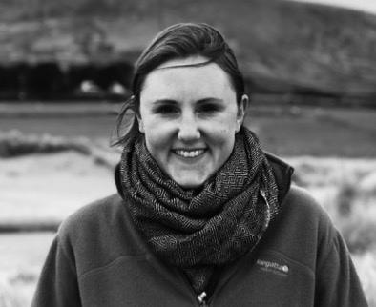
Katie Martin
Katie Lynch

Slide 7
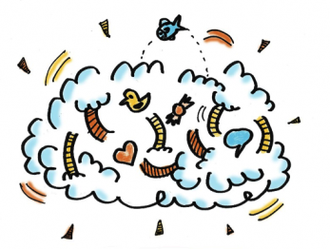
Reflection
Reflect on what you’ve heard this morning..
Consider:
- What are your initial thoughts/ feelings
- Your approach to exploring ‘Wellbeing and Health’

Slide 8
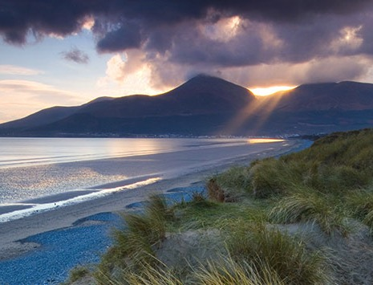


Slide 9
Reflection in Pairs
Share your reflections on:
- Your initial thoughts/ feelings
- Your approach to ‘Wellbeing and Health’ with students

Slide 10

Wellbeing and Global Citizenship Education
What is the connection?
Opportunities for GCE in Wellbeing

Slide 11

What is Wellbeing?
400 hours will be available for learning in the area of Wellbeing in junior cycle beginning with a minimum of 300 hours of timetabled engagement from 2017 and moving to the full complement of time as the new junior cycle is fully implemented in schools

Slide 12
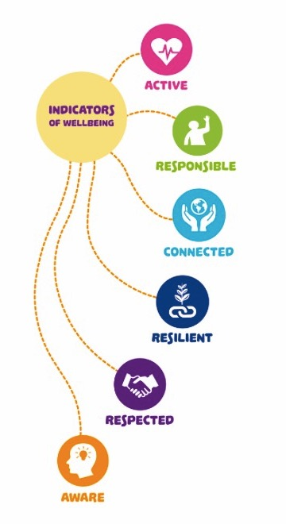
Connected to my school, friends, community and the wider world
Am I aware of what my personal values are and do I think through my decisions?
Do I feel I’m listened to and valued? Do I show care and respect for others?
Do I take action to protect and promote my wellbeing an that of others?
Appreciate that my actions impact on mine and others wellbeing in local and global contexts
Notes:
Six indicators have been identified as central to wellbeing

Slide 13
What is Global Citizenship Education?
“an educational process aimed at increasing awareness and understanding of the rapidly changing, interdependent and unequal world in which we live.
By challenging stereotypes and encouraging independent thinking, GCE helps students critically explore the root causes of global justice issues and how they link with our everyday lives
GCE inspires solidarity by supporting people to realise their full rights, responsibilities and potential as global citizens in order to take meaningful action for a just and sustainable world” – Irish Aid
Global citizenship involves key dimensions — awareness (of self and others), responsibility, participation and connection

Slide 14
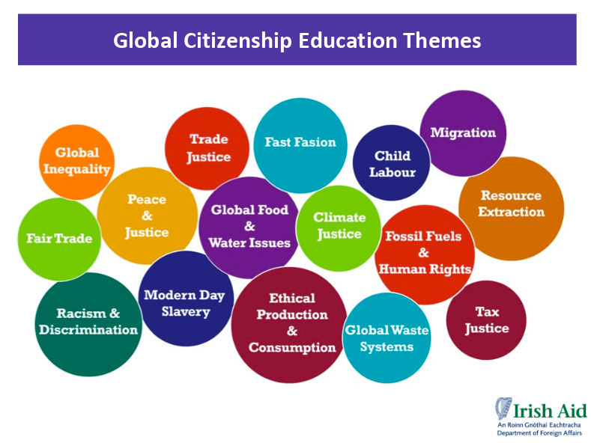

Slide 15
WWGS & Wellbeing Indicators
Responsible | Young people take responsibility for their own learning. (student/team-lead) .The issues they choose to focus on and the innovative actions they implement to tackle these issues show that the students are protecting and promoting their wellbeing and the wellbeing of others.
Connected | Students work with others within and beyond their school. This creates a sense of connectedness to their community and a recognition that they have an important role to play in taking action for global issues and in the wellbeing of others.
Resilient | Exploring and taking action on global issues enables the young people to recognise that they must be persistent, resilient and constantly innovating to produce meaningful change on the issues they have chosen.
Aware | Through the exploration of global issues, researching, reflecting and developing innovative actions, students become more self-aware and come to recognise how their values impact on themselves and the lives of others. They also learn to challenge themselves and reach mature decisions by reflecting on their knowledge, actions., values and attitudes.

Slide 16
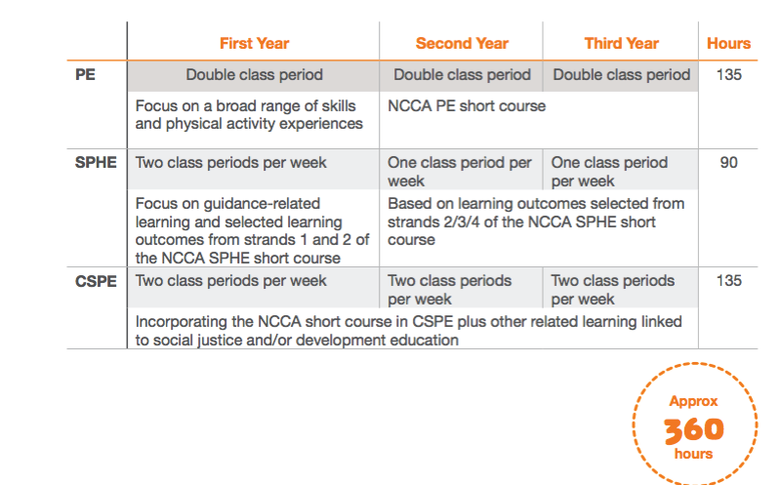

Slide 17
Health and Wellbeing
Giant Steps using Health and Wellbeing statements
Games
All to Play For
Dizzying Goals
Individual and Team Challenges
World Cup Challenge
Global Goals orienteering challenge
Dance and Gymnastics
Using Dance to Tackle Climate Change https://www.youtube.com/watch?v=wb3j_gpoL50
Interpretative Dance of Global Goals
World Cup challenge-what dances of your country’s team?
Physical Education Junior Cycle:

Slide 18
Rights & Responsibilities
Responsible Production and Consumption
Setting your sights on rights
70 years of UN Declaration on Human Rights
Global Citizenship
Climate Change, Sustainable Living and Development
Living in a Democracy
Exploring Peace, Justice and Conflict
CSPE-Civil Social Personal Education:

Slide 19
Strand 1: Who am I?
This strand focuses on developing self-awareness and building self-esteem.
Strand 2: Minding myself and others.
This strand provides opportunities for students to reflect on how they can best take care of themselves and others.
Strand 3: Team up.
This strand focuses on students learning about important relationships in their lives and building relationship skills.
Strand 4: My mental health.
This strand focuses on building positive mental health, examining young people’s experience of mental ill health and learning how to support themselves and others in challenging times.
SPHE Social Personal Health Education:

Slide 20
Other areas of learning and Wellbeing
Example: a unit (12 hours) on sustainable living and wellbeing might be provided within home economics, science or geography and counted as part of the school’s wellbeing programme.
When identifying elements of learning (beyond CSPE, PE, SPHE) → important that the rationale for their inclusion is clear, that they are linked to the six wellbeing indicators

Slide 21


Global Citizenship @ Woodbrook College
Any questions please feel free to mail me suzanne.hand@woodbrookcollege.ie

Slide 22


What was our idea?
With the introduction of the new Wellbeing curriculum, we decided to go straight to 400 hours over three years.
We decided whole person development was important and all teachers were asked to pitch a module for inclusion under the wellbeing hours.
CSPE, SPHE AND PE were core Wellbeing hours and we then decided to run three 10-week modules that would alternate throughout First Year.

Slide 23
So, what did that look like?
Wellbeing Programme – 400 hours over 3 years
CSPE & SPHE running throughout the 3 years
Global Citizenship Module
Friends for Life Module
PE running throughout the 3 years
Study Skills Module
3 x 10 week modules which would change year to year.

Slide 24
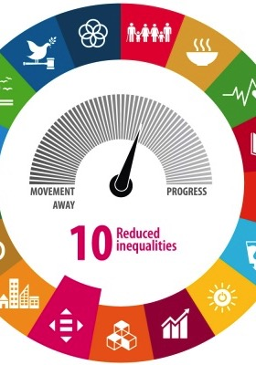
Where did I start?
I selected one of the SDG’s and designed a 10-week module on it. I started with Reduced Inequalities Goal 10
I used a template from the JCT website to outline my Learning Intentions and identify links with the Key Wellbeing Indicators
I spoke with the Wellbeing Co-Ordinator to make sure the module met the criteria and I also decided I would like there to be some action element for each class at the end of the ten weeks.

Slide 25
Course Outline – Each week I would just have an outline of what I wanted to get done.
Week 1 – Example of what I prepared before class
Things to remember
Don’t put yourself under pressure to have every second of 10 weeks planned out.
I found the class really evolved as we went based on what interested the kids etc.
Any action – sharing a tweet, making a poster, producing a slogan etc. is progress it doesn’t have to be huge!
The support from WWGS is awesome ask and you are not on your own!
If you are enjoying it, they are enjoying it – there is no exam so take the opportunity to try different approaches and have some fun with it!
Intro to SDG’s and the idea of Global Citizenship
Brainstorming Ideas and Active Learning Games etc.
Outline expectations and introduce idea of some action however small being taken

Slide 26
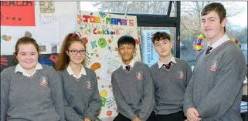
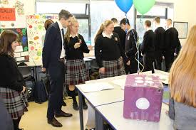
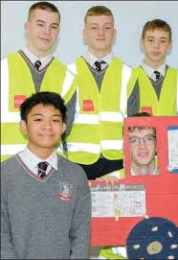
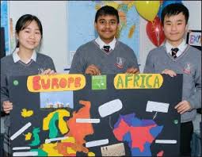
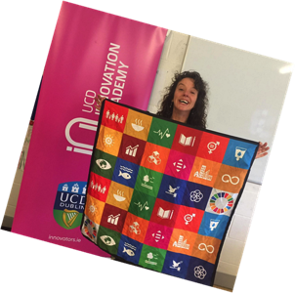

In our second year I chose SDG 3 Good Health and we decided to hold a festival Woodbrook Wellfest to celebrate the kids action projects. They amazed me – projects ranged from a Healthy eating cookbook and a climate change board game to a road safety video and a redrawn map of Africa and Europe according to the most recent climate change info. We invited Simon Harris TD and celebrated them being active citizens.

Slide 27
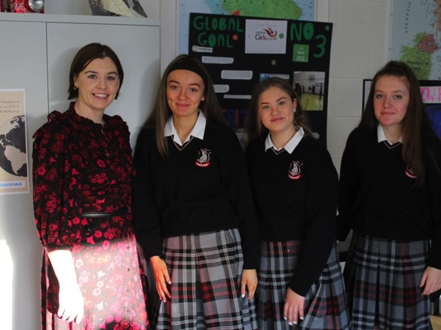
Last Tips
GO FOR IT ITS GREAT FUN!

Slide 28
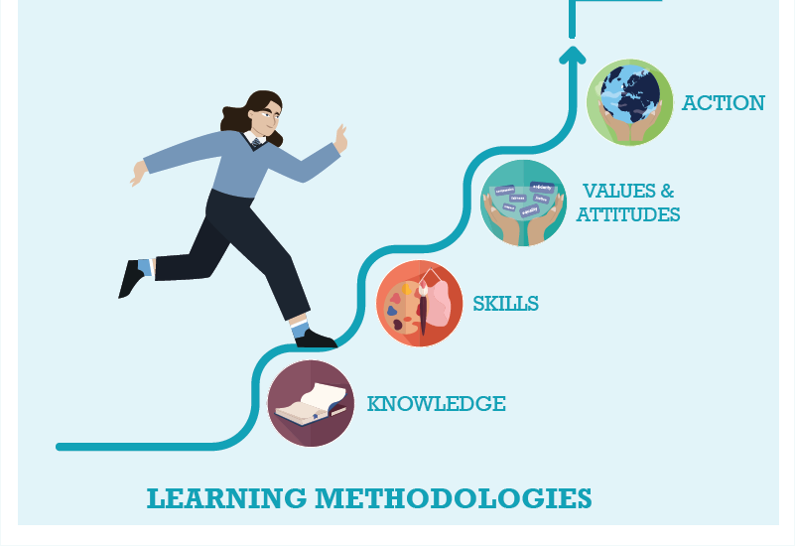




WWGS: 6 Step Programme
Life Below Water as a justice issue: from Knowledge to Action
Page
22

Slide 29

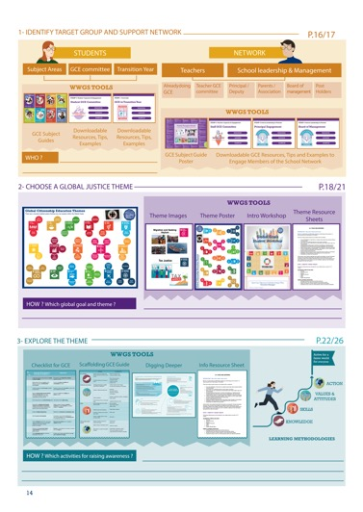
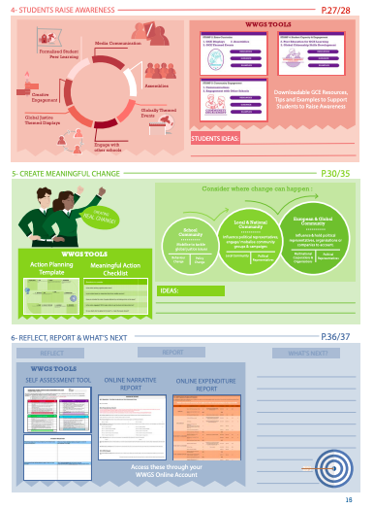
Page
14-15
Notes:
Briefly talk through the 6 steps

Slide 30
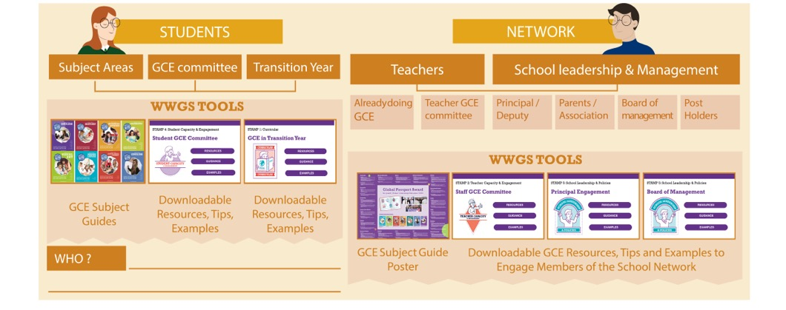
Pages
18-19
STEP 1:
IDENTIFY TARGET GROUP AND SUPPORT NETWORK
Notes:
Ask everyone to reflect on the student group they intend to work with and who in the school they can engage as a support network. Remind them that it’s not all about TY!

Slide 31

TASK:
Consider:
What opportunities are there to explore
Justice issues around ‘Wellbeing and Health’ in your subject area(s)?

Slide 32
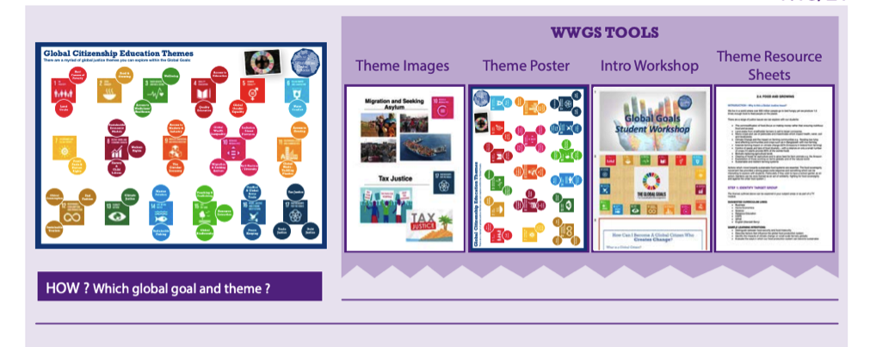
http://www.worldwiseschools.ie/6-step-programme/
Pages
18-21
STEP 2:
CHOOSE A GLOBAL JUSTICE THEME
Notes:
Introduce the step and the tools available – invite them to use their phone to view the tools on their 6 step programme

Slide 33
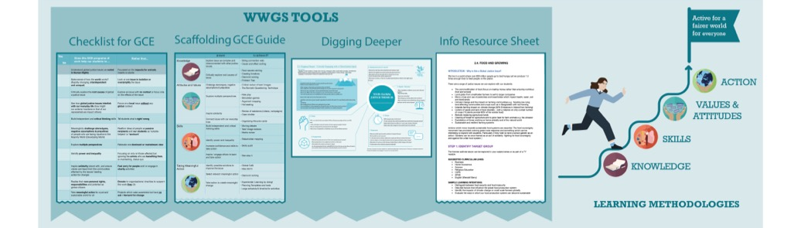
Pages
22-26
STEP 3:
EXPLORE THE THEME
Notes:
Be sure to change to your own date here!!

Slide 34
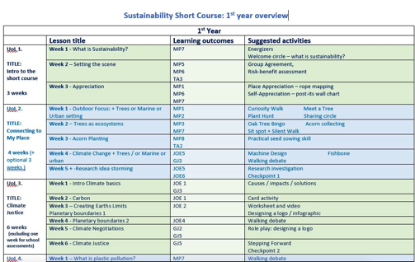
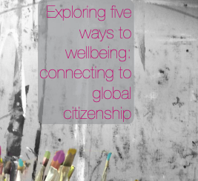
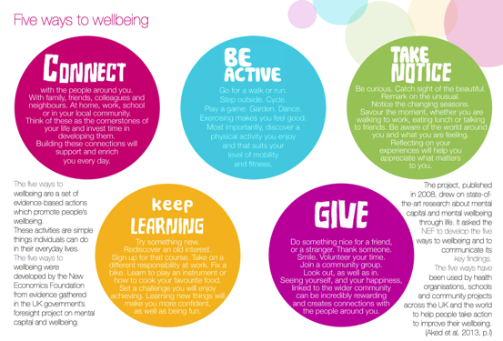
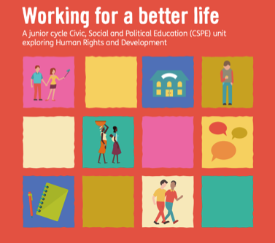
STEP 3: EXPLORE THE THEME
TEACHING AND LEARNING MATERIALS

Slide 35
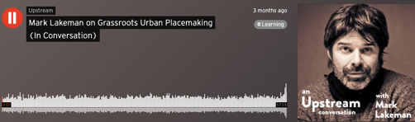
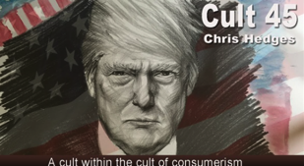

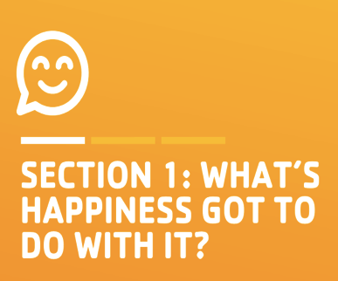

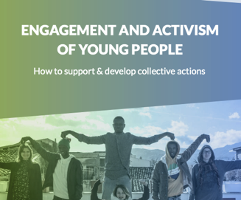
STEP 3: EXPLORE THE THEME
TEACHING AND LEARNING MATERIALS:
Podcasts:
Magazine:
Films:
Activity guides:

Slide 36
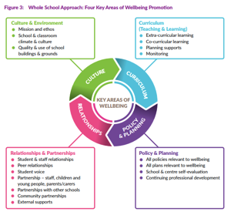
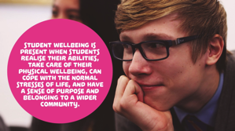
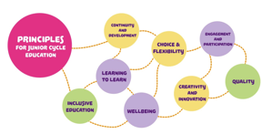
STEP 3: EXPLORE THE WELLBEING FRAMEWORK
TEACHING AND LEARNING MATERIALS

Slide 37
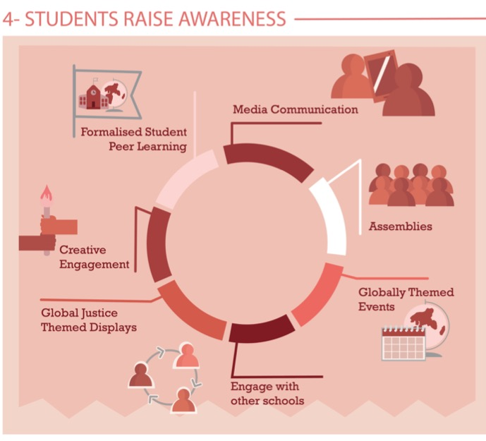
Share Learning
Pages
28-29
Notes:
Media Communication
Assemblies – Intercom
Themed Events –
Global Justice themed displays
Creative engagement
Formalised peer learning

Slide 38
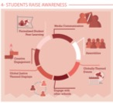
Celebrate UN days of celebration
20th of February – World Day of Social Justice
20th March – International Day of Happiness
5th of April – International Day of Conscience
7th of April – World Health Day
10th of October – World Mental Health Day
24th of October – World Development Information Day
13th of November – World Kindness Day
Create an awareness raising campaign
What areas of wellbeing have students expressed concern or interest? Let them take the lead to promote messages they feel are important to share
Write letters to the local newspaper, media outlet or school newspaper
Can your message reach local media? Local newspaper/newsletter/bulletin. Could you use the school social media to share your message wider again?
Make a video
Why not share the learning further than a poster? You could do a mini-series of videos to bring out every week/bi-weekly? Or record enough for one class period to share the learning further
Create an Art Piece

Slide 39
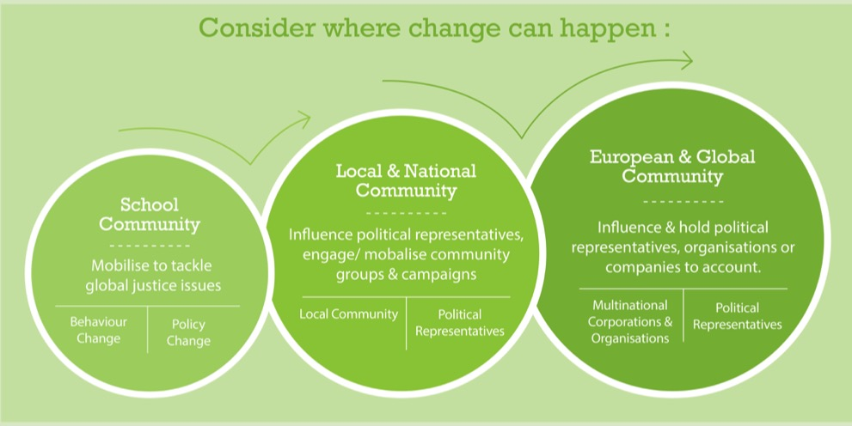
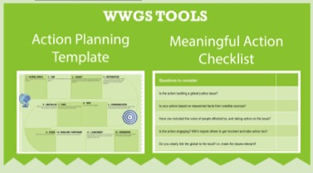
Page
30-35
STEP 5: TAKING MEANINGFUL ACTION
Aims to create Actual Change

Slide 40

STEP 5: TAKING MEANINGFUL ACTION
Ideas for School Community Actions:
Advocate to have Global Citizenship Education as part of your wellbeing framework
Invite senior management to discuss the benefits to the whole school in integrating GCE as part of your wellbeing framework
Create a wellbeing and kindness policy for the school
Start a repair cafe
Ideas for Local Community and National Actions:
Campaign for wellbeing of people and planet to be at the heart of policy and politics - getting in touch with local representatives, TDs etc.
Join a local community group to volunteer/campaign with
Organise activities and demonstrations - it is important to increase the frequency and quality of media coverage on wellbeing of people and planet (over the economy)
Encourage Discussion - Many people still put economic growth ahead of human and planetary wellbeing - try to discuss why it could be the other way around.
Use social media to share information - Have you heard any debates on the topic on the radio or news? If not, contact radio and TV broadcasters to ask for the debate to be publicised.
Ideas for European and Global Community Actions:
Link in with international campaigns and lobby your EU representative
SS4C, 350.org, Fridays for Futures, NHNA, FoE
Land defenders & eco warriors
#lessismore
Notes:
There are many ways of doing this - get in touch with your education officer to discuss further)

Slide 41
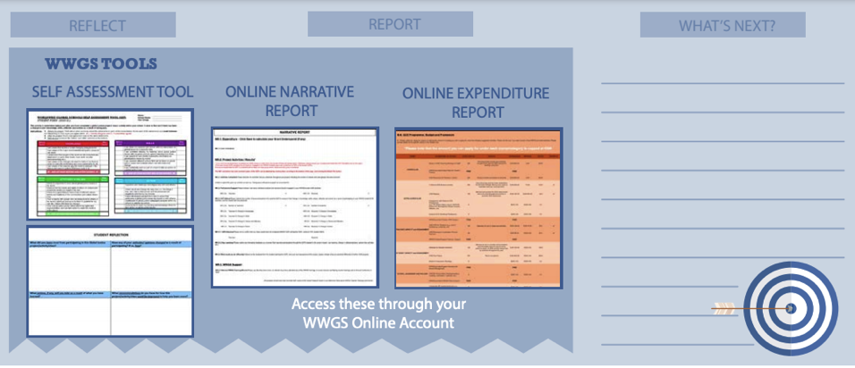
STEP 6:
REFLECT, REPORT AND WHAT’S NEXT?
Pages
36-41

Slide 42
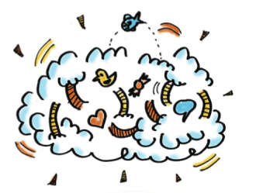
- What are the steps are you going to take next?
- What supports do you need?
Reflection & What Next?

Slide 43
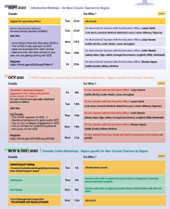
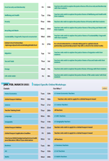
Upcoming Dates
Pages
4-6
Thematic Training Sessions
December
Wellbeing & Health
RECORDED
- Tax & Trade
- Energy
- Anti-Racism
- Fast Fashion
- Food Security & Biodiversity
- Poverty
- Recycling & Waste
- Sustainability/ Degrowth
- Migration
- Life Under Water
Global Passport Award
Webinar 17th of January
Subject Specific Workshops
Jan- March 2020
Notes:
In terms of the breakdown of trainings, outline the 5 types of training
Purple – starter trainings – (today) for new schools and teachers new to GCE (perhaps their school has been involved longer)
Pink – WWGS approach and adapting to covid-19 – for ALL schools and teachers. Even for schools who have been involved for a while. Updated theory and practice
Green – Thematic areas
Blue – subject specific
Yellow – standard WWGS trainings and events. And deadlines.

Slide 44
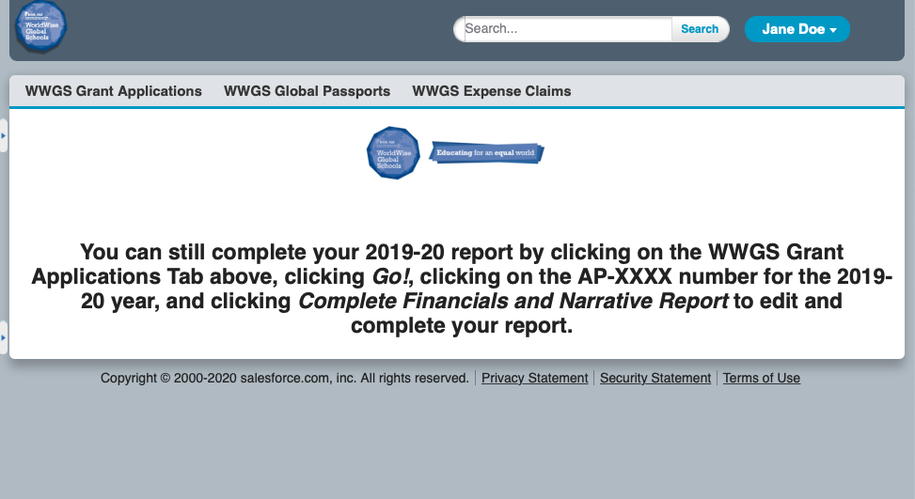
Or, if you think you will have an underspend, use your grant

Slide 45
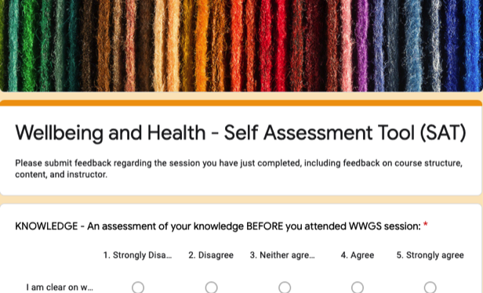
Evaluation for Today
https://forms.gle/fQvoe88mfJ4tZYZn9
Notes:
https://forms.gle/fQvoe88mfJ4tZYZn9

Slide 46



Thank you!
Questions???
Sinead.hayes@worldwiseschools.ie
087 3502877

