Slide 1

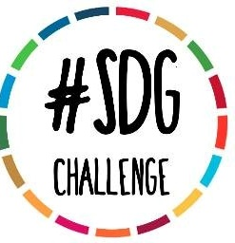

My GCE Journey Journal
A personal online interactive journal exploring Global Citizenship Education for students

Slide 2
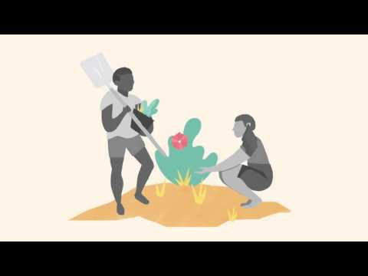
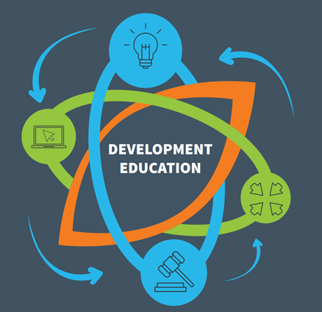
Welcome to your personal
‘My Global Citizenship Education Journey’
Journal!
This online interactive journal is a space for you to learn about global issues and to think critically about your role in the world!
All you need is a copybook, or you can use a word document on your computer.
There will be a number of ways we will facilitate your learning. Click on to the next slides to learn why and how!
Link for video: https://youtu.be/tPdtGrnj7sU

Slide 3
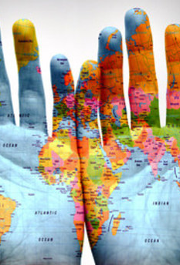
What is included in the journal?
This monthly journal will include information on:
Global Citizenship Education
The Sustainable Development Goals
Guidance on how to be an active citizen and incorporate active citizenship into all aspects of your school life, home life and community.
Every month there will be a different focus and prompts for you to consider and activities to do in school and at home.
It is a personal journal for you to monitor your journey to deeper awareness and care for the world around you, both at a local and global level.

Slide 4

What to expect:
In this Journal there will be information and a number of prompts. The activities are there as a guide to think more critically about something you have just read or watched. The activities will be as follows:
By myself: This indicates an activity to do on your own. You may have to write down your thoughts or investigate something further.
At home: This means you should discuss or come up with an action at home.
With my class: This will be facilitated through your teachers with guidance from us. It will usually involve an activity
Think about in my community: This means think about how a certain SDG or theme and how it relates to your community.
Globally: How does this relate in a global sense?
There will be examples to aid you along the way!
Remember! There are no right or wrongs answers, it’s all about thinking more critically about the world around us.

Slide 5
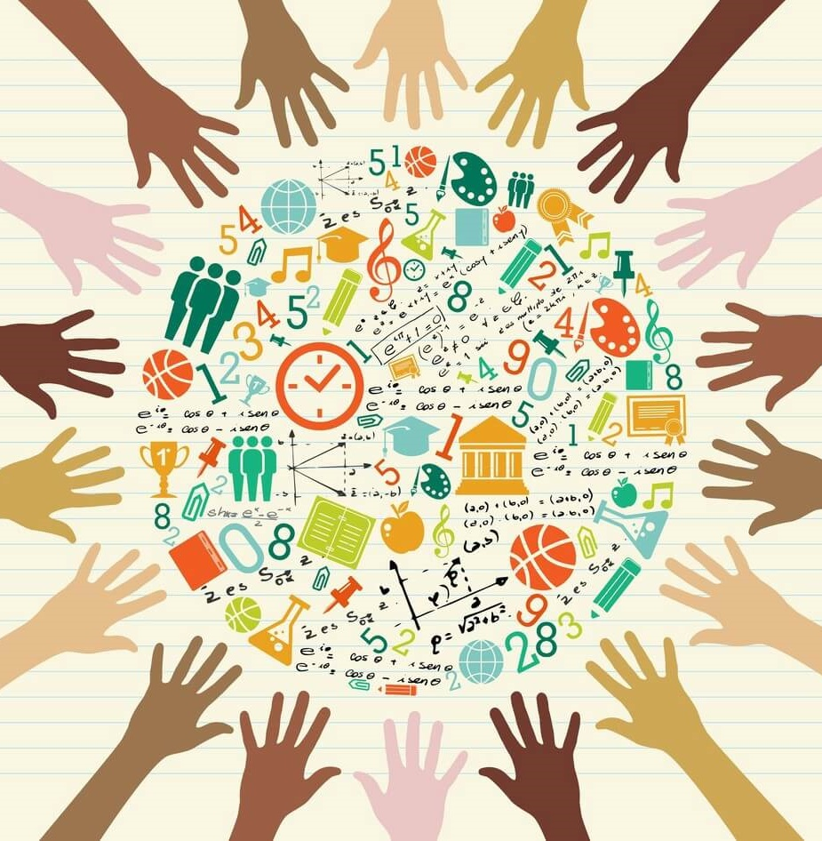
What is Global Citizenship Education?
Global Citizenship Education is a form of learning that involves active participation in projects that address global issues of a social, political, economic, or environmental nature.
It encourages us to see ourselves as citizens of the world and to consider the impact our actions have and how it affects other people, places and things elsewhere.
For example: What is the carbon footprint of our breakfast? Find out here: https://www.bbc.com/news/science-environment-46459714

Slide 6
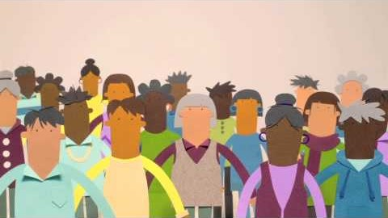
Active Citizenship
Active citizenship is quite simply doing anything to express values or to achieve something for the common good.
Link for video: https://youtu.be/kiZNO_Lca8k

Slide 7
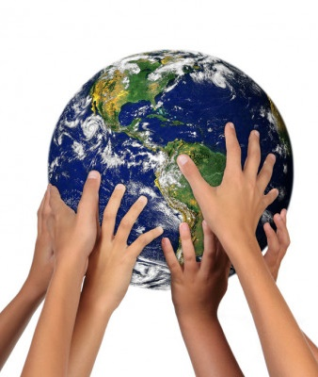
Why is this important?
“We are the first generation that can end poverty, and the last one that can take steps to avoid the worst impacts of climate change. With the adoption of a new development agenda, sustainable development goals and climate change agreement, we can set the world on course for a better future. This must be a time for global action. Future generations will judge us harshly if we fail to meet our obligation”. – Ban Ki-moon

Slide 8

The Sustainable Development Goals
The Sustainable Development Goals apply to all countries – including Ireland – meaning that they are universal.
There are 17 Goals in total, with 169 targets (specific objectives associated with each goal).
The goals apply to everyone. For this reason, and with the cooperation of everyone, the Sustainable Development Goals have the potential to change everything – how we live and work, with whom we work, our views of the world, our vision and values for the planet – today and into the future.
Link for video: https://youtu.be/5G0ndS3uRdo

Slide 9
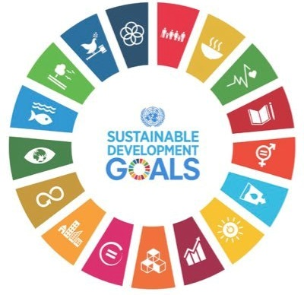
Let’s talk about the SDGs!
By myself:
What are they?
Who are they for?
Who is responsible for them?
Looking at the picture of the SDGs how many can you name?
Name one behaviour change that has occurred in your life because of the SDGs?
Example: Recycling

Slide 10
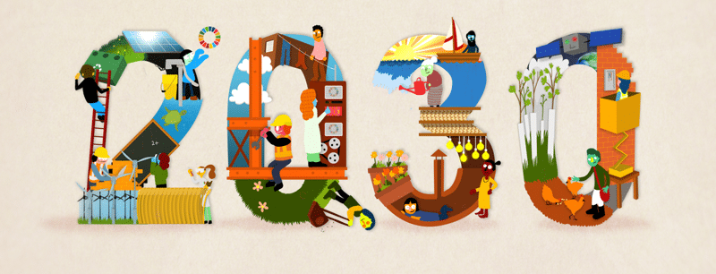

More on the SDGs:
There are 6 Ps to remember when thinking about the SDGs:
People
Planet
Prosperity
Peace
Partnership
And the most important: PARTICIPATION

Slide 11
Why should I care about the SDGs and Development Education?
Often we see that symptoms of problems are being treated. This is necessary and important but it doesn’t fix the reasons why the problem has occurred.
Development Education seeks to identify root causes of problems, as opposed to just meeting the immediate needs the problem creates. As Global Citizens who think critically you have the power to change the way the world works.
There are no easy answers and many of the problems are very complex but it’s important that we see ourselves as people who are in a position to contribute to the problem or to be a part of the solution.
For example: A patient goes to see a doctor. The patient has a pain in their stomach. The doctor doesn’t investigate why but gives the patient painkillers. Will the patient get better?
At home: With your caregiver have a discussion about one thing in Ireland that it seems like the symptoms of a problem is being addressed but not what is causing the problem.

Slide 12
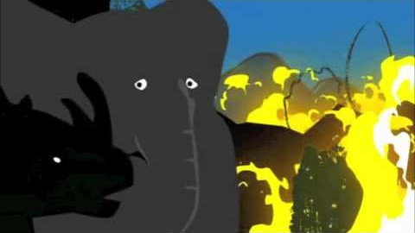
But I’m just one person?
Sometimes our actions may seem insignificant, but every action has a reaction.
It is so important that we always do our best with the knowledge we have.
It is important we approach this journey with an open mind and that we are always trying our best and acting compassionately.
Link to video:
https://youtu.be/5mM11v_16-o

Slide 13
Global Citizenship Quiz
1. What can be understood as global citizenship education?
a) It is a way to know more about international relations.
b) It is a way to become a diplomat.
c) It is a way to understand the world and to connect, relate and share with other cultures and peoples.
2. Why is global citizenship education relevant today?
a) Because global citizens are needed in light of contemporary challenges.
b) It might be a way to counter nationalism.
c) It is not relevant.

Slide 14
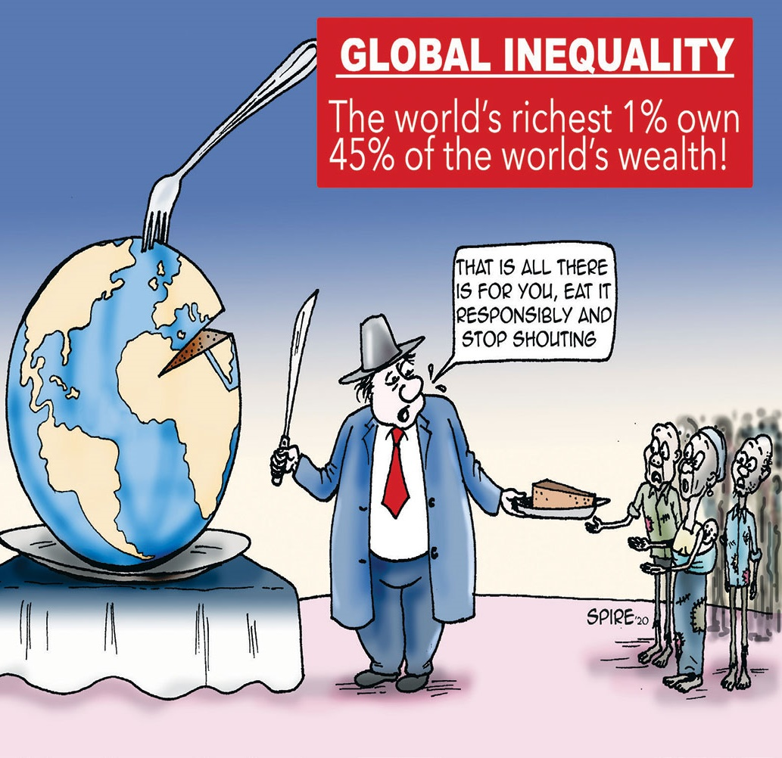
Discuss at home:
What do you think about this?
The world is becoming more and more unequal.
The richest 10% of people in the world own 82% of the world’s wealth.
And the top 1% own 45%.
Source: Global Wealth Report (2019)

Slide 15
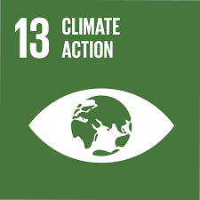
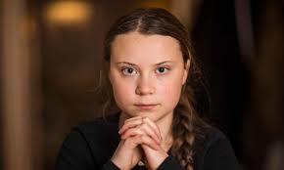
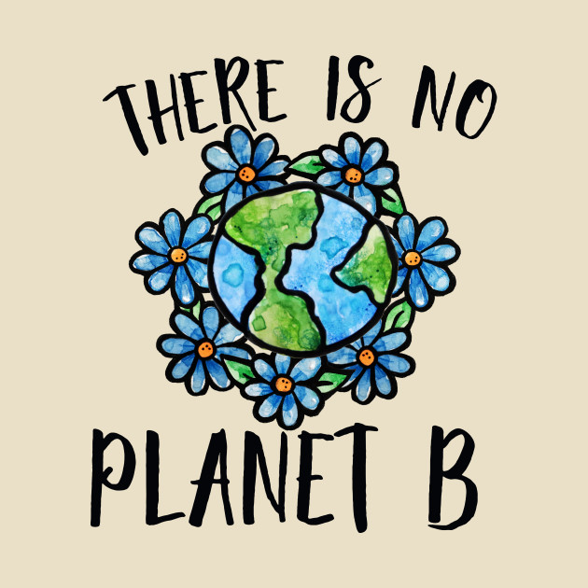
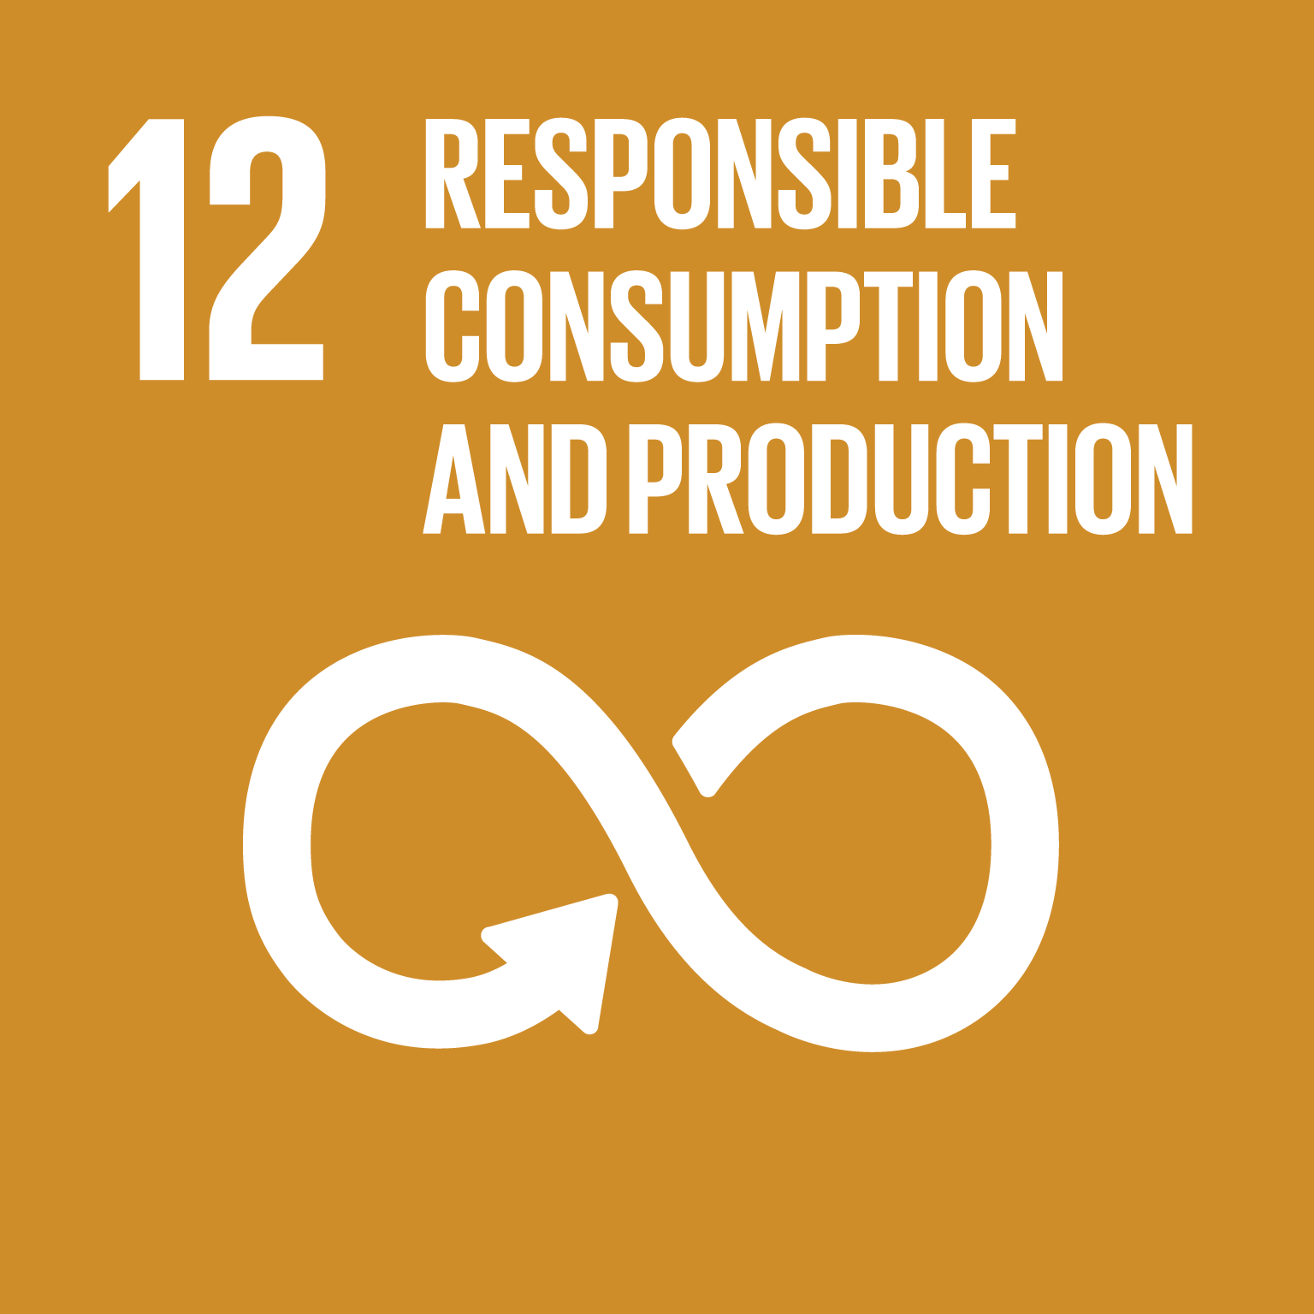
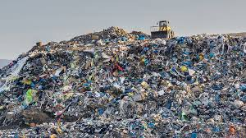
Thank you for your participation!
Next month we will be focusing on SDG 12: Sustainable Consumption and Production and SDG 13: Climate Action

