Slide 1
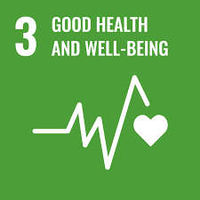
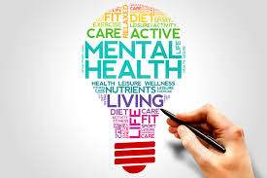

SDG 3: Good Health and Well-being
Katie Martin and Katie Lynch from Development Perspectives

Slide 2

Outline
What we do
The aim of this workshop
Overview of SDG 3
Coping mechanisms
Picture Activity
Climate Change Food Calculator
Conscious consumerism
Minimalism
Coping mechanisms
Gratitude
Q&A

Slide 3


Where are you Zooming us from and what subjects do you teach?

Slide 4

Development Perspectives
Development Perspectives is a Louth based development education NGO that works with adults and youths nationally and internationally.
“Development Perspectives’ mission is to contribute to lessening poverty, inequality and climate change through transformative education and active global citizenship.”
Development Perspectives recognises the importance of learning from different local and global perspectives.
We have a number of projects: Saolta, the #SDGChallenge, SDG Advocate Training, Erasmus+ Projects, SDG Challenge Schools, STIRE and DPTV.

Slide 5
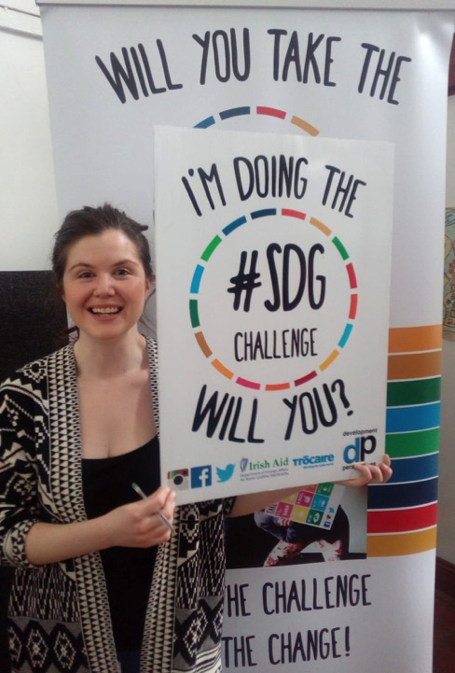
The #SDGCHALLENGE
The #SDGchallenge is a development education project which aims to equip individuals with the knowledge, skills and motivation to take informed action to contribute towards the achievement of the Sustainable Development Goals (SDGs).
The #SDGchallenge is a 17-month project which focuses on one goal per month with online Information packs, Workshops & Advocacy Training to engage all learning styles.
The motto behind it is: Take the Challenge! Be the Change!
Current Challenge is #AmazingWomen!
Notes:
Mention Workshops coming up and current #SDGChallenge

Slide 6


The SDG Challenge Schools

Slide 7
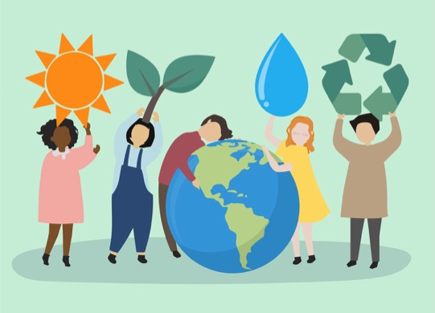
The aim of today’s webinar
To learn about SDG 3 in the context of our health, both mentally and physically
To learn about the connection between our health, the health of others and the health of our planet
To explore our interconnection with nature and how we can show up for ourselves, others and our planet

Slide 8

What is SDG 3 Good Health and Well-being about?
Goal 3’s aim is to ensure healthy lives and promote well-being for all at all ages.

Slide 9
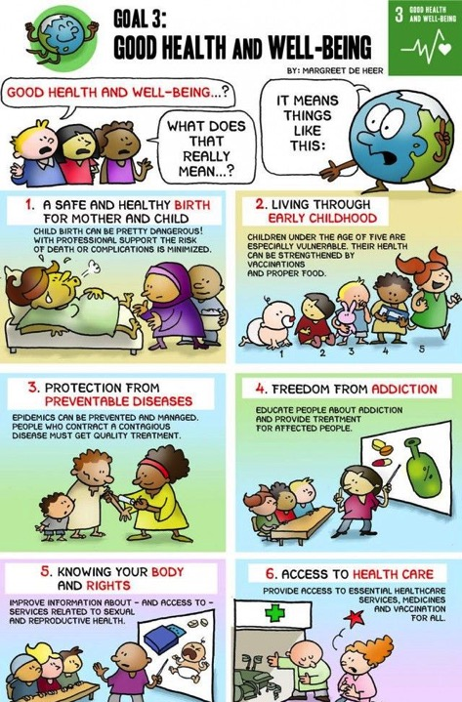
What is included in the Goal?
The Goal addresses all major health priorities, including reproductive, maternal and child health; communicable, non-communicable and environmental diseases; universal health coverage; and access for all to safe, effective, quality and affordable medicines and vaccines.

Slide 10
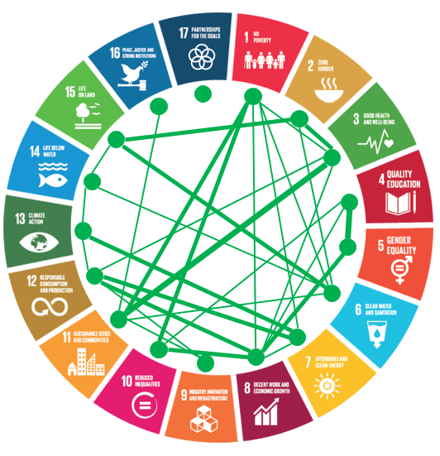
How is this connected to other Goals?
Health and well-being is directly impacted by things like stress and environmental factors. Some are more obvious than others:
Examples:
Environmental factors kill millions of people every year, causing nearly one quarter of all deaths worldwide.
Air pollution is the world’s largest environmental health risk killing 6.5 million people prematurely every year
Pollution, chemical exposure, climate change and ultraviolet radiation contribute to more than 100 diseases affecting primarily young children and elderly people.
However, SDG 3 is connected to action/inaction in every goal. Human rights are essential to health and wellbeing

Slide 11
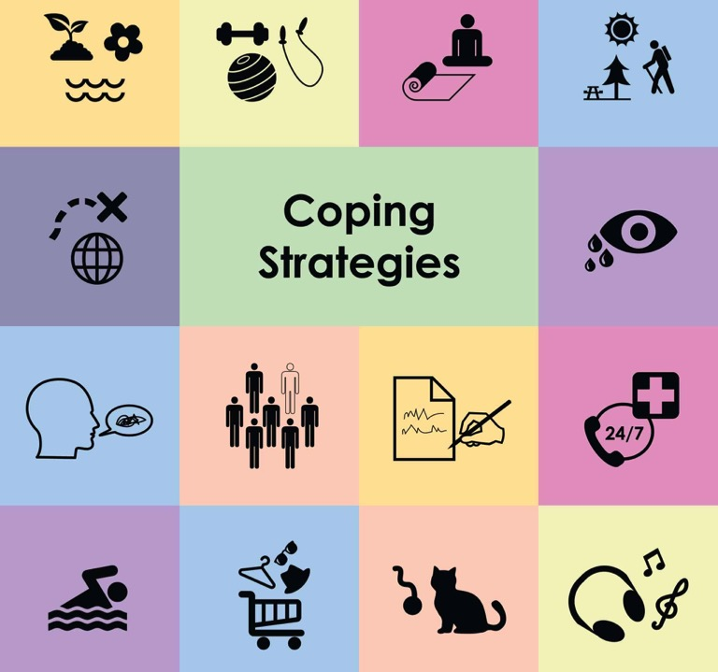
What are your coping mechanisms when you’re feeling overwhelmed?
Notes:
Menti.com Enter code: 64 28 26 7

Slide 12
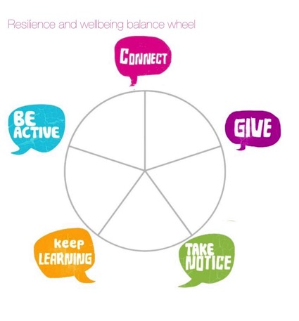
Wheel of Well-being
Connect
Be active
Take Notice
Keep Learning
Give

Slide 13
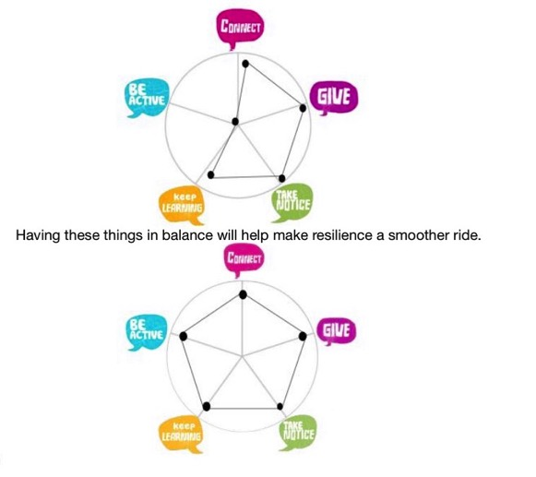
Wheel of Well-being

Slide 14
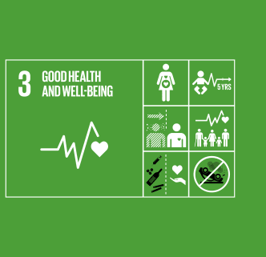
Picture Activity
Looking at the following photos, which one do you think is the most related to SDG 3 Good Health and Well-being?

Slide 15
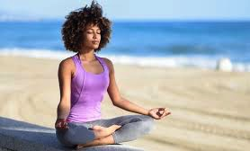
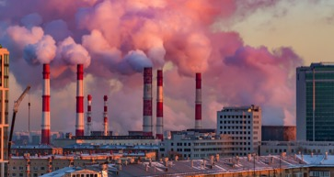
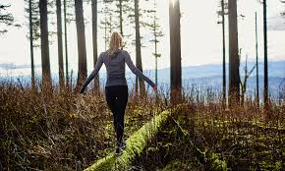
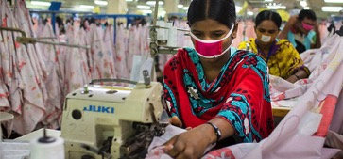
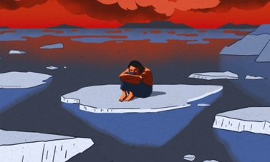
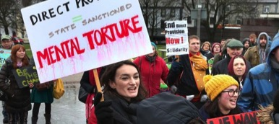
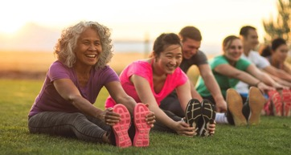

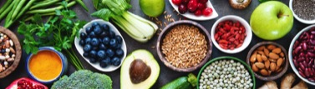

Slide 16
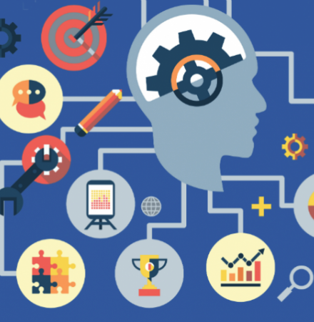
Is your photo helpful or harmful to well-being?

Slide 17
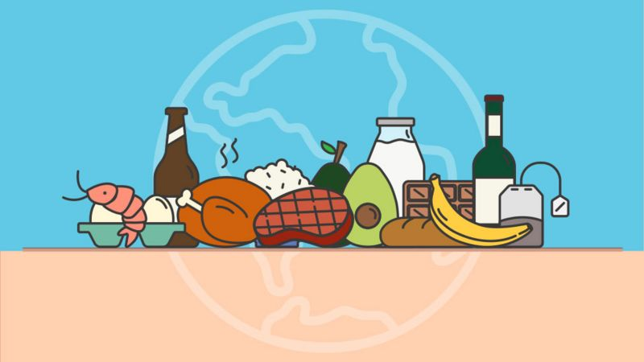
Climate Change Food Calculator

Slide 18
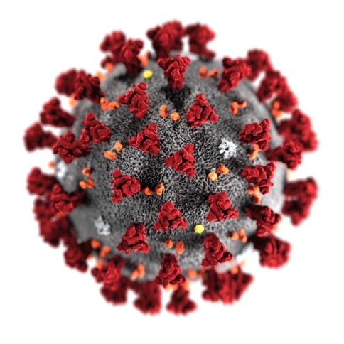
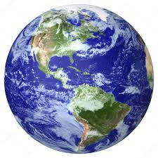
Covid 19 and our relationship with nature
Notes:
https://updates.panda.org/interconnected

Slide 19
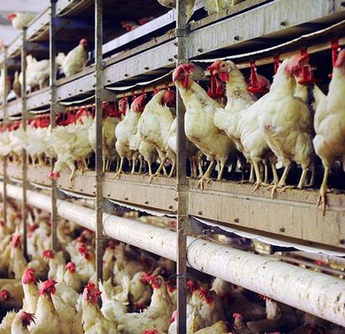
Nature is our life-support system.
The transmission of zoonotic diseases from animals to humans has long been recognized as a serious threat by global health experts.
Studies show that 75% of all emerging diseases come from wildlife, with recent years witnessing the emergence of SARS (from civet cats) and MERS (from dromedary camels). To help curb future pandemics, we must greatly reduce the opportunities for viruses to jump from animals to people.
It is crucial that we rebalance our relationship with nature to secure a sustainable future for people and the planet.

Slide 20
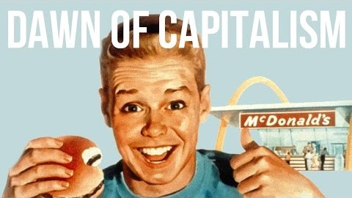
Conscious Consumerism
Notes:
Critically interrogating whether what we buy meets our needs
How advertising seems to know our needs and desires but the companies behind the ads don’t actually care about meeting these needs

Slide 21

Minimalism
Minimalism is not about having less: it’s about making time for what really matters
Minimalism has been shown to... save time, reduce overwhelm, increase energy, reduce worry and financial insecurity, reduce overstimulation, reduce feelings of guilt, comparison, and decision fatigue.
Notes:
https://wellandwealthy.org/minimalism-stop-depression-and-anxiety/

Slide 22
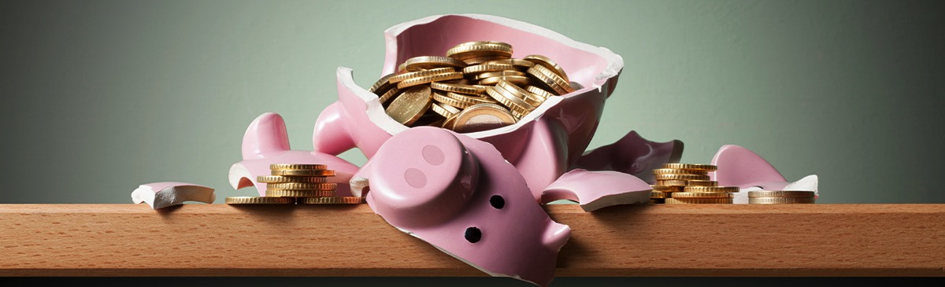
What are we measuring in society?
While a lot of people assume health and well-being are correlated with wealth or the absence of poverty it is obvious that high GDP does not necessarily mean health.
Focusing exclusively on GDP and economics to measure development ignores the negative effects of economic growth on society, such as climate change and income inequality.
In order to see how well society is actually doing it is important to look at things such as The World Happiness Report.
It prompts the question how am I measuring my own success?
Notes:
https://hbr.org/2019/10/gdp-is-not-a-measure-of-human-well-being

Slide 23
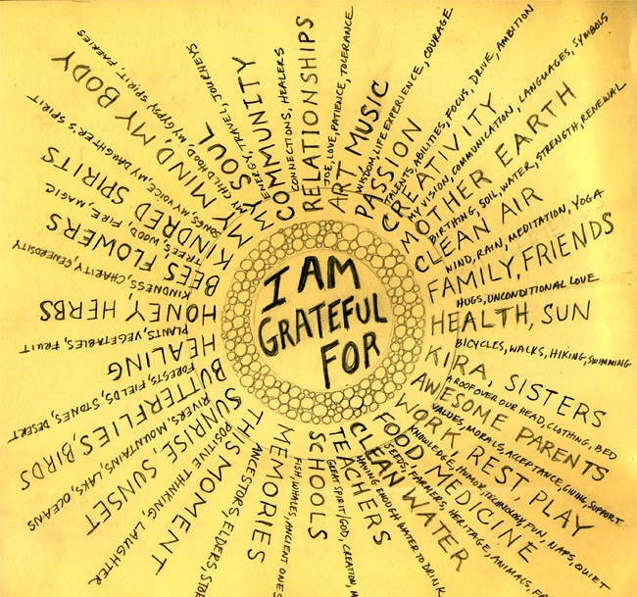
Gratitude

Slide 24
From this workshop are there any new coping mechanisms you would use?

Slide 25
Below is attached a number of resources and links either teachers have shared with us or we generally share.
Links shared by teachers:
1. The World's Largest Lesson: https://www.stmacdaras.ie/?s=Worlds+largest+lesson
2. How to make EcoBricks: https://www.youtube.com/watch?v=MQYsXxHKgMk
3. Carbon Footprint: https://www.wwf.org.uk/myfootprint
4. Resources site: https://msaflynn.wixsite.com/globalcitizenship
Other useful websites:
1. WorldWise Global Schools: https://www.worldwiseschools.ie/
2. Self Help Africa Global Citizenship Education: https://selfhelpafrica.org/ie/education/?gclid=Cj0KCQiAhZT9BRDmARIsAN2E-J2sVgENFljtfavxZgHfpsqQLWxb1XnMgQs0_IaHeIn5SPFsCO-ZmvkaAn4ZEALw_wcB
3. Centre for Global Education: https://www.centreforglobaleducation.com

Slide 26


Slide 27


