Slide 1
THE ART OF INEQUALITY
Art resource for 11-14 year olds

Slide 2
SESSION 1
Can information be beautiful?
Notes:
Before class:
Open the hyperlink on slide 7 (by clicking on the web address with the right-hand mouse button), so that it has time to load.
Check that your sound system is working.
Check whether the text on slide 4 will be legible from the back of the class. If not, you could print out a full-page copy of the slide or ask individuals to approach the board to read out particular sections.
Gauge prior knowledge of (info)graphic design as a medium:
Purpose
Methods
Examples.

Slide 3
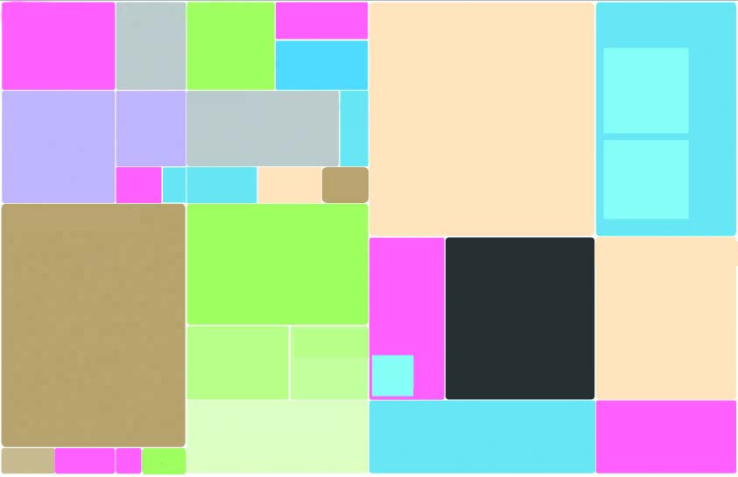
This is not abstract art!
Notes:
Explain:
This is not just an abstract pattern, it’s an infographic that has had all explanatory text removed.
The whole box, and the way it has been divided up, represents certain facts and figures.
It was designed in 2009 by David McCandless, a London-based graphic designer and data journalist.
Ask:
What does it remind you of visually?
What sort of data do you think it may represent? I’m not looking for the right answer, just creative ideas.
Share and critique guesses as a class.
Differentiate:
Make it easier: Only give the following hints if learners are not generating plausible guesses on their own:
What if I told you that the entire rectangle represented billions of pounds?
And that the smaller boxes represent amounts of money used for different purposes or generated in different ways?
Source: http://www.informationisbeautiful.net/2010/the-billion-dollar-o-gram-2009/
Credit: InformationisBeautiful.net

Slide 4
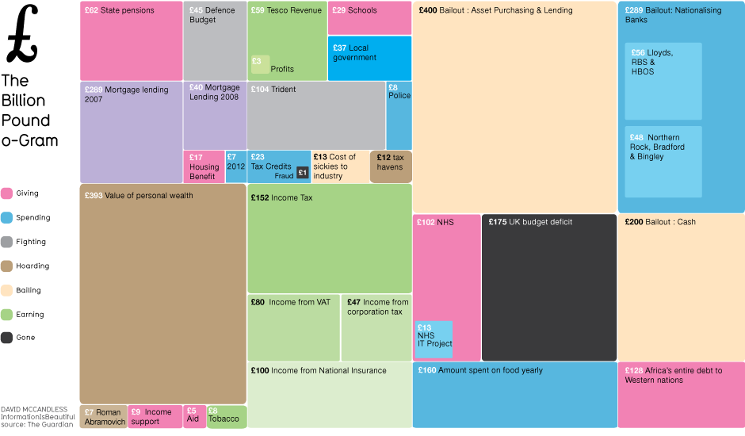
THE BILLION POUND-O-GRAM
Notes:
Explain:
David McCandless created this “treemap”* to show the relative size of the different budgets and amounts the government spent on different things. When mentioned in the news, these were nearly always reported separately and in billions of pounds, which made it difficult for ordinary people to interpret and compare them.
* A method for displaying hierarchical data using nested rectangles (Wikipedia)
Ask:
Find two boxes of similar sizes. Does it surprise you or not that the same amount was spent on these two items?
For example: Running the NHS costs about as much as we spend on food each year
Guess how many times the pink SCHOOLS box would fit into the blue BAILOUT OF BANKS box
10 times.
Is this surprising? Fair? Sustainable?
Do you think the colour of the boxes is significant? How?
(Colour code revealed on the next slide.)
Differentiate:
Make it easier: Some explanations of terms may be needed:
Bailout: A colloquial term for giving money to a company or country which faces serious financial difficulty or bankruptcy
Budget deficit: The amount by which a government, company, or individual’s spending exceeds its income over a particular period of time.
Source: http://www.informationisbeautiful.net/2010/the-billion-dollar-o-gram-2009/

Slide 5
COLOUR CODE
Giving
Spending
Fighting
Hoarding
Bailing
Earning
Gone
Notes:
Explain:
David McCandless uses a colour code to reveal the different uses, origins or destinations of the money.
Ask:
Can you remember which colour dominated the Billion-Pound-O-Gram?
Cream (bailing)
Flip back to the previous slide for learners to discuss in pairs:
Did you guess that represented “bailing”?
What do you think about the fact that more money was spent on “bailing” than all the other types of spending represented?
What does this mean?

Slide 6
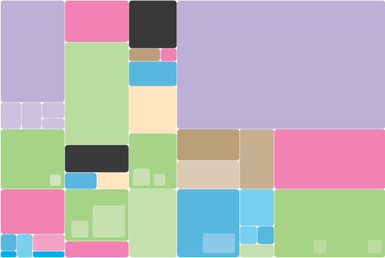
THE DESIGNER’S PURPOSE
  “This image arose out of frustration with reporting of billion dollar amounts in the news. That is, that they’re … literally mind-boggling amounts of money.
  So here we’ve scraped reported figures from The New York Times, The Guardian, and other news outlets and visualized them as a treemap so you can see in one place figures that would otherwise be scattered across multiple news reports.”
Notes:
Read this quotation by David McCandless. Discuss it with the class.
Differentiate:
Make it easier: Explore the conventions and format of “treemaps” @
http://www.coolinfographics.com/blog/tag/treemap
Source: http://www.informationisbeautiful.net/2010/the-billion-dollar-o-gram-2009/

Slide 7
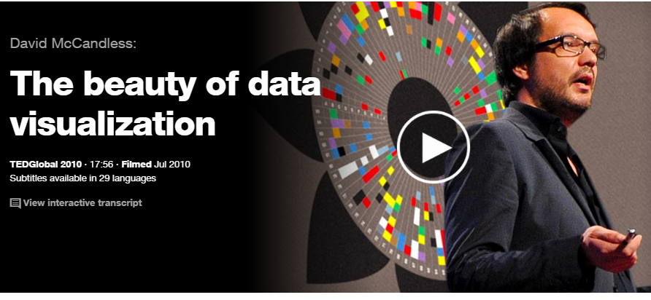
INFOGRAPHICS TED TALK
http://www.ted.com/talks/david_mccandless_the_beauty_of_data_visualization#t-25399
Notes:
Show the first three minutes of David McCandless’s TED talk:
Be aware that McCandless walks his audience through the dollar (American) version of the Billion-Pound-O-Gram.
Prompt a class or small group discussion by asking:
What is the purpose of McCandless’s infographics?
He uses his eyes to solve the problem of information overload by visually summarizing masses of statistics or data. He calls this “knowledge compression”.
He makes patterns and connections within this data more clear.
He tries to produce a piece of aesthetically pleasing design.
What is “information overload”?
Why are infographics trendy today?
Differentiate:
Make it harder: Watch an extra two minutes of the video clip when McCandless is walking us through “Mountains Out of Molehills”. Ask learners:
What does it mean to make a mountain out of a molehill?
Why is the audience laughing when McCandless reveals what each mountain represents?
Do you prefer the Billion-Pound-O-Gram or Mountains Out of Molehills? Why?
Source: http://www.ted.com/talks/david_mccandless_the_beauty_of_data_visualization#t-226509

Slide 8
SESSION 2
What is inequality?
Notes:
Before class:
Open the hyperlink on slide 13 (by clicking on the web address with the right-hand mouse button), so that it has time to load.
Check that your sound system is working.
Check whether the text on slide 10 will be legible from the back of the class. If not, you could print out a full-page copy of the slide or ask individuals to approach the board to read out particular sections.
[Optional: Ask learners to bring in Monopoly sets from home. You will need one set per group of four to eight learners.]

Slide 9
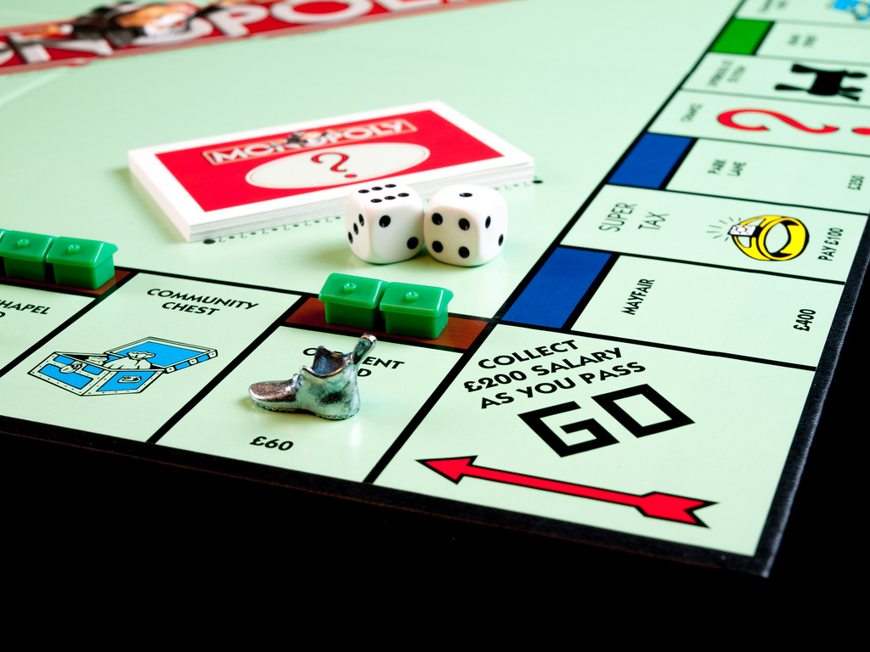
How does Monopoly work?
Notes:
Gauge which learners have played Monopoly regularly.
Divide the class into groups of four to eight players with at least one regular Monopoly player in each group.
Give each group a mini-whiteboard or scrap paper and markers.
Ask the groups to write down everything they remember about the game Monopoly. This could include:
What do you need to play the game?
A board, a token for each player, dice, money, houses, hotels, chance cards, community chest cards
What are the rules?
How do you play?
How can you win the game? Do you need luck or certain skills?
Share and compare responses.
Differentiate:
Make it easier: If learners aren’t familiar enough with the game to answer these questions independently, bring in a Monopoly set to share and/or project the 13-step guide from: http://www.wikihow.com/Play-Monopoly
Photo source: William Warby https://qzprod.files.wordpress.com/2015/02/11513424364_f48b8cb877_b.jpg

Slide 10
LET’S PLAY: What if we changed the rules?
Players start with different amounts of money:
  Player 1 with £2,500
  Player 2 with £1,500
  The rest with £500
Buying properties:
  Player 1 can buy any property
  Player 2 can buy maroon, orange and utilities
  The rest can only buy purple and light blue
Players receive different amounts of money when they pass GO:
  Player 1 gets £250
  Player 2 gets £150
  The rest get £50
Notes:
Explain that learners are now going to do one of two things:
Option A (if the learners have been able to bring in enough Monopoly sets): Play Monopoly with some significant changes in the rules. If possible, ensure the players who are familiar with the game are spread out amongst the groups.
Option B (if you don’t have the time or Monopoly sets): Imagine playing Monopoly with some significant changes in the rules.
Reveal each rule and check for understanding of how they differ from the standard rules.
Ask each group to (A) play then report or (B) predict how the game’s outcome differs on their whiteboard or paper.

Slide 11
AFTER PLAY: How did the new rules change the game?
How much did the amount you started with determine your success?
Did it matter how much previous Monopoly experience or skill you had?
How did/would it feel to lose the game very early on?
How could we relate this new version of the game to the real world?
Notes:
Invite responses to these questions one at a time, trying to tease out key issues and definitions relating to inequality:
Poverty trap: If you’re already poor you can find yourself trapped in poverty and unable to escape from it, however much talent you have and however hard you work.
Free market: A free market means fair competition. However, in reality, all markets have rules and many of these are biased in ways that aren’t obvious at first but that favour people who are already rich.
Deregulation: This means doing away with laws that govern, for example, the way business is done. In practice, deregulation often gives commercial enterprises the freedom to act in ways that are not beneficial to society, for example, by paying their workers less and avoiding paying taxes.

Slide 12
CASE STUDY: What Is Inequality?
Nthabiseng was born to a poor black family in Limpopo, a rural area in South Africa. On the same day, Pieter was born nearby in a rich suburb of Cape Town. Nthabiseng’s mother had no formal schooling and her father is unemployed, whereas Pieter’s parents both completed university education at Stellenbosch University and have well-paid jobs.
As a result, Nthabiseng and Pieter’s life chances are vastly different.
Nthabiseng is almost one-and-a-half times as likely to die in the first year
of her life as Pieter. He is likely to live more than 15 years longer than
Nthabiseng.
Pieter will complete on average 12 years of schooling and will most
probably go to university, whereas Nthabiseng will be lucky if she
gets one year. Such basics as clean toilets, clean water or decent
health care will be out of her reach. If Nthabiseng has children there
is a very high chance they will also grow up equally poor.
Notes:
Differentiate:
Make it longer: This case study is an optional extra slide that can be read and discussed if time permits.
Read aloud this case study comparison taken from the World Bank’s World Development Report 2006.
Ask the class the questions below. If possible, encourage them to relate their thoughts to their experience in the Monopoly game and to the new vocabulary they have learnt.
Who is in a more privileged position from birth?
What aspects of the two children’s lives seem unfair?
How is the future prosperity of these children linked to their past?
Source: Oxfam GB (2014) ‘Even it up’, Oxford: Oxfam GB, p. 25.
The statistics are taken from:
UNDP (2010) ‘Millennium Development Goals. Goal 4: Reduce child mortality’, http://www.statssa.gov.za/MDG/2010_MDG_GOAL_4_REDUCE_CHILD_MORTALITY.pdf
National Planning Commission (2013) ‘Divisive effects of institutionalised racism’, http://npconline.co.za/pebble.asp?relid=85
World Bank (2006) ‘World Development Report 2006: Equity and Development’, Washington, DC: World Bank Group
Statistics South Africa (2012) ‘Census 2011’, http://statssa.gov.za/publications/P03014/P030142011.pdf
B. Harris et al. (2011) ’Inequities in access to health care in South Africa’, Journal of Public Health Policy 32, S102–23.
P. Piraino (2014) ‘Intergenerational earnings mobility and equality of opportunity in South Africa’, Southern Africa Labour and Development Research Unit, University of Cape Town, http://www.opensaldru.uct.ac.za/handle/11090/696

Slide 13

What is inequality?
http://www.oxfam.org.uk/get-involved/campaign-with-us/find-an-action/even-it-up
Notes:
Watch Oxfam’s three-minute campaign film about inequality.
Direct the learners to discuss some or all of these questions:
What facts and figures can you remember from the video?
What examples of inequality have you seen or experienced? … At home? At school? In Britain? In the world?
How can we define inequality?
Does it matter that some people are much richer than others? If so, why?
Why is it important to tackle inequality now?
How can we tackle inequality?
Differentiate:
Make it easier: You could use the following prompts to help tease out a web of ideas together on the board:
What facts and figures can you remember from the video?
For example, seven out of ten people live in countries where the gap between rich and poor is bigger than it was three decades ago.
2. What examples of inequality have you seen or experienced? … At home? At school? In Britain? In the world?
3. How can we define inequality?
Wide differences in a population in terms of their wealth, their income and their access to essential services such as health and education
Multi-dimensional: race, gender, geography and economy.
4. Does it matter that some people are much richer than others? If so, why?
People with a lot more money have more power and influence and can put pressure on politicians and organisations to do the things they want them to do.
5. Why is it important to tackle inequality now?
Because inequality:
Makes it impossible to eliminate global poverty
Doesn’t allow for social mobility
Fuels crime and even violent conflict
Corrupts politics and damages democracy. In rich and poor countries alike, money yields power and privilege, at the expense of the rights of the majority.
6. How can we tackle inequality?
By challenging the extreme concentration of wealth/power in the hands of elites
All governments providing free public health and education
Pay all workers a “living wage”
Promote women’s economic equality and women’s rights
Close international tax loopholes.
Source: http://www.oxfam.org.uk/get-involved/campaign-with-us/find-an-action/even-it-up

Slide 14

By 2016 …
Notes:
Explain that the final activity in this session will be a practical one in which they will draw their first infographic by hand to communicate this statistic calculated this year by Oxfam:
If we took the entire wealth of the planet and divided it into two, almost half would go to the richest 1%, while the other half would have to be shared amongst the remaining 99%.
Critique this Oxfam poster in pairs, ensuring learners tease out:
It’s not actually an infographic as it does not use symbols and it is very text-heavy.
The high quality of the photo is eye-catching.
The expressions on the children’s faces convey a sense of surprise and confusion in the statistic.
The typeface is fun, which does not match the gravity of the message.
Source: http://www.oxfamamerica.org/static/media/resized/top-1-percent-richer-than-rest-of-world-2016-Oxfam_610nc.jpg

Slide 15
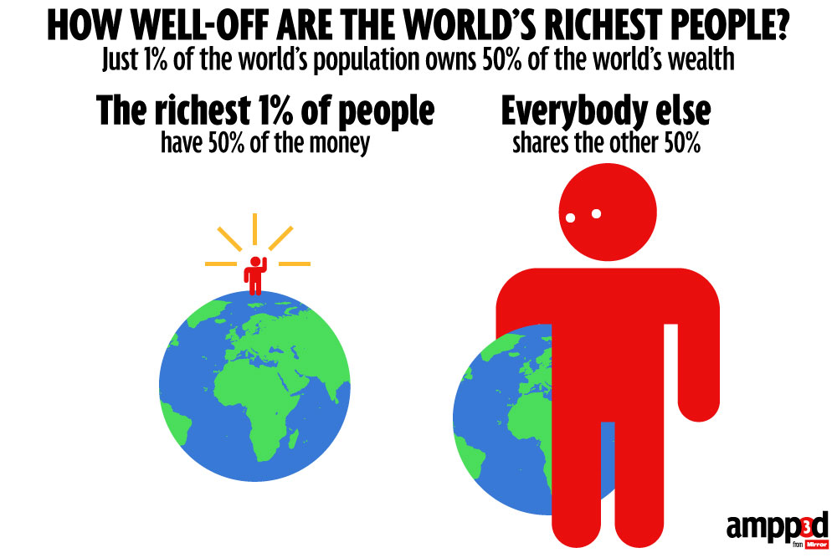
How could this infographic be improved?
Notes:
Critique the Daily Mail’s infographic based on the same statistic, this time focusing on:
How could this poster have been designed better? Potential ideas:
Earth split into two instead of two globes
99 (or at least several) small pictogram people instead of one
Another layer or at least background colour added to create depth and interest
Scales or a see-saw added to symbolise uneven distribution
A symbol for money or wealth incorporated.
Ask learners to think about what symbols they could use to convey the message even more clearly in their drawing.
Coins
(weight) scales
Multiple small pictograms (symbols of humans) representing the 99% versus one large pictogram for the 1%.
Source: http://s3.mirror.co.uk/mirror/ampp3d/2015/January/19/world-wealth.jpg

Slide 16
Draw your own infographic
By 2016,
the world’s richest 1% will have more wealth than the rest of the world combined.
Notes:
Reiterate that now is the time for the final activity of this session: drawing their first infographic by hand to communicate the statistic on this slide.
Distribute coloured pencils and paper or sketchbooks.
Guide learners as they work, ensuring they avoid overcomplicating or over-filling their design.
Differentiate:
Make it easier: You could start with a basic template that you prepare before class or that you compose together during the discussion of Slide 14.
Make it longer: An element of collage using coloured papers could be introduced and/or learners could work in pairs to peer-assess the clarity of the message and effectiveness of design choices. Learners could also be given more time to find inspirational secondary source material (on the internet or from hard copy resources on hand) to inform their drawing of symbols.
Source: http://www.oxfamamerica.org/static/media/resized/top-1-percent-richer-than-rest-of-world-2016-Oxfam_610nc.jpg

Slide 17
SESSION 3
Big Ideas in Design History
Notes:
Before class:
Check whether the text on slide 19 will be legible from the back of the class. If not, you could print out a full page copy of the slide or ask individuals to approach the board to read out particular sections.

Slide 18

What do we already know about the infographic design process?
http://neomam.com/interactive/13reasons/
Notes:
Gauge prior knowledge:
What four design elements did we use to analyse the work of David McCandless in Session 1?
Colour
Typography
Space
Texture (Remember: in design terms, texture refers to the creation of depth rather than surface quality).
Can you think of any other decisions a designer has to make when working on an infographic?
Why are infographics so popular in journalism and advertising today?
They allow an audience to take in a lot of information (ideas, facts or statistics) quickly and easily.
Explain:
In this session, we will be focusing on effective choices you can make regarding symbols, typeface and colour.
Differentiate:
Make it longer: Learners may enjoy scrolling through “13 Reasons Why Your Brain Craves Infographics” explained visually at: http://neomam.com/interactive/13reasons/
Source: http://neomam.com/interactive/13reasons/

Slide 19
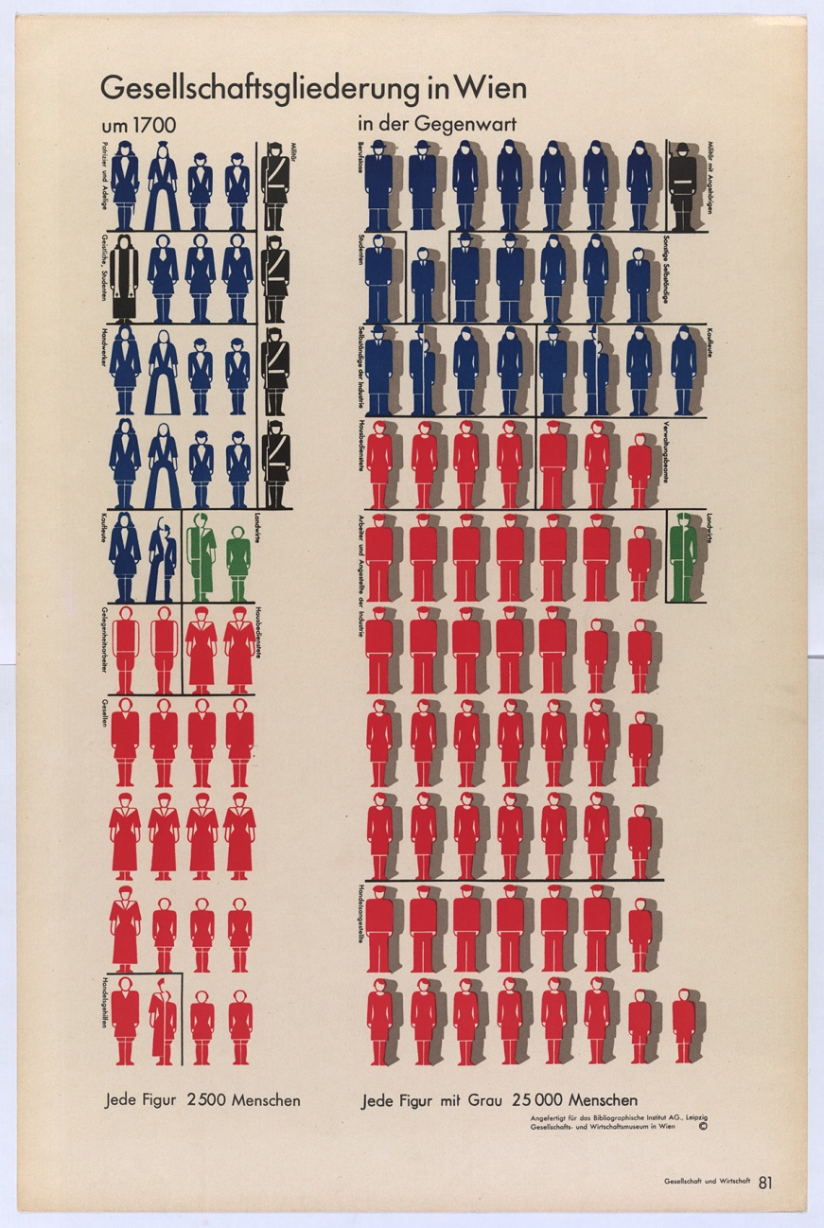
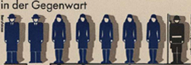
Pictograms
Notes:
Discuss and record on Activity Sheet 3.1:
Designer: Otto Neurath
Design: Structure of Society in Vienna, 1938
Choice: Pictograms (simple images using only lines and blocks of black and white)
Effect: To cut down on text; create a universal visual language
Use the close-up on the right to clarify:
What does this remind you of?
Toilet door sign
The other name for this type of graphic is “isotype”. Can you guess what this stands for?
International System of Typographic Picture Education
What sorts of jobs can you recognise from the pictograms?
Labourers, office workers, soldiers, police officers
What information is Neurath communicating?
Shifts in types of occupations between 1700 and the present
Growing number of the population in paid work
Source: http://www.designboom.com/design/otto-neurath-gypsy-urbanism/
Photo: © MAK
Ownership: MAK – Austrian Museum of Applied Arts / Contemporary Art

Slide 20
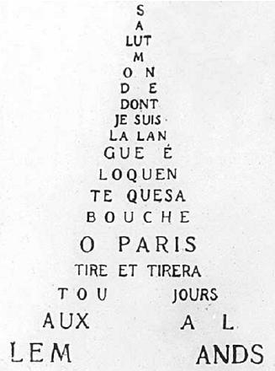
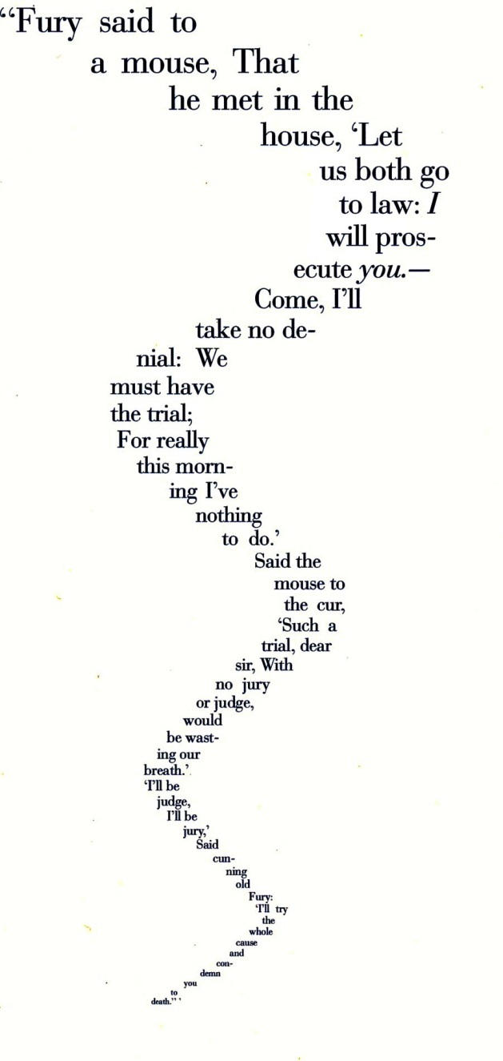
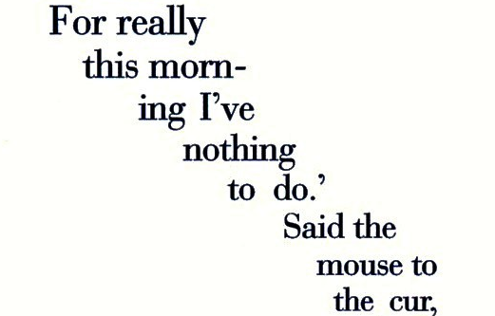
Calligrams
Notes:
Discuss and record on Activity Sheet 3.1:
Designer: Guillaume Apollinaire
Design: Eiffel Tower, 1918
Choice: The lettering conforms to a recognisable shape (calligram)
Effect: Cuts down on the need for a separate title or labels
Use all the images on the screen to clarify:
Can you guess the roots of the word “calligram”?
Kallos = beauty, gramma = thing written (Ancient Greek)
Can you think of any other packaging or advertisements that use this same technique?
The calligram on the right is by the author and poet Lewis Carroll. What shape do you think he is trying to make? Why?
A mouse’s tail because this is a mouse’s tale (a tale told by a mouse)
If you had known about calligrams last session, could you have improved your 1% design?
Source: https://upload.wikimedia.org/wikipedia/commons/f/fc/Guillaume_Apollinaire_Calligramme.JPG
http://www.lewiscarroll.org/tag/the-mouses-tale/

Slide 21

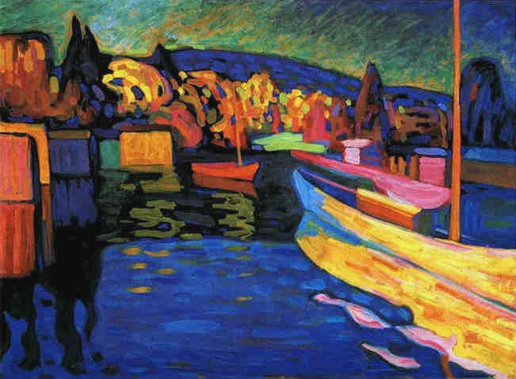
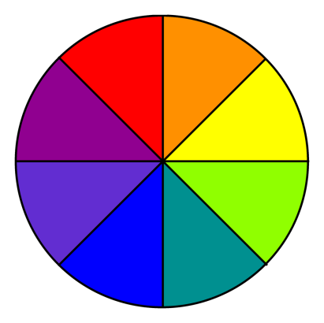
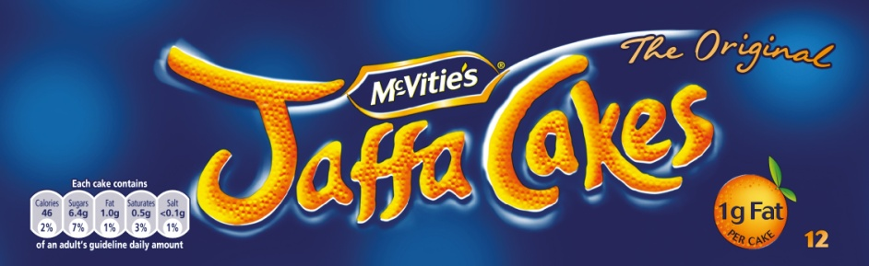
Complementary Colours
Notes:
Discuss and record on Activity Sheet 3.1:
Designer: Lester Beall
Design: Rural Electrification Administration Posters Series, 1934
Choice: Complementary colour blocks positioned next to each other
Effect: Demand attention and appear to vibrate
Use all the images on the screen to clarify:
Where do complementary colours sit in relation to each other on the colour wheel? Can you give examples?
Opposite. Blue/orange, red/green, yellow/purple. The complement is a mix of the other two primary colours.
How does Beall use blocks of colour to convey a message?
Colour association: orange for heat, blue for cold.
The division between the blocks of colour suggests a simple landscape (horizon line).
The negative (white) space depicts a thermometer and the blue lines represent electricity cables.
Painters also make use of this effect. Wassily Kandinsky's selection and placement of colours in Autumn Landscape with Boats (1908) was influenced by the Fauvist movement.
“Fauves’’ in French means “wild beasts”. Can you guess how they were given this name? An art critic called Louis Vauxcelles visited one of their shows and thought that the colours were too unrealistic and the brushstrokes too vigorous, so he tried to put them down by referring to them as “wild beasts”.
Why is packaging often designed with complementary colour blocks close together?
To grab our attention in the shop so that we will buy the product.
Differentiate:
Make it longer: Colour blocking can be traced back to traditional Japanese woodblock prints,
e.g. http://www.globalgraphica.com/wp-content/uploads/2011/03/hokusai-wood-block-print-mount-mt-fuji-36-views-1-japanese-art-classic-visual-culture.jpg
Source: http://image.invaluable.com/housePhotos/Swann/85/113585/H0132-L04681302.jpg
https://commons.wikimedia.org/wiki/File:Vassily_Kandinsky,_1908_-_Autumn_Landscape_with_Boats.jpg
http://www.unitedbiscuits.com/media-centre/media-library/our-products/jaffa-cakes/
Courtesy of the Cary Graphic Arts Collection, Rochester Institute of Technology

Slide 22

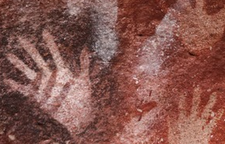
Overlapping Transparent Colours
Notes:
Discuss and record on Activity Sheet 3.1:
Designer: Fanette Mellier
Design: La Fête de la Musique, 2009
Choice: Overlapping transparent colours
Effect: To create an illusion of depth
Use the close-ups on the right to clarify:
Is this a new/contemporary technique only used in digital graphic design?
No, even prehistoric painters, who used their hands as stencils, overlapped colours and shapes to create depth.
What symbol has been used to signify the event is musical?
A musical note.
What mood is created by the notes being positioned at a variety of angles?
Chaotic, exciting, festive.
Which musical note looks as if it is at the back? Why?
The yellow in the bottom left-hand corner as it is partially covered by three other notes.
Source: http://fetedelamusique2.culture.fr/medias/image/affiche_fm_2008.jpg
Further examples: http://www.moma.org/collection/object.php?object_id=8825

Slide 23
Refining Your 1% Design
Essential message:
By 2016, the richest 1% will have more wealth than the rest of the world combined.
Design options:
Pictograms Complementary colours
Calligrams Overlapping transparent colours
Notes:
After Activity 3.2 (peer-assessment), learners will now need time (and perhaps a new sheet of paper) to revise their designs so that they can incorporate their chosen design idea.
Monitor each learner’s progress.
Common traps may include
Overcomplicating the design to the point where the basic statistic is no longer clear and/or
Committing to new sizes and shapes too quickly with heavy rather than faint lines.
Differentiate:
Make it harder: Learners could be asked to come up with their own assessment criteria in Activity 3.2. They could also then be challenged in Activity 3.3 to incorporate more than one of the design ideas covered in the slideshow.

