Slide 1

Tax & Trade in the Global Citizenship Classroom
3rd November 2020
Éilis Ryan
Financial Justice Ireland
STARTING SHORTLY
March 2020
Éilis Ryan
Notes:
- Welcome

Slide 2

In pairs, 2 minutes to answer 3 questions;
Name & Where you are now?
One way you think the global financial system impacts on your life?
Notes:
Welcome - Before we begin the session formally, a few minutes to get to know one another
Breakout Sessions - 3 Questions in pairs - Feedback to entire group

Slide 3
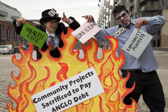
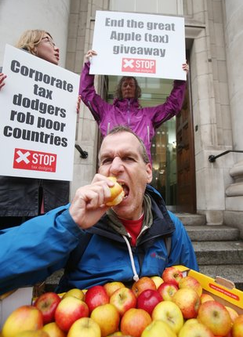
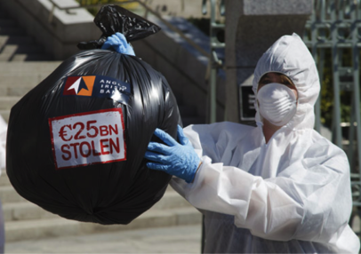
Who are we?
Financial Justice Ireland is a global financial justice organisation
We are working towards a fair global financial and economics system that works for everyone and doesn’t take the planet for granted
We focus on the root causes of global inequality, not the symptoms
We use research, policy, campaigning, education, to critically engage people to take informed action

Slide 4
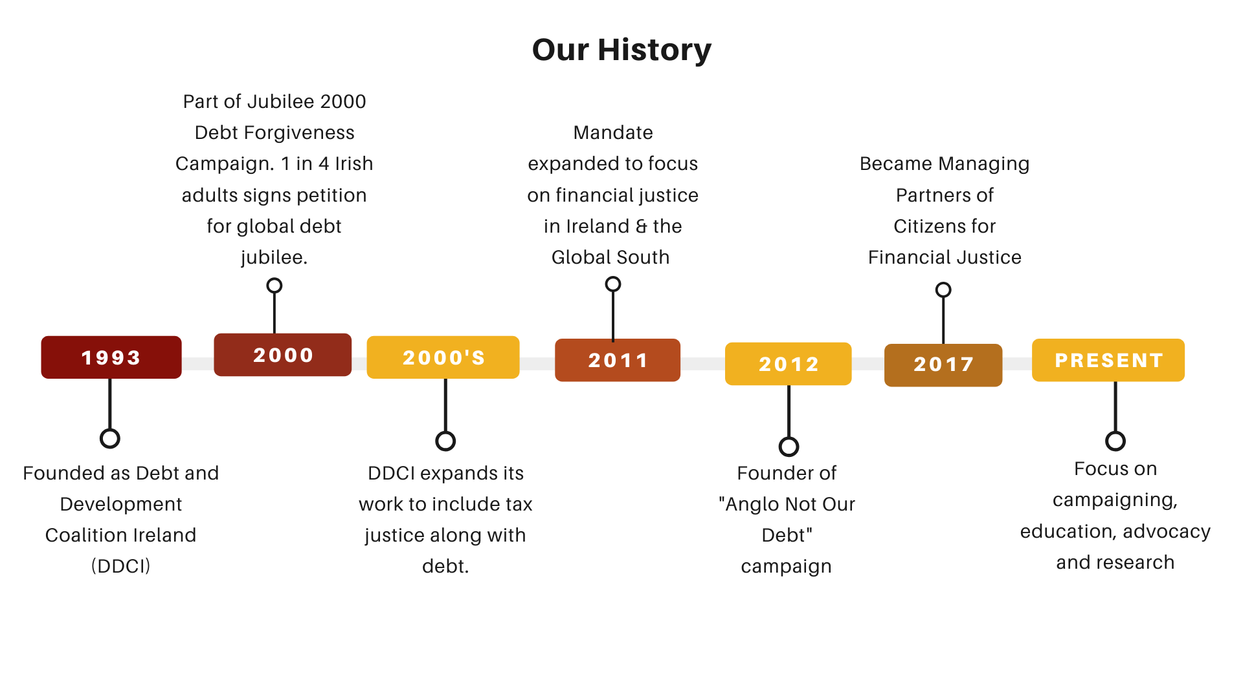

Slide 5

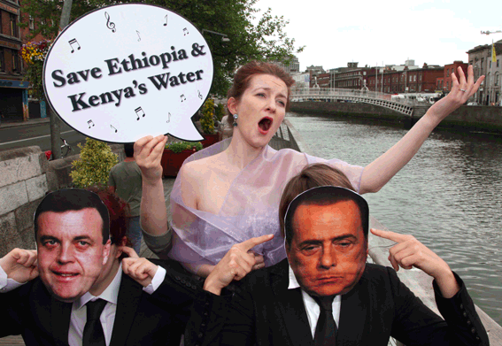
Campaigning
Notes:
Burn the bondholders campaign stunt (Anglo not our debt 2011/12)
Protest against water privatisation by IMF / WB in Gibe Dam, Ethiopia (2009)
Apple Tax report launch examining the sweetheart deal apple received from Irish government (2015)

Slide 6


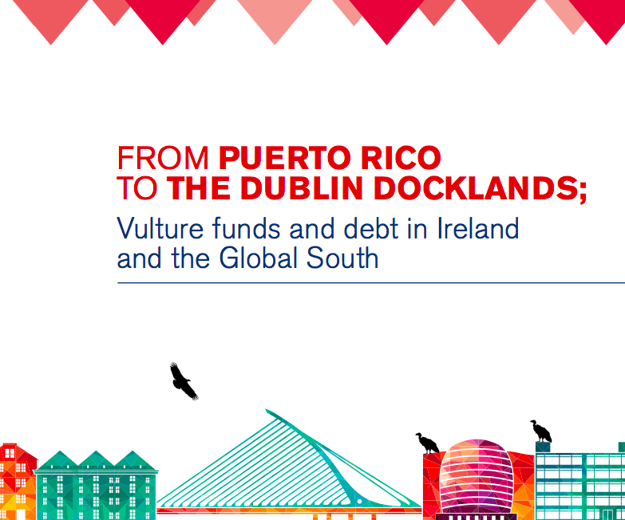
Policy & Research
Available at www.financialjustice.ie

Slide 7
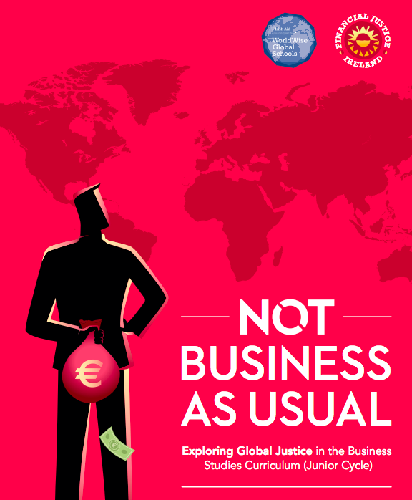
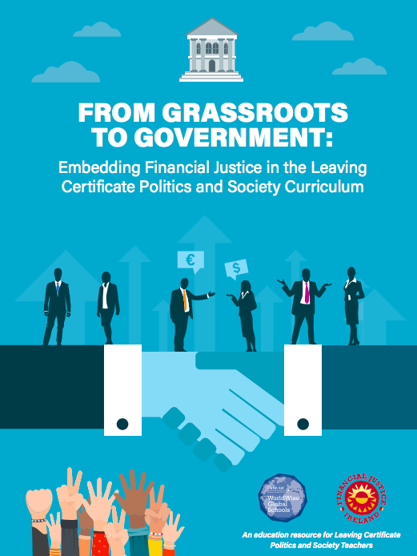
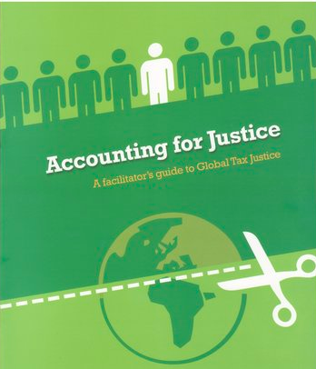

Education
Notes:
How The World Works – aimed at TY and up
Politics and Society
Accounting for Justice (tax justice resource)
Not Business As Usual – Business Studies
“We Can Solve It” – Maths JC

Slide 8
Why bother with economics?

Slide 9
Notes:
This is the view of a “healthy society” we have all signed up to.
Uncontroversial
End poverty
Zero hunger
But fundamentally,

Slide 10
Notes:
This is the view of a “healthy society” we have all signed up to.
Uncontroversial
End poverty
Zero hunger
Traditionally, a core part of this, is the idea that what is needed to achieve these things is money; and so, wealthy countries give X to Africa each year.
But the problem is, so long as wealthy countries are holding the purse strings, this system is very undemocratic. Pays the piper…

Slide 11
Notes:
But the problem is, so long as wealthy countries are holding the purse strings, this system is very undemocratic. Pays the piper…
So, if we are interested in empowering those living in the Global South to make their own choices, then it is just as important that they figure out why there isn’t sufficient money in the Global South to fund things themselves
This is a murky question. Why?

Slide 12
Notes:
Because a huge amount of wealth in the Global North is generated by extracting money from the Global South

Slide 13
“We are a rich nation, then, while others are poor.
But there is more to it than that.
We are a rich nation to some extent because others are poor.
Part of our prosperity is due to the fact that people in the developing countries are not getting a fair deal. ”
- Bishop’s Letter establishing Trócaire, 1973
Notes:
Because a huge amount of wealth in the Global North is generated by extracting money from the Global South

Slide 14
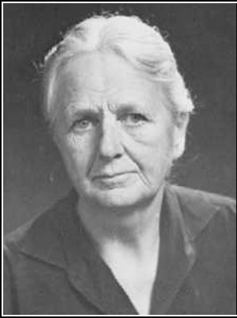
“The purpose of studying economics is not to acquire a set of ready-made answers to economic questions, but to learn how to avoid being deceived by economists.”
Joan Robinson (1903-83)
British economist
Notes:
Whatever economic ideas are “in power” determine who gets what and how. So, it’s controversial.
This means that (a) if we want to understand who is powerful, we have to have a basic grasp of economics, and (b) no ideas about economics are “neutral”

Slide 15
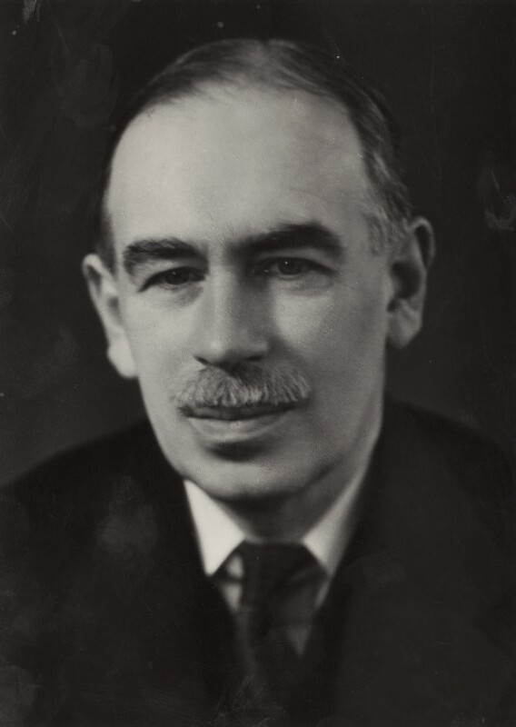
“Practical men, who believe themselves to be quite exempt from any intellectual influences, are usually slaves of some defunct economist.”
John Maynard Keynes (1883-1945), British economist
Notes:
We want to challenge the idea that economics - whether its a report from the IMF, a meeting from a Minister etc., is values free.
We hope that this course will give you the tools to identify the ideology, bias or opinion behind the facts presented on the morning news - and equally behind the reports which charities produce!

Slide 16
How do we fund our society?
Borrow money - Debt
‘Sovereign debt’ – a bit like a long-term personal loan for countries. Countries borrow money from other countries, multilateral institutions, and private lenders.
Raise money - Tax
Governments can set their own rules to tax individuals & corporations international transfer of money subject to international rules.
Sell to other countries – Trade
If a country sells (i.e. exports) more than they buy (i.e. imports), they have a “trade surplus” (i.e. profits) which they can invest in their economy.
Productive state enterprises
If a country has shares or owns a company which makes profits, this can be invested. (Finland)
Wages
Workers are paid for the work they do. This funds a portion of their needs. The more corporate profits which go to workers, the less the state is required to subsidise (e.g. FIS).
Notes:
The first reason to bother
Working Family Payment €500 million in 2020.

Slide 17
How do we fund our society?
  Key Questions
  Are these options available to all countries?
  What determines which tools are available and when?
  How do these effect the different outcomes in different countries?

Slide 18
How do governments raise money to pay for public services?
  Key Questions
  Are these options available to all countries?
  What determines which tools are available and when?
  How do these effect the different outcomes in different countries?
  “Financial Justice” = governments having the space to make their own decisions

Slide 19
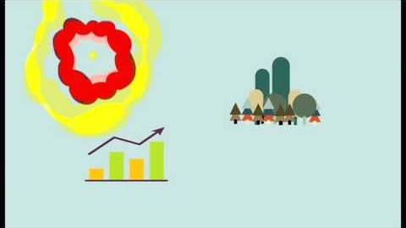
Thomas Piketty’s “Capital in 3 minutes”

Slide 20
Tax

Slide 21
Race to the bottom on corporate tax rates
Global corporation tax rates have dropped in the last 10 years – by 2053 will reach 0%
UK rate was 28% in 2010, 19% in 2017, will be 17% in 2020
US rate dropped from 35% to 20%
NI adopted 12½ % corporation tax in last April

Slide 22
Why a race to the bottom?
Post-1945: countries could decide how much money left their countries and was invested (“capital controls”).
“Capital controls” were gradually removed from the late 1970s – 1980s; ushered in neoliberal era.
Because a corporation can move its money so easily, it has enormous influence over what government policies are and aren’t “acceptable.”

Slide 23
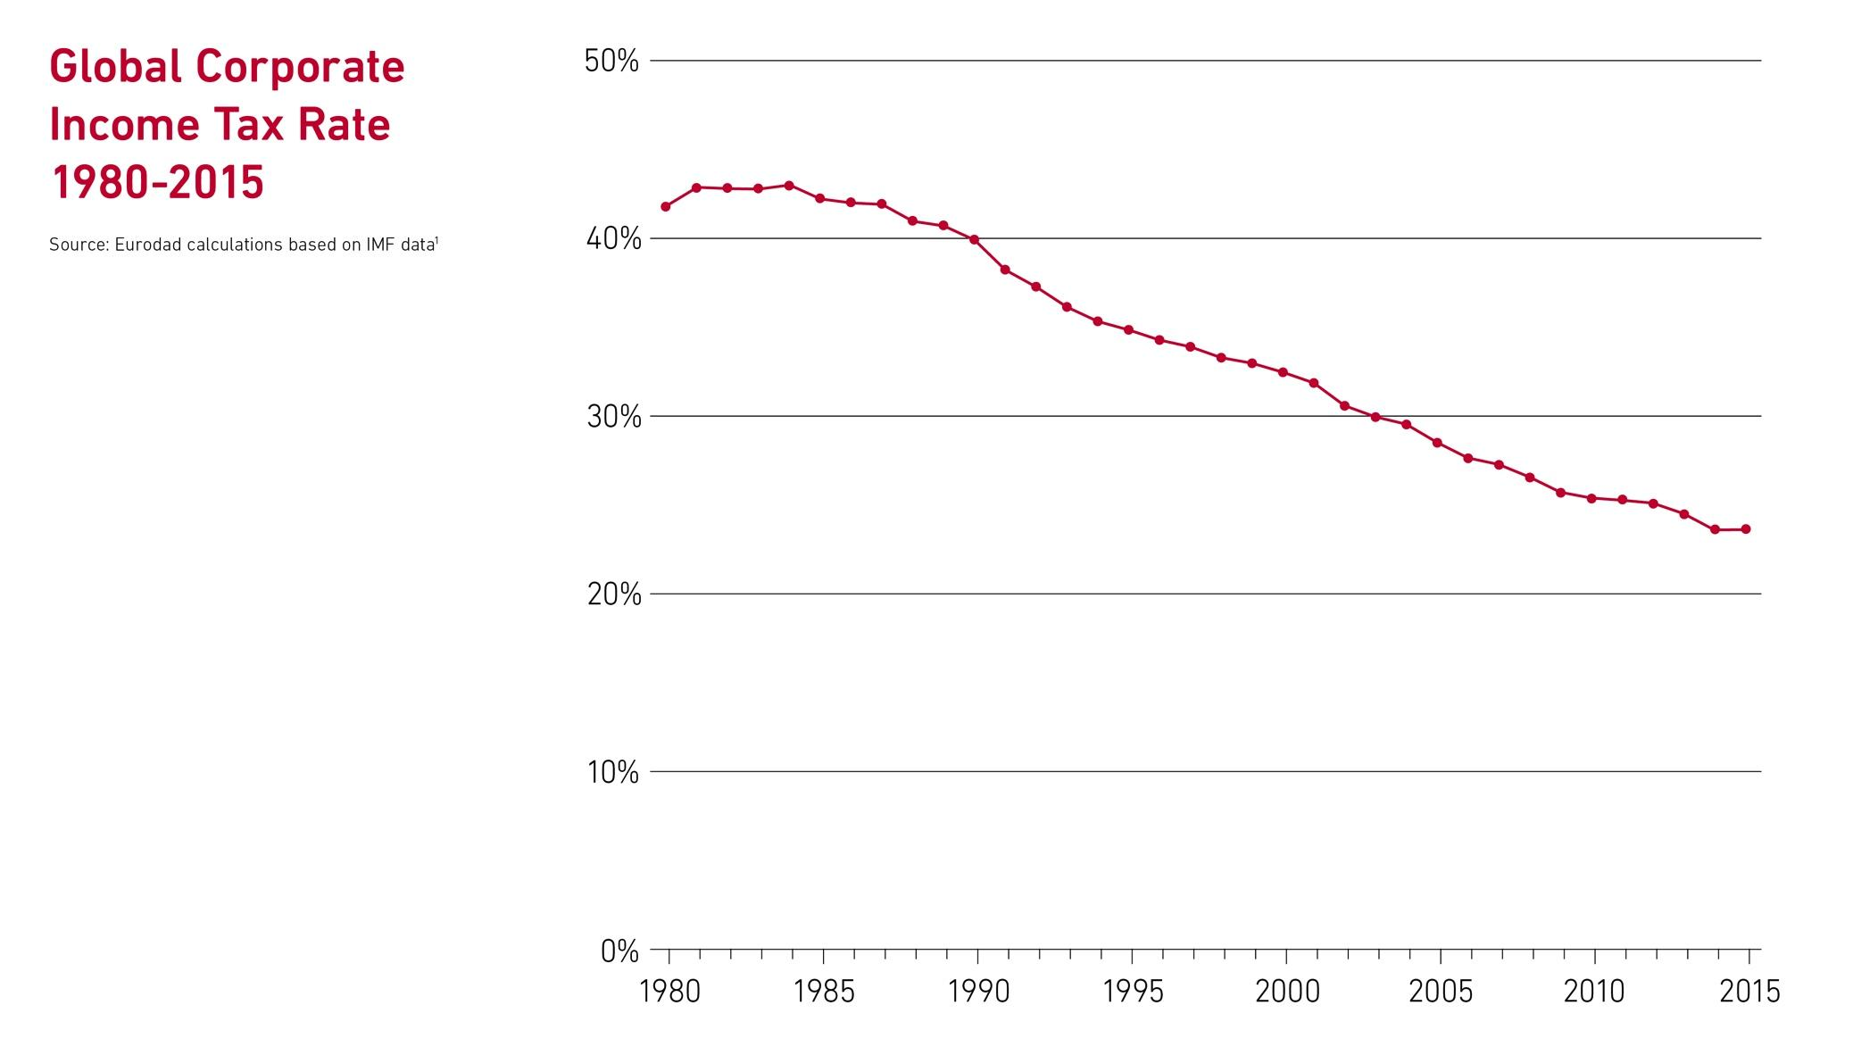

Slide 24
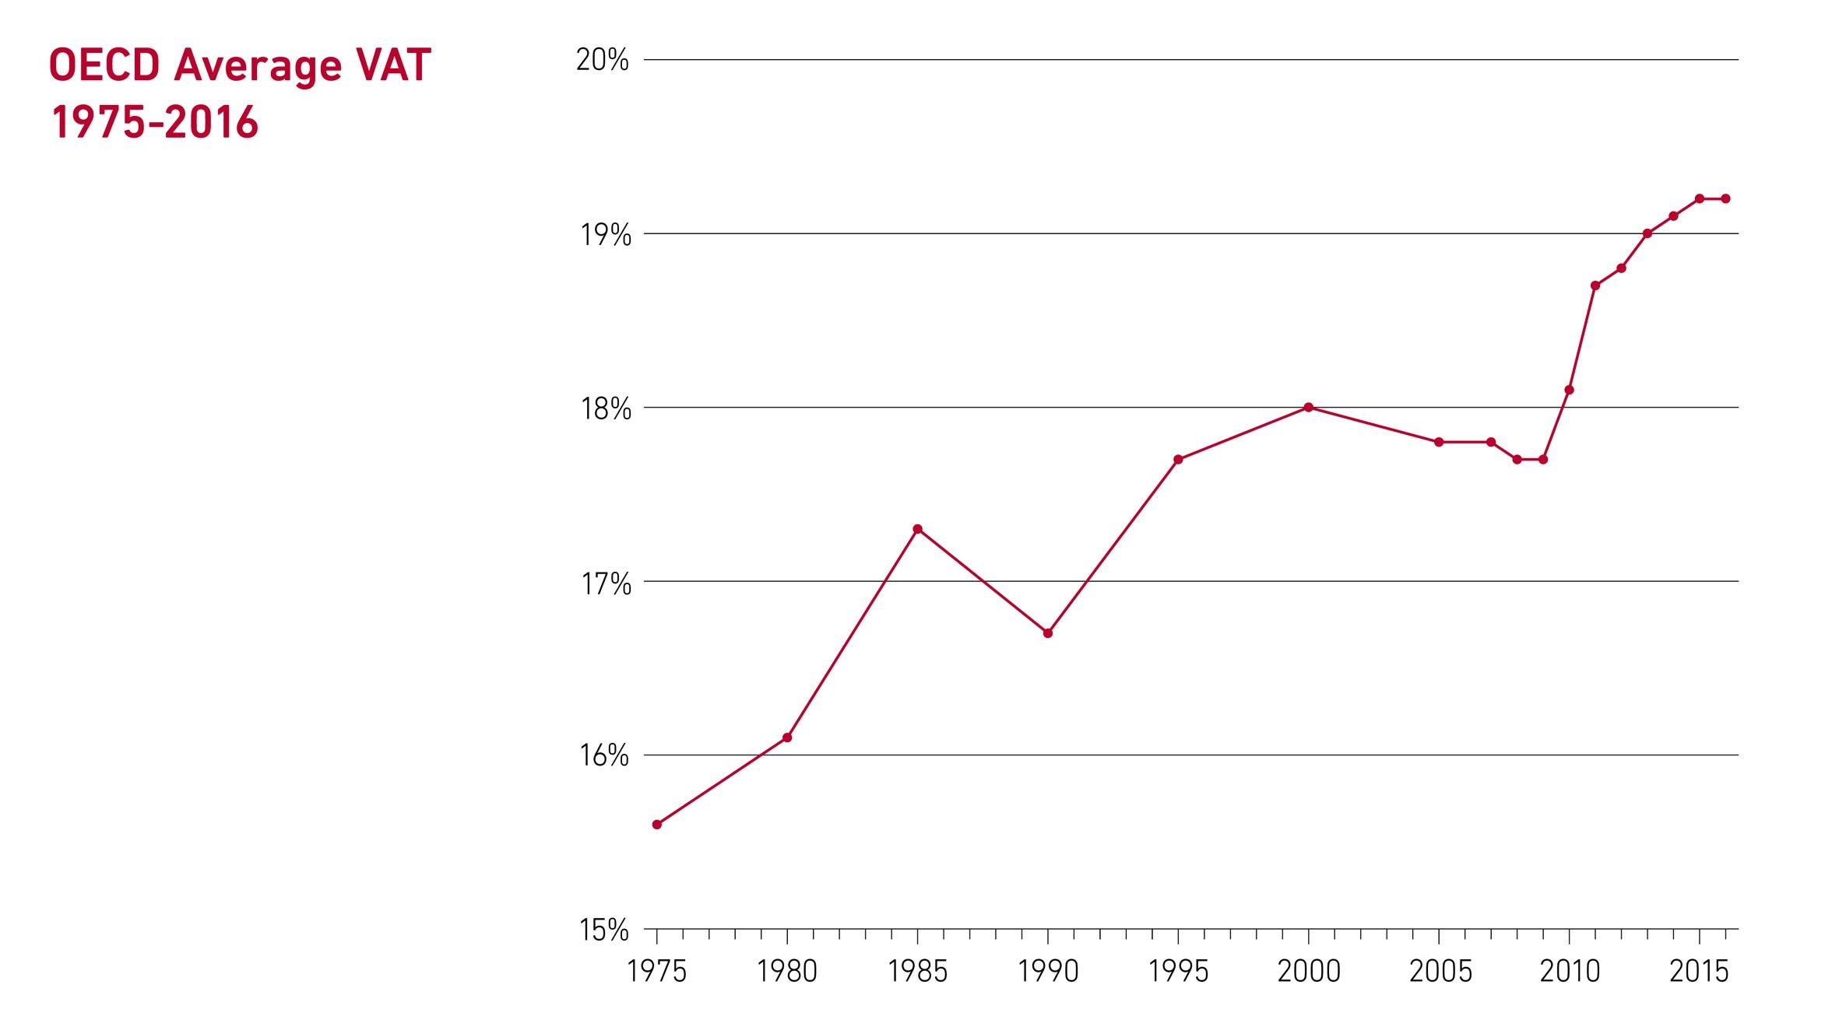

Slide 25
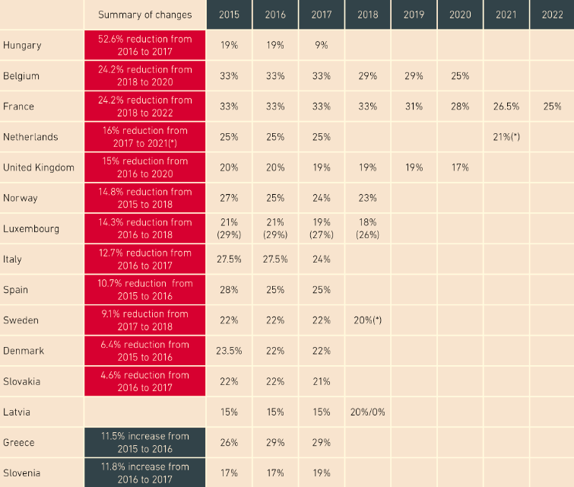
European Corporate Tax Cuts 2015-2022
Notes:
In the Global South, these patterns are far worse.
The ability to raise corporate tax was a HUGE factor in Europe building health systems, public housing, public transport. Without it, its impossible to do. The objective in the Global South must be

Slide 26
Associated British Foods in Zambia
Zambia Sugar has generated profits of $123 million, but admits to paying “virtually no corporate tax” in Zambia.
It has found legal ways to siphon over US$83.7 million (US$13 million a year) – a third of pre-tax profits – out of Zambia into tax havens including Ireland, Mauritius and the Netherlands.
Zambian public services have lost an estimated US$27 million as a result of the company’s tax avoidance schemes and special tax breaks which is enough money to put 48,000 children in school.
The revenues lost to tax havens is 10 times bigger than the amount the UK gives Zambia in aid for education each year.
Zambia is currently defaulting on its international debts – why?
(Credit: ActionAid)
Notes:
An investigation released by ActionAid revealed that the Associated British Foods group (ABF), owner of Silver Spoon sugar, Ryvita and Primark, has been dodging its tax bill in Zambia, one of the world’s poorest countries.
The report, Sweet Nothings, which is the result of 12 months of research focusing on the multinational’s sugar operations in Zambia, has discovered that since 2007:
Mostly legal mechanisms

Slide 27
Trade

Slide 28
Trade and the Global South: A historic double standard
Economies in colonized countries were developed to serve developed countries. Colonising countries set the rules so that countries in Africa, Asia would;
  Export raw materials needed to make profitable goods (timber, sugar)
  Import developed commodities (processed food, manufactured goods)
Because raw materials are always worth less than manufactured goods, colonized countries remained dependent on their colonisers

Slide 29
Trade and the Global South: A historic double standard
Post-colonialism, countries tried to change the rules;
  Havana Charter for an International Trade Organisation, signed in 1948 by 56 countries from the Global South
  Designed by John Maynard Keynes
  Aimed to eliminate the trade inequality
Rejected in favour of a parallel agreement signed by 8 countries (United States, the United Kingdom, Canada, Australia, France, Belgium, the Netherlands, and Luxembourg).
This went on to become the World Trade Organisation

Slide 30
Trade and Global Poverty
Global trade rules insist on open markets in the Global South.
  Less developed economies have to compete with products imported from very developed economies.
  BUT this wasn’t how rich countries developed; they protected their countries’ industries until they were strong.
Without the opportunity to develop industry in their own countries governments never build up the kind of exports that can help them to
In the 1970s/80s, some countries in the Global South tried to leave this system, but were eventually forced to re-open markets to competition from rich countries.

Slide 31
Energising students around tax & trade
(and the economy, stupid)

Slide 32
Focus on the 1%
Notes:
These are the processes which have enabled the 3 wealthiest men to go from having $220 billion ten years ago to $440 billion today.

Slide 33
Focus on democracy
Notes:
Investigate, with students, the rules behind the various global institutions, their history, what they now have responsibility for.
UN; one country one vote – responsible for aid, hunger
IMF / World Bank
Look at the history of what poor countries asked for

Slide 34
Personalise it
Notes:
Today’s generation of young people

Slide 35


Stay in touch
www.financialjustice.ie
@FinJusticeIre
facebook.com/financialjusticeireland
education@financialjustice.ie

