Slide 1


Tax and Trade
WWGS Thematic Online Training Series
LIZZY NOONE, DUBLIN
Laura Cahill, Cork
Notes:
Welcome
- Introduce ourselves
Type in your name and the name of your school in the chat! Also change your name on your Zoom to your first name
Invite people to use the chat

Slide 2
‘We are told that free trade would create an international division of labour and therefore give to each country the production which is in most harmony with its natural advantage. You believe perhaps, gentlemen that the production of coffee and sugar is the natural destiny of the West Indies. Two centuries ago, nature-which does not trouble herself with commerce-had planted neither sugar cane nor coffee trees there’

Slide 3

Hopes & Fears
- What do you HOPE to get out of todays session?
- Any FEAR about todays session?

Slide 4
Housekeeping
To mute and un-mute
Turn your camera on
Please use the chat function

Slide 5

Session Plan
Welcome
An Introduction to Tax and Trade-Eílís Ryan
Q and A
Break & Reflection
Tax and Trade: from Knowledge to Action
WWGS 6 Step Programme
Live Case Study Rachel McEntee-St Oliver’s Community School, Drogheda
Reflection and Next Steps
Notes:
Todays session will be broken into 3 key areas:
Read through slide

Slide 6
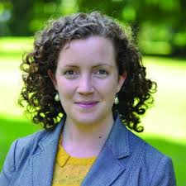
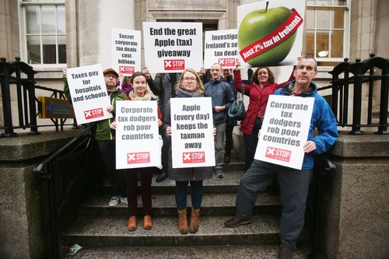
An Introduction to Financial Justice-Tax and Trade
Eílís Ryan

Slide 7
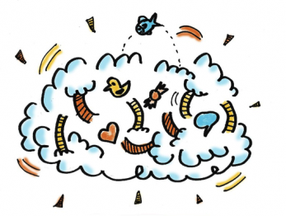
Reflection
Reflect on what you’ve heard this morning..
Consider:
- What are your initial thoughts/ feelings
- Your approach to exploring tax and trade with students

Slide 8



Slide 9
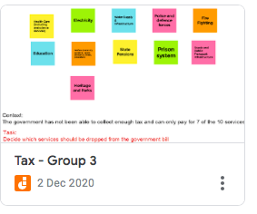
TASK:
You will be given cards representing public services-you (as a member of the government) has been asked to get rid of 3 due to not enough tax coming in to the country.

Slide 10
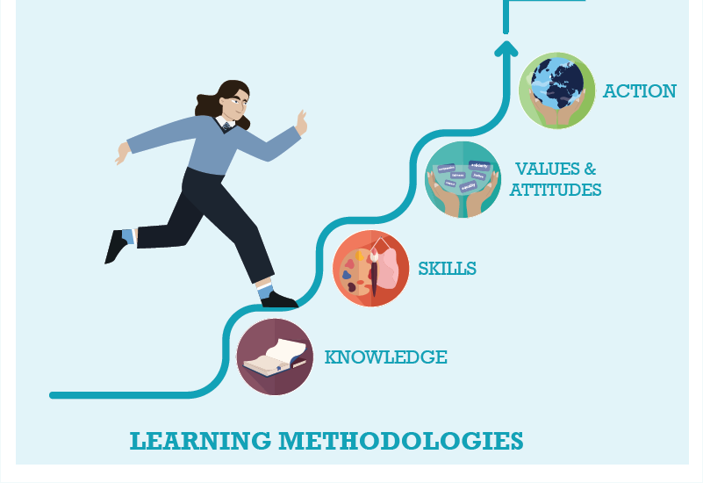



WWGS: 6 Step Programme
Tax and Trade as a justice issue: from Knowledge to Action
Page
22

Slide 11

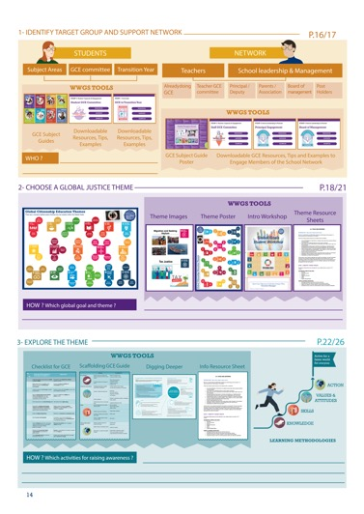
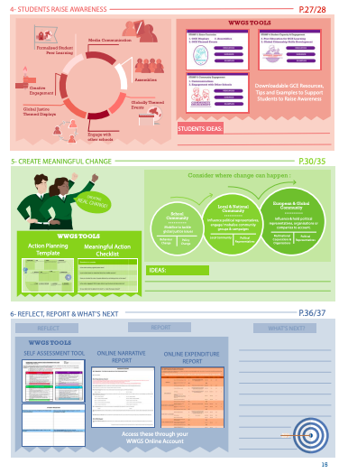
Page
14-15
Notes:
Briefly talk through the 6 steps

Slide 12
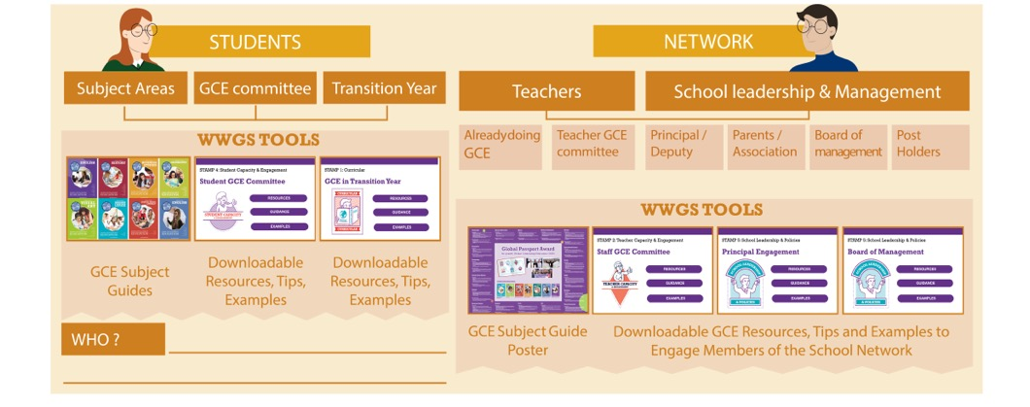
Pages
18-19
STEP 1:
IDENTIFY TARGET GROUP AND SUPPORT NETWORK
Notes:
Ask everyone to reflect on the student group they intend to work with and who in the school they can engage as a support network. Remind them that it’s not all about TY!

Slide 13

Some subject ideas!!
History Timeline of Trade Protectionism, American Civil War, World War 2, GATT, the 1980s!
Music: Hamilton
English: Language and propaganda-exploring ‘free’ trade.
Modern Foreign Languages: language and culture around Tax and Trade in different countries (use our guide as a starting point)

Slide 14

http://www.worldwiseschools.ie/6-step-programme/
Pages
18-21
STEP 2:
CHOOSE A GLOBAL JUSTICE THEME
Notes:
Introduce the step and the tools available – invite them to use their phone to view the tools on their 6 step programme

Slide 15
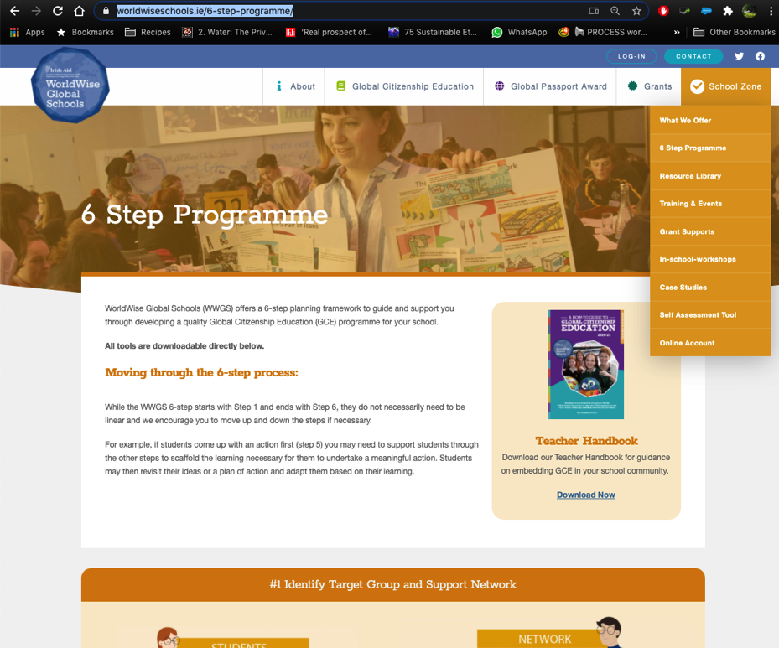

Slide 16

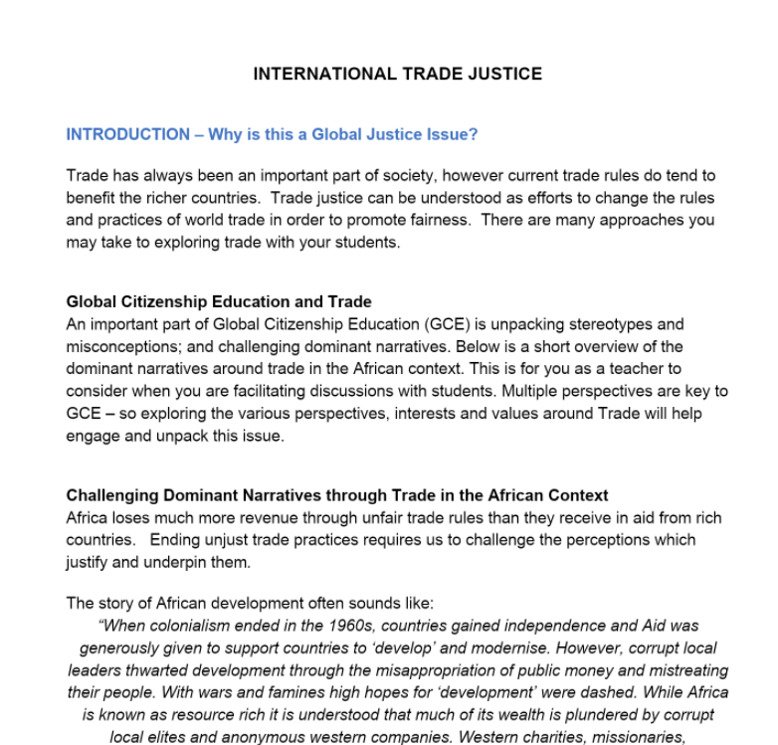
1. Hover over the symbol and a drop down menu appears!
2. Click on the theme and the resource sheet will pop up!
Notes:
Intro to thematic information sheets

Slide 17
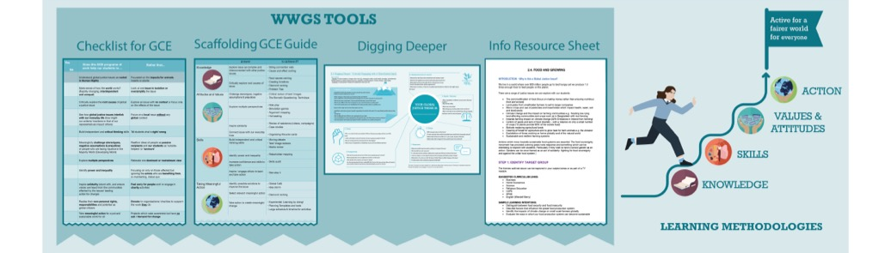
Pages
22-26
STEP 3:
EXPLORE THE THEME
Notes:
Be sure to change to your own date here!!

Slide 18

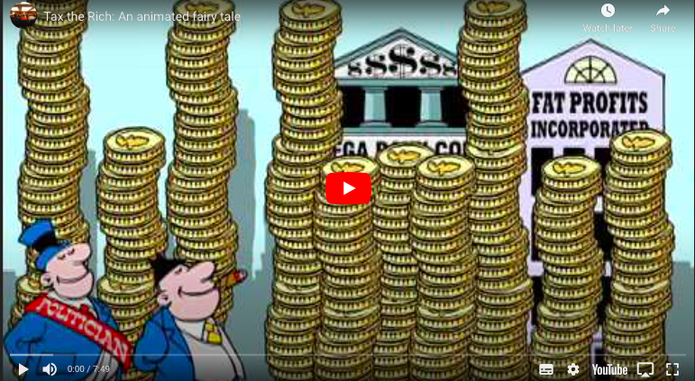



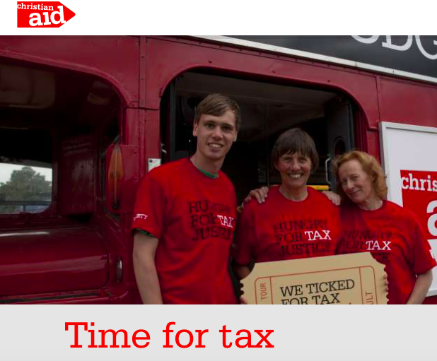
STEP 3: EXPLORE THE THEME-TAX
TEACHING AND LEARNING MATERIALS:

Slide 19
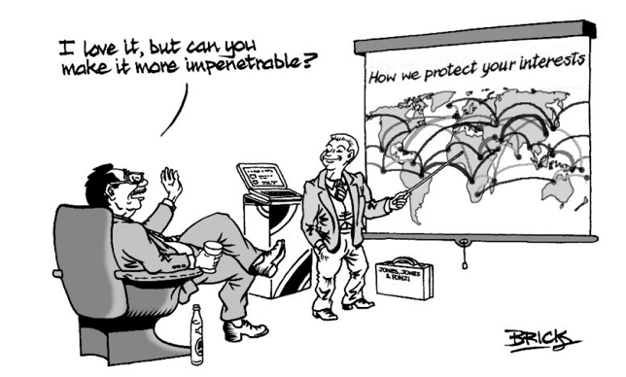
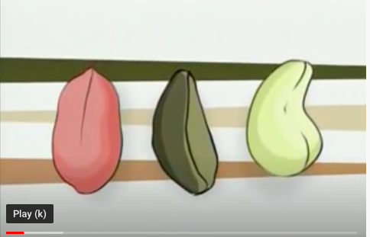




STEP 3: EXPLORE THE THEME-TRADE
TEACHING AND LEARNING MATERIALS: Information websites:

Slide 20
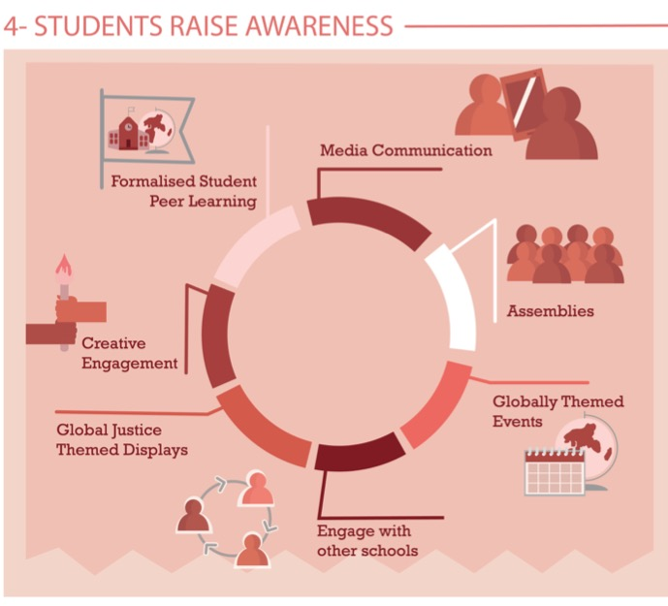
Share Learning
Pages
28-29
Notes:
Media Communication
Assemblies – Intercom
Themed Events –
Global Justice themed displays
Creative engagement
Formalised peer learning

Slide 21
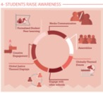
TAX
Poster campaign of shocking facts about tax
Undertake a Tax Justice project and raise awareness on their findings
Make a video on tax justice to show the other classes
Social media campaign

Slide 22
TRADE
Celebrate Fairtrade Fortnight with all students doing the Trading Game
Run an unfair swap shop a stunt
Undertake a Trade Justice project and raise awareness on their findings
Students create a timeline of trade with Africa

Slide 23
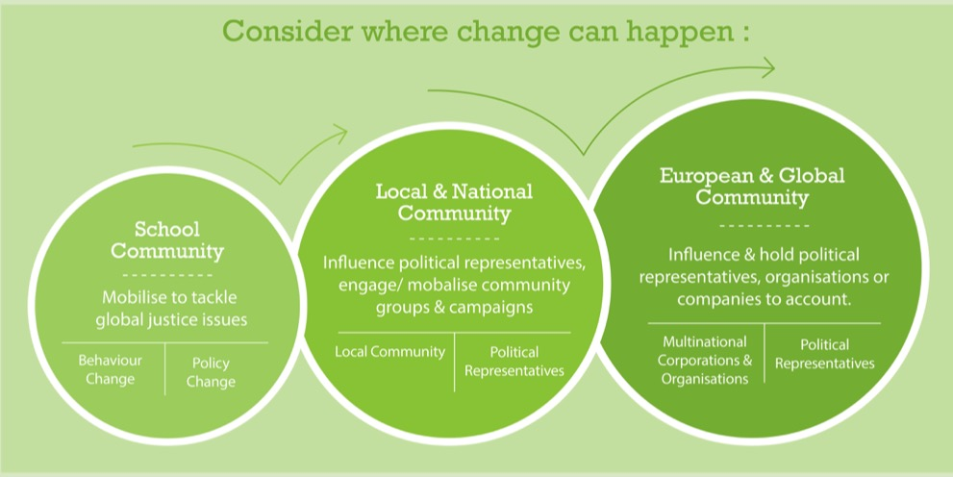
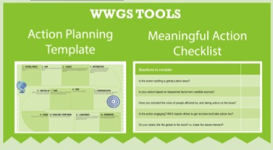
Page
30-35
STEP 5: TAKING MEANINGFUL ACTION
Aims to create Actual Change

Slide 24

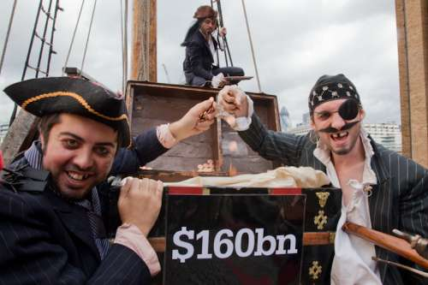
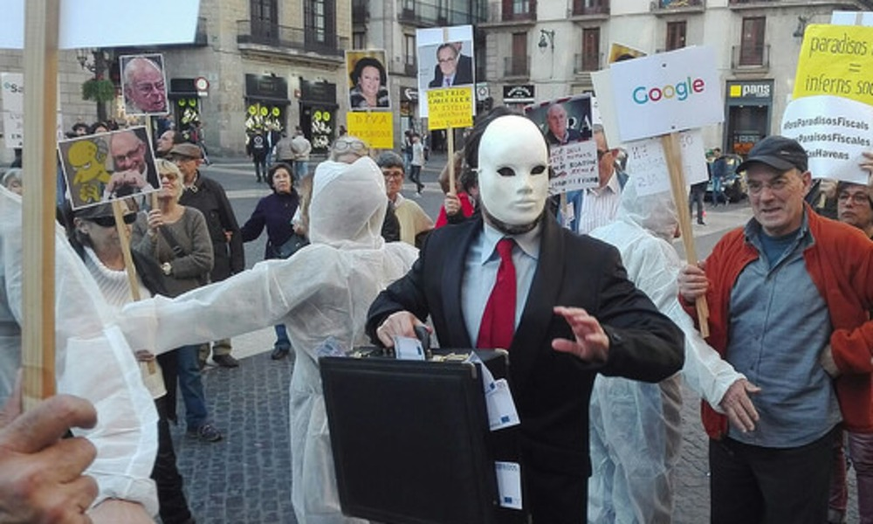
STEP 5: TAKING MEANINGFUL ACTION
TAX
Ideas for School Community Actions:
-Simulating a tax transaction
-Make Tax Justice Famous!
Ideas for Local and National Community Actions:
Join Citizens for Financial Justice and find local activists in your area and get involved in their local campaign activities.
Write to your local TDs and ask them to your classroom
through video link to discuss the importance of tax of
public service.
Ideas for European and Global Community Actions:
-Join the Tax Justice Network
-Start your own Tax campaign
-Publc Services International have lots of campaigns their most
recent one is ‘Make Amazon Pay’

Slide 25
STEP 5: TAKING MEANINGFUL ACTION
TRADE
Ideas for School Community Actions:
-Look at the products we use as individuals or as a school, have a vote on the products to research, find out where they come from and whether a fair price is been given for the product and it’s components.
-Become a Fairtrade School
Ideas for Local and National Community Actions:
-Become a Fairtrade Town
-Investigate how trade rules effect your local community
-Research and evaluate a pertinent trade agreement.
Ideas for European and Global Community Actions:
Join global campaigns to end Trade inJustice

Slide 26
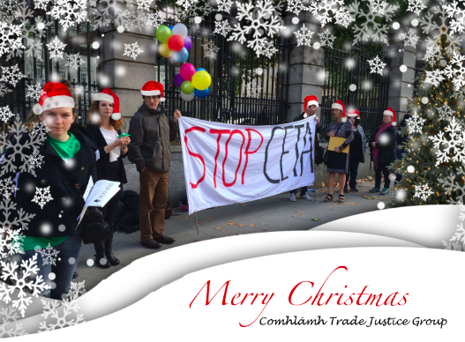

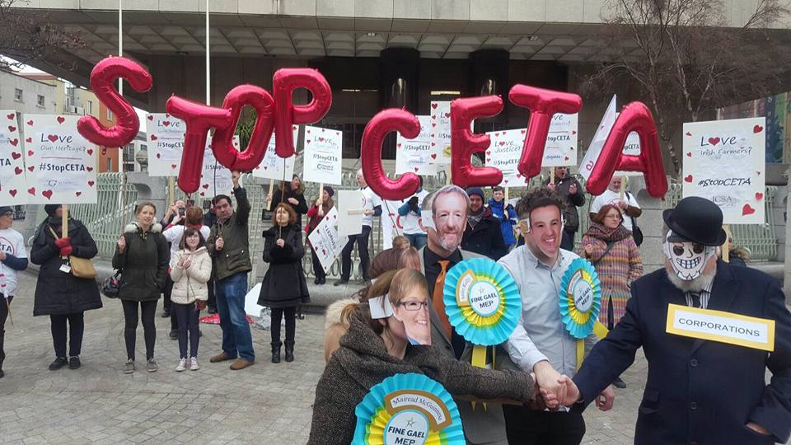
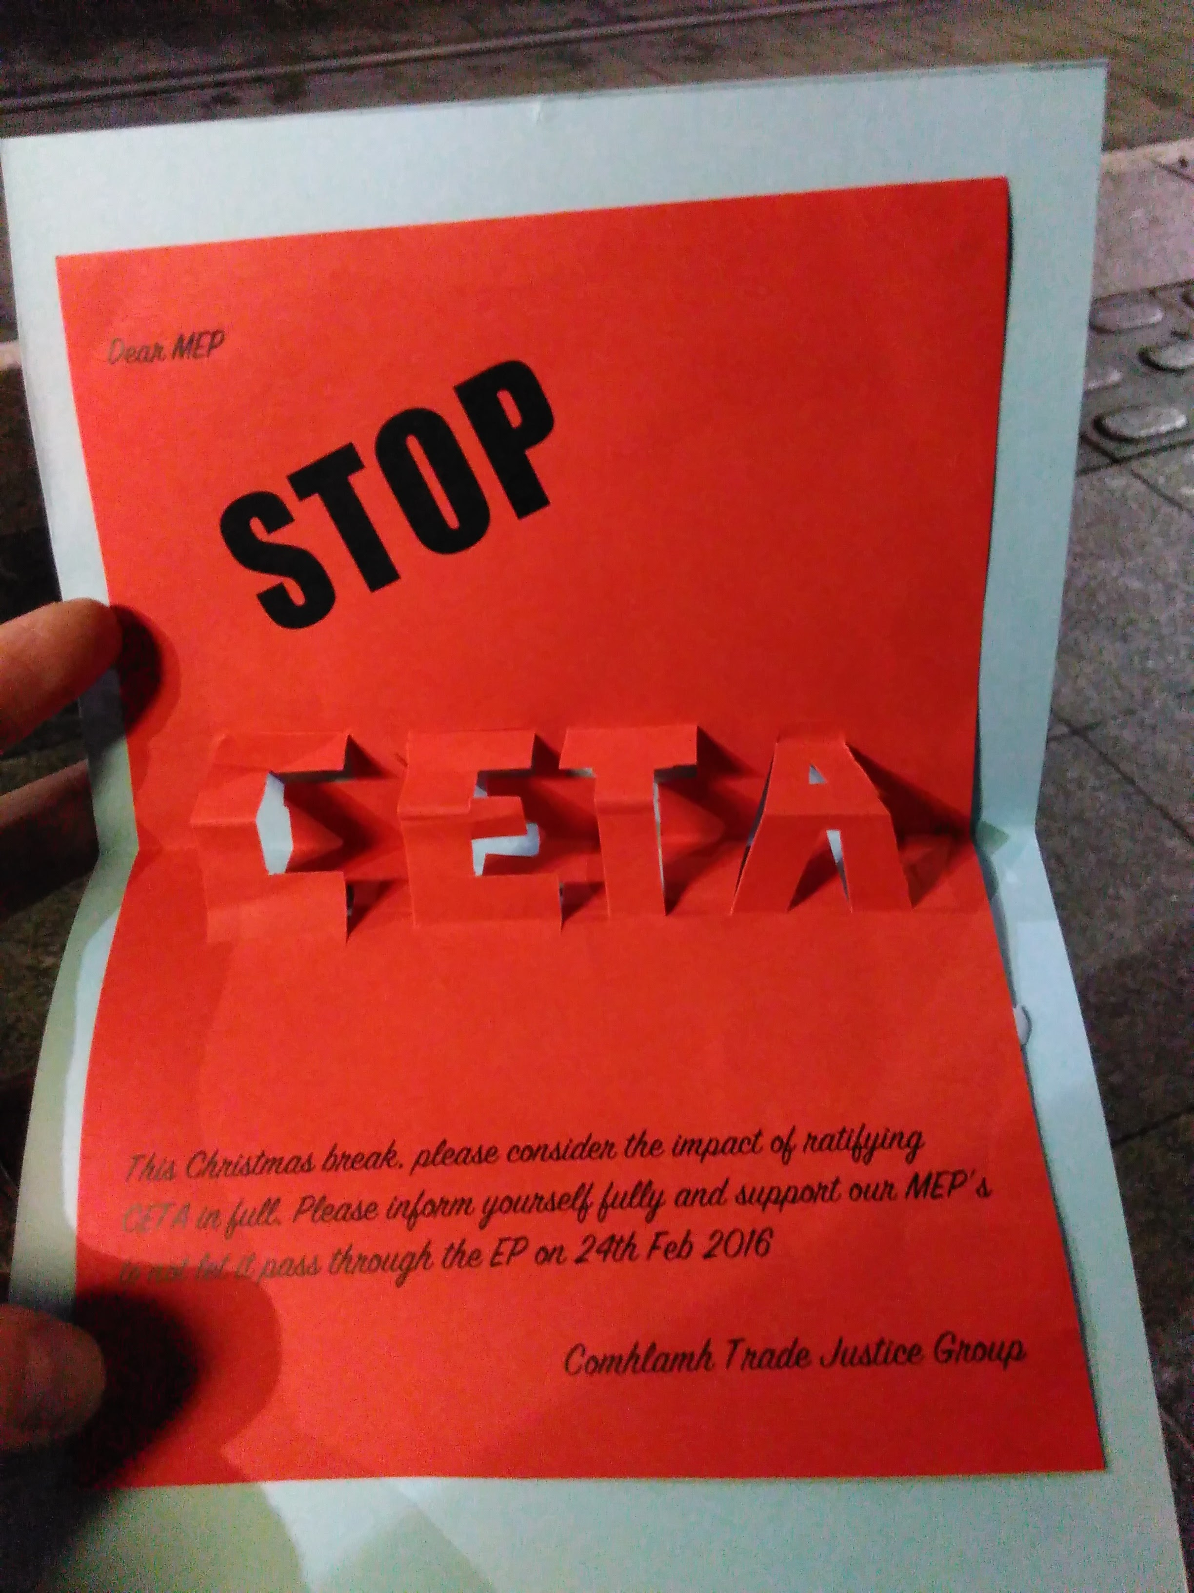
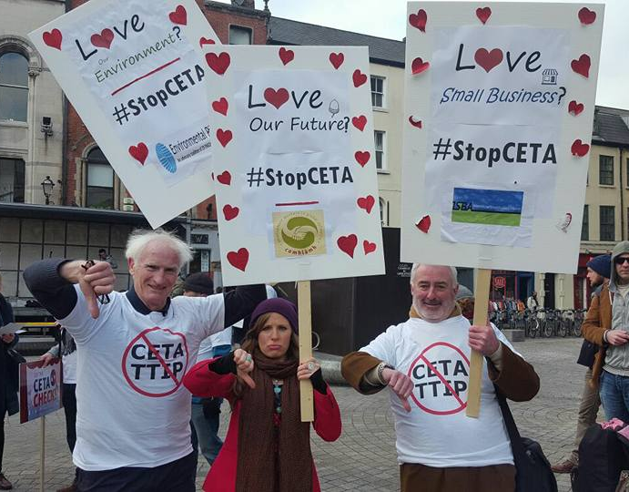

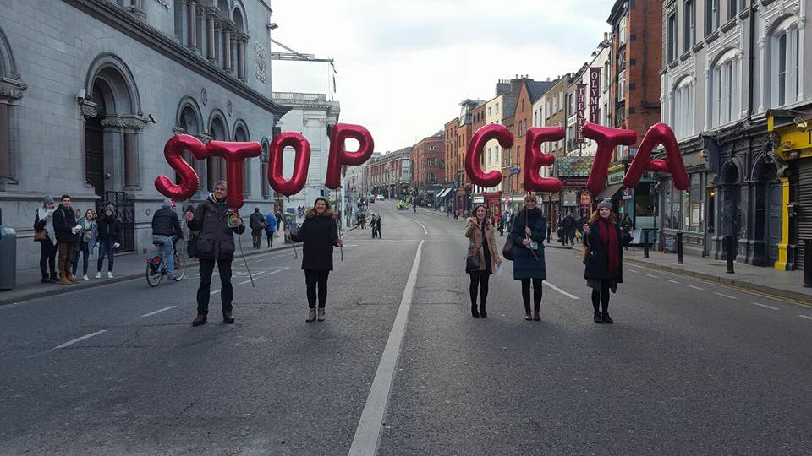
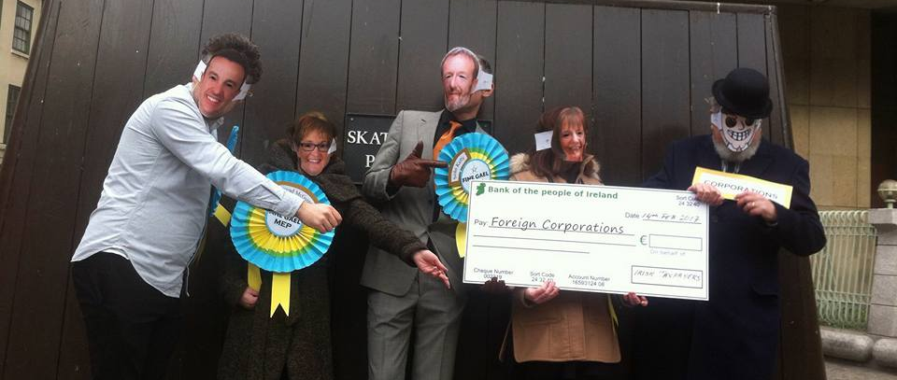
Getting Creative!

Slide 27
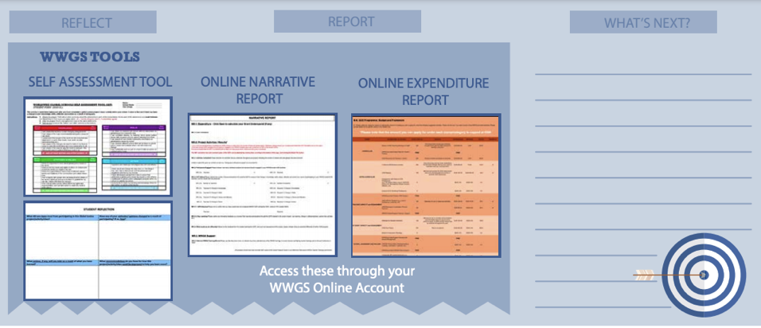
STEP 6:
REFLECT, REPORT AND WHAT’S NEXT?
Pages
36-41

Slide 28

TEACHER INPUT
Rachel McEntee, St Oliver’s Community School, Drogheda

Slide 29
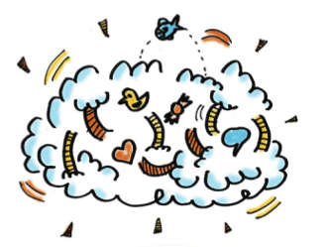
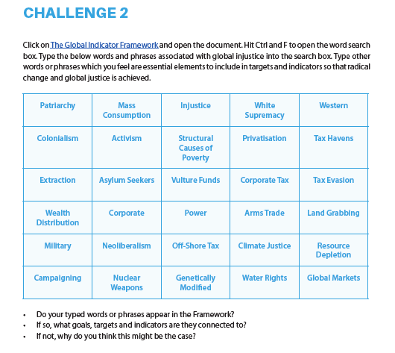
- What are the steps are you going to take next?
- What supports do you need?
Reflection & What Next?

Slide 30
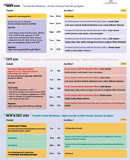
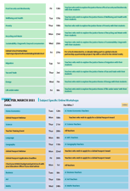
Upcoming Dates
Pages
4-6
Thematic Training Sessions
November
- Anti-Racism: - RECORDED
- Fast Fashion: RECORDED
- Food Security & Biodiversity: RECORDED
- Poverty: RECORDED
- Recycling & Waste: RECORDED
- Sustainability/ Degrowth: Recorded
December
- Migration: Tues 1st-Recorded
- Tax & Trade: Now!
- Energy: Mon 7th
- Life Under Water: Wed 9th
- Wellbeing & Health: Fri 11th
Global Passport Award
Webinar - January
Subject Specific Workshops
Jan- March 2020
Notes:
In terms of the breakdown of trainings, outline the 5 types of training
Purple – starter trainings – (today) for new schools and teachers new to GCE (perhaps their school has been involved longer)
Pink – WWGS approach and adapting to covid-19 – for ALL schools and teachers. Even for schools who have been involved for a while. Updated theory and practice
Green – Thematic areas
Blue – subject specific
Yellow – standard WWGS trainings and events. And deadlines.

Slide 31
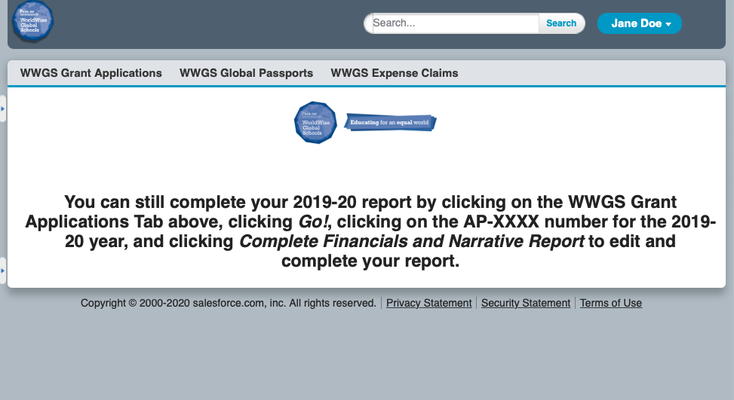
Or, if you think you will have an underspend, use your grant

Slide 32

Evaluation for Today
https://forms.gle/vQhgtJ1Xj27F5sTRA
Notes:
https://forms.gle/vQhgtJ1Xj27F5sTRA

Slide 33



Thank you!
Questions???
Lizzy.noone@worldwiseschools.ie
086 8720879

