Slide 1
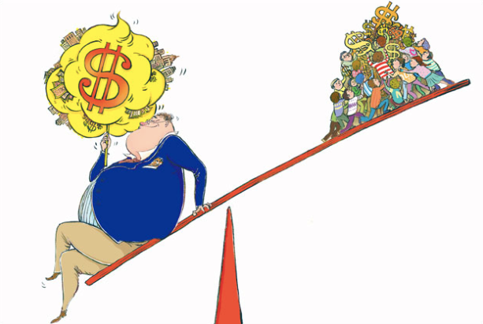

Slide 2


Unlearning and Reconstructing!

Slide 3
Click on The Global Indicator Framework and open the document. Hit Ctrl and F to open the word search
box. Type the words and phrases associated with global injustice into the search box.
• Do your typed words or phrases appear in the Framework?
• If so, what goals, targets and indicators are they connected to?
• If not, why do you think this might be the case?

Slide 4
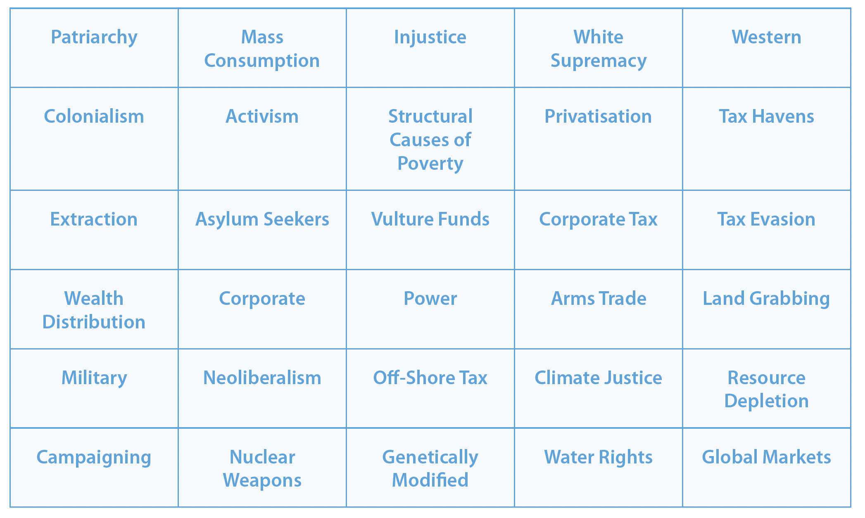
Word Games!
1.
2.
3.
4.
5.
6.

Slide 5


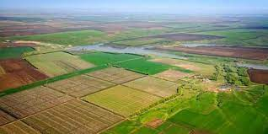
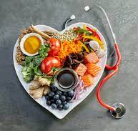
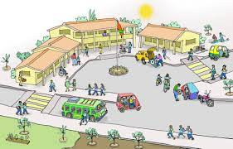

Inequality
All of this could…
10 billion tonnes
800 million hectares
23 exajoules of energy
200 million person-years of labour

Slide 6
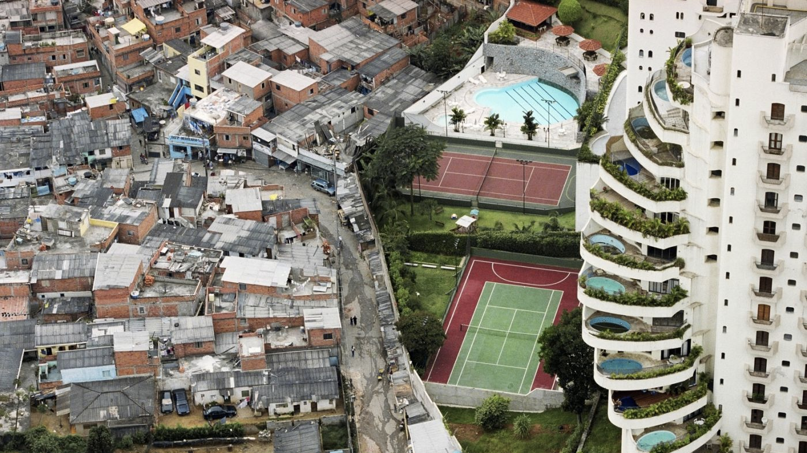

Slide 7
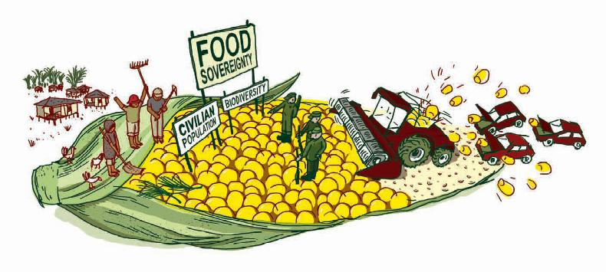

Slide 8
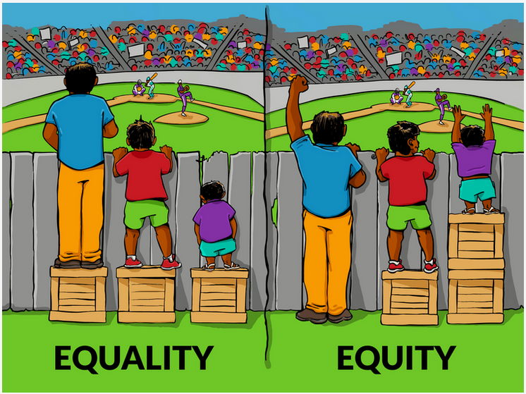

Slide 9
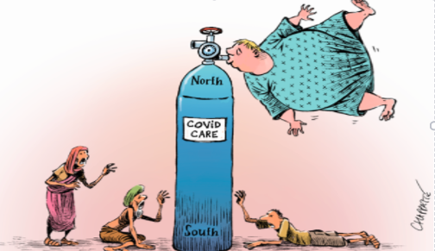

Slide 10
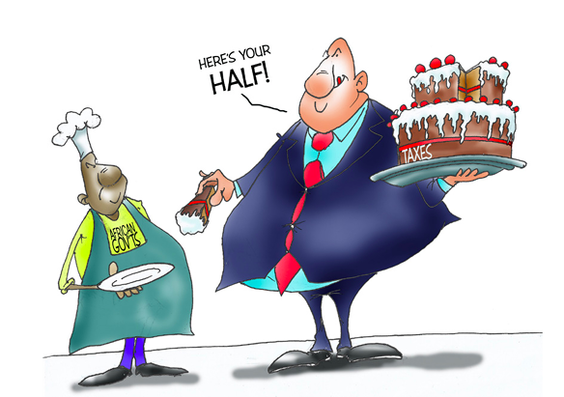

Slide 11
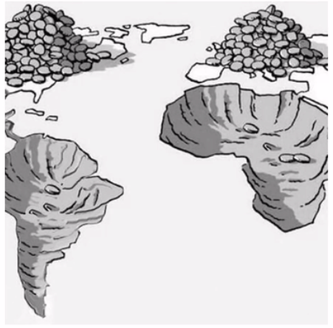

Slide 12

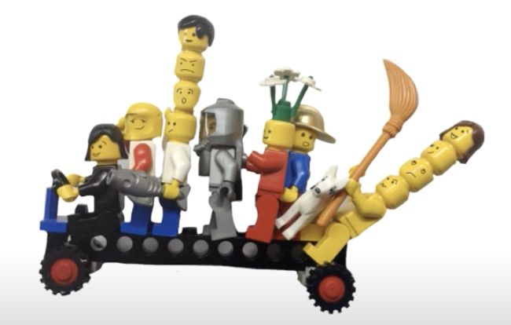
The BUS
Complexity
Notes:
Front
Middle
Back
Imagineeveryoneintheroomasbusesfullofpassengersofdifferentages.Ineachbus,thereisadriver,passengersgatheredatthefront,inthemiddleandattheback.Inyourownbus,therearepassengersyouknowandpassengersyoudon’tknow.Therearepassengerswhoaredrawingyourattention,otherswhowanttohidefromyou.
Thepointofthisfirstexerciseistolearntoobserveandsitwiththepeopleinourbus,withoutjudgement.
Inordertocreatetheconditionsforthistohappen,wefocusonastimulusandlookforthreepassengerswithinourbusthatcallourattention:oneatthefront,oneinthemiddleandoneattheback.Registerwhateachpassengerissayingwithaspeechbubble,athoughtbubbleandaheartbubble,representingwhatisbeingsaid,whatisbeingthought(andwhy)andwhatisbeingfeltandanticipated(e.g.hopes,attachments,fearsandanxieties).
Inrelationtoyourpassengers,payattentiontotheirage,whetherthereistraumainvolved,theirleveloftoleranceforuncertaintyandtheirresponsetobeingobserved.Inrelationtoyourownobservation(youobservingyourselfobserve),payattentiontoyourrelationshiptotheactivityitself:areyouworriedaboutfollowinginstructionsaccurately?areyouadaptingthetask?areyoudistracted?areyouresistingit?Thereisnorightorwronghere,justobserve.
Next you will be asked to sit in pairs to share what you want to share in relation to what you have learned from your observations. It is important to emphasise that you are not being asked to describe what is happening in the bus or in the observation itself, but what you are learning about the bus and the process of observation in general terms.

Slide 13

How does the Digging Deeper Model work?
-Give the students a piece of stimulus related to a global issue
-Take them through a journey of the questions in:
Stretch and Challenge
Power
Perspectives
Background & Root Causes
Equity/Fairness
Future
Responses
Notes:
We could give different themes to each group:
Climate Change-stimulus
Global Health
Fast Fashion
Why Chain

Slide 14


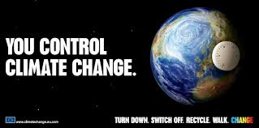
Visit to the Irish Aid Centre-AID
School Fairtrade Event-TRADE
Young Environmental Awards-CLIMATE CHANGE

