Slide 1
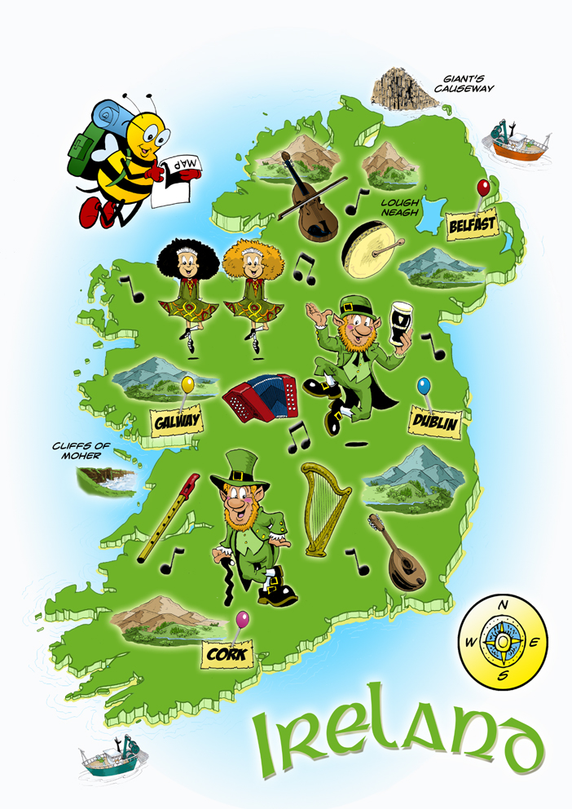

Slide 2
‘the problem with stereotypes is not that they are
untrue but they are incomplete’
Chimamanda Adichie.

Slide 3
‘All young people have loads of energy and imagination’
‘All young men are reckless road users’
‘All older people are lonely’
‘Women are naturally caring’
‘All teenagers don’t care about anything except themselves’

Slide 4
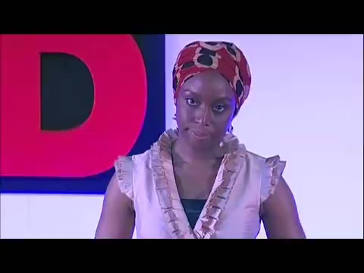
The danger of a single story

Slide 5
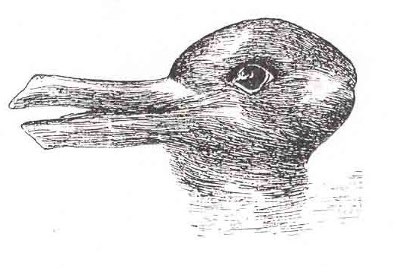
All knowledge is partial and incomplete

Slide 6
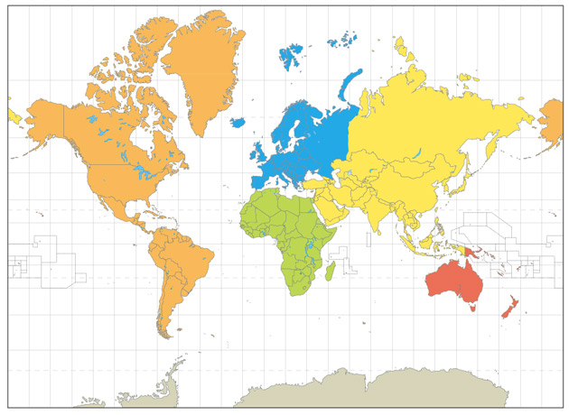
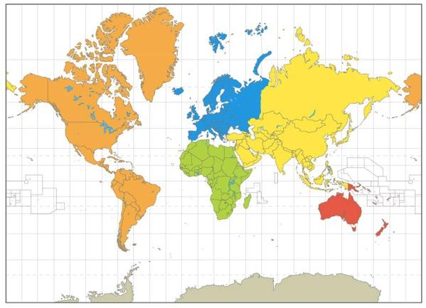
History…
..Maps Racial Biology, Colonisation

Slide 7
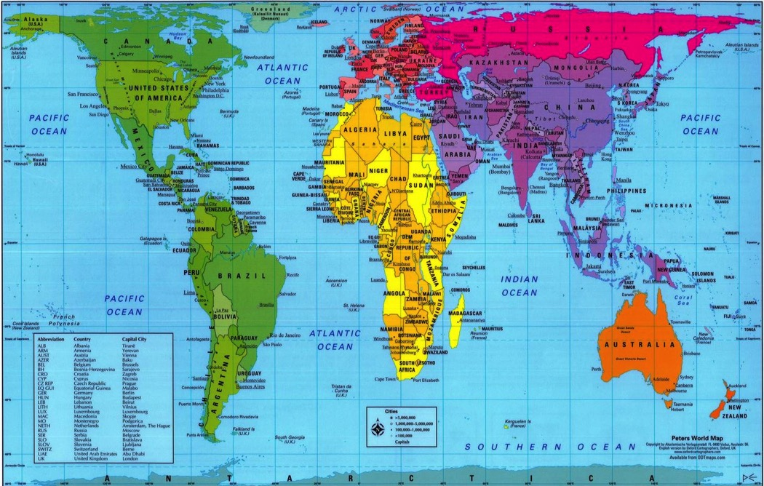

Slide 8
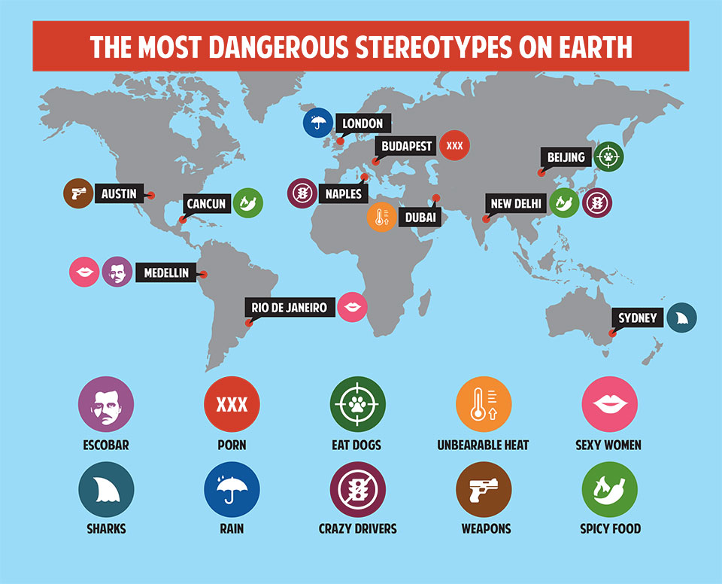

Slide 9
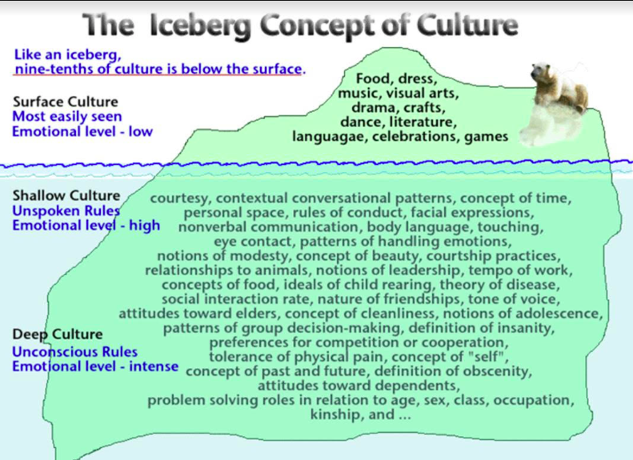
Intercultural Communications
Notes:
Poverty exists primarily because of the action or indeed inaction of those who hold power and privilege. And it can be an uncomfortable realisation that we – as inhabitants of the 16th richest country in the world - find ourselves implicated in the systems that perpetuate inequality. But once identified and recognised, those structures that privilege a minority of the world’s population can and should be challenged. Inequality is bad for everyone, and on a global level it is increasing exponentially (both within and between countries). Development education provides us with a critical opportunity to question why this is happening: and to not settle for easy, simple or pat answers, but to really explore issues, challenging ourselves as individuals in the process.
So, development education is, at its heart, education for transformation and positive change. Nothing less.
“In terms of how the UK public understands and engages with global poverty, it can be said they are stuck in roughly the same place as they were in 1985. The most widespread model for public engagement has been labelled as the 'Live Aid Legacy', which casts the UK public in the role of 'dominant giver', and Southern publics in the role of 'grateful receiver'. In this model, the causes of poverty are internal to poor countries, and nothing to do with global politics. All the UK public can do is give money. In the UK public's mind Africa is stuck, but at the same time the UK public is stuck in this transaction frame for development.”

Slide 10
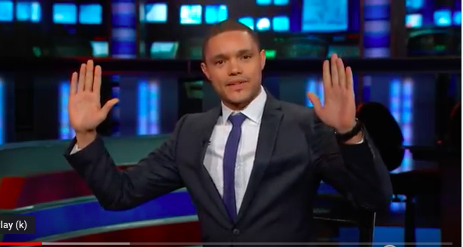
Trevor Noah Spot the Africa
https://www.youtube.com/watch?v=AHO1a1kvZGo

Slide 11
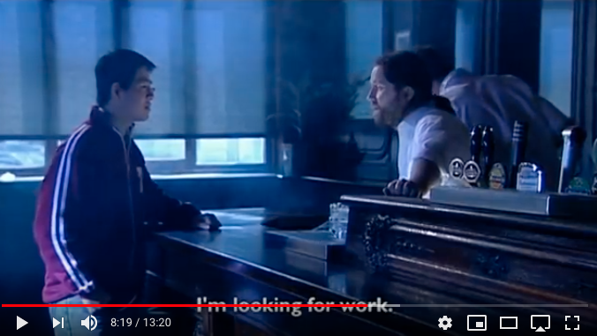
https://www.youtube.com/watch?v=JqYtG9BNhfM
<iframe width="560" height="315" src="https://www.youtube.com/embed/JqYtG9BNhfM" frameborder="0" allow="accelerometer; autoplay; encrypted-media; gyroscope; picture-in-picture" allowfullscreen></iframe>

Slide 12
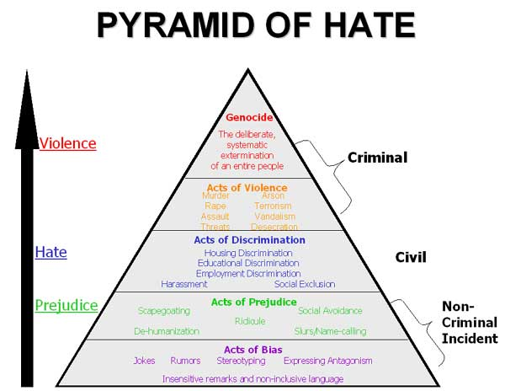

Slide 13
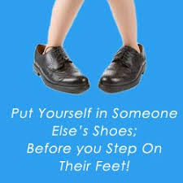
What Now?
Continue the conversation! Better out than in!
Use Humour-it can break down barriers
Stop Hate Speech! Saying 'NO' to HATE SPEECH http://youtu.be/hxpS9X918gQ
Report!
I-Report www.ireport.ie/

