Slide 1



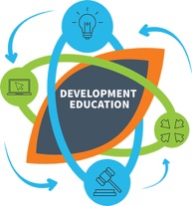


Change in Language
Notes:
Development Education is a direct and active educational response to the issues of inequality and injustice that characterise the world we live in.
Development Education is an approach to education that is driven by the core values and attitudes – justice, solidarity and empathy – and has at its heart a radical and transformative agenda to challenge the structural causes of poverty and inequality. It also, therefore, entails a critical action component to put learning into practice in our everyday lives.
Development Education also encompasses key skills that we all require in life – namely those of critical thinking and analysis, of being able to question and challenge the messages and information we receive every day.
Development Education is underpinned by core methodologies, namely participative and learner-centred approaches to teaching that value the acquisition of skills and knowledge above getting the “right” answer.
DE combines the following key components:
Knowledge, ideas and understanding: factual information about local and global justice issues.
Values and attitudes: an appreciation of human interdependence; solidarity, empathy and a sense of respect towards self and others.
Skills: critical thinking, reflection, problem solving, analysis, teamwork.
Action: to effect change for a more just and equal world.
Methodology: learner-centred and active methodologies
DE can be incorporated into all post-primary curricular areas, if you need assistancewww.developmenteducation.ie for resources that may assist with your subjects. Another useful resource is A Study of the Opportunities for DE, which includes a summary of the opportunities for integrating DE across all post-primary subject areas.
You can show the IDEA dev ed video
iframe width="640" height="390" src="http://www.youtube.com/embed/9B_bZnWvAtI" frameborder="0" allowfullscreen></iframe>
http://www.youtube.com/watch?v=9B_bZnWvAtI&feature=player_detailpage#t=1

Slide 2

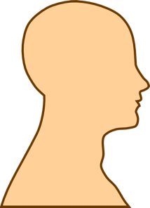


Development Education = Knowledge + Skills + Attitudes and values + Action
Methodology
Puge’s concept of Transformational Learning
(Head/Heart/ Hand)
Knowledge
Attitudes and Values
Skills + Action

Slide 3

Global Citizenship Education
“an educational process aimed at increasing awareness and understanding of the rapidly changing, interdependent and unequal world in which we live”
By challenging stereotypes and encouraging independent thinking, DE helps students critically explore the root causes of global justice issues and how they link with our everyday lives
DE inspires solidarity by supporting people to realise their full rights, responsibilities and potential as global citizens in order to take meaningful action for a just and sustainable world”

Slide 4


Our Approach
+
QUALITY
(Global Passport + ‘Doing DE’ series)
SUSTAINABILITY (teacher capacity building)

Slide 5
WWGS intro
On the bus-people
Jobs game
4 quick activities
Why it’s important to address
Stereotype of places-maps
Exercise-pick a country
Subject links

Slide 6
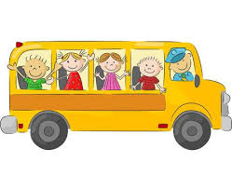
Choose someone to sit beside on the BUS!!

Slide 7

Share your experience of your trip to Ireland in picture form!
Notes:
Poverty exists primarily because of the action or indeed inaction of those who hold power and privilege. And it can be an uncomfortable realisation that we – as inhabitants of the 16th richest country in the world - find ourselves implicated in the systems that perpetuate inequality. But once identified and recognised, those structures that privilege a minority of the world’s population can and should be challenged. Inequality is bad for everyone, and on a global level it is increasing exponentially (both within and between countries). Development education provides us with a critical opportunity to question why this is happening: and to not settle for easy, simple or pat answers, but to really explore issues, challenging ourselves as individuals in the process.
So, development education is, at its heart, education for transformation and positive change. Nothing less.
“In terms of how the UK public understands and engages with global poverty, it can be said they are stuck in roughly the same place as they were in 1985. The most widespread model for public engagement has been labelled as the 'Live Aid Legacy', which casts the UK public in the role of 'dominant giver', and Southern publics in the role of 'grateful receiver'. In this model, the causes of poverty are internal to poor countries, and nothing to do with global politics. All the UK public can do is give money. In the UK public's mind Africa is stuck, but at the same time the UK public is stuck in this transaction frame for development.”

Slide 8
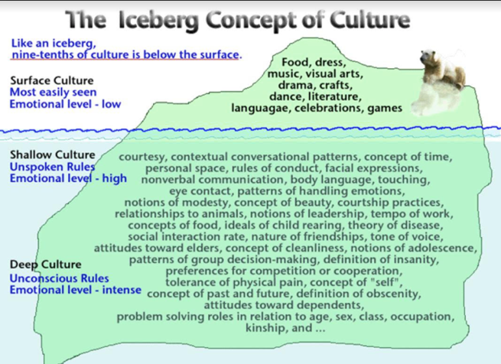
Intercultural Communications
Notes:
Poverty exists primarily because of the action or indeed inaction of those who hold power and privilege. And it can be an uncomfortable realisation that we – as inhabitants of the 16th richest country in the world - find ourselves implicated in the systems that perpetuate inequality. But once identified and recognised, those structures that privilege a minority of the world’s population can and should be challenged. Inequality is bad for everyone, and on a global level it is increasing exponentially (both within and between countries). Development education provides us with a critical opportunity to question why this is happening: and to not settle for easy, simple or pat answers, but to really explore issues, challenging ourselves as individuals in the process.
So, development education is, at its heart, education for transformation and positive change. Nothing less.
“In terms of how the UK public understands and engages with global poverty, it can be said they are stuck in roughly the same place as they were in 1985. The most widespread model for public engagement has been labelled as the 'Live Aid Legacy', which casts the UK public in the role of 'dominant giver', and Southern publics in the role of 'grateful receiver'. In this model, the causes of poverty are internal to poor countries, and nothing to do with global politics. All the UK public can do is give money. In the UK public's mind Africa is stuck, but at the same time the UK public is stuck in this transaction frame for development.”

Slide 9
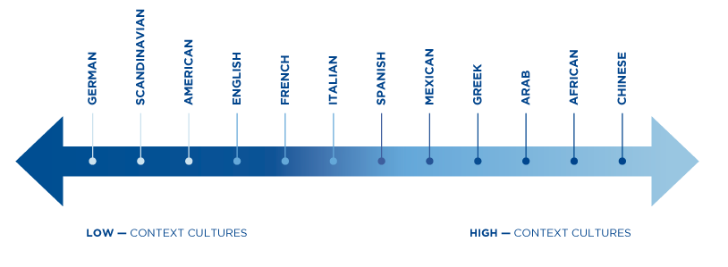
High context and low – context cultures

Slide 10
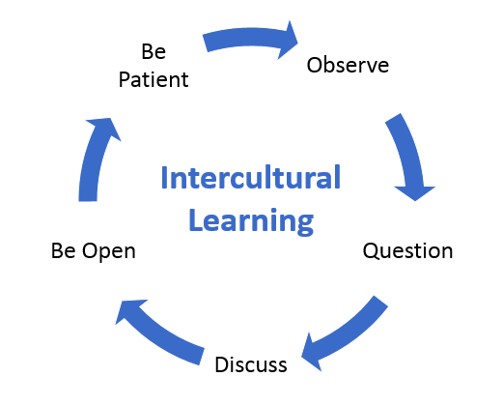

Slide 11
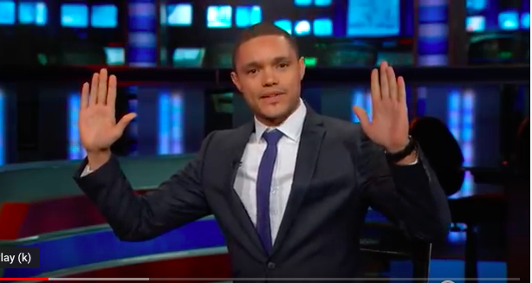
Trevor Noah Spot the Africa
Notes:
To start our session on Challenging Stereotypes and Inspiring Solidarity….and so we can relax and enjoy our cuppa-I introduce to you Trevor Noah the South African comedian who currently hosts the Daily Show. This is a clip from 2014 when he was a guest on the show. At the time, Ebola was in the news!

Slide 12
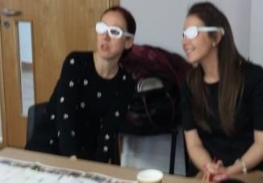
Why are we changing the maps? – Unsettling and further reflection of fundamental assumptions https://www.youtube.com/watch?v=eLqC3FNNOaI
I was shocked to find out that what we have been taught our whole life was wrong. It made me consider what else we have been taught that is wrong (Teacher B).
Notes:
The next step is the ‘unlearning’ or ‘deconstructing’
The unlearning process was initiated using a clip from ‘The West Wing’ (‘Why are we changing maps? https://www.youtube.com/watch?v=eLqC3FNNOaI) as suggested by Campbell and Baikie 2013 as a means of challenging assumptions and the notion of a ‘world view’.
Show clip
The clip takes you through Mercator maps and relative country sizes and positioning to the Peters projection map (on your tables) and the up-side down map (table)
At this stage I hand out A4 copies of the Peter’s Projection map, Upside-down map and the Eckert VI (GA suggested).
Many teachers go very quiet at this stage – it is best to leave them for some time to digest this video, explore the images and discuss amongst themselves.
Once ready, you can gather their thoughts/impressions.
Learning Point - Not only do our influences affect our world view, our world view is subject to influence.
This highlights Andreotti’s ‘colonial framing’ of the world quite well.
This is a surprisingly ‘unsettling’ experience for the participants. By questioning a fundamental assumption of knowledge it allowed all other ‘layers’ to be subject to scrutiny. It was also a liberating experience as it opens up new possibilities and avenues of thinking or questioning and is usually referred to throughout the session.
Participants themselves rate this intervention high in terms of impact on almost all session I have run it.

Slide 13
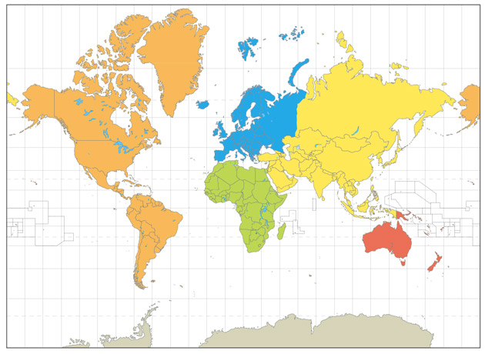
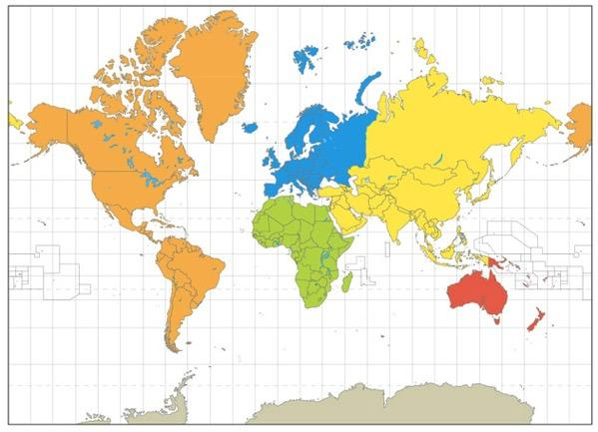
Mercator Map

Slide 14
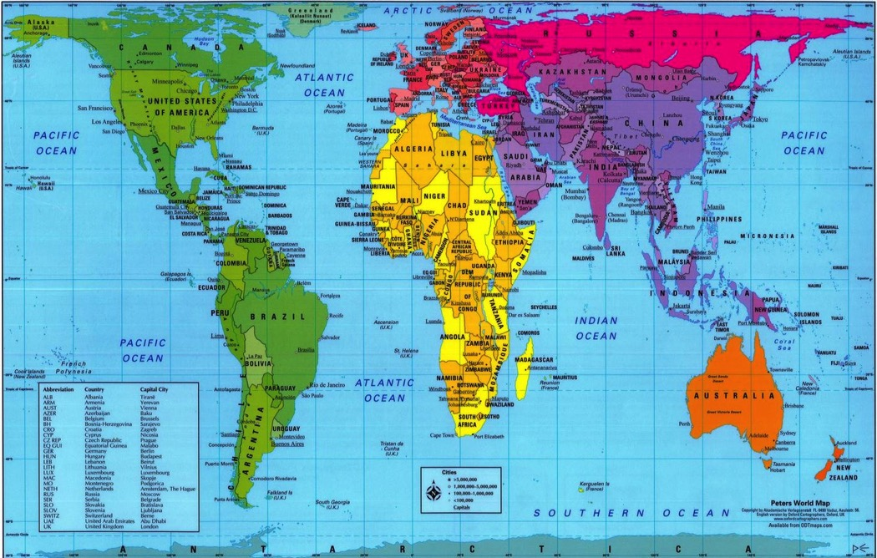

Slide 15
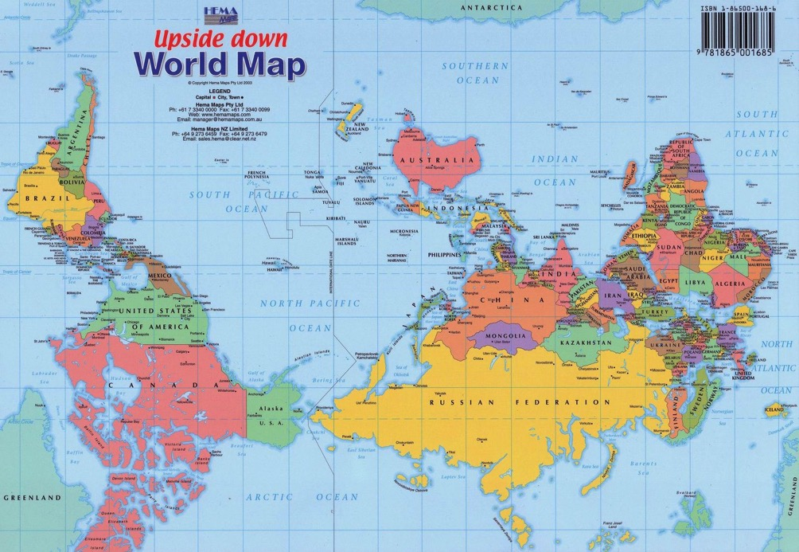

Slide 16
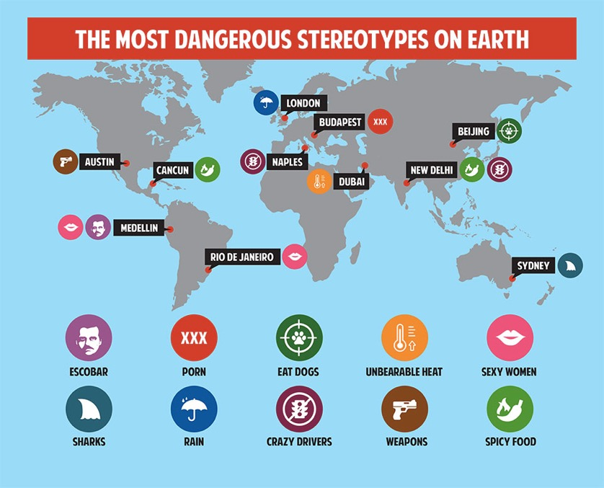

Slide 17

Despite a lot of GCE activity in Ireland, research tells us:
Students have high level of concern and interest in the issues
Low levels of understanding about the root causes of poverty and inequality
GCE is often defined as Fasting, Fun
and Fundraising
National Survey of Third Level Students on Global Development, Jan 2013, SUAS Development Education in Irish Post-Primary Schools –
Notes:
In fact unless you work in the sector in Ireland, you are bound to misunderstand development the work of International Development and the developing world in general and that is no surprise when all we are exposed to is appeals and in the media natural disasters, war, conflict corruption starvation.
So this session is based aroundmany years of research, analysis and soul searching of the NGO community and in particular those working in campaigning and education. The work of Martin Kirk on Finding Frames is helpful to teachers in this regard. Martin Kirk worked for Oxfam for many years and a good example to start with is....
Oxfam’s boss was on Undercover Boss a few years back-the main thing that people knew about Oxfam is that ‘they run orphnages” . This is obvioulsy untrue but this misplaced belief exposes a bigger problem then just a case of misinformation!
Why do people hold this belief?-it follows logically on their thoughts of poverty and in this case of Oxfam. This is because of how we process information-our brain tends to fill in the gaps. This is just making common sense of the world.
And this is evident in Ireland with survey done on third level students and in the wider public on the research coined as the Live Aid Legacy
Live Aid Legacy
“In terms of how the UK and Irish public understands and engages with global poverty, it can be said they are stuck in roughly the same place as they were in 1985. The most widespread model for public engagement has been labelled as the 'Live Aid Legacy', which casts the UK public in the role of 'dominant giver', and Southern publics in the role of 'grateful receiver'. In this model, the causes of poverty are internal to poor countries, and nothing to do with global politics. All the UK public can do is give money. In the UK public's mind Africa is stuck, but at the same time the UK public is stuck in this transaction frame for development.”

Slide 18


Root causes of poverty, injustice and inequality
What root causes can we think of?

Slide 19
Causes & Consequences
People are suffering from malaria
There is no health centre to get treatment
The government doesn’t have enough have enough money to pay for clinics or give out bed nets to prevent people being bitten at night by malaria-carrying mosquitoes
Big companies are not paying the right amount of tax to governments in the countries where they make their money
International laws allow big companies to hide money in tax havens

Slide 20
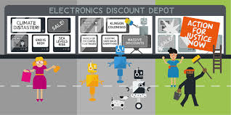
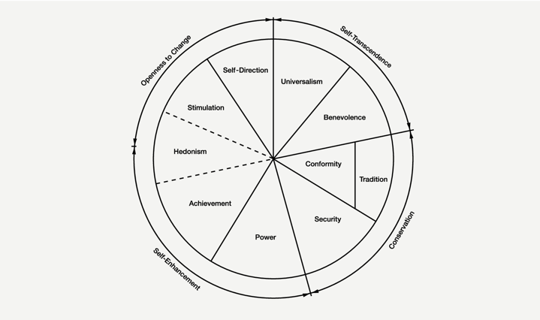
FRAMES
Notes:
At the heart of this common sense in the ‘moral order frame’ belief that the world is naturally made up of hierarchies, and that these hierarchies have an inherent moral dimension; those at the top deserve to be where they are, as do those at the bottom . Orphanages represent a pretty extreme form of this because they are symbols of the classic relationship between vulnerable helpless people - children, even! - in need, and their powerful heroic, parent-like benefactors. This explains why this is problem which can't be fixed by just giving them another example of rich white folk saving poor, (mostly) black victims:
the dominant and powerful creation story that exists, in which the root of individual poverty is reduced to a simplistic explanation of laziness and moral irresponsibility or regrettable but natural and therefore acceptable misfortune. Development NGOs have a duty to re-write this, and the first essential step is stop fuelling it. To put things very simply, NGOs either need to stop using the language of overcoming poverty or ending poverty and stick exclusively to humanitarian response language, or they need to dramatically change their business model and get away from charity with its toxic moral order.
The charity frame embodies the logic that rich people give a little bit of money to poor people, usually because poor people can’t seem to help themselves. It’s a really tough call for fundraisers because we know that people respond to that idea, because it’s been the dominant idea of how to help people for at least a century now. But it’s the opposite logic from real change and justice. So to extract yourself from the charity frame you need to stop talking in those terms.

Slide 21
Top Tips for Teaching Global Justice adapted from Martin Kirk’s tips for NGOs!
1. Never start inside the charity development aid frame.
2. Change how you frame poverty in everything you say.
3. Avoid using any imagery of people passive, helpless, suffering victims.
4. Question the media!
5. Be political.
6. Avoid ‘the White Saviour Complex’ at all costs.
Notes:
So we as WWGS have adapted this for teachers and offer 6 top tips on avoiding reinforcing stereotypes and having a solidarity as opposed to a charity approach or frame to your work.

Slide 22
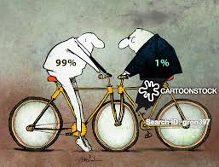
Never start inside the charity development aid frame start with the 1%/99% Frame.
Wealth Inequality puts the majority of the world in the same boat! What are the systems that allow this to happen???
Notes:
It is the logic of charity: it puts your mind in the place of choosing between which poor people - e.g. pot bellied poor children in generic African villages or elderly poor people in India - are more worthy of the help of the generous and morally superior rich. That is the calculation invoked, and it is the logic, or at least an essential bit of it, behind that most craven but popular argument against foreign aid, “charity begins at home”.
A far better frame to start from would be the Occupy 1%/99% frame. That puts you and your audience’s mind in the place of contrasting the super rich with the rest of us, including the impoverished, who are now our in-group rather than a distant “other”. It invokes the vast inequalities inherent in the system, and starts the story with that truth in mind. It’s a more more powerful and relevant starting point if you want people to support political change.

Slide 23
2. Change how you frame poverty in everything you say.
‘Mass poverty is not natural, it doesn't happen by accident’. Martin Kirk
Ask your students WHY and what are the root causes or frame it differently…...OR make it a more active statement.....
‘half a million children are living in poverty’
"The government (or the way we live, our economic system etc) is helping keep half a million children in poverty"
Notes:
Mass poverty is not natural, it doesn't happen by accident. We humans long since passed the point where we could say, “it wasn’t us”. There are actors who are making decisions - consciously or otherwise - that create or contribute to it. We need to name them, all the time. The other side have control of this idea right now, and name who they blame all the time - poor people themselves (a feature of the moral order frame). The discourse is drenched in it. In practice this means always using active not passive sentence constructions. Never say "half a million children are living in poverty.” That obscures the cause and the only actor is the "victim". Far better to say, "The government (or your campaign target) is helping keep half a million children in poverty". That does two things - it makes it an active process, therefore something that can be altered rather than a “just the way it is” fact of nature that must be lived with. Secondly, in the mind of the reader, it activates a scenario in which there are real agents at work. People engage much more in ideas when they can literally imagine things happening. People doing things. A story unfolding. This is essential if you want to stimulate an emotional and morality based reaction.

Slide 24
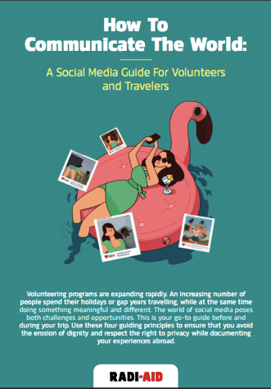
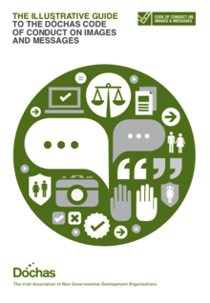
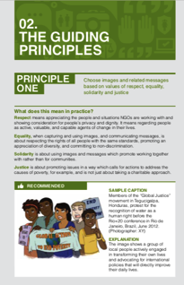
3. Avoid using any imagery of people passive, helpless, suffering victims.
Notes:
Use imagery of people fighting back against injustice, working hard. Being the agents in their own lives, just as we all are. Our job is to demonstrate and promote ideas of solidarity between equals and so frames of victims and saviours - in language, imagery, whatever - as the poison; the polar opposite of solidarity. The Rusty Radiator Awards are an excellent showcase of exactly what we desperately need be moving away from. There are also lots of good, positive examples of new ways of thinking. Kickstarter, and indeed the whole concept of crowdfunding, is powerful because it starts from the logic of networks, which are horizontal structures and therefore negate the idea of the moral hierarchy. Of course, in the wrong hands, such tools can be polluted by charity logic, and as long as charity is such a dominant idea in this area, great care needs to be taken to not let that happen. But they do offer a glimpse of the very rich territory that can be explored, where the presumption is that people are equal for the purposes of the job at hand.

Slide 25
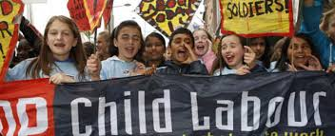
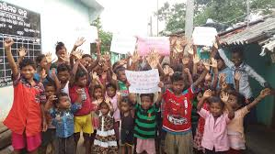
…...Use imagery of people fighting back!
Notes:
Use imagery of people fighting back against injustice, working hard. Being the agents in their own lives, just as we all are. Our job is to demonstrate and promote ideas of solidarity between equals and so frames of victims and saviours - in language, imagery, whatever - as the poison; the polar opposite of solidarity. The Rusty Radiator Awards are an excellent showcase of exactly what we desperately need be moving away from. There are also lots of good, positive examples of new ways of thinking. Kickstarter, and indeed the whole concept of crowdfunding, is powerful because it starts from the logic of networks, which are horizontal structures and therefore negate the idea of the moral hierarchy. Of course, in the wrong hands, such tools can be polluted by charity logic, and as long as charity is such a dominant idea in this area, great care needs to be taken to not let that happen. But they do offer a glimpse of the very rich territory that can be explored, where the presumption is that people are equal for the purposes of the job at hand.

Slide 26
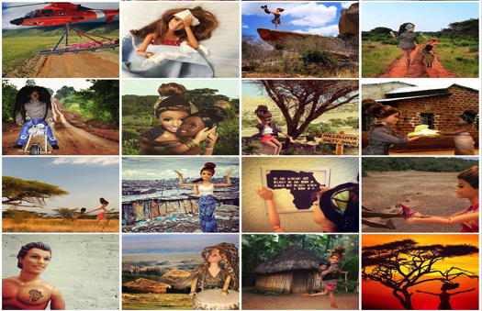
4. Question the Media & indeed people’s own social media?
Notes:
Don’t over sell what you are doing-don’t make claims that you have saved a whole population of people. It is important to empower the students but as part of a bigger movement!!
Saviour Barbie and No White Saviour are great ways to introduce this

Slide 27
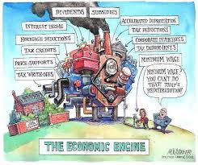
5. Be Political
Notes:
Not party political - no one wants (or needs) to run up against the Charity Commission - but political in the sense of never letting the audience forget this is primarily a question of humans in power making better, more just, less self-centric decisions. It's not the world battling this nasty but natural problem. It's us trying to alter the political economy that creates the problems in the first place. A political economy that has plenty of champions to target. This might mean making some tough choices. People feeling better about second hand clothes or even recycling can in fact actively depoliticise the real issues and oversell their impact: unless seen in the proper logical context, they are actually actively problematic. And right now, the only safe assumption is that the proper context is missing.

Slide 28
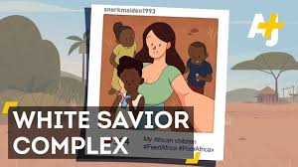
6. Avoid the White Saviour Complex at all costs!
Notes:
Never promise more than a donation or action can achieve. Be optimistic, by all means. But always, ALWAYS, be realistic about your role it is so exciting to see students empowered by doing good but unless they extract themselves from the charity frame they should be considered the most toxic opposition to commensurate action on inequality and climate change.

Slide 29
DE Links with the Curriculum
Junior Cycle | Senior Cycle
Key Skills Subject Specifications New Junior Cycle: Key Skills Subject Specifications Statements of Learning (SOL) | Key Skills Subject Specifications
Education for Sustainable Development
Strategy developed-opportunity to develop an ESD policy in the school
Well being Framework
-Feeling Connected

Slide 30
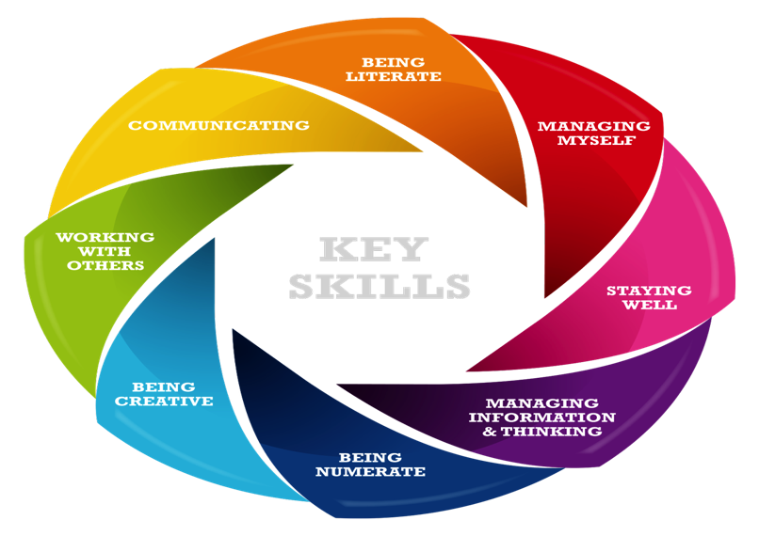
Key Skills-Junior Cycle
Notes:
Gaeilge, English, Modern Languages, History, Geography, CSPE, Mathematics, Physics, Chemistry, Biology, Accounting, Business, Economics, Music, Agricultural Science

Slide 31
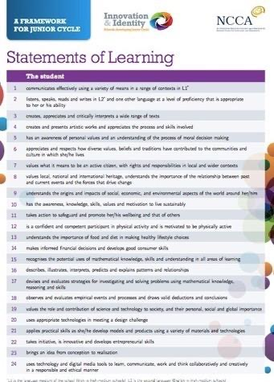
24 Statements of Learning (SOL) for Junior Cycle
STRONG DE LINKS
Task: highlight the Statements of Learning that have similar aims to Global Citizenship Education

Slide 32
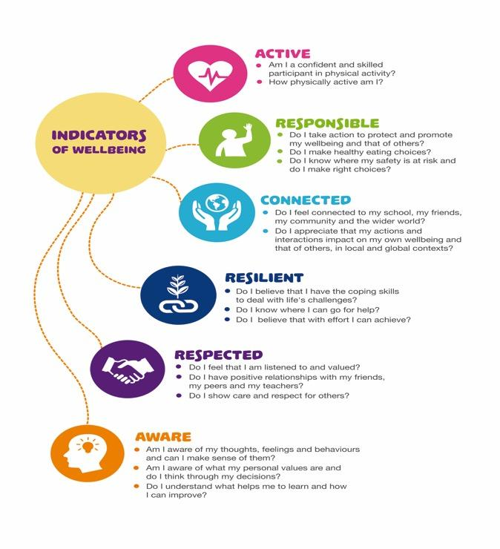
Well being Framework
Notes:
You are already integrating it into Wellbeing week!
•Do I feel connected to my school, community & the wider world?
-Do I appreciate that my actions & interactions impact on my wellbeing & that of others in local & global contexts?
Physical Education Junior Cycle:
Health and Wellbeing
-Giant Steps using Health and Wellbeing statements
Games
-All to Play For
-Dizzying Goals
Individual and Team Challenges
-World Cup Challenge
-Global Goals orienteering challenge
Dance and Gymnastics
-Using Dance to Tackle Climate Change
https://www.youtube.com/watch?v=wb3j_gpoL50
-Interpretative Dance of Global Goals
-World Cup challenge-what dances of your country’s team?

Slide 33
Junior Cycle MUSIC
The UN Declaration of Human Rights (Article 27) affirms the rights of everyone to ‘participate in the cultural life of the community and to enjoy the arts’.
With an increasingly diverse and pluralist population, this understanding of others through a cultural lens will encourage students to develop as responsible and ethical citizens.
Strand 2: Innovate and Ideate
2.2 create a musical statement (such as a rap or an advertising jingle) about a topical issue or current event and share with others the statement’s purpose and development
Strand 3: Culture & Context
3.1 collaborate with fellow students and peers to produce a playlist and a set of recordings to accompany a local historical event or community celebration
3.4 compose and perform an original jingle or brief piece of music for use in a new advertisement for a product, and record the composition-ADBUSTERS!
3.6 associate/match music excerpts to a variety of texts (words, film, language) and justify the reasons as to why this piece of music was chosen to match the text
CBA 1 using a global justice issue as stimulus/ exploring different styles of music.

Slide 34




The rationale for junior cycle English recognises the important contribution that students with ‘knowledge and command of language’ can make ‘to political, social and cultural life and as thoughtful and active citizens’ (DES, 2015: 4).
to develop in students ‘a mature and critical literacy to prepare them for the responsibilities and challenges of adult life in all contexts’ and ‘an awareness of the value of literature… for enhancing their sense of cultural identity’. The syllabus states that ‘developing control and power over language is the most essential educational achievement for all students if they are to become confident, thoughtful and discriminating adults and citizens’ (DES, 2001: 5-6).

Slide 35
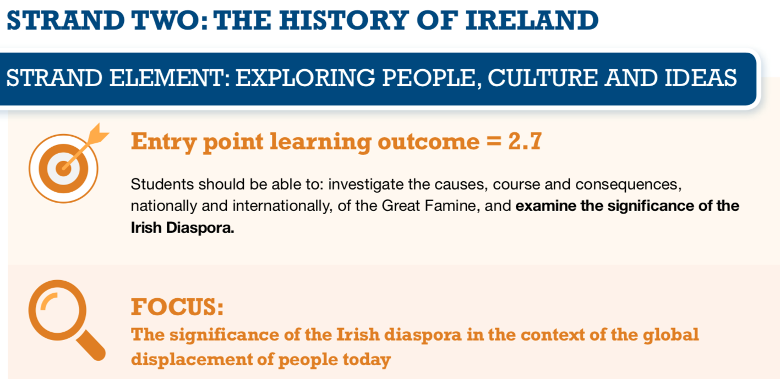
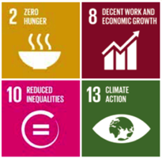
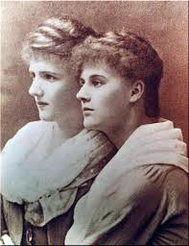
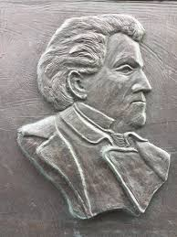
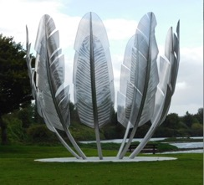
Notes:
paweł edmund strzelecki-polish humanitarian
Eva gore booth
Choctaw Indian Cork
Europe is the destination of the minority of refugees each year:

Slide 36
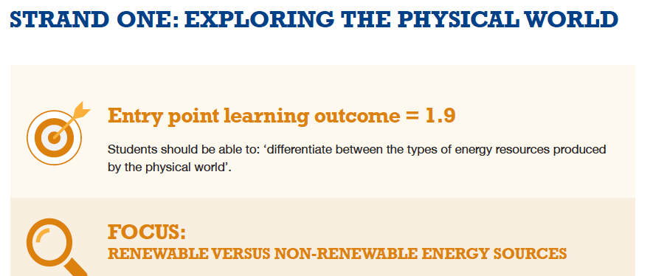
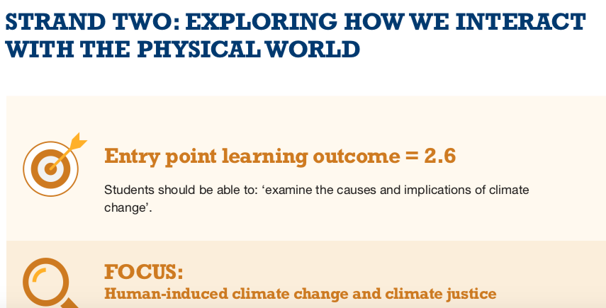

Slide 37
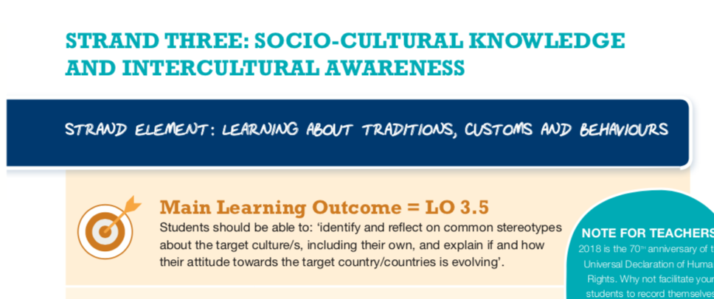
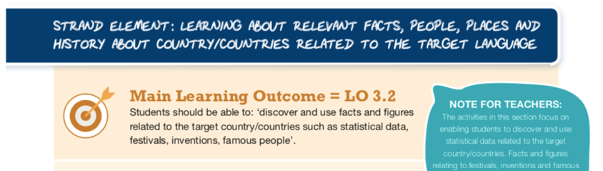
https://lasc.ie/resources/for-teachers/

Slide 38
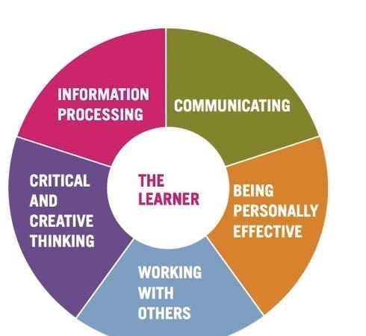
Key Skills-Senior Cycle
• recognises the impact of real-world constraints
• evaluate outcomes of solutions and decisions both in the short and long term

Slide 39
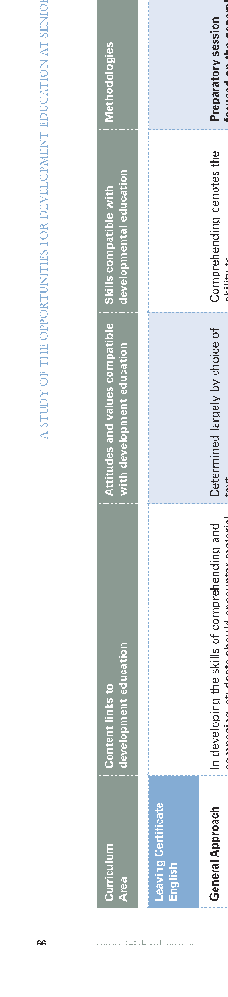

English

Slide 40
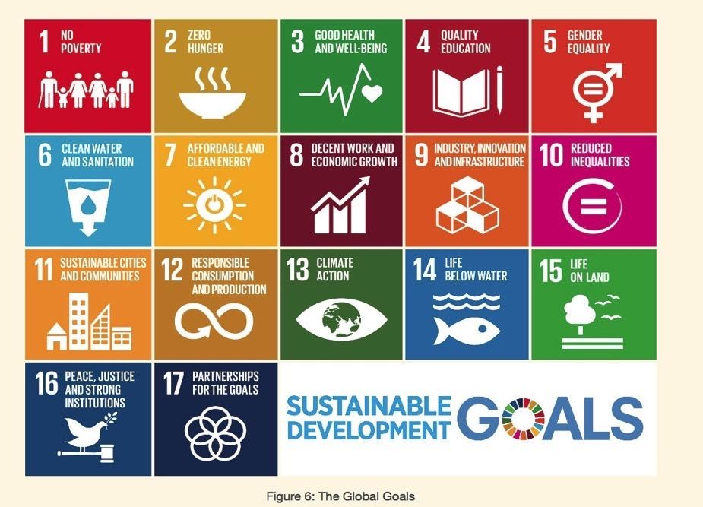

Slide 41
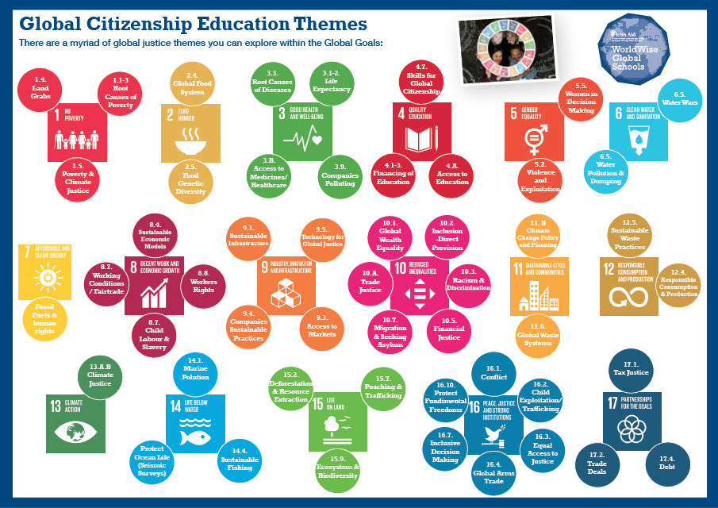
Notes:
ACTIVITY
Everyone stands in a circle. In the middle of the circle there are cards with an image and theme on the front.
Give people a few minutes to walk around and take a look at all of the cards. Explain that at some point they will be asked to move to the card that they would like to explore a little more or are interested in. Only two people per card.
For new teachers ask them to pick a them they are LIKELY TO EXPLORE or would LIKE TO with their students.
For established teachers ask them to pick a theme that CHALLENGES THEM

Slide 42
R.E.: Global Justice and Morality
Maths: You could do a lesson on ratios using some inequality statistics; 5:50:500
Geography: You could do a local study in your country that examines the differences in people’s living standards. You might want to use census data or government statistics to highlight how quality of life is not the same for everyone.
History: When studying inequalities and movements to redress these from history, such as the American civil rights movement or the Suffragettes in the UK, can you draw comparisons with situations around the world today?
P.E.: Fair Play/All to Play For
For us all
Art: Framing Our World
Notes:
10.1 Progressively achieve and sustain income growth of the bottom 40% of the population at a
rate higher than the national average.
10.2 Empower and promote the social, economic and political inclusion of all, irrespective of age, sex, disability, race, ethnicity, origin, religion or economic or other status.
10.3 Ensure equal opportunity and reduce inequalities of outcome, including by eliminating discriminatory laws, policies and practices and promoting appropriate legislation, policies and action in this regard.
10.4 Adopt policies, especially fiscal, wage and social protection policies and progressively achieve greater equality.
10.5 Improve the regulation and monitoring of global financial markets and institutions and strengthen the implementation of such regulations.
10.6 Ensure enhanced representation and voice for developing countries in decision making in global international economic and financial institutions in order to deliver more effective, credible, accountable and legitimate institutions.
10.7 Facilitate orderly, safe, regular and responsible migration and mobility of people, including through the implementation of planned and well-managed migration policies.
About 2.6 billion people are facing difficulties in accessing electricity full time.
2.5 billion people worldwide lack access to basic sanitation.
1 – 1.5 billion people do not have access to reliable phone services.
In 2013, it is estimated that there were more than half a billion jobs in manufacturing. Every job in manufacturing creates 2.2. jobs in other sectors.

Slide 43
R.E: Investigate the causes of conflict looking at what people/congregations are doing to bring about peace.
English: Chalklines on JC Reading List-good way of looking at child labour. You could explore political cartoons that highlight inequality, corruption with your students
Geography: You could use the arms trade as an example of international trade. Where are arms produced and by whom? Who are they being sold to? What about the illicit trade in arms, why is this so dangerous? Students could do a mapping exercise with connecting lines or arrows to show which countries dominate the trade. (Information can be found on sites such as Wikipedia and Amnesty International.)
History:
Explore the major conflicts in history in the context of causes & consequences.
Explore the wider impacts on society of reforms in for example child labour, on education, women’s rights and health care. Despite these reforms why are children around the world still forced to work?.
Notes:
Target 16.1: Significantly reduce all forms of violence and related death rates everywhere.
Target 16.2: End abuse, exploitations, trafficking and all forms of violence against and torture of children.
Target 16.3: Promote the rule of law at the national and international levels and ensure equal access to justice for all.
Target 16.4: Significantly reduce illicit financial and arms flows, strengthen the recovery and return of stolen assets and combat all forms of organized crime.
Target 16.5: Substantially reduce corruption and bribery in all their forms.
By 2030 the UN want to:
Target 16.6 Develop effective, accountable and transparent institutions at all levels.
Target 16.7 Ensure responsive, inclusive, participatory and representative decision-making at all levels.
Target 16.8 Broaden and strengthen the participation of developing countries in the institutions of global governance.
Target 16.9 Provide legal identity for all, including birth registration.
Target 16.10 Ensure public access to information and protect fundamental freedoms, in
accordance with national legislation and international agreements.
The number of refugees of concern to the United Nations High Commissioner for Refugees (UNHCR) stood at 13 million in mid-2014, up from a year earlier.
Corruption, bribery, theft and tax evasion cost some US $1.26 trillion for developing countries per year.
The rate of children leaving primary school in conflict-affected countries reached 50% in 2011, which amounts to 28.5 million children.
Human trafficking affects every country of the world, as country of origin, transit or destination. Victims from at least 127 countries have been found to be exploited in 137 States.
With the devastating impact of the arms industry in many parts of the world including Palestine, we are asking you to get involved with the Irish Palestine Solidarity Campaign (IPSC) calling on the Irish government to place an immediate arms embargo upon the state of Israel.
http://www.ipsc.ie/noarmstrade

Slide 44
Gaeilge: Athrú Aeráide Cóir Aeráide
Maths: Students could explore: Earth Overshoot Day, the nos. of species endangered by climate change; these could be compared to the number of people in your local area or country. Students explore ways to present this information such as a hierarchy or pictograms.
Geography: Students could explore the impact of climate change in a particular location. How would the environment be affected? How would people’s lives change? What would the economic impact be?
Science: Students could explore the causes of climate change and investigate some of the technologies that have been developed to reduce the impact, for example, alternative energy sources, carbon capture, biofuels and smart grid technologies.
English: write a letter to your local TD about the government’s commitment to climate change-Citizens Assembly meeting 30/9
All: Stop Climate Chaos-UN Summit Dec 2017
Notes:
They will be discussing How the State can make Ireland a leader in tackling climate change

Slide 45
Maths: Students could collect data on food waste in their home or school canteen and then learn to present and analyse the data effectively. They could then explore ways to reduce food waste. Alternatively, students could compare food waste statistics for their country with others around the world; why do they think some countries waste more food than others?
Metalwork: looking at what metals are more sustainable & good for the environment
Art: Recreate, Junk Couture
Business/Economics: CSR and waste
Geography: You could research the supply chain of a resource or product – where does it come from, who are all the people involved in bringing the finished product to shops, who earns what money? Classic examples include bananas, chocolate, a pair of jeans and now palm oil.
Science: Students could investigate the impact of pesticides and other chemicals on the environment. For examples, neonicotinoids and bees. Why do we need them? How do they work? What impact do they have? What are the alternatives?
P.E. Recycled Sports Day
Notes:
Example of DE project on Water:
Recording of overall water consumption.
Recording of water consumption in school toilets. How many swimming pools would this fill. For how many years would this provide drinking water to an Irish and African family.
Measuring of school roof to find area
Recording of local rainfall to find out how much rainfall will fall on the roof. This information will be available from the local weather station.
Recording of number of toilets/urinals and how much water each one consumes per flush
Installation of dual flush systems
Design, manufacture and installation of signs promoting water conservation within the school by the students.
Putting perspective on how much water we use. A simple project like taping 8 water bottle together showing that this is the amount of water needed to flush just one toilet.
The meal project where we analyse how much water is used in the production of our food. It can take up to 700 gallons to make one hamburger so with such statistics and more attitudes may change towards or consumption of beef.
There are many websites containing brilliant educational videos on water and its use worldwide. Waterfootprint.org will allow students to calculate individual water footprint and the water footprint for a country.
Why bothering about your water footprint?
Freshwater is a scarce resource; its annual availability is limited and demand is growing. The water footprint of humanity has exceeded sustainable levels at several places and is unequally distributed among people. There are many spots in the world where serious water depletion or pollution takes place: rivers running dry, dropping lake and groundwater levels and endangered species because of contaminated water. The water footprint refers to the volumes of water consumption and pollution that are ‘behind’ your daily consumption.
Water footprint reduction at home
As a consumer, you can reduce your ‘direct water footprint’ (home water use) by installing water saving toilets, applying a water-saving showerhead, closing the tap during teeth brushing, using less water in the garden and by not disposing medicines, paints or other pollutants through the sink.
Save water in the supermarket
Your ‘indirect water footprint’ – the water consumption and pollution behind all the goods you buy – is much larger than your direct water footprint at home. You have basically two options to reduce your indirect water footprint. One option is to substitute a consumer product that has a large water footprint by a different type of product that has a smaller footprint. Examples: eat less meat or become vegetarian, drink tea instead of coffee, or even better drink plain water. And replacing cotton clothes by clothes from artificial fibre saves a lot of water.
But this approach has limitations, because you may find it difficult to drastically change your consumption pattern. What still remains, however: you can select the cotton, beef or coffee that has a relatively low water footprint or that has its footprint in an area that doesn’t have high water scarcity. This requires that retailers provide you with proper information to make such choices. In this respect, ask product transparency from businesses and regulation from governments!
Oct - 7,14,21,28. Research into the importance of water on our planet. How much do we use personally. Where is water really used and how much does it take to make e.g. a hamburger, a loaf of bread, a bag of potatoes. Research and recording of current water consumption levels within the school toilets and how much water washing machines and dishwashers use. Research into how much water is needed to produce our food, build our houses will add an extra dimension to this project. A look at water conservation around the world through case studies and documentaries. The “story of bottled water” and “Story of Stuff” on YouTube is very enlightening.
Nov - 4,11,18,25 Research on where the school water comes from (e.g. Local reservoir or lake) and the energy and of course water it takes to clean and filter it. Research on the energy needed to pump this water from source to school. Research on where surface water from the school ends up. Does it end up back at its original source? Research into how water consumption can be cut at home. There is a lot of information available on water.ie and seai ireland.
Dec - 2,9,16,23,30 Water saving measures within the school. By this stage we will hopefully have our rainwater harvesting system in place. However through research students will most likely find out that we can still cut our consumption of the harvested water. Students will come up with a list measures to achieve this. Research may include the timing of automatic flush systems for urinals over the weekends or on school holidays. Hippo bags also reduce the amount of water in a flush.
Jan – 13,20,27 Design of awareness posters that can be strategically placed around the school. These aim to reminds us to reduce our individual water consumption
Feb – 3,10,17,24 Students will embark on an awareness campaign armed with all of their research over the past few months. They will conduct interviews with students and staff through a quick questionnaire about how much water they think they use and then reveal how much they actually use.
Mar -3,10,17,24,31 Drawing up of a school policy on water usage and a code of good practice. Poster design to raise awareness on the use and release of cleaning products into the water course. Research may include new more environmentally cleaning products, dishwasher tablets, washing powder, the replacement of mass amounts of shampoo and shower gels in the home and sports dressing rooms. The power of lemon juice and baking soda as a cleaning product ..what are cleaning products actually made from?
Apr – 7,14,21,28. Accurate recording of results and presentation in table format. How much our consumption of clean drinking water was reduced by. What are the ecological benefits of this? What are the financial benefits of this and where could this money be used elsewhere in the school? Possibly more environmental projects? Promotion of the projects to the local community through TY student led visits to the school to view the project. Promotion of the project to schools in the locality through school visits.
May – 5,12,19,26 Reflection and evaluation on the project and its results. How could it be improved upon? Is there an area for improvement for next years TY group? Is this a stepping stone that may lead us to other areas where we can be kinder to our planet? Can our energy consumption be reduced??

Slide 46
Radiators for Norway
Radiators for Norway

Slide 47
Teaching and learning resources on Stereotypes
Anti Rumours Training Resource
NYCI Global Rights Nobel Goals
Spotlight on Stereotyping-Equality Authority
Changing Perspectives CDETC Curriculum Development Unit.
https://publicinterest.org.uk/aid-is-just-a-sticking-plaster/
Orphanages, Latrines & Soap Powder-7 things we can do to change the Poverty Discourse
Notes:
There are plenty of tools that are available for you to use in the classroom and for any further advice just ask

Slide 48
Teaching and learning resources
Educate Together Resource Bank- www.learning.educatetogether.ie
Other useful websites:
www.worldwiseschools.ie
www.developmenteducation.ie
www.youthdeved.ie
www.globaldimension.co.uk
www.globalgoals.org
Sign up to www.ideaonline.ie e-curricular
Notes:
Already using Global Teacher sharing resources on your One Drive

