Slide 1
Click Title
Sustainability

Slide 2







Notes:
The initiative is a partner ship between JCT and a number of organsiations
Amgen Biotech
Science Gallery Dublin
Worldwide Global School
Sustainable Energy authority of Ireland (SEAI)
British and Irish Association of Zoos and Aquaria (BIAZA)
Science Foundation Ireland in their work with the European Space Education Resource Office (Ireland)

Slide 3

Our vision is to provide Junior Cycle teachers with rich STE(A)M CPD experiences in keeping with national and international best standards; this provision will allow for interdisciplinary responses to societal challenges in subject-specific and cross-curricular contexts.
Notes:
So lets go right back to the start. This is the vision for STEAM in Junior Cycle. Today it will primarily focus on the curricular area of science but within that we hope to provide ideas for interdisciplinary approach to science and going forward this initiative will expand to incorporate other subject and curricular areas and teachers and organisations from these areas.

Slide 4
Todays Partners
WORKSHOP ONE
WORKSHOP TWO
WORKSHOP THREE
Notes:
Today you will experience 3 workshops as shown – but these are linked by a common thread.

Slide 5
sustainability
Notes:
Today we will be focussing on the sustainability element of the science specification. Now while each of the workshops will deal with different contextual learning outcomes within this ele

Slide 6
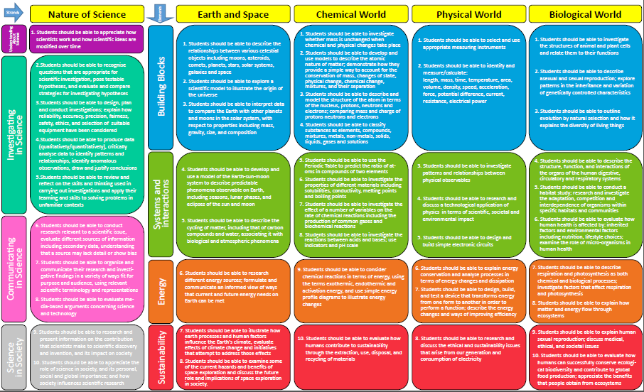
Students should be able to appreciate how scientists work and how scientific ideas are modified over time
Students should be able to appreciate the role of science in society; and its personal social and global importance; and how society influences scientific research
Notes:
While each workshop will highlight particular contextual strand learning outcomes there are two NoS learning outcomes which unite our day.
But as we have discovered previously in order to truly understand a learning outcome we must understand the action verb associated with it. Here it is appreciate

Slide 7
Students should be able to appreciate how scientists work and how scientific ideas are modified over time
Appreciate- Recognise the meaning of; have a practical understanding of
Students should be able to appreciate the role of science in society; and its personal social and global importance; and how society influences scientific research
Notes:
We will be focusing on developing a practical understanding of how scientists work and in recognising the influence of science on society and of society on science

Slide 8
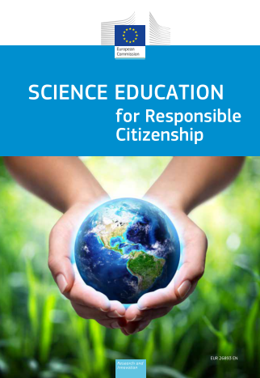
“Innovative new ideas and creative solutions often emerge at the margins of disciplines… Linking the arts and humanities with science, technology, engineering and mathematics brings the scientist, engineer, entrepreneur, artist and designer into dialogue to oﬀer the widest range of opportunity and academic and societal insight for experimentation and innovation”
Notes:
And this is where the STE(A)M agenda comes to life – Can I invite you to read this abstract from a report by the expert group to science education to the European Commission entitled “Science education for responsible citizenship – Responsible citizenship which is ignited through development of the key skills of Junior Cycle

Slide 9

https://undsci.berkeley.edu/
Science and technology feed off of one another, propelling both forward. Scientific knowledge allows us to build new technologies, which often allow us to make new observations about the world, which, in turn, allow us to build even more scientific knowledge, which then inspires another technology …
Notes:
This is a very useful websites specifically related to the Nature of Science (has many resources and thought provoking pieces for classrooms and for teachers) and here the link between science and technology is highlighted – invite to read..

Slide 10
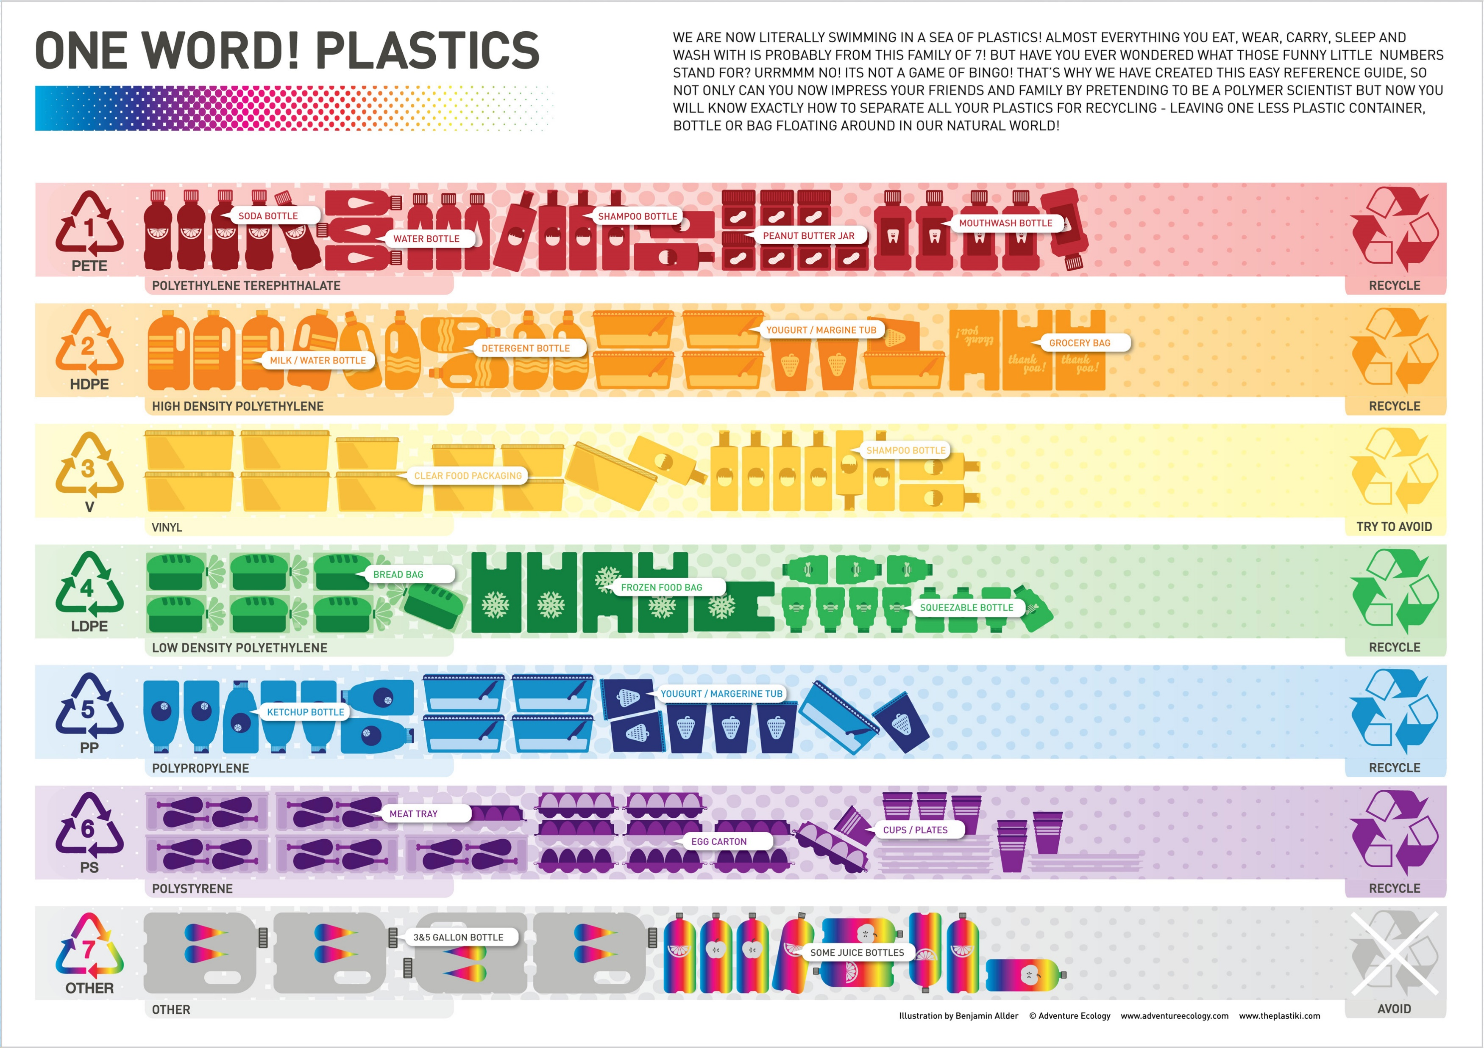
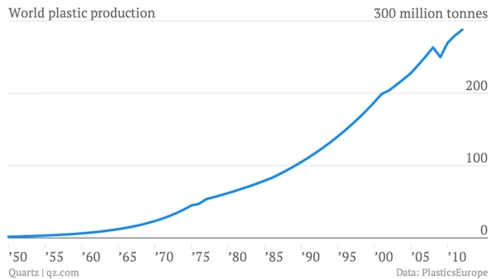
Notes:
While technological developments have led to a change in the production of plastics and to the development of bioplastics –( do we know all the symbols??) and yet world plastic production is on the rise – we know the damage – the scientists are making developments but what impact do we /can we have as a society – this will be explored in the first workshop…

Slide 11
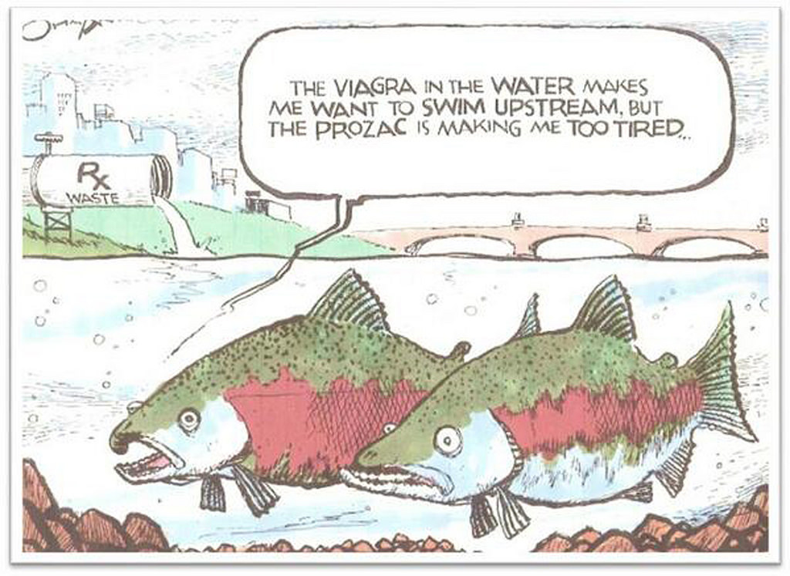
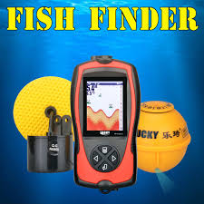
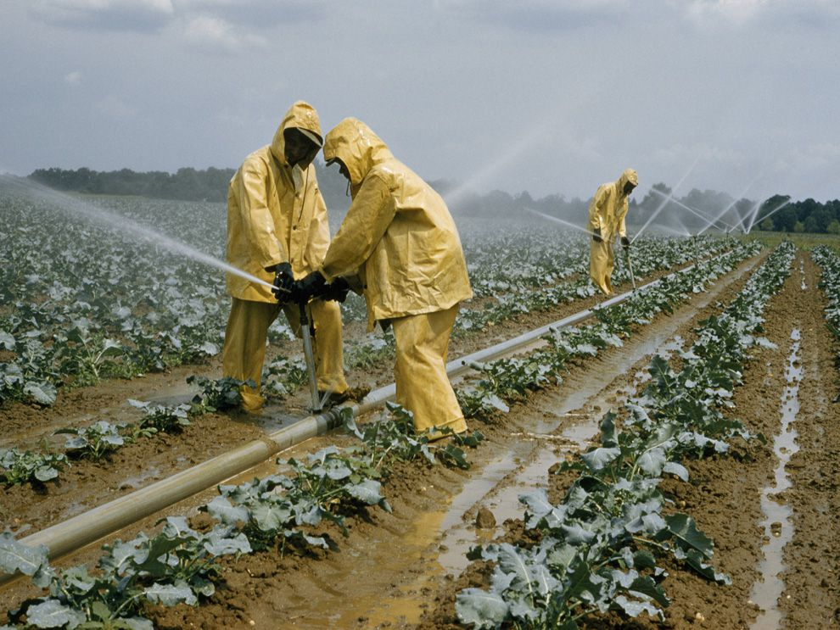
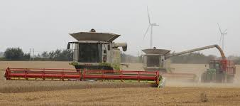
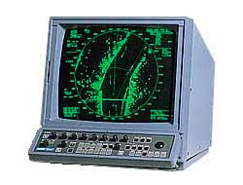
Great Technological advances…
What is the down side?
Notes:
In the world of agriculture and fishing there have been huge technological developments - but developments can have consequences and in the second workshop we shall explore how humans can maybe redress some of the impacts of our scientific development and work to conserve biological diversity

Slide 12
Societal Issues
Scientific Research
Technological Advances
Manufacturing advances
Implementation
Notes:
And this is key to understanding a STE(A)M agenda - The cyclical nature of the relationship between science and society. So while societal needs and demands can drive scientific research and technological development this can go on to have impacts on society which can further drive the research agenda. And then throughout History we have seen many examples of scientific research and development and scientific discoveries in the wrong hands – the human impace.

Slide 13
Decisions
Actions
Consequences
Notes:
Part of what is involved in developing scientific literacy and informed citizens who can make choices involves consideration to the above relationship. And maybe sometimes we should pause and consider the above relationships – remember the butterfly effect – every decision has consequences …ever action has a ripple effect – and this is the focus of the final workshop of the day –
So without further ado I would like now to begin this STE(A)M journey and hand you over to ---- for the first workshop.

Slide 14
Sustainability
WorldWise Global Schools
Lizzy Noone
Education Officer
WorldWise Global Schools

Slide 15
In today’s workshop we will explore
Sustainability as a theme in STE(A)M
Teaching and learning activities relating to Sustainability

Slide 16
Focus for today’s workshop
STRAND THREE: CHEMICAL WORLD | STRAND ONE: THE NATURE OF SCIENCE
Strand element: Sustainability | Strand element: Science in society
Students should be able to: LO 10. evaluate how humans contribute to sustainability through the extraction, use, disposal, and recycling of materials. | Students should be able to: LO 9. research and present information on the contribution that scientists make to scientific discovery and invention, and its impact on society LO 10. appreciate the role of science in society; and its personal, social and global importance; and how society influences scientific research.

Slide 17

LO 10. evaluate how humans contribute to sustainability through the extraction, use, disposal, and recycling of materials | Evaluate (data): collect and examine data to make judgments and appraisals; describe how evidence supports or does not support a conclusion in an inquiry or investigation; identify the limitations of data in conclusions; make judgments about ideas, solutions or methods Evaluate (ethical judgement): collect and examine evidence to make judgments and appraisals; describe how evidence supports or does not support a judgement; identify the limitations of evidence in conclusions; make judgments about ideas, solutions or methods
LO 9. research and present information on the contribution that scientists make to scientific discovery and invention, and its impact on society | Research: to inquire specifically, using involved and critical investigation
LO 10. appreciate the role of science in society; and its personal, social and global importance; and how society influences scientific research. | Appreciate: recognise the meaning of; have a practical understanding of

Slide 18
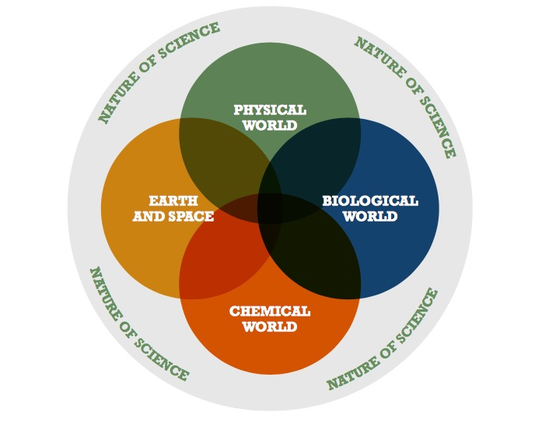
The strands of the specification for junior cycle science
Todays workshop

Slide 19
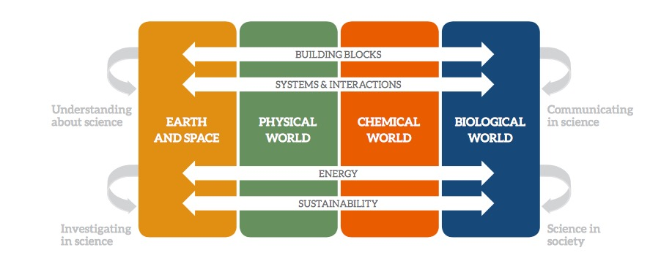
The elements of the contextual strands
Todays workshop

Slide 20
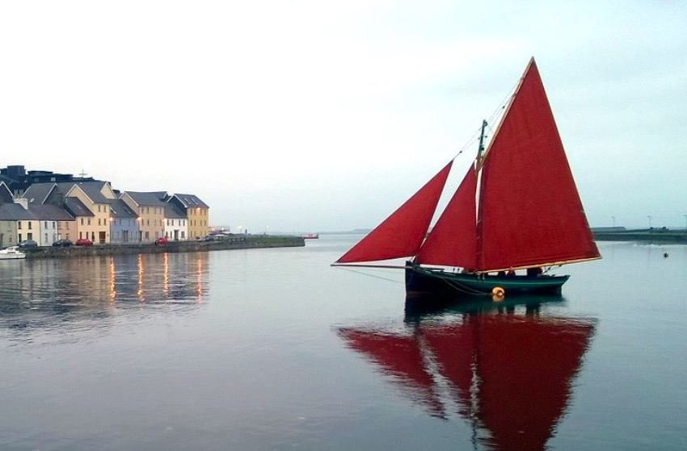
First things first..
Reflection
Self Assessment Tool (SAT) part 1

Slide 21
Focus for today’s workshop
STRAND THREE: CHEMICAL WORLD | STRAND ONE: THE NATURE OF SCIENCE
Strand element: Sustainability | Strand element: Science in society
Students should be able to: LO 10. evaluate how humans contribute to sustainability through the extraction, use, disposal, and recycling of materials. | Students should be able to: LO 9. research and present information on the contribution that scientists make to scientific discovery and invention, and its impact on society LO 10. appreciate the role of science in society; and its personal, social and global importance; and how society influences scientific research.

Slide 22
STRAND THREE: CHEMICAL WORLD
LO. 10. evaluate how humans contribute to sustainability through the extraction, use, disposal, and recycling of materials.
Plastic
Extraction | Use | Disposal | Recycling
1. 2. 3. | 1. 2. 3. | 1. 2. 3. | 1. 2. 3.

Slide 23
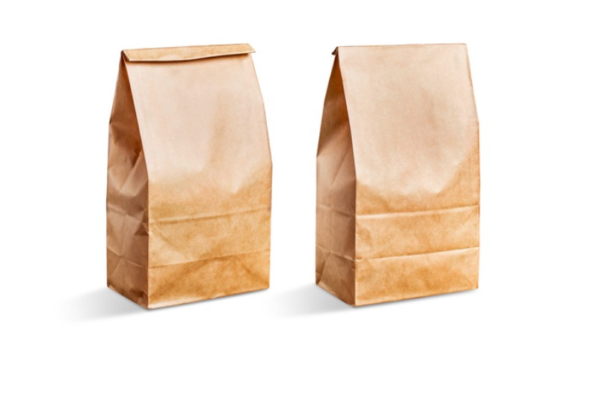
What do we mean by Sustainability?
Social
Sustainability
Environmental
Sustainability

Slide 24
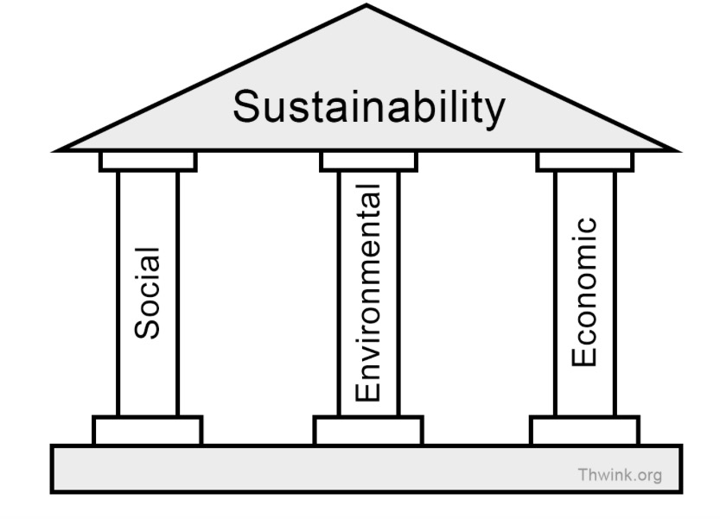
Pillars of Sustainability/Sustainable Development

Slide 25
What do we mean by Sustainability
(Sustainable Development)?
Environmental
Sustainability
Social
Sustainability
Task Part 1: In groups
On your table is an envelope with a selection of words.
With your group, decide if the words are associated with:
A) Social Sustainability
B) Economic Sustainability
C) Environmental Sustainability
D) Applies to all of the above
Put the words in the relevant bag
(3 minutes)

Slide 26
What do we mean by Sustainability?
Social
Sustainability
Environmental
Sustainability
Task Part 2: In groups
There are 3 photos on your table.
Examine these photos and Identify examples or aspects of the three
dimensions of sustainability in the photograph.
A) Social Sustainability
B) Economic Sustainability
C) Environmental Sustainability
Using the post-it notes on your table, label where you can see aspects of the three
dimensions of sustainability in the photograph
(5 minutes)

Slide 27
What do we mean by Sustainability?
Environmental
Sustainability
Social
Sustainability
Task Part 3: In groups
In your group, you must come up with a definition for sustainability/sustainable development (5 minutes)

Slide 28
What do we mean by Sustainability?
Definition of Sustainable Development
‘Sustainable development’ can be defined as….
‘development which meets the needs of the present without compromising the ability of future generations to meet their own needs.’
Sustainable development is a continuous process of economic, environmental and social change aimed at promoting wellbeing of citizens now and into the future.

Slide 29
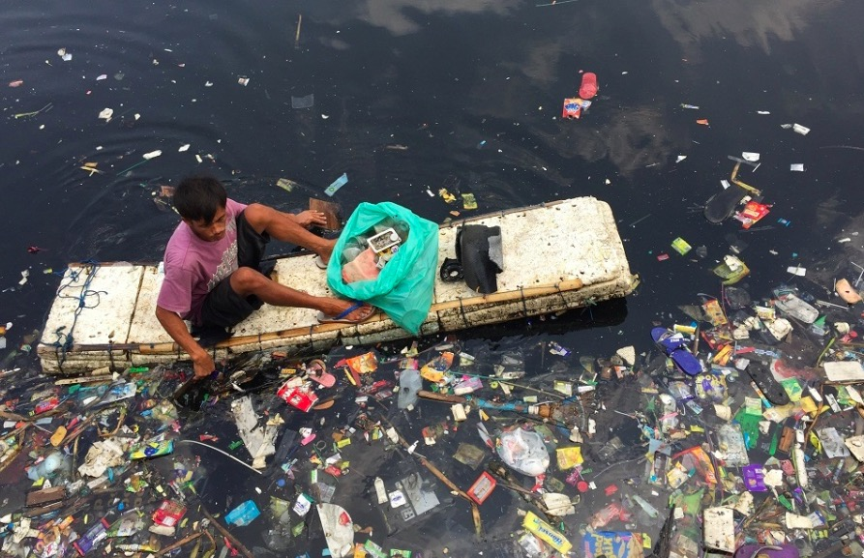
A Whopping 91% of Plastic Isn't Recycled
Billions of tons of plastic have been made over the past decades, and much of it is becoming trash and litter

Slide 30
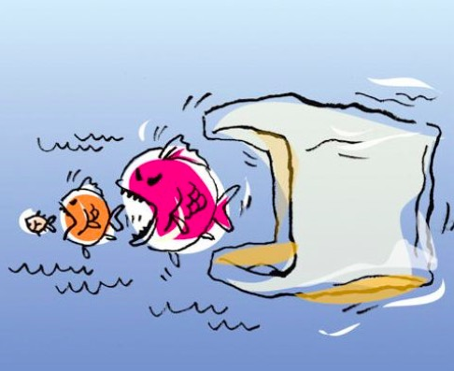
What does this cartoon tell us?

Slide 31
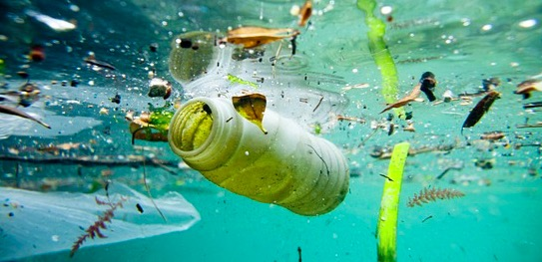
Life Cycle Activity
https://www.youtube.com/watch?v=eg-E1FtjaxY

Slide 32
Life Cycle Activity
https://www.youtube.com/watch?v=eg-E1FtjaxY
What is a product life cycle?
A life cycle is the different stages a product will go through, from it first being created to it no longer being used.
Task: In groups
Using the cards on your table and the life cycle template, decide as a group what the life cycle of your product (that contains plastic) is.
Your group may have:
A plastic fork
A mobile phone
A coffee cup
A plastic bottle

Slide 33
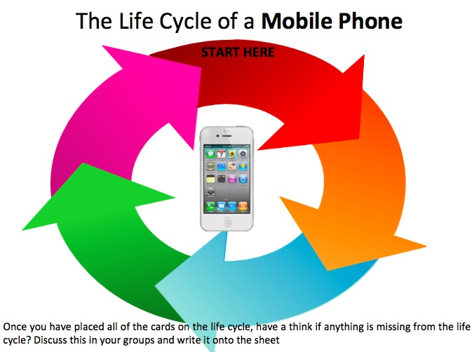

Slide 34
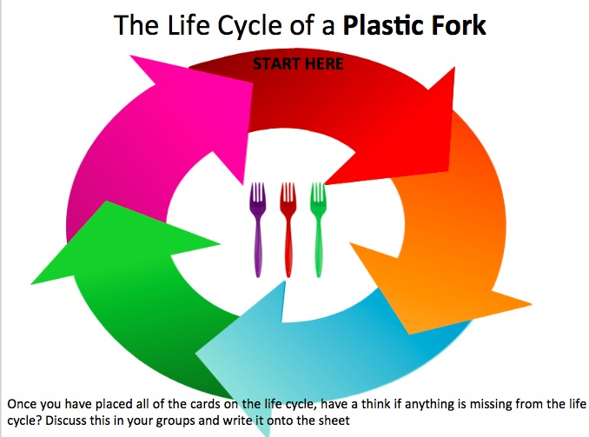

Slide 35
STRAND THREE: CHEMICAL WORLD
LO. 10. evaluate how humans contribute to sustainability through the extraction, use, disposal, and recycling of materials.
Extraction | Use | Disposal | Recycling
1. 2. 3. | 1. 2. 3. | 1. 2. 3. | 1. 2. 3.

Slide 36
What really happens to the plastic you throw away?

Slide 37
STRAND THREE: CHEMICAL WORLD
LO. 10. evaluate how humans contribute to sustainability through the extraction, use, disposal, and recycling of materials.
Extraction | Use | Disposal | Recycling
1. 2. 3. | 1. 2. 3. | 1. 2. 3. | 1. 2. 3.

Slide 38
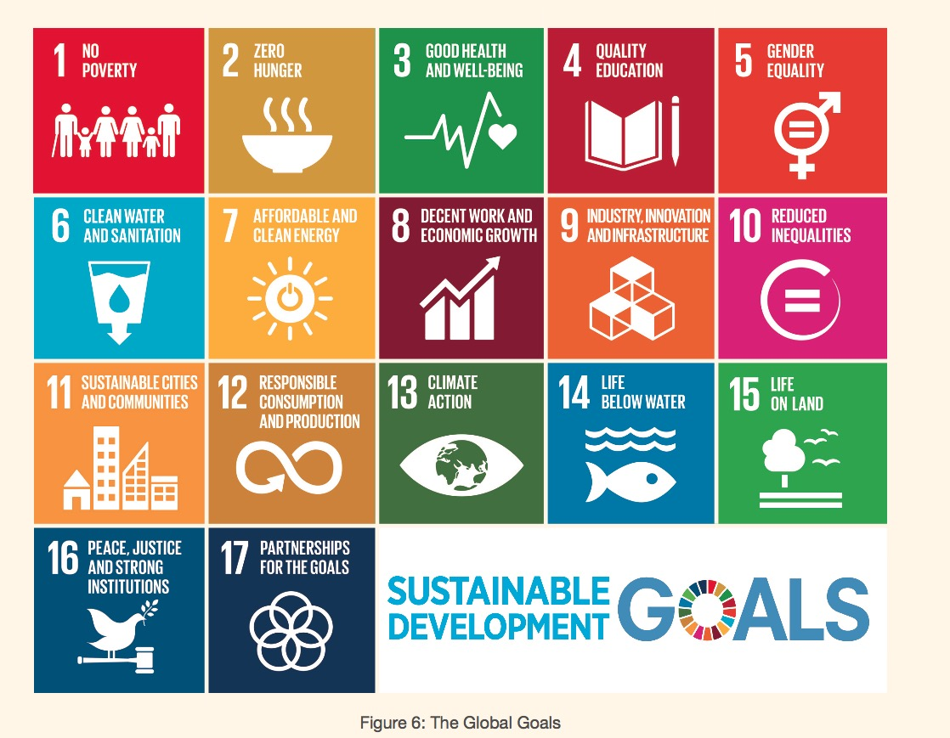
The Global Goals 2015-2030

Slide 39
The Global Goals 2015-2030

Slide 40
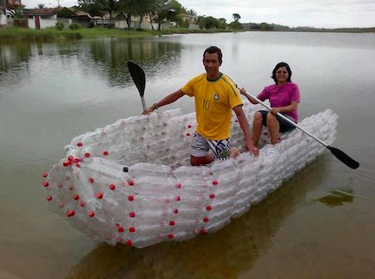
Get Creative!
UPCYCLING

Slide 41
Task Introduction
Recycling is good, but upcycling is better! Recycling is turning what we normally throw away into something we can use again either, in its current form or as something else. Upcycling is taking something we normally recycle and transforming it into something more valuable.
We create too much waste, and upcycling is a fun way to reduce the amount of rubbish we generate. In this project, students will create upcycled items for their own use, to give as gifts or to sell perhaps?

Slide 42
Get Creative!
UPCYCLING
Students coming up with a plan! (this includes collecting materials and trying things out)
Students presenting their plans to their peers and receiving feedback
Host a ‘gallery walk’ where other members of the school can come in and see the students at work, creating their upcycled products
Exhibition
Focus for today

Slide 43
Get Creative!
UPCYCLING
Students coming up with a plan! (this includes collecting materials and trying things out)
Students presenting their plans to their peers and receiving feedback
Host a ‘gallery walk’ where other members of the school can come in and see the students at work, creating their upcycled products
Exhibition
Focus for today

Slide 44
Get Creative!
UPCYCLING
Planning template (page 1):
What type of product will we make? | Who will this product be for?
What kind of materials will we need? | Where will we get our materials from?
Who will do what? (roles within the group) | Where will we get more ideas from? | Challenges we might face
 |  | How will we overcome these challenges?

Slide 45
Get Creative!
UPCYCLING
Planning template (page 2):
First sketch of product design
TASK: In groups, develop your ideas for your plastic product and sketch them on the sheet provided.
Annotate your design ideas with notes to give additional information about your design(s).

Slide 46
Use as many boxes as you need to produce a step by step plan of how to make your product. Don’t forget to include information about the materials and equipment you need.
1 | 2 | 3
4 | 5 | 6
7 | 8 | 9

Slide 47
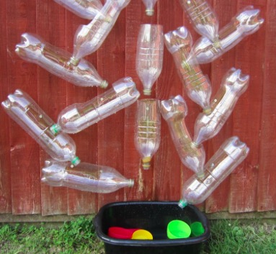
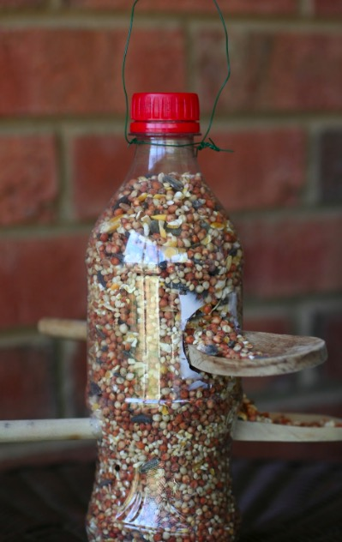
Examples

Slide 48
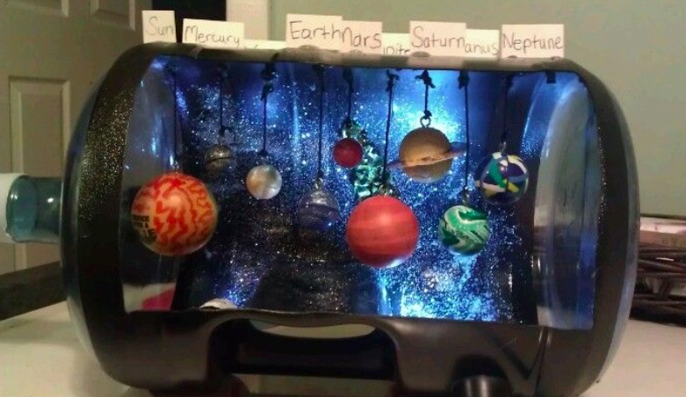
Examples

Slide 49
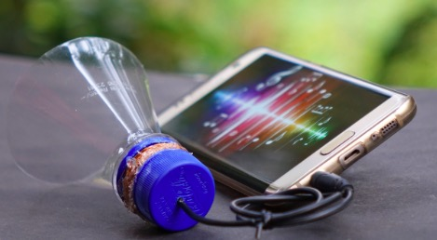
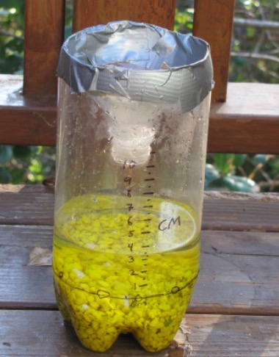
Examples

Slide 50
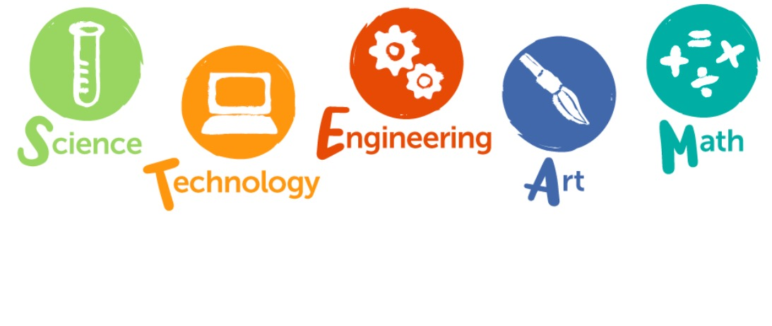
Tasks might include:
Designing the layout for the fair.
Creating flyers, posters, and postcards to advertise the date and location of the fair.
Creating advertisements for students’ individual products.
Creating public service announcements about recycling and upcycling to play during the fair.
Developing how-to instructions explaining how to get started with upcycling at home.

Slide 51
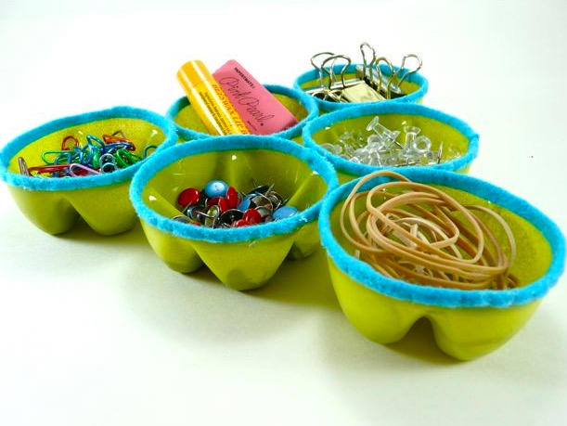
Examples

Slide 52
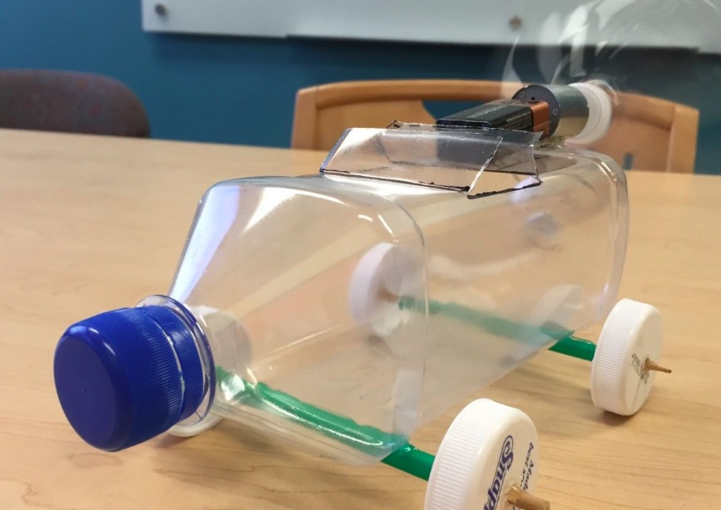
Examples

Slide 53
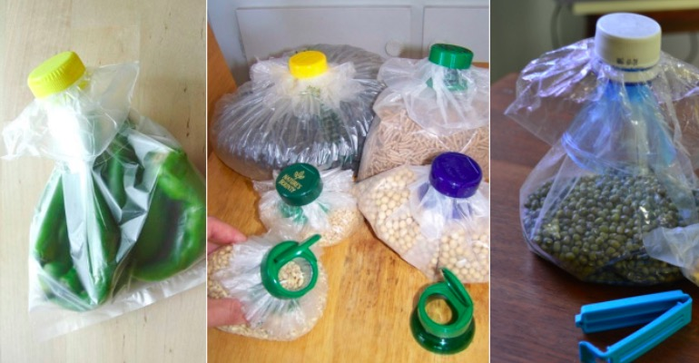
Examples

Slide 54
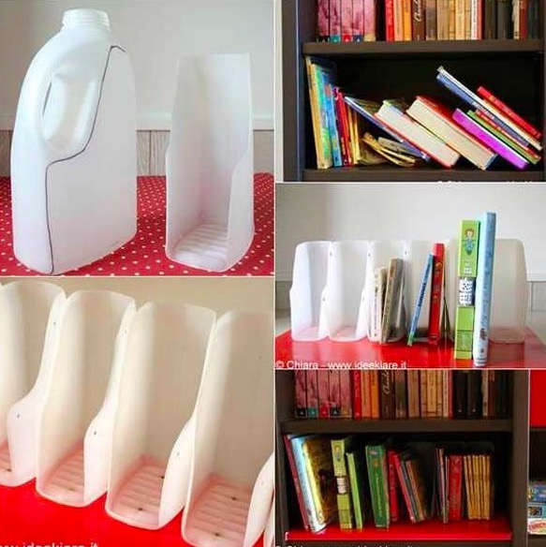
Examples

Slide 55
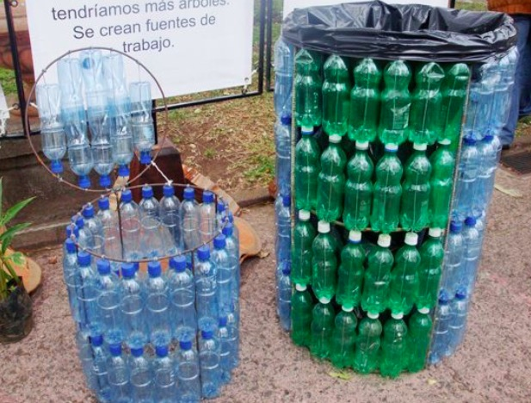
Examples

Slide 56
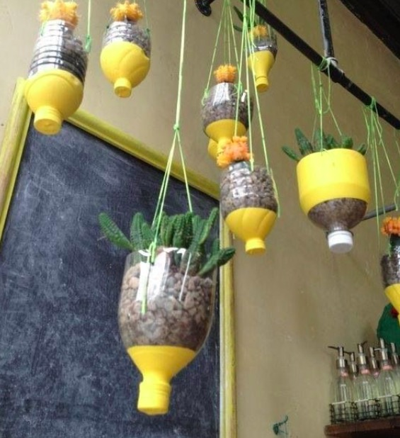
Examples

Slide 57
Science in the News
Activity: Pair, square and share
In pairs, read the article.
Find references to the role that science and technology played in the article.
Join with another pair, discuss and come up with a shared list
Links to Chemical World: LO 10

Slide 58
STRAND THREE: CHEMICAL WORLD
Revisiting our Learning Outcome
LO. 10. evaluate how humans contribute to sustainability through the extraction, use, disposal, and recycling of materials.
Extraction | Use | Disposal | Recycling
1. 2. 3. | 1. 2. 3. | 1. 2. 3. | 1. 2. 3.

Slide 59
And lastly..
Reflection
Self Assessment Tool (SAT) part 2

Slide 60
American Bison And Its Role In The Conservation Of Ecological Biodiversity
Tayto Park

Slide 61
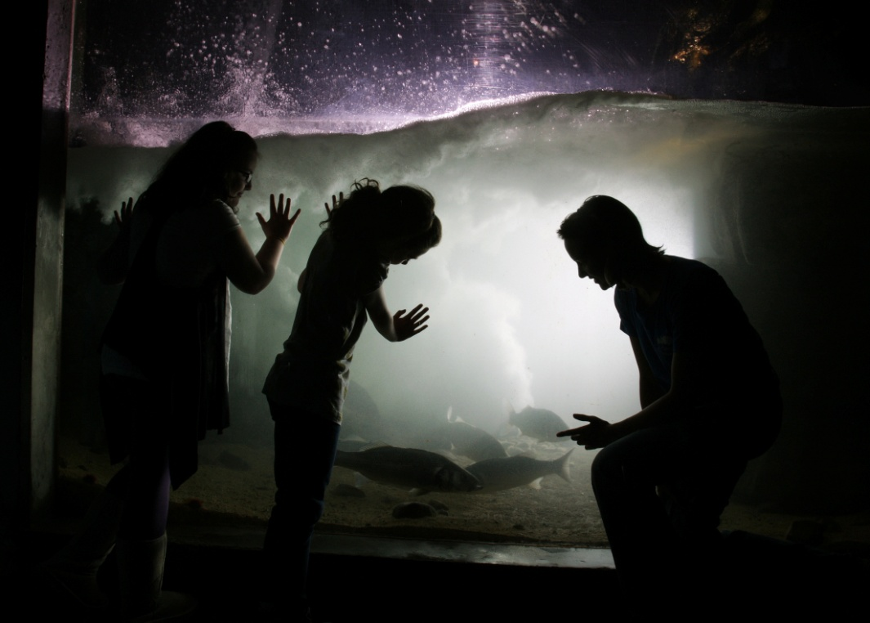
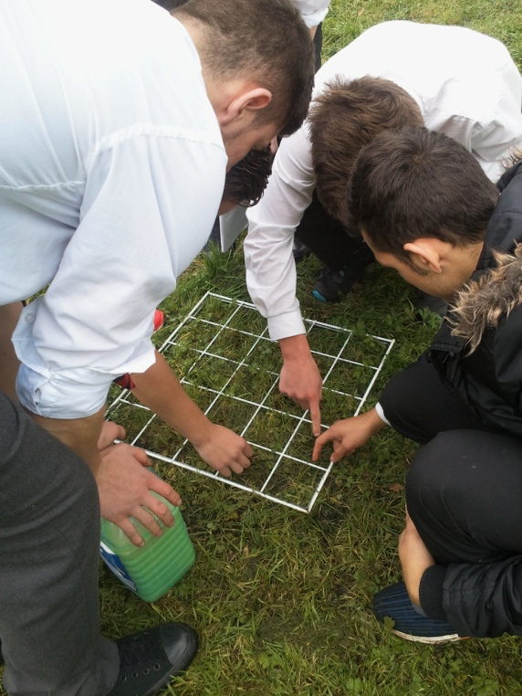
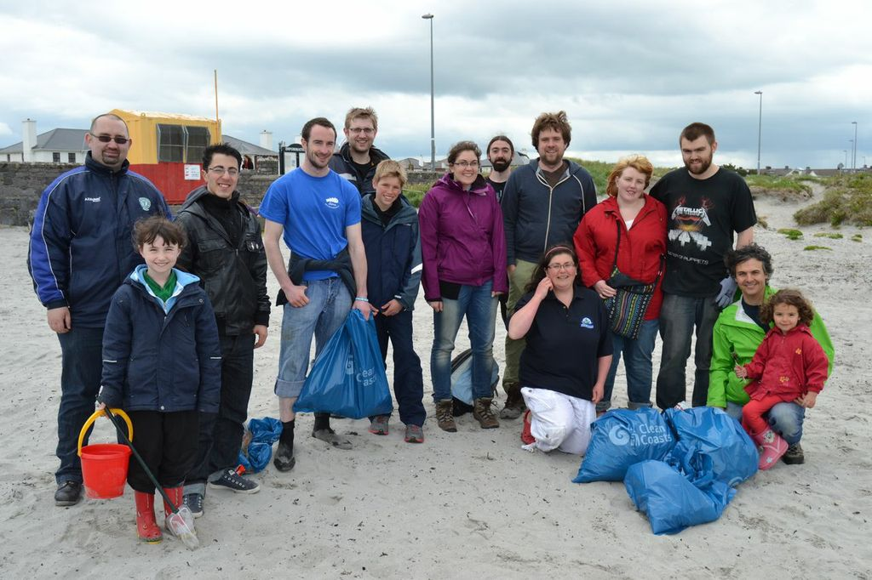
BIAZA- Our Vision
To be a powerful force in the care and conservation of the natural world.
Notes:
Two of the four strands of the BIAZA mission highlight education

Slide 62
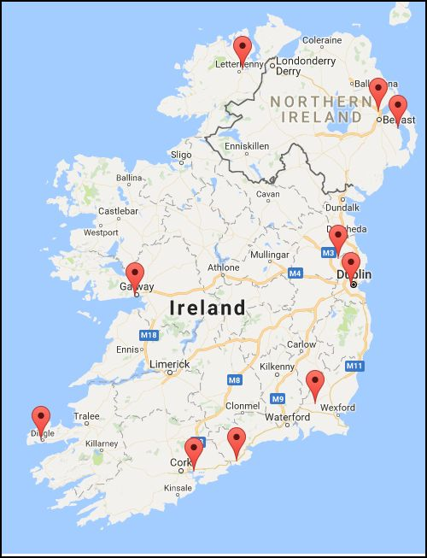

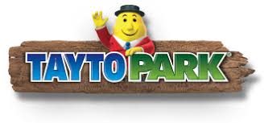

Collections throughout Ireland

Slide 63
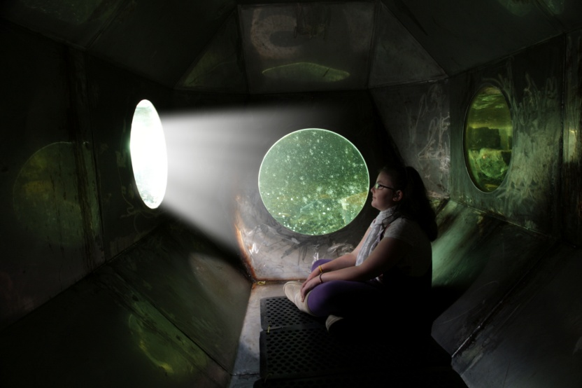
Why we exist?
Modern zoos and aquariums are dedicated
  to conserving the natural world through research and conservation programmes
  to educating and inspiring their visitors to do the same.

Slide 64
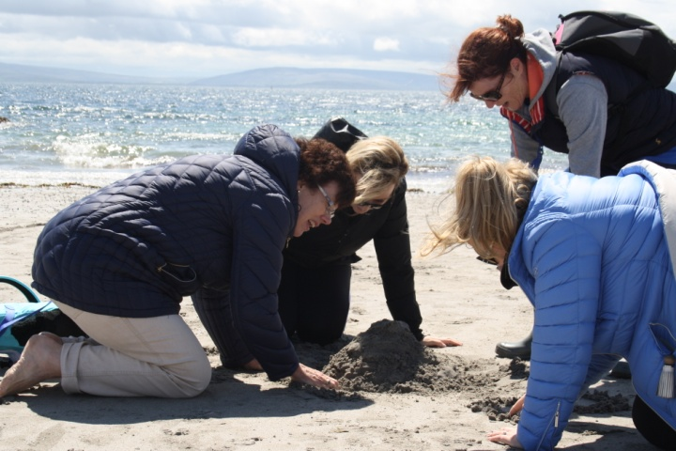
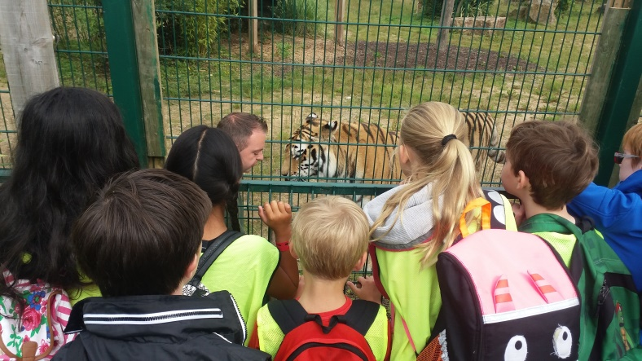
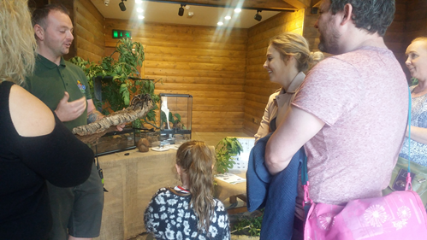
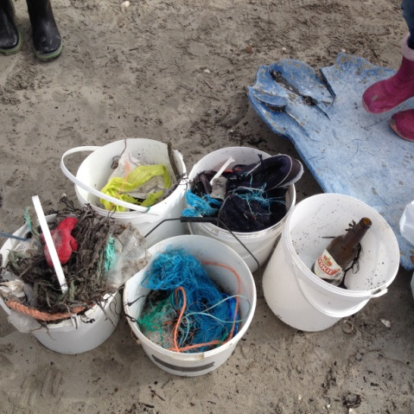
What we do?
Education
Conservation
Research
Public Engagement
Outreach
Training

Slide 65
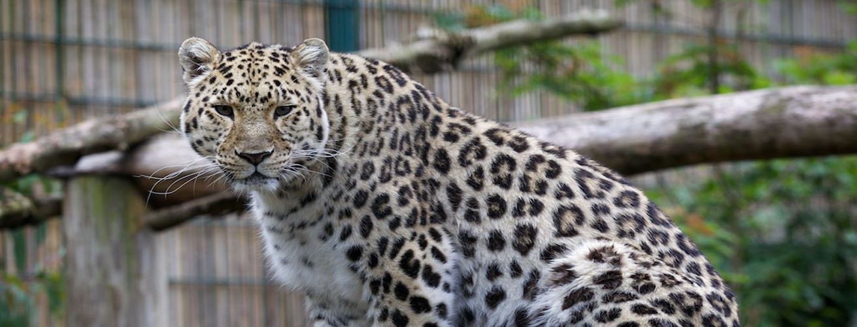
Tayto Park
  The mission of Tayto Park is dedicated to creating adventure
  Passing on knowledge, conserving nature
  Serving our community.

Slide 66
Today’s Learning Outcomes
BW10:Students should be able to evaluate how humans can successfully conserve ecological biodiversity and appreciate the benefits that people obtain from ecosystems
NOS1:Students should be able to appreciate how scientists work and how scientific ideas are modified over time
NOS10:Students should be able to appreciate the role of science in society; and its personal, social and global importance; and how society influences scientific research

Slide 67
Action Verbs
Evaluate (ethical judgement) - Collect and examine evidence to make judgments and appraisals; describe how evidence supports or does not support a judgement; identify the limitations of evidence in conclusions; make judgments about ideas, solutions or methods
Appreciate - Recognise the meaning of; have a practical understanding of

Slide 68
3 things from today........
Introduction to a prairie ecosystem
  Meet the characters
  Look at their roles
  Make a food chain
Evaluate the significance of American Bison in Ecological Biodiversity
Examine the role of science in a local/ global issues

Slide 69
Roles within a Marine Ecosystem
Break up your page into 4 columns and sort your cards into their sets
Organism Name | Picture | Role | Definition

Slide 70
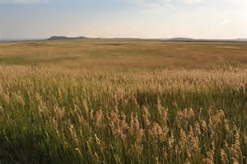
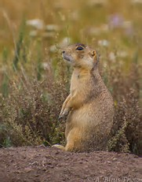
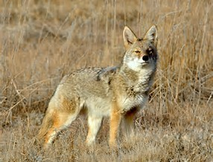

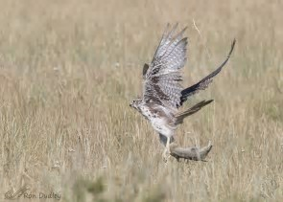

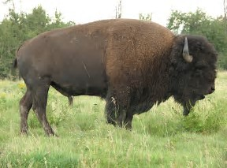
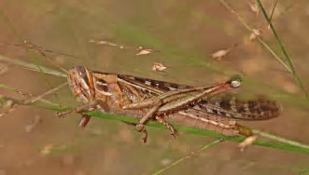
Meet our Characters
Notes:
To insert proper pictures....

Slide 71

Food Wed

Slide 72

American Bison
Notes:
Comprehension- can they identify and hence do they understand the terms in a context- choose the correct vocabulary- no hints- information presented and given physical - sets group up with relevant background knowledge - give them questions to see if they understand - read between the lines - what has our intro really told us?
E.g what type of consumer is a bison
What does migrant mean etc

Slide 73
Activity
Split your group up, and each take one page looking at the factors associated with having American Bison on the Prairie.
Use your workbook to summarise the information before sharing it with your group
Notes:
The ecological importance of bison
in mixed-grass prairie ecosystems
Dr. Sylvia Fallon, Staff Scientist Natural Resources Defense Council
Extract the data:
Look at all the positives of bision.
No headings just an article
Ask them to extract points and come up with a snappy heading?

Slide 74

How will your story end?
Summarise the pros and cons
Consider the following:
  Has the reintroduction of
  American Bison been worth it?
Report back to your group, discuss a conclusion for your story – feel free to note points in your workbook
Notes:
Bison have a unique ecology that has profound effects on mixed-prairie ecosystems. Their grazing style provides spatial and temporal heterogeneity which benefits plant and animal species diversity. Bison also increase overall plant productivity by enhancing nutrient cycling and nitrogen availability. Their distinctive behavioral trait of wallowing further creates spatial patchiness of resource availability and boosts plant species composition. Finally, predators and scavengers benefit from consuming bison while the remains confer rich nutrients to prairie soils and plant communities.
Dr. Sylvia Fallon, Staff Scientist Natural Resources Defense Council

Slide 75

Discussion Time
Notes:
Keystone Species
Current conservation of keystone species
Are different strategies needed for different animals- e.y Apex Preditors such as the Tiger

Slide 76

The American Bison is a Keystone Species

Slide 77
Food Wed
Notes:
Appreciate more so how the Bison plays a major role in the wider food web – hence keystone

Slide 78


Amur Tiger is a Keystone species
Notes:
Are different strategies needed for different animals- e.y Apex Preditors such as the Tiger
Is it safe for the human population to have an abundance of tigers?
What about live stock?
Trackers important, education important
What would the ecosystem look like without tigers
Do humans need to reconsider their interactions with nature in those areas

Slide 79

Thank You
For more information about education workshops or school modules
education@taytopark.ie

Slide 80
Junior Cycle Science:
Playing with the Thorny Issues
Science Gallery Dublin

Slide 81

Our mission is to ignite creativity and discovery where science and art collide

Slide 82
Video removed from here

Slide 83

NEW IDEAS
CREATIVITY
RESEARCH
INNOVATION
OBSERVATION
COLLABORATION
EXPERIMENTATION
SPECULATION
PHILOSOPHY
CRITICALITY
DISCOVERY
DEBATE
ART
SCIENCE

Slide 84


Slide 85

What’s the difference between a collapse, a downfall, and a downright apocalypse? How will it all end, and why do we love to wonder? Ice or fire, zombies or bombs? Out with a bang or a whimper? And can we do anything to stop the decline?

Slide 86
Video removed from here

Slide 87
START
CHOICE A
CHOICE B
Resulting Scenario 1
Resulting Scenario 2

Slide 88
Choice slides imputed from here
Scenario
A
B

Slide 89
A resulting scenario

Slide 90
B resulting scenario

Slide 92
Pick a scenario or devise your own
It is 2053 and 88.4% of Irish people are obese
In a crime-ridden future, satellite data and face recognition technology can be combined to locate criminals from space and pre-empt serious illegal actions.
The human population is under threat from a deadly virus and about 0.5% of the population carry a gene that gives immunity. Biotechnicians and geneticists have come up with a way to catalogue the genetic information of all citizens on a DNA database and use the naturally immune members of the population
Notes:
The human population is under threat from a deadly virus and about 0.5% of the population carry a gene that gives immunity. Biotechnicians and geneticists have come up with a way to catalogue the genetic information of all citizens on a DNA database and use the naturally immune members of the population
In a crime-ridden future, satellite data and face recognition technology can be combined to locate criminals from space and pre-empt serious illegal actions
With new innovative shoal detection technologies and sophisticated boat/netting design, we have the possibility of increasing the capture of Atlantic Cod and boosting our food supplies for developing countries
In the future communications devices such as TVs, phones and tablets have become increasingly cheap to buy and use, and every home can run up to 5 screens at a time at a low cost
Plants that depend on pollination make up 35% of global crop production volume. Aggressive agricultural practices have wiped out 93% of pollinating insects

Slide 93
A few things to consider:
Who are the key players?
What are the potential ethical challenges?
Can you progress from this topic to related issues in other areas of STEM – e.g. turning to AI, genetic modification, geoengineering?
Can you progress from this topic to economics, politics, sociology etc?

Slide 94
Discussion Questions:
Could/would you use this as a teaching tool?
What learning outcomes from the Junior Cycle Science specification could be experienced?
What are the potential stumbling blocks – operational and/or content?
Other questions or comments?

Slide 95
Thank You!
Come to our educators get-together in SGD on December 4th between 5.30pm and 8pm – spend some time in a relaxed setting developing this and other resources with other educators over a beverage of your choice – and please bring along a non-science teacher!
Leave your email address today or contact education@dublin.sciencegallery.com to sign up to our Education mailing list to hear about what’s coming up
Come visit Science Gallery Dublin – contact tours@dublin.sciencegallery.com for info about tours
Encourage your students to sign up for our TY Mentoring Weeks through our website: dublin.sciencegallery.com/education

Slide 96


T
H
N
K
s
https://www.surveymonkey.com/r/2D7ZRPW
Notes:
Thanks ---
Feedback link
Going forward

