Slide 1
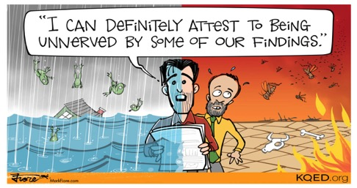

St Louis Science
Global Citizenship Education
Lizzy Noone
WorldWise Global Schools
3rd of February, 2018
Notes:
Moving Debate
Root causes
Video Global Inequality

Slide 2

Hopes & Fears
- What do you HOPE to get out of todays session?
- Any FEAR about todays session?

Slide 3



Housekeeping
Put on Speaker View
To mute and un-mute
Turn your camera on
Please use the chat function

Slide 4





Aims of the WWGS Programme
Notes:
The WWGS programme aims to:
familiarise learners with the concepts of interdependence, development, globalisation and sustainability
enable teachers to move learners from a charity mentality to a social justice mentality
community of practice that stretches across regions and continents. An informal and flexible network that can share experience and resources
stimulate critical thinking about global issues, both at a whole school and learner level help schools promote greater awareness and understanding of global justice issues.

Slide 5

What is Global Citizenship Education?
“an educational process aimed at increasing awareness and understanding of the rapidly changing, interdependent and unequal world in which we live”
By challenging stereotypes and encouraging independent thinking, GCE helps students critically explore the root causes of global justice issues and how they link with our everyday lives
GCE inspires solidarity by supporting people to realise their full rights, responsibilities and potential as global citizens in order to take meaningful action for a just and sustainable world

Slide 6
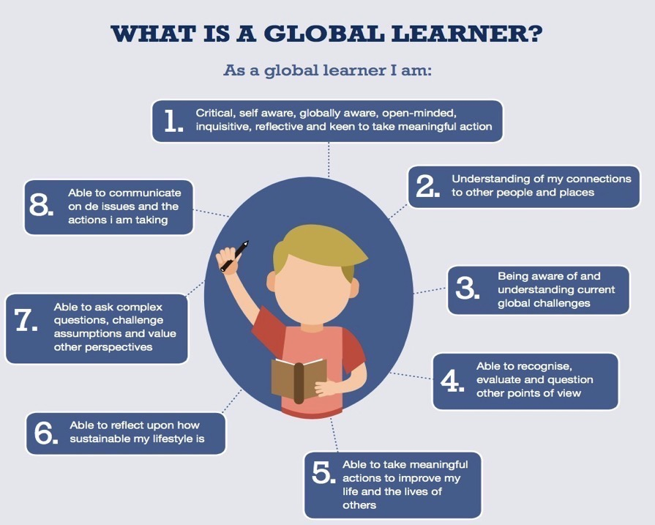

Slide 7
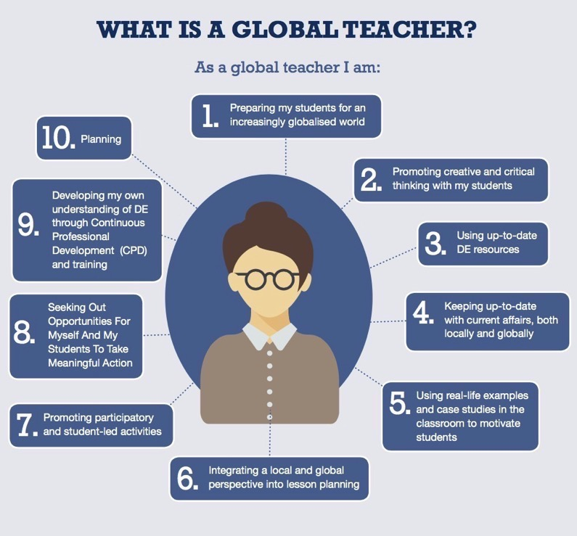

Slide 8
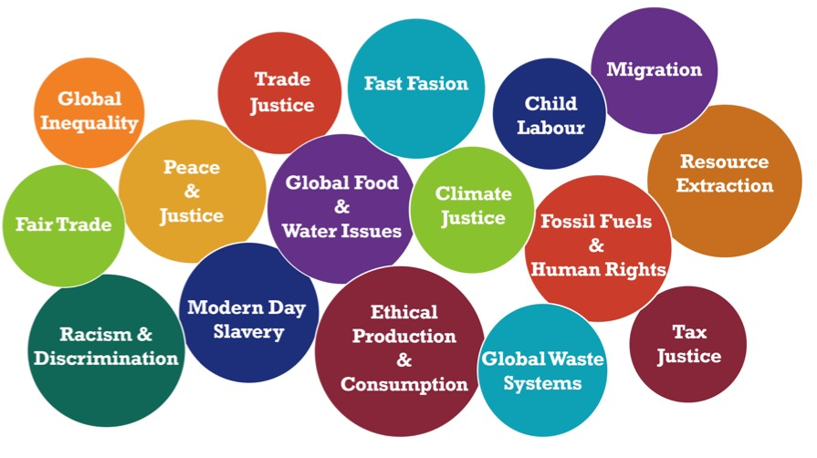
Global Citizenship Education Themes

Slide 9
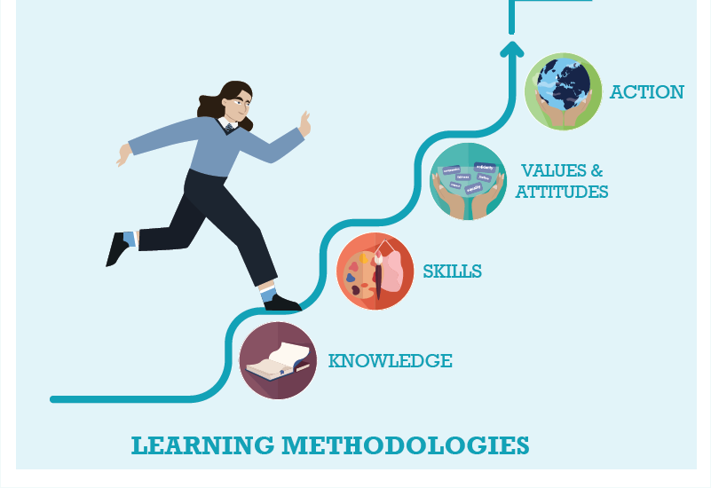



WWGS: 6 Step Programme
Anti-Racism: from Knowledge to Action
Page
22
Notes:
Knowledge – understand the meaning of racism –Individual, Institutional, Structural (or societal) Historical
Values - empathy respect for diversity and tolerance, and inclusiveness, ensure diverse voices are heard
Skills – Student feel confident to talk about racism and to act in anti-racism ways
Action – Take action to create anti-racist spaces

Slide 10

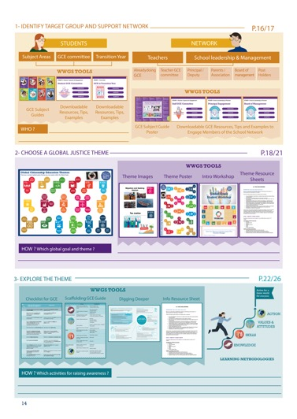
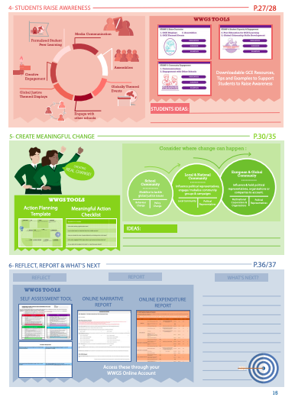
Page
14-15
Notes:
Briefly talk through the 6 steps

Slide 11

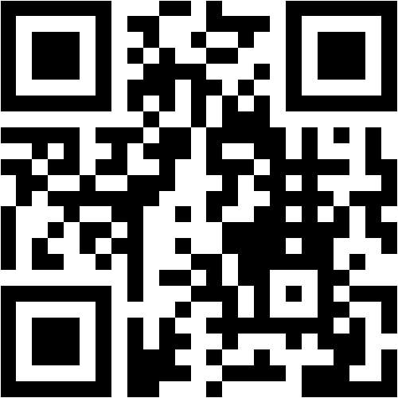
https://www.menti.com/s7vgux1xtw
Name 3 areas-
Consider the different disciplines:
-Chemistry
-Biology
-Physics

Slide 12

TASK:
Consider:
What opportunities are there to explore
Global justice themes in Science?
Pick a Strand if you’d like to narrow it down.

Slide 13








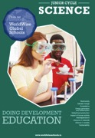




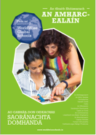


GCE and the Curriculum
Available in Irish
Notes:
WWGS Provide subject specific resources to support teachers integrate GCE into their subject areas.
Go to the ”Tools” section of our website to download these.

Slide 14
DE Links with the Curriculum
Junior Cycle | Senior Cycle
Key Skills Subject Specifications New Junior Cycle: Key Skills Subject Specifications Statements of Learning (SOL) | Key Skills Subject Specifications
Education for Sustainable Development
Strategy developed-opportunity to develop a ESD policy in the school
Well being Framework
-Feeling Connected

Slide 15
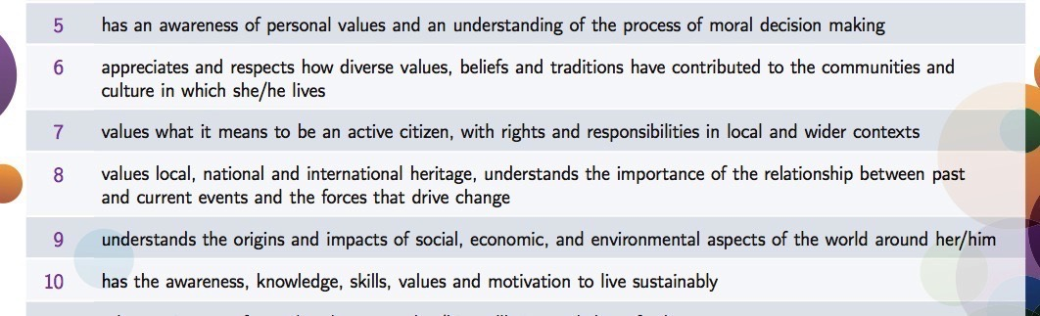
Very Strong DE Links
SOL 5-10
That’s a quarter of all SOL!!

Slide 16
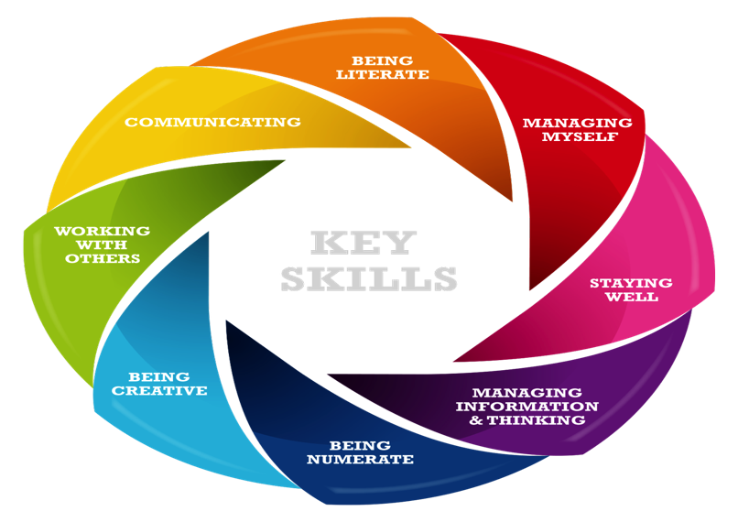
Key Skills-Junior Cycle
Task: Look at the Action Verbs put a dot on the ones you think are similar to GCE Skills
Notes:
Gaeilge, English, Modern Languages, History, Geography, CSPE, Mathematics, Physics, Chemistry, Biology, Accounting, Business, Economics, Music, Agricultural Science

Slide 17


The nature of things around us: Some properties of matter; measurement; the nature of matter
B. Some effects of energy: Energy; some effects of heat on matter; movements of living and non-living things; making work easy (machines)
C. Life activities: New life from old life; seeding in plants and animals; uses of food in living things; getting rid of waste materials from the body
D. Humans and their environment: Crop production; raising animals; food processing; a balanced diet; hygiene and health.

Slide 18
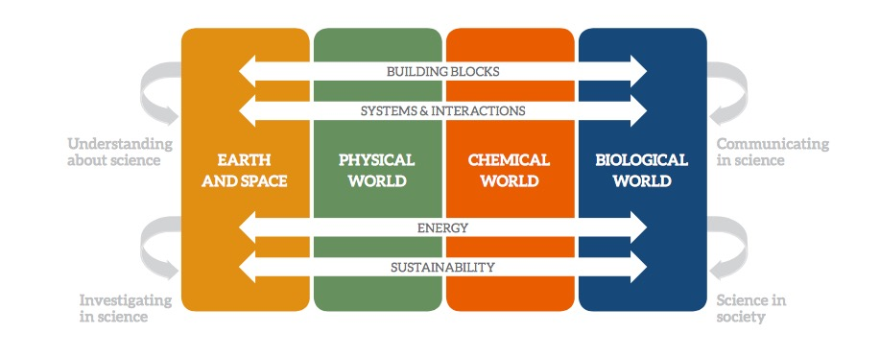
Science-The elements of the contextual strands

Slide 19

What do we mean by Sustainability?
Environmental
Sustainability
Social
Sustainability
Task Part 3: In groups
In your group, you must come up with a definition for sustainability/sustainable development (5 minutes)

Slide 20
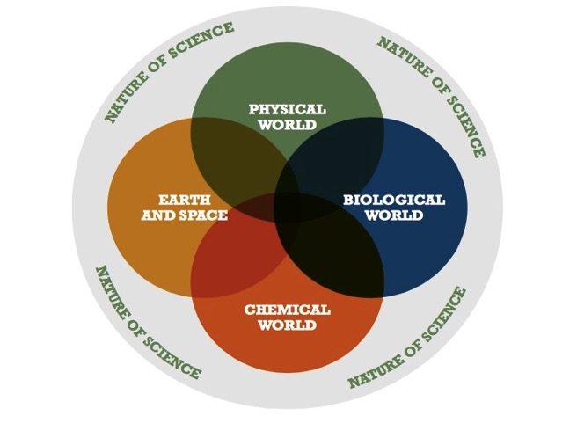
The strands of the specification for junior cycle science

Slide 21
STRAND THREE: CHEMICAL WORLD | STRAND ONE: THE NATURE OF SCIENCE
Strand element: Sustainability | Strand element: Science in society
Students should be able to: LO 10. evaluate how humans contribute to sustainability through the extraction, use, disposal, and recycling of materials. | Students should be able to: LO 9. research and present information on the contribution that scientists make to scientific discovery and invention, and its impact on society LO 10. appreciate the role of science in society; and its personal, social and global importance; and how society influences scientific research.

Slide 22
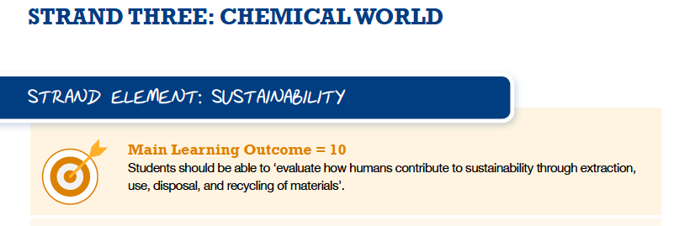
Extraction | Use | Disposal | Recycling
1. 2. 3. | 1. 2. 3. | 1. 2. 3. | 1. 2. 3.

Slide 23
Life Cycle Activity
https://www.youtube.com/watch?v=eg-E1FtjaxY
What is a product life cycle?
A life cycle is the different stages a product will go through, from it first being created to it no longer being used.
Task: In groups-discuss all the stages from extraction to disposal (or reuse??) that the product will go through:
Consider:
The materials needed
The scientific processes needed for each stage
Human rights considerations at each stage
Environmental considerations at each stage
Your group may have:
A plastic fork
A mobile phone
A coffee cup

Slide 24
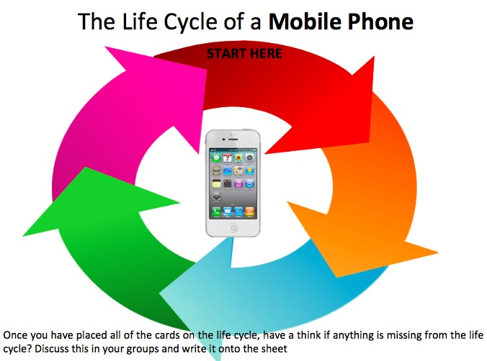

Slide 25
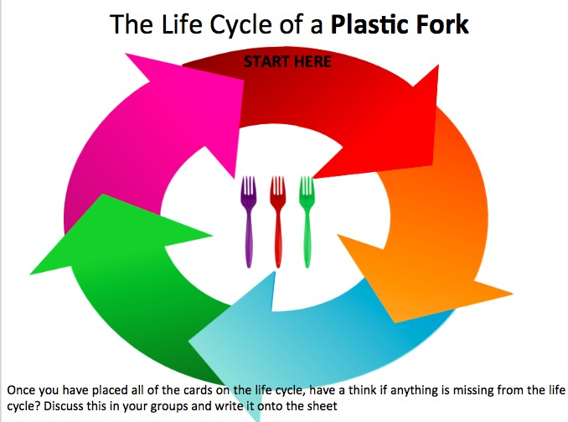

Slide 26


The life cycle of a coffee cup
Once you have placed all of the cards on the life cycle, have a think if anything is missing from the life cycle? Discuss this in your groups and write it onto the sheet

Slide 27
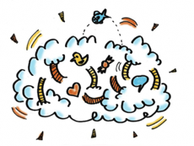
Reflection
What parts of the lifecycle could we do better to ensure wellbeing of people and planet?
Environmental, Social, Ecological, Economic Sustainability

Slide 28
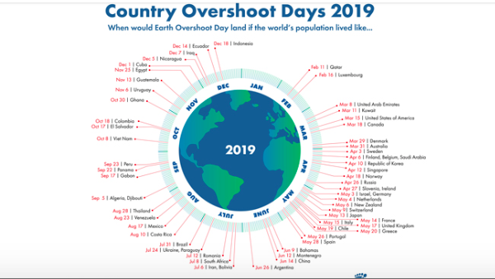
Notes:
The pandemic gave us a chance to appreciate nature and gave us a glimpse into what a fossil free future might look like offering a break from addictive consumerism (one would hope!)
George Monibot said that’ it [the pandemic] has to be a tipping point. This has to be a point to transform where we move from one system an exploitative political and economic system to a completely different one private sufficiency and public luxury.

Slide 29
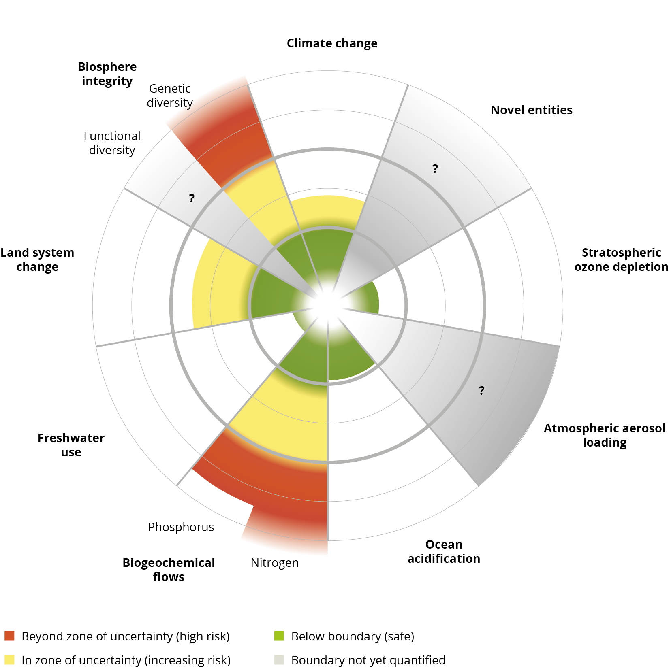
Planetary Boundaries-4 of the 9 have been crossed as a result of human activity-which ones???

Slide 30
Boundary Climate Change Biodiversity Loss Ocean Acidification Land Use Change Nitrogen and Phosphorous Loading Freshwater Use Atmospheric Aerosol Loading Biogeochemical Flows-Chemical Pollution Ozone Depletion | Limit 350ppm 10 species per million 25%conversion of forested land | Status Quo TOO HIGH! 415ppm boundary crossed in 1990 TOO HIGH! Nearing TOO HIGH TOO HIGH! TOO HIGH!

Slide 32
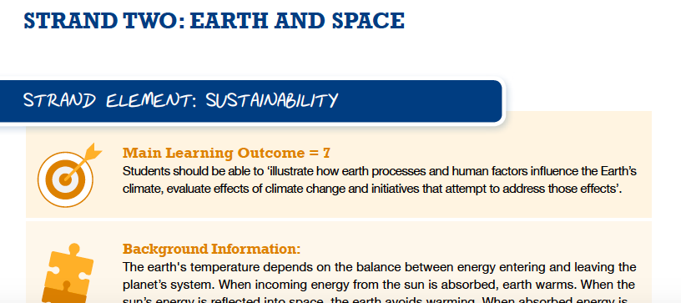

Slide 33
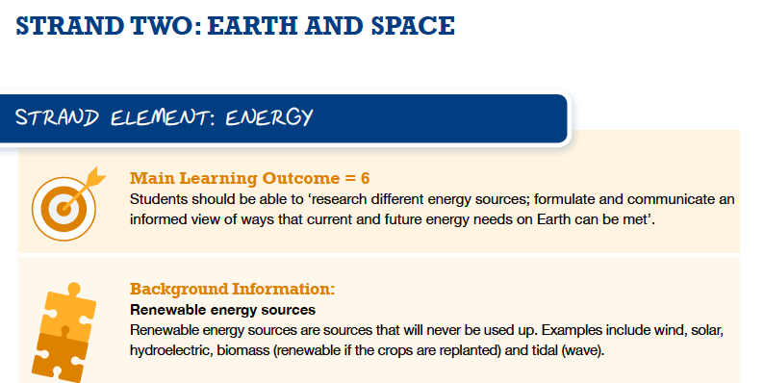

Slide 34
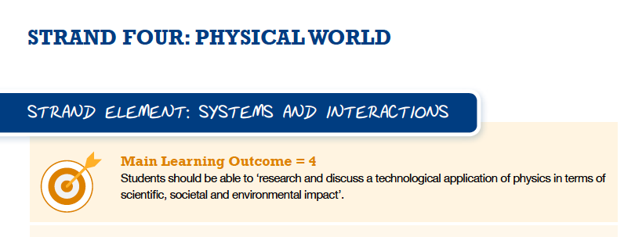

Slide 35
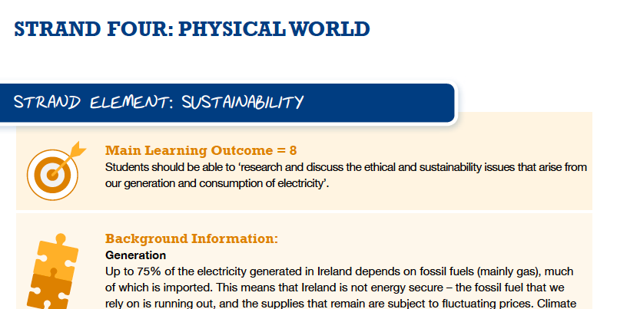

Slide 36
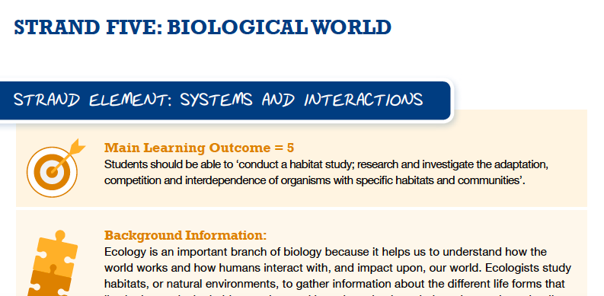

Slide 37
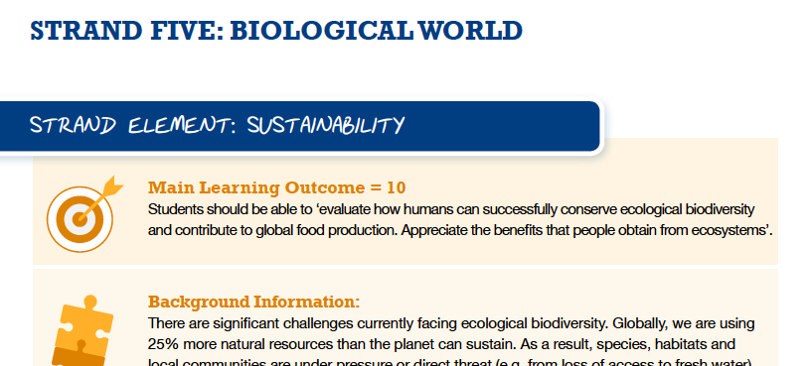

Slide 38
Science in Society
Pair and Share!
Consider global current affairs:
How has science influenced policy and politics?

Slide 39
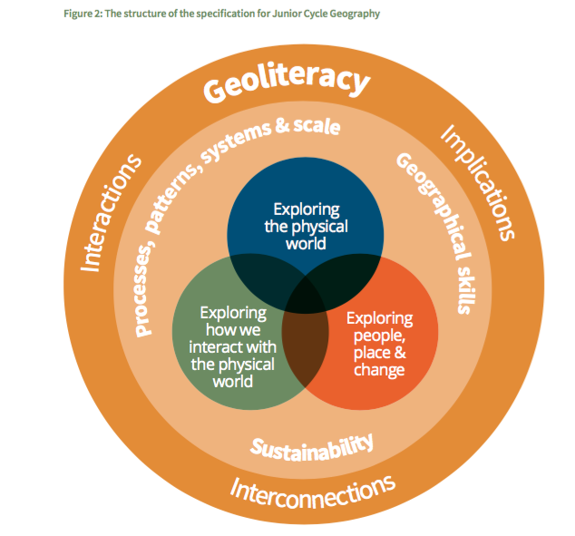

Slide 40
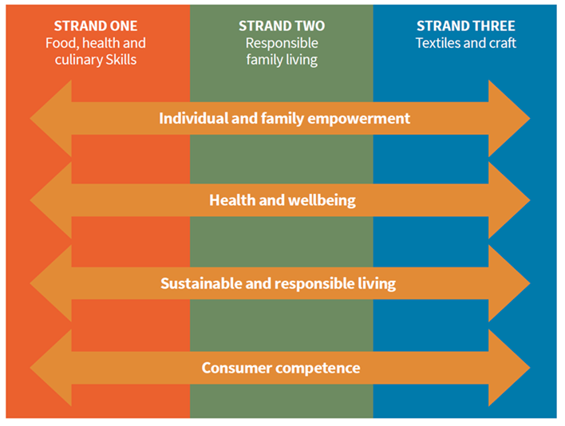

Slide 41
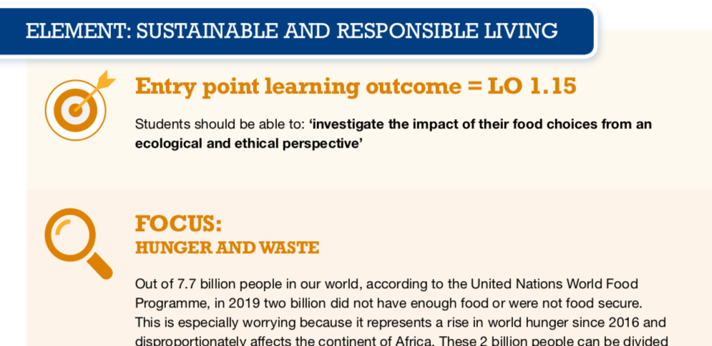

Slide 42
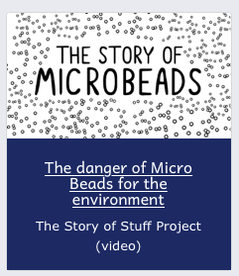


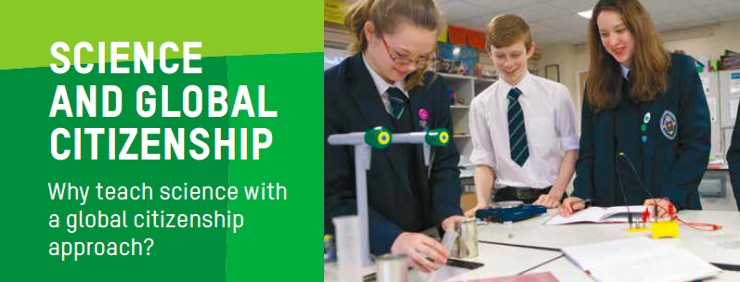
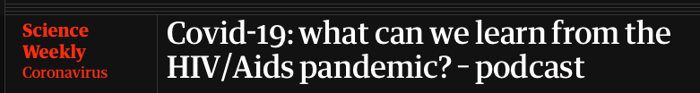
STEP 3: EXPLORE THE THEME
TEACHING AND LEARNING MATERIALS: Resources

Slide 43
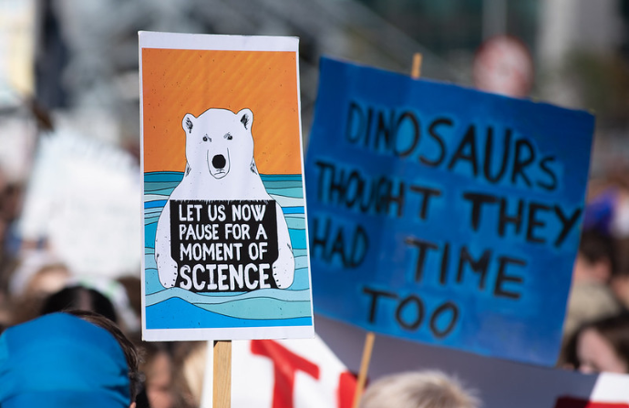

Slide 44
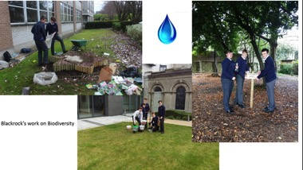
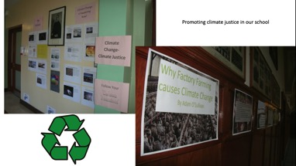
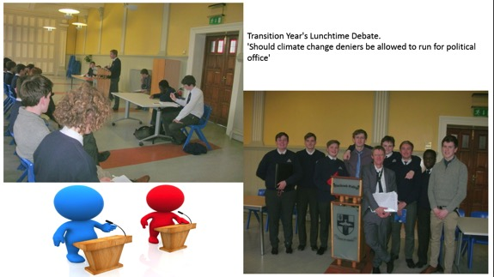
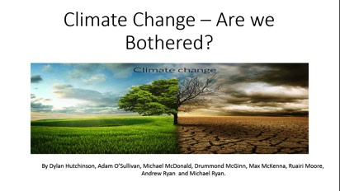

Slide 45
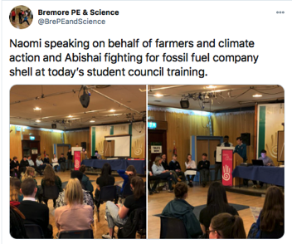
Eadaoin Twohill
St Oliver’s Community School, Drogheda
‘All Junior Cycle students explore:
working on water cycle and carbon cycle - links here to life on land and life below water. i also went into water treatment, water consumption and water conservation which link to a few goals too (12 and 6)
looking at how human factors influence the earth's climate and evaluating initiatives that attempt to address those affects. In my class we looked at making changes to transport, eating less beef, recycling better and reforestation as initiatives. (Goals 13, 7, 12)
ethical and sustainability issues around electricity generation - we looked at child working conditions in Colombia mines to help us discuss ethical issues around electricity generation how humans contribute to sustainability through extraction, use, disposal and recycling of materials - most teachers do plastics here and a few of us have done conflict metals too (goals - 8, 12)’
‘In Science class, we calculated the food miles of various foods, the benefits of reducing food miles and way we could do this.
We made posters on the life cycle of food and gave advice on how we could make each stage more sustainable.
We did group projects on plastics- reducing consumption, reusing and recycling as well as focusing on 5 global issues including pollution, global warming, plastics for the sustainable world.’

Slide 46
‘In Junior Cycle Science sustainability is a major theme. The carbon-cycle is explored and also fuel consumption. An interesting Jigsaw activity looked at the cause and effect of irresponsibility with energy resources and how this has an effect on Climate Change. There was an analysis of carbon dioxide levels increasing in the atmosphere over time and also students looked at sea levels figures and discussed the reasons why they are rising. There was a cross-curricular approach with CSPE on the whole issue of Waste Management. Parents were informed and students encouraged recycling and composting in the home as a result.
Second year science students explored different ways of harnessing the sun's energy.
A definite link between Junior Cycle Science and Construction studies was also explored under the umbrella of the importance of trees.
Controlled forestation was explored. In Woodwork the importance of reusing and re=constituting timber and cut-offs was put into practice’.
Jenny Murray, Ballyhaunis Community School

Slide 47
In Science pupils are taught about the environmental impact of climate change and the percentage increase in CO2 in the earths atmosphere from 0.03% to 0.04%. In Year 12 students calculated their carbon footprint from worksheets obtained online and investigated how they could reduce it.
St Louis SS Kilkeel
‘In Science class they look at issues concerning our biodiversity and climate change. What action can they take to help reduce their impact? This offers opportunities to link the work done in class to the extra curricular work in our Green Schools projects and the work of the Student voice’.
Linda Reilly, Ardscoil Phobail, Granard

Slide 48
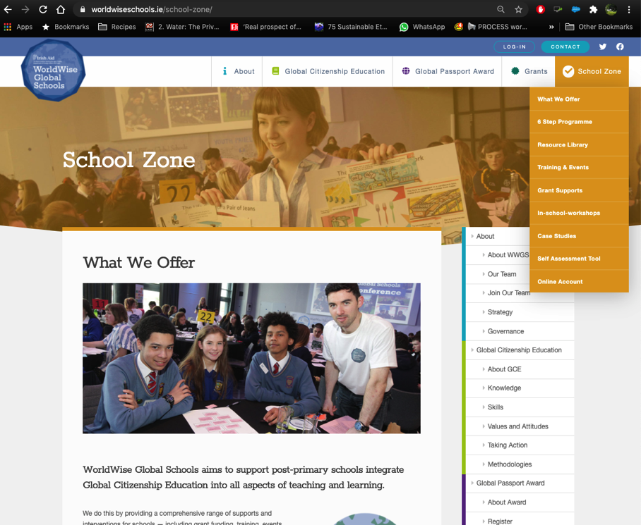

Slide 49
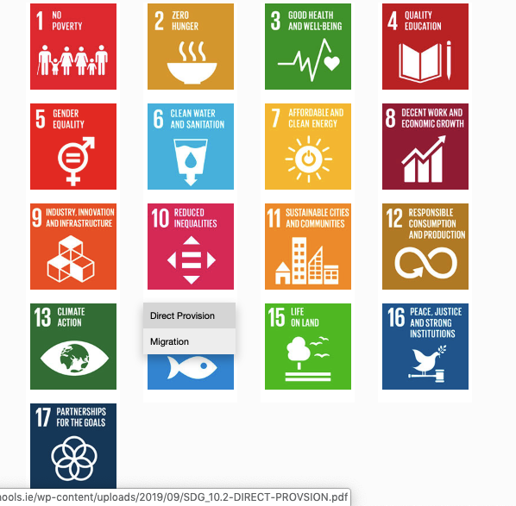
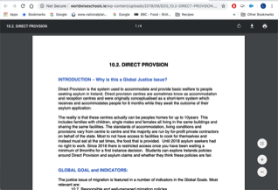
1. Hover over the symbol and a drop down menu appears!
2. Click on the theme and the resource sheet will pop up!
Notes:
Intro to thematic information sheets

Slide 50
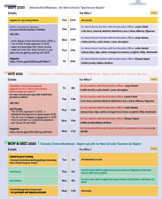
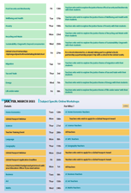
Upcoming Dates
Thematic Training Sessions
November
- Recycling & Food Waste: Mon 23rd
- Sustainability/ Degrowth: Wed 25th
December
- Migration: Tues 1st
- Tax & Trade: Thur 3rd
- Energy: Mon 7th
- Life Under Water: Wed 9th
- Wellbeing & Health: Fri 11th
Recordings available
Critical Approach
Anti-Racism: Thur 5th-
-Fast Fashion: Mon 9th
- Food Security & Biodiversity: Fri 13th
School Management Symposium
Wednesday 11th November!
Global Passport Award
Webinar 17th of November
Notes:
In terms of the breakdown of trainings, outline the 5 types of training
Purple – starter trainings – (today) for new schools and teachers new to GCE (perhaps their school has been involved longer)
Pink – WWGS approach and adapting to covid-19 – for ALL schools and teachers. Even for schools who have been involved for a while. Updated theory and practice
Green – Thematic areas
Blue – subject specific
Yellow – standard WWGS trainings and events. And deadlines.

Slide 51


Thank you!
Questions???
Lizzy.noone@worldwiseschools.ie
www.worldwiseschools.ie

