Slide 1

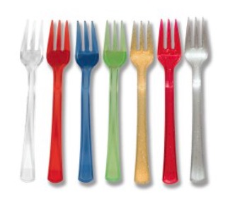
The life cycle of a plastic fork
Once you have placed all of the cards on the life cycle, have a think if anything is missing from the life cycle? Discuss this in your groups and write it onto the sheet

Slide 2
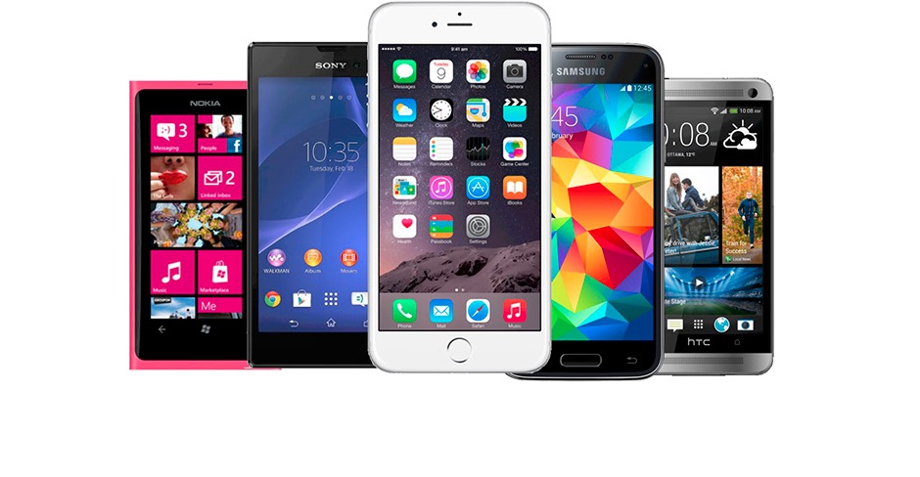
The life cycle of a mobile phone
Once you have placed all of the cards on the life cycle, have a think if anything is missing from the life cycle? Discuss this in your groups and write it onto the sheet

Slide 3

The life cycle of a coffee cup
Once you have placed all of the cards on the life cycle, have a think if anything is missing from the life cycle? Discuss this in your groups and write it onto the sheet

