Slide 1
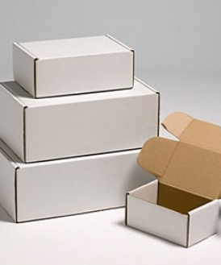
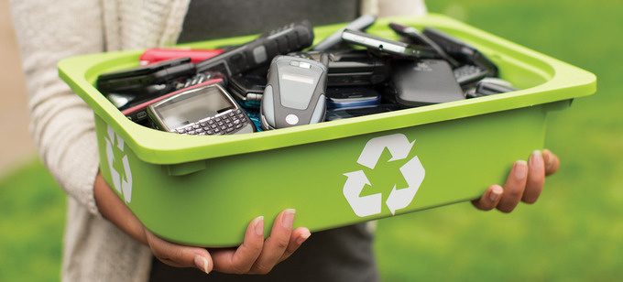
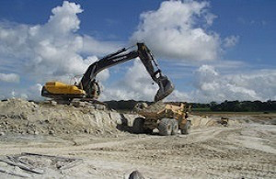
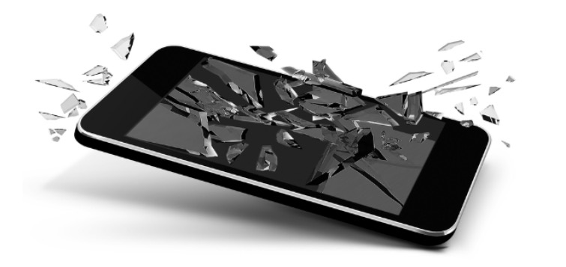
The packaging is to protect the product but also to provide information about it. Often the packaging is excessive and it normally becomes waste. Lately, more is being recycled.
Millions of phones are discarded. Lately many organisations allow phones to be reused and recycled. Those are are not suitable to be used again can be separated properly to take out the parts that still work and recycle the other parts.
A phone is made up of many materials. A phone consists of 40% metals, 20% ceramics and 40% plastics. Most raw materials must be processed before manufacturers can actually use them .
Often peoples phone only last a few years or can break.

Slide 2

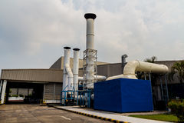
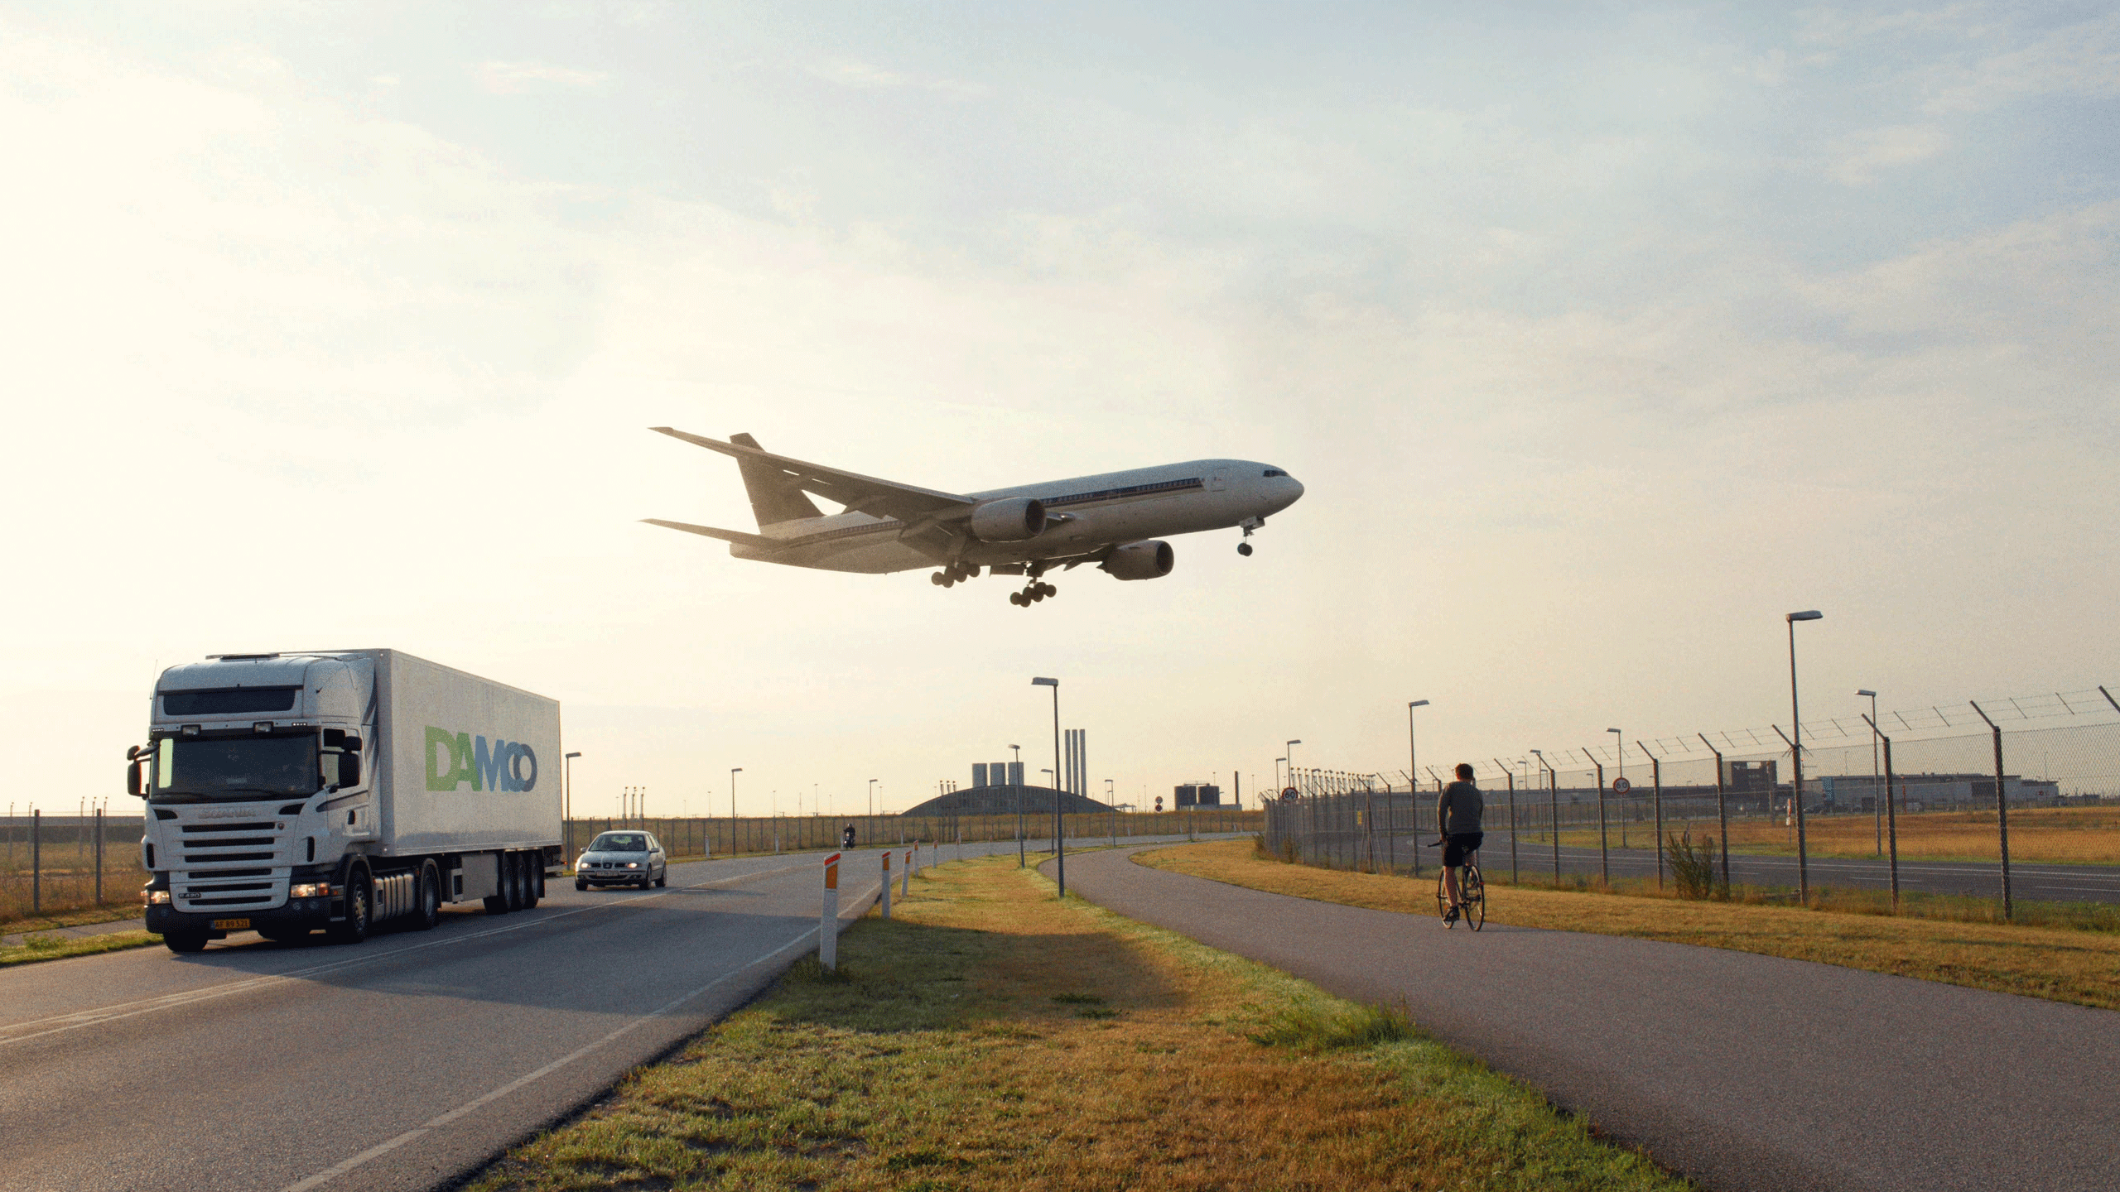
Consumers like to have the latest in technology and might go through many mobile phones in their lifetime. Some might even own two, perhaps a work and personal phone. Phones are advancing at a fast pace that some people constantly replace their phones.
The manufacturing of each part is held in several different places, sometimes all around the world and can travel long distances to the assembly point where the final phone is put together. E.g. the battery might be made in a different part than the plastic for the phone cover.
Each part of the phone has to be transported to the manufacturing center. Sometimes the distances are excessive. Then the phone needs to be transported to each of the retailers around the world who sell the product to the consumer

Slide 3
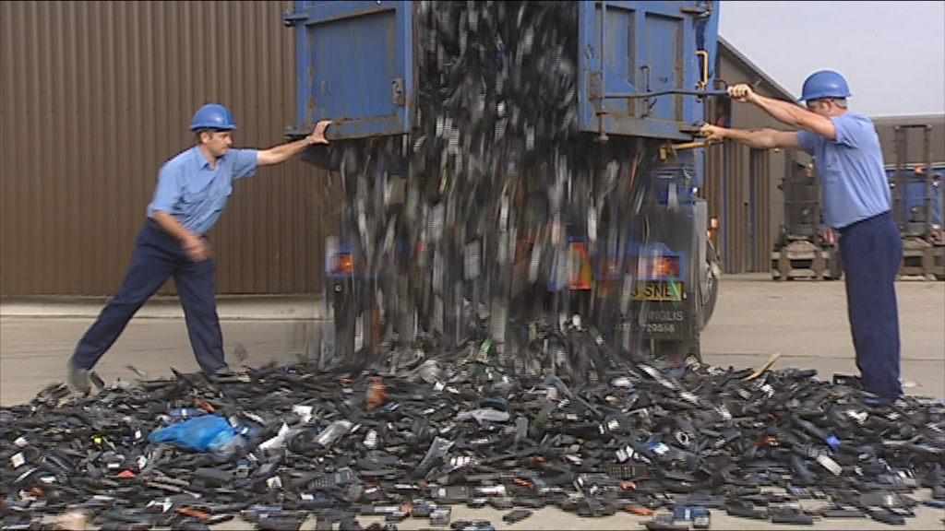
Due to the race between companies to try and out do each other by having the best product in the market results in large numbers of phone to be disposed off. Most if not all of them end in cellphone land fills where they pile and pile, these piles are expected to go no where. This can cause very harmful environmental problems

Slide 4
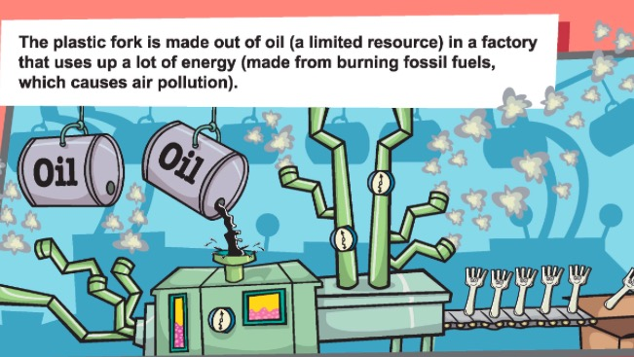
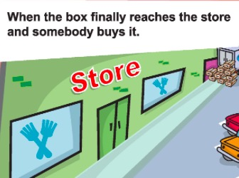
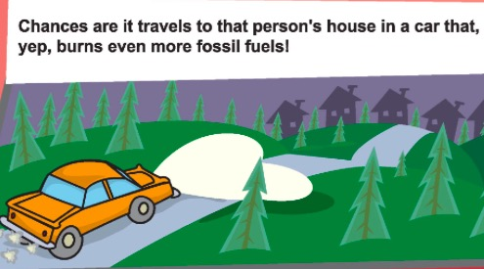
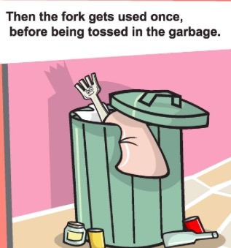
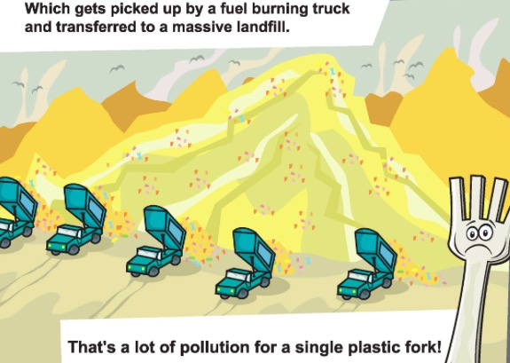

Slide 5
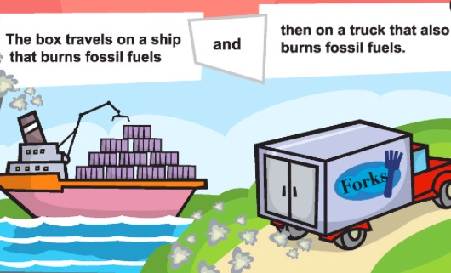
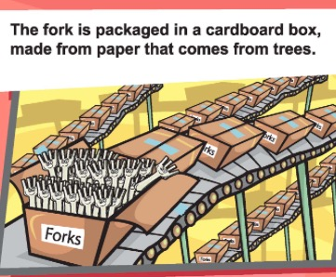

Slide 6
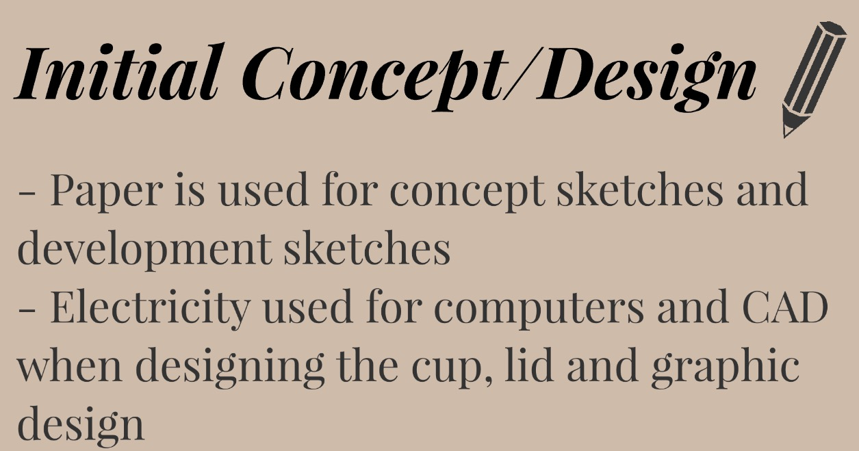
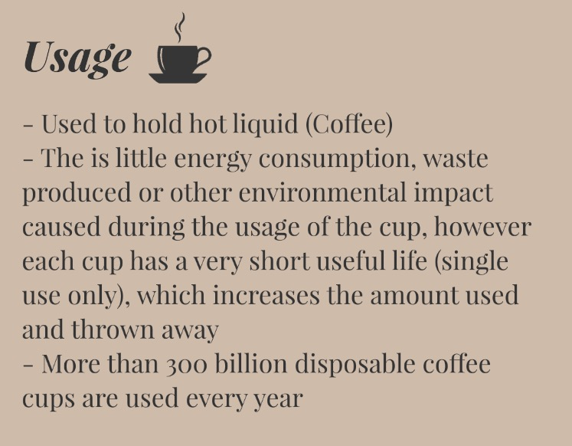

Slide 7
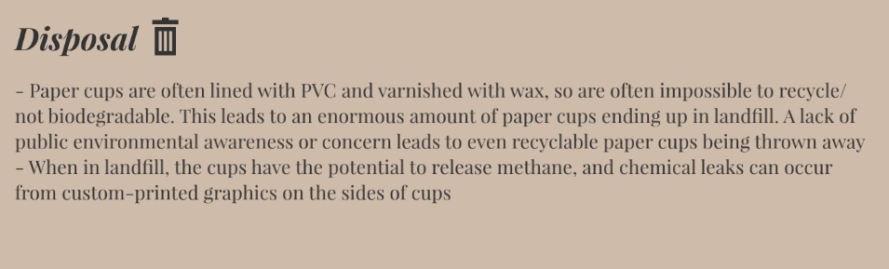
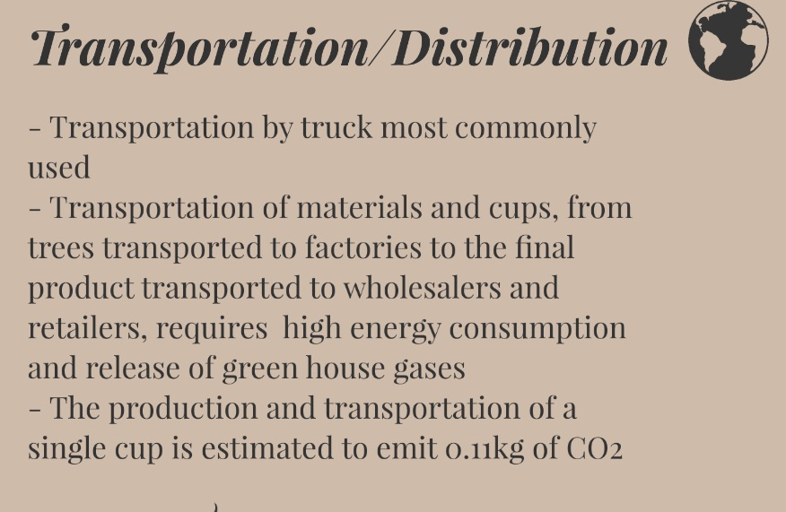

Slide 8
