Slide 1
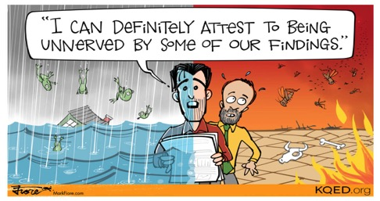


Science and
Global Citizenship Education
Lizzy Noone
WorldWise Global Schools
Notes:
Moving Debate
Root causes
Video Global Inequality

Slide 2
What is Global Citizenship Education?
“an educational process aimed at increasing awareness and understanding of the rapidly changing, interdependent and unequal world in which we live”
By challenging stereotypes and encouraging independent thinking, GCE helps students critically explore the root causes of global justice issues and how they link with our everyday lives
GCE inspires solidarity by supporting people to realise their full rights, responsibilities and potential as global citizens in order to take meaningful action for a just and sustainable world

Slide 3




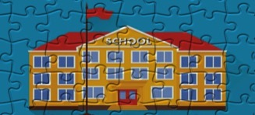
Aims of the WWGS Programme
Notes:
The WWGS programme aims to:
familiarise learners with the concepts of interdependence, development, globalisation and sustainability
enable teachers to move learners from a charity mentality to a social justice mentality
community of practice that stretches across regions and continents. An informal and flexible network that can share experience and resources
stimulate critical thinking about global issues, both at a whole school and learner level help schools promote greater awareness and understanding of global justice issues.

Slide 4
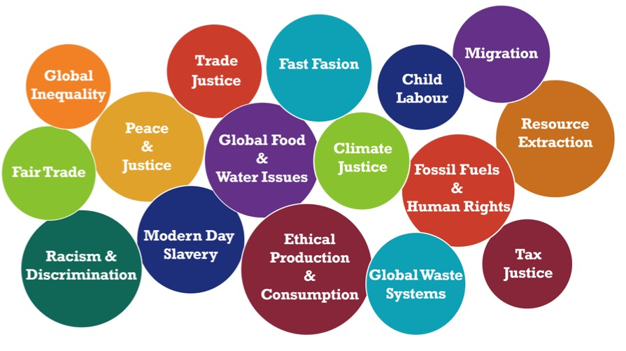
Global Citizenship Education Themes

Slide 5
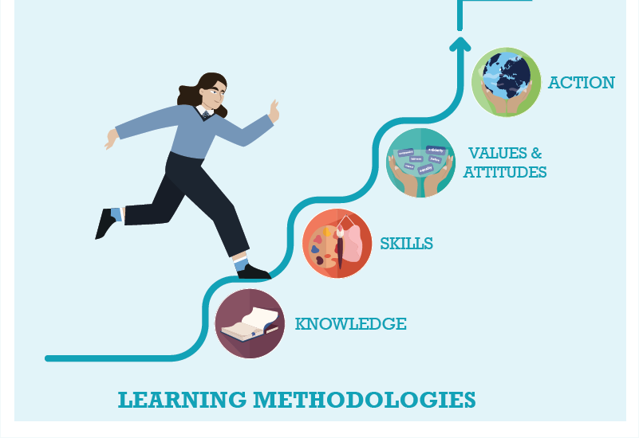



WWGS: 6 Step Programme from Knowledge to Action
Page
22
Notes:
Knowledge – understand the meaning of racism –Individual, Institutional, Structural (or societal) Historical
Values - empathy respect for diversity and tolerance, and inclusiveness, ensure diverse voices are heard
Skills – Student feel confident to talk about racism and to act in anti-racism ways
Action – Take action to create anti-racist spaces

Slide 6

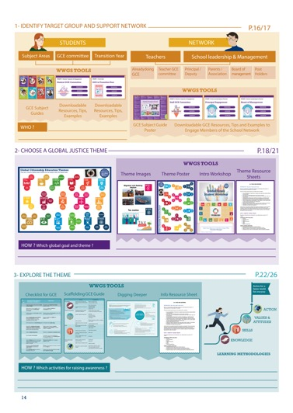
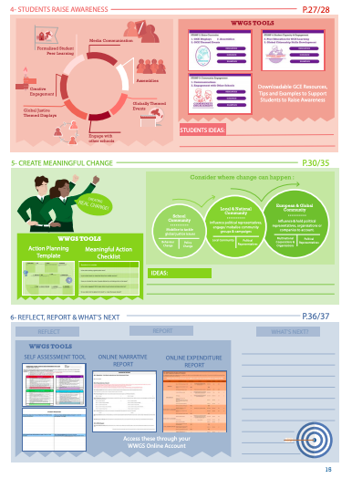
Page
14-15
Notes:
Briefly talk through the 6 steps

Slide 7

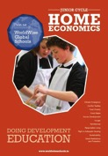



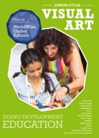


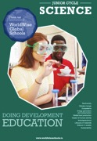

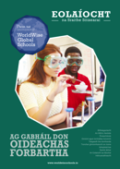


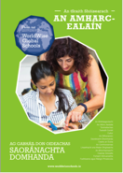


GCE and the Curriculum
Available in Irish
Notes:
WWGS Provide subject specific resources to support teachers integrate GCE into their subject areas.
Go to the ”Tools” section of our website to download these.

Slide 8
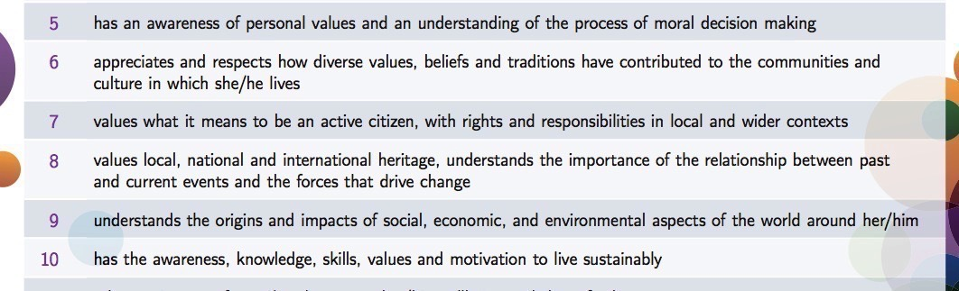
Very Strong GCE Links
SOL 5-10
That’s a quarter of all SOL!!

Slide 9
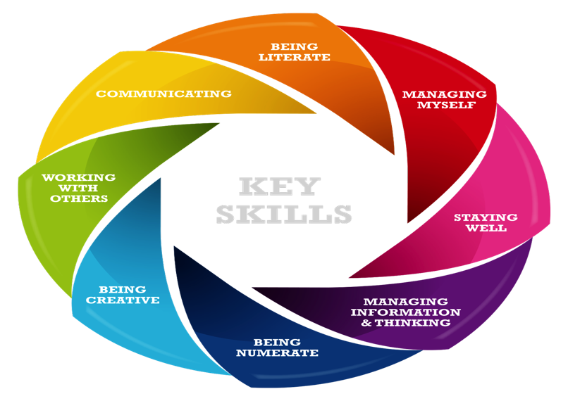
Key Skills-Junior Cycle
Notes:
Gaeilge, English, Modern Languages, History, Geography, CSPE, Mathematics, Physics, Chemistry, Biology, Accounting, Business, Economics, Music, Agricultural Science

Slide 10
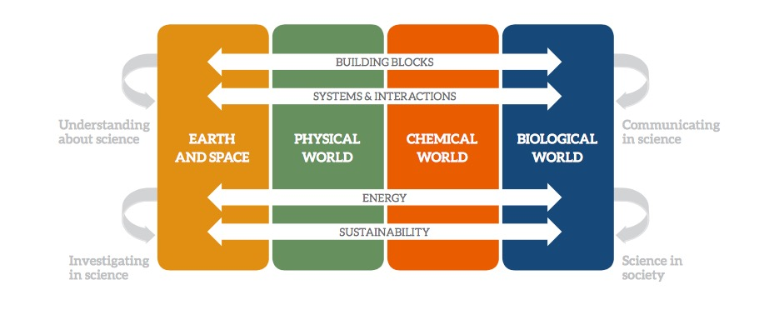
Science-The elements of the contextual strands

Slide 11
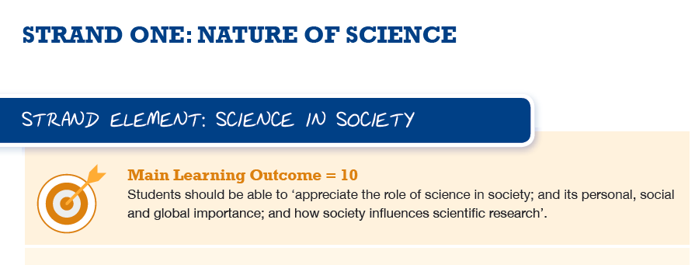

Slide 12
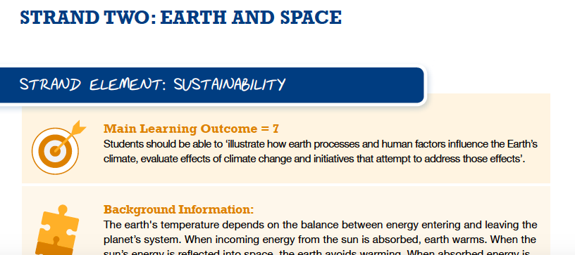
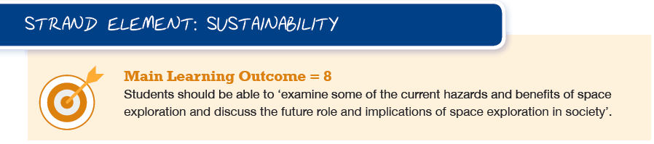

Slide 13
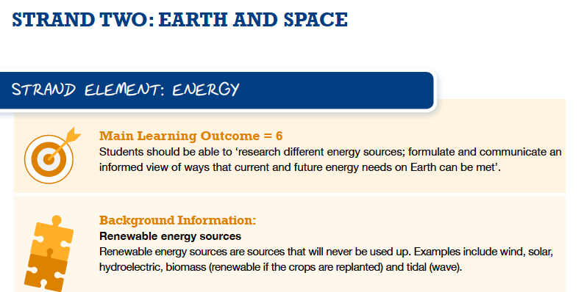

Slide 14
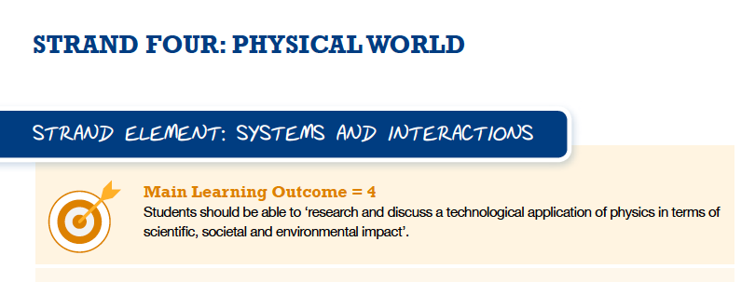
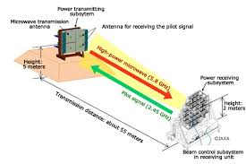

Slide 15
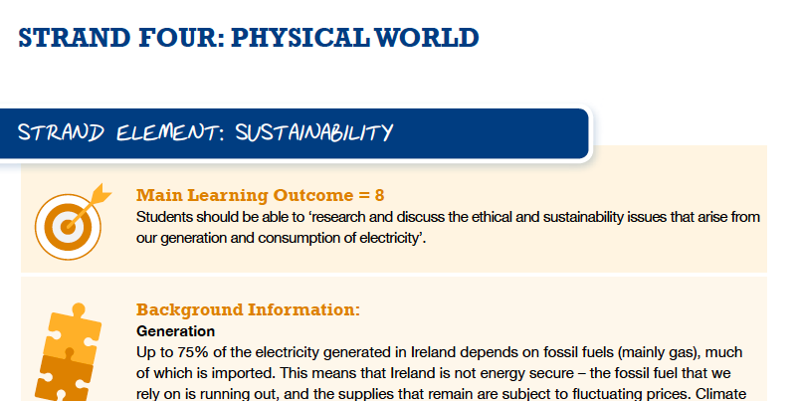

Slide 16
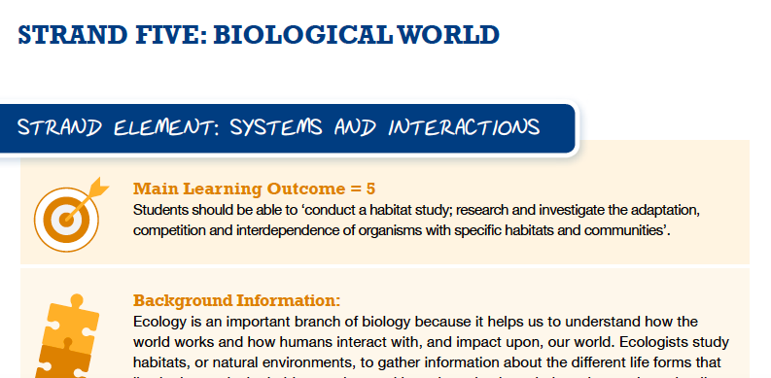

Slide 17
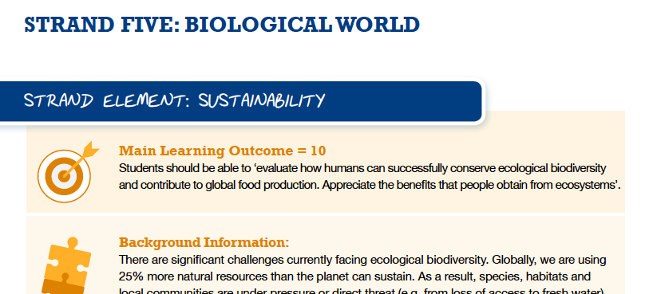

Slide 18
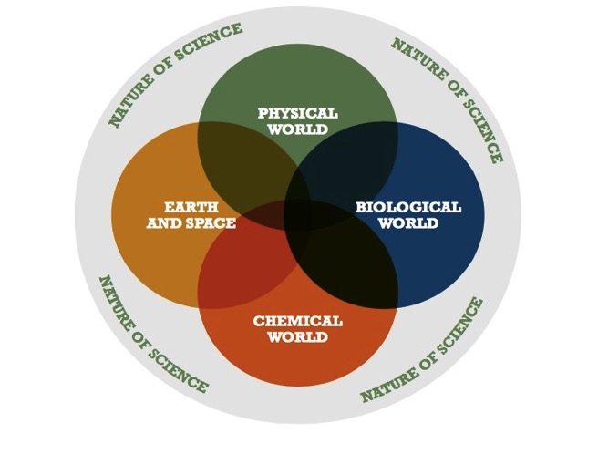
The strands of the specification for junior cycle science

Slide 19
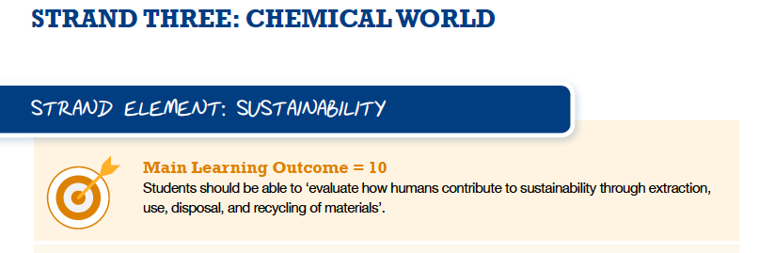
Extraction | Use | Disposal | Recycling
1. 2. 3. | 1. 2. 3. | 1. 2. 3. | 1. 2. 3.

Slide 20
Life Cycle Activity
https://www.youtube.com/watch?v=eg-E1FtjaxY
What is a product life cycle?
A life cycle is the different stages a product will go through, from it first being created to it no longer being used.
Task: In groups-discuss all the stages from extraction to disposal (or reuse??) that the product will go through:
Consider:
The materials needed
The scientific processes needed for each stage
Human rights considerations at each stage
Environmental considerations at each stage
Your group may have:
A plastic fork
A mobile phone
A coffee cup

Slide 21
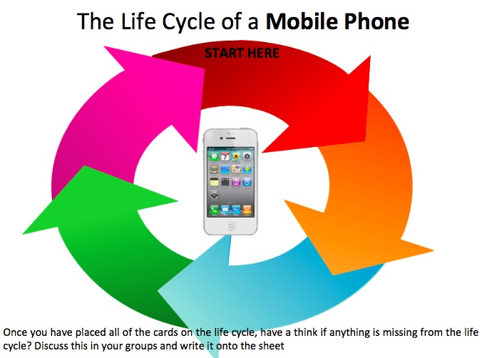

Slide 22
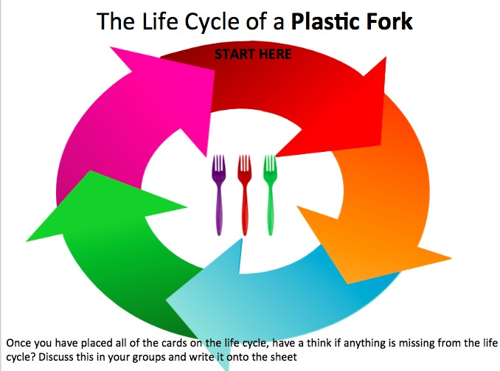

Slide 23


The life cycle of a coffee cup
Once you have placed all of the cards on the life cycle, have a think if anything is missing from the life cycle? Discuss this in your groups and write it onto the sheet

Slide 24
Reflection
What parts of the lifecycle could we do better to ensure wellbeing of people and planet?
Environmental, Social, Ecological, Economic Sustainability

Slide 25
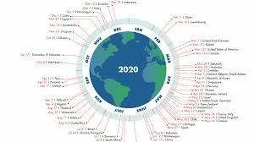
Country Overshoot Day
Notes:
The pandemic gave us a chance to appreciate nature and gave us a glimpse into what a fossil free future might look like offering a break from addictive consumerism (one would hope!)
George Monibot said that’ it [the pandemic] has to be a tipping point. This has to be a point to transform where we move from one system an exploitative political and economic system to a completely different one private sufficiency and public luxury.

Slide 26
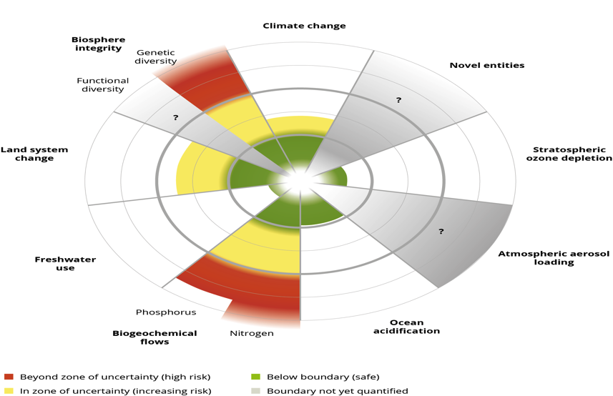
Planetary Boundaries-4 of the 9 have been crossed as a result of human activity-which ones???

Slide 27
Boundary Climate Change Biodiversity Loss Ocean Acidification Land Use Change Nitrogen and Phosphorous Loading Freshwater Use Atmospheric Aerosol Loading Biogeochemical Flows-Chemical Pollution Ozone Depletion | Limit 350ppm 10 species per million 25%conversion of forested land | Status Quo TOO HIGH! 415ppm boundary crossed in 1990 TOO HIGH! Nearing TOO HIGH TOO HIGH! Too HIGH Not finite TOO HIGH!

Slide 29
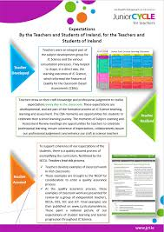
CBAs
Consider global current affairs:
How has science influenced policy and politics?
CBA 1: Experimental Investigation
-Societal Challenges of Europe-Eu Horizon 2020 Programme
• Health, demographic change and wellbeing;
• Food security, sustainable agriculture and forestry, marine and maritime and inland water research, and the bio-economy;
• Secure, clean and efficient energy;
• Smart, green and integrated transport;
• Climate action, environment, resource efficiency and raw materials;
• Europe in a changing world - inclusive, innovative and reflective societies;
• Secure societies - protecting freedom and security of Europe and its citizens.
CBA 2: Science in Society
-Covid vaccine equal distribution-look at other factors like trade, patents for example.
-Science influence on one of the SDGs
-Science providing a powerful narrative for us to tackle climate change, ecological breakdown

Slide 30
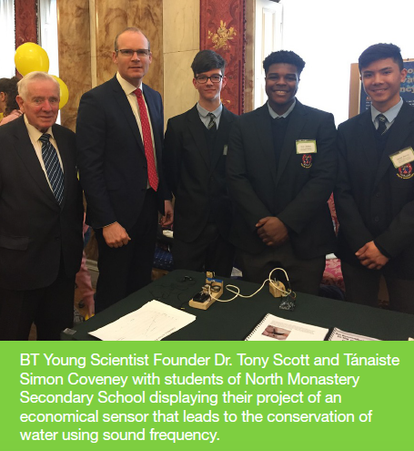
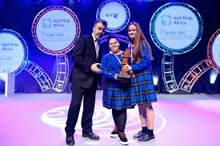

Criteria:
1. Show a clear understanding of the causes of poverty, injustice and inequality in a Global South context and a willingness to learn more. Issues might include: Food and livelihood security; climate change and the environment (e.g. deforestation, clean water and sanitation, fertile soil, soil erosion, fishery, energy, air quality, pollution); gender equality; appropriate technology; access to education; health issues e.g. HIV/AIDS, TB, maternal/child health.
2. Use appropriate and sustainable technology, solutions and/or materials that can be adopted and implemented at local community level in the Global South.
3. Demonstrate a clear understanding of the local context, target audience and needs, which the project is designed for.
4. Demonstrate an understanding of the connections between the local (Ireland) and the global level in relation to the chosen development issue and project, as well as an understanding of a partnership approach to development.

Slide 31
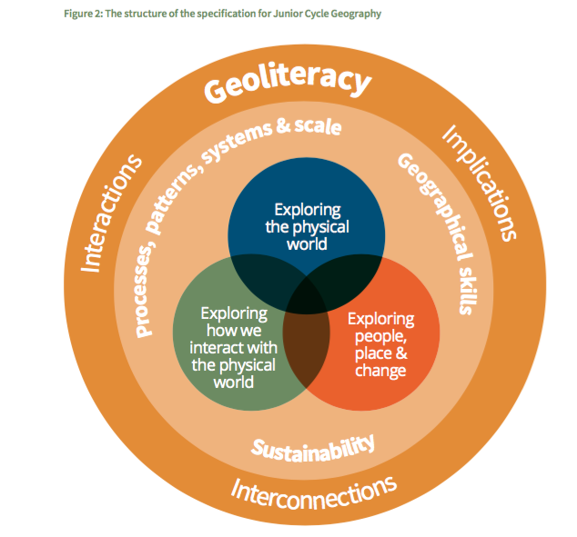

Slide 32
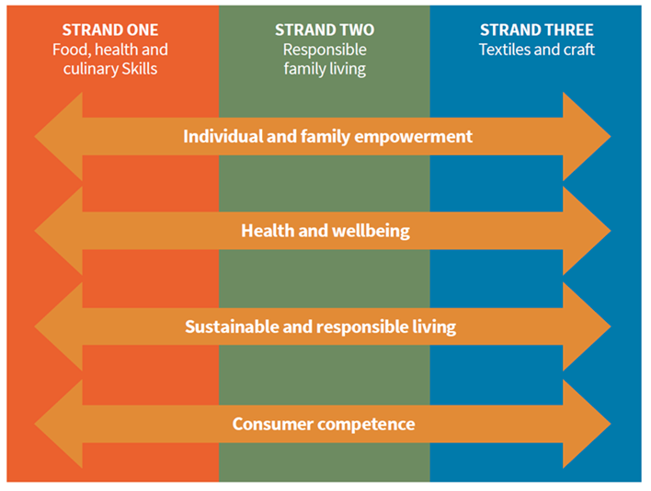

Slide 33
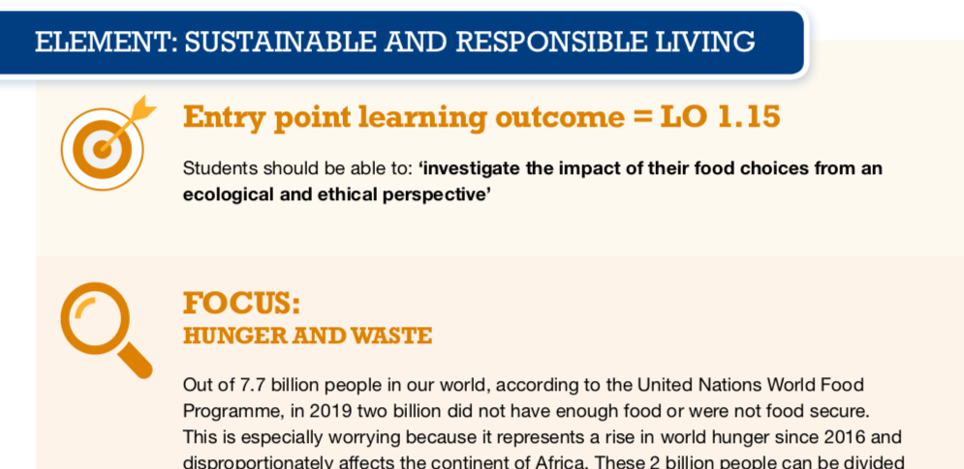

Slide 34
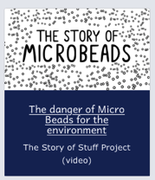


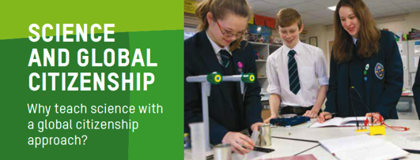
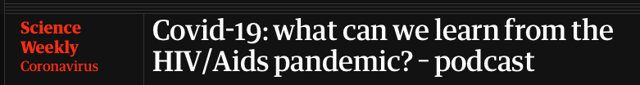
STEP 3: EXPLORE THE THEME
TEACHING AND LEARNING MATERIALS: Resources

Slide 35
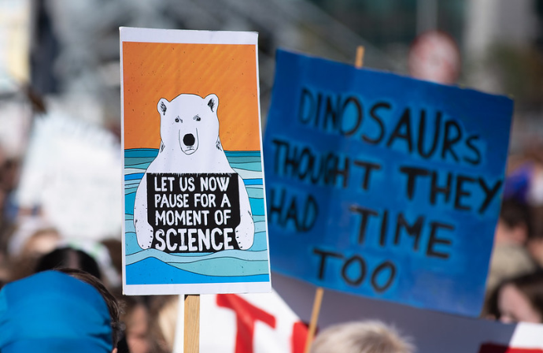

Slide 36
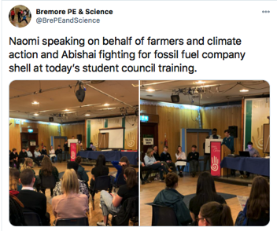
Eadaoin Twohill
St Oliver’s Community School, Drogheda
‘All Junior Cycle students explore:
working on water cycle and carbon cycle - links here to life on land and life below water. i also went into water treatment, water consumption and water conservation which link to a few goals too (12 and 6)
looking at how human factors influence the earth's climate and evaluating initiatives that attempt to address those affects. In my class we looked at making changes to transport, eating less beef, recycling better and reforestation as initiatives. (Goals 13, 7, 12)
ethical and sustainability issues around electricity generation - we looked at child working conditions in Colombia mines to help us discuss ethical issues around electricity generation how humans contribute to sustainability through extraction, use, disposal and recycling of materials - most teachers do plastics here and a few of us have done conflict metals too (goals - 8, 12)’
‘In Science class, we calculated the food miles of various foods, the benefits of reducing food miles and way we could do this.
We made posters on the life cycle of food and gave advice on how we could make each stage more sustainable.
We did group projects on plastics- reducing consumption, reusing and recycling as well as focusing on 5 global issues including pollution, global warming, plastics for the sustainable world.’

Slide 37
‘In Junior Cycle Science sustainability is a major theme. The carbon-cycle is explored and also fuel consumption. An interesting Jigsaw activity looked at the cause and effect of irresponsibility with energy resources and how this has an effect on Climate Change. There was an analysis of carbon dioxide levels increasing in the atmosphere over time and also students looked at sea levels figures and discussed the reasons why they are rising. There was a cross-curricular approach with CSPE on the whole issue of Waste Management. Parents were informed and students encouraged recycling and composting in the home as a result.
Second year science students explored different ways of harnessing the sun's energy.
A definite link between Junior Cycle Science and Construction studies was also explored under the umbrella of the importance of trees.
Controlled forestation was explored. In Woodwork the importance of reusing and re=constituting timber and cut-offs was put into practice’.
Jenny Murray, Ballyhaunis Community School

Slide 38
In Science pupils are taught about the environmental impact of climate change and the percentage increase in CO2 in the earths atmosphere from 0.03% to 0.04%. In Year 12 students calculated their carbon footprint from worksheets obtained online and investigated how they could reduce it.
St Louis SS Kilkeel
‘In Science class they look at issues concerning our biodiversity and climate change. What action can they take to help reduce their impact? This offers opportunities to link the work done in class to the extra curricular work in our Green Schools projects and the work of the Student voice’.
Linda Reilly, Ardscoil Phobail, Granard

Slide 39
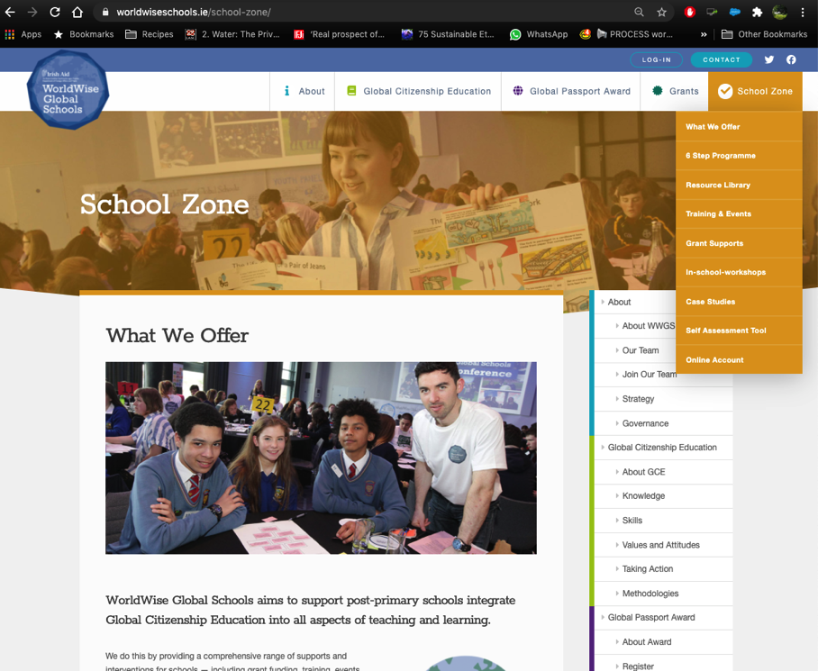

Slide 40
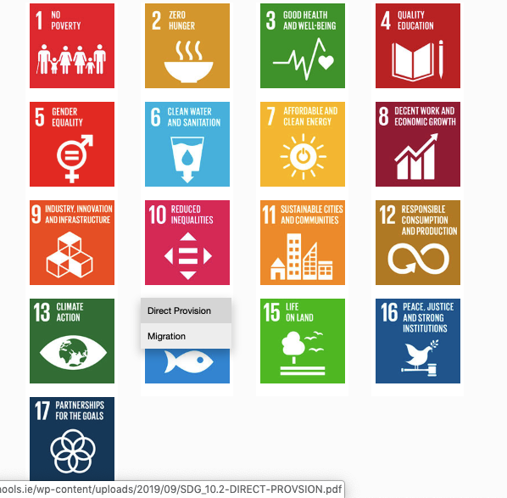
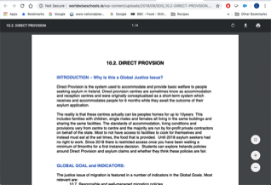
1. Hover over the symbol and a drop down menu appears!
2. Click on the theme and the resource sheet will pop up!
Notes:
Intro to thematic information sheets

Slide 41





A framework for GCE in schools

Slide 42
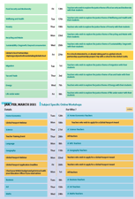
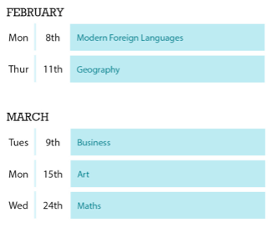
Upcoming Dates www.worldwiseschools.ie/training-and-events/
Thematic Training Sessions
All recorded and available on our website
Subject Specific Training:
Home Ec-12th of January
Science: 21st of January
National Teacher Training- ‘Working as a community of GCE practice’
28th of January 2021 9.30-12.00
Global Passport Webinar:
Jan 18th 4.30pm
Feb 22nd 4.30pm
Notes:
In terms of the breakdown of trainings, outline the 5 types of training
Purple – starter trainings – (today) for new schools and teachers new to GCE (perhaps their school has been involved longer)
Pink – WWGS approach and adapting to covid-19 – for ALL schools and teachers. Even for schools who have been involved for a while. Updated theory and practice
Green – Thematic areas
Blue – subject specific
Yellow – standard WWGS trainings and events. And deadlines.

Slide 43


Thank you!
Everything here:
https://www.worldwiseschools.ie/resource-item/science-resources/
Lizzy.noone@worldwiseschools.ie
www.worldwiseschools.ie

