Slide 1
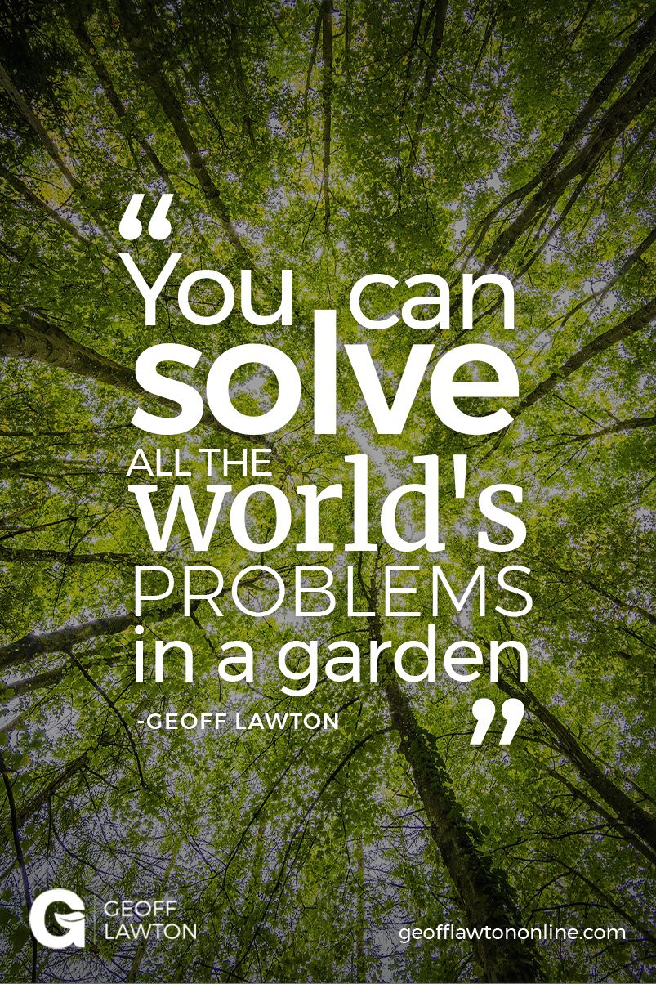

Slide 2
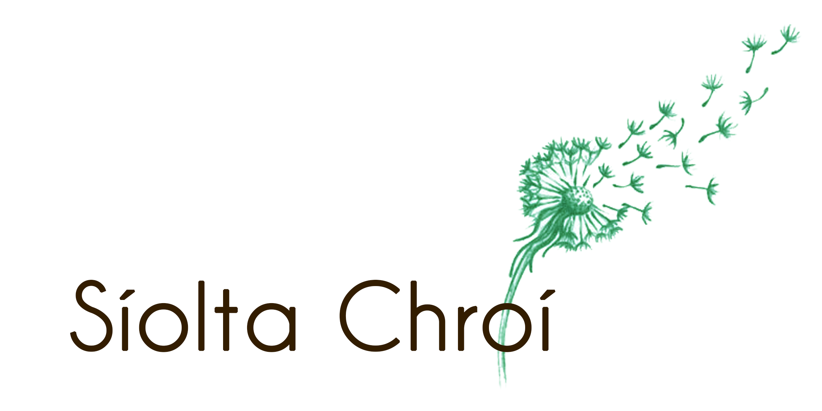
Siolta chroi

Slide 3
Our vision
We envision a more connected world where ecosystems are restored and thriving. Humans are working in cooperation with wider nature and one another and we all have the opportunity to explore our full human potential.
People are awake. The ecosystem is working together like the hum of beehive.
Our mission
We aim to restore Ireland’s ecosystems and communities. We do this through 1) education focused on regenerative cultures; 2) exploring resilient and regenerative food systems; and 3) carrying out ecosystem restoration work.

Slide 4
The 3 pillars of our work
Regenerative culture
Regenerative and resilient food systems
Eco system restoration

Slide 5
Regenerative Culture
The concept of Regenerative Culture acknowledges that the regeneration of degraded ecosystems and landscapes is not only a physical or technical concern, it is a deeply cultural one too. The dominant way of thinking in our culture has us disconnected from the natural world. If we make changes to heal the land but don’t change our relationship to that land, we will continue to damage the planet around us in one way or another.
We believe that deep individual and collective work is required that brings us through a journey of self-awareness, healing and transformation.

Slide 6
Resilient and Regenerative food systems
In the face of climate change, a regenerative food system will create resilience by localizing economies, sequestering carbon and building greater food security. Our current food system is carbon heavy, de-localized and in many cases is poisoning the planet and our bodies.

Slide 7
Ecosystem Restoration
Síolta Chroí believe that ecosystem restoration is both possible and necessary.
Ecosystem restoration provides tools to restore degraded landscapes. The soil and regenerative agricultural practices offer a chance to stave off the worst effects of climate change. Sequestering the excess carbon in our atmosphere on a massive scale is one of the last remaining solutions. By rehabilitating degraded ecosystems and restoring the soil to health on a wide scale, we can sequester enough carbon to create a safe level in the atmosphere (350ppm).

Slide 8
What type of world do we want?
So we should ask ourself the question rather than what we don’t want, we should ask what type of world do we want.
However there is systemic structural inequalities that we need to understand, challenge and divest from.

Slide 9
Our starting assumptions at Siolta Chroi
Many if not all the issues we face as a global and local community comes from the fact that humans see them as separate from wider nature.
We live in an unequal ever changing world
The unjust systems are not an accident, they are designed that way
Our culture is traumatised and we act out of this trauma both on each other and wider nature.
Language is important “I own this land” etc is a fallacy Guardians not gardeners
Young people are carrying so much already

Slide 10
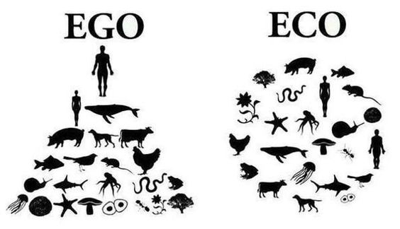

Slide 11
Systemic structural inequalities
Seeing nature as “ours” to be controlled
Patriarchy
Racism
Colonialism - Decolonial education - indigenous rights and land use, indigenous communities as custodians of biodiversity
Neo-liberial capitalism
Corporate control
income inequality,
Seed control- eg Monsanto
loss of seed diversity
A lack of food sovereignty,
Food choices - Happy Pear

Slide 12
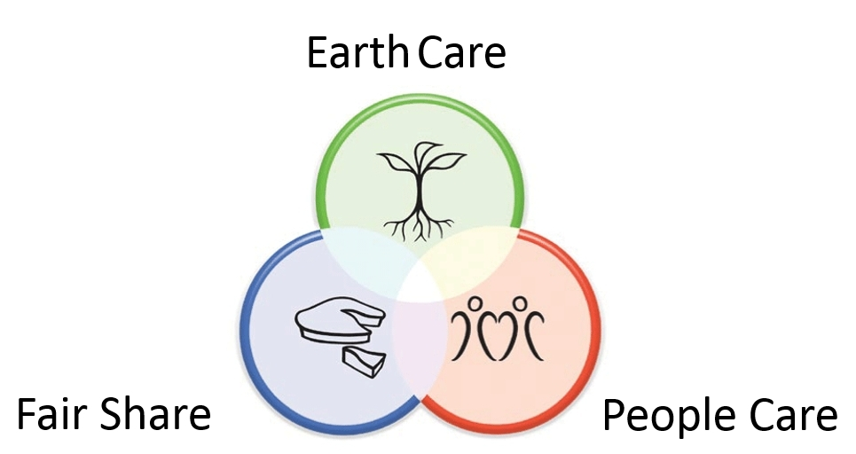
Permaculture

