Slide 1
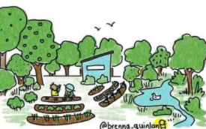


School Gardens and Global Citizenship Education

Slide 2
Today’s Session
Input from Gareth Conlon – Síolta Chroí
Relating this to your WWGS Programme
Using the Six-Step Programme to explore justice issues in your garden project
Resources and helpful links
Evaluation and Q&A

Slide 3
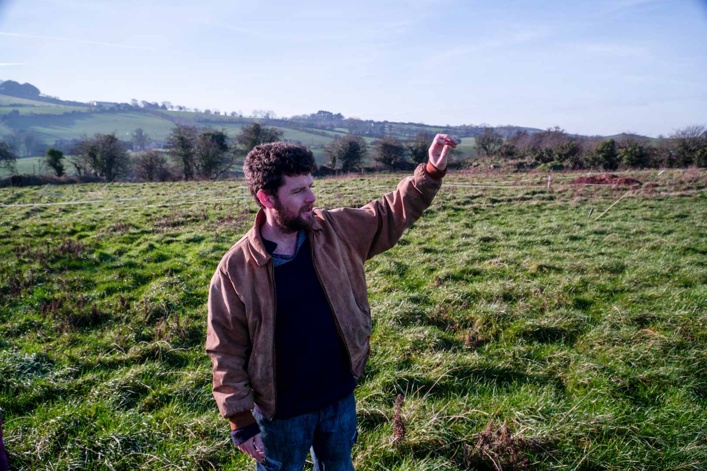
Gareth Conlon

Slide 4


WWGS SIX-STEP PROGRAMME

Slide 5

Guiding Principles of GCE

Slide 6
Exploring the Theme
Indigenous Communities as Custodians of Biodiversity
Peasant Farmers Struggle
Ecosystem Restoration
Native Plants and Solidarity
Food Systems and Food Sovereignty
Seed Sovereignty
Alternatives to Industrial Farming
Business and Human Rights
Indigenous Land Rights
Multilateral Environmental Schemes
Mono-culture Carbon Credit-schemes

Slide 7

International Days of Solidarity, Awareness and Action
February 20th - World Day of Social Justice
March 21st – International Day of Forests
April 17th - International Day of Peasant’s Struggle
April 22nd – International Mother Earth Day
20th May - World Bee Day
June 5th – World Environment Day
August 9th - International Day of the World's Indigenous Peoples
October 16th – World Food Day
December 5th – World Soil Day
December 10th – Human Rights Day
20th December – International Human Solidarity Day

Slide 8
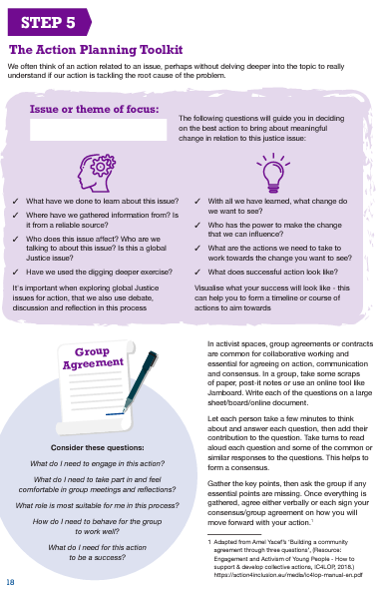
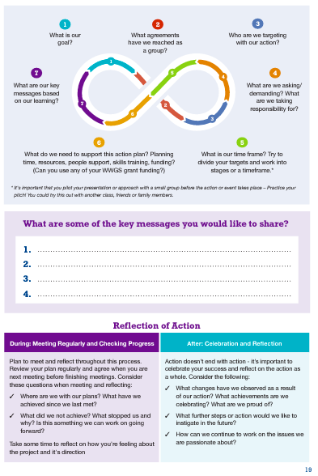
Action Planning Toolkit
Notes:
Beyond boarders - https://galwayowc.wordpress.com/beyond-borders/
Tackling controversial issues - https://developmenteducation.ie/media/documents/tackling_controversial_issues.pdf

Slide 9

Using Your Grant
CPD for teachers
Speaker fees
Workshop for students, teachers, school management
Information/learning resources
Planning meetings (substitution, refreshments etc.)
School Management and Policy Meetings
Student action/awareness materials and skills building
Limits apply to Garden Spending
*Remember to scaffold events and activities!

Slide 10








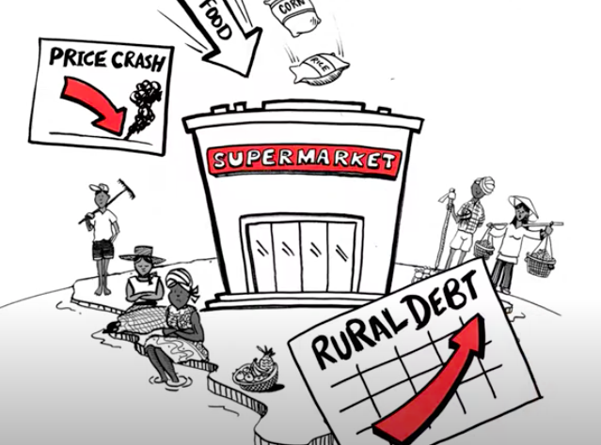
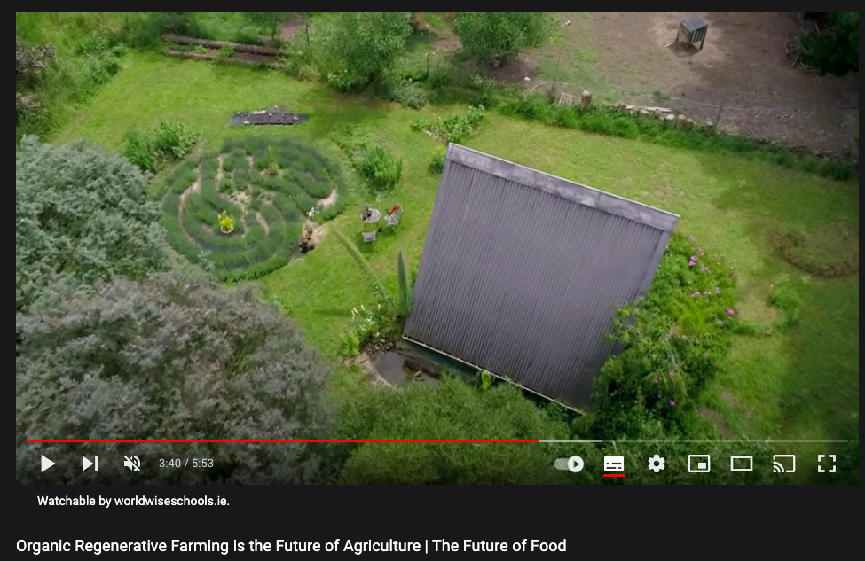
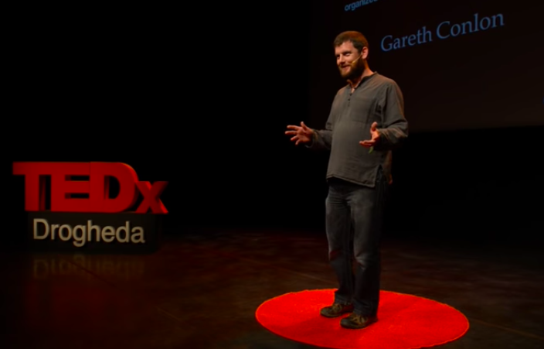

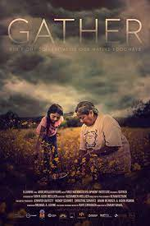

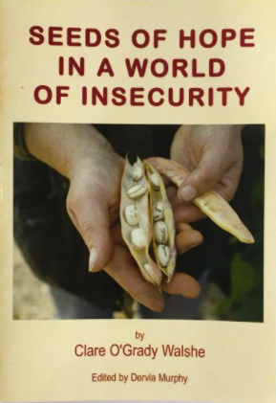


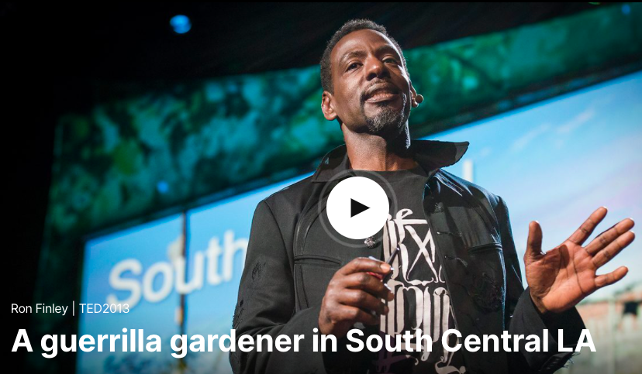
Resources
Notes:
https://viacampesina.org/en/25nov2021-call-to-action-peasant-women-fighting-for-their-rights-against-hunger-and-violence/

Slide 11
Thank you!
*Please take a few minutes to fill in our evaluation

