Slide 1


Learning to Unlearn
moving educators from a charity mentality towards a social justice mentality
Jen Simpson
thinkingthroughlearning@gmail.com
jensimpson@Sapere.org.uk
Notes:
This paper is based on my GLP Innovation Fund study aimed to explore the interventions which could be used during twilight/training sessions to engender a move from charity to social justice mentality
I have placed quotes from my paper throughout the PowerPoint notes indicated by *
Comments about the interventions are in italics
My email is on the PowerPoint if anyone would prefer to contact me directly.

Slide 2
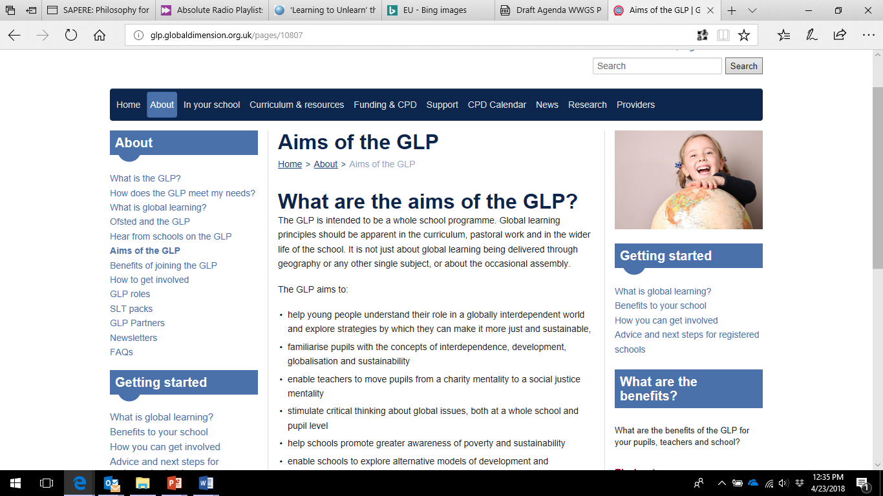
Why?
Framework for developing the Social Justice mindset
Clarifying Social Justice mentality
Interventions and activities for use in GLP ‘twilight’ programme
Notes:
I chose to run this study to support the GLP aim of moving from a charity mindset to a social justice mindset within the GLP delivery
Info on GLP England – issue around this move to social justice within twilight session.

Slide 3
Learning to Unlearn
Through embracing a practice of deconstruction and reconstruction of knowledge (Campbell and Baikie, 2013) teachers can encourage critical and reflective learning or learning to unlearn which has the potential to result in a “major shift in perspective” (Hoggan, Simpson and Stuckey, 2009:8).
Charity mentality V’s Social Justice mentality
Notes:
The ‘major shift’ required is the move from charity mentality to social justice mentality
The process of ‘deconstruction and reconstruction’ is the Learning to Unlearn based on the work by Jan Fook (2006)

Slide 4
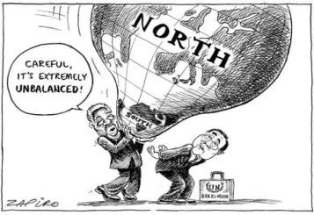
Charity mentality V’s Social Justice mentality
‘Charity has two conventional pathologies: the unjust dependency of the recipient, and the unjustified condescension of the giver’ (Mills, cited in Saunders-Hastings, 2014: 233)
‘Active global citizenship’ as a means of creating ‘little developers’ (Biccum, 2010) – ‘market colonialism’
Whether social justice is
‘A social justice mentality or
mindset could be considered a
commitment to equality, a
developed critical or independent
thinking which results in ethical
action’.
Notes:
Brief intro- more later
*Commentary and debate on charity is not new; J.S. Mills writing in the late 1860’s demonstrates the paradox of charity or philanthropy which had increased across Victorian Britain in the face of greater prosperity for middle and upper classes following the Industrial Revolution and the subsequent widening gap between the social classes.
His criticism of the response centres on the lack of or type of education of those providing the charity, namely women in this instance. He argued that by focusing on the ‘education of sentiments rather than understanding’ and ‘looking to immediate effects on persons and not to remote effects on classes of persons’ (Mills, cited in Saunders-Hastings, 2014: 246) were ultimately detrimental to those they wished to aid.
*I would suggest for many that this mentality has not developed or changed greatly in recent decades though it may have been re-packaged into more palatable forms such as Band Aid or Comic Relief or through education initiatives such as active global citizenship, but essentially the message remains the same; ‘we learn about you and we help you’ (Tallon 2012:8) reinforcing that sense of responsibility without questioning why.
*A charity mentality can be constructed by the constant messaging from education initiatives , charity campaigns and images promoting the same message; ‘we learn about you and we help you’ (Tallon 2012:8) reinforcing that sense of global responsibility to the ‘Other’ without questioning why
It comes down to education
*One criticism of education and the work of NGOs has been that, in the past, too much emphasis was placed on the helplessness of those in the ‘South’ and the need for individuals to act for change (Bryan and Bracken, 2011 cited in Bryan 2013: 9)
*If, as suggested by Standish (2009 cited in Tallon 2012) too much emphasis is placed on action over theory or exploration of complex issues then there is the potential for certain agendas to influence the way we think about the ‘other’.
*Biccum (2010) further argues that educators have been actively encouraged to promote ‘active global citizenship’ as a means of creating little developers able to participate in the global economy but without the skills or experience of critically engaging with issues such as inequality and injustice, what I suggest is a form of ‘market colonialism’.
*The challenge of defining a social justice mentality is that it is not a ‘fixed’ concept rather, as Bourn (2014) suggests, it is a result of a number of influences and ultimately it depends on an individuals’ perspective. In addition, opinions are mixed on whether social justice is an approach to learning (Bryan et al, 2009), a way of thinking (Bourn, 2014) or an act (Bryan, 201 3). No matter the process or method it is generally agreed that by engaging in social justice it will eventually produce positive outcomes such as challenging stereotypes and promoting equality on a personal level or affecting changes within society on a social level. Therefore, a social justice mentality or mindset could be considered a commitment to equality, a developed critical or independent thinking which results in ethical action.
Hackman (2005: 103) advocates that social justice could be used as a ‘pedagogical lens’ for learning suggesting that social justice needs more significance within education as a whole.
Audrey Bryan et al (2009b: 31) implies that the importance on the role of social justice has been amplified with modern globalization and the realization that many issues are indeed global ones which ‘transcend borders’. If this is the case, the role of educators in encouraging young people to develop a social justice mentality is more significant than ever, as is the need to overcome a charity mentality and see beyond our colonial psyche to engender a truly equal global society

Slide 5
Challenges for teaching and learning
The culture of ‘quick fixes’ as highlighted by Carlisle et al (2006)
Charity as a starting point for schools.
On the edge of the curriculum – where is the educational value?
Pressures with curriculum and training
Notes:
*Challenges:
Another challenge for educators and the GLP is the culture of ‘quick fixes’ as highlighted by Carlisle et al (2006) whereby schools engagement in social justice or global issues are led by international disasters or media coverage therefore approached ad hoc or on the edge of the curriculum and considered an addition to core learning done
It must be recognised that a charity mentality is often the starting point into learning about global issues and development (Bourn, 2014). Charity, within a school setting, can also be an integral part of the school ethos, encouraging young people to be thoughtful, caring and morally ‘correct’. Which is not a criticism in many ways as it is aimed at developing values, though Andreotti and Spivak may ask ‘whose values?’
In an educational climate where schools must justify any deviation from core subjects, or Ofsted standards the educational value must be justified. Much of global learning is linked to the SMSC or values which, I believe, has a tendency to actually de-value its core educational significance. It puts it on the periphery of the curriculum or what some consider the ‘hidden’ curriculum as it is difficult to plan for or ‘test’. Using the focus of ‘charity’ allows schools to tick-boxes and has demonstrable results such as donations, events and assemblies. (Simpson, J: 6 2016)

Slide 6
The Interventions
Employing the ‘learning to unlearn’ ideology I designed the training session around the critical reflection process proposed by Fook (2006):
Unsettling or unearthing of fundamental assumptions
Potential for further reflection of assumptions
Breakthrough connections are made/recognizing the origins of assumptions
Evaluating assumptions against current experience/experiences of others
Old assumptions are reframed
Changes within practice based on new/reconstructed understanding
Notes:
Interventions were designed to work with minimal or no interference or input from the trainer around Fook’s 6 stage process to ensure critical reflection.
*Learning is considered to be, essentially, about moving the learner forward whether it is their knowledge, skills, behaviour, understanding or initiating change. In order to achieve deep learning it is suggested that learners must engage in active unlearning (Spivak, 2004 cited in Andreotti 2006: 45) and in this case, unlearning the charity mentality or deconstructing assumptions and preconceptions of the ‘other’ and reconstructing knowledge through the lens of social justice

Slide 7
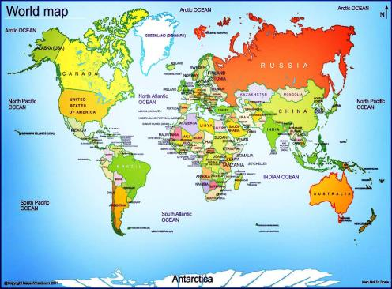
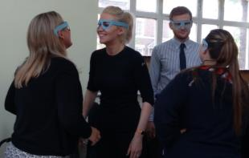
Framing (part 1) – Unearthing of fundamental assumptions
The world and me
Elements of your identity
Notes:
Before challenging adults or children to ‘unlearn’ we must first consider what has already been learnt.
Ask participants to write their ‘elements’ on post-it notes or directly only a small copy of a world map. Individually at first and then to share with others so they can begin to see similarities and differences.
This should act as a springboard for the unlearning stage.

Slide 8
Framing (part 1) – Unearthing of fundamental assumptions
D –‘You could write some of these down’
A - ‘I wouldn’t think of those . . . I am not middle-aged, married or a parent’
D - ‘I wonder if we see the world different, you and me?’
Notes:
Examples of comments from the original research session.
Another opportunity to reflect on similarities and differences

Slide 9
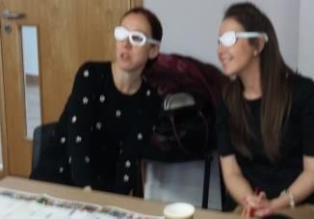
Why are we changing the maps? – Unsettling and further reflection of fundamental assumptions https://www.youtube.com/watch?v=eLqC3FNNOaI
I was shocked to find out that what we have been taught our whole life was wrong. It made me consider what else we have been taught that is wrong (Teacher B).
Notes:
The next step is the ‘unlearning’ or ‘deconstructing’
The unlearning process was initiated using a clip from ‘The West Wing’ (‘Why are we changing maps? https://www.youtube.com/watch?v=eLqC3FNNOaI) as suggested by Campbell and Baikie 2013 as a means of challenging assumptions and the notion of a ‘world view’.
Show clip
The clip takes you through Mercator maps and relative country sizes and positioning to the Peters projection map (on your tables) and the up-side down map (table)
At this stage I hand out A4 copies of the Peter’s Projection map, Upside-down map and the Eckert VI (GA suggested).
Many teachers go very quiet at this stage – it is best to leave them for some time to digest this video, explore the images and discuss amongst themselves.
Once ready, you can gather their thoughts/impressions.
Learning Point - Not only do our influences affect our world view, our world view is subject to influence.
This highlights Andreotti’s ‘colonial framing’ of the world quite well.
This is a surprisingly ‘unsettling’ experience for the participants. By questioning a fundamental assumption of knowledge it allowed all other ‘layers’ to be subject to scrutiny. It was also a liberating experience as it opens up new possibilities and avenues of thinking or questioning and is usually referred to throughout the session.
Participants themselves rate this intervention high in terms of impact on almost all session I have run it.

Slide 10
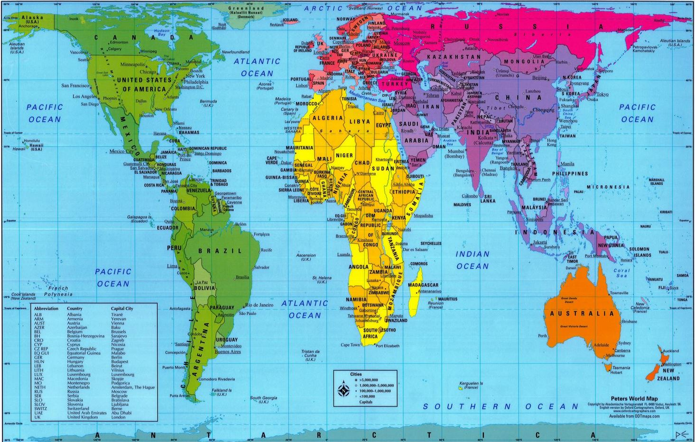

Slide 11
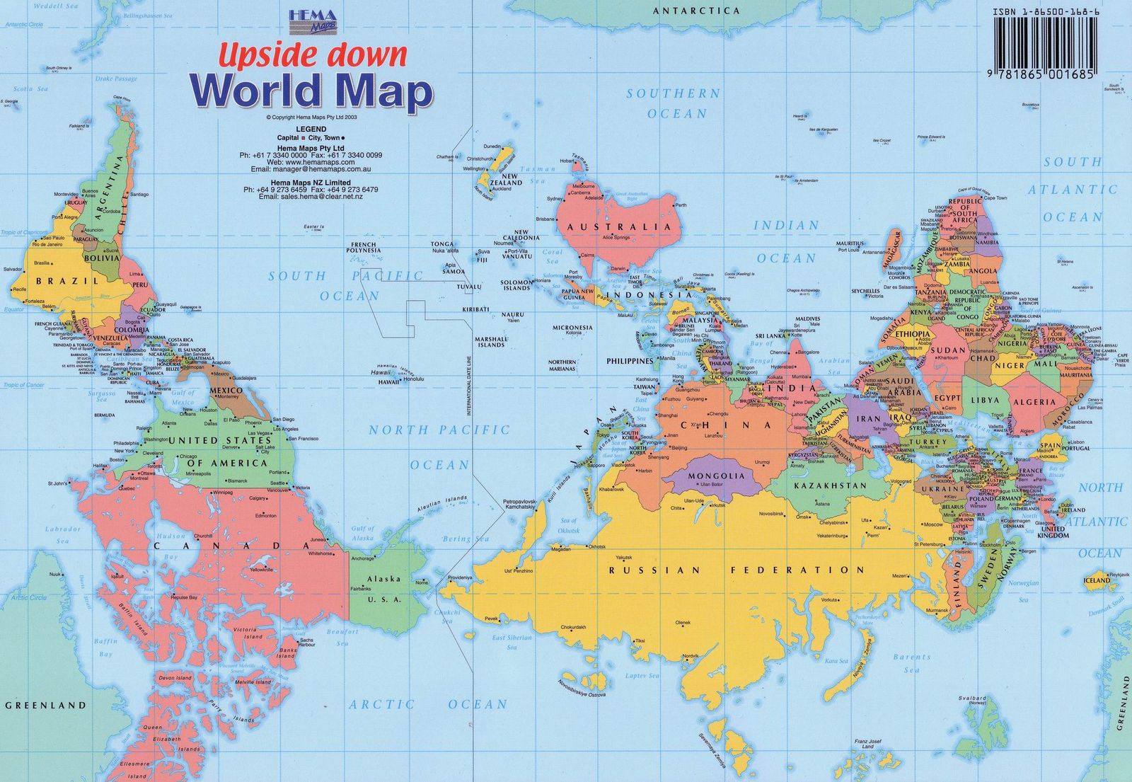

Slide 12
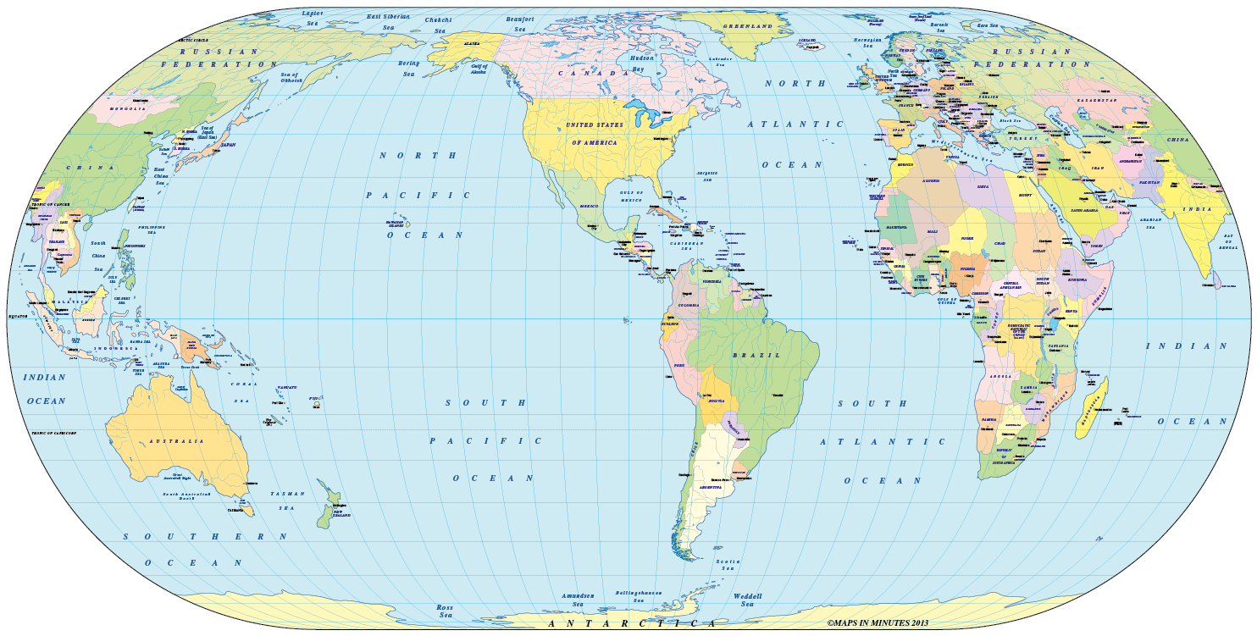

Slide 13
Framing (part 2) - Breakthrough connections are made/recognizing the origins of assumptions
C – ‘We should have a balanced view’
D – ‘But we don’t have a balanced view do we? Because of the way we have been brought up and the way we’ve been taught these countries are portrayed.
Notes:
Now that the participants had been ‘unsettled’ the next stage allows for a deeper exploration of those ‘assumptions’ while the participants have still got that sense of ‘openness’ to their understanding.
This intervention was designed to mimic what Anderotti (2006) refers to as the ‘colonial framing’ of the world by introducing a ‘hidden’ frame of influences; subliminal or ones they would not actively associate with being part of their identity but are part of the culture/world they live in.
It was to further challenge the participants assumptions and their origins
This was challenging for them but in analysing the dialogue there are examples of impact on their thinking. – click for quote
*The purpose of the intervention is not for participants to agree or make the connections in that moment of dialogue, which would be too much to expect. Instead, it provides the critical thinking point which the individuals can reflect on a personal basis or potentially re-visit as a group during future GLP twilight sessions encouraging that process of ‘reflection and reconsideration as mentioned earlier (Bourn, 2014: 30).

Slide 14
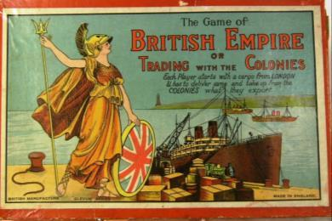

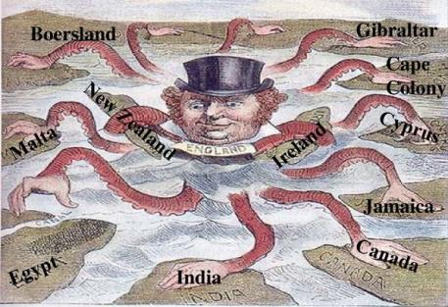


‘Hidden’ influences
Colonial
Democracy
Media
First World
History
Power
Notes:
This is the ‘new’ slide that I use to discuss the Hidden influences – the ‘frame’ analogy is a little obscure for many teachers.
I still ask how these hidden Influences may affect:
Your world view
Your approach to teaching and learning
Your engagement with the ‘South’
Table discussions.
Not only are we dealing with our own perceptions of the world based on experiences, distorted view of the world influenced by others but also hidden influences which might impact on our perceptions of the world also.
Young people also competing with this information, arguably at an increased rate in our progressively computerized society – fake news, facebook scandal.

Slide 15
Charity mentality V’s Social Justice mentality
‘Colonial framing of the world’
‘sanctioned ignorance’
(Andreotti 2006;4)
Remove the
smoke-screen
Notes:
*This, as Jefferess and Andreotti (cited in Tallon 2012:7) argue, perpetuates an unequal relationship and continues a ‘colonial framing of the world’. This focus on the West’s responsibility towards the South places those in the West in a position of power, creating a seemingly kind and benevolent master but a master nonetheless.
*As highlighted by Mills in 1869, this standard message of promoting a charity mentality as the norm has the potential to produce unwanted or unhelpful outcomes for both recipient and the giver. It can distort people’s perceptions of other countries or peoples, particularly those in the ‘South’ and it can become a smoke screen behind which hide complicated issues and historical prejudices which allow the continuation of unfair practices and promote unbalanced societies. Andreotti (2006: 44) likens it to a ‘sanctioned ignorance’ for societies of the West, preventing critical engagement whilst perpetuating the ‘myth’ of the West as the ‘good guys’ on a civilizing mission.
*If we consider social justice mentality in relation to that the main difference is that we remove the smoke-screen of ‘sanctioned ignorance’; By engaging in critical reflections into local and global injustices, especially from the perspectives of others, we begin to disrupt those ‘myths’ about our relationship with the global ‘South’.

Slide 16
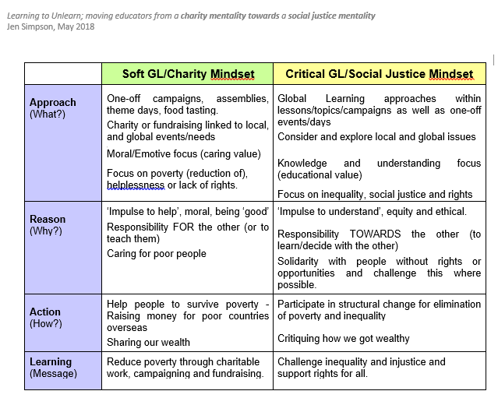
Charity Vs Social Justice Mindset
– Old assumptions are reframed
Notes:
Sort initiatives/school activities into the columns.

Slide 17









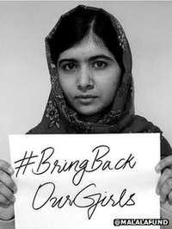


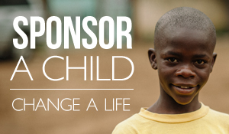

Slide 18
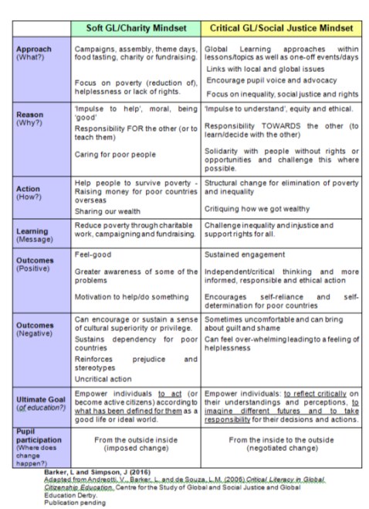
Notes:
This is again a practical activity aimed at providing an opportunity for the participants to begin to reconstruct or reframe their new understandings around a social justice mindset thereby encouraging their future educational practice around a social justice approach.
Teachers in groups are given a selection of school ‘initiatives’ to sort into the columns based on the descriptions – as it says, using the first 4 rows is easier.
These include, Fairtrade, Eco-schools, Foodbank, comic relief etc etc
What impact will that have on negative outcomes? Or positive?
How does it impact on pupil participation?
Which relates more closely to your school ethos or vision?
*It may be that, like the research group, many are placed in the charity mindset side. There we various comments around:
Lack of confidence in teaching about the complex issues involved in social justice; because ‘you shy away from stuff you don’t know’ (teacher D)
That Charity mindset presented ‘easier solutions’ (teacher B) for primary age children
The over-assumption of it being a subject to be taught and that they should have expert knowledge: Fear like doing RE, don’t know enough about Islam what I thought I knew might not be right and we are giving a skewed view (teacher C).
*My responses include:
Yes, global issues are complex even on a local level but a 5 year old can understand injustice ‘It’s not fair!’ and observe inequality ‘only boys play football’
Why should primary age children have ‘easy solutions’? Young people are capable of far deeper thinking and educators have a role in empowering them to be agents for change. Challenging global inequality is not simple but it is important to being somewhere or perhaps we grow up still seeing the world as one image!
The role of a teacher is not to so much impart knowledge, but to facilitate learning, providing opportunities for young minds to explore challenging and complex concepts (even if they have no solutions).
*This is not meant for teachers and schools to turn away from charitable work altogether, but instead to critically consider how their involvement and teaching around charity can impact on their learners’ perceptions of people and places.

Slide 19
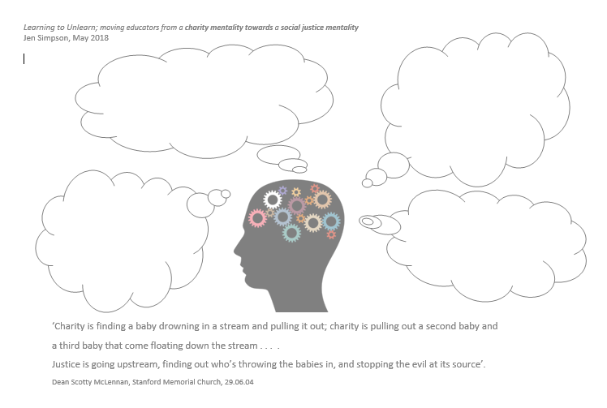
Charity is… - Charity vs Social justice

Slide 20
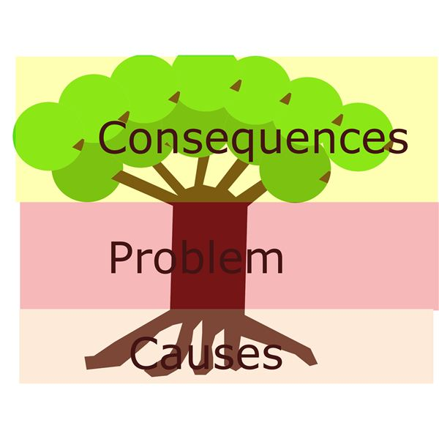
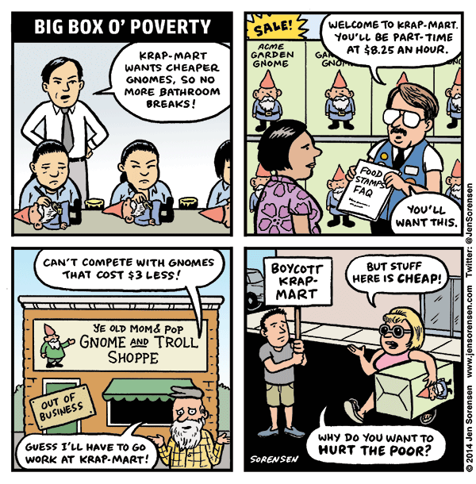
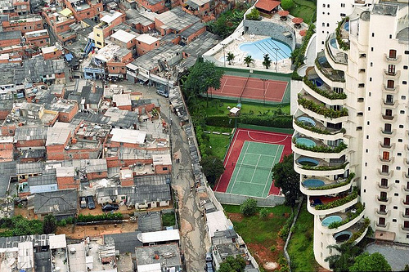
Poverty vs Inequality
Notes:
*I particularly chose an example which was designed to push the participants into reviewing their own role within social injustice, for as Bryan (2013) stresses we must recognize that our own lifestyles, actions and choices are part of a structurally unjust world.

Slide 21
Evaluation/Follow-up review - Changes within practice based on new/reconstructed understanding
D –‘It has made me question my own life, my family life and my perspective on my teaching of geography and global issues’.
F - I have been inspired to do some more research into the issues raised, reading papers and listening to talks to gain a deeper insight into some of the issues, particularly the issue of tackling poverty and providing education for all.
Notes:
Some were profound

Slide 22
In conclusion . . .
Why learning to unlearn?
Why Social Justice mentality for educators?
B –‘I think we may be less willing to join in with the loudest shouting charities and instead focus on something that we have really looked into and researched.’
Initial evidence shows impact on individuals and their practice.
The framework can be applied to other ‘twilights’ and for novice/experienced trainers
A – ‘I think to some degree the older children would begin to understand that for things to change dramatically, charity isn't just the answer.’
Global issues ‘transcend borders’ (Bryan,2009: 31)
Equal global society
Notes:
*Essentially, the message that we should be engendering a social justice mentality amongst teachers and pupils is an important one in our global world where issues such as poverty, climate change, war and refugees transcend borders and the need for equality and preservation of rights are not part of history but are current and relate to us all.

Slide 23
Thank you
Jen Simpson
thinkingthroughlearning@gmail.com
jensimpson@Sapere.org.uk
www.glp-e.org.uk
Notes:
This paper is based on my GLP Innovation Fund study aimed to explore the interventions which could be used during twilight/training sessions to engender a move from charity to social justice mentality
I have placed quotes from my paper throughout the PowerPoint notes indicated by *
Comments about the interventions are in italics
My email is on the PowerPoint if anyone would prefer to contact me directly.
commissioned by IOE on behalf of the GLP

