Slide 1


Blakestown
Community School
Development Education
Lizzy Noone
WorldWise Global Schools
16th of March, 2018
Notes:
Moving Debate
Root causes
Video Global Inequality

Slide 2
Pick a potato!

Slide 3
Our Approach
NGOS
Schools
Funding
Support
Training
Increased spread of Quality Development Education in Post-Primary schools in Ireland

Slide 4

Our Approach
+
QUALITY
(Global Passport + ‘Doing DE’ series)
SUSTAINABILITY (teacher capacity building)

Slide 5


Agree or Disagree
Development Education is providing school books for children in poor countries.
DE is about effecting change in the world
DE is about making students understand how lucky they are
I am not responsible in any meaningful way for what happens to the people living in poverty
Ireland’s commitment to climate change is a load of hot air
Notes:
Many people view DE as simply ‘teaching about far away places’ (e.g. “Saris, steel bands and samosas” stereotype) – but in fact it encompasses a lot more than simply the content of what we teach or facilitate in the classroom. DE is of course partially content-driven, and we need sufficient knowledge in order to engage with it confidently: but it is primarily an approach to education that takes as its starting point the fact that our world is a vastly unequal place.

Slide 6
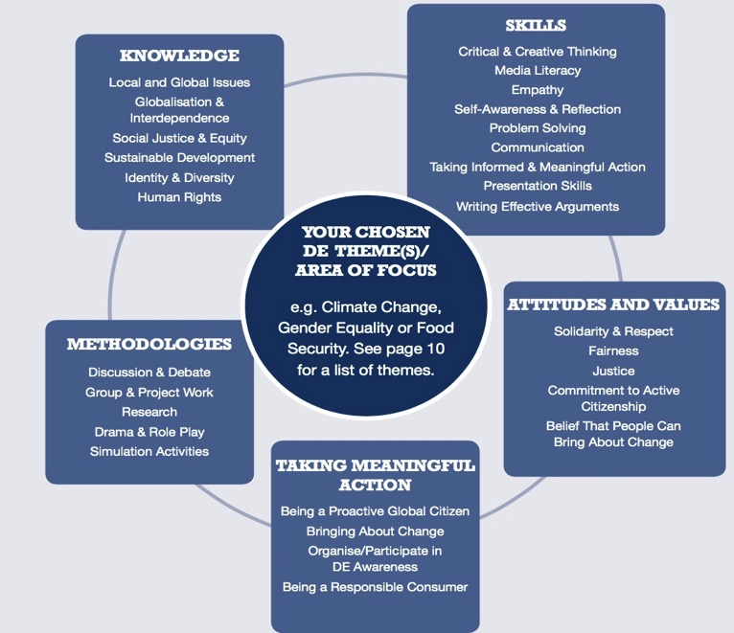
Notes:
DE is driven by core values and attitudes (primarily JUSTICE, SOLIDARITY and EMPATHY), and has at its heart a radical and transformative agenda – hence the ACTION component. Therefore, a process cannot be described as DE if it doesn’t contribute to some kind of positive change – be that in myself, in my community, in my behaviour, in my perspective, in our collective narrative of development.
DE also encompasses key skills that we all require in life – namely those of critical thinking and analysis, of being able to question and challenge the messages and information we receive every day.

Slide 7
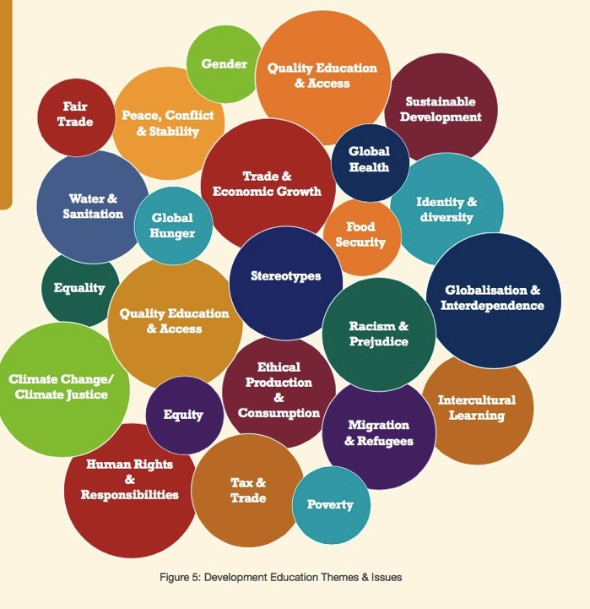
Notes:
Essentially Development Education is about exploring ideas and understanding:
Of relationships and power – the ways in which power relationships share people’s lives; their civil, political and social rights and responsibilities; their status as citizens; the implications of an increasingly global and interdependent society; the nature of economic, social, cultural and political relationships and how they affect people.
Of disparities in human living conditions – the continued existence of inequality at local and global scales and of different perspectives on such divides; the values base of these perspectives and the implications for popular understanding of the issues.
Of the concepts of democracy, governance & citizenship – democratic practices and procedures; the rights of citizens here and elsewhere; the history of the struggle for democracy and the need to nurture it as well as to seek change for it to be more inclusive; ways in which global governance should/could develop.
Of cultural identities, conflict & conciliation – the concept of identity and its implications for individuals, communities, states and internal co-operation; the dangers of ethnocentricity and ways in which it fuels conflict and aggression; different experiences of conciliation and the skills necessary to achieve it.
Of rights and responsibilities – the principles of equality, participation and democracy; ways in which rights are matched with responsibilities and the implications of this locally and globally.
Of gender identities – the nature of discrimination and responses to it (including legal frameworks); ‘stories’ which have been hidden from history because of gender discrimination and of the implications of gender issues for people’s experiences – here & elsewhere.
Of sustainable development – the impact of human action and inaction on the environment here and elsewhere; the concept of responsibilities to future generations not yet born; the global nature of natural environmental systems and our links to such systems; proposals and experiences to improve sustainability.
Of technological change – the opportunities and difficulties of rapid change in international technology and of the danger that it will continue to benefit some and disadvantage many, thus maintaining rather than reducing current inequalities.

Slide 8
DE Links with the Curriculum
Junior Cycle | Senior Cycle
Key Skills Subject Specifications New Junior Cycle: Key Skills Subject Specifications Statements of Learning (SOL) | Key Skills Subject Specifications
Education for Sustainable Development
Strategy developed-opportunity to develop a ESD policy in the school
Well being Framework
-Feeling Connected

Slide 9
Assessment and Reporting
Level 2 Learning Programmes
Subjects
Wellbeing
Short Courses
Other Learning
Experiences
8 Key Skills
24 Statements of Learning
Curriculum
8 Principles

Slide 10
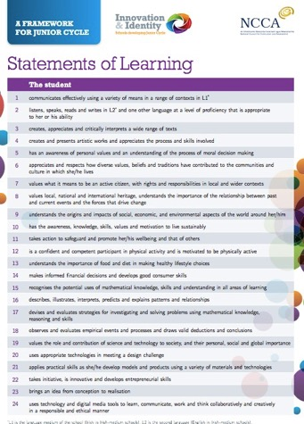
24 Statements of Learning (SOL) for Junior Cycle
STRONG DE LINKS
Task: highlight the Statements of Learning that have similar aims to Global Citizenship Education

Slide 11
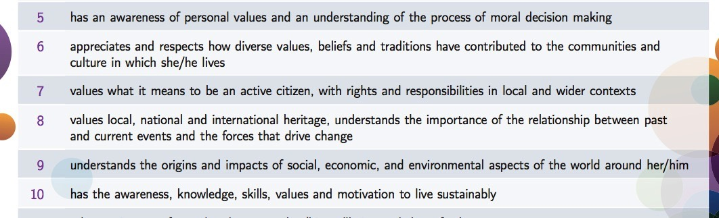
Very Strong DE Links
SOL 5-10
That’s a quarter of all SOL!!

Slide 12
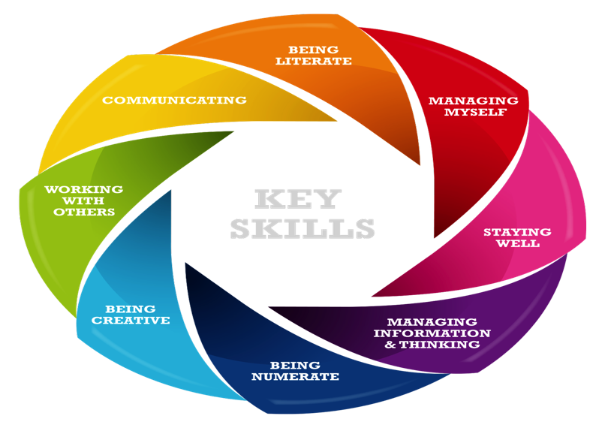
Key Skills-Junior Cycle
Notes:
Gaeilge, English, Modern Languages, History, Geography, CSPE, Mathematics, Physics, Chemistry, Biology, Accounting, Business, Economics, Music, Agricultural Science

Slide 13
Junior Cycle Religion
Section A - The Search for meaning
Section B – Christianity
Section C – Religious faiths in Ireland today Section D – Morality in action
Section E – God-talk
Section F – A living faith – doing justice Section G – Celebrating faith
Section H – Story-telling

Slide 14
Junior Cycle Religion
Background-the specification will include:
The role of RE in building understanding about and respect for a the diverse nature of religion & beliefs in contemporary Ireland and in the wider world.
How RE can equally recognise value and contribute to the experience of students from a plurality of relgious traditions and cultures.
The potential to incorporate engagement in action for social justice global sustainability and service learning as part of the course.

Slide 15
Junior Cycle Religion
Consultation:
‘The course should enable students to gain an informed attitude towards non religious responses to life and an understanding of inter religious relations’.
‘the course should no longer be taught from a specific viewpoint’.
‘While a new religion syllabus must take into account all the faith communities in a school and pupils should learn about other faiths, it is also crucial that students are allowed to explore their own faith in a safe environment.’
A further consideration that some respondents wished to highlight was the role of R.E. in promoting social justice, sustainable development, equality and respect for diversity.

Slide 16
Junior Cycle Religion
A few activities!!
Myth vs Fact
The Future you want

Slide 17
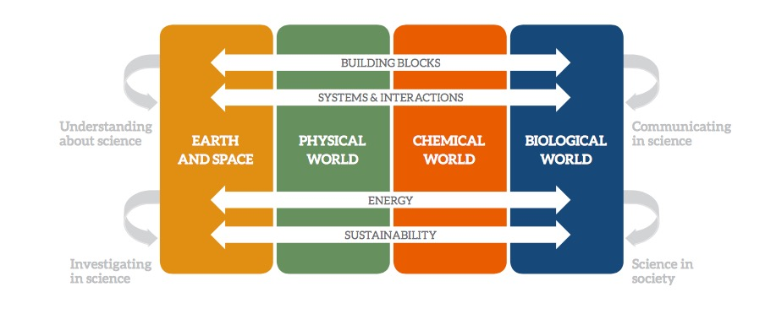
Science-The elements of the contextual strands

Slide 18
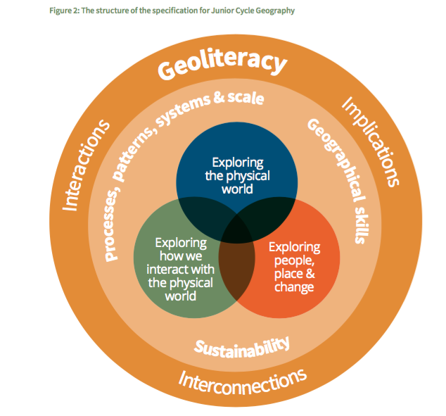

Slide 19
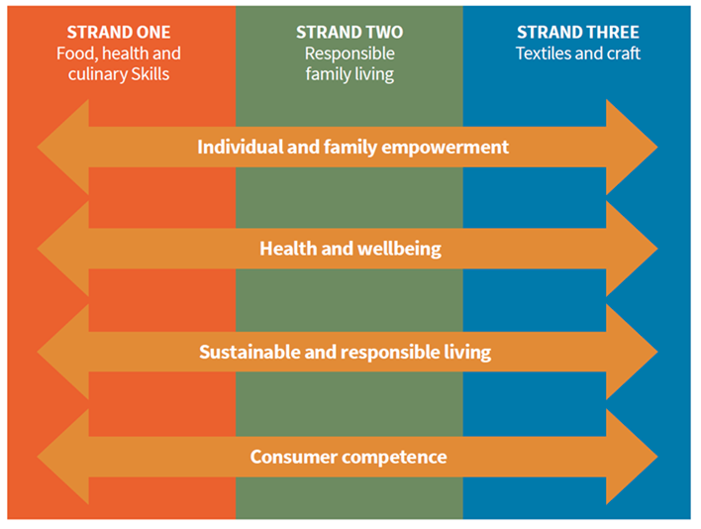

Slide 20
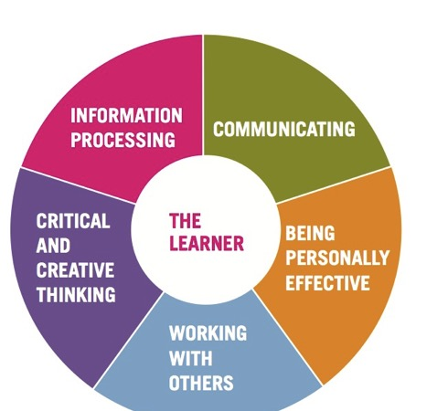
Key Skills-Senior Cycle
• recognises the impact of real-world constraints
• evaluate outcomes of solutions and decisions both in the short and long term

Slide 21
Leaving Cert Religion
Section B: Christianity
e.g. Laudato Si, root causes of violence
Section D: Moral decision-making
Human Rights, Common Good
Exploring Slavery & Child Labour
Section F: Justice & Peace
Causes & Consequences
Section J: Religion & Science
Laudato Si, GM Foods

Slide 22
Leaving Cert Religion
Section B: Christianity
Children in Conflict Giant Steps
Section J: Religion & Science
Climate Justice spaceship

Slide 23
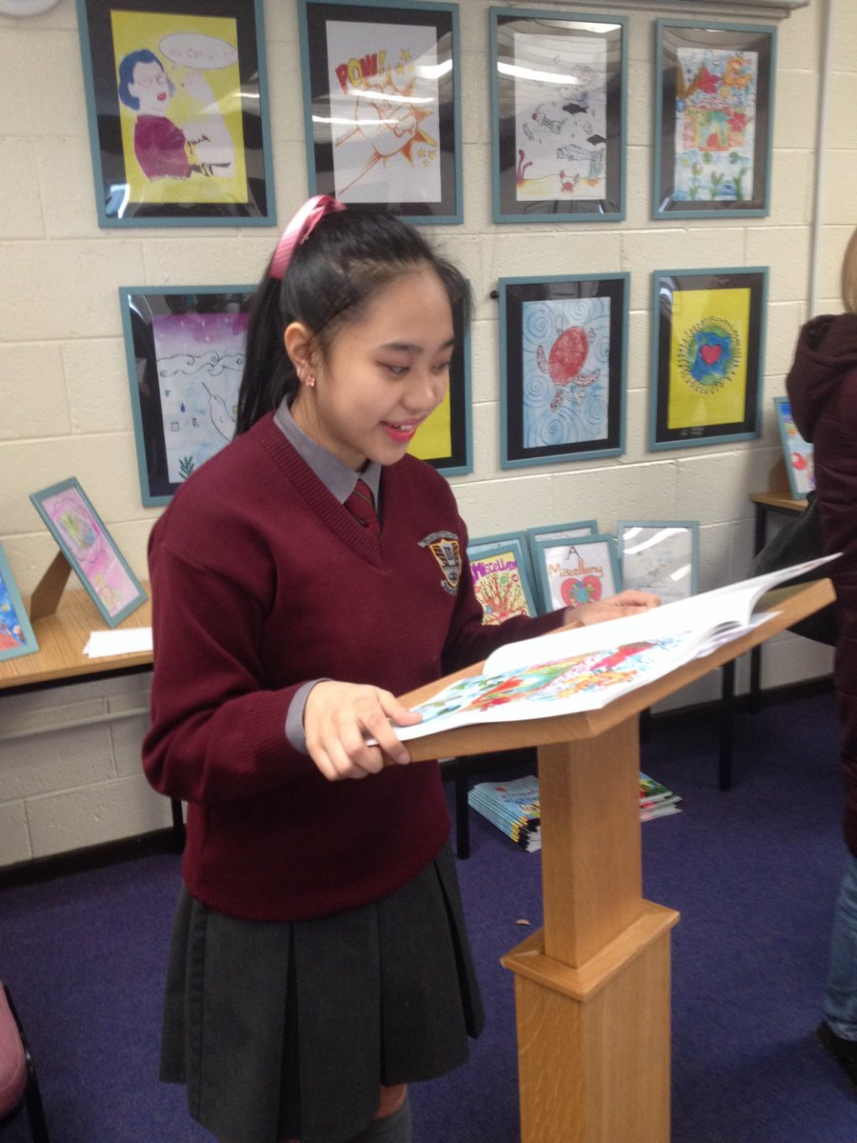
Cross Curricular
Picking a Theme that’s cross curricular
Working on a creative project together
Working on an event or awareness day together
Skill based cross curricular projects

Slide 24
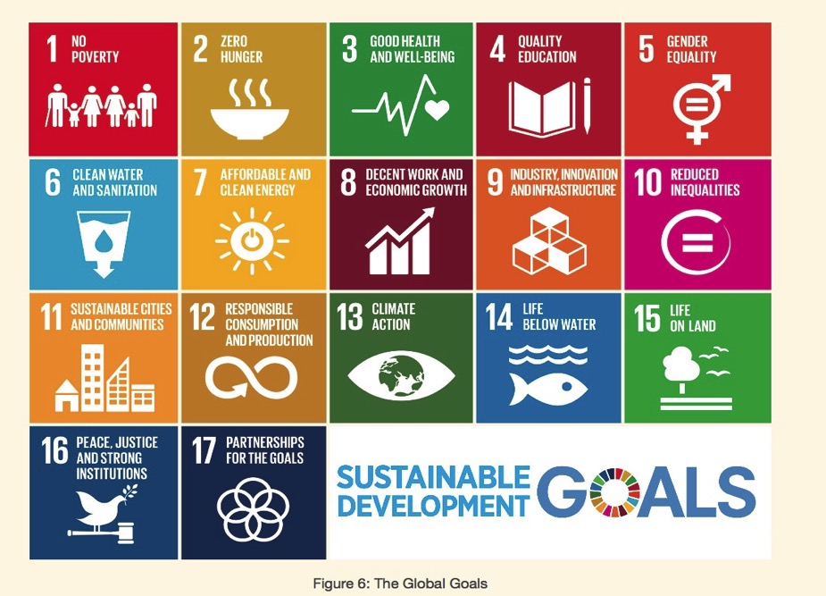

Slide 25
Pick a Global Goal you find important
In your groups-brainstorm on what you could do in RE on that goal using the UNESCO tool

Slide 26


Way to introduce students to the Global Goals
Identify Issue/Problem at Local, National, Global
What goal addresses it?
Solutions?

Slide 27
R.E.: Global Justice and Morality
Maths: You could do a lesson on ratios using some inequality statistics; 5:50:500
Geography: You could do a local study in your country that examines the differences in people’s living standards. You might want to use census data or government statistics to highlight how quality of life is not the same for everyone.
History: When studying inequalities and movements to redress these from history, such as the American civil rights movement or the Suffragettes in the UK, can you draw comparisons with situations around the world today?
P.E.: Fair Play/All to Play For
For us all
Art: Framing Our World
Notes:
10.1 Progressively achieve and sustain income growth of the bottom 40% of the population at a
rate higher than the national average.
10.2 Empower and promote the social, economic and political inclusion of all, irrespective of age, sex, disability, race, ethnicity, origin, religion or economic or other status.
10.3 Ensure equal opportunity and reduce inequalities of outcome, including by eliminating discriminatory laws, policies and practices and promoting appropriate legislation, policies and action in this regard.
10.4 Adopt policies, especially fiscal, wage and social protection policies and progressively achieve greater equality.
10.5 Improve the regulation and monitoring of global financial markets and institutions and strengthen the implementation of such regulations.
10.6 Ensure enhanced representation and voice for developing countries in decision making in global international economic and financial institutions in order to deliver more effective, credible, accountable and legitimate institutions.
10.7 Facilitate orderly, safe, regular and responsible migration and mobility of people, including through the implementation of planned and well-managed migration policies.
About 2.6 billion people are facing difficulties in accessing electricity full time.
2.5 billion people worldwide lack access to basic sanitation.
1 – 1.5 billion people do not have access to reliable phone services.
In 2013, it is estimated that there were more than half a billion jobs in manufacturing. Every job in manufacturing creates 2.2. jobs in other sectors.

Slide 28
Maths: Students could collect data on food waste in their home or school canteen and then learn to present and analyse the data effectively. They could then explore ways to reduce food waste. Alternatively, students could compare food waste statistics for their country with others around the world; why do they think some countries waste more food than others?
Metalwork: looking at what metals are more sustainable & good for the environment
Art: Recreate, Junk Couture
Business/Economics: CSR and waste
Geography: You could research the supply chain of a resource or product – where does it come from, who are all the people involved in bringing the finished product to shops, who earns what money? Classic examples include bananas, chocolate, a pair of jeans and now palm oil.
Science: Students could investigate the impact of pesticides and other chemicals on the environment. For examples, neonicotinoids and bees. Why do we need them? How do they work? What impact do they have? What are the alternatives?
P.E. Recycled Sports Day
Notes:
Example of DE project on Water:
Recording of overall water consumption.
Recording of water consumption in school toilets. How many swimming pools would this fill. For how many years would this provide drinking water to an Irish and African family.
Measuring of school roof to find area
Recording of local rainfall to find out how much rainfall will fall on the roof. This information will be available from the local weather station.
Recording of number of toilets/urinals and how much water each one consumes per flush
Installation of dual flush systems
Design, manufacture and installation of signs promoting water conservation within the school by the students.
Putting perspective on how much water we use. A simple project like taping 8 water bottle together showing that this is the amount of water needed to flush just one toilet.
The meal project where we analyse how much water is used in the production of our food. It can take up to 700 gallons to make one hamburger so with such statistics and more attitudes may change towards or consumption of beef.
There are many websites containing brilliant educational videos on water and its use worldwide. Waterfootprint.org will allow students to calculate individual water footprint and the water footprint for a country.
Why bothering about your water footprint?
Freshwater is a scarce resource; its annual availability is limited and demand is growing. The water footprint of humanity has exceeded sustainable levels at several places and is unequally distributed among people. There are many spots in the world where serious water depletion or pollution takes place: rivers running dry, dropping lake and groundwater levels and endangered species because of contaminated water. The water footprint refers to the volumes of water consumption and pollution that are ‘behind’ your daily consumption.
Water footprint reduction at home
As a consumer, you can reduce your ‘direct water footprint’ (home water use) by installing water saving toilets, applying a water-saving showerhead, closing the tap during teeth brushing, using less water in the garden and by not disposing medicines, paints or other pollutants through the sink.
Save water in the supermarket
Your ‘indirect water footprint’ – the water consumption and pollution behind all the goods you buy – is much larger than your direct water footprint at home. You have basically two options to reduce your indirect water footprint. One option is to substitute a consumer product that has a large water footprint by a different type of product that has a smaller footprint. Examples: eat less meat or become vegetarian, drink tea instead of coffee, or even better drink plain water. And replacing cotton clothes by clothes from artificial fibre saves a lot of water.
But this approach has limitations, because you may find it difficult to drastically change your consumption pattern. What still remains, however: you can select the cotton, beef or coffee that has a relatively low water footprint or that has its footprint in an area that doesn’t have high water scarcity. This requires that retailers provide you with proper information to make such choices. In this respect, ask product transparency from businesses and regulation from governments!
Oct - 7,14,21,28. Research into the importance of water on our planet. How much do we use personally. Where is water really used and how much does it take to make e.g. a hamburger, a loaf of bread, a bag of potatoes. Research and recording of current water consumption levels within the school toilets and how much water washing machines and dishwashers use. Research into how much water is needed to produce our food, build our houses will add an extra dimension to this project. A look at water conservation around the world through case studies and documentaries. The “story of bottled water” and “Story of Stuff” on YouTube is very enlightening.
Nov - 4,11,18,25 Research on where the school water comes from (e.g. Local reservoir or lake) and the energy and of course water it takes to clean and filter it. Research on the energy needed to pump this water from source to school. Research on where surface water from the school ends up. Does it end up back at its original source? Research into how water consumption can be cut at home. There is a lot of information available on water.ie and seai ireland.
Dec - 2,9,16,23,30 Water saving measures within the school. By this stage we will hopefully have our rainwater harvesting system in place. However through research students will most likely find out that we can still cut our consumption of the harvested water. Students will come up with a list measures to achieve this. Research may include the timing of automatic flush systems for urinals over the weekends or on school holidays. Hippo bags also reduce the amount of water in a flush.
Jan – 13,20,27 Design of awareness posters that can be strategically placed around the school. These aim to reminds us to reduce our individual water consumption
Feb – 3,10,17,24 Students will embark on an awareness campaign armed with all of their research over the past few months. They will conduct interviews with students and staff through a quick questionnaire about how much water they think they use and then reveal how much they actually use.
Mar -3,10,17,24,31 Drawing up of a school policy on water usage and a code of good practice. Poster design to raise awareness on the use and release of cleaning products into the water course. Research may include new more environmentally cleaning products, dishwasher tablets, washing powder, the replacement of mass amounts of shampoo and shower gels in the home and sports dressing rooms. The power of lemon juice and baking soda as a cleaning product ..what are cleaning products actually made from?
Apr – 7,14,21,28. Accurate recording of results and presentation in table format. How much our consumption of clean drinking water was reduced by. What are the ecological benefits of this? What are the financial benefits of this and where could this money be used elsewhere in the school? Possibly more environmental projects? Promotion of the projects to the local community through TY student led visits to the school to view the project. Promotion of the project to schools in the locality through school visits.
May – 5,12,19,26 Reflection and evaluation on the project and its results. How could it be improved upon? Is there an area for improvement for next years TY group? Is this a stepping stone that may lead us to other areas where we can be kinder to our planet? Can our energy consumption be reduced??

Slide 29
Gaeilge: Athrú Aeráide Cóir Aeráide
Maths: Students could explore: Earth Overshoot Day, the nos. of species endangered by climate change; these could be compared to the number of people in your local area or country. Students explore ways to present this information such as a hierarchy or pictograms.
Geography: Students could explore the impact of climate change in a particular location. How would the environment be affected? How would people’s lives change? What would the economic impact be?
Science: Students could explore the causes of climate change and investigate some of the technologies that have been developed to reduce the impact, for example, alternative energy sources, carbon capture, biofuels and smart grid technologies.
English: write a letter to your local TD about the government’s commitment to climate change-Citizens Assembly meeting 30/9
All: Stop Climate Chaos-UN Summit Dec 2017
Notes:
They will be discussing How the State can make Ireland a leader in tackling climate change

Slide 30
R.E: Investigate the causes of conflict looking at what people/congregations are doing to bring about peace.
English: Chalklines on JC Reading List-good way of looking at child labour. You could explore political cartoons that highlight inequality, corruption with your students
Geography: You could use the arms trade as an example of international trade. Where are arms produced and by whom? Who are they being sold to? What about the illicit trade in arms, why is this so dangerous? Students could do a mapping exercise with connecting lines or arrows to show which countries dominate the trade. (Information can be found on sites such as Wikipedia and Amnesty International.)
History:
Explore the major conflicts in history in the context of causes & consequences.
Explore the wider impacts on society of reforms in for example child labour, on education, women’s rights and health care. Despite these reforms why are children around the world still forced to work?.
Notes:
Target 16.1: Significantly reduce all forms of violence and related death rates everywhere.
Target 16.2: End abuse, exploitations, trafficking and all forms of violence against and torture of children.
Target 16.3: Promote the rule of law at the national and international levels and ensure equal access to justice for all.
Target 16.4: Significantly reduce illicit financial and arms flows, strengthen the recovery and return of stolen assets and combat all forms of organized crime.
Target 16.5: Substantially reduce corruption and bribery in all their forms.
By 2030 the UN want to:
Target 16.6 Develop effective, accountable and transparent institutions at all levels.
Target 16.7 Ensure responsive, inclusive, participatory and representative decision-making at all levels.
Target 16.8 Broaden and strengthen the participation of developing countries in the institutions of global governance.
Target 16.9 Provide legal identity for all, including birth registration.
Target 16.10 Ensure public access to information and protect fundamental freedoms, in
accordance with national legislation and international agreements.
The number of refugees of concern to the United Nations High Commissioner for Refugees (UNHCR) stood at 13 million in mid-2014, up from a year earlier.
Corruption, bribery, theft and tax evasion cost some US $1.26 trillion for developing countries per year.
The rate of children leaving primary school in conflict-affected countries reached 50% in 2011, which amounts to 28.5 million children.
Human trafficking affects every country of the world, as country of origin, transit or destination. Victims from at least 127 countries have been found to be exploited in 137 States.
With the devastating impact of the arms industry in many parts of the world including Palestine, we are asking you to get involved with the Irish Palestine Solidarity Campaign (IPSC) calling on the Irish government to place an immediate arms embargo upon the state of Israel.
http://www.ipsc.ie/noarmstrade

Slide 31
Root causes of poverty, injustice and inequality
Rank the root causes in your groups
What other root causes can we think of?

Slide 32
Causes & Consequences
People are suffering from malaria
There is no health centre to get treatment
The government doesn’t have enough have enough money to pay for clinics or give out bed nets to prevent people being bitten at night by malaria-carrying mosquitoes
Big companies are not paying the right amount of tax to governments in the countries where they make their money
International laws allow big companies to hide money in tax havens

Slide 33
Back to our potatoes!!

Slide 34
WORLD VIEW
https://www.ted.com/talks/chimamanda_adichie_the_danger_of_a_single_story
https://www.ted.com/talks/verna_myers_how_to_overcome_our_biases_walk_boldly_toward_them?referrer=playlist-small_ways_to_change_the_world

Slide 35
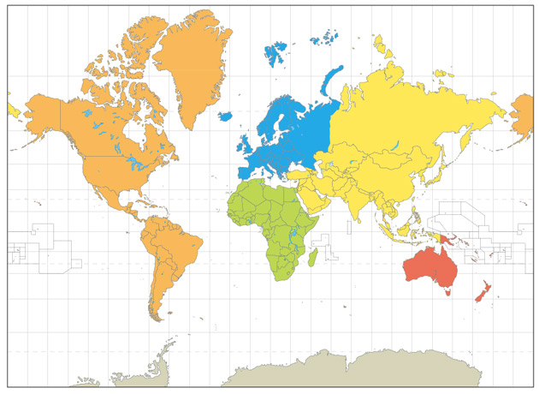
Mercator Map

Slide 36
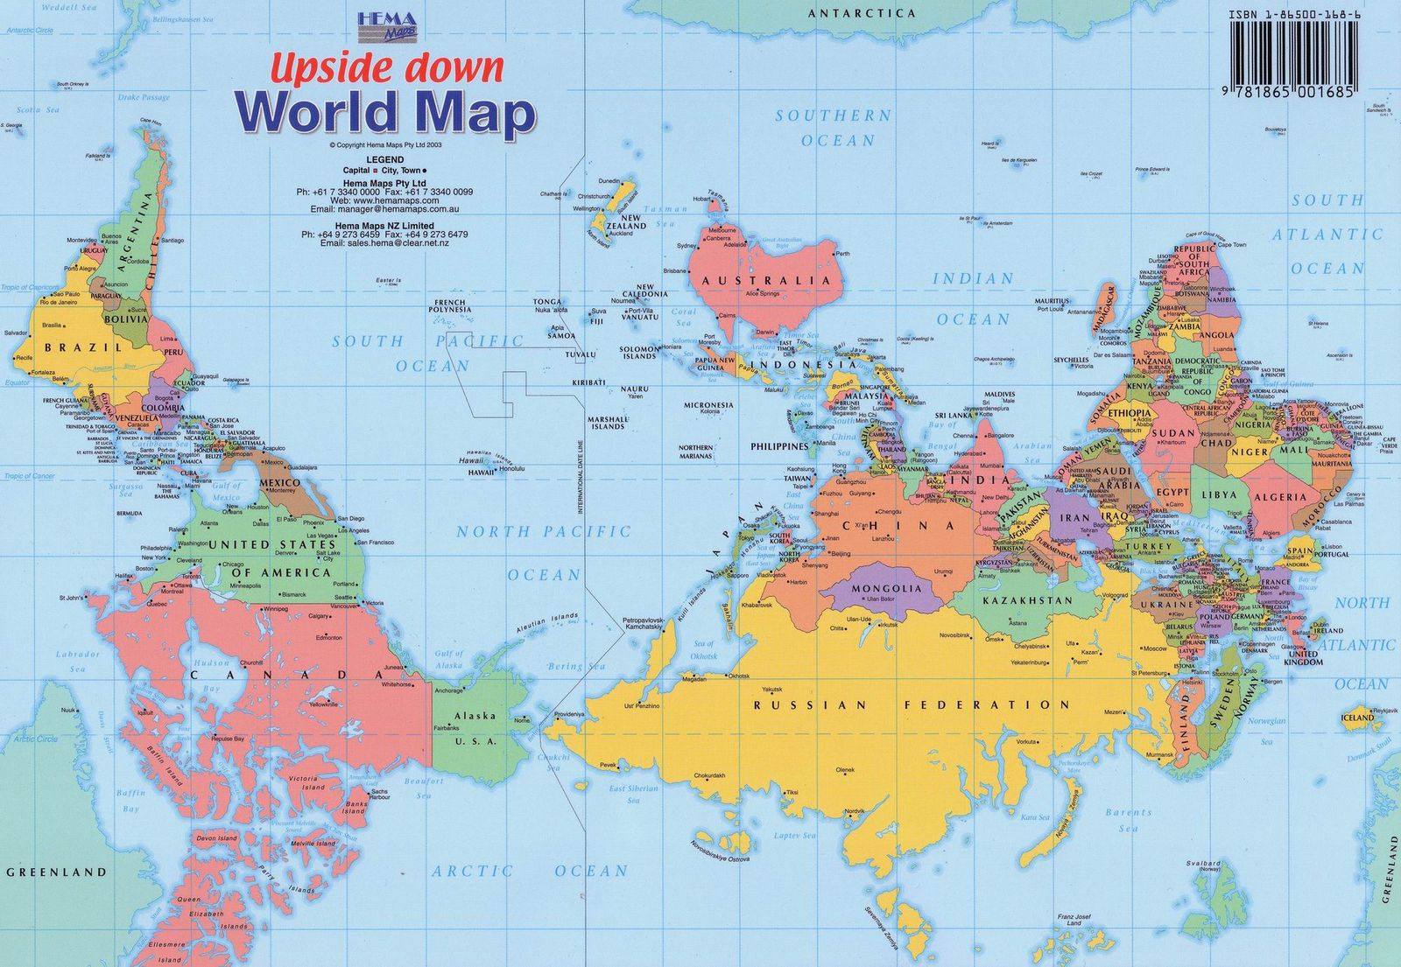

Slide 37
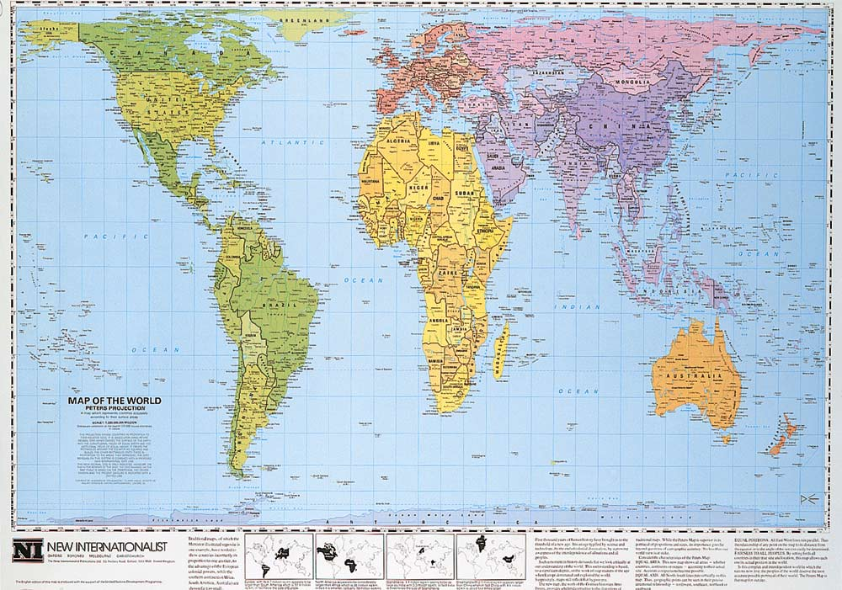
Peter’s Projection Map
HOW THE WORLD WORKS
Mapping our world

Slide 38
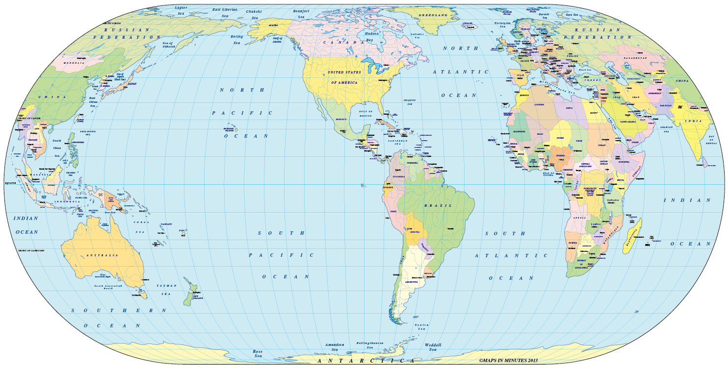

Slide 39
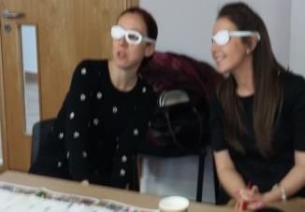
Why are we changing the maps? – Unsettling and further reflection of fundamental assumptions https://www.youtube.com/watch?v=eLqC3FNNOaI
I was shocked to find out that what we have been taught our whole life was wrong. It made me consider what else we have been taught that is wrong (Teacher B).
Notes:
The next step is the ‘unlearning’ or ‘deconstructing’
The unlearning process was initiated using a clip from ‘The West Wing’ (‘Why are we changing maps? https://www.youtube.com/watch?v=eLqC3FNNOaI) as suggested by Campbell and Baikie 2013 as a means of challenging assumptions and the notion of a ‘world view’.
Show clip
The clip takes you through Mercator maps and relative country sizes and positioning to the Peters projection map (on your tables) and the up-side down map (table)
At this stage I hand out A4 copies of the Peter’s Projection map, Upside-down map and the Eckert VI (GA suggested).
Many teachers go very quiet at this stage – it is best to leave them for some time to digest this video, explore the images and discuss amongst themselves.
Once ready, you can gather their thoughts/impressions.
Learning Point - Not only do our influences affect our world view, our world view is subject to influence.
This highlights Andreotti’s ‘colonial framing’ of the world quite well.
This is a surprisingly ‘unsettling’ experience for the participants. By questioning a fundamental assumption of knowledge it allowed all other ‘layers’ to be subject to scrutiny. It was also a liberating experience as it opens up new possibilities and avenues of thinking or questioning and is usually referred to throughout the session.
Participants themselves rate this intervention high in terms of impact on almost all session I have run it.

Slide 40
‘Charity is finding a baby drowning in a stream and pulling it out; charity is pulling out a second baby and a third baby that come floating down the stream….Justice is going upstream, finding out who’s throwing the babies in and stopping them at source’
Dean Scotty McLennan,
Stanford Memorial Church
Notes:
These are the types of values that development education can foster:
Empathy not sympathy: Empathy is about feeling with other people, sympathy is about feeling for. (I’ve put some cartoons in the folder for this)
It’s important that we try and put students in the shoes of people affected by the global issues we are covering and make sure that they feel with instead of feeling sorry for people who are affected by the issues learned about in class.
Solidarity not charity: It’s important to instill a sense of solidarity in our students that we stand with people as our fellow human beings to work together on the root causes of global injustice instead of seeing people as ‘charity cases’ and resorting to fundraising as the only action to ‘help’. Making connections with how our lifestyles and behaviours can impact the world’s people and planet is a good place to start.
Respect for self – in a just & democratic society respect for self is central to the flourishing of the well being of both the individual and the wider community. Respecting oneself brings both the capacity to act autonomously & to be self-motivated. It is an essential pre-requisite to have respect for others & to be concerned about their concerns.
Respect for others and human rights for all– in a pluralist democracy the disposition to respect & care for others are central to living interdependently. The positive relationships forged among individuals & groups are essential to the development of qualities such as cooperation, interdependence and respect for a diversity of people & cultures, which allows us to live and work in the realities of the world of today – and the future.
A sense of social responsibility – in a society geared to the general well being of all, it is essential to develop a commitment to social responsibility based on the critical scrutiny of information and evidence within an awareness of power relationships, principles and traditions. Such a disposition to social responsibility should also entail a commitment to social justice and equity and the sustainable use of the environment.
A sense of belonging – world citizenship depends on a disposition to be part of the enterprise as a whole, a commitment to common purposes that goes beyond personal interests, a willingness to participate as an active citizen, engendered by an understanding of the world as a place where each individual feels valued, and where both group & individual concerns and opinions are respected.
A commitment to learning – in a world increasingly characterised by change and adaptation the need to have a disposition to learning, to making new connections and new meanings, is fundamental. This would also need commitment to procedural values such as: willingness to adopt a critical stance towards information; willingness to give reasons why one holds a view or acts in a certain way, and to expect similar reasons from others; respect for evidence in holding and forming opinions; willingness to be open to the possibility of changing one’s own attitudes and values in the light of the evidence.
Belief that you can make a difference-We can actually effect change! There will be times when you and your students may not think that you are having any impact so don’t lose heart and let your teaching and learning slide into apathy.

Slide 41


Despite a lot of DE activity in Ireland, research tells us:
Students have high level of concern and interest in the issues
Low levels of understanding about the root causes of poverty and inequality
DE is often defined as Fasting, Fun and Fundraising
National Survey of Third Level Students on Global Development, Jan 2013, SUAS
Development Education in Irish Post-Primary Schools – Knowledge, Attitudes and Activism, 2007

Slide 42
How should I approach the chosen DE theme(s) or issue(s)?
Make connections→ between the local and global. This should be a key focus, regardless of the DE theme(s) you are exploring.
Explore the root causes→ of the theme(s) you have chosen, and examining it from a global justice perspective: Who is a effected by this issue? Who is responsible? Is it fair? What can be done to address it?
Exploring viewpoints and perspectives on the theme(s) →It is vital that time is given to exploring multiple perspectives, as it allows you to acquire a more comprehensive understanding of these theme(s) .
Reflect on your DE work→ For example, what have you learned about yourself, your communities, and the wider world as a result of this process?

Slide 43
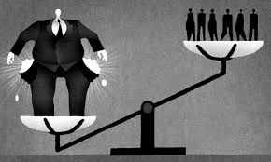
Asking the right questions!
The most important question of all when exploring global issues, injustice and inequality…WHY?
Ask Why 5 times and you should get to the root of the problem. Here are some other questions you might consider:
-Whom does this issue affect?
-What are the root causes?
-What are the consequences?
-What’s our connection with the issue?
-Who has the power?
-Who is responsible?
-Is it fair?
-What can be done to address it?

Slide 44
Plans for opting out?
15 minutes
What should we call it?
How much can we mimic ET Ethical Education Curriculum?
Let’s choose some topics?

Slide 45
TYPES OF ACTION?
Raising Awareness
Using the Sport & the Arts to get your message across
Mobilising for individual change
Campaigning for Change:
-In your school
-Influencing national & international policy
Notes:
When taking action students should be able to:
Choose an issue to take action on and explain why they have chosen it. Don’t jump straight into the action part-explore the issue in depth first.
Identify an appropriate way of taking action on their chosen issue, justifying reasons for choosing this approach.
Work in groups to plan their action
Consider what they have learned about their chosen theme in planning their actions.
Whatever action you choose, students should try to reach as many people as possible and to involve as much of the school community in order to have a greater impact. Along the way students should communicate their chosen actions.
“The most common actions that take place in schools are fundraising activities. After having completed this year, I feel it is more important to be creating awareness in schools of the issues that are affecting people locally and globally. Fundraising can play a part of this however education is key”. Orla McGuinness, Teacher at Errigal College
Below are many suggested actions you and your students could take but it’s certainly not exhaustive-every year, students are coming up with creative and engaging ways to change the world. When brainstorming with your students on taking action why not use the following list and ask the students to rank them in groups to come up with a general consensus on the actions that will be taken.
1. Raising Awareness
Create a website or social media page to raise awareness of the issue and ways that people can take action.
Develop a series of lessons for classes in your school on the issue and what they can do. This will help you reach more people and have a greater impact.
Make a video, audio or photograph presentation to stimulate discussion about the issue, and get people to debate it.
2.Be creative!-Using the Arts to get your message across
Something really unique and creative will attract attention for the issue you’re working on. Winners of this year’s YSI WWGS One World Award, Our Lady’s College, Greenhills, had an exhibition of photos of their teachers aged 13 to highlight the fact that the most common age for girls to be trafficked is 13.
Organise an art or poetry show, or other creative platform, at your school or in your community around the issue(s) you have been exploring.
Margaret Aylward Secondary School explores global issues through art amongst other subject areas. In 2016, they explored the issue of migration simulating the experience of having to travel by boat across dangerous seas. The students put themselves in the shoes of people forced to flee and discussed and listed the items they would bring on the boat. After much exploration of the issue, they set about making their own boat out of clay, firing it in the kiln etc. The Botanic Gardens agreed to exhibit their boats on a pond in the gardens in the summer of 2016. The boats were on show again in May 2017 in the Ballymun Axis. Alongside the boats, artwork from students living in a refugee camp in Greece about their journey was displayed. The students also exhibited their memes work on the Global Goals and their pottery spoons as a result of exploring Goal 2-No Hunger. Students gave workshops on issues of migration and the Global Goals to accompany the exhibition.
Create a installation, sculpture or mural on the issue and display it in your school and in the local community. Ashbourne Community School’s TY students painted a mural of the Global Goals in their school yard-see it pictured here.
Perform a play on how the issue affects people, for example, in assembly, or in other schools. Could DE be incorporated into your school musical? Beaufort College, Navan (hyperlink to case study on the Global Passport section) did just that and had a Global Goals musical (pictured here)
Create a film to raise awareness on your chosen theme(s) and survey the change in attitudes of the audience before and after the film.
3. Mobilising for individual change
Find out what individual actions can have a positive impact on the issue you are focusing on and mobilise the student population to take these individual actions.
Take personal action: make choices about your life based on what you have learned, for example, change what you eat, wear and spend money on.
Students are very open to action if inspired in the right way. Alan Curran St Macdara’s Community College
4. Campaigning for Change!
In your school
Develop an action plan on your chosen theme(s) and present it to school management
Find out what policies or practices your school has in place (or has not) that might affect change on the issue you’re working on e.g. if learning about deforestation-can you reduce the amount of paper being used and make the connection!
Make your school and/or community a Fairtrade School or Fairtrade Town. (Picture: St Joseph’s SS Rush)
Influencing national and international policy
Find out which organisations can help you, and join their local, national or global campaigns.
Sign up for the Concern Campaign Academy to build students campaigning skills.
Set up your own on line petition at www.change.org
Speak to (put our arguments to) someone in a powerful position, for example, writing a letter or an email, sending a petition or an opinion survey, or visit him or her.
Invite one of your local TD to the school for a discussion about your chosen theme, find out about the policy, and prepare questions.
Lobby a politician on a specific piece of legislation/policy.

Slide 46
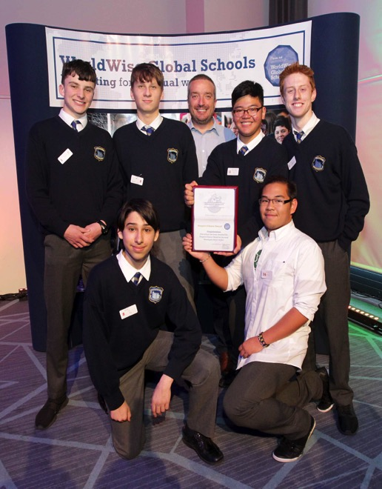
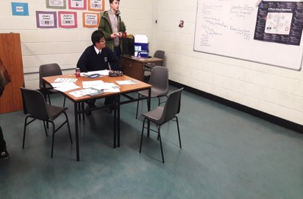
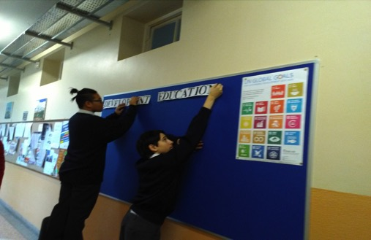

Slide 47
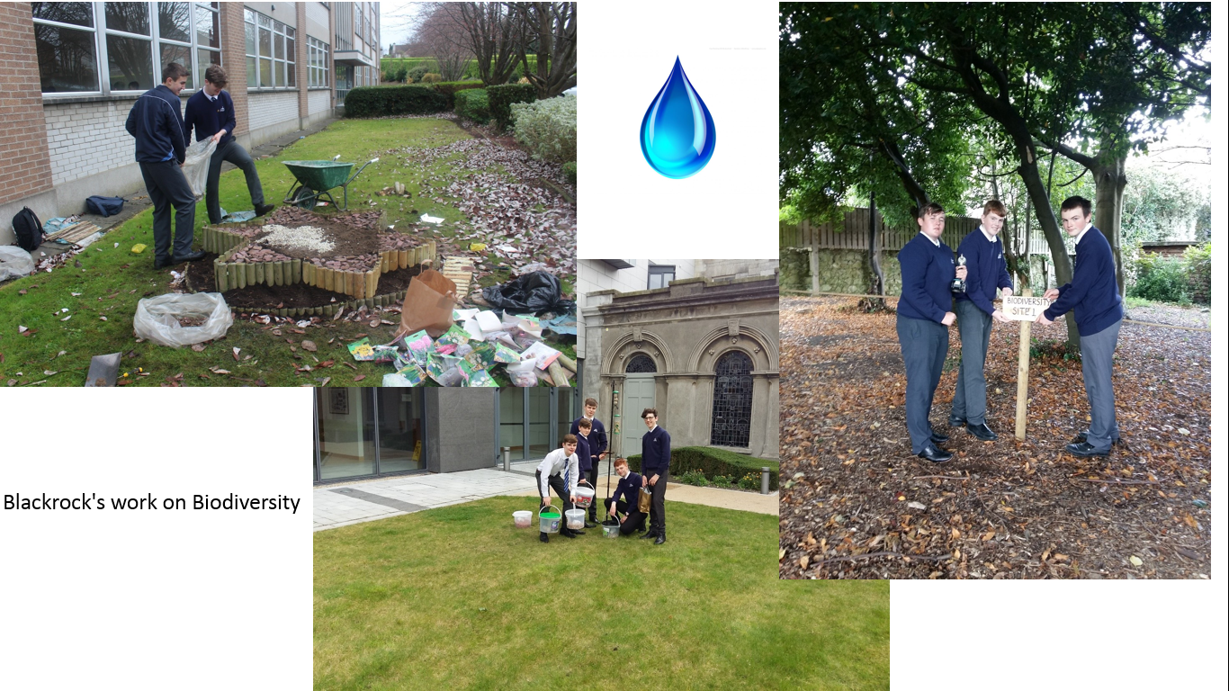
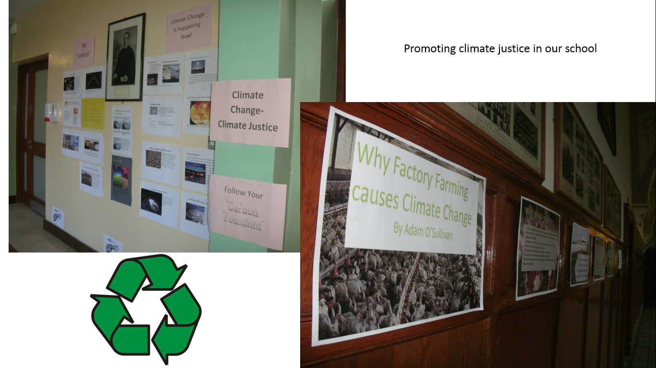
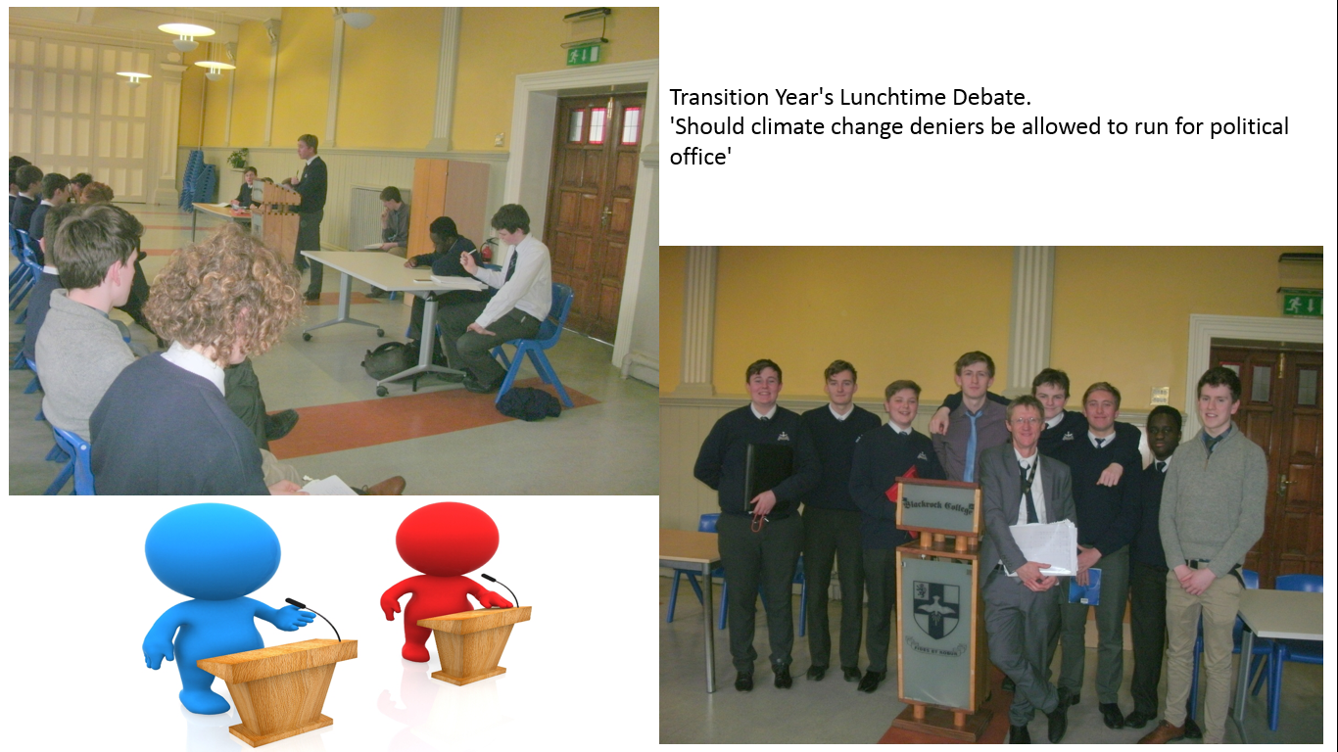
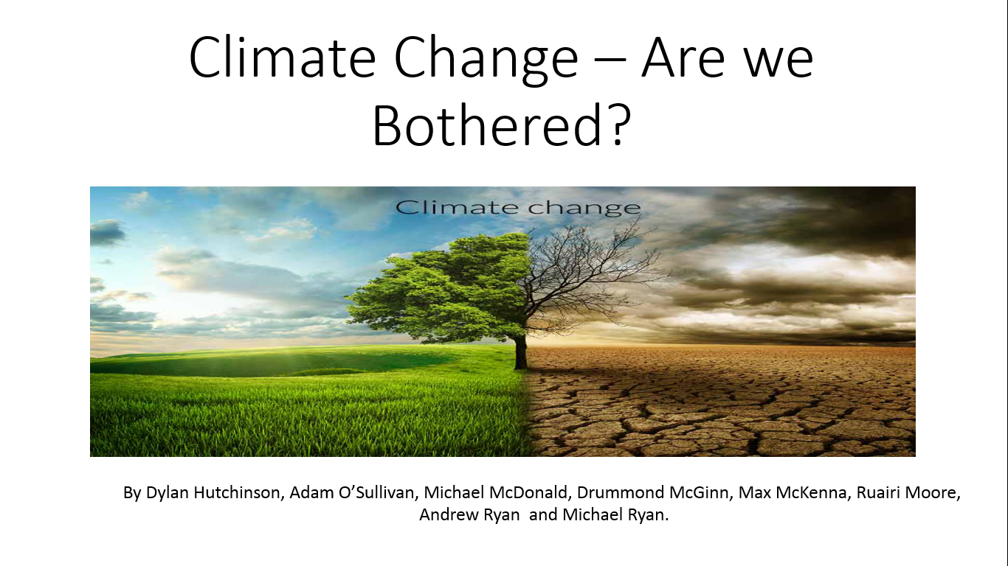

Slide 48
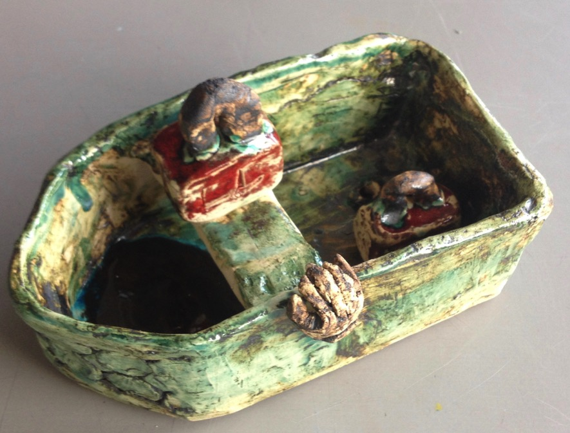

Slide 49
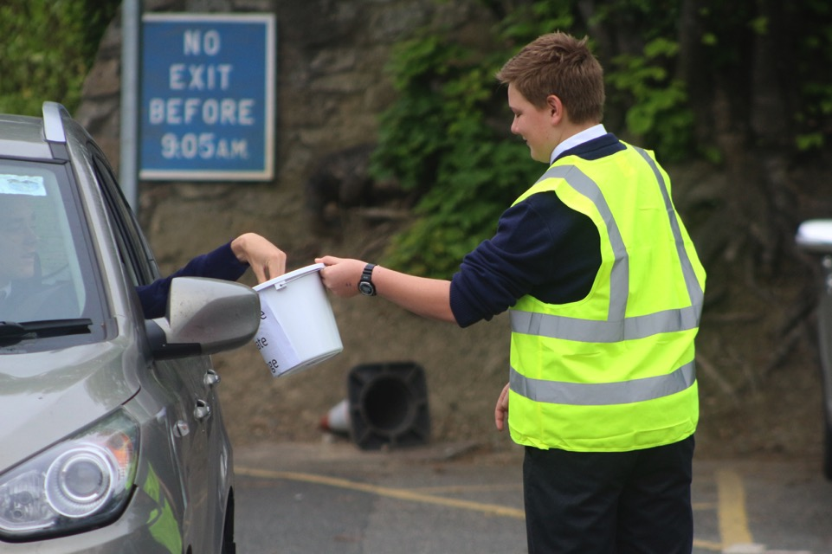

Slide 50
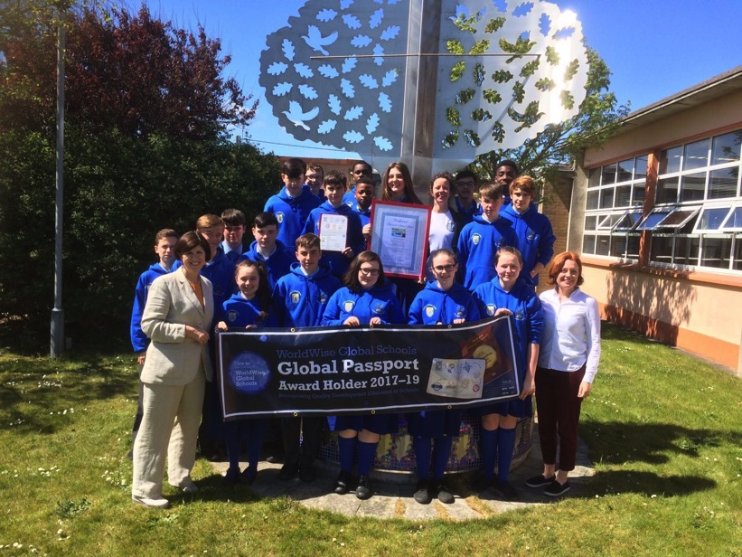
Notes:
Music dept looked at migration as an issue when preparing for Grease

Slide 51
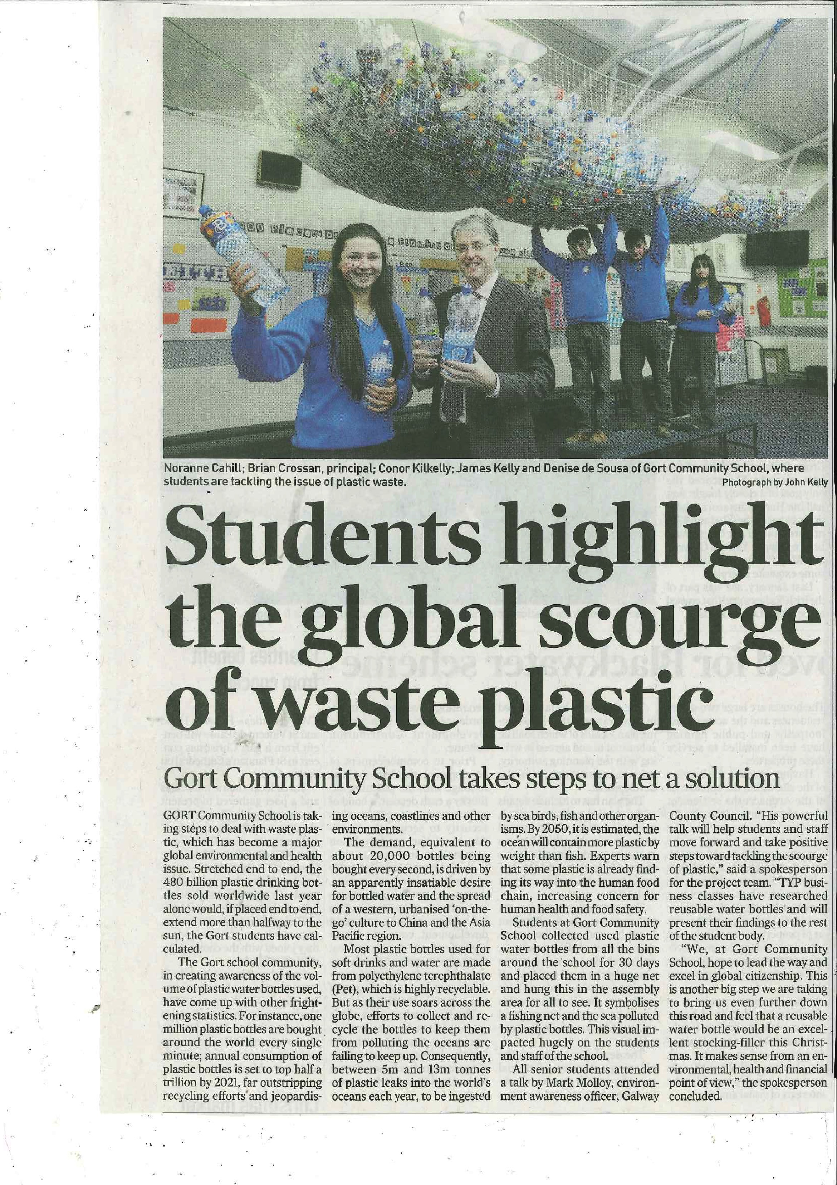

Slide 52
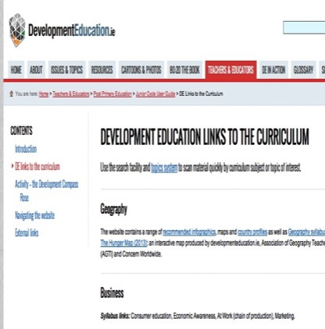

Teaching and learning material www.worldwiseschools.ie www.youthdeved.ie
Developmenteducation.ie globaldimension.org.uk worldslargestlesson.globalgoals.org
Notes:
Already using Global Teacher sharing resources on your One Drive

Slide 53
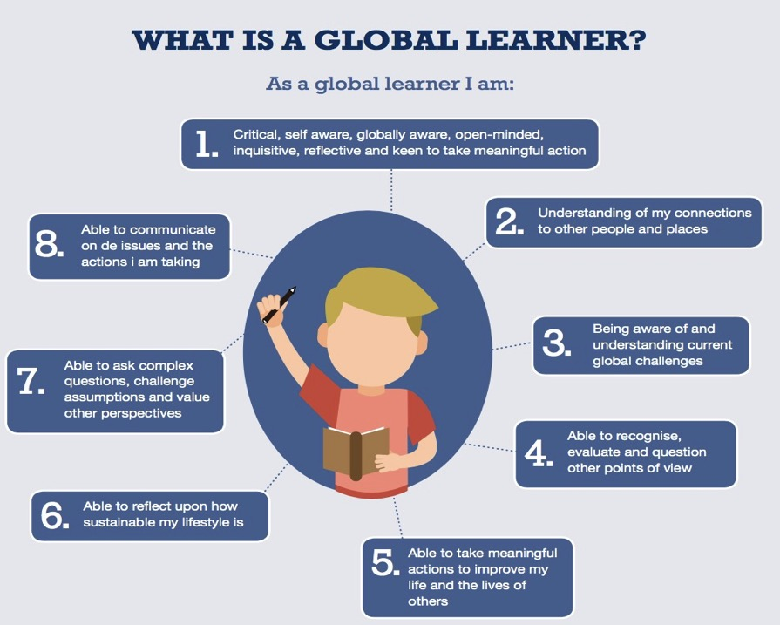

Slide 54
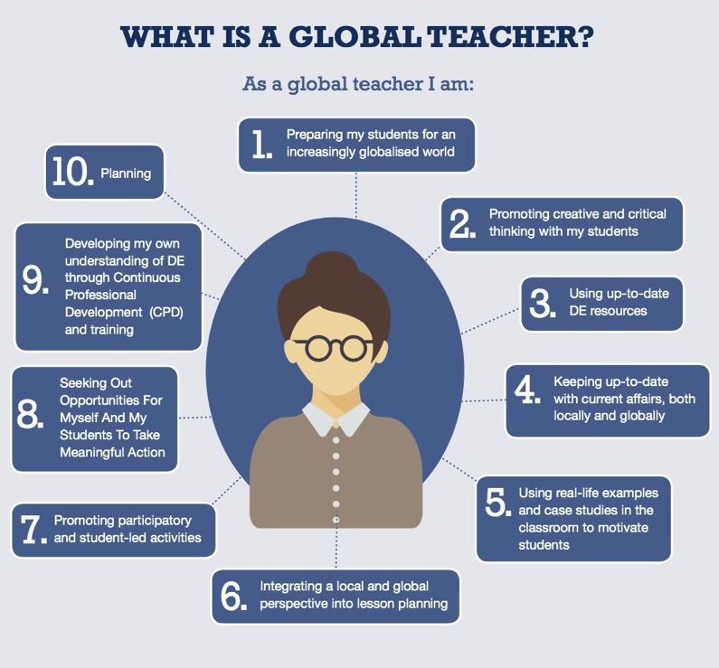

Slide 55
Thank you!
Questions???
Lizzy.noone@worldwiseschools.ie
www.worldwiseschools.ie

