Slide 1


Recycling & Waste
WWGS Thematic Online Training Series
LIZZY NOONE, DUBLIN
LAURA CAHILL, CORK
Notes:
Welcome
- Introduce ourselves
Type in your name and the name of your school in the chat! Also change your name on your Zoom to your first name
Invite people to use the chat

Slide 2

Hopes & Fears
- What do you HOPE to get out of todays session?
- Any FEAR about todays session?

Slide 3
Housekeeping
To mute and un-mute
Turn your camera on
Please use the chat function

Slide 4

Session Plan
An Introduction the Global Issues around Recycling and Waste
Claire Downey, Community Reuse Network Ireland (CRNI)
Schools Experience of Exploring Waste as a Justice Issue
Breda Geoghegan, Loreto Secondary School, Clonmel
Break & Reflection
Recycling and Waste: from Knowledge to Action
WWGS 6 Step Programme
Reflection and Next Steps
Notes:
Todays session will be broken into 3 key areas:
Read through slide

Slide 5

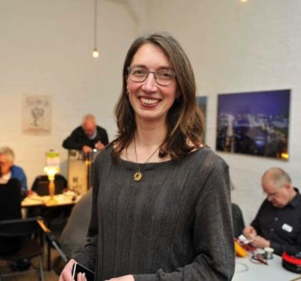
An Introduction to Waste and Recycling as
Global Justice Issues
Claire Downey, Community Reuse Network Ireland (CRNI) Executive
Notes:
Ran repair shops

Slide 6

TEACHER INPUT
Breda Geoghegan, Loreto Secondary School, Clonmel

Slide 7
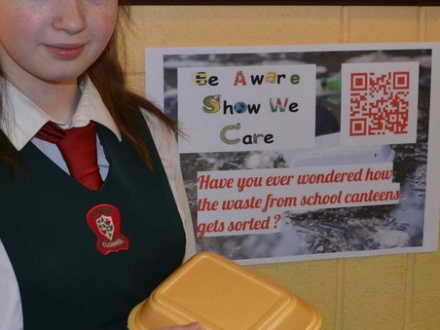

Slide 8
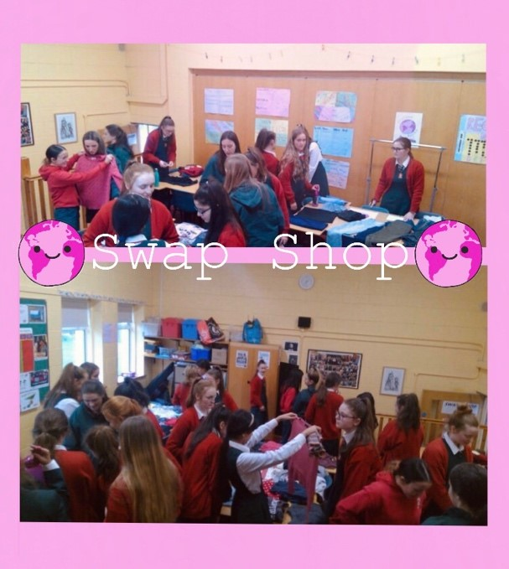

Slide 9

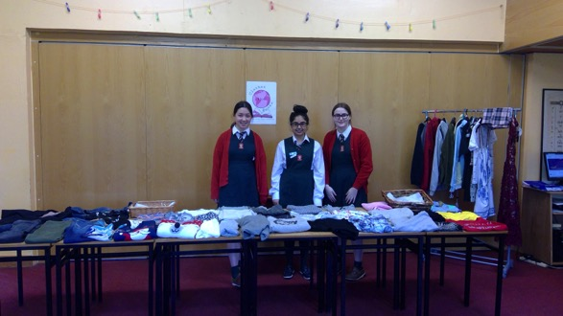
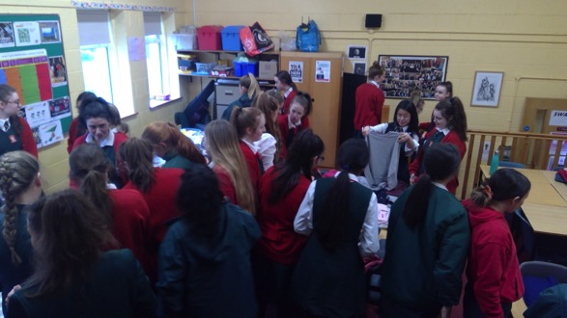

Slide 10
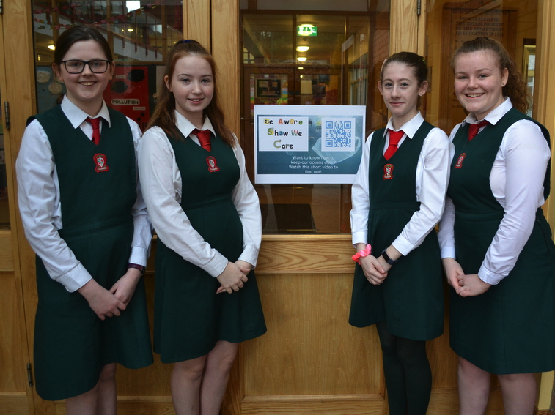

Slide 11

Reflection
Reflect on what you’ve heard this morning..
Consider:
- What are your initial thoughts/ feelings
- Your approach to exploring waste with students

Slide 12



Slide 13
Reflection in Pairs
Share your reflections on:
- Your initial thoughts/ feelings
- Your approach to exploring waste with students

Slide 14
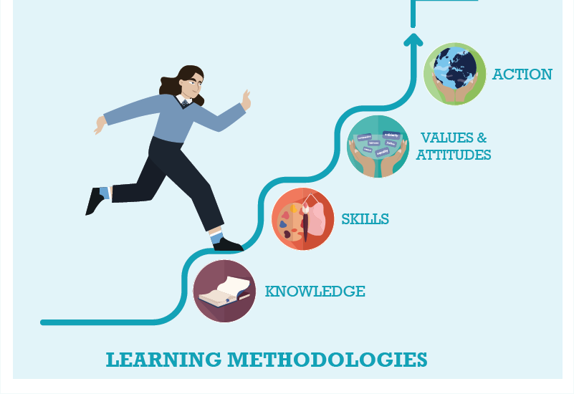



WWGS: 6 Step Programme
Waste as a justice issue: from Knowledge to Action
Page
22

Slide 15

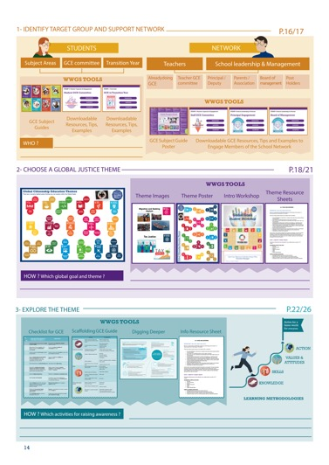
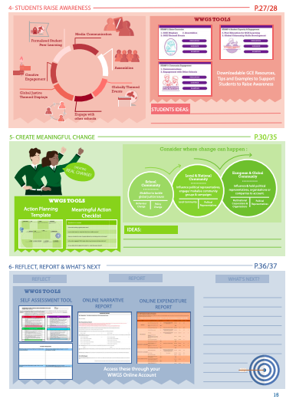
Page
14-15
Notes:
Briefly talk through the 6 steps

Slide 16
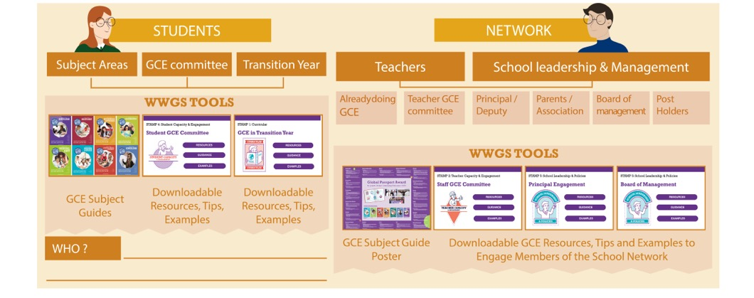
Pages
18-19
STEP 1:
IDENTIFY TARGET GROUP AND SUPPORT NETWORK
Notes:
Ask everyone to reflect on the student group they intend to work with and who in the school they can engage as a support network. Remind them that it’s not all about TY!

Slide 17

TASK:
Consider:
What opportunities are there to explore
Justice issues around waste in your subject area(s)?

Slide 18

http://www.worldwiseschools.ie/6-step-programme/
Pages
18-21
STEP 2:
CHOOSE A GLOBAL JUSTICE THEME
Notes:
Introduce the step and the tools available – invite them to use their phone to view the tools on their 6 step programme

Slide 19
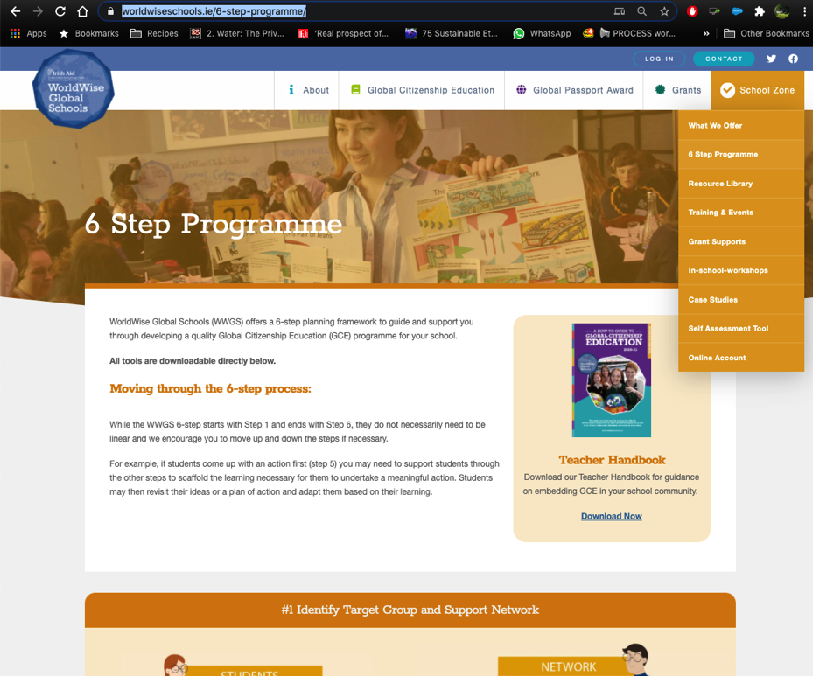

Slide 20

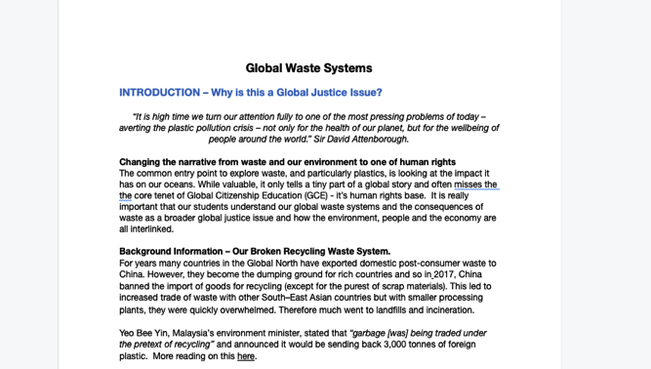
1. Hover over the symbol and a drop down menu appears!
2. Click on the theme and the resource sheet will pop up!
Notes:
Intro to thematic information sheets

Slide 21
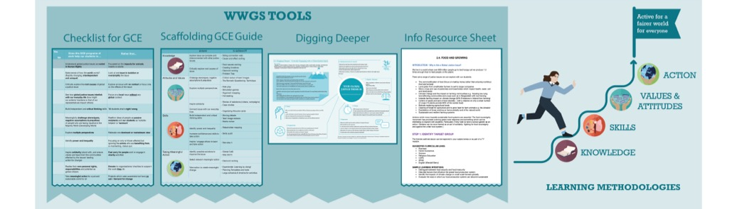
Pages
22-26
STEP 3:
EXPLORE THE THEME
Notes:
Be sure to change to your own date here!!

Slide 22
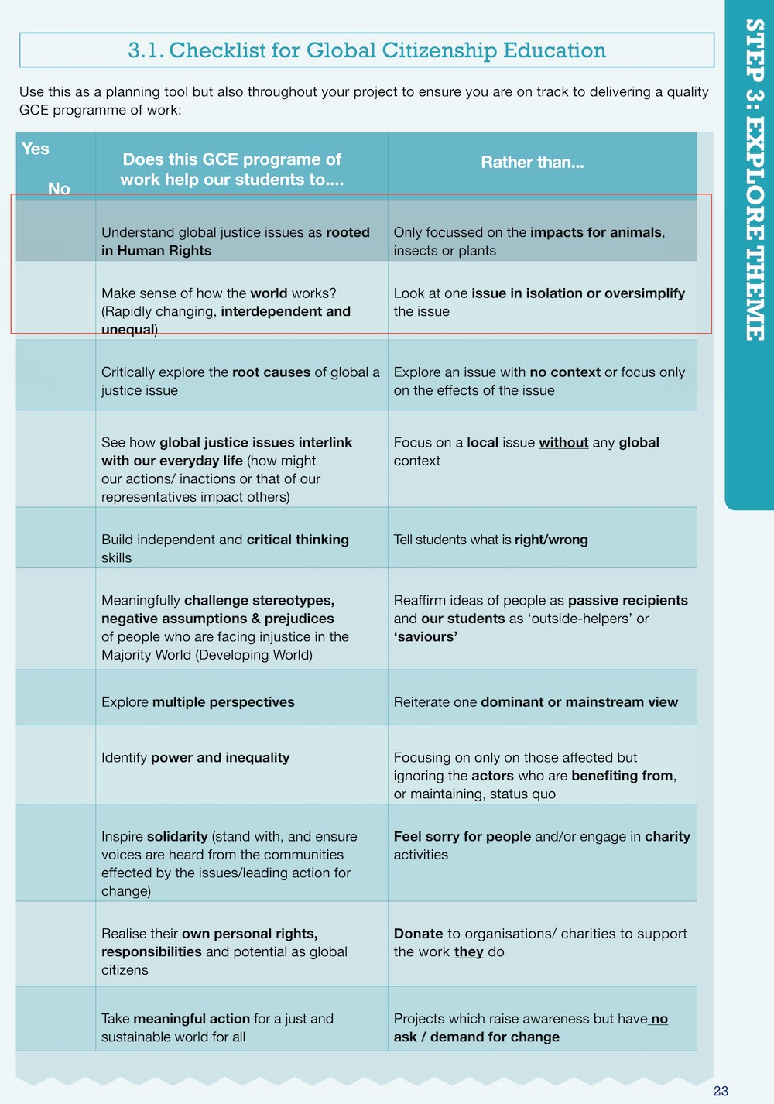

Slide 23
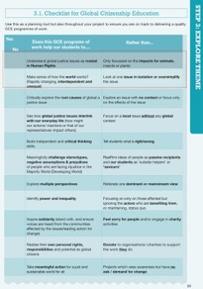
Task
Instructions
Review the two points on the GCE checklist which have been framed in red
What practical things can you do to ensure that your take a GCE approach to waste in the classroom?
(ensure it falls into the left column and not the right?)
Notes:
Room 1: https://docs.google.com/document/d/1ADSyfeoNwfrDDegX8E_FhGlOnjgYYM7CuKnYW5mhv7g/edit?usp=sharing
Room 2:
https://docs.google.com/document/d/1GFRoNr_DzpuzIVtSATNCvYrNNgG5kDTwZKcrn3hX8to/edit?usp=sharing
Room 3
https://docs.google.com/document/d/1v2aWuQhkaG3XTZlR24cu63LkKnSu_45V1nEHTTcnPoo/edit?usp=sharing
Room 4
https://docs.google.com/document/d/1B8L4PpZGmOZsfR0OuFbJ5J6d41v9w5jQui0UU2w6wEw/edit?usp=sharing
Room 5
https://docs.google.com/document/d/1u9pBYugUSs0JP5a5hQ2cHqTDEfWxKx1eP8xGm83Rc40/edit?usp=sharing

Slide 24


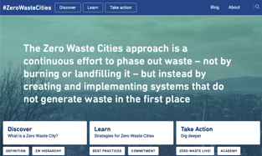

STEP 3: EXPLORE THE THEME
TEACHING AND LEARNING MATERIALS: Information websites:

Slide 25



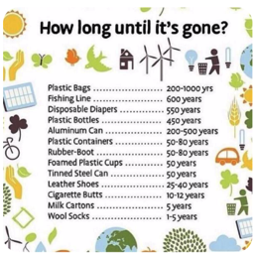

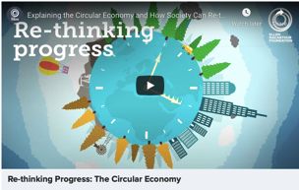
STEP 3: EXPLORE THE THEME
TEACHING AND LEARNING MATERIALS:
Activity Resources:
Short Documentaries:
Infographics
Short Videos:

Slide 26
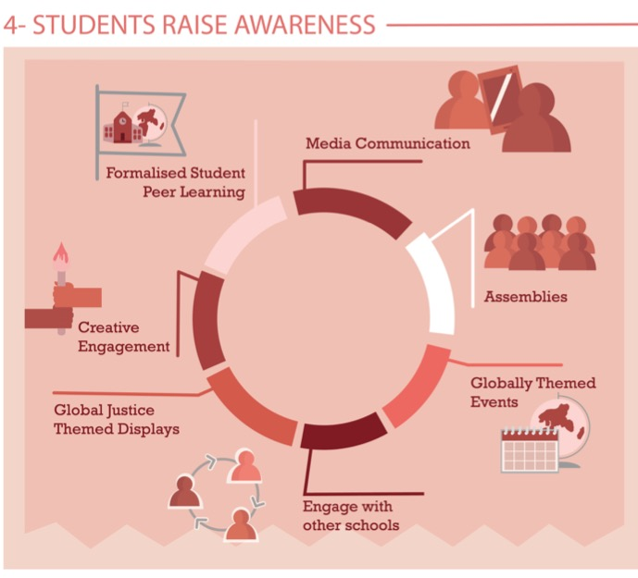
Share Learning
Pages
28-29
Notes:
Media Communication
Assemblies – Intercom
Themed Events –
Global Justice themed displays
Creative engagement
Formalised peer learning

Slide 27
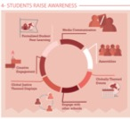
Celebrate National Reuse Month – show the videos in classes
Celebrate UN days of action:
    Food Loss and Waste Reduction 29th September.
    World Creativity and Innovation day - 21st April
    Valuing our Cities and Communities day - 31st October
Learn and create awareness campaign – myth busting around waste and recycling – showcase circular economy
Do an online workshop on upcycling/ waste management/ sustainable design – share your learning with other students & showcase your work

Slide 28
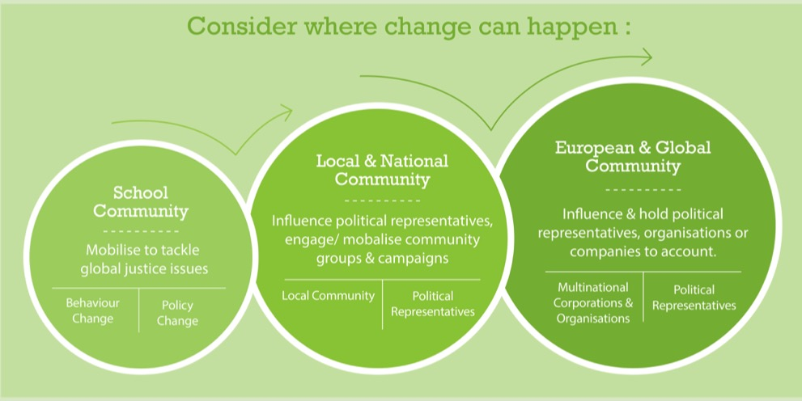
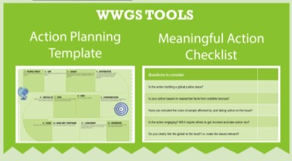
Page
30-35
STEP 5: TAKING MEANINGFUL ACTION
Aims to create Actual Change

Slide 29

STEP 5: TAKING MEANINGFUL ACTION
Ideas for School Community Actions:
Campaign on careful and ethical consumption
Run a repair café for your school e.g. clothes, bikes
– Create a waste policy with key stakeholders
Ideas for Local and National Community Actions:
- Participate in or organise events, activities, discussions on the issues of waste and importance of zero waste initiatives. Showcase actions and organisations/ community initiatives (Ideas on CRNI website). Stream an event online!
Start the journey to become a zero waste city – Voice
Ideas for European and Global Community Actions:
Join campaigns based on the UN Basel Convention on Waste.
Campaign to accelerate a systemic transition to a circular economy to drastically reduce natural resource use and greenhouse gas emissions – analyse and campaign on the 10 priorities of zero waste Europe
Tearfund – Rubbish Campaign to challenge corporations waste
Trash tied to Trade – start a campaign
Planned obsolesce campaigns
Buy nothing campaign

Slide 30
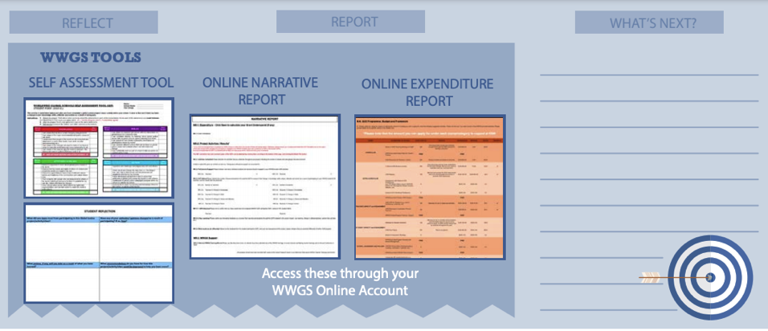
STEP 6:
REFLECT, REPORT AND WHAT’S NEXT?
Pages
36-41

Slide 31

- What are the steps are you going to take next?
- What supports do you need?
Reflection & What Next?

Slide 32
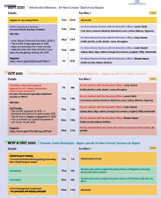
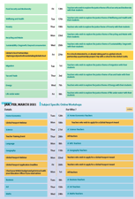
Upcoming Dates
Pages
4-6
Thematic Training Sessions
November
- Anti-Racism: - RECORDED
- Fast Fashion: RECORDED
- Food Security & Biodiversity: RECORDED
- Poverty: RECORDED
- Recycling & Waste: Now!
- Sustainability/ Degrowth: Wed 25th
December
- Migration: Tues 1st
- Tax & Trade: Thur 3rd
- Energy: Mon 7th
- Life Under Water: Wed 9th
- Wellbeing & Health: Fri 11th
Global Passport Award
Webinar 17th of November
Subject Specific Workshops
Jan- March 2020
Notes:
In terms of the breakdown of trainings, outline the 5 types of training
Purple – starter trainings – (today) for new schools and teachers new to GCE (perhaps their school has been involved longer)
Pink – WWGS approach and adapting to covid-19 – for ALL schools and teachers. Even for schools who have been involved for a while. Updated theory and practice
Green – Thematic areas
Blue – subject specific
Yellow – standard WWGS trainings and events. And deadlines.

Slide 33
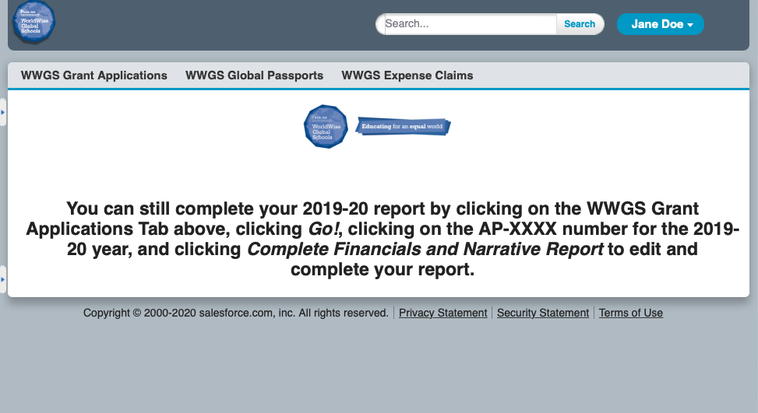
Or, if you think you will have an underspend, use your grant

Slide 34
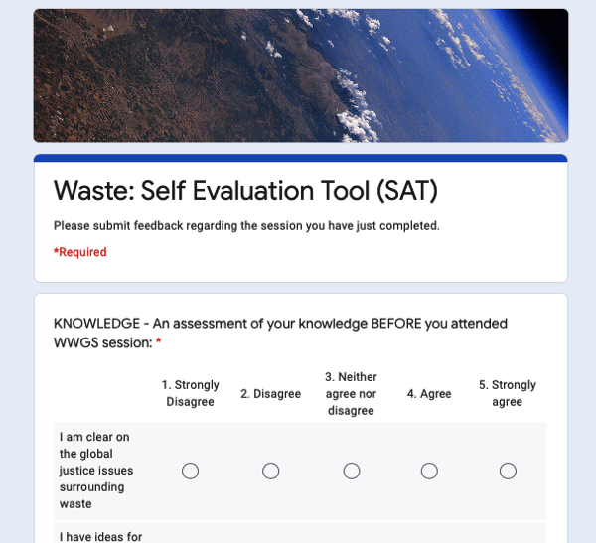
Evaluation for Today
https://forms.gle/8Vm1YJYXwpKfEoNq9

Slide 35



Thank you!
Questions???
Laura.cahill@worldwiseschools.ie
087 3587640

