Slide 1
Exploring Poverty
Aims:
To examine current indicators of poverty and development;
To assess the Sustainable Development Goals as the main policy response to poverty;
To discuss the capacity of the SDGs to support effective development education.
De-growth – what is it and how can it respond to the challenges of neoliberalism?

Slide 2
Key Indicators of Poverty
Half of the world’s population live on less than $5.50 a day;
The world’s billionaires – 2,153 people in 2019 – controlled as much wealth as 4.6 billion people;
The combined wealth of the 22 richest men is more than the wealth of all the women in Africa;
The monetary unpaid work of all women globally is at least $10.8 trillion annually – three times the size of the world’s technology industry;
A wealth tax of just 0.5% on the richest 1% over a decade could create could create 117 million jobs in education, health and other vital sectors.
Notes:
Oxfam, Time to Care (2020) https://oxfamilibrary.openrepository.com/bitstream/handle/10546/620928/bp-time-to-care-inequality-200120-en.pdf

Slide 3
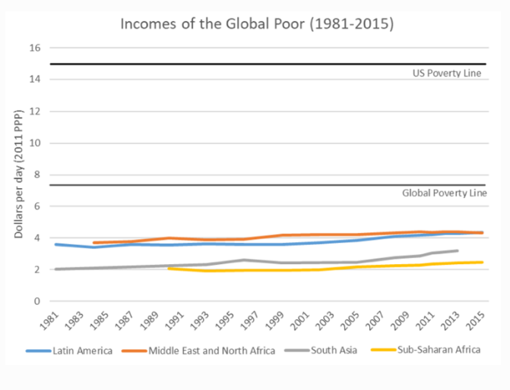
Poverty Trends
Notes:
Jason Hickel: https://www.jasonhickel.org/blog/2019/4/27/200-years-to-end-poverty
The poverty lines used in this graph is $7.40 per day, the minimum necessary for decent nutrition and normal life expectancy. At this rate it will take around 200 years to end global poverty at $7.40 per day, and 500 years to end poverty at the US poverty line of $15 per day.

Slide 4
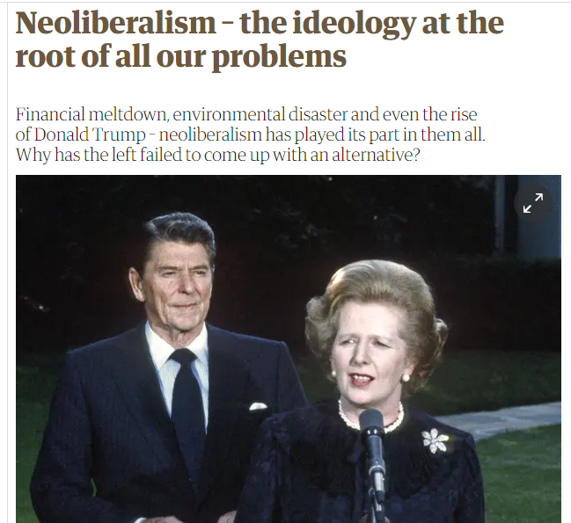
Notes:
George Monbiot (2016) https://www.theguardian.com/books/2016/apr/15/neoliberalism-ideology-problem-george-Monbiot

Slide 5
Neoliberalism Definition
“Neoliberalism sees competition as the defining characteristic of human relations. It redefines citizens as consumers, whose democratic choices are best exercised by buying and selling, a process that rewards merit and punishes inefficiency. It maintains that “the market” delivers benefits that could never be achieved by planning”.
Notes:
George Monbiot, Guardian, (2016) https://www.theguardian.com/books/2016/apr/15/neoliberalism-ideology-problem-george-monbiot

Slide 6
Neoliberal Characteristics
The market knows best – Neoliberals want to reduce the role of the state in economic planning and decision-making;
Trickle-down economics: in a market-based system a rising sea of prosperity will raise all ships – in theory;
Public services – health, education, energy, utilities, transportation – are privatised;
Reduce tariffs on trade – do as I say not as I do;
Tax cuts for the rich and the gradual withdrawal of welfare support;

Slide 7
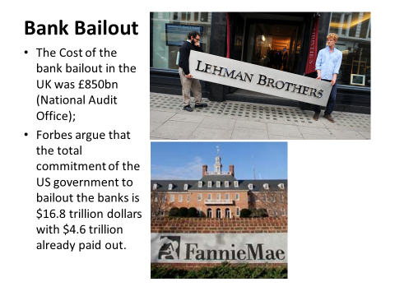
Notes:
http://www.independent.co.uk/news/uk/politics/163850bn-official-cost-of-the-bank-bailout-1833830.html
https://www.forbes.com/sites/mikecollins/2015/07/14/the-big-bank-bailout/#5098f77e2d83

Slide 8
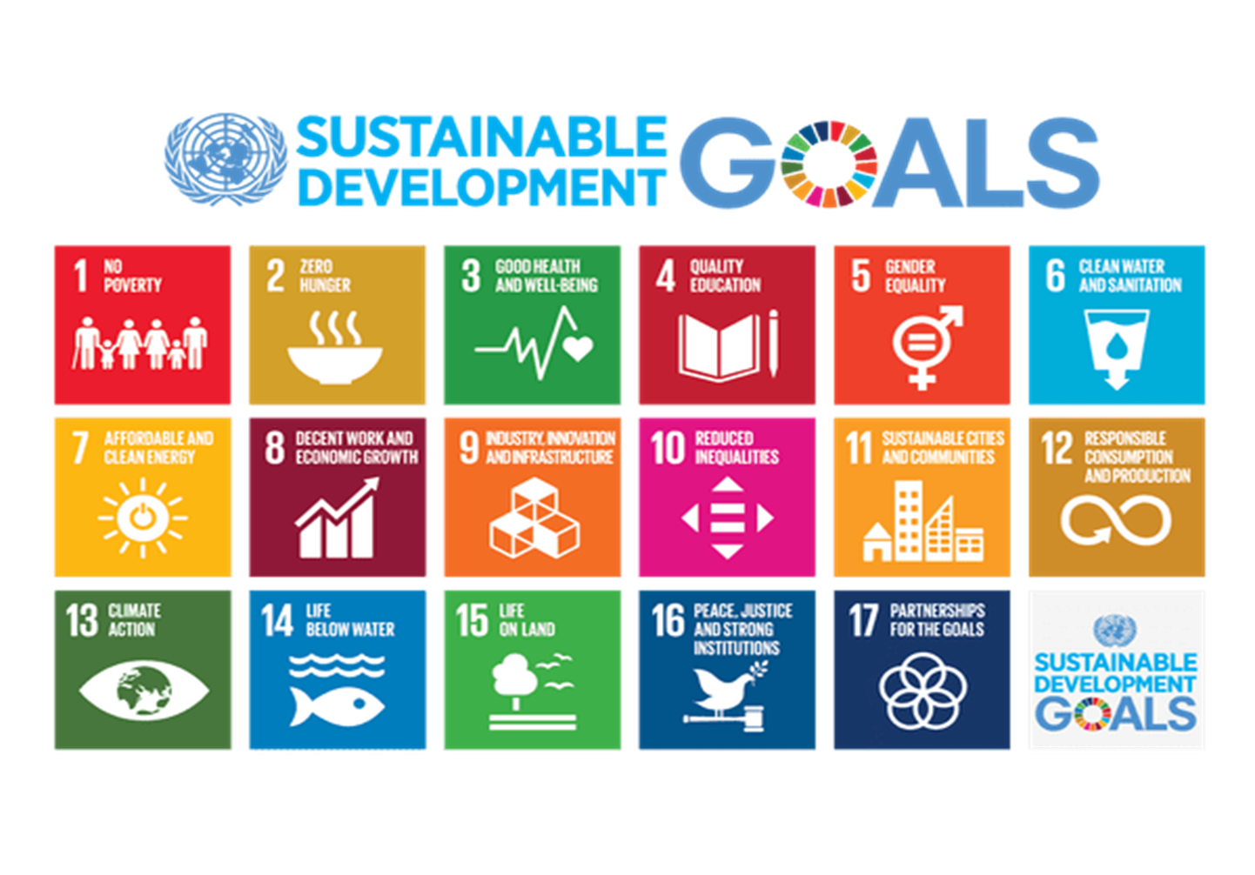
Notes:
https://sustainabledevelopment.un.org/sdgs

Slide 9
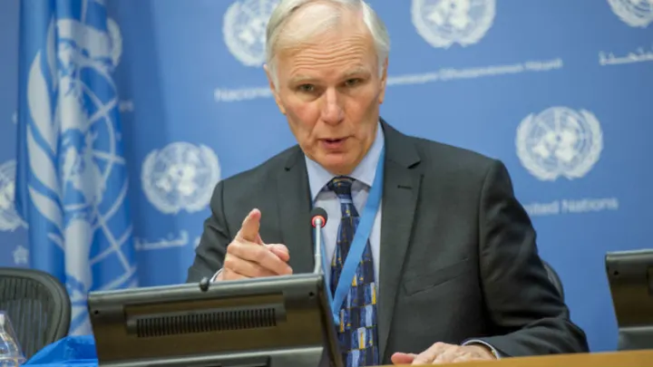
Philip Alston, UN Rapporteur on Extreme Poverty and Human Rights
Notes:
Philip Alston, “The Parlous State of Poverty Eradication” (2020) https://chrgj.org/wp-content/uploads/2020/07/Alston-Poverty-Report-FINAL.pdf

Slide 10
Philip Alston’s Critique of the SDGs
Eradicating poverty: the SDGs, like the Millennium Development Goals before them, use the World Bank International Poverty Line of $1.90 a day as a barometer of poverty. Its too low a level to support a life of dignity.
Human rights: the SDGs fails to frame their targets in the context of human rights. ‘There is not a single reference to any specific civil and political right, and human rights in general remain marginal and often invisible in the overall SDG context’.
Finance: The Goals are heavily dependent on private sector funding which calls into question their sustainability as a public good.
Inequality: The Rapporteur found low levels of attention by governments with this issue, particularly in regard to gender. At the current rate of growth, he argues, ‘closing the gender pay gap in economic opportunity is projected to take 257 years’
Notes:
Philip Alston, “The Parlous State of Poverty Eradication” (2020) https://chrgj.org/wp-content/uploads/2020/07/Alston-Poverty-Report-FINAL.pdf

Slide 11
Philip Alston’s Critique of the SDGs
Evaluation: The Rapporteur finds the annual High-Level Political Forum as a mechanism for monitoring SDG progress as weak and characterised by its ‘voluntary nature’. The SDGs are characterised by “bland reports and colourful posters”.
Growth: The Rapporteur questions the sustainability of the SDG 8’s commitment to achieving 7 per cent GDP growth in least developed countries as ‘likely unattainable’ and ‘at odds with emerging challenges to the traditional growth paradigm’.
Climate Change: The Rapporteur found that the Goals “have had little impact in slowing climate change”.
“The UN and its member states are sleepwalking towards failure...Five years after their adoption, it is time to acknowledge that the SDGs are simply not going to be met.”
Notes:
McCloskey (2020) https://www.opendemocracy.net/en/transformation/poverty-political-choice/

Slide 12
Development Education Definition
Development Education is an educational process which enables people to understand the world around them and to act to transform it. It works to tackle the root causes of injustice and inequality, globally and locally to create a more just and sustainable future for everyone.
Irish Development Education Association (IDEA)
https://www.ideaonline.ie/development-education

Slide 13
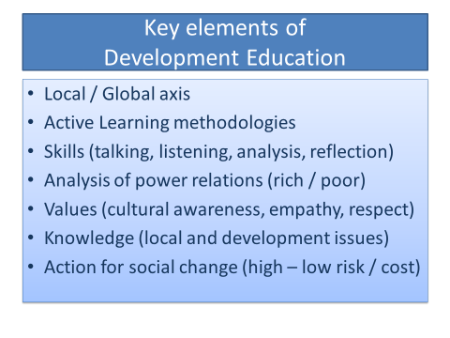

Slide 14
The SDGs:
Soft or Critical Development Education?
Soft | Critical
Raises awareness of the SDGs and aligns the Goals to education targets in formal and informal education. | Challenges the legitimacy of the Goals and their capacity to support critical thinking and transformative action.
Doesn’t challenge the assumptions underpinning the Goals or frame the Goals in an historical context. | Discusses the legacy of European colonialism and how the exploitation of the global South helped to develop the global North.
Promotes active citizenship and critical thinking which evokes actions which are ‘reactive’ to the already existing power structures. | Promotes overtly political actions which directly challenge the prevailing international power structures and underpinning neoliberal agenda.
Notes:
https://www.developmenteducationreview.com/issue/issue-3/soft-versus-critical-global-citizenship-education
Let’s Talk SDGs, Centre for Global Education, 2016 https://www.centreforglobaleducation.com/sites/default/files/Let%27s%20Talk%20SDGS.pdf

Slide 15
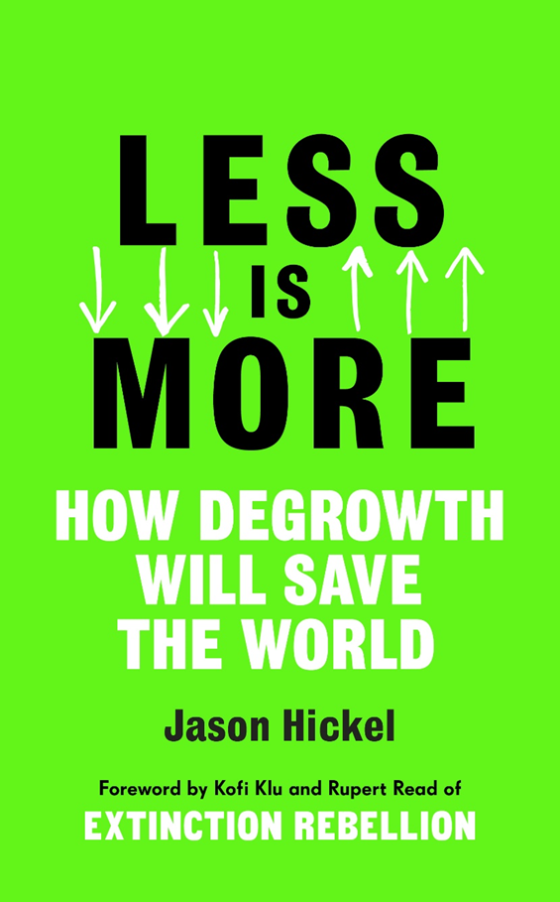
Degrowth

Slide 16
Degrowth Definition
“A planned downscaling of the energy and resource use to bring the economy back into balance with the living world in a safe , just and equitable way.”
Jason Hickel, Less is More, p.29

Slide 17
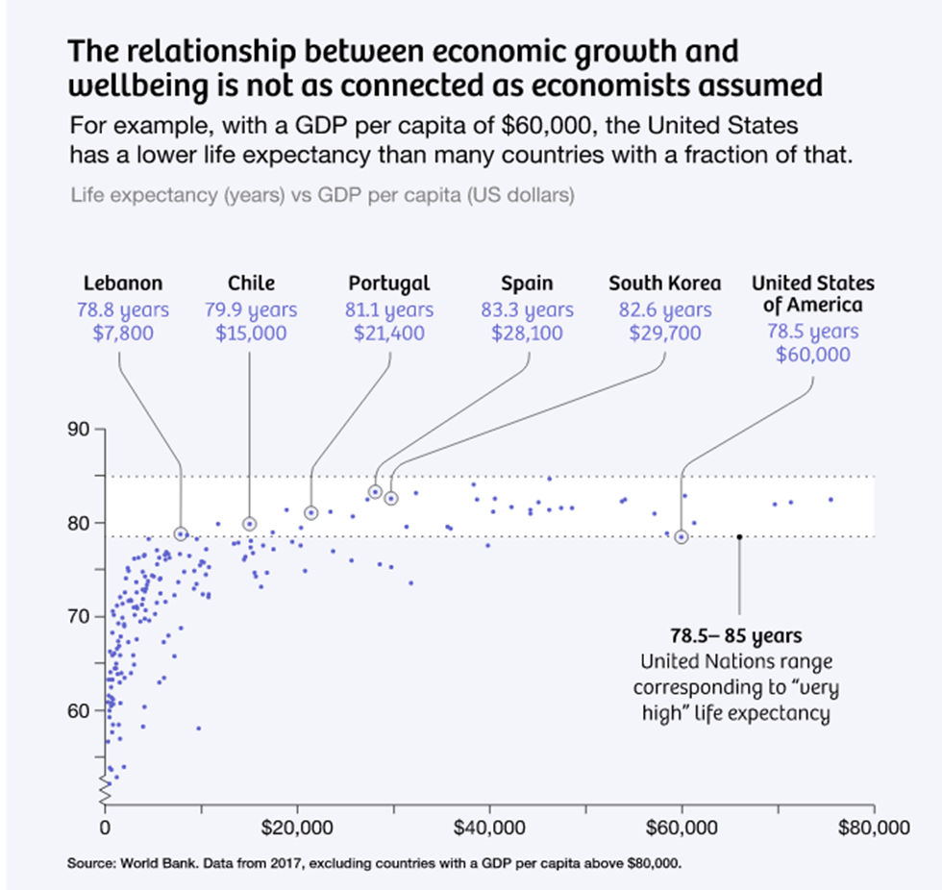
Growth v Life Expectancy
Notes:
Jason Hickel based on World Bank, 2017 $38,000 of US per capita income is wasted. Costa Rica beats the US on life expectancy despite having 80% less income.

Slide 18
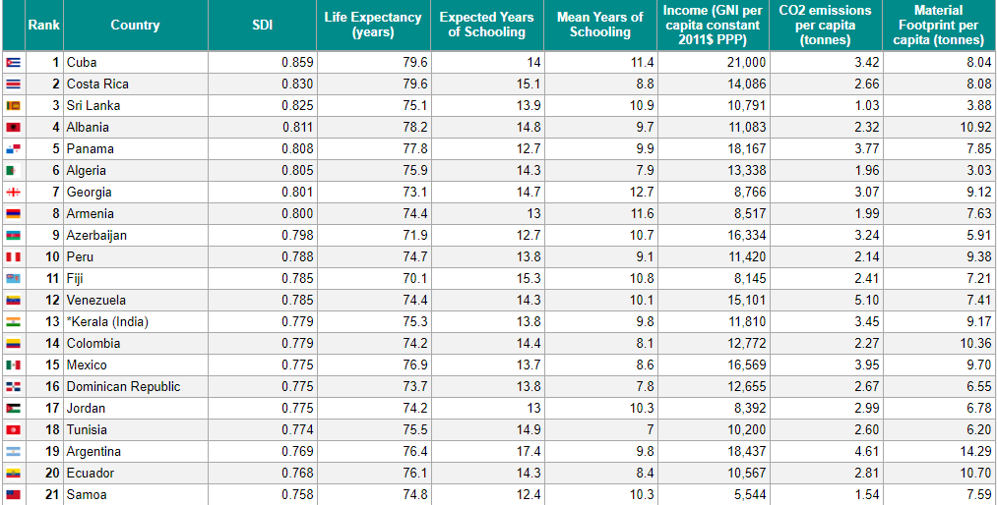
Sustainable Development Index

Slide 19
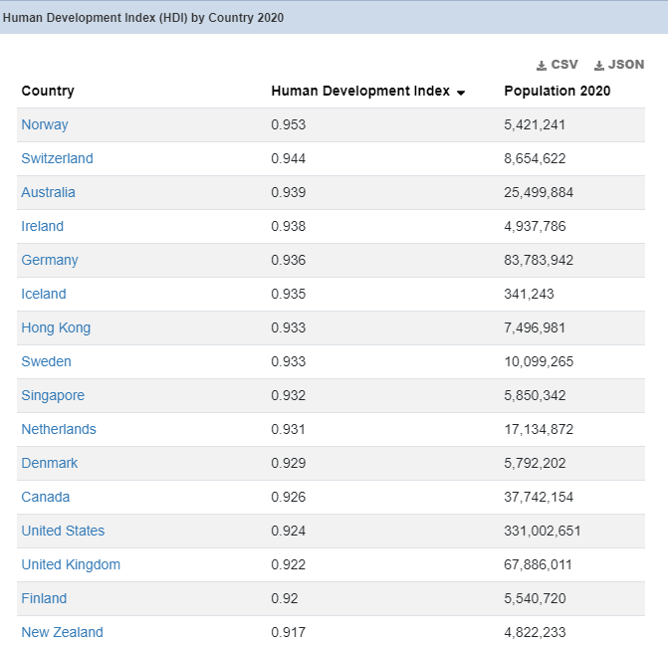
Human Development Index 2020

Slide 20
Follow-up Questions
To what extent are the SDGs equipping development educators with the capacity and resources to understand the root causes of poverty and inequality in the global South?
What can we do as educators to critically interrogate the neoliberal model of development and make it understandable to learners?
What impact will COVID-19 have on the successful delivery of the SDGs?
To what extend is growth necessary for development?
Do the SDGs comply with the IPCC recommendations to limit global warming to 1.5°C of the pre-industrial average?

Slide 21
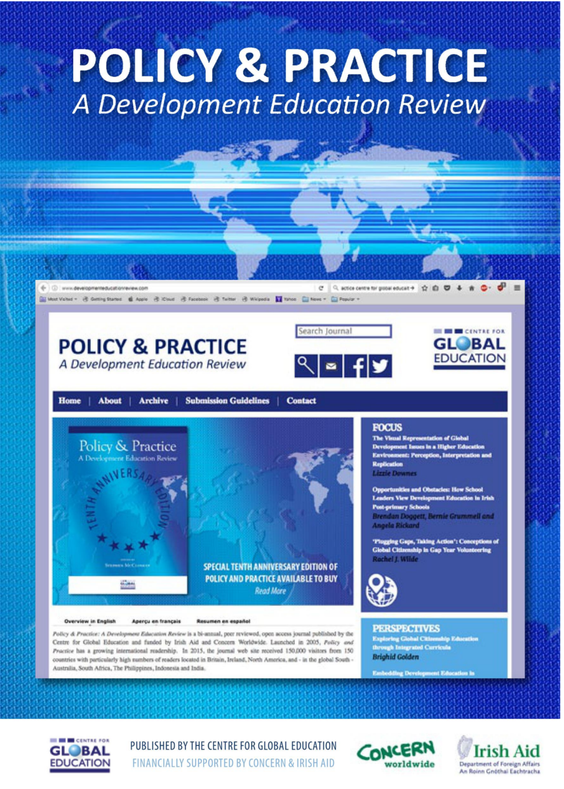
Notes:
www.developmenteducationreview.com

Slide 22

Notes:
https://www.centreforglobaleducation.com/sites/default/files/Let%27s%20Talk%20SDGS.pdf

Slide 23

Centre for Global Education
9 University Street
Belfast
BT7 1FY
Tel: (0044) 2890 241879
E-mail: stephen@centreforglobaleducation.com
www.centreforglobaleducation.com
www.facebook.com/centreforglobaleducation

