Slide 1
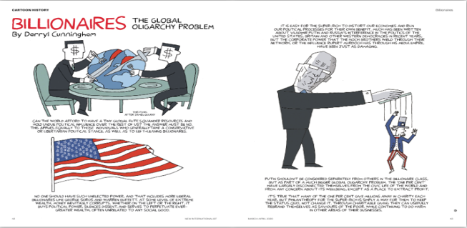

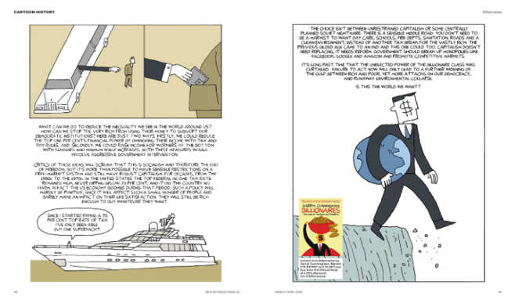
Poverty
WWGS Thematic Online Training Series
Lizzy Noone
Notes:
Welcome
- Introduce ourselves
Type in your name and the name of your school in the chat! Also change your name on your Zoom to your first name
Invite people to use the chat

Slide 2
“Overcoming poverty is not a task of charity, it is an act of justice. Like Slavery and Apartheid, poverty is not natural. It is man-made and it can be overcome and eradicated by the actions of human beings. Sometimes it falls on a generation to be great. YOU can be that great generation. Let your greatness blossom.”
Nelson Mandela

Slide 3

Hopes & Fears
- What do you HOPE to get out of todays session?
- Any FEAR about todays session?

Slide 4
Housekeeping
To mute and un-mute
Turn your camera on
Please use the chat function

Slide 5

Session Plan
An Introduction to Poverty
Stephen McCloskey
Schools Experience of Changing the narrative on
poverty
Claire Ní Chanainn, Mount Mercy College, Cork
Discussion Forum
Break & Reflection
Poverty: from Knowledge to Action
WWGS 6 Step Programme
Reflection and Next Steps
Notes:
Todays session will be broken into 3 key areas:
Read through slide

Slide 6


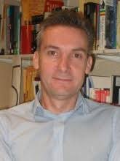
Stephen McCloskey
An Introduction to Poverty
Notes:
Stephen McCloskey is Director of the Centre for Global Education based in Belfast since 1995. Editor of Policy and Practice and Local to Global Key Issues in Development Studies. He’s also involved in education projects on the Gaza strip.

Slide 7
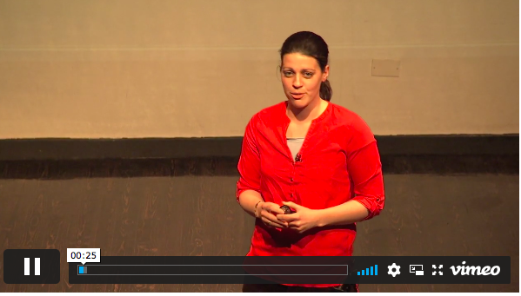
GUEST TEACHER
Claire Ní Chanainn,
Mount Mercy College, Cork
Notes:
Irish and history teacher, swimmer, Director of Providence North East India

Slide 8

Q&A AND DISCUSSION TIME
How do you adapt from a charity approach to poverty to one of solidarity in your school?

Slide 9

Reflection
Reflect on what you’ve heard this morning..
Consider:
- Your own journey on exploring poverty
- Your approach to poverty with students

Slide 10


Slide 11
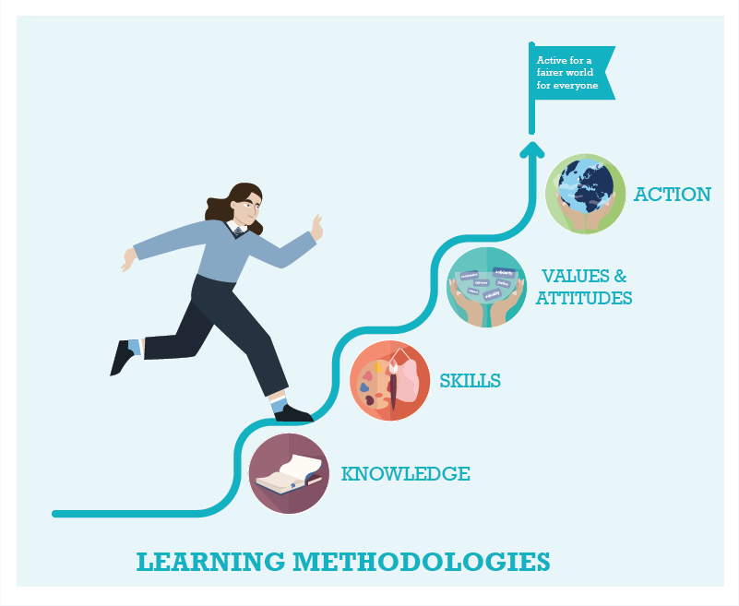



WWGS: 6 Step Programme
Poverty: from Knowledge to Action
Page
22
Notes:
Knowledge – understand the meaning of racism –Individual, Institutional, Structural (or societal) Historical
Values - empathy respect for diversity and tolerance, and inclusiveness, ensure diverse voices are heard
Skills – Student feel confident to talk about racism and to act in anti-racism ways
Action – Take action to create anti-racist spaces

Slide 12

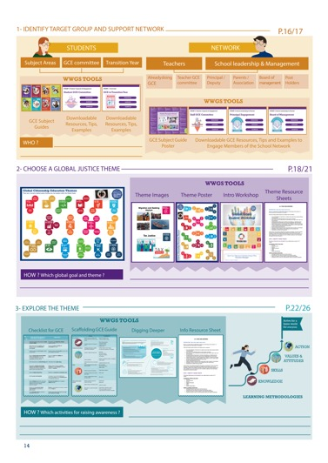
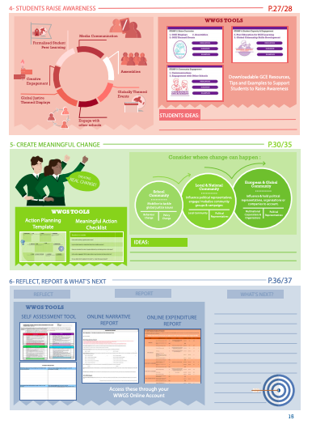
Page
14-15
Notes:
Briefly talk through the 6 steps

Slide 13
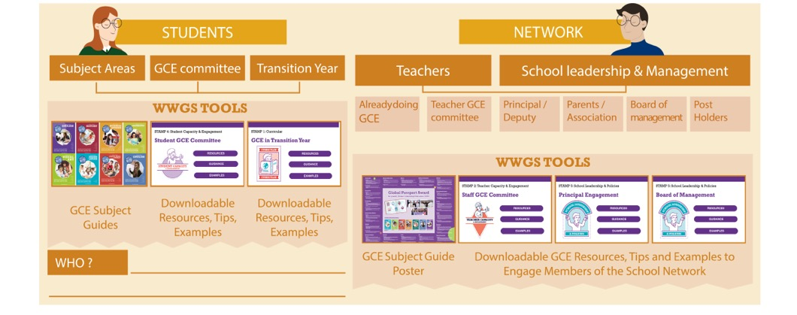
Pages
18-19
STEP 1:
IDENTIFY TARGET GROUP AND SUPPORT NETWORK
Notes:
Ask everyone to reflect on the student group they intend to work with and who in the school they can engage as a support network. Remind them that it’s not all about TY!

Slide 14

TASK:
Consider:
What opportunities are there to explore
Poverty in your subject area(s)?

Slide 15
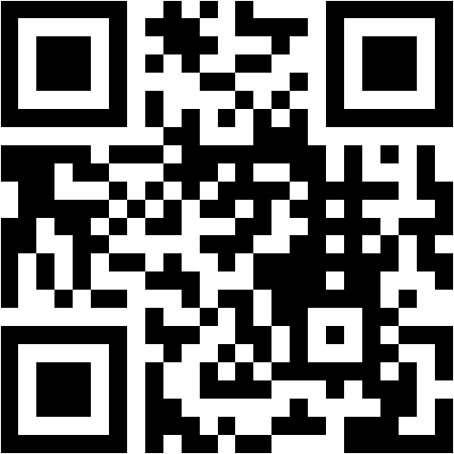
Menti-Meter
What opportunities are there to explore poverty themes in your subject area(s)?
Write 3 possible thematic areas connected with your subject.
Access:
Click the link in the chat
https://www.menti.com/8y9d2m7ekv
OR Put your camera on the QR code
with your phone
OR Go to www.menti.com & put in the code:
27 20 36
Notes:
https://www.menti.com/2wpn7dssic
PUT UP THE MENTIMETER AFTER THIS SLIDE…...log in lizzy.noone@worldwiseschools.ie log in P0ppyU1tan again we might need to wipe each mentimeter after each.
Do you agree that the ‘Pandemic is a Portal’?
You could also consider asking students what they might bring with them through the portal-get them to think of emotions and skills as well as possessions!
Is there any other questions you could ask?

Slide 16
AND…...
ROOT CAUSES OF POVERTY
TAX AND TRADE JUSTICE
DEBT
AND....
LAND RIGHTS
PRIVITISATION
PROPER WAGES
SOCIAL PROTECTION
CLIMATE CHANGE

Slide 17

http://www.worldwiseschools.ie/6-step-programme/
Pages
18-21
STEP 2:
CHOOSE A GLOBAL JUSTICE THEME
Notes:
Introduce the step and the tools available – invite them to use their phone to view the tools on their 6 step programme

Slide 18
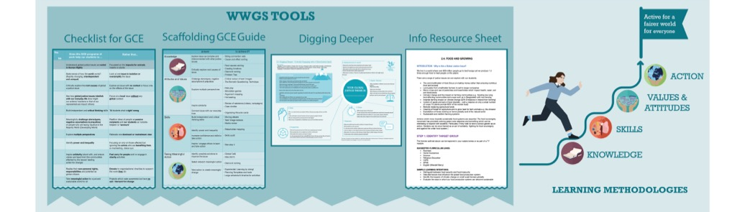
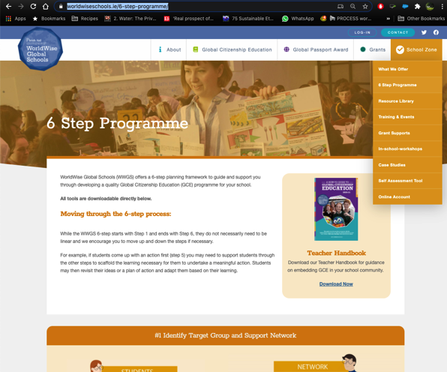
Pages
22-26
STEP 3:
EXPLORE THE THEME
Notes:
Be sure to change to your own date here!!

Slide 19
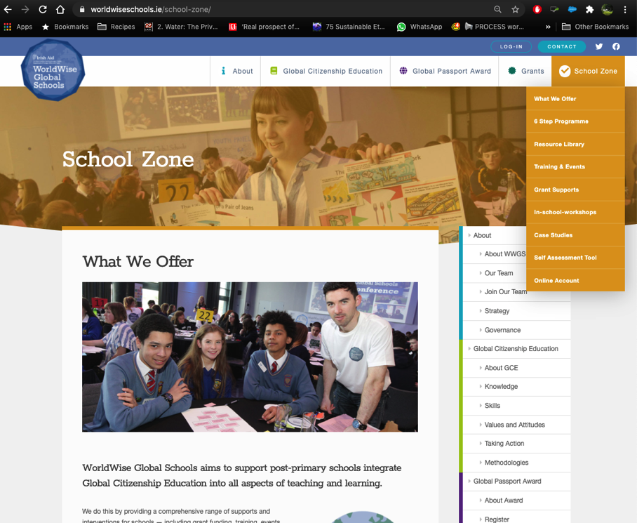

Slide 20

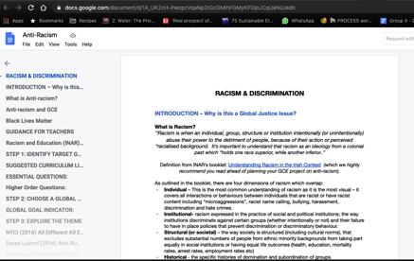
1. Hover over the symbol and a drop down menu appears!
2. Click on the theme and the resource sheet will pop up!
Notes:
Intro to thematic information sheets

Slide 21
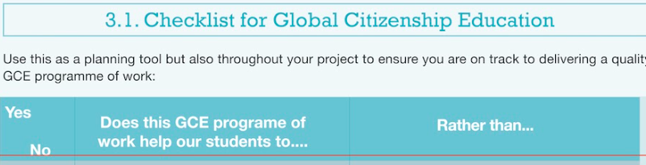
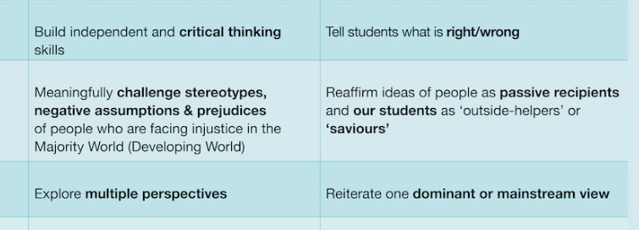
What practical things can you do to ensure that your programme of work on poverty would fall into the left column and not the right?
https://docs.google.com/document/d/1ADSyfeoNwfrDDegX8E_FhGlOnjgYYM7CuKnYW5mhv7g/edit?usp=sharing

Slide 22





STEP 3: EXPLORE THE THEME
TEACHING AND LEARNING MATERIALS: Resources

Slide 23






STEP 3: EXPLORE THE THEME
TEACHING AND LEARNING MATERIALS:
Blogs, Vlogs and Social Media:
Books:
Short Videos:
Wealth vs Poverty
Podcast: https://poverty-unpacked.org

Slide 24
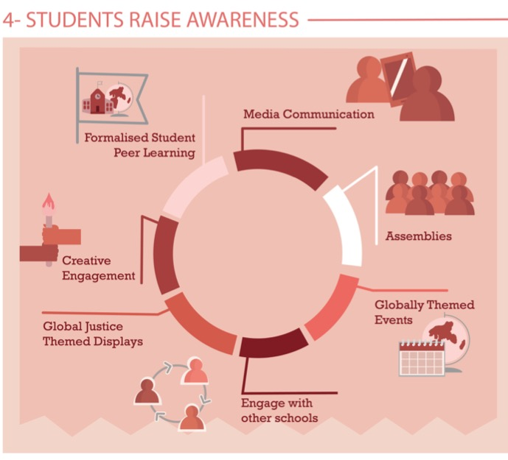
Share Learning
Pages
28-29
Notes:
Media Communication
Assemblies – Intercom
Themed Events –
Global Justice themed displays
Creative engagement
Formalised peer learning

Slide 25
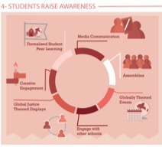

Educate others-this is a really powerful way to change!
Do a survey about students perceptions
and share the results!
Organise a campaign about poverty
Myth busting, change the systems that keep poverty
in place
  School assemblies
  Peer-to-peer learning-videos to show other classes
  Social media forums
  Creative Engagement (written, art, theatre, etc.)
Write a piece for the local newspaper
  Write a press release
  Do an interview
  Write an op-ed in their local paper
  Invite a reporter to see what they are doing and write something about it.

Slide 26
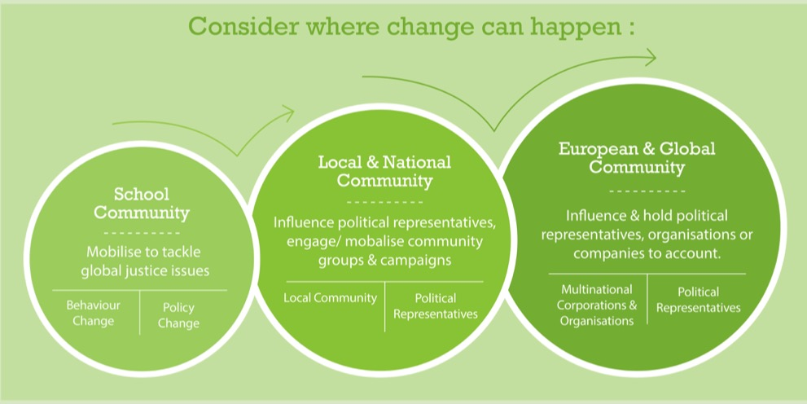
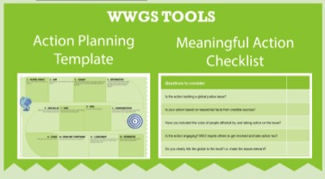
Page
30-35
STEP 5: TAKING MEANINGFUL ACTION
Aims to create Actual Change

Slide 27


Ideas for School Community Actions:
  Create a campaign that changed the narrative on
  poverty in your school.
  - Dignity campaign
Ideas for Local and National Community Actions:
  Community Awareness Campaign on Poverty
  Advocate for a change in policy/ legislation
  Join All Together in Dignity https://www.atdireland.ie/wp/
  Solidarity Protest/ Art
Ideas for European and Global Community Actions:
  #Cancelthedebt
  Take part in a tax justice campaign
  https://www.landrightsnow.org/
  https://www.globallivingwage.org

Slide 28
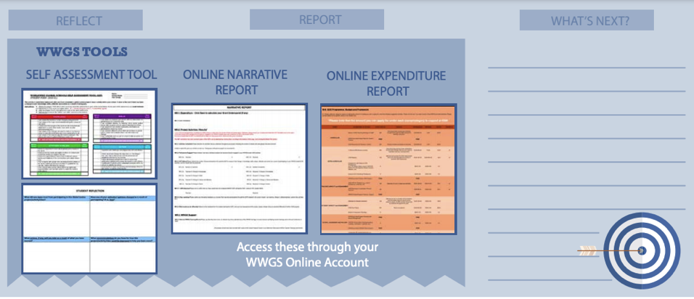
STEP 6:
REFLECT, REPORT AND WHAT’S NEXT?
Pages
36-41

Slide 29
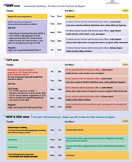
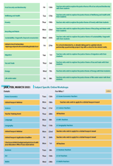
Upcoming Dates
Pages
4-6
Thematic Training Sessions
November
- Recycling & Food Waste: Mon 23rd
- Sustainability/ Degrowth: Wed 25th
December
- Migration: Tues 1st
- Tax & Trade: Thur 3rd
- Energy: Mon 7th
- Life Under Water: Wed 9th
- Wellbeing & Health: Fri 11th
Recordings available
Critical Approach
Anti-Racism: Thur 5th-
-Fast Fashion: Mon 9th
- Food Security & Biodiversity: Fri 13th
School Management Symposium
Wednesday 11th November!
Global Passport Award
Webinar 17th of November
Notes:
In terms of the breakdown of trainings, outline the 5 types of training
Purple – starter trainings – (today) for new schools and teachers new to GCE (perhaps their school has been involved longer)
Pink – WWGS approach and adapting to covid-19 – for ALL schools and teachers. Even for schools who have been involved for a while. Updated theory and practice
Green – Thematic areas
Blue – subject specific
Yellow – standard WWGS trainings and events. And deadlines.

Slide 30
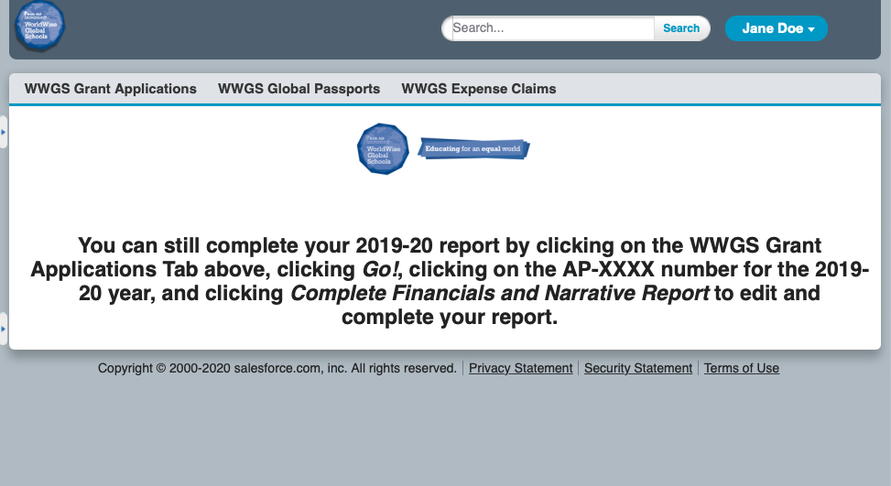

Slide 31
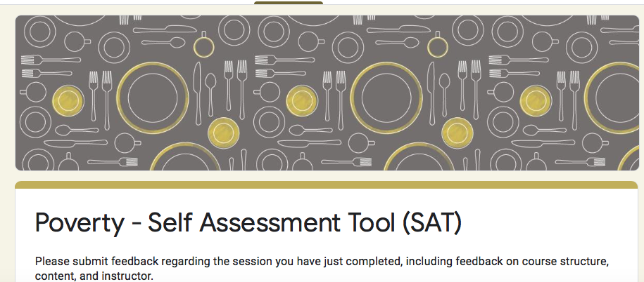
Evaluation for Today
https://forms.gle/o2xEw2BxMQ1VYw9w7
Notes:
https://forms.gle/5BeX3P9Qg1XYmRWz7

Slide 32


Thank you!
Questions???
Lizzy.noone@worldwiseschools.ie
086 8720879

