Slide 1
A sporting chance?
Use the Olympics to explore inequality

Slide 2
PE SESSION
Fairer sports for all

Slide 3
RULES
Why do we have rules?
How do rules make sports fairer?
How do rules make school fairer?
How do rules make the world fairer?
Rule Book

Slide 4
ARE THE SAME RULES ALWAYS “FAIR”?
Yes
No
What about for people of…
different ages
different abilities
different genders
particular needs
different backgrounds?

Slide 5
EXAMPLE 1
You want to organise a running race, but some of you are 8 years old and some of you are 14 years old.
What rule would you use to make the race fair?
Allow some runners to start before others…
Make some runners run further than others…
Add on time to some runners’ finishing times…
Make some runners run in wellington boots and allow others to run in trainers…

Slide 6
EXAMPLE 1
You want to organise a running race, but some of you are 8 years old and some of you are 14 years old.
Did the rule you made to solve this problem make the race fairer for:
A few runners
Some runners
Most runners
All runners?

Slide 7
EXAMPLE 2
You meet some young people from another country who have never played basketball before.
What rule would you use to make the game fair?
Give two points if…
Make sure each team has…
Show someone the red card if…
Limit match time to…
Organise extra training for…

Slide 8
EXAMPLE 2
You meet some young people from another country who have never played basketball before.
Did the rule you made to solve this problem make the race fairer for:
A few players
Some players
Most players
All players?

Slide 9
EXAMPLE 3
Some young people in the bicycle race have old bikes with few or no working gears. Others have newer bikes with many gears.
What rule would you use to make the race fair?
Give…
Allow some people to start before others…
Add on time to some riders’ finishing times...

Slide 10
EXAMPLE 3
Some young people in the bicycle race have old bikes with few or no working gears. Others have newer bikes with many gears.
Did the rule you made to solve this problem make the race fairer for:
A few riders
Some riders
Most riders
All riders?

Slide 11
MAKING IT FAIR
Are there any other examples of where using the “normal” rules of sports might not be fair.
Think
Pair
Share

Slide 12
ARE THE OLYMPICS FAIR?
Yes
No
What about countries where
They have less money
Competitors have fewer resources?

Slide 13
A FAIR SPORTS DAY
You are going to organise a sports day which everyone in your class/year/school is going to take part.
However, you need to make sure it is completely fair for everyone to be able to fully participate.
How can you design the rules to help?

Slide 14
SPORTS DAY TEAMS
All the people taking part will be organised into teams.
Each team will represent one of the countries taking part in the Olympics.
Each team will need to come up with a fairness motto for the Sports Day.

Slide 15
OUR TEAM FAIRNESS MOTTO

Slide 16

OLYMPIC AND PARALYMPIC VALUES
Friendship
Excellence
Determination
Respect
Inspiration
Courage
Equality
Notes:
Image source: International Olympic Committee - www.olympic.org/ Note: This is editorial usage only and this resource is not associated in any way with the International Olympic Committee.

Slide 17
LOOKING BACK
How did your sports day go?
Was your sports day fair? How?
Was everyone able to participate?
Did people enjoy it? Why/why not?
Do you need to change rules sometimes to make things fairer?
What have you learned through organising the event and taking part?

Slide 18
IS OUR WORLD FAIR?
How about life generally? What rules are there to make it fairer?
Who sets the rules?
If there are unfair things in life, how can rules be used to change them?

Slide 19
DO WE NEED RULES THAT HELP MAKE OUR WORLD FAIRER?
Yes
No
We need… because…
We don’t need… because…
The types of rules we need are…

Slide 20
EXAMPLE
People pay tax to pay for services such as schools and hospitals.
Should everyone pay the same amount of tax?
Or should people with less money pay less tax?

Slide 21
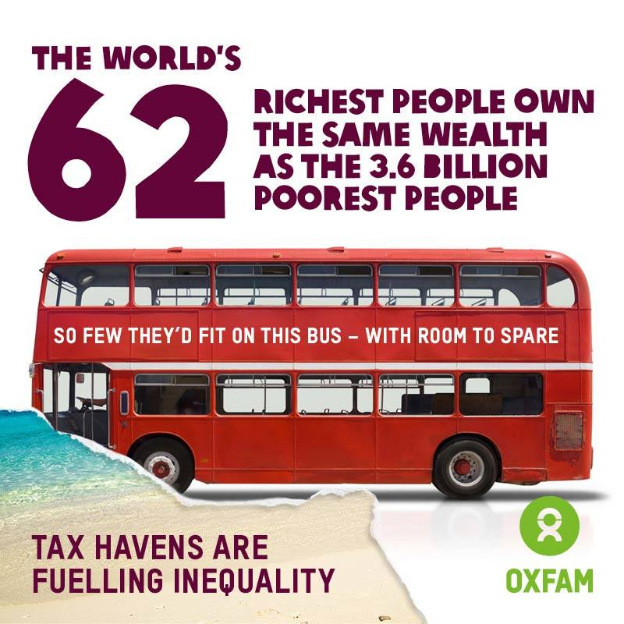
Notes:
Source: An Economy for the 1%: How privilege and power in the economy drive extreme inequality and how this can be stopped (Deborah Hardoon, Ricardo Fuentes-Nieva and Sophia Ayele, Oxfam International, 2016)
policy-practice.oxfam.org.uk/publications/an-economy-for-the-1-how-privilege-and-power-in-the-economy-drive-extreme-inequ-592643

Slide 22

WHAT WOULD HELP MAKE OUR WORLD FAIRER?

