Slide 1
A sporting chance?
Use the Olympics to explore inequality

Slide 2
INTRODUCTION
Notes:
The following slides could be used as an introduction to the subject-specific resources. This could be done in class or form time, or alternatively in an assembly.

Slide 3
WHAT DO YOU KNOW ABOUT THE OLYMPIC GAMES?
Where are the Summer Olympic Games taking place in 2016?
Beijing
Rio de Janeiro
Sydney
Notes:
Click forward on the slide to reveal the correct answer: Rio de Janeiro.

Slide 4
WHAT DO YOU KNOW ABOUT THE OLYMPIC GAMES?
How many nations will be taking part in the Rio 2016 Olympic Games?
206
184
93
Notes:
Click forward on the slide to reveal the correct answer: 206.

Slide 5
WHAT DO YOU KNOW ABOUT THE OLYMPIC GAMES?
How many athletes will be taking part in the Rio 2016 Olympic Games?
13,400
10,500
9,700
Notes:
Click forward on the slide to reveal the correct answer: 10,500.

Slide 6
WHAT DO YOU KNOW ABOUT THE OLYMPIC GAMES?
Which of the following sports will not be contested in the Rio 2016 Olympics?
Golf
Beach volleyball
Cricket
Notes:
Click on the slide to reveal the correct answer: Cricket.

Slide 7
WHAT DO YOU KNOW ABOUT THE OLYMPIC GAMES?
204 nations took part in the London 2012 Olympic Games. How many nations won at least one medal?
156
112
85
Notes:
Click forward on the slide to reveal the correct answer: 85.

Slide 8
WHAT DO YOU KNOW ABOUT THE OLYMPIC GAMES?
Which nation came top of the medal table at the London 2012 Olympic Games?
UK
USA
China
Notes:
Click forward on the slide to reveal the correct answer: USA.

Slide 9
WHAT DO YOU KNOW ABOUT THE OLYMPIC GAMES?
How many athletes from the UK were there at the London 2012 Olympic Games?
556
423
279
Notes:
Click forward on the slide to reveal the correct answer: 556.

Slide 10
WHAT DO YOU KNOW ABOUT THE OLYMPIC GAMES?
How many athletes from Sierra Leone were there at the London 2012 Olympics?
41
23
2
Notes:
Click forward on the slide to reveal the correct answer: 2.

Slide 11

WHAT’S IMPORTANT?
Friendship
Excellence
Determination
Respect
Inspiration
Courage
Equality
Notes:
Explain that the Olympic and Paralympic Games are based some core values (three Olympic values and four Paralympic values). Ask learners what they think these values might be. Click forward on the slide to reveal the seven values.
Ask learners to think of people in their school, community or the wider world who have shown these values.
Image source: International Olympic Committee - www.olympic.org/ Note: This is editorial usage only and this resource is not associated in any way with the International Olympic Committee.

Slide 12






















SIMILARITIES AND DIFFERENCES
Notes:
Explain that 206 nations from around the world will be taking part in the Rio 2016 Olympic Games. Say that these flags are of some of the countries taking part in the games. Ask learners if they can identify any of them.
Then ask learners what similarities and differences they think there will be between these countries and the people living in them.
Discuss learners’ ideas as a whole class. Possible discussion questions include:
Where have your ideas about these similarities and differences come from? For example, ideas could be based on previous learning in school, visits to other countries or the media.
Have you made any assumptions about other countries?
What evidence are you basing your ideas and assumptions on?
From left to right
First row from top: Ethiopia, India, Peru, Vietnam, UK, Brazil
Second row from top: Ghana, China, Norway, Pakistan, Ukraine, Nigeria
Third row from top: Mexico, Italy, South Africa, Iran, Malawi
Fourth row from top: Russian Federation, United States, Tunisia, Chile, Bulgaria
Fifth row from top: Nepal, Mongolia, Australia, Philippines, Bolivia
Sixth row from top: Yemen, Rwanda, Jamaica, Germany, Japan

Slide 13
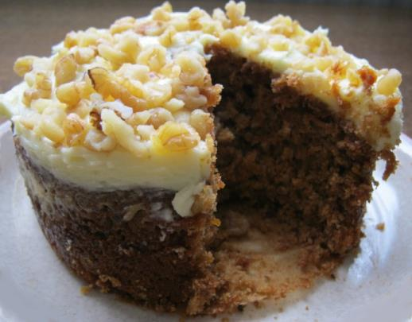
WHAT DOES INEQUALITY MEAN?
We can think of inequality as the difference between the things some groups of people have compared to other people.
It is a bit like looking at how a big a slice of cake one person has compared to another.
Notes:
Explain that we can think of inequality as the difference between the things some groups of people have compared with other groups of people. It is a bit like looking at how big a slice of cake one person has compared with another.
Photo credit: Liz Newbon/Oxfam

Slide 14
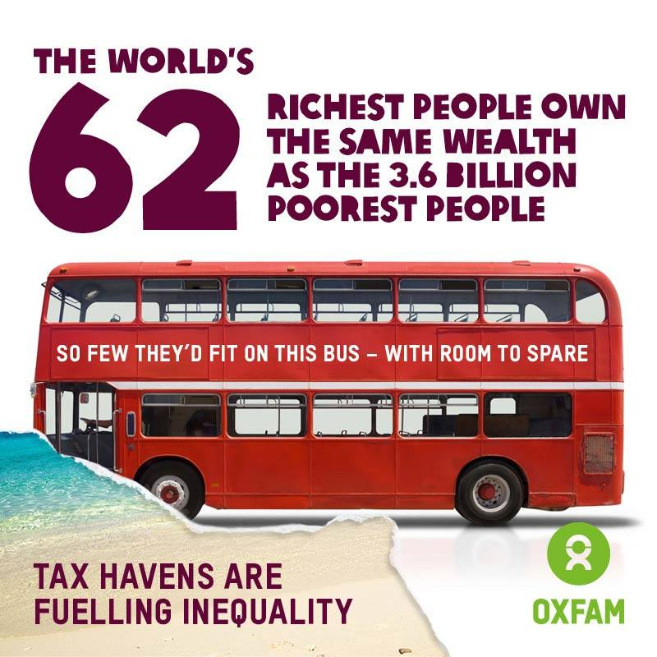
Notes:
Say that Oxfam published this statistic in January 2016, stating that the world’s richest 62 people own the same wealth as the poorest half of the world’s population. Explain that the richest 1% now have more wealth than the rest of the world combined. Ask learners to imagine that our world just had 100 people in it. If that was the case, this last statistic means that one person would have more wealth than the other 99 people put together. You might like to use the analogy of sharing out a cake, where one person would have more than half of the cake and the rest would be shared among 99 people.
Discuss learners’ responses to these statistics. Do they think these distributions are fair?
Data source:
An economy for the 1%: How privilege and power in the economy drive extreme inequality and how this can be stopped (Deborah Hardoon, Ricardo Fuentes-Nieva and Sophia Ayele, Oxfam International, 2016) policy-practice.oxfam.org.uk/publications/an-economy-for-the-1-how-privilege-and-power-in-the-economy-drive-extreme-inequ-592643
Working for the few: Political capture and economic inequality (Ricardo Fuentes-Nieva and Nick Galasso, Oxfam International, 2014) policy-practice.oxfam.org.uk/publications/working-for-the-few-political-capture-and-economic-inequality-311312

Slide 15
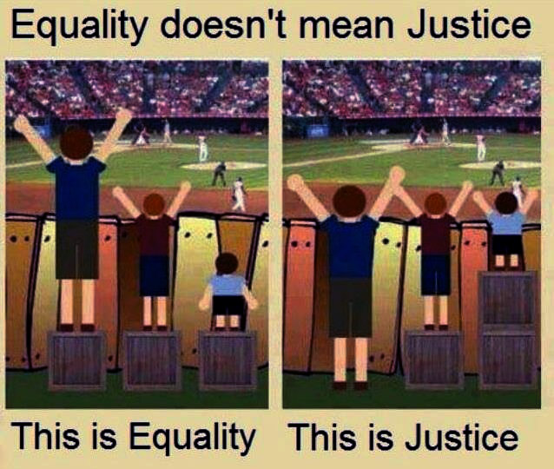
Notes:
Discuss the statement: Everyone in our society should be equal. Draw out the point that there will always be some inequality and we shouldn’t expect everyone to be the same. Ask learners whether they think it would it be fair if everyone earned the same amount of money. For example, some people might deserve more money for having more responsibilities in their work. The needs of different people will also vary (for example, children will have different needs to adults), so it wouldn’t be fair if everyone had exactly the same.
Explain that equality aims to make things fair by giving everyone the things they need to enjoy good, healthy lives. However this only works if everyone starts from the same place and needs the same things. Fairness is about trying to understand what different people need in order to enjoy good, healthy lives. For example, in school, younger children may get extra playtime or go to lunch earlier whereas older children may have more responsibilities around the school. Ask learners to think of other examples.
Image info: Please note that the image source is unknown despite attempts to identify this.

Slide 16


INEQUALITY BETWEEN COUNTRIES
There is inequality between countries in the world.
This means things are not shared fairly between countries.
For example, some countries are wealthy while others are extremely poor.

Slide 17

COUNTRY INCOMES
The World Bank classifies each country as either:
a low-income country (LIC)
a lower-middle-income country (LMIC)
an upper-middle-income country (UMIC)
or a high-income country (HIC)
Which group do you think each of these countries is in?
Brazil
UK
Nepal
Nigeria
UMIC HIC LIC LMIC
Notes:
Explain that there are huge differences between the incomes of countries. An organisation called The World Bank pays close attention to this. They lend money to different countries, and calculate countries’ “income”, which they work out as an average per person to be able to compare countries with more or less people. To calculate it they add up the total amount of money being made in that country over the year. They then divide this by the number of people in the country. They do this calculation in dollars so they can compare all countries fairly. The World Bank then sorts countries into different groups depending on their income.
Ask learners which income group they think each of the countries shown is in. Discuss learners’ ideas and their reasons for these. Click forward on the slide to reveal the correct answers, and discuss learners’ responses. Are they surprised by any of the answers? Which ones and why?

Slide 18

INEQUALITY WITHIN COUNTRIES
There is also inequality within countries.
This means things are not shared fairly within the same country.
For example, some people may have more money than others.
Notes:
Explain that there is also often inequality within countries, where many people have only a little and a few people have a lot. We can give each a country a fairness score according to how equal or unequal it is.

Slide 19
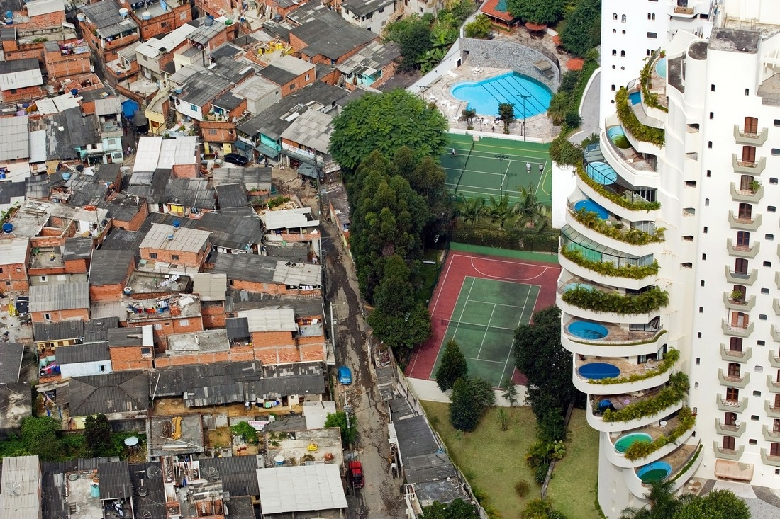
Notes:
Explain that Brazil is a very unequal country where some people have much more wealth and [many more] life opportunities than others. Say that this image was taken in the city of São Paulo in Brazil. On one side is the Paraisópolis favela, on the other is the affluent district of Morumbi. You may need to explain that a favela is a slum area or shanty town, there are many favelas in cities and towns across Brazil.
Ask learners how this image makes them feel. What similarities and differences do learners think there might be between life on the opposite sides of the image?
Image info: São Paulo, Brazil. 2008. The Paraisópolis favela (Paradise City shanty town) borders the affluent district of Morumbi.
Photo credit: Tuca Vieira

Slide 20
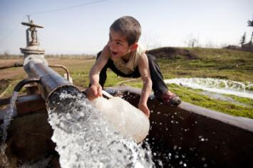
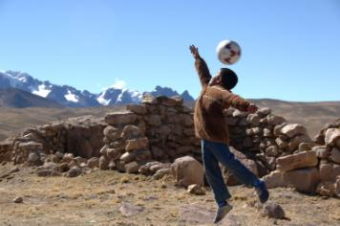
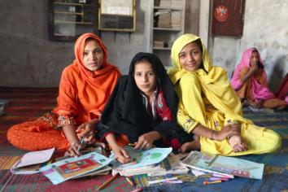
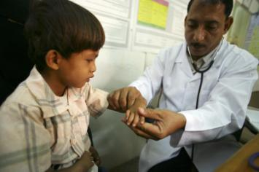
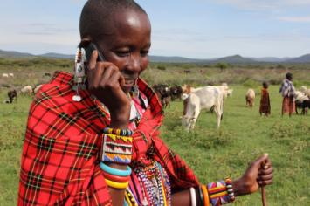
THINKING ABOUT INEQUALITY
Inequality is not just about how money is shared between and within countries.
There can also be inequality in the kinds of opportunities people have in life.
Notes:
Explain that inequality isn’t just about how much money is shared out between or within countries. Inequality also affects the opportunities that people have. Ask learners to think about other ways in which people’s lives might be unequal, such as access to water, education and healthcare.
Clockwise from top left.
Access to water
Image info: A boy collects water from a well in Dargalar, Azerbaijan.
Photo credit: David Levene/Oxfam
Access to play
Image info: Lucas lives in Macuscani, a small town high in the mountains of Peru.
Photo credit: Annie Bungeroth/Oxfam
Access to education
Image info: Students at a girls’ school in the village of Sanjar Bhatti, Kambar Shahdad Kot district, Sindh Province, Pakistan. From left to right- Gori Bhatt, Amna Khatoon Brohi and Shazzia Bhatti.
Photo credit: Irina Werning/Oxfam
Access to healthcare
Image info: Dr Amen Yagoub looks at Barka age 6 at the Maddodha Health Clinic in Sayoun, Yemen.
Photo credit: Abbie Trayler-Smith/Oxfam
Access to technology
Image info: Women’s leader Noorkishili Naing’isa receives a call on her mobile phone while grazing her livestock in Mairowa Chini, Ololosokwan, Ngorongoro, Tanzania.
Photo credit: Geoff Sayer/Oxfam

Slide 21
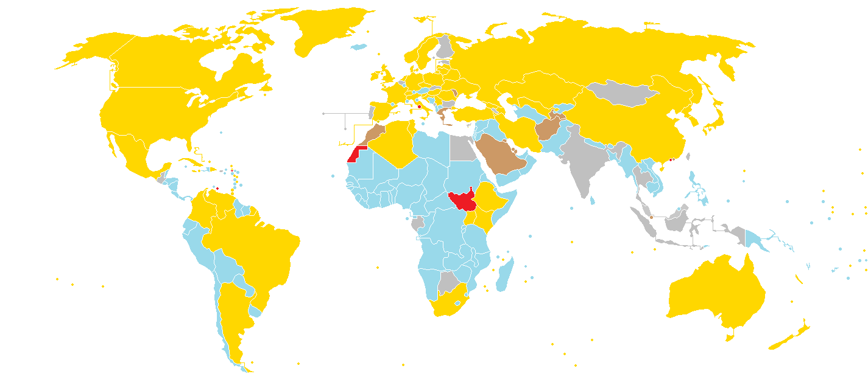
OLYMPIC MEDALS
Notes:
Say that there can also be inequalities in sport. For example some athletes have access to better facilities and training than others. Explain that this world map shows the medals achieved by countries participating in the London 2012 Olympic Games.
Gold represents countries that won at least one gold medal.
Silver represents countries that won at least one silver medal.
Bronze represents countries that won at least one bronze medal.
Blue represents countries that didn’t win any medals.
Red represents countries that did not participate in the London 2012 Olympic Games.
Discuss learners’ responses to this map. Are they surprised by the data? Do they think this inequality is fair?
Note: This map was created on 9th August 2012 and may not represent the final
Credit: Spacejam2: commons.wikimedia.org/wiki/File:2012_Summer_Olympics_medal_map.png
Licensed under the Creative Commons Attribution-Share Alike 3.0 Unported license: creativecommons.org/licenses/by-sa/3.0/deed.en

Slide 22

TAKING ACTION
Notes:
Explain that Oxfam, along with many other organisations and people around the world, is taking action to reduce inequality. Oxfam is putting pressure on decision-makers and big businesses to try and even things up and make the world a fairer place.

Slide 23
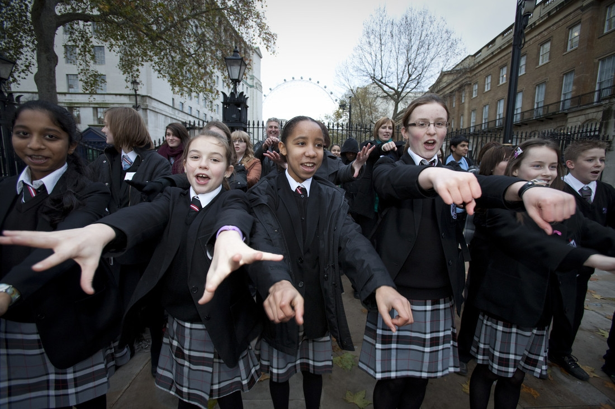
WHAT WOULD HELP MAKE OUR WORLD FAIRER?
Notes:
Finish by discussing what learners think should be done to make our world a fairer place.
Image info: A group of 28 school students from around the country joined Oxfam on a visit to 10 Downing Street in 2009. They represented the 1000 students who took part in Oxfam’s global citizenship conferences during the autumn term and were carrying a book of messages to hand Prime Minister Gordon Brown ahead of the Copenhagen Climate Change Conference.
Photo credit: Crispin Hughes/Oxfam

