Slide 1
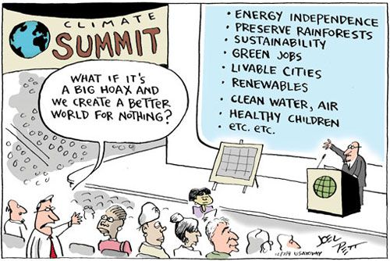
Notes:
Phil & Lizzy

Slide 2


Slide 3

What is Global Citizenship Education?
Irish Aid define GCE as:
“an educational process aimed at increasing awareness and understanding of the rapidly changing, interdependent and unequal world in which we live”
What is missing from this definition?

Slide 4

…..
By challenging stereotypes and encouraging independent thinking, GCE helps students critically explore the root causes of global justice issues and how they link with our everyday lives
GCE inspires solidarity by supporting people to realise their full rights, responsibilities and potential as global citizens in order to take meaningful action for a just and sustainable world

Slide 5

Agents for change –World Shapers
Definitions across the board for global Citizenship Education appear to agree that GCE should result in behavior change on the part of the learner or to inspire action, empowerment and determination you bring about change (McCloskey 2016)
Question for reflection: Is your school producing agents for change, for transformative change?
Maastricht Declaration on Global Education in Europe (2002). “Global Education is education that opens people's eyes and minds to the realities of the world, and awakens them to bring about a world of greater justice, equity and human rights for all.
Notes:
Cultivating young leaders who are active in change

Slide 6
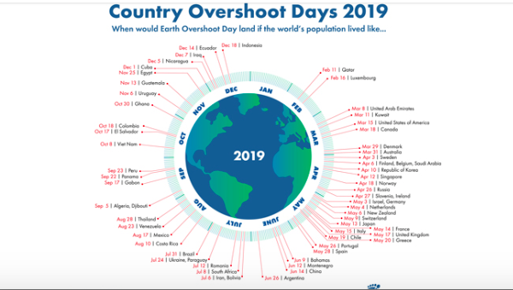

Slide 7
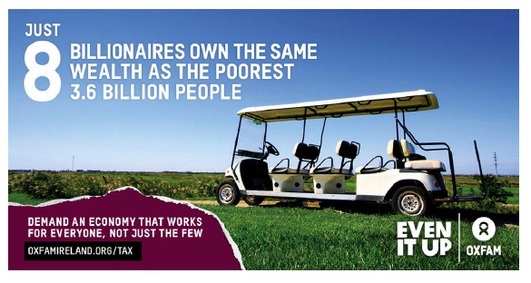
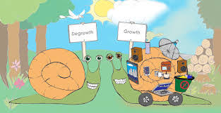

Slide 8


‘Charity is finding a baby drowning in a stream and pulling it out; charity is pulling out a second baby and a third baby that come floating down the stream….Justice is going upstream, finding out who’s throwing the babies in and stopping them at source’
Dean Scotty McLennan,
Stanford Memorial Church
Notes:
These are the types of values that development education can foster:
Empathy not sympathy: Empathy is about feeling with other people, sympathy is about feeling for. (I’ve put some cartoons in the folder for this)
It’s important that we try and put students in the shoes of people affected by the global issues we are covering and make sure that they feel with instead of feeling sorry for people who are affected by the issues learned about in class.
Solidarity not charity: It’s important to instill a sense of solidarity in our students that we stand with people as our fellow human beings to work together on the root causes of global injustice instead of seeing people as ‘charity cases’ and resorting to fundraising as the only action to ‘help’. Making connections with how our lifestyles and behaviours can impact the world’s people and planet is a good place to start.
Respect for self – in a just & democratic society respect for self is central to the flourishing of the well being of both the individual and the wider community. Respecting oneself brings both the capacity to act autonomously & to be self-motivated. It is an essential pre-requisite to have respect for others & to be concerned about their concerns.
Respect for others and human rights for all– in a pluralist democracy the disposition to respect & care for others are central to living interdependently. The positive relationships forged among individuals & groups are essential to the development of qualities such as cooperation, interdependence and respect for a diversity of people & cultures, which allows us to live and work in the realities of the world of today – and the future.
A sense of social responsibility – in a society geared to the general well being of all, it is essential to develop a commitment to social responsibility based on the critical scrutiny of information and evidence within an awareness of power relationships, principles and traditions. Such a disposition to social responsibility should also entail a commitment to social justice and equity and the sustainable use of the environment.
A sense of belonging – world citizenship depends on a disposition to be part of the enterprise as a whole, a commitment to common purposes that goes beyond personal interests, a willingness to participate as an active citizen, engendered by an understanding of the world as a place where each individual feels valued, and where both group & individual concerns and opinions are respected.
A commitment to learning – in a world increasingly characterised by change and adaptation the need to have a disposition to learning, to making new connections and new meanings, is fundamental. This would also need commitment to procedural values such as: willingness to adopt a critical stance towards information; willingness to give reasons why one holds a view or acts in a certain way, and to expect similar reasons from others; respect for evidence in holding and forming opinions; willingness to be open to the possibility of changing one’s own attitudes and values in the light of the evidence.
Belief that you can make a difference-We can actually effect change! There will be times when you and your students may not think that you are having any impact so don’t lose heart and let your teaching and learning slide into apathy.

Slide 9

Despite a lot of GCE activity in Ireland, research tells us:
Students have high level of concern and interest in the issues
Low levels of understanding about the root causes of poverty and inequality
GCE is often defined as Fasting, Fun
and Fundraising
National Survey of Third Level Students on Global Development, Jan 2013, SUAS Development Education in Irish Post-Primary Schools –
Notes:
In fact unless you work in the sector in Ireland, you are bound to misunderstand development the work of International Development and the developing world in general and that is no surprise when all we are exposed to is appeals and in the media natural disasters, war, conflict corruption starvation.
Oxfam’s boss was on Undercover Boss a few years back-the main thing that people knew about Oxfam is that ‘they run orphnages” . This is obvioulsy untrue but this misplaced belief exposes a bigger problem then just a case of misinformation!
Why do people hold this belief-it follows logically on their thoughts of poverty and in this case of Oxfam. This is because of how we process information-our brain tends to fill in the gaps. This is jyst making common sense of the world.

Slide 10
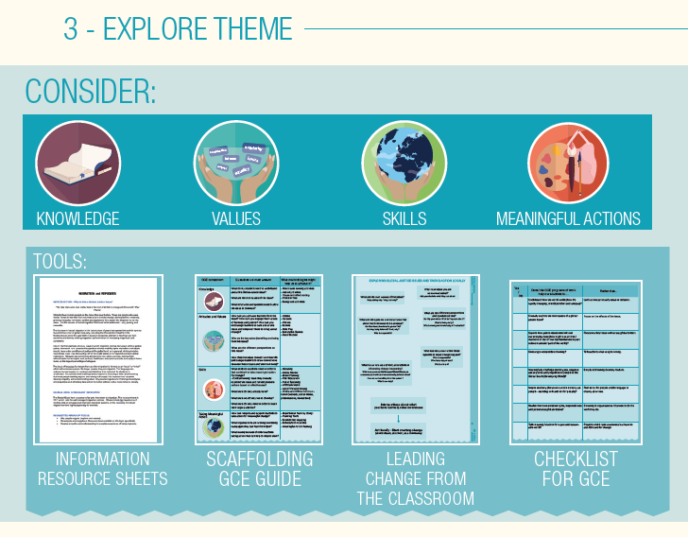
Notes:
Explain that they are now going to move on to step 3 where they will start to explore the theme
Provide a very short overview of the resources provided to assist teachers to do this
In this activity they are going to focus on thinking about the local to global link.
Ask them to brainstorm Step 3
Use the template to consider questions posed and the global to local links of this issue

Slide 11
Checklist of Global Citizenship Education
Notes:
Print out this checklist for participants

Slide 12
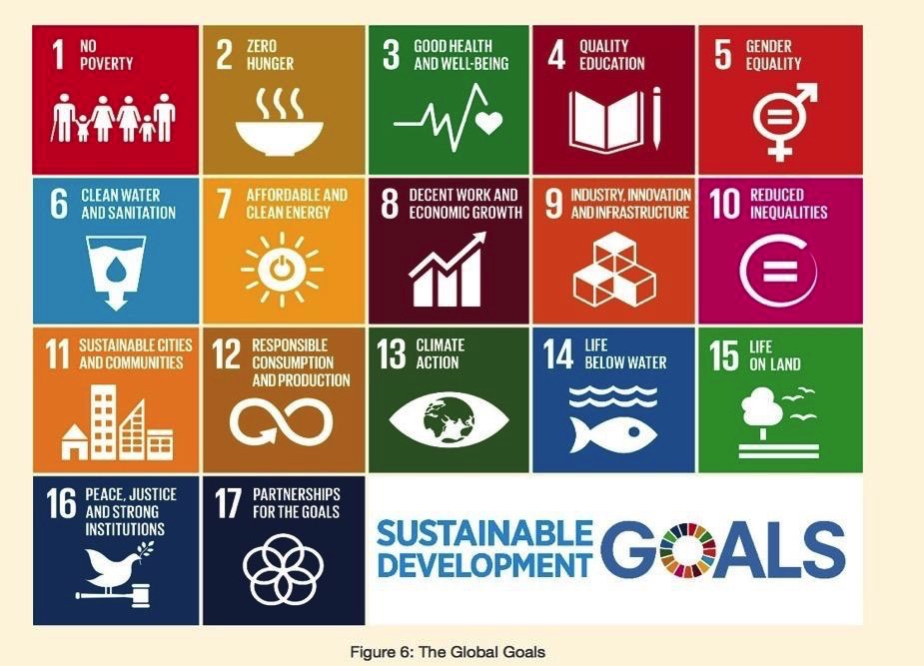

Slide 13
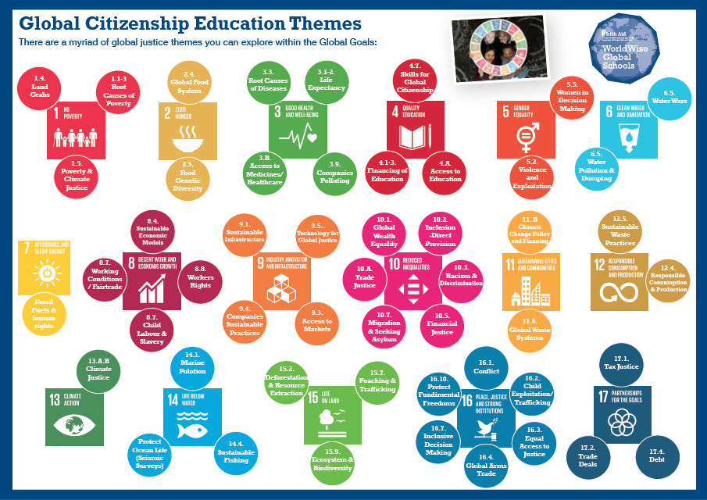
Notes:
ACTIVITY
Everyone stands in a circle. In the middle of the circle there are cards with an image and theme on the front.
Give people a few minutes to walk around and take a look at all of the cards. Explain that at some point they will be asked to move to the card that they would like to explore a little more or are interested in. Only two people per card.
For new teachers ask them to pick a them they are LIKELY TO EXPLORE or would LIKE TO with their students.
For established teachers ask them to pick a theme that CHALLENGES THEM

Slide 14
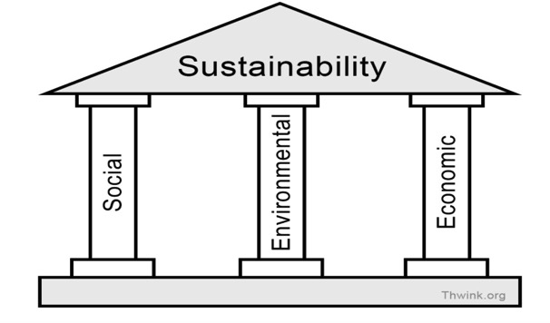
Pillars of Sustainability/Sustainable Development
Write down 3 words that you think of when you think of sustainability-go to the person the other side of you this time!!

Slide 15
What do we mean by Sustainability?
Definition of Sustainable Development
‘Sustainable development’ can be defined as….
‘development which meets the needs of the present without compromising the ability of future generations to meet their own needs.’
Sustainable development is a continuous process of economic, environmental and social change aimed at promoting wellbeing of citizens now and into the future.

Slide 16


Deadline 28th February 2020
Three Awards
Externally Accredited - The total score achieved in all 6 Stamps will determine which of the Passport types is awarded.
30-49 50-109 110-150
Notes:
Emerging – apparent/in the early stages/small number of students or teachers involved/small measures in place/GCE is present in your school at a small-scale
Established – the next stage – GCE very much exists in the school for a while and is therefore recognized by a broader number of students + teachers and generally accepted as part of the schools activity and policies
Exceptional – very much entrenched in the daily activities of the school/is visually apparent and largely acknowledged and practiced by most students and teachers in the school. A regular occurance in the classroom and school/ official links established with in the local community/familiar, popular, routine, standard, well known, prominent,
We are review the word Special and we are considering changing the name of this award

Slide 17
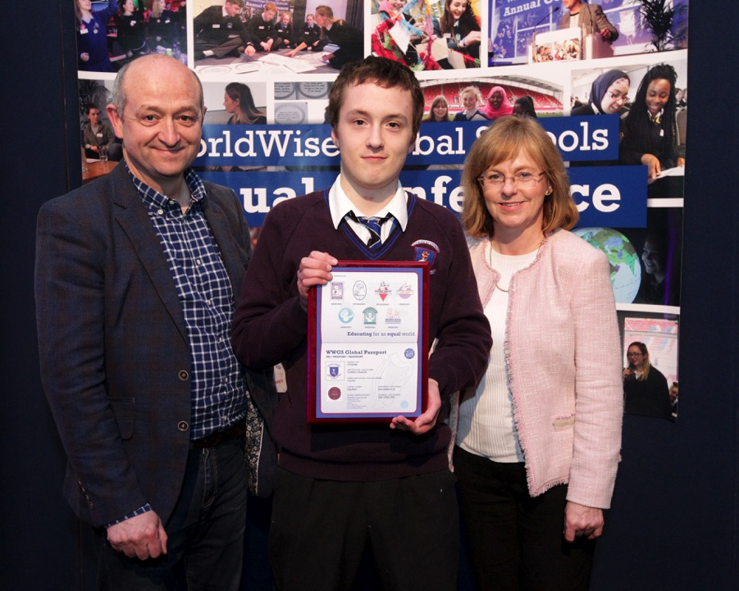
Notes:
The WWGS programme is excellent the support of the Education officer was always at hand for queries and very helpful-Joe Monaghan, Clarin

Slide 18
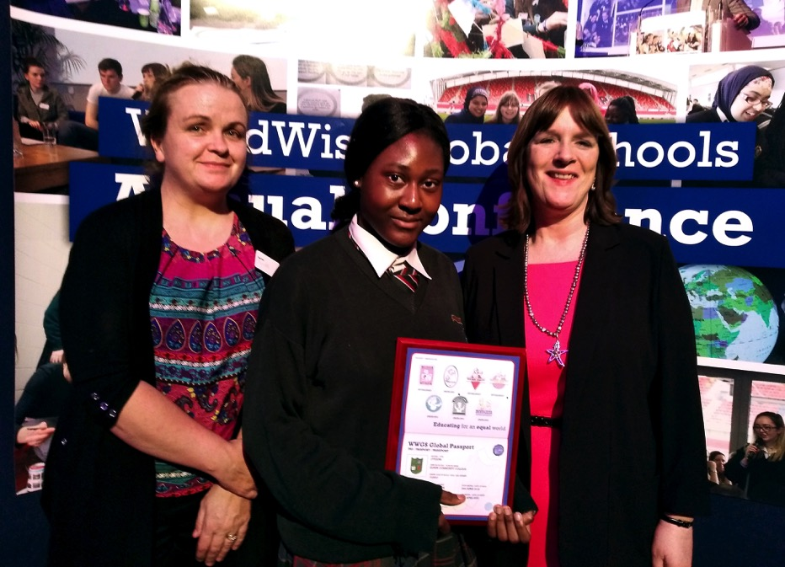

Slide 19
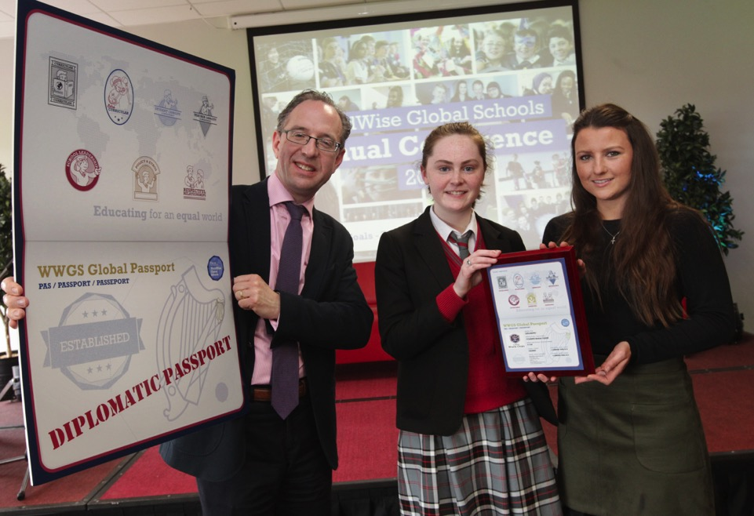

Slide 20
Leading GCE in post-primary schools
Need for a holistic approach which includes school leadership in embedding GCE, this is acknowledged as important (Toland, 2006)
Supportive school leadership and management is critical for those teachers who are delivering GCE
GCE may percolate across all curriculum areas and extra-curricular activities but is it included in your staff planning days?
  Question for reflection: How formalised is GCE in your schools

Slide 21
Leading GCE in post-primary schools
‘the art of leadership lies in the balancing of the different interests’ (Bottery 2013).
WWGS acknowledges the complexity of the school eco-system, but this offers a useful lens to examine how GCE can complement other interests and initiatives in schools
Recent literature on GCE often focuses on students, teachers and the curriculum with leadership only noted tangentially. However, literature on school leadership highlights the importance of leaders being driven by a moral purpose, but this literature rarely interact with GCE literature.
  Question for reflection: What is your moral purpose as school leader?

Slide 22






A framework for GCE in schools

Slide 24
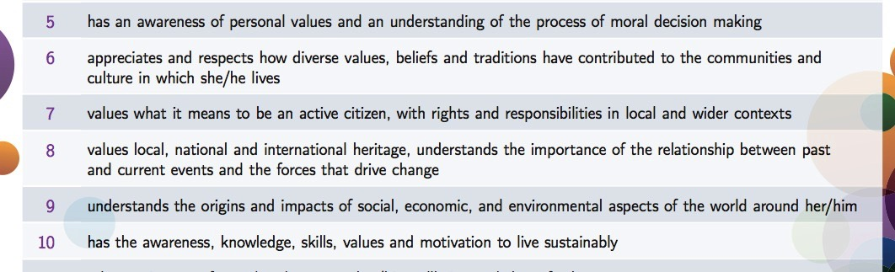
Statements of Learning – Junior Cycle
Very Strong GCE Links SOL 5-10
That’s a quarter of all SOL at JC

Slide 25
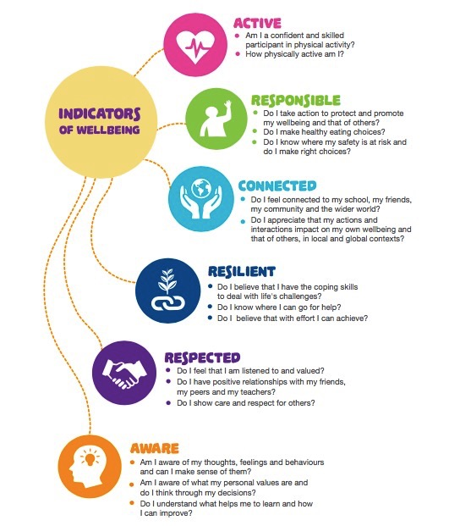
Wellbeing Indicators

Slide 26

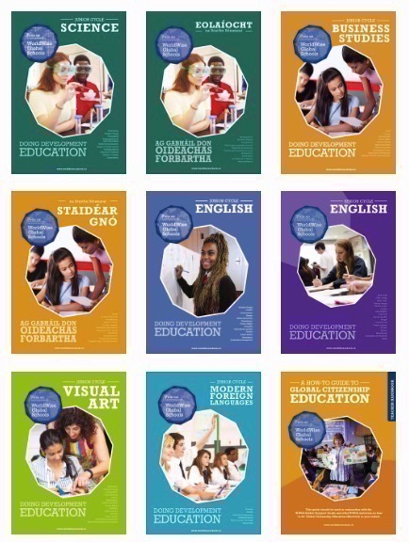

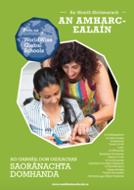
Doing DE Series
Coming Soon….
Home Ec, Irish, Maths
...and Wellbeing

Slide 27
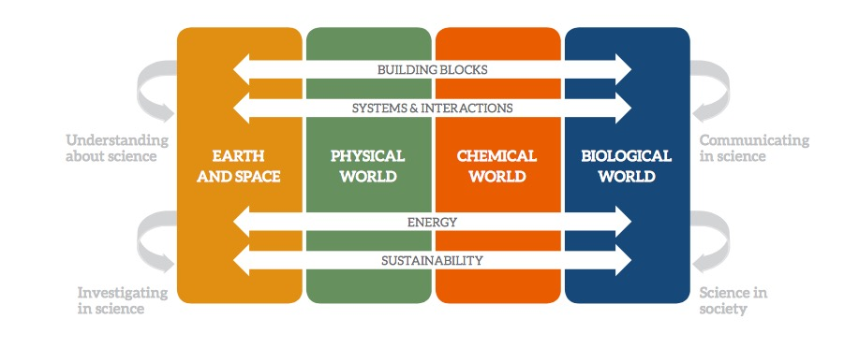
The elements of the contextual strands
Todays workshop

Slide 28
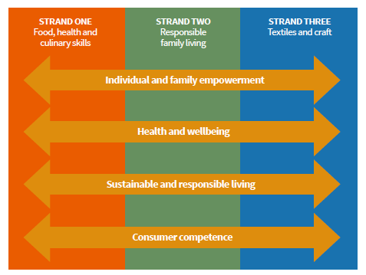

Slide 29
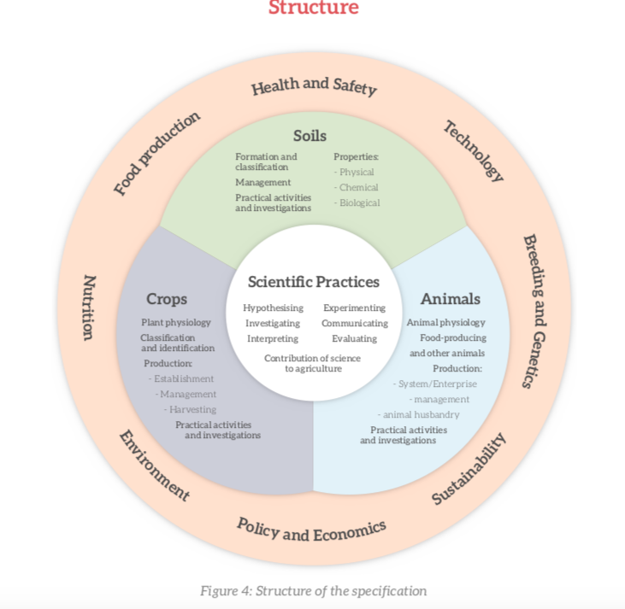

Slide 30
Number Strand
N.2 investigate equivalent representations of rational numbers so that they can:
b. use and understand ratio and proportion
Explore and Calculate the Gini Coefficient and the Palma Ratio
http://shlegeris.com/gini
Oxfam wealth inequality campaign and education
Isotope-Ratio Mass Spectrometer (IRMS)
The Infinite Monkey Cage-Climate Change

Slide 31
2nd Year students are doing statistics in maths class. We’re currently looking into the votes and seats won in the last general election in Ireland and comparing the percentage of votes to the proportion of the seats they actually got. We’re hoping to continue on and look at the elections in the UK and US and compare them to our system - which is more democratic etc. We’ll then (hopefully) do a project on gerrymandering and dividing constituencies to ‘favour’ some outcomes over others etc, and look at how Trump won despite Clinton getting more votes.
Kate Minnock NWETSS
Our 2nd year Maths students looked at the statistics of elephant deaths in Southern India. During Fairtrade Fortnight they looked at percentages and profit margins for Fairtrade farmers versus market rates.
Colleen Cooney, Moville Community College

Slide 32
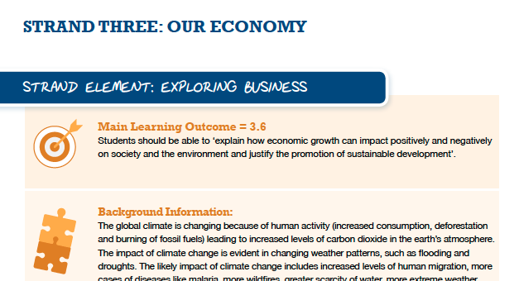
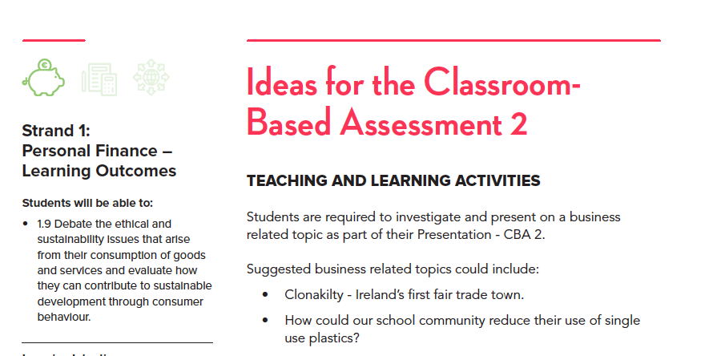

Slide 33
Junior Cycle MUSIC
The UN Declaration of Human Rights (Article 27) affirms the rights of everyone to ‘participate in the cultural life of the community and to enjoy the arts’.
With an increasingly diverse and pluralist population, this understanding of others through a cultural lens will encourage students to develop as responsible and ethical citizens.
Strand 2: Innovate and Ideate
2.2 create a musical statement (such as a rap or an advertising jingle) about a topical issue or current event and share with others the statement’s purpose and development
Strand 3: Culture & Context
3.1 collaborate with fellow students and peers to produce a playlist and a set of recordings to accompany a local historical event or community celebration
3.4 compose and perform an original jingle or brief piece of music for use in a new advertisement for a product, and record the composition-ADBUSTERS!
3.6 associate/match music excerpts to a variety of texts (words, film, language) and justify the reasons as to why this piece of music was chosen to match the text
CBA 1 using a global justice issue as stimulus/ exploring different styles of music.

Slide 34
Wood Technology
The sustainable use and management of this natural resource is important as the world faces the challenges of the 21st century. From habitats to construction or recreation to oxygen creation this resource can wellbeing of our planet.
Strand 2: Design Thinking
‘Students consider the environmental and social impacts of design decisions and investigate how to minimise material use and manage waste’.
Strand 3: Wood Science and Materials
They explore the role of forestation and wood in terms of local/global ecology and sustainability and recognise the importance of considering the impact on the natural environment when sourcing materials.
ELEMENT 4: ENVIRONMENT AND SUSTAINABILITY
The learning outcomes in this element encourage students to appreciate the environmental benefits and impacts of using wood as a natural and renewable resource, and to use sustainable practice throughout their learning. Students explore the role of forestation and wood in terms of global and local ecology and sustainability.
The new JC Applied Technology places a strong emphasis where possible to look at use of recyclable or biodegradable materials in use for class CBA projects and examination projects. Rebecca Dobson Athlone CS

Slide 35
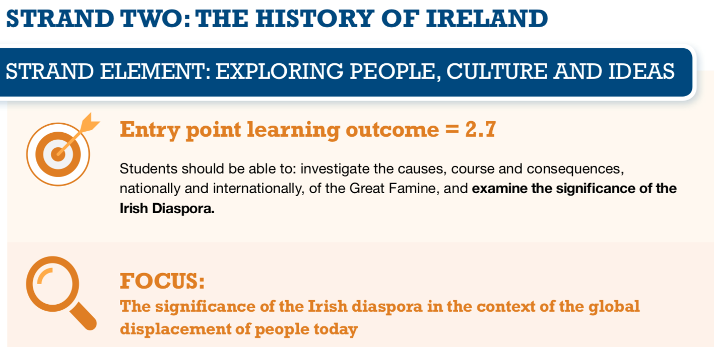
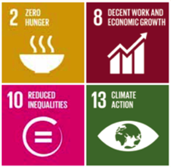
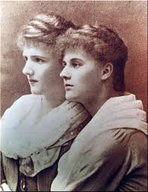
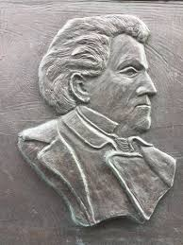
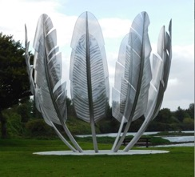
Notes:
paweł edmund strzelecki-polish humanitarian
Eva gore booth
Choctaw Indian Cork
Europe is the destination of the minority of refugees each year:

Slide 36
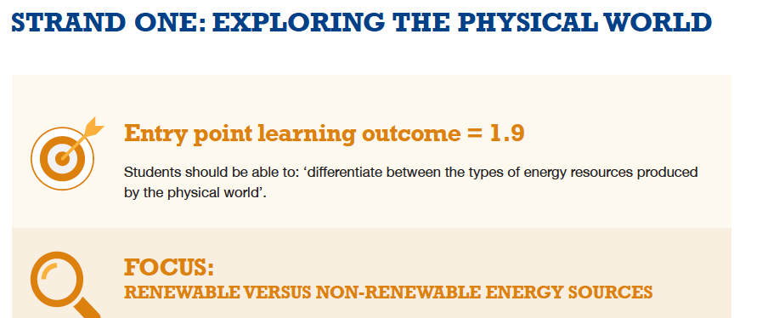
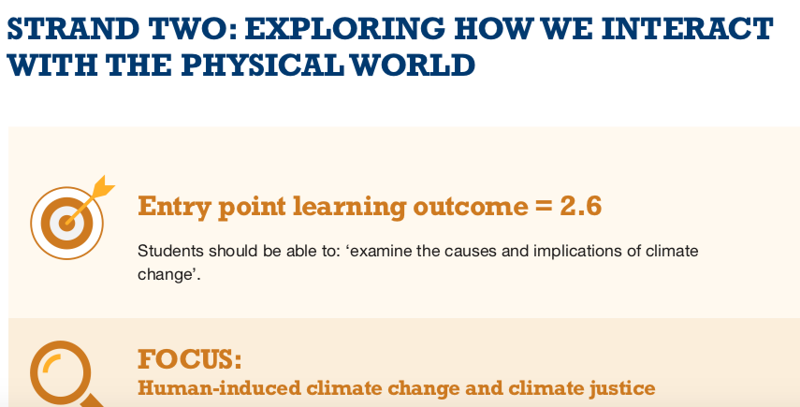

Slide 37
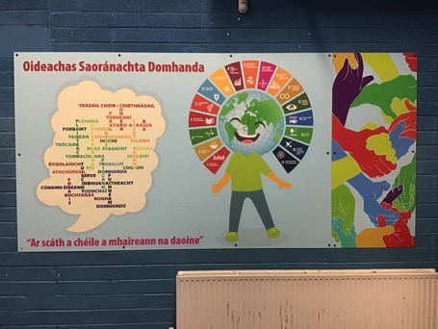
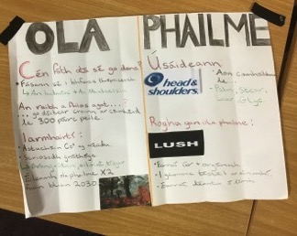
For Gaeilge Senior Cycle Local and global issues explored and discussed in preparation for oral element of curriculum. Seachtain na Gaeilge celebrates sayings in Irish that represent unity. global justice human rights etc
Jer Holland Loreto Fermoy

Slide 38
The issue of colonialism and the development of a country and it's identity has been discussed and compared to our own national identity and how that was formed. 6th Year Geography and LCVP, in Geography we studied about soil and human interactions with soil in particular - deforestation, over-cropping and overgrazing in the Sahel Region. Similarly, the looked at population issues and migration (push and pull factors). Also, we looked at NGO's and volunteering in crisis areas. This linked into LCVP as we looked at the role of the volunteer and their rights and responsibilities
CSPE classes in first year have been introduced to an awareness of global issues including the environment, the importance of education, buying fair trade/locally/organically and thinking about the issues that can surround each of these actions. The L2LP's have restored a strong Green schools committee and are committed to being sustainable in the school. Noel McGreal
In first year CSPE and English, a cross-curricular approach was taken to learning about developmental education and relating it to English and poetry and writing for the poetry competition "When Love Conquers Fear" for Trocaire. In Second Year Geography and History, a cross-curricular approach was taken in relation to the role of colonialism in the world. In History, students studied 'Exploration' and 'Plantations' with an emphasis on exploitation of the native peoples. This was further developed as studied focused on economic inequality - Developed vs. Developing and how these inequalities stem from the past.

Slide 39
English CBA: As pupils prepare for their CBA assignment in English, where they deliver a speech to the class, we take this opportunity to show speeches such as the Girl who silenced the world in 5 minutes. This encourages pupils to explore GCE themes in the speeches that they prepare.
Joanne Mallon St Louis SS Dundalk
In my 6 week module with Agriculture for TY I am covering "The influence of modern agriculture on society and the environment"
C.S.P.E: 1st -3rd years studied Global Citizenship. Sustainability: including how we connect with ecosystems, sustainable development, calculating their own individual ecological footprints, learning about sustainable strategies to help our planet. Local and Global Development. The reality of poverty and inequality, the causes of poverty, local development and the favelas in Brazil. ( this is done in a culturally sensitive way as one of our students is Brazilian) Effective global change learning about Power and influence, the analysis of Climate Change, Responsible consumption and production. A campaign for change. June Coghlan Colaiste Dhulaigh

Slide 40
Learners work on cross-curricular level on a regular basis with a DE focus. Recently learners looked at the statistics (Maths) of those affected by Water Crisis and then designed solutions to meet these needs (Technology/Science/Engineering/Woodwork/Metalwork).
Students work regularly in geography on crises globally from disaster and then critique this knowledge with English essays and newspaper reports to raise awareness in our school blog.
Colaiste Bhaile Chlair

Slide 42
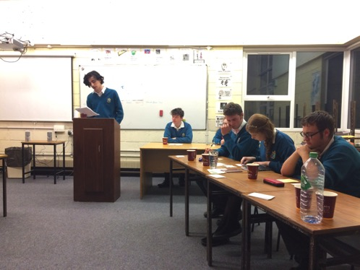
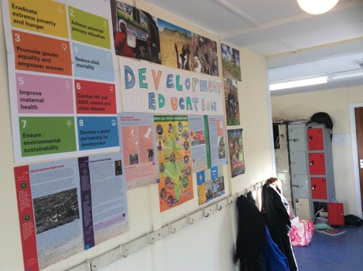
Members of the student council decided on getting rid of plastic drinks bottles in favour of having a tap for drinking water to cut down on waste. Elphin
The annual 'Green Concern' provides opportunities for the whole school to take part and create awareness
Sancta Maria

Slide 43
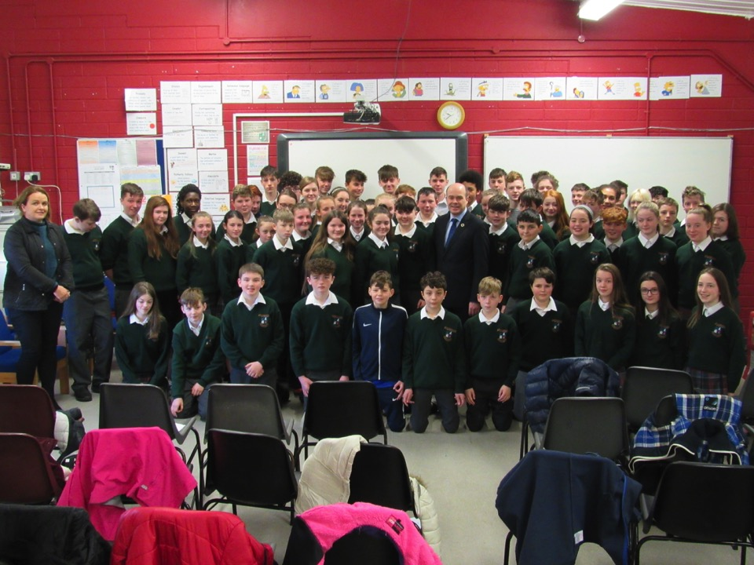

Slide 44














Large community of NGOs involved in Post-Primary GCE in Ireland

Slide 46

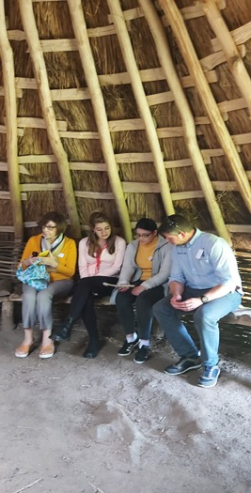
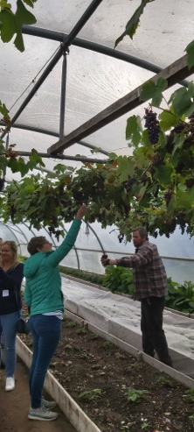
30th January Killashee House, Kildare
WWGS Teacher Training
Centralised Training and Regional Training
Format:
WWGS Inputs
Peer Learning
Teacher Inputs
Case Studies
Workshops
Share good practice
Evaluation
What we explore
Teaching Controversial Issues
Active T&L Methodologies
Global Passport Framework
The Global Goals
Developing a School Policy for Global Citizenship

Slide 47
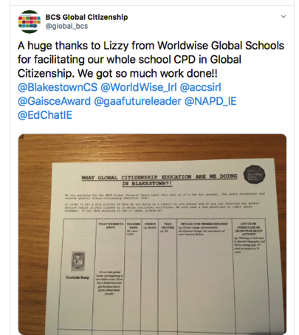
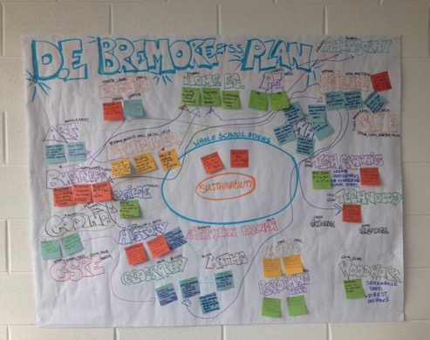
In-Service for Schools

Slide 49
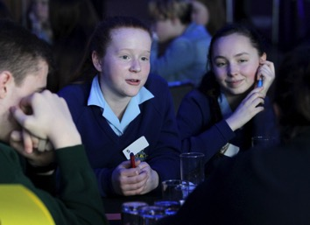
WWGS Annual Conference
April 2nd 2019 Cork

Slide 50
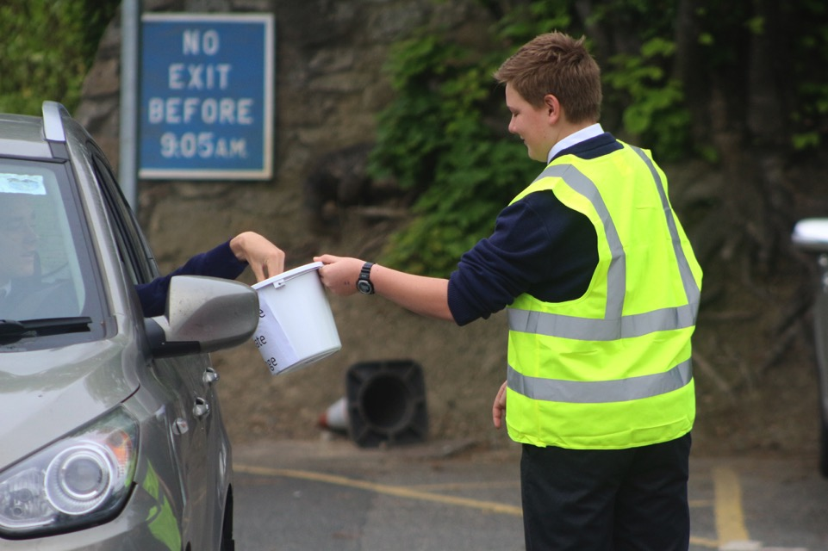

Slide 51
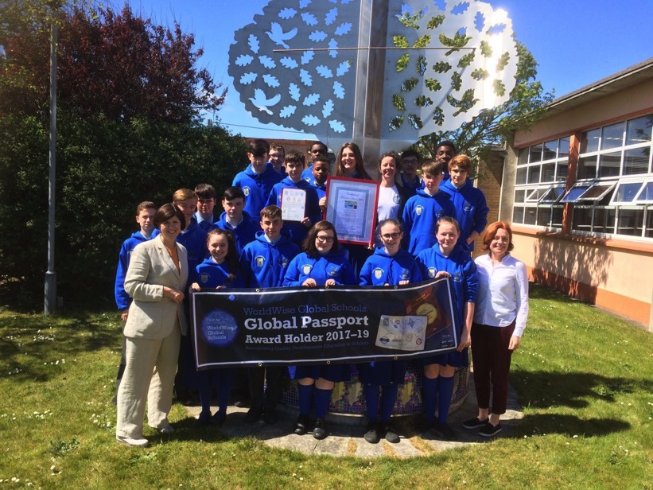
Notes:
Music dept looked at migration as an issue when preparing for Grease

Slide 52
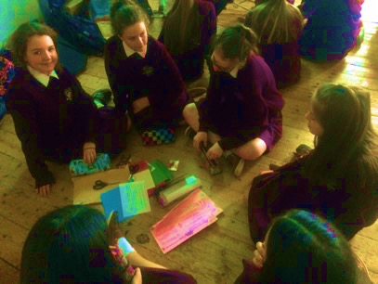

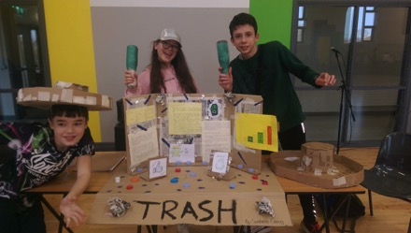

Slide 54
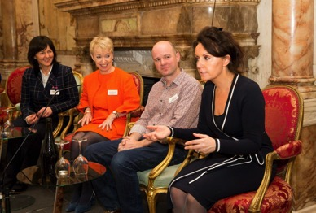
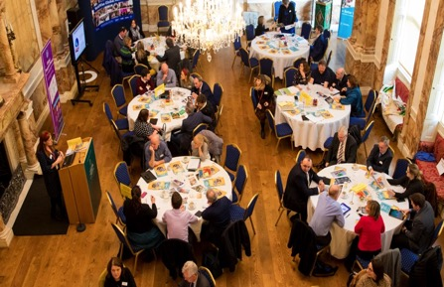
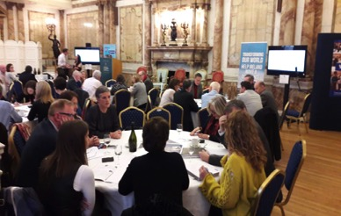
Symposium for School Management on Global Citizenship Education

Slide 55
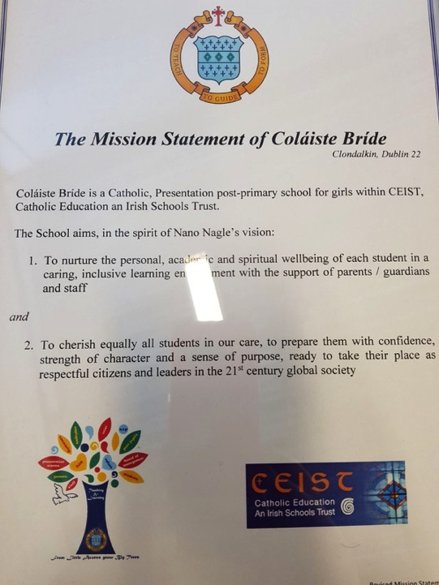
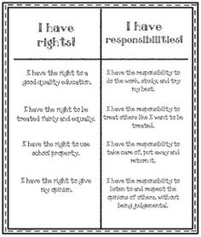

Slide 56
The Board of Management has commited to the implementation of GCEpolicy within the school and is very supportive of all DE intiatives within the school and local community. Teacher members of the Board are involved in GCE Activities
St Colman’s College

Slide 57
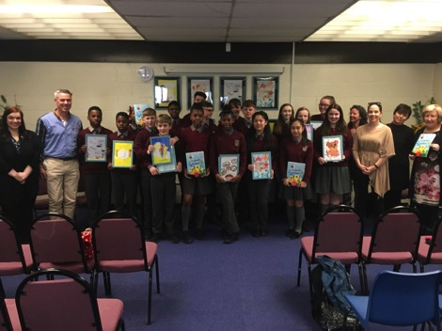
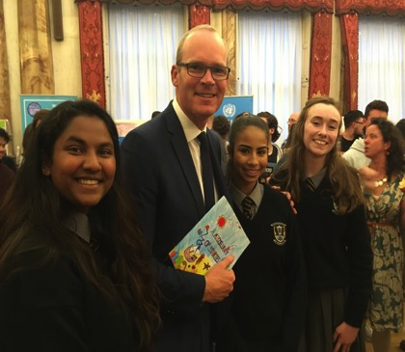
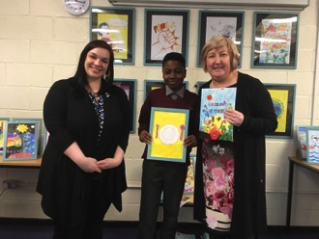
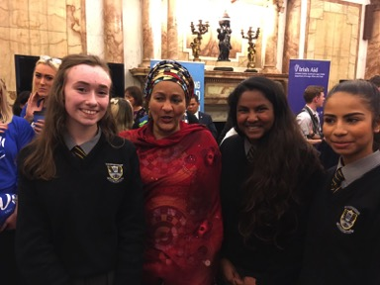

Slide 59





Slide 60

Lizzy.noone@worldwiseschools.ie
0868720879

