Slide 1

MORE OR LESS EQUAL?
English slideshow B
Notes:
Closely linked to the national curricula in England, Scotland and Wales, More or Less Equal? enables learners to develop their knowledge, skills and understanding through an exploration of young people’s lives in Ethiopia, India, Peru, Viet Nam and the UK. With separate sessions in geography (social studies in Scotland), maths and English, More or Less Equal? can be used in both a subject-specific and cross-curricular way.

Slide 2
ENGLISH 3
A life in the day of…

Slide 3
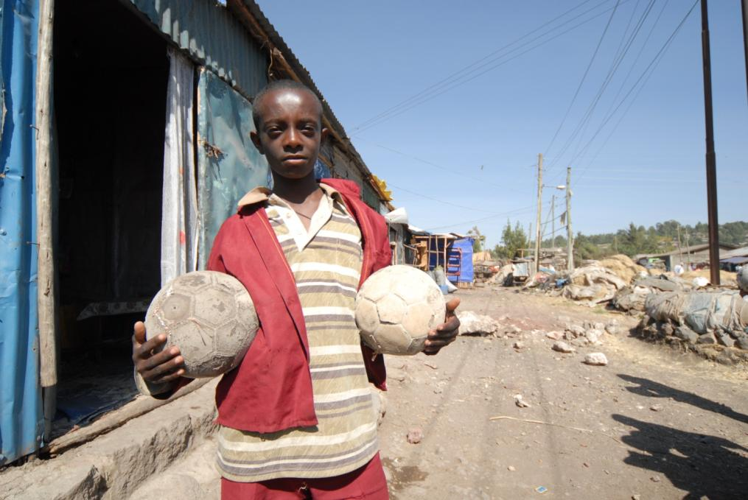
Afework Ethiopia
Here is Afework. In his spare time he likes playing football with his friends and watching TV.
Notes:
Afework (A-fee-work) is a 12-year-old boy who lives in Addis Ababa, the capital city of Ethiopia.
Photo credit: © Young Lives/Aida Ashenafi

Slide 4
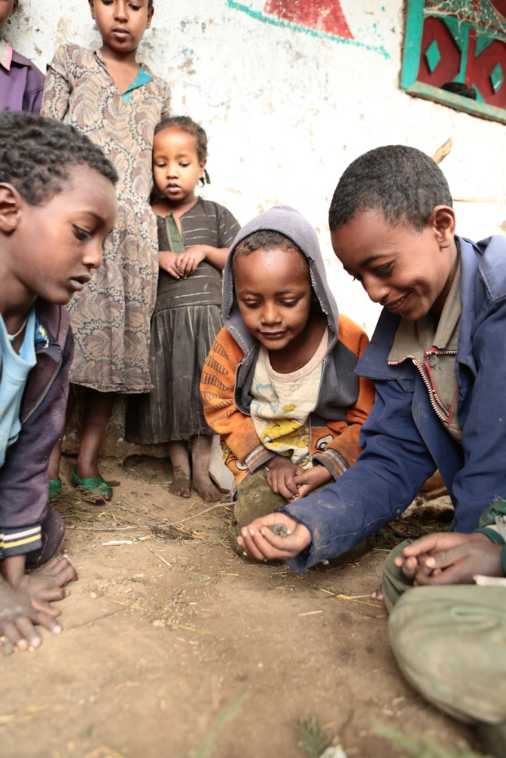
Tufa Ethiopia
Here is Tufa at a friend’s house. They are using nutshells to play a game.
Notes:
Tufa (Too-fa) is 13 year old boy who lives in a rural area of Oromia region in Ethiopia.
Photo Credit: © Young Lives/Antonio Fiorente

Slide 5
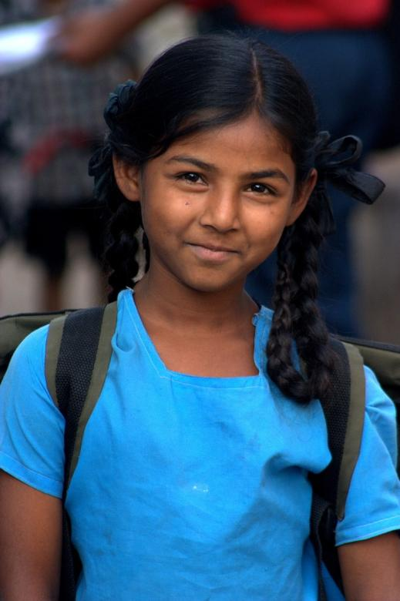
Harika India
Harika has to work hard to help her mother at home.
Notes:
Harika (Har-i-ka) is a 12 year old girl who lives in a village in the state of Telangana in India.
Photo credit: © Young Lives/Farhatullah Beig

Slide 6
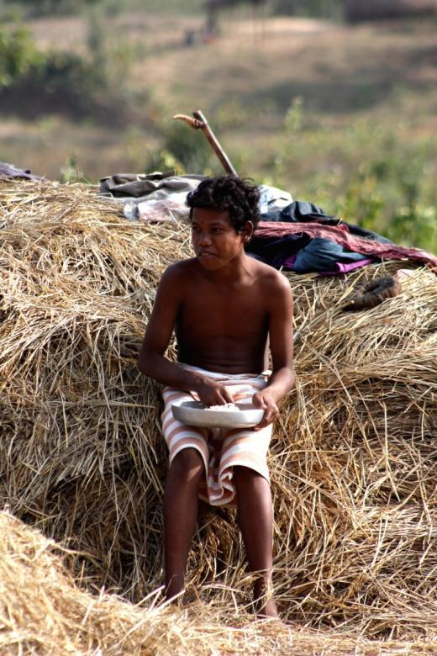
Ravi India
Here is Ravi eating his lunch.
He is having dal (lentils) and rice.
Notes:
Ravi (Rav-y) is a 12-year-old boy who lives in a village in the state of Andhra Pradesh in India.
Photo credit: © Young Lives/Farhatullah Beig

Slide 7
ANALYSING A LIFE IN THE DAY OF…
Mostly written in the present tense to describe life and day as they are now but sometimes written in the past tense to explain things that have already happened.
Written in the first person.
Uses time connectives.
Events in chronological order but each event is embellished with thoughts, feelings and memories, making this more than a time log.
Includes personal information (facts, thoughts and descriptions) such as about family and friends, likes and dislikes, interests and dreams for the future.
Events described can be ones that happen every day or only on some days, such as “On Thursdays...” or “At weekends...”.

Slide 8
ENGLISH 4
Making difficult choices

Slide 9
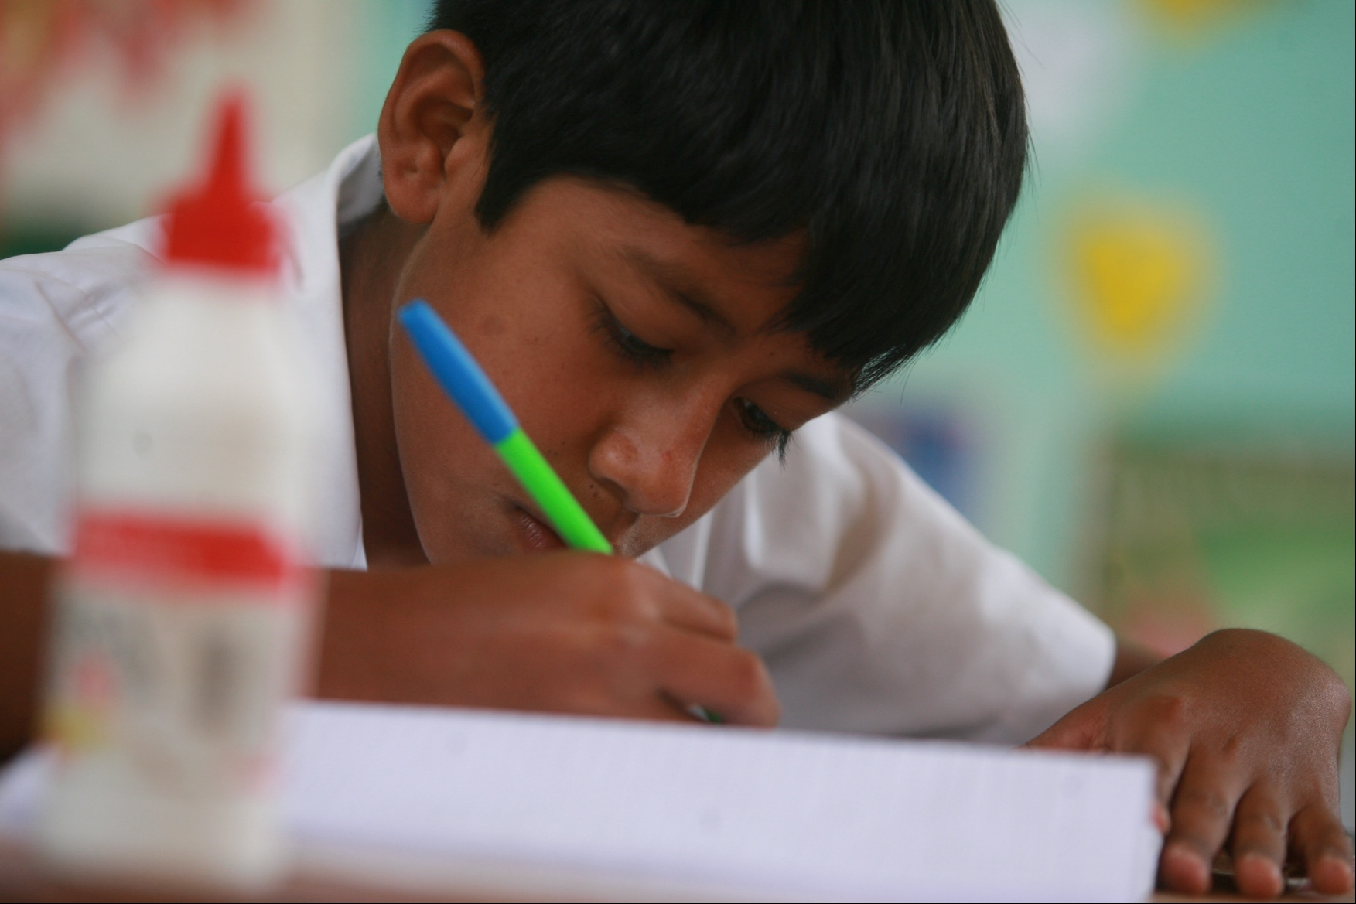
Elmer Peru
Notes:
This is Elmer (El-mer). He is 12 years old and lives with his older sister Eva in Lima. Lima is the capital city of Peru. Elmer came to the city from his village earlier this year so that he could start secondary school. Elmer misses his family and friends in the village but knows that he will be going home one day.
Elmer’s sister Eva is 25 and has two small children. Her husband is a carpenter. Elmer also moved to the city to help look after Eva’s children. He takes care of them in the afternoons and on Saturdays when she works in a restaurant.
They live next to a busy road in a densely populated part of the city. It is close to Elmer’s school. Their apartment is on the second floor above a car repair shop. The living room and kitchen are spacious and they have electrical appliances: a television, a DVD player, a stereo, a fridge and a cooker. Moving to Lima meant a big change in Elmer’s life. He moved from the primary school in his village to a large secondary school in the city. Elmer likes the playground in his new school though he wishes it was cleaner. He thinks that secondary school is more difficult than primary school because there is more homework and there are more teachers.
At home in his village, Elmer helped his parents on their farm. He took care of the animals, worked the land and picked coffee. Sometimes Elmer got paid a small amount for this. Elmer spent a lot of time playing with his little sister and taking care of his youngest brother. In Lima, Elmer likes going out and playing in the park. He doesn’t like all the cars and noise. He thinks that his village is nicer because there are more trees.
Elmer wants to complete secondary school, to go to university and to become a doctor. He would like to have a wife and children but not until he is at least 25 years old. In the future he would like to travel and visit other places.
Photo credit: © Young Lives/Sebastian Castañeda Vita

Slide 10
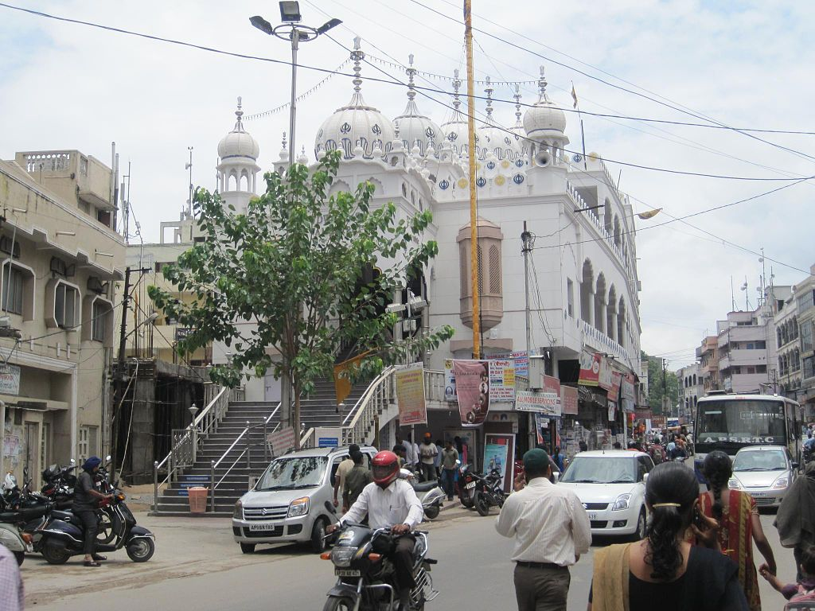
Hyderabad India
Notes:
Image info: A street in Hyderabad.
Photo credit: Shashi Bellamkonda (Flickr: Hyderabad Scenes, www.shashi.co)
Licensed under the Creative Commons Attribution-Share Alike 2.0 Generic license: creativecommons.org/licenses/by/2.0/

Slide 11
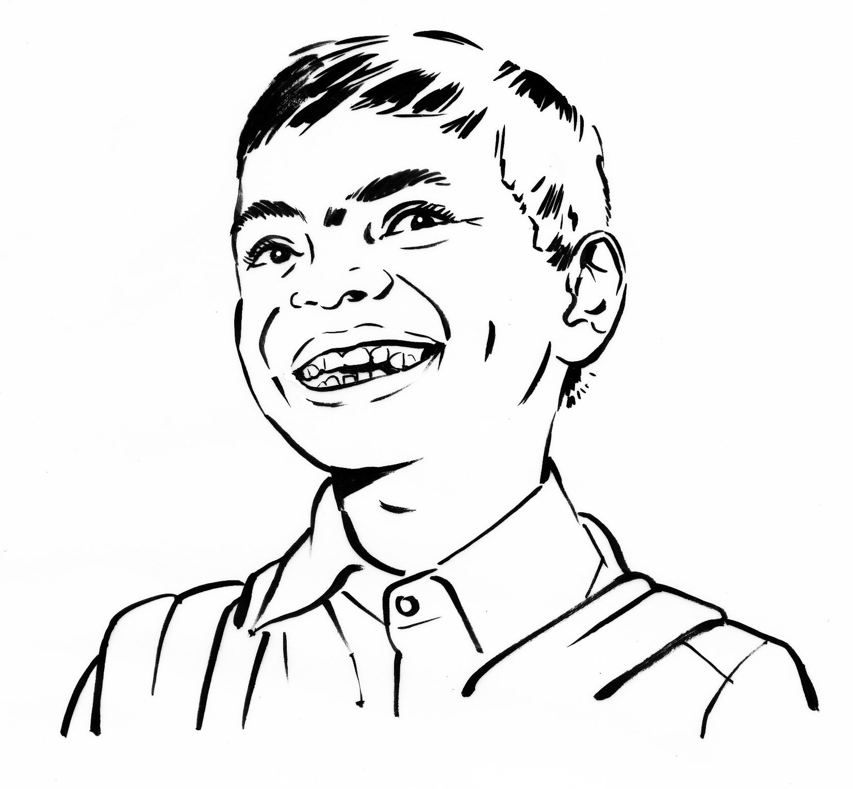
Naresh Hyderabad, India
Notes:
Image credit: Gary Wing

Slide 12
ENGLISH 5
The gender debate

Slide 13
This house believes that life is more difficult for girls living in poverty than for boys.
What do you think?

Slide 14
ENGLISH 6
Wishes for the future

Slide 15
MY WISHES FOR THE FUTURE
My country
My community
Me and my family

