Slide 1

MORE OR LESS EQUAL?
English slideshow A
Notes:
Closely linked to the national curricula in England, Scotland and Wales, More or Less Equal? enables learners to develop their knowledge, skills and understanding through an exploration of young people’s lives in Ethiopia, India, Peru, Viet Nam and the UK. With separate sessions in geography (social studies in Scotland), maths and English, More or Less Equal? can be used in both a subject-specific and cross-curricular way.

Slide 2
ENGLISH 1
Welcome to my life

Slide 3
WHAT IS YOUNG LIVES?
Young Lives is an international research project looking at how poverty is affecting young people’s lives. It is led by a team in the Department of International Development at the University of Oxford in the UK.
Researchers have followed the lives of 12,000 young people in four different countries – Ethiopia, India, Peru and
Viet Nam – for 15 years, from 2000 to 2015.

Slide 4
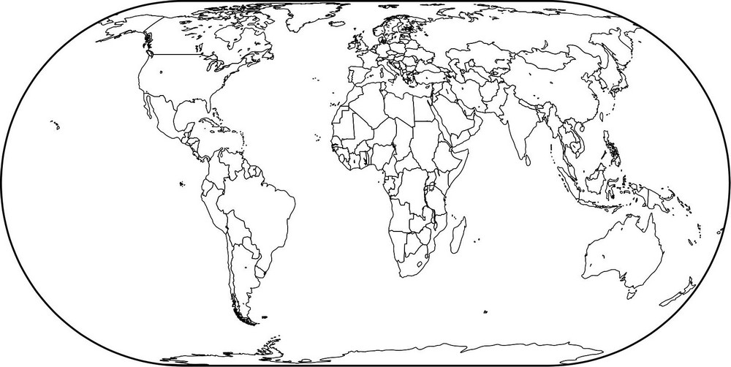
WHERE IN THE WORLD?
UK
Viet Nam
Ethiopia
India
Peru
Can you locate the UK, Ethiopia, India, Peru and Viet Nam on a world map?
Notes:
Click forward on the slide to reveal the locations of these countries.
The countries will appear in the following order: the UK, Ethiopia, India, Peru and Viet Nam.
Map source: Geographical Association www.geography.org.uk

Slide 5
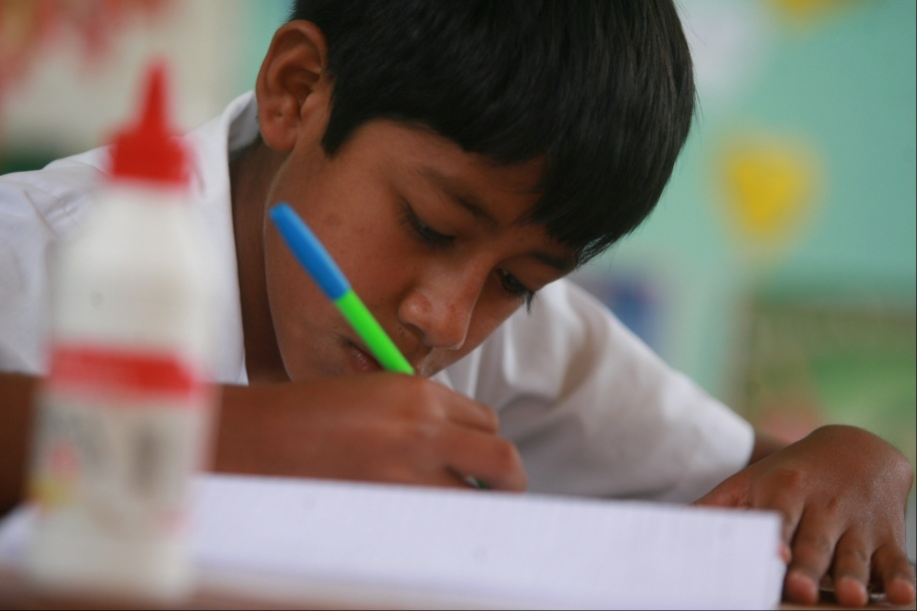
WHAT IS YOUNG LIVES?
The researchers have collected a lot of data about the young people’s lives. They have also interviewed the young people and some of their families.
This is Elmer, one of the young people interviewed in the project. He is from Peru.
Notes:
Photo credit: © Young Lives/Sebastian Castañeda Vita

Slide 6
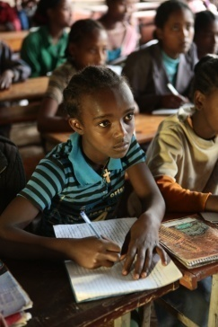
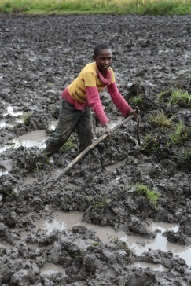
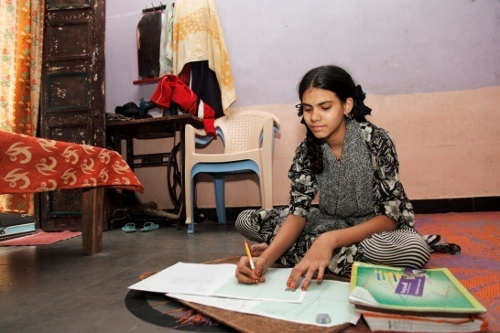
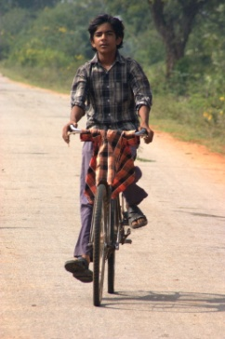

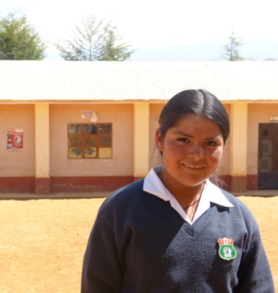
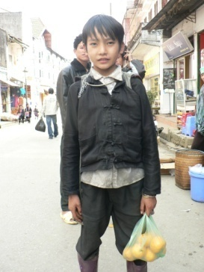
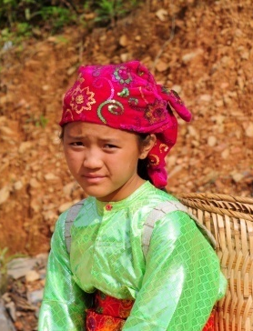
WHAT IS YOUNG LIVES?
The researchers have also been following some of these young people more closely. They have spent time with these young people in their communities to find out more about their lives.
Notes:
Clockwise from top left:
Photo credit: © Young Lives/Antonio Fiorente
Photo credit: © Young Lives/Antonio Fiorente
Photo credit: © Young Lives/Sarika Gulati
Photo credit: © Young Lives/Farhatullah Beig
Photo credit: © Young Lives/Nguyen Quang Thai and Trinh Van Dang
Photo credit: © Young Lives/Pham Viet Anh
Photo credit: © Young Lives/Mariluz Aparicio
Photo credit: © Young Lives/Sebastian Castañeda Vita

Slide 7
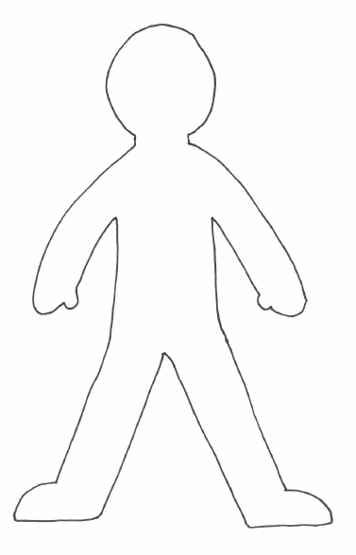
INTRODUCING…
Do they go to school?
What do you know about this young person?
If they don’t go to school, why don’t they? Would they like to go to school?
How old are they?
Do they work? If so, why? What do they have to do?
How would you describe their personality?
Who do they live with?
What do they do in their spare time?
How do you think this young person feels about their life?
Where do they live?
Do they have to help at home? What do they have to do?
What is their home like?
What holidays do they celebrate?
What would they like to do or be in the future?

Slide 8

Netsa Ethiopia
Notes:
This is Netsa (Ne-as-sa). She is 12 years old and lives in a slum area in the city of Addis Ababa, the capital of Ethiopia. She is an only child and lives with her foster mother.
Netsa is in grade 5 at a local government school. She used to go to private school but had to drop out because the fees went up and her mother couldn’t afford them any more. Netsa likes her school. There is a library with some new books. There is one toilet for grades 5 to 8 but it doesn’t work properly. Netsa studies English, Amharic, maths, science and geography.
Netsa gets home from school at 4.30pm and then helps at home until 6.00pm. She helps her foster mother by washing the dishes, cooking, cleaning the house and making the beds. Her mother bakes injera to sell in the neighbourhood.
On Sundays Netsa goes to church in the morning. After that she eats her breakfast and has a bath. Then Netsa washes her school uniform and does household chores. She plays from 5.00pm to 6.00pm and then studies in the evenings before going to bed.
Netsa thinks that she will have a better life than her mother if she finishes her education. Her mother studied up to grade 7. Netsa wants to finish at grade 12 and go to university. She would like to be a doctor in the future.
Photo credit: © Young Lives/Antonio Fiorente

Slide 9

Hadush Ethiopia
Notes:
This is Hadush (Haa-doo-sh). He is 13 years old and lives in a village in a rural area in the Tigray region, in the northern part of Ethiopia. Hadush lives with his father, stepmother and older siblings. His mother died when Hadush was small and his father married again six years ago.
Hadush doesn’t go to school but his sisters do. He looks after the cattle instead. From time to time Hadush goes to a traditional school at the house of a teacher who is a priest. He likes this school but plans to start regular school next year.
Hadush’s home is in a compound. Inside there are three buildings – the hidmo, the seqela and the adarash. The hidmo (which means ‘home’) is a small room made of stone. The floor is made of earth, and its walls are rough. The seqela is a cattle pen. The adarash is a sleeping room with a traditional mattress on a bed made of mud. The family have a light and a radio but no tables or chairs. They don’t have electricity but there are plans to install an electricity supply in their community in the future.
Hadush works to support his family. He likes his work and is proud to do it. Hadush works around 10 hours a day, from 8.00am until 6.00pm. He also helps his stepmother to collect firewood and fetch water.
Hadush says that he is good at everything – nothing is impossible for him.
Photo credit: © Young Lives/Antonio Fiorente

Slide 10

Sarada India
Notes:
This is Sarada (Saa-ru-daa). She is 12 years old and lives in a rural village in the south of the state of Telangana in India. Sarada lives with her mother, sister and brother. Sarada has been disabled since birth. She can walk short distances but she finds it difficult to stand for any length of time.
Sarada is in the last year of upper primary school. She thinks education is very important. At school, Sarada takes part in a number of extra-curricular activities and she has won some prizes. Her mother wasn’t educated herself and thinks that it is very important that Sarada and her brother go to school.
Sarada loves her family though she argues with her brother sometimes. Her father remarried and lives with Sarada’s stepmother and stepbrothers and stepsisters in Mumbai. They come to visit once a year.
Sarada doesn’t have many friends at school. Her best friend was an older girl called Sabeena but she was married at the age of 15. Sarada doesn’t see Sabeena much any more and misses her. Sarada doesn’t think that young women should get married too early. Many girls in her village are married at the age of 14 or 15. Sarada thinks they should wait until they are 20. Her stepsister in Mumbai was married at the age of 12 and now has three children.
In the future Sarada would like to study and go to high school. However, the high school is eight kilometres away and you have to go by bus. Many girls in Sarada’s village drop out at this stage because their parents don’t want them to travel on public transport on their own.
Sarada would like to be a judge so that she can improve society and stop people doing wrong things and harming others. Or she would like to be a businesswoman, starting a small tailoring centre or opening a shop to sell goods that she has sewn. One day, Sarada would like to own her own house and maybe get married.
Photo credit: © Young Lives/Sarika Gulati

Slide 11

Salman India
Notes:
This is Salman (Sull-maan). He is 12 years old and lives in a poor neighbourhood in the city of Hyderabad, the capital of Telangana state in India. Salman comes from a Muslim family. He lives with his mother and two younger and two older siblings. Salman’s father died of a heart attack when he was six years old. They live close to the city centre. Salman likes where they live. He thinks that the other people in their community are nice people and that you can trust them.
Salman dropped out of school in grade 1 and now work as a sales assistant in a shoe shop. His mother works as a servant, looking after the house of a rich person. Salman’s mother says that she can’t afford to send him to school. Life is very hard for her without Salman’s father. Salman misses his father too. He keeps a photo of his father with him.
Salman earns 30 rupees (about 30p) a day, most of which he gives to his mother. Salman keeps five rupees for his own spending money. Sometimes the customers give Salman tips because he is poor. His mother gives him a packed lunch for work every day. There are three other boys working in the shop. The younger one works in the afternoon and studies in the morning. Salman likes the owner of the shop where he works because he looks after him and the other boys.
Each day Salman normally spends 10 hours sleeping, eight hours working and six hours playing. Now Salman can only play when he comes home from work. He also watches television. Salman likes comedy programmes such as Mr Bean.
Salman thinks that he has to work hard to earn money and have good health. He has no choice but to continue to work. Salman isn’t sure what he wants to do in the future. He thinks that perhaps one day he will start his own shop. Or maybe he will go back to school.
Photo credit: © Young Lives/Farhatullah Beig

Slide 12

Elmer Peru
Notes:
This is Elmer (El-mer). He is 12 years old and lives with his older sister Eva in Lima. Lima is the capital city of Peru. Elmer came to the city from his village earlier this year so that he could start secondary school. Elmer misses his family and friends in the village but knows that he will be going home one day.
Elmer’s sister Eva is 25 and has two small children. Her husband is a carpenter. Elmer also moved to the city to help look after Eva’s children. He takes care of them in the afternoons and on Saturdays when she works in a restaurant.
They live next to a busy road in a densely populated part of the city. It is close to Elmer’s school. Their apartment is on the second floor above a car repair shop. The living room and kitchen are spacious and they have electrical appliances: a television, a DVD player, a stereo, a fridge and a cooker. Moving to Lima meant a big change in Elmer’s life. He moved from the primary school in his village to a large secondary school in the city. Elmer likes the playground in his new school though he wishes it was cleaner. He thinks that secondary school is more difficult than primary school because there is more homework and there are more teachers.
At home in his village, Elmer helped his parents on their farm. He took care of the animals, worked the land and picked coffee. Sometimes Elmer got paid a small amount for this. Elmer spent a lot of time playing with his little sister and taking care of his youngest brother. In Lima, Elmer likes going out and playing in the park. He doesn’t like all the cars and noise. He thinks that his village is nicer because there are more trees.
Elmer wants to complete secondary school, to go to university and to become a doctor. He would like to have a wife and children but not until he is at least 25 years old. In the future he would like to travel and visit other places.
Photo credit: © Young Lives/Sebastian Castañeda Vita

Slide 13

Eva Peru
Notes:
This is Eva (Aa-va). She is 14 years old and lives with her mother and father in a small rural village in the southern Andean highlands in Peru. Eva goes to a school in a nearby city; it takes her 45 minutes to get there. Eva would like to live in the city one day.
Eva’s father became ill last year. He had a back injury and can’t work any more. Since then Eva has had to work on the farm at weekends and during school holidays. Eva needs to work to be able to afford clothes and the return fare for the school bus. Eva likes to work but she doesn’t like it when she has to work late.
Everyone in Eva’s family reads and writes but they have very few books at home. Eva liked primary school more than secondary because there was less work and she had more friends.
In the mornings during the week, Eva cooks and does chores before school. She has to wash the family’s clothes. Eva likes to do this. In the evenings, she watches television.
Eva thinks that they are taught well at her school. There is a library, gardens and a workshop. They grow vegetables at school and Eva plays volleyball. There aren’t enough classrooms at her school but they are building new ones. Some classrooms have two study sections – some people go in the mornings and some go in the afternoons. Eva studies in the afternoons at the moment but she would prefer to study in the mornings.
Eva wants to learn and complete school. She thinks that school will be useful for her future. Her dream is to go to university to study nursing.
Photo credit: © Young Lives/Mariluz Aparicio

Slide 14

Phuoc Viet Nam
Notes:
This is Phuoc (F-ooo-c). He is 16 years old and lives with his family in the city of Da Nang. Phuoc is in grade 11. His school is one of the largest in the city. Phuoc is very proud to go there. There was an entrance exam and Phuoc had to study hard to pass it.
It takes Phuoc 20 minutes to cycle to school each day. He has an older sister who is in her final year of studying architecture. Phuoc tries to study as much as he can. He is specialising in English, literature and maths. He also takes part in some extra-curricular activities such as the Boy Scouts and karate.
In his free time, Phuoc helps his parents to look after their store. He also helps his mother to mop the floor and sometimes to cook. In the Boy Scouts Phuoc learned how to cook, go to the market and find wood. Sometimes Phuoc goes on outings and picnics with his class. As well as studying, Phuoc also likes to read books and listen to music. Sometimes he watches television or reads newspapers. Phuoc likes horror and action films the most. When Phuoc watches television, he usually watches the Science Channel though he also watches cartoons once in a while for fun.
Sometimes Phuoc goes back to visit his mother’s hometown in the countryside. He likes the countryside. Life is relaxing there and more comfortable. Phuoc prefers the city, however, as he thinks that it’s easier to work in the city and the quality of life is higher.
Phuoc wants to graduate from high school and get accepted into a university. His dream is to obtain a Master’s degree in the future or maybe even a PhD. He would like to work in the tourism industry or in foreign relations. Phuoc wants to try hard and study overseas, maybe in the UK or Australia. Even if Phuoc goes away to study, he thinks that he would like to return to Da Nang one day.
Photo credit: © Young Lives/Pham Viet Anh

Slide 15

H’Mai Viet Nam
Notes:
This is H’Mai (H-My). She is 13 years old and lives with her family in a poor rural area in Phu Yen province, Viet Nam. She is the second oldest of four children. The family are from the H’Roi ethnic minority group.
H’Mai had to drop out of regular school in grade 6 because her parents didn’t have enough money to pay the fees. Although primary education is free in Viet Nam, there are a number of additional fees. Many children here drop out of secondary school because their parents can’t afford the school fees or other expenses, or because they live too far away from school and don’t have any form of transport, or because they have to work in the fields and so fall behind with their school work.
The family live in a small house with two rooms, a living room and a bedroom. There is another traditional building behind the house, with a kitchen and a bedroom, where they spend most of their time. In front of the house there is a well. H’Mai’s family don’t have a table or chairs and there isn’t any electricity in their house. There is an electricity supply in H’Mai’s village but her family can’t afford the connection. H’Mai dreams of having electricity at home one day.
H’Mai works on the family farm during the day and goes to night school from 7.00pm to 9.00pm on Tuesdays, Thursdays and Saturdays. She is in grade 9. On the farm H’Mai helps to herd the cows and cut grass. The family own about one hectare of land and they grow rice, beans, cassava and wheat.
When H’Mai isn’t working or studying she looks after her younger siblings. She also helps her mother with the housework. H’Mai does the laundry and cooks. She spends some free time with her cousin, who lives next door.
Photo credit: © Young Lives/Nguyen Quang Thai and Trinh Van Dang

Slide 16
ENGLISH 2
Inequalities in young lives

Slide 17
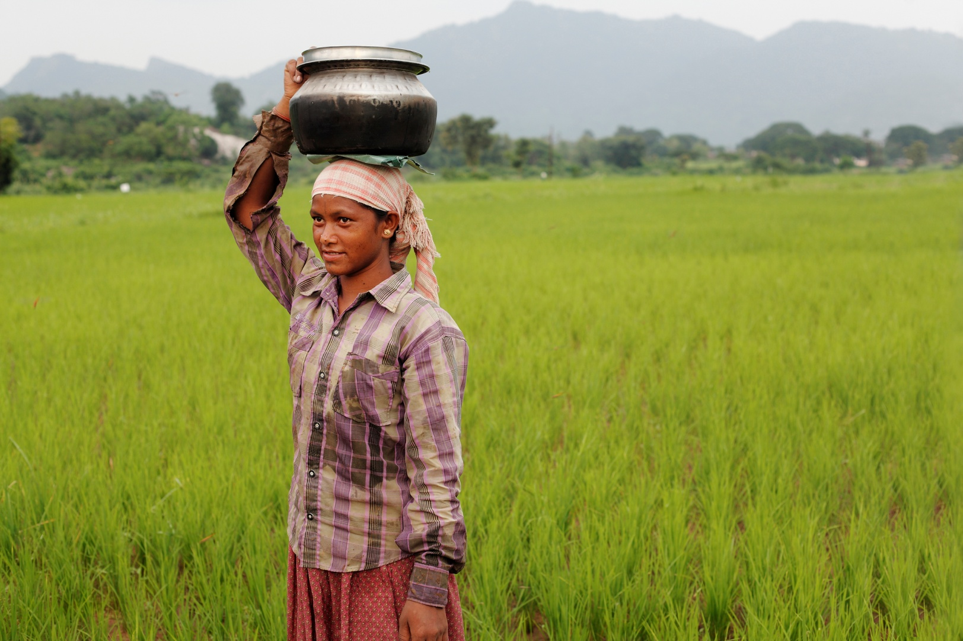
Helping with household chores such as collecting water or firewood.
Notes:
Image info: A young woman collects water in rural Andhra Pradesh, India.
Photo credit: © Young Lives/Sarika Gulati

Slide 18
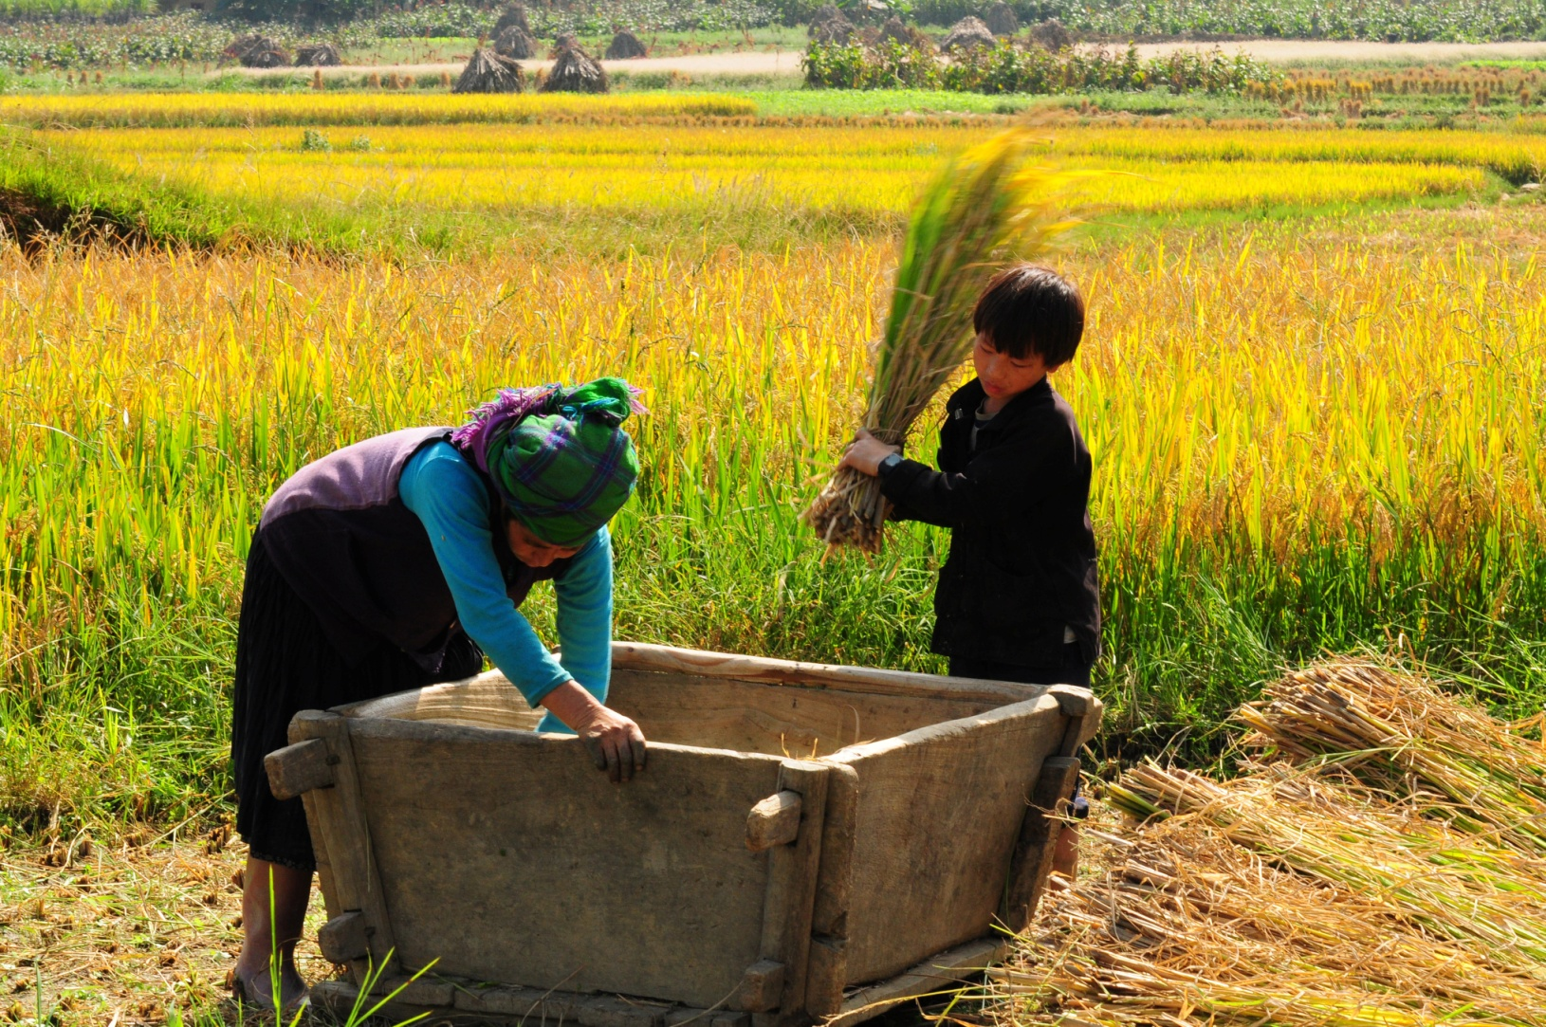
Working on the family farm or business.
Notes:
Image info: Harvesting rice in rural Vietnam. The lives of children in rural and urban Vietnam are quite different: children in urban Vietnam spend quite a lot of their time after school in extra classes or on extra-curricular activities, while children in rural Vietnam spend a lot of their time on agricultural or household tasks.
Photo credit: © Young Lives/Nguyen Quang Thai and Trinh Van Dang

Slide 19
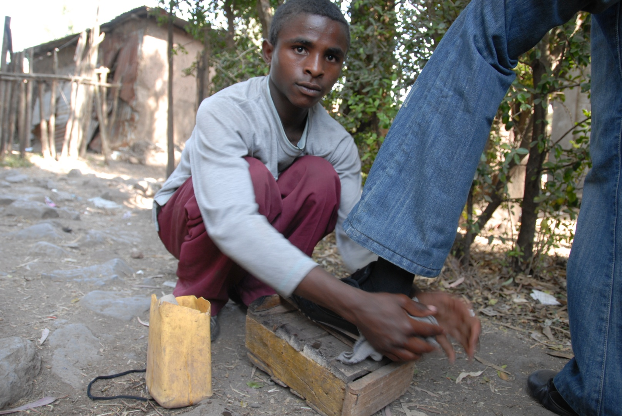
Working for pay outside the family home.
Notes:
Image info: Shoe-shining is a way to earn money in towns in Ethiopia.
Photo credit: © Young Lives/Aida Ashenafi

Slide 20
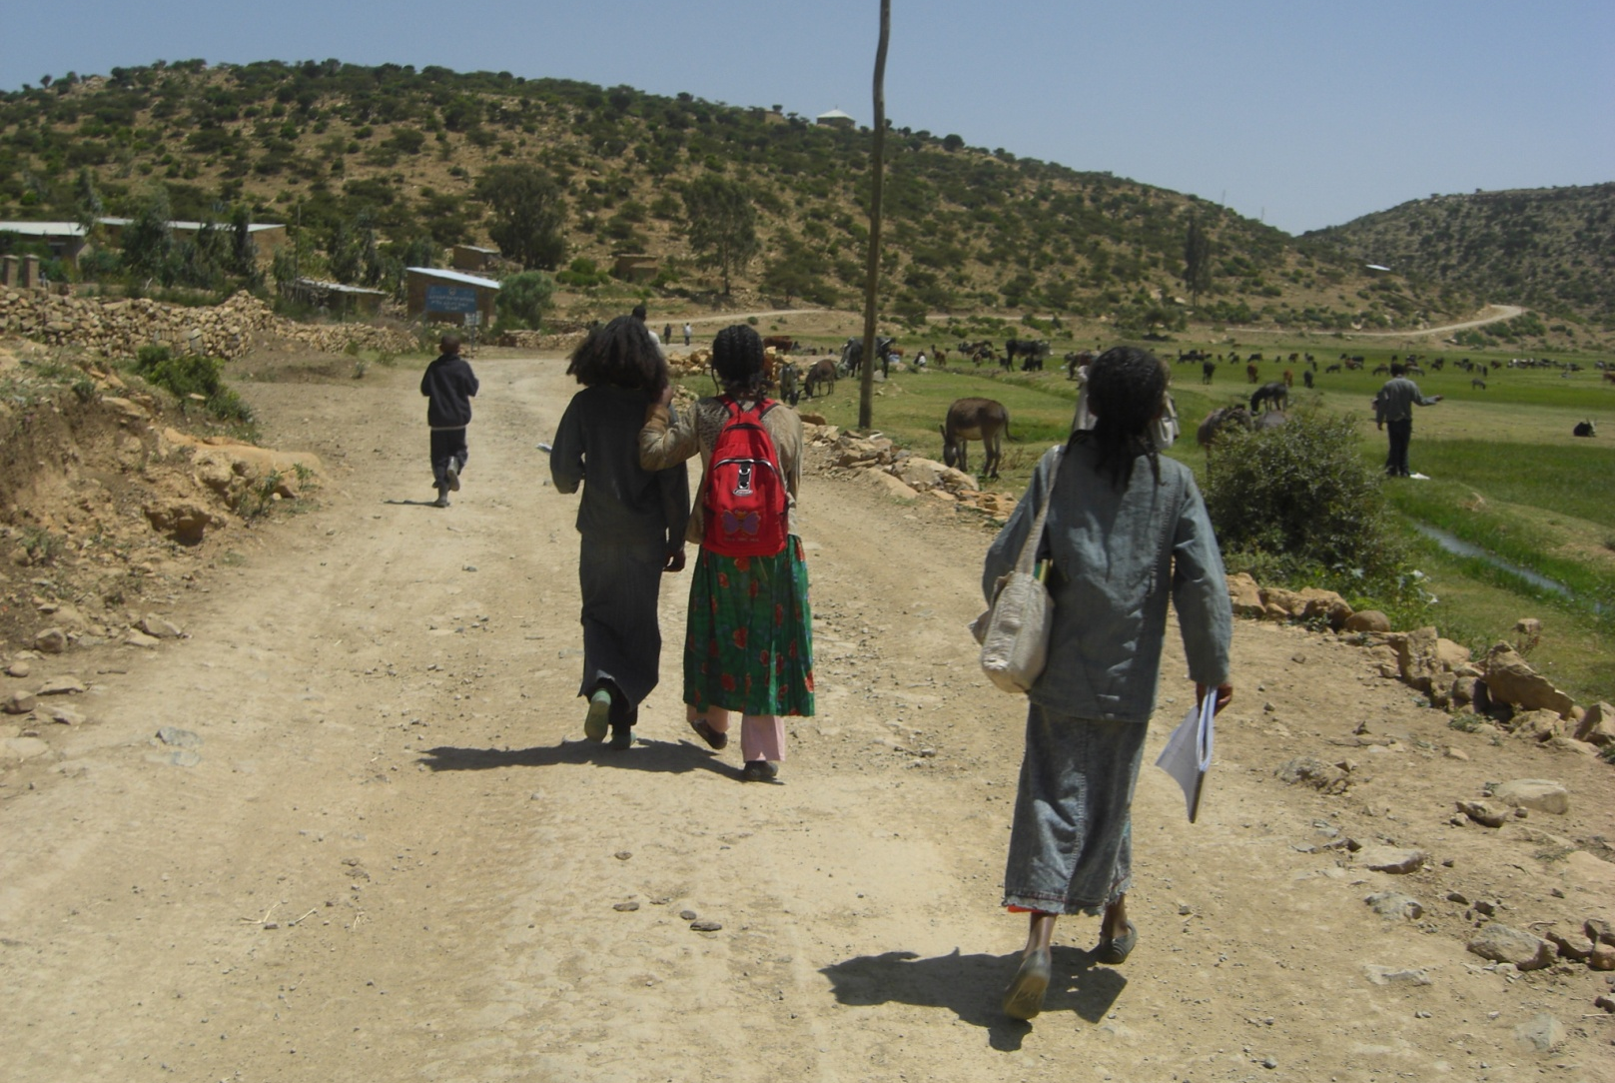
Going to school.
Notes:
Image info: On the way to school in rural Ethiopia. In some parts of Ethiopia, children can spend up to an hour walking each way to school.
Photo credit: © Young Lives/Yisak Tafere

Slide 21
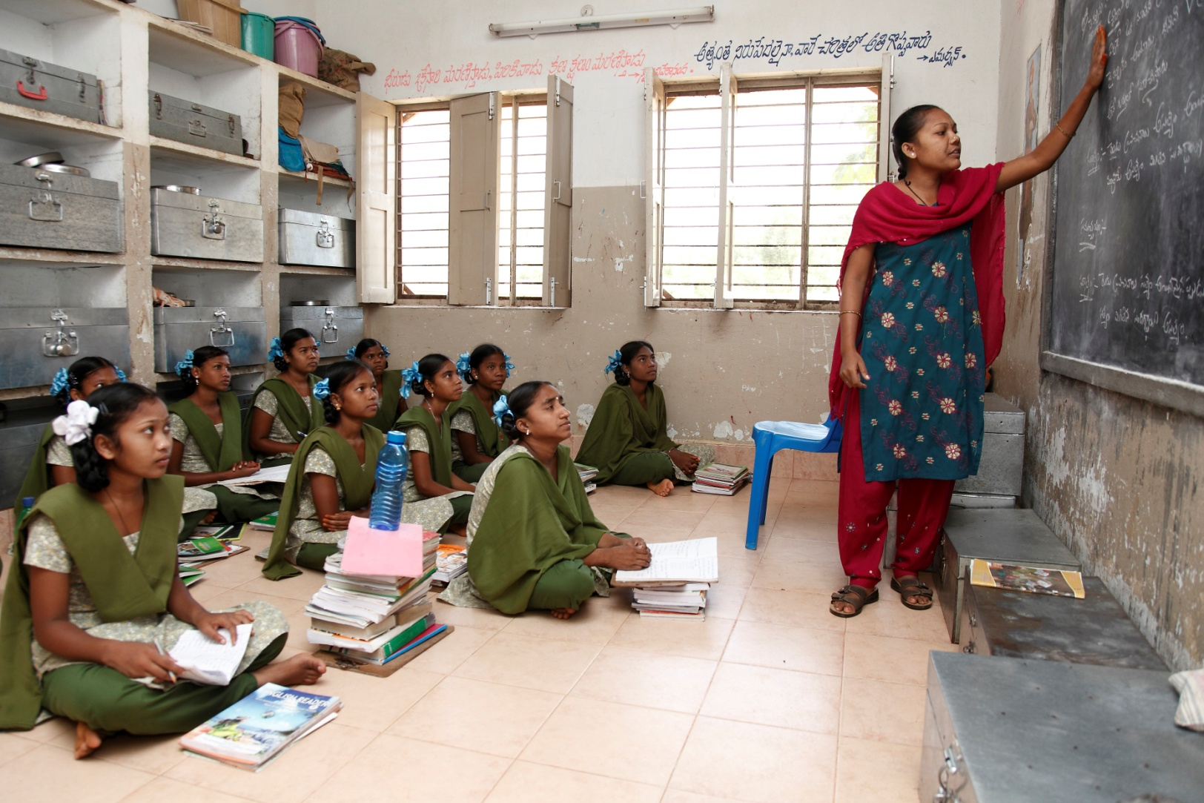
At school.
Notes:
Image info: Girls in a boarding school in Andhra Pradesh, India (notice how their trunks are stacked at the back of the classroom). Gender-segregated schools are common in India, especially at the secondary level, when children may have to board at a school in the nearest town some distance from home.
Photo credit: © Young Lives/Sarika Gulati

Slide 22
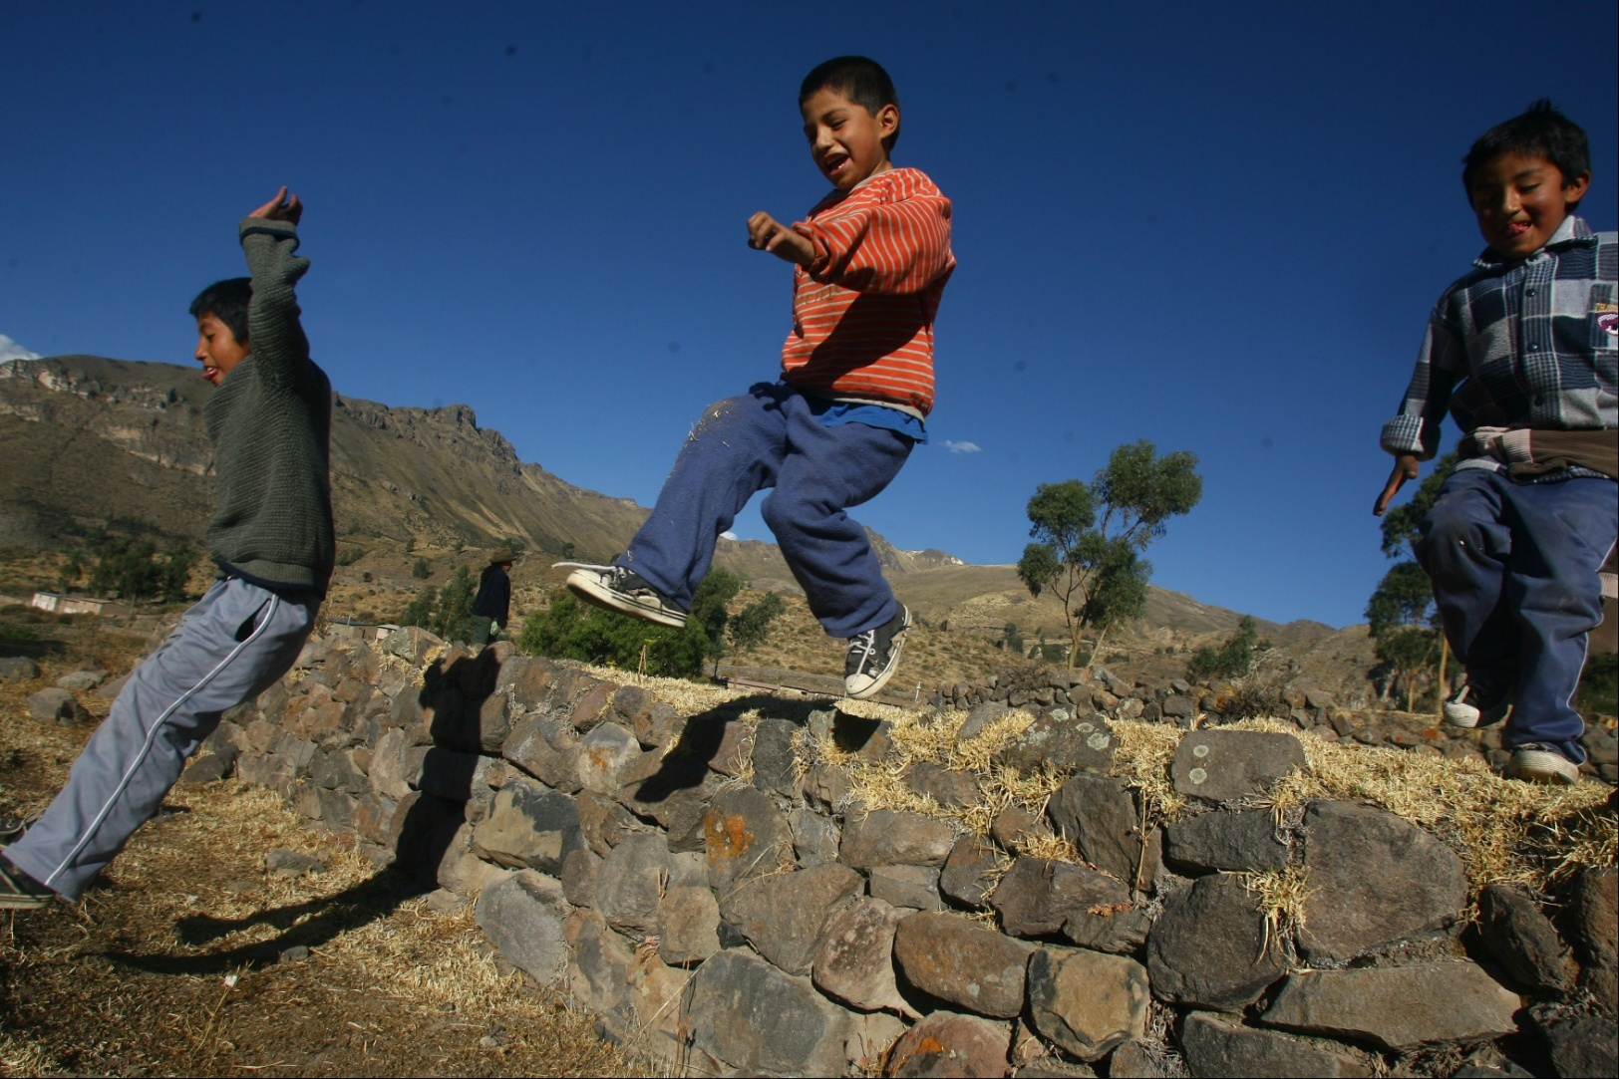
Free time.
Notes:
Image info: Boys playing running and jumping games in the southern Andean highlands of Peru.
Photo credit: © Young Lives/Giancarlo Shibayama

Slide 23
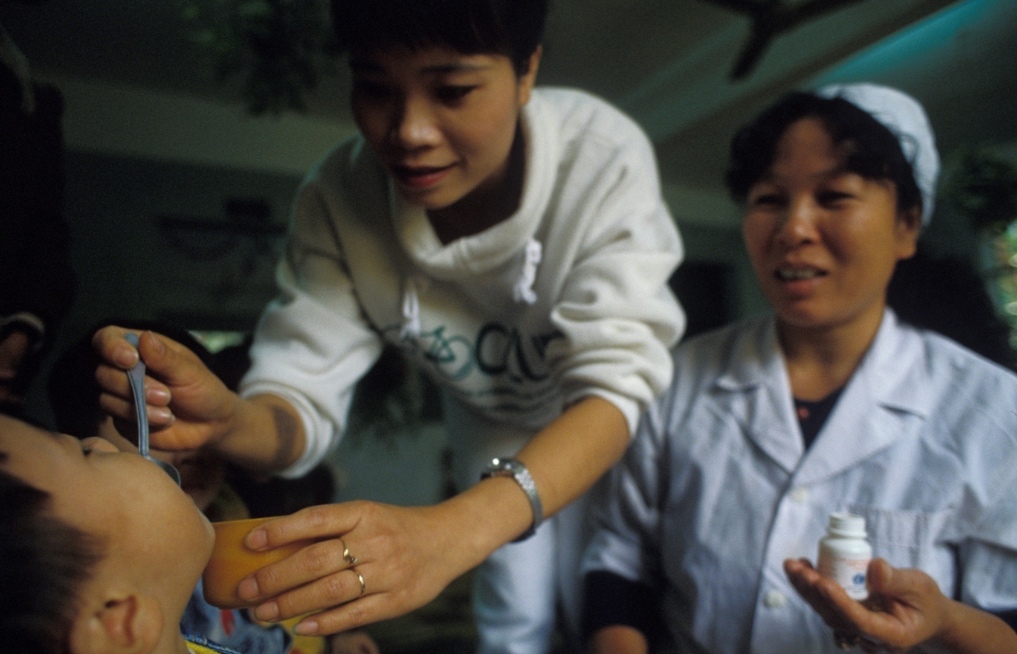
Going to the health centre.
Notes:
Image info: Oral polio drops are administered in a primary school in Viet Nam during an immunisation programme.
Photo credit: Peter Barker/PANOS

Slide 24
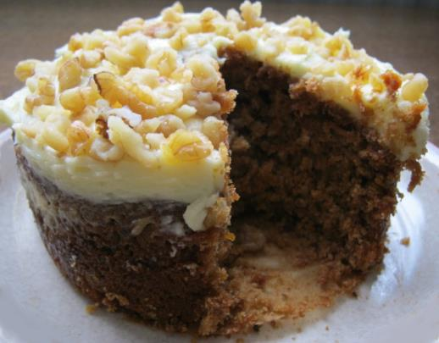
WHAT DOES INEQUALITY MEAN?
We can think of inequality as the difference between the things some groups of people have compared with other groups of people.
It is a bit like looking at how a big a slice of cake one person has compared with another.
Notes:
Photo credit: Liz Newbon/Oxfam

Slide 25


INEQUALITY BETWEEN COUNTRIES
There is inequality between countries in the world.
This means things are not shared fairly between countries.
For example, some countries are wealthy while others are extremely poor.
Notes:
Explain that there is inequality between countries, for example some countries are wealthy while others are extremely poor.

Slide 26

INEQUALITY WITHIN COUNTRIES
There is also inequality within countries.
This means things are not shared fairly within the same country.
For example, some people may have more money than others.
Notes:
Explain that there is also often inequality within countries, where many people have only a little and a few people have a lot.

Slide 27
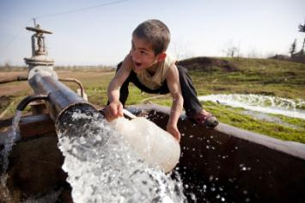
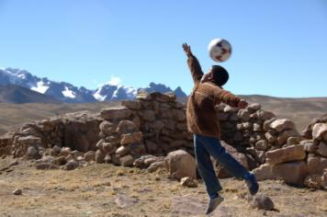
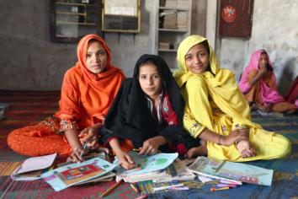
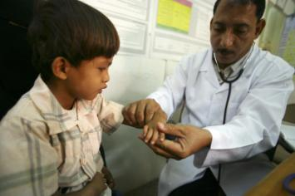
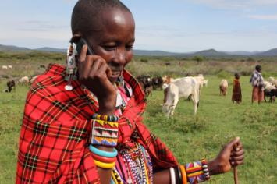
THINKING ABOUT INEQUALITY
Inequality is not just about how money is shared between and within countries.
There can also be inequality in the kinds of opportunities people have in life.
Notes:
Tell learners that inequality isn’t just about how much money is shared out between or within countries. Inequality also affects the opportunities that people have. Ask learners to think about other ways in which people’s lives and opportunities might be unequal. Discuss their ideas and make the point that there are many ways in which inequality affects people’s lives, such as access to water, education and health care, and opportunities for and conditions of employment.
Photographs, clockwise from top left:
Access to water
Image info: A boy collects water from a well in Dargalar, Azerbaijan.
Photo credit: David Levene/Oxfam
Access to play
Image info: Lucas lives in Macuscani, a small town high in the mountains of Peru.
Photo credit: Annie Bungeroth/Oxfam
Access to education
Image info: Students at a girls’ school in the village of Sanjar Bhatti, Kambar Shahdad Kot district, Sindh Province, Pakistan. From left to right: Gori Bhatt, Amna Khatoon Brohi and Shazzia Bhatti.
Photo credit: Irina Werning/Oxfam
Access to technology
Image info: Women’s leader Noorkishili Naing’isa receives a call on her mobile phone while grazing her livestock in Mairowa Chini, Ololosokwan, Ngorongoro, Tanzania.
Photo credit: Geoff Sayer/Oxfam
Access to health care
Image info: Dr Amen Yagoub examines Barka, 6, at the Maddodha Health Clinic in Sayoun, Yemen.
Photo credit: Abbie Trayler-Smith/Oxfam

Slide 28
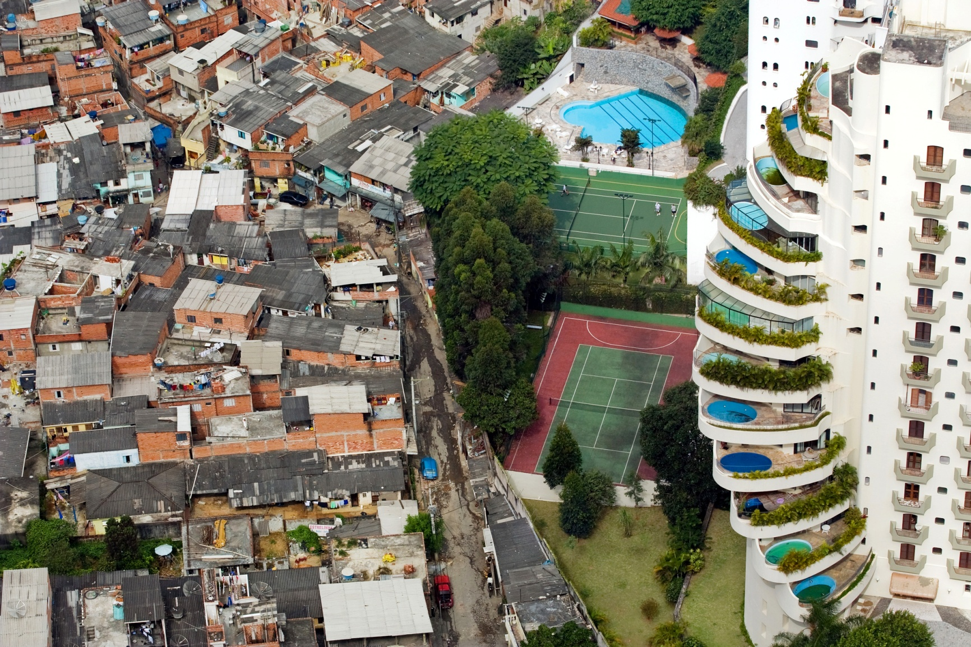
EXTREME INEQUALITY IS UNJUST
Notes:
Explain to learners that inequality becomes a problem when it reaches such an extent that it is unjust, meaning that there is very unfair distribution of resources between different groups of people. This extreme inequality results in vast differences in opportunities, inputs and outcomes for people and tends to slow down the pace of poverty reduction.
With older learners, you might also like to explain that inequality can have a range of both local and global causes, explored more fully elsewhere in the resource and in the Background notes for teachers.
Image info: São Paulo, Brazil in 2008. The Paraisópolis favela (Paradise City shanty town) borders the affluent district of Morumbi.
Photo credit: Tuca Vieira

Slide 29
WHAT DOES INEQUALITY MEAN?
INEQUALITY

