Slide 1
Ebola: Behind the headlines
November 2014
Notes:
Introductory note (do not read out)
This presentation has been designed to be used in either an assembly or classroom setting. Its content is straightforward and appropriate across the 11-18 age range. However teachers should preview the presentation before use to make sure it is fit for their particular purpose and make any amendments they feel are necessary. Additional primary source materials have been provided to assist with further curriculum making.
The Ebola outbreak in West Africa has grabbed international headlines.
Much of the coverage has been about the threat Ebola poses to countries such as Britain and the USA.
This risk exists but is very small. In this presentation we’ll look behind the headlines to explain what the Ebola virus is, why the outbreak in West Africa has been so serious, the longer term impact of Ebola and what is being done to stop the disease spreading.

Slide 2
What is Ebola?
Notes:
Ebola is a very dangerous and deadly disease. However, it is difficult to catch. We know how to stop it spreading but we do know how to cure it yet.

Slide 3
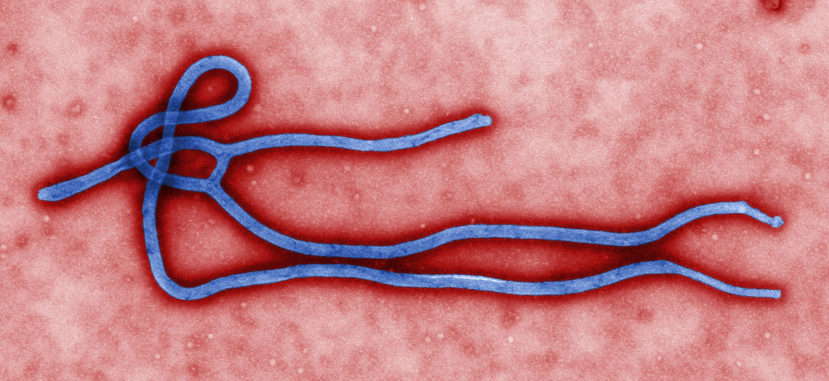
The Ebola virus
Notes:
This is an image of the Ebola virus taken under a microscope.
Ebola (or Ebola Virus Disease to give it its full name) is an infectious disease. It was first identified in 1976 following an outbreak near the River Ebola in Zaire (now Democratic Republic of the Congo). The scientists who discovered the disease named it after the nearby river.
The fruit bat is the ‘natural reservoir’ of the disease – the bats are not affected by it, but carry it in their bodies. Ebola outbreaks almost always occur near forested areas where human settlements are close to the habitats of these bats and other animals such as chimpanzees that eat the bats. The disease spreads to humans when a person is bitten or scratched by an infected animal or eats an infected animal’s meat.
Ebola outbreaks have been relatively rare and the number of human deaths has been small compared to other tropical diseases. Between 1976 and 2012 the World Health Organisation recorded 15 Ebola outbreaks, almost all in central Africa, and 1,590 deaths caused by the disease. This compares with 627,000 deaths caused by malaria in 2012 alone.
Once a person is infected, Ebola spreads between humans in four ways.
Infection happens primarily through direct contact with the blood and body fluids of an infected person (Fluids have to enter broken skin - a cut or scratch -or via the mouth, nose or eyes) and contact with items (clothes, sheets, cooking utensils, food) contaminated with the bodily fluids
It can also be caught through sexual contact and breastfeeding.
Ebola is NOT spread through the air by coughs and sneezes, like flu.
It can only be caught when someone is showing symptoms of the disease and is not infectious before this stage.
Therefore it is quite difficult to catch.
Symptoms of Ebola include vomiting, diarrhoea and bleeding. These make an infected person contagious. There is currently no known vaccine or cure for Ebola. However medical research has been speeded up this year in the hope of developing successful drugs in 2015.
In the current outbreak, 70% of people who have caught the disease have died, although the fatality rate in different outbreaks has varied between 25% and 90%.
Do not read out
Image Credit: CDC/Cynthia Goldsmith. http://phil.cdc.gov/phil/details.asp?pid=10816
References
http://apps.who.int/iris/bitstream/10665/137091/1/roadmapsitrep22Oct2014_eng.pdf?ua=1
Observer 26.10.2014
http://www.who.int/malaria/media/world_malaria_report_2013/en/
http://www.who.int/mediacentre/factsheets/fs103/en/

Slide 4
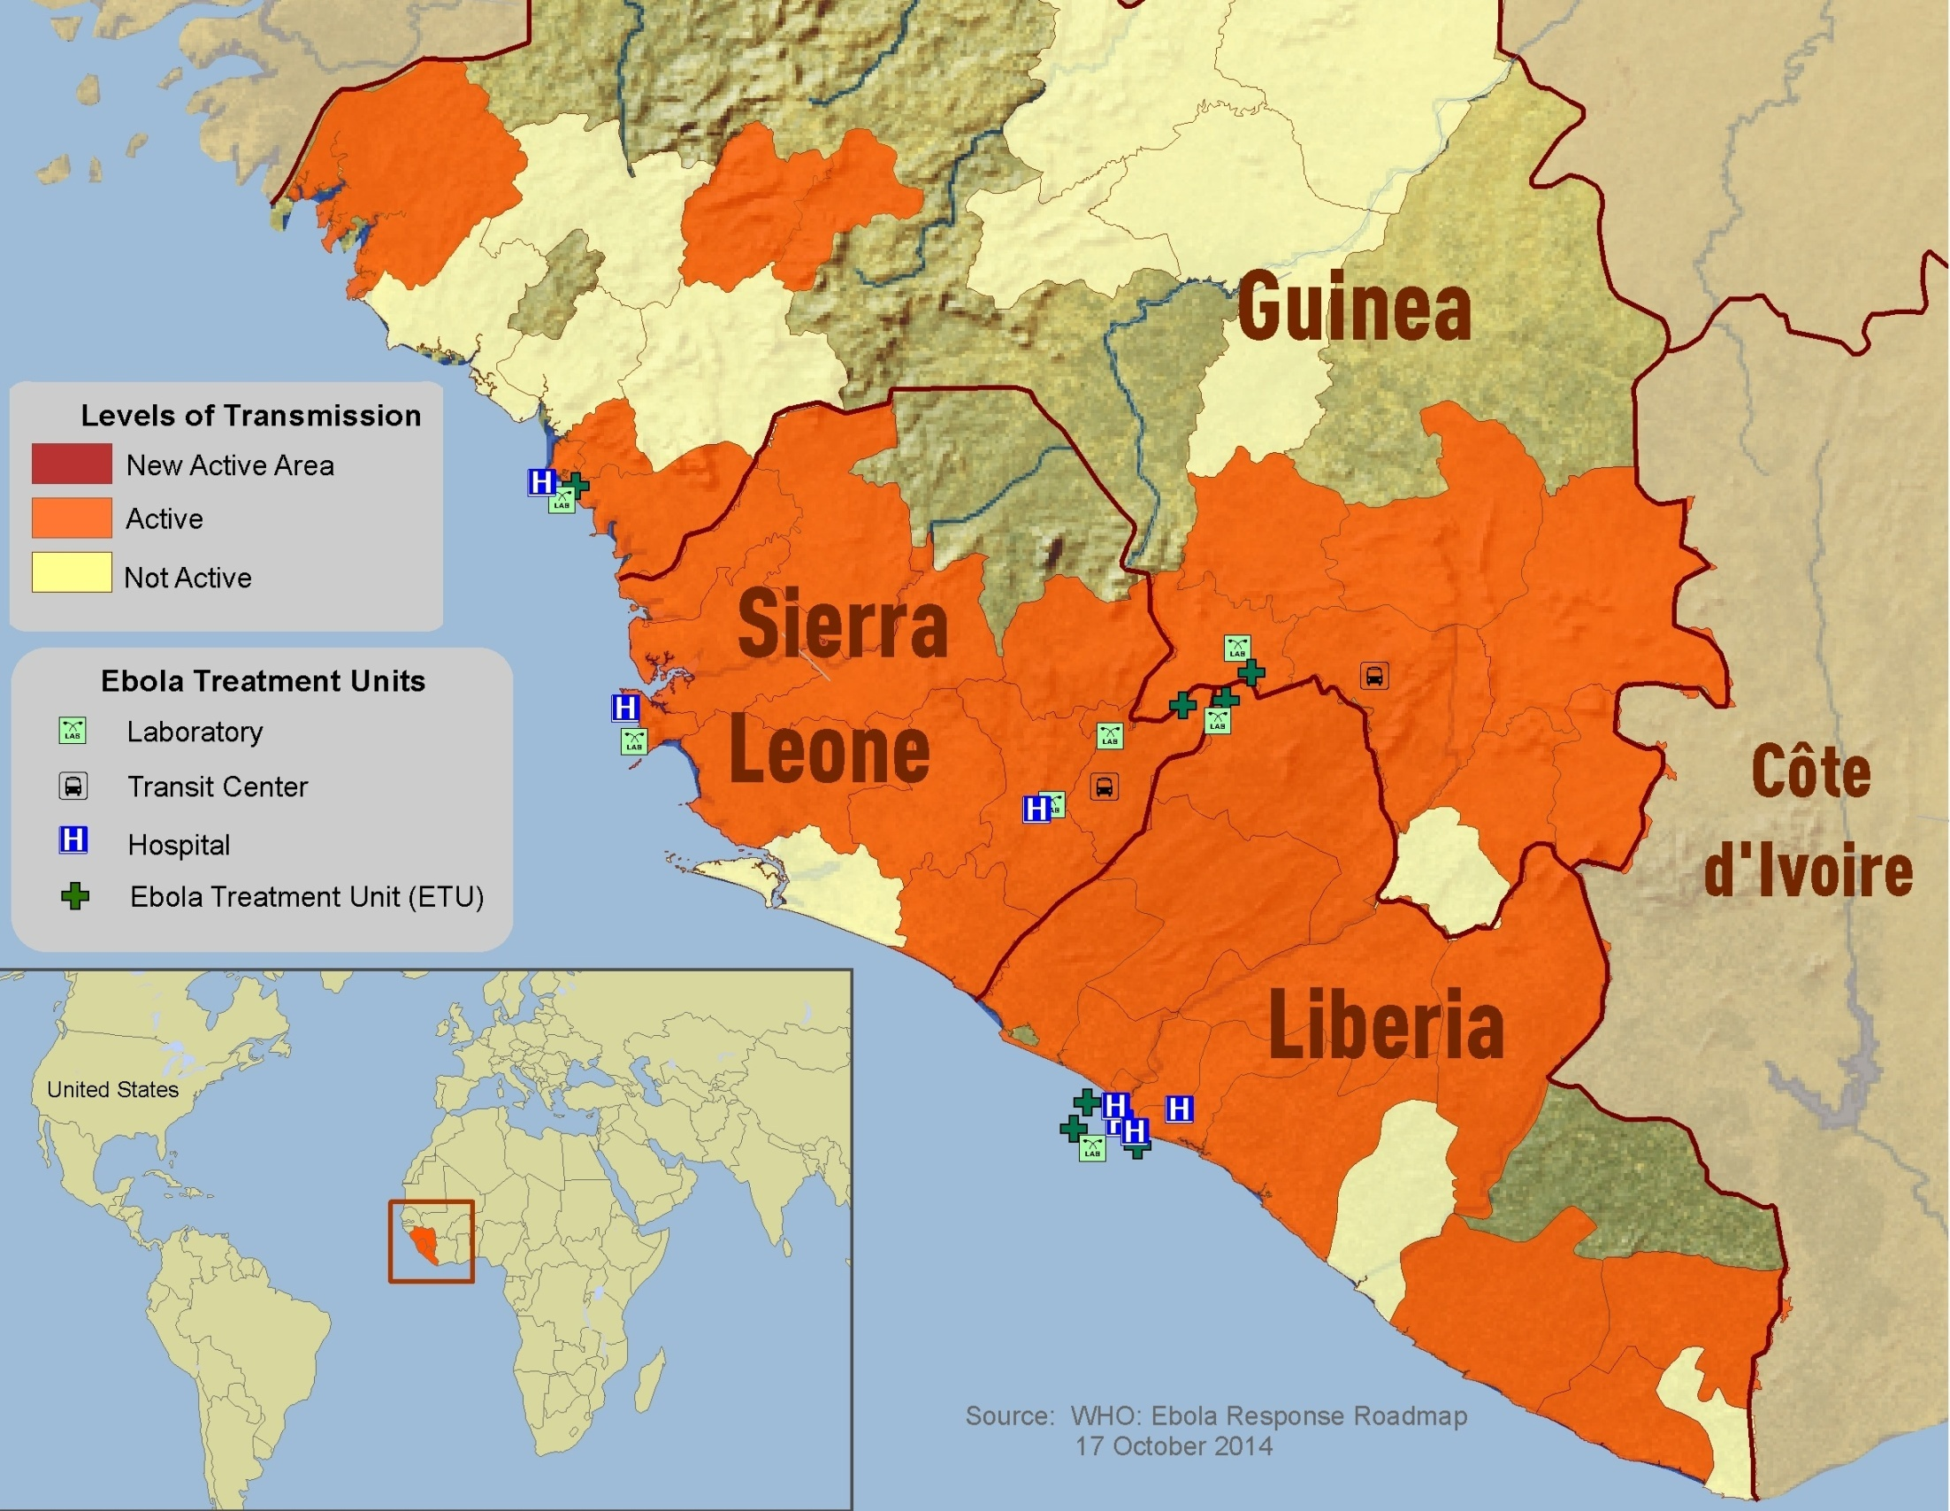
X
Notes:
The current West Africa Ebola crisis is believed to have begun in December 2013 with the death of an infected child in Gueckedou, Guinea (marked on the map with a red x)
By October 2014, the disease had spread throughout much of Guinea and most of Liberia and Sierra Leone. Cases have occurred in all the areas coloured orange on the map. Previous outbreaks of Ebola have been restricted to relatively small and isolated rural areas. This is the first time the disease has spread across entire countries and entered big cities. As of 23 October 2014, 10,114 people had been infected with Ebola and 4,912 people had died.
Do not read out
Map credit: Centers for Disease Control and Prevention (CDC) http://www.cdc.gov/vhf/Ebola/outbreaks/2014-west-africa/distribution-map.html
This work is in the public domain in the United States because it is a work prepared by an officer or employee of the United States Government as part of that person’s official duties under the terms of Title 17, Chapter 1, Section 105 of the US Code.
Reference
http://apps.who.int/iris/bitstream/10665/137091/1/roadmapsitrep22Oct2014_eng.pdf?ua=1

Slide 5
A perfect storm?
Notes:
Until now Ebola outbreaks have been concentrated in The Democratic Republic of the Congo, South Sudan and Uganda. Outbreaks have been relatively small. The largest outbreak was in 1976, when 431 people died.
Oxfam has warned that Ebola now risks becoming ‘the definitive humanitarian disaster of our generation.’ So a key question is why has this outbreak been so different and so serious?
This part of the presentation will explore the different factors that have come together at the same time to create the emergency. Some are long term and difficult to quickly put right. Others could have been put right if people had been more alert and vigilant.

Slide 6
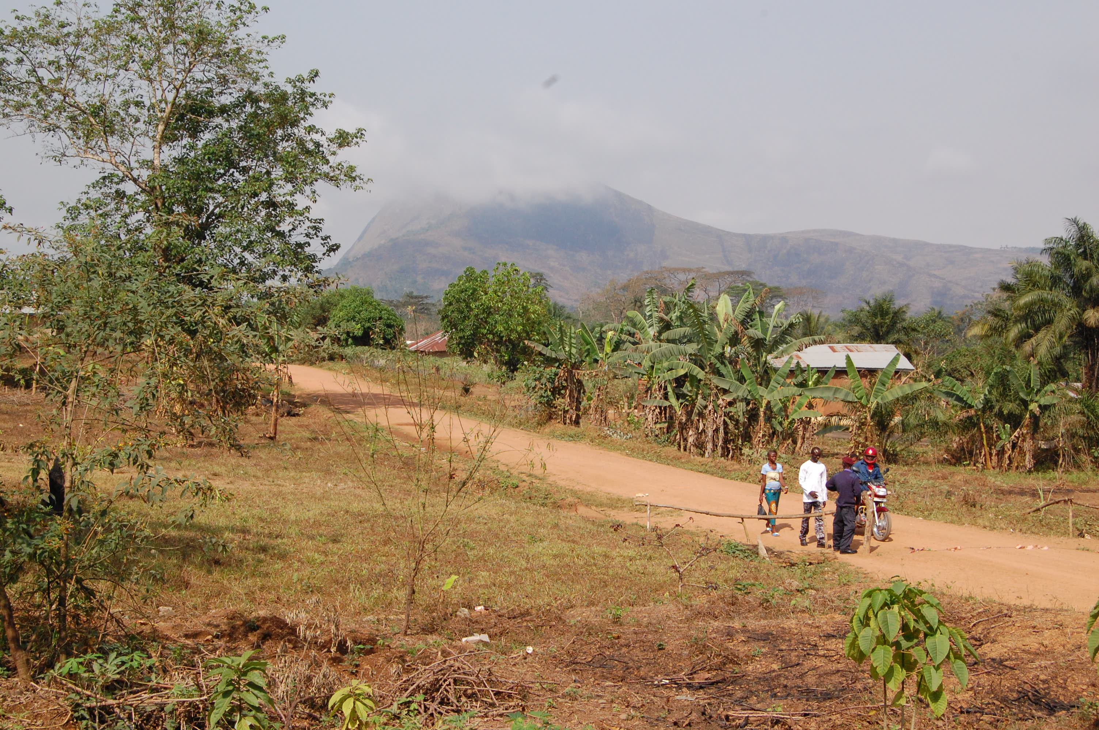
Where the outbreak began
Notes:
The West Africa Ebola outbreak started in Gueckedou in Guinea (see map on slide 4) when a child is believed to have eaten infected bushmeat.
Gueckedou is in a remote area of southern Guinea, far away from the capital city of Conakry, where government departments and the country’s limited medical facilities are concentrated. Furthermore the borders of three countries meet near Gueckedou (see map on slide 4). These countries are Guinea, Sierra Leone and Liberia. The entire region is far from capital cities and government power. The people who live here are used to crossing national borders freely as part of their everyday lives, so Ebola could potentially spread easily between countries.
There had never been an outbreak of Ebola in West Africa before, so nobody was expecting it. Initially, health workers thought they might have been dealing with cases of malaria or cholera. They had no experience of Ebola and didn’t know how to test for it.
This photograph of the Beudu chiefdom in Sierra Leone’s Kailahun District, is a few kilometres across the border from Gueckedou. Sierra Leone’s border with Liberia lies a further short distance to the south.
Do not read out
Photo credit: The view outside Benwondoo Women’s Centre, Beudu, Sierra Leone.
John McLaverty/Oxfam

Slide 7
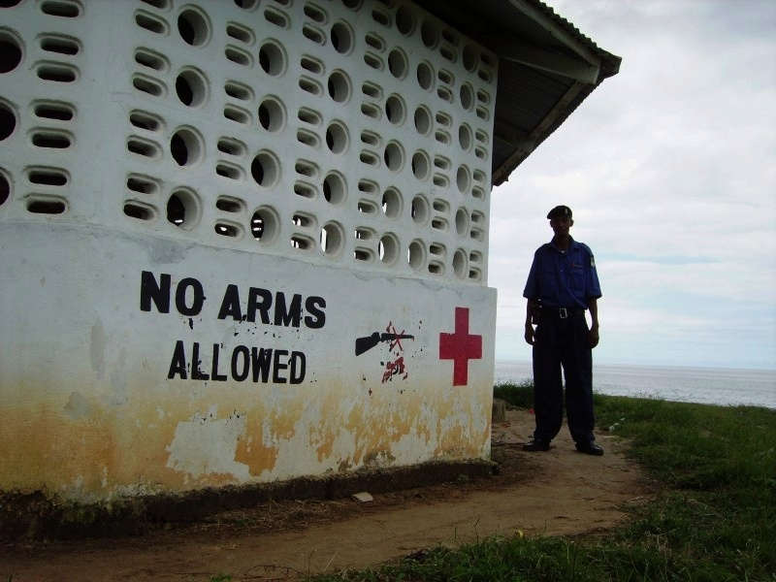
War and conflict
Notes:
Guinea, Liberia and Sierra Leone have all experienced political instability and violence in recent years. The Liberian Civil War lasted, almost uninterrupted, between 1989 and 2002. This war spilled over into the Sierra Leonean Civil War, which lasted between 1991 and 2002. These wars were brutal, devastated communities and caused severe damage to both countries’ economies and public services. Guinea has not had a civil war but has been politically unstable since 1984, and experienced serious political violence in 2013.
It takes many years to rebuild after a damaging war, particularly if a country is very poor to begin with. Before the Ebola outbreak there were signs of economic growth and an improvement in government in all three countries. However, fragile governments that are rebuilding after a major conflict usually have fewer resources to cope with emergencies. Also people may also not fully trust their governments or each other.
Do not read out
Photo credit: A deserted First Aid shelter on Lumley Beach, Freetown, Sierra Leone (2006)
Ben Margolis/Oxfam

Slide 8
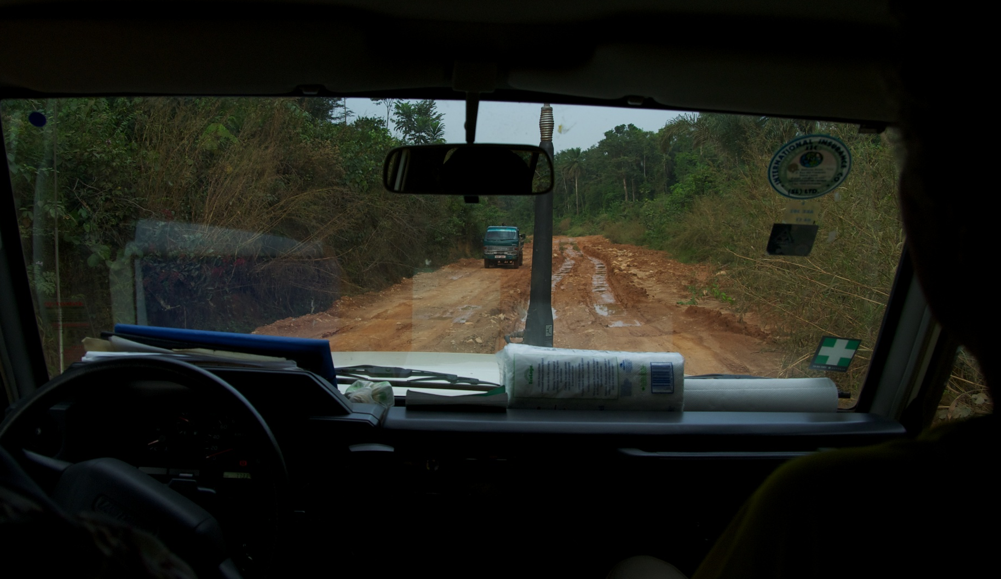
Travel
Notes:
This photograph shows travel on the main road between Sierra Leone’s third largest city, Kenema, and the town of Kailahun, close to where the Ebola outbreak began across the border in Guinea. This is the type of forested region where Ebola outbreaks have usually occurred
The photo was taken during the dry season when travel is relatively easy and convenient. Look through the front window of the car to see the condition of the road. Travelling even a short distance takes several hours.
Only 8% of Sierra Leone’s roads have a paved (e.g.tarmac) surface. This makes travel slow, expensive and inconvenient. It is difficult to move people and materials into Kailahun and transport patients to hospital.
The challenges of transport and communication in Sierra Leone, Liberia and Guinea are another reason why responding to the Ebola outbreak was so difficult. It took several weeks for the outbreak to be recognised and longer for the international community to respond.
Do not read out
Photo credit: The highway between Kenema and Kailahun, Sierra Leone, 2011
Vince Haig/Oxfam
Reference:
https://www.cia.gov/library/publications/the-world-factbook/geos/sl.html

Slide 9
April 2014
Were warnings ignored?
Notes:
The Ministry of Health in Guinea acknowledged an outbreak of hemorrhagic fever on 19 March, and the medical charity MSF had set up an isolation centre by 24 March. On 25 March the World Health Organisation (WHO) declared an Ebola outbreak.
During April 2014 the medical charity MSF opened more Ebola treatment centres in response to the deepening emergency. MSF claimed that the global response to the outbreak was too slow. It accused the World Health Organisation (WHO) and the global community of failing to react swiftly enough. In a new and dangerous development, Ebola cases were now being reported many miles apart.
It is possible that people unaware of how to respond to an Ebola outbreak in their communities tried to move away to safety. They therefore carried the disease to new places. Ebola is best contained if infected people are isolated and confined to a small area. But by now disease was spreading from Guinea into Liberia and Sierra Leone. It had also reached Guinea’s capital city Conakry.
It the meantime a totally separate outbreak of Ebola broke out in the Democratic Republic of the Congo. However the response in the DRC was different. The country, although poor, had contained 10 previous outbreaks of Ebola. Its team is experienced and well prepared. Their response was rapid. By October 2014 the number of deaths had stabilized at 43 and no new cases had been reported for 3 weeks. This shows that Ebola can be contained and controlled. It’s rapid spread is not inevitable.
Do not read out
Note: The WHO has promised to investigate claims that its response to the crisis was inadequate once the emergency has abated. Many NGOs have programmes in Guinea, Liberia and Sierra Leone and Oxfam works in Sierra Leone and Liberia. The issue of whether all organisations responded appropriately is valid and open to question.
References:
http://www.bbc.co.uk/news/world-africa-29668603
http://www.bbc.co.uk/news/world-africa-26825869
http://www.theguardian.com/commentisfree/2014/oct/15/Ebola-outbreak-central-africa-contained

Slide 10
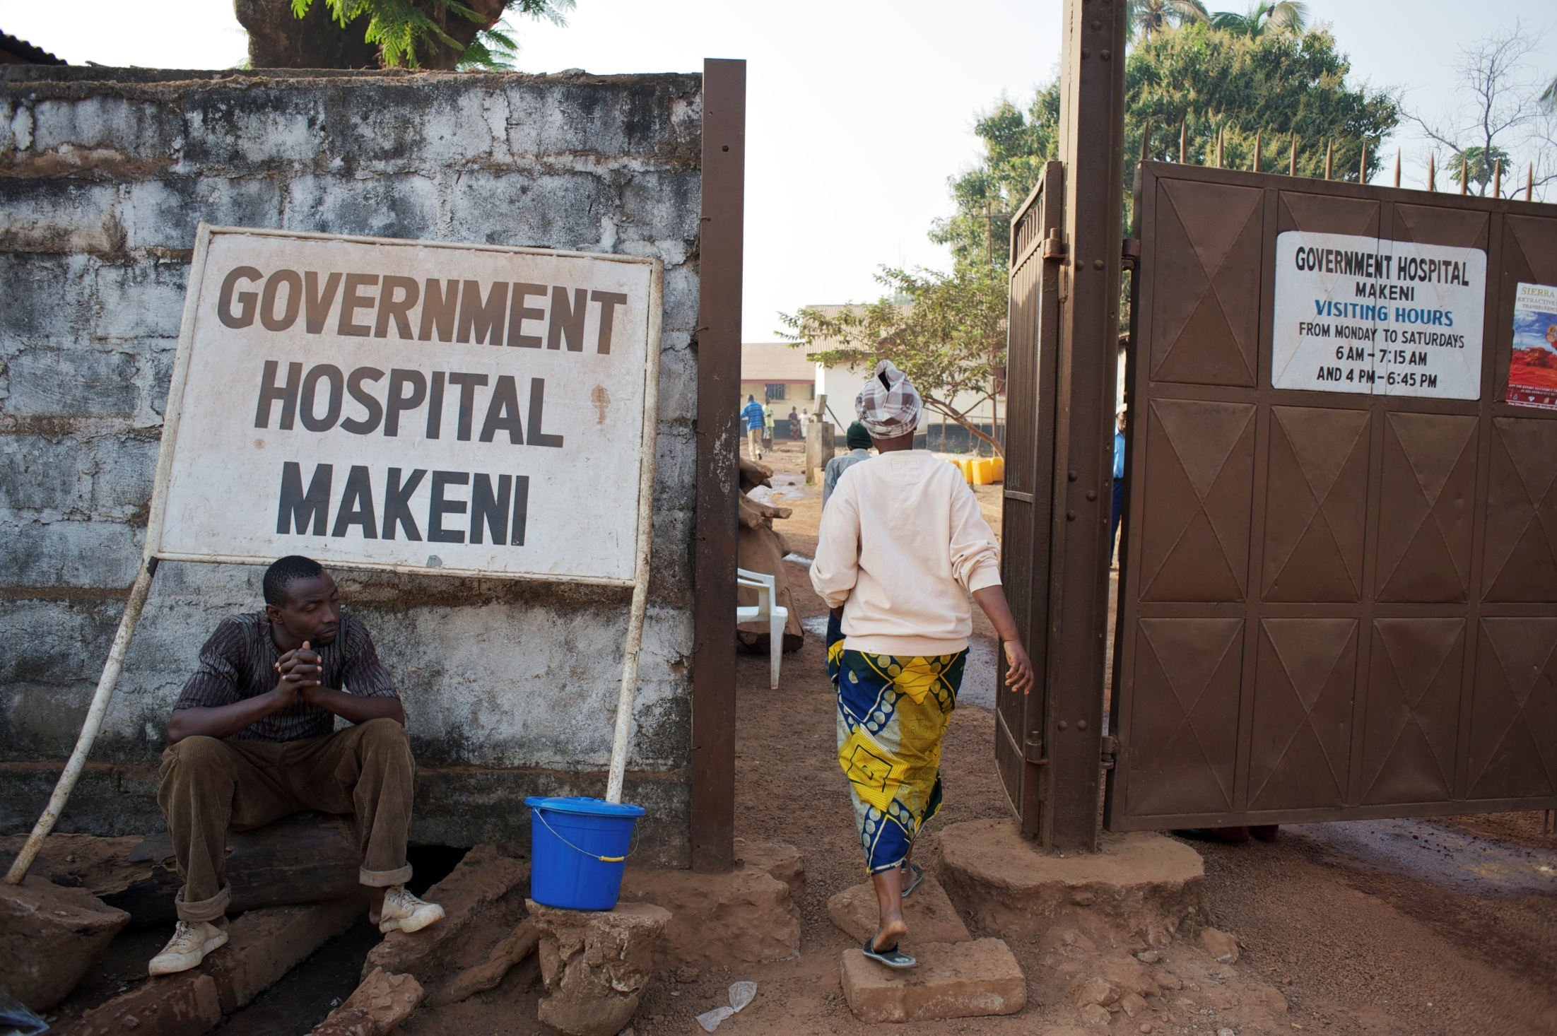
Health
Notes:
Health services in Guinea, Liberia and Sierra Leone are fragile and unable to cope with a major health emergency.
Although there have been recent improvements in Sierra Leone’s health service, there are still only 120 doctors serving a population of around 6 million people. (To compare, imagine a city the size of London having only 160 doctors!) Sierra Leone’s doctors do an amazing job, but when doctors are spread so thinly across a country’s population it makes identifying and treating any life-threatening diseases much more difficult.
This photograph shows the main entrance to Makeni Government Hospital in Makeni, central Sierra Leone. On the day Oxfam visited in 2011 there was one Sierra Leonean doctor and two volunteer doctors from the UK on duty for the whole hospital.
Do not read out
Photo credit: The entrance to Makeni Government Hospital, Makeni, Sierra Leone
Aubrey Wade/Oxfam

Slide 11
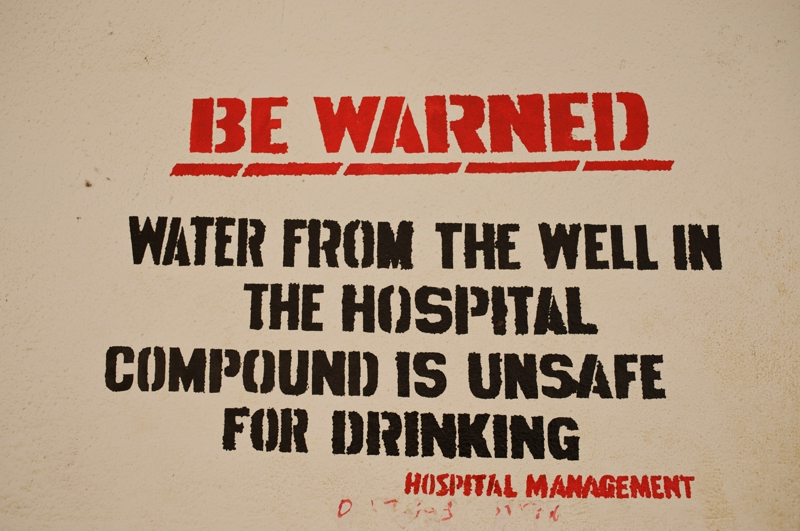
Water
Notes:
Water is an essential element in the treatment of Ebola. Drinking water is required to keep patients hydrated and clean water in large quantities is needed to disinfect any surfaces that have come into contact with a patient’s bodily fluids. Oxfam estimates it takes 250 litres of water per day to treat an Ebola patient. But clean water is in short supply across Guinea, Liberia and Sierra Leone.
For example access to water in Sierra Leone is relatively low, although improving. Much of the country’s water system was destroyed by the Civil War between 1991 and 2002. In 2010 only 55% of Sierra Leone’s population had access to clean water.
This sign was posted around the wards of Connaught Hospital in Freetown during 2011. It shows the significant challenges there are in providing clean and safe water in Sierra Leone. If it’s difficult to access clean water in the country’s main hospital, it’s even more difficult for communities up and down the country.
Do not read out
Photo credit: Sign on the wall of Connaught Hospital, Sierra Leone, 2011
Aubrey Wade/Oxfam
Reference: http://www.wateraid.org/~/media/Files/UK/Keeping%20Promises%20case%20studies/Sierra%20Leone%20the%20financing%20of%20the%20water%20sanitation%20and%20hygiene%20sector.pdf

Slide 12
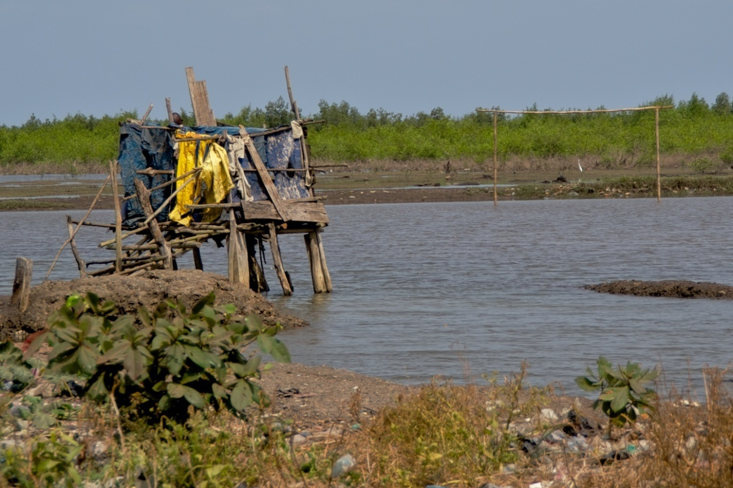
Sanitation
Notes:
The situation is even more challenging when it comes to sanitation. In 2010 only 13% of people in Sierra Leone had access to a proper toilet. Ebola spreads through contact with bodily fluids, so good hygiene and sanitation are important in controlling its spread.
The photograph was taken in 2011 and shows a drop toilet built on the coastline at Pamaronkor, an urban slum just east of Freetown, Sierra Leone. There are several of these toilets built next to each other. The movement of the tide is intended to flush faeces out to sea. However, there were lots of faeces deposited along the shore line. Houses and families’ cooking and washing areas were just a few metres away. If you look closely you can see football goalposts. People play football here at low tide. The risk of many diseases spreading is high.
Do not read out
Photo credit: A drop toilet in Pamaronkor, Freetown, Sierra Leone
Vince Haig/Oxfam
Reference: http://www.wateraid.org/~/media/Files/UK/Keeping%20Promises%20case%20studies/Sierra%20Leone%20the%20financing%20of%20the%20water%20sanitation%20and%20hygiene%20sector.pdf

Slide 13
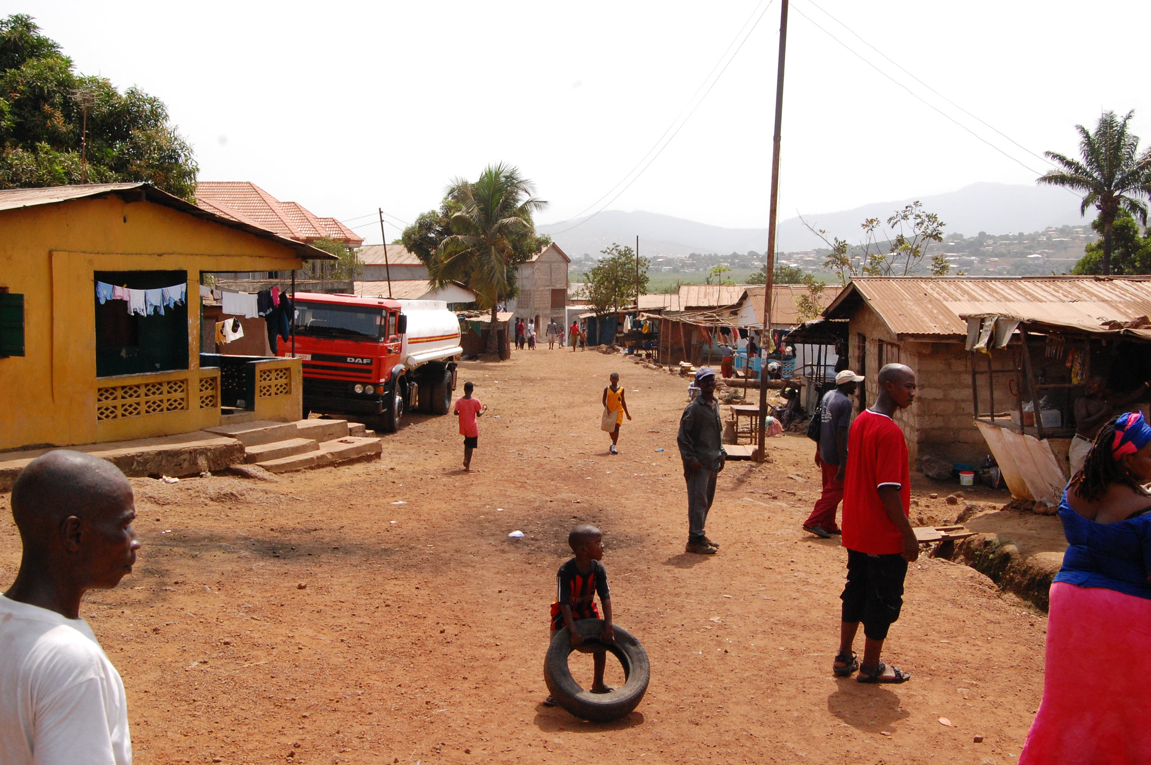
Urbanisation
Notes:
Sierra Leone’s civil war between 1991 and 2002 didn’t only damage and destroy the country’s health, water and sanitation services. It also displaced large numbers of people who fled the war. Many of these people moved to the capital city of Freetown, which grew quickly. The result of this rapid urbanisation is that 70% of Freetown is now an unplanned urban slum. The photo shows the entrance road to the Pamaronkor slum, just east of Freetown, Sierra Leone. Just a few years ago this area was countryside.
If Ebola spreads from the countryside to a densely populated city community it becomes very difficult to control. As we have seen there is little clean water and poor sanitation in communities like this. Many residents are recent arrivals from the countryside and retain family links with rural areas. The movement of people to and fro, from the countryside to the city, further risks the spread of Ebola. Many people in the countryside were frightened of catching Ebola so they moved elsewhere. The result of this was to spread Ebola to new parts of the country, including the big towns and cities.
Do not read out
Photo credit: The entrance road to the Pamaronkor urban slum, just east of Freetown, Sierra Leone (2011)
John McLaverty/Oxfam
Reference: http://www.wateraid.org/~/media/Files/UK/Keeping%20Promises%20case%20studies/Sierra%20Leone%20the%20financing%20of%20the%20water%20sanitation%20and%20hygiene%20sector.pdf

Slide 14
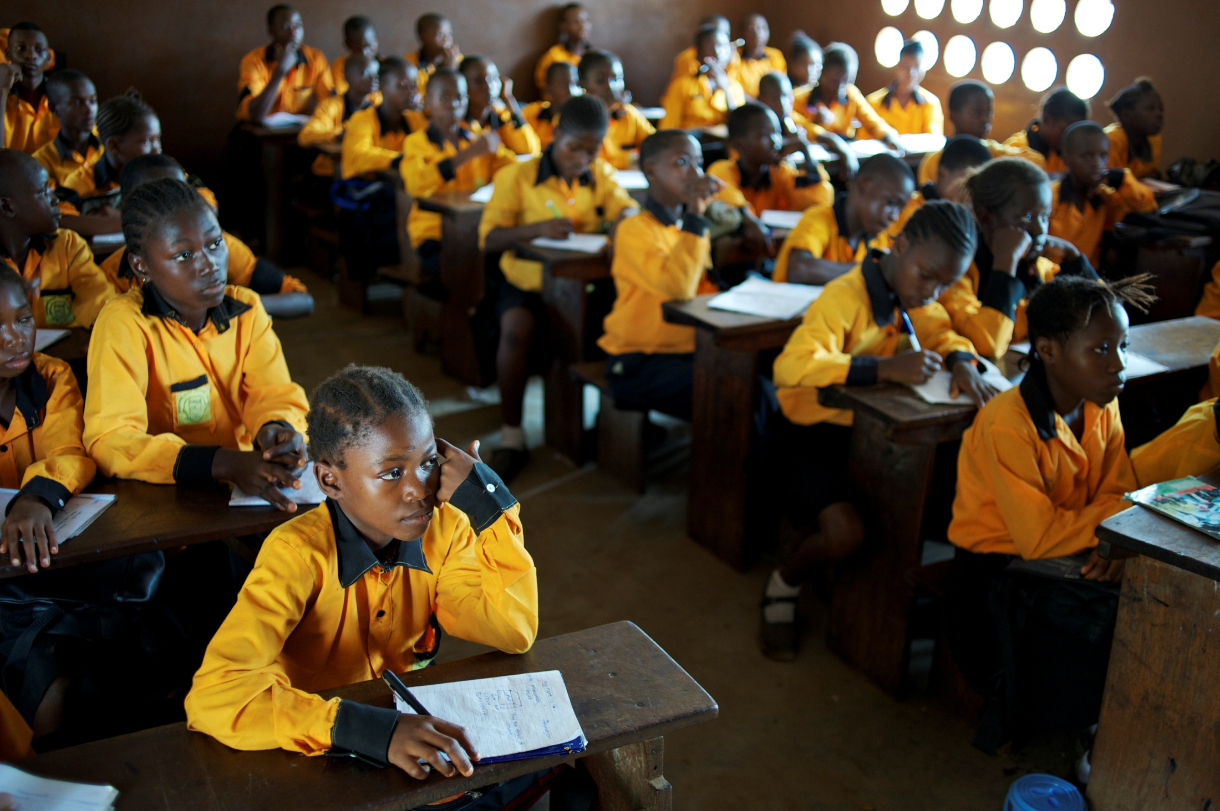
Education
Notes:
Schools were destroyed and education was disrupted during Sierra Leone’s Civil War between 1991 and 2002. There have been recent improvements in school enrolment. However, only 43% of Sierra Leone’s adults are literate.
Controlling Ebola requires a well informed population, knowledgeable about the steps they need to take to control the disease. This becomes more difficult when fewer people are literate and able to read posters, leaflets or other advice. Radio, mobile phones and community health workers visiting every house are important ways of keeping people informed. Research conducted in Sierra Leone during August 2014 found that many people had potentially dangerous misconceptions about Ebola. Person to person word of mouth communication and the radio were the found to be most effective ways of teaching people about the disease. However organising large numbers of community health workers is a challenging job for governments with limited finances.
Do not read out
Photo credit: The year 6 class at Pamaronkor Community Primary School in a slum area of Eastern Freetown, 2011
Aubrey Wade/Oxfam
References
http://www.unicef.org/infobycountry/sierraleone_statistics.html
http://reliefweb.int/report/sierra-leone/study-public-knowledge-attitudes-and-practices-relating-ebola-virus-disease-evd

Slide 15
The impact of Ebola
Notes:
A unique set of circumstances have come together at the same time to risk making the West African Ebola crisis the ‘disaster of our generation’ (Oxfam)
Some of these causes could have been managed better if the global community had been more alert and acted quickly. Others are much more difficult to manage.
The media has concentrated on the number of Ebola deaths. This is right to do. Each death is a tragedy for the family and loved ones of the deceased. However, the outbreak is having a much wider impact on all the affected countries and this is often hidden from the headlines. Here are some key points to think about.

Slide 16
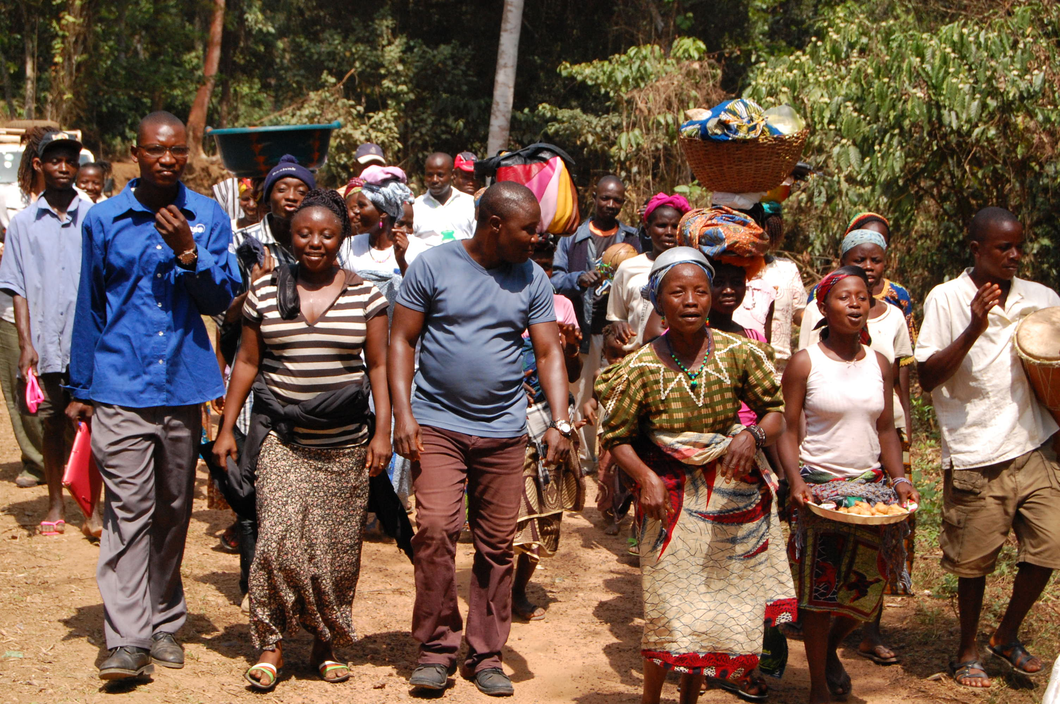
Farmers
Notes:
The photo shows farmers returning at the end of a day’s work in their fields in Konouadu village, Kailahun District, Sierra Leone (2011). Agriculture is important for the economies of Guinea, Liberia and Sierra Leone. But farming in all three countries is a precarious occupation at the best of times as changing weather patterns make food production unpredictable.
In addition the UN has estimated that 47% of farmers have had their work ‘considerably disrupted’ by the Ebola outbreak. In Kailahun District, at least 40% of farmers have abandoned their land because of their fear of being infected by Ebola. Seasonal workers have not made the journey to participate in the harvest and fields have been left empty. This threatens to push rural communities back into poverty and create food shortages in all three countries.
Do not read out
Photo credit: Farmers returning home at the end of a day’s work in their fields in Konouadu village, Kailahun District, Sierra Leone (2011)
John McLaverty/Oxfam
References:
http://www.fao.org/about/who-we-are/director-gen/faodg-news-archive/detail/en/c/251949/
http://www.irinnews.org/report/100738/Ebola-hits-west-africa-food-security

Slide 17
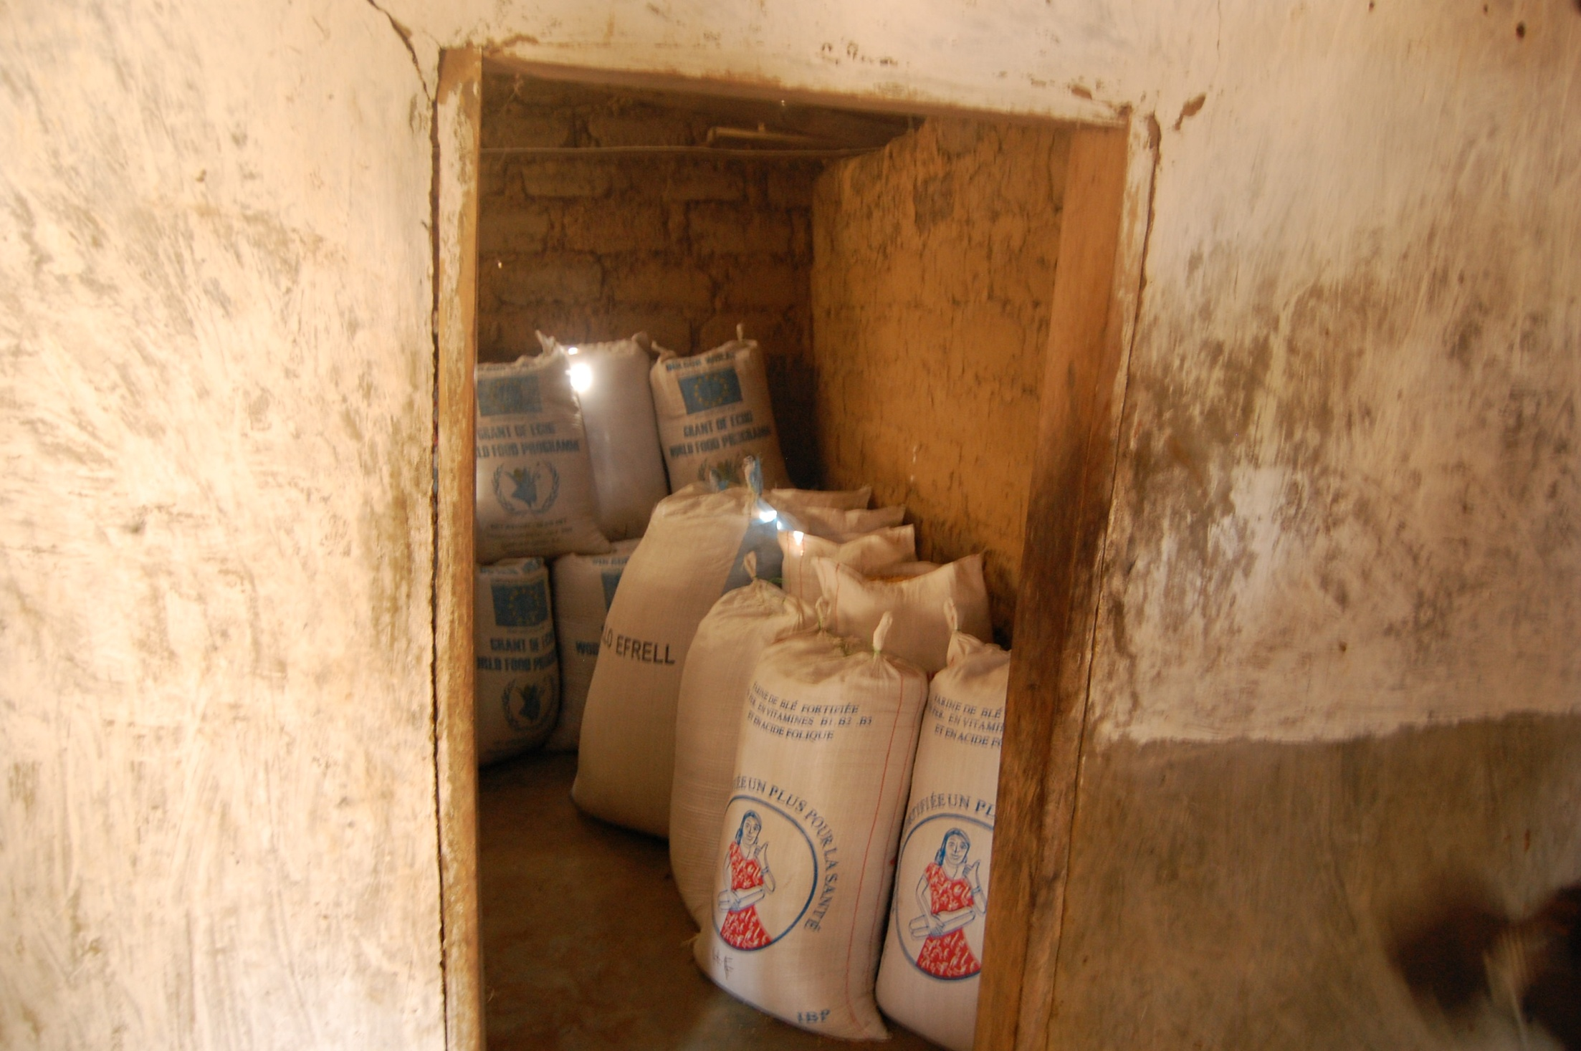
Food prices
Notes:
The areas of Sierra Leone most seriously affected by Ebola are responsible for 18% of the country’s rice output. As a result of the impact of Ebola on farming, rice prices jumped by 30% in these regions. People who have lost their jobs and incomes because of Ebola also face paying higher prices for food. Many are struggling to survive.
The Ebola outbreak is threatening to push people back into poverty, even if they haven’t caught the disease. The economic prospects of all three countries appeared quite optimistic before the outbreak. These predictions have now been scaled down.
The photo shows rice ready to be taken to the market in Konouadu village, Kailahun District, Sierra Leone (2011)
Do not read out
Photo credit: Rice store in Konouadu village, Kailahun District, Sierra Leone (2011)
John McLaverty/Oxfam
Reference:
http://www.investopedia.com/articles/investing/101314/Ebolas-economic-impacts-liberia-sierra-leone-and-guinea.asp

Slide 18
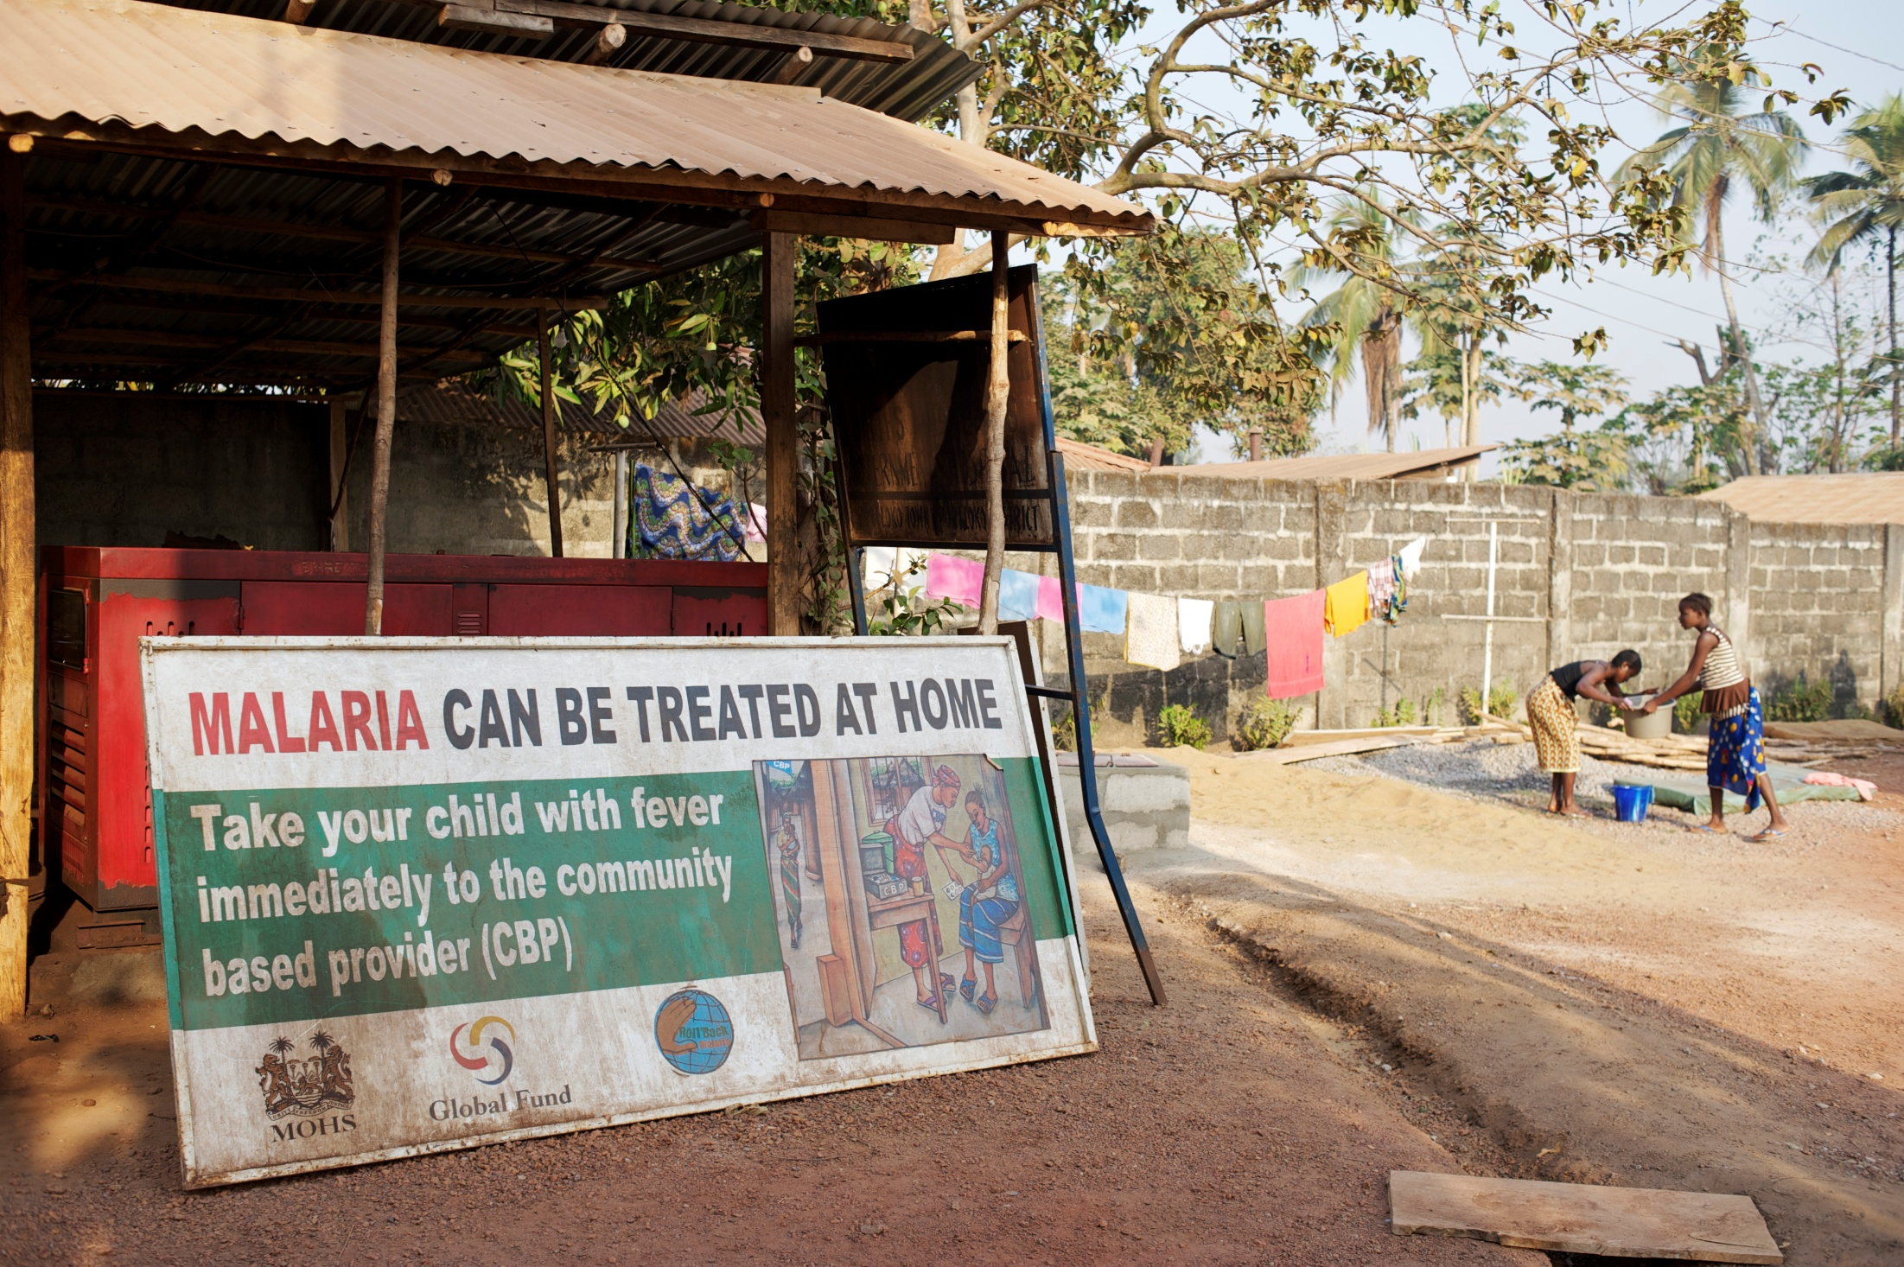
Health
Notes:
The crisis has also meant that health services have concentrated their efforts on treating Ebola patients. Many courageous doctors and nurses have lost their lives. Other essential medical services have come under severe strain. Services have collapsed, frightened medical staff have left their posts and patients are too frightened to attend hospital. As a result, for example, fewer women are having babies in hospital, fewer children are receiving essential vaccinations and fewer people are receiving treatment for other deadly diseases such as malaria.
The photo shows a sign in the compound of Makeni Government Hospital, Makeni, Sierra Leone (2011)
Do not read out
Photo credit: Sign in the compound of Makeni Government Hospital, Makeni, Sierra Leone (2011)
Aubrey Wade/Oxfam
References:
http://america.aljazeera.com/articles/2014/9/16/Ebola-impact-publichealth.html
http://www.washingtonpost.com/world/africa/with-Ebola-crippling-the-health-system-liberians-die-of-routine-medical-problems/2014/09/20/727dcfbe-400b-11e4-b03f-de718edeb92f_story.html

Slide 19
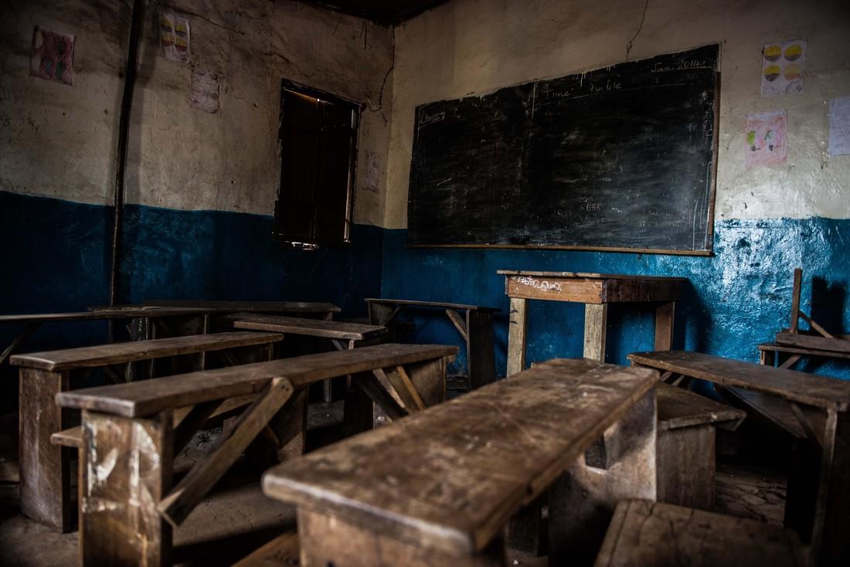
Education
Notes:
This is an empty primary school classroom in Tengbeh Town, Sierra Leone. The school has been closed since June 2014 because of the Ebola crisis. The headmaster is really concerned about the children's well-being now they are out of school. He is worried about their health - if they were at school he could be teaching them how to prevent Ebola. Sierra Leone’s education system is weak. It will take time to get children back to school and learning again.
Do not read out
Photo credit: Empty primary school, Tengbeh Town, Sierra Leone (2014)
Tommy Trenchard/Oxfam

Slide 20
How Ebola is being stopped
Notes:
There is no cure for Ebola. However patients who receive good medical care stand a better chance of survival.
As the disease is highly contagious patients should be kept isolated from other people. The doctors and nurses treating Ebola patients wear protective suits to avoid being infected.
However the best way to stop Ebola is to prevent it from spreading from person to person in the first place. This involves educating and helping people in the community and trying to stop them from catching the disease. Small things, like washing your hands regularly, can make a big difference. This is the struggle against Ebola that has been largely hidden from the headlines.

Slide 21
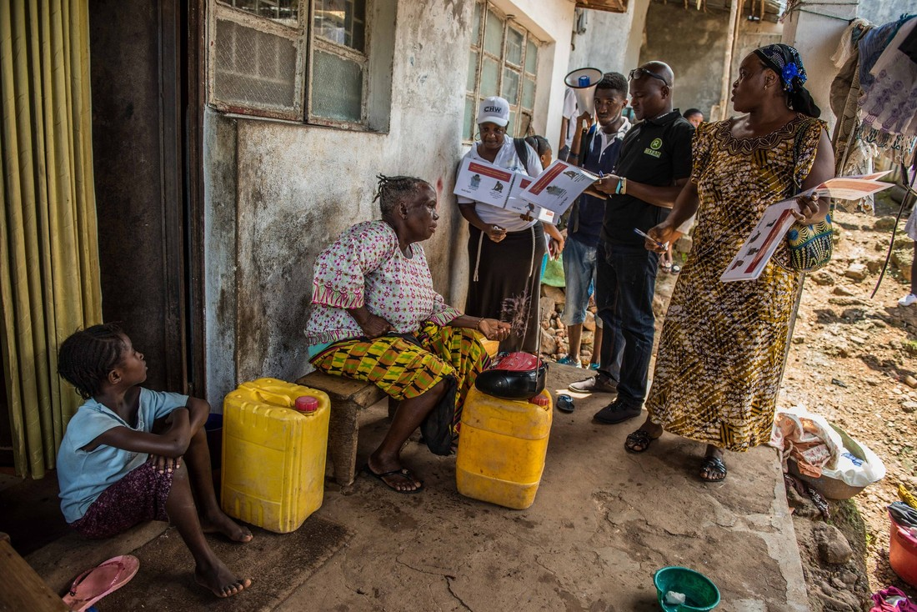
Community Health Workers
Notes:
Community Health Workers knock on people’s doors and teach the community about the signs and symptoms of Ebola, how to prevent it and what to do if a family member becomes infected. Ebola spreads more easily if people don’t know how to recognise the disease or what to do when someone becomes ill. However in August 2014 only 39% of people surveyed in Sierra Leone had ‘comprehensive knowledge’ of Ebola. A sick person kept at home risks spreading Ebola to other family members and visitors to the house.
Community Health Workers also look after handwashing stands and also promote their messages there. The Community Health Workers have to be recruited, trained, paid and provided with materials. Oxfam provides training and equipment for this vital work.
Do not read out
(Community Health Training Materials from Sierra Leone are included with this resource)
Photo Caption: Isata Sesay and Moriba Bangura listen to community health workers Adama Bangura, Abdul Razak Baimba and Mary Kamara (2014)
Tommy Trenchard/Oxfam
Reference: http://reliefweb.int/report/sierra-leone/study-public-knowledge-attitudes-and-practices-relating-ebola-virus-disease-evd

Slide 22
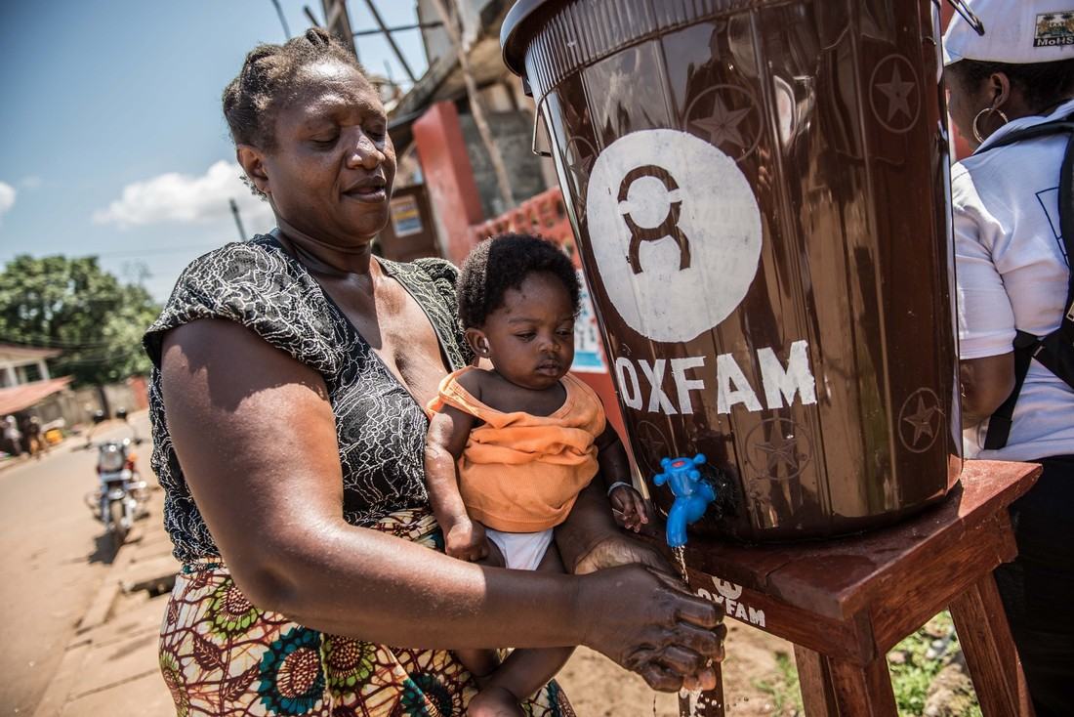
Hand washing stations
Notes:
Hygiene is very important in preventing the spread of Ebola. However even something as simple as washing your hands with soap is difficult when people do not have access to soap and clean water. Here are Hawa Sesay and daughter Hawa Koroma using the Oxfam hand-washing station in Tengbeh Town, Freetown, Sierra Leone. Hand-washing stations like this have been set up in communities across Sierra Leone, Guinea and Liberia.
Do not read out
Photo Caption: Hawa Sesay and daughter Hawa Koroma using the Oxfam hand-washing station in Tengbeh Town, Freetown, Sierra Leone (2014)
Tommy Trenchard/Oxfam

Slide 23
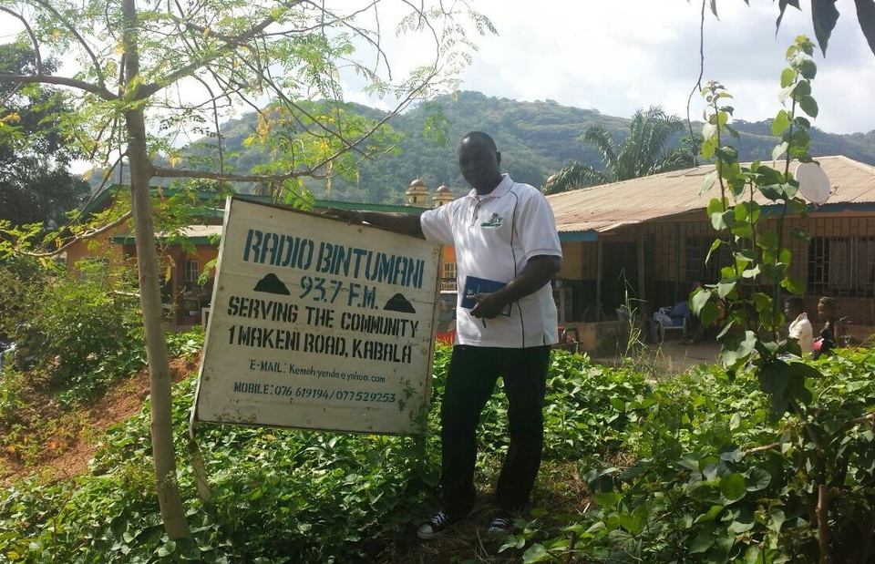
Radio jingles
Notes:
Few people in Sierra Leone watch TV or read a newspaper. Radio is therefore very important for broadcasting news and information. This is Steven Bockarie Mansaray, the manager of the local radio station in Kabala, northern Sierra Leone. His radio station has been playing Ebola jingles to inform people of the signs and symptoms of Ebola and how to prevent the disease. He says that the promotion of health messages has been key to keeping Ebola out of Koinadugu district for so long. In August 2014 85% of Sierra Leoneans said that radio was their preferred means for receiving information about Ebola.
Do not read out
Photo credit: Steven Bockarie Mansaray is the manager of the local radio station in Kabala, Sierra Leone. He has been playing Ebola jingles (2014)
Holly Taylor/Oxfam
Reference: http://reliefweb.int/report/sierra-leone/study-public-knowledge-attitudes-and-practices-relating-ebola-virus-disease-evd

Slide 24
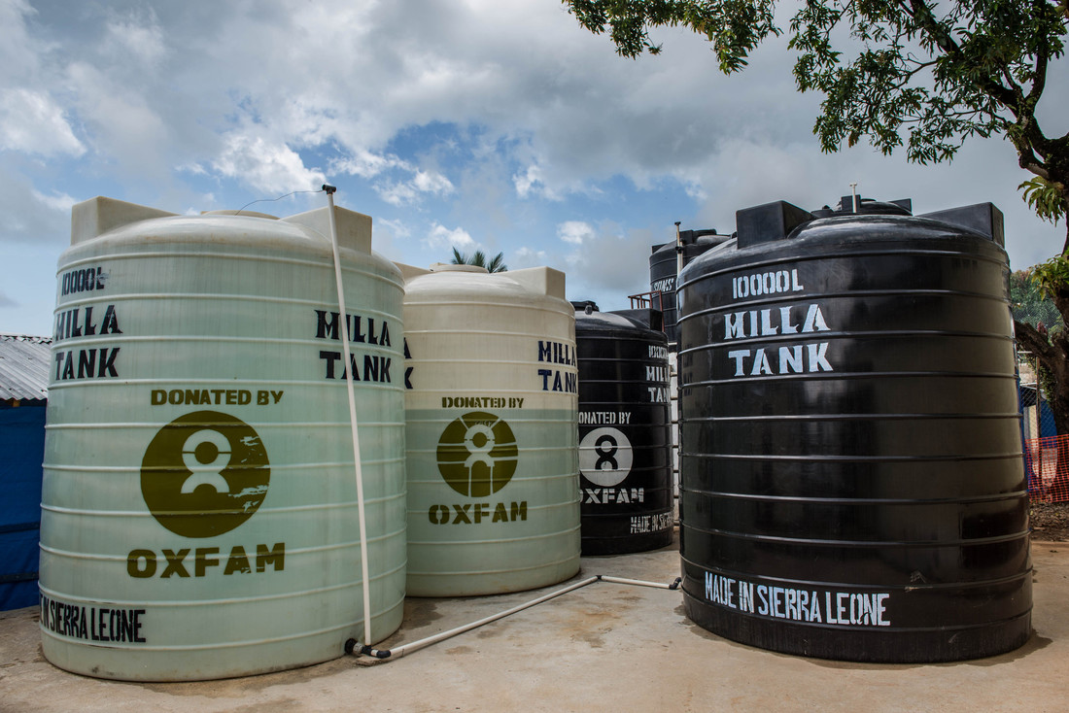
Water
Notes:
Hospitals do not only require doctors, nurses and medical equipment. They also require large quantities of water. As we saw earlier a clean water supply cannot be taken for granted in Sierra Leone, even in a hospital. Ebola patients require 250 litres of water per day, compared with the 15 litres usually required during other emergencies. Much of this water is used in chlorine disinfectant and basic hygiene.
New medical facilities are being quickly built across Sierra Leone, Liberia and Guinea, both to treat Ebola patients and to monitor patients while they are being tested for the disease.
These are Oxfam water storage tanks at the Ebola Holding Centre in Lakka, just outside Freetown, Sierra Leone. Oxfam does not provide direct medical care but has supplied holding centres and hospitals with water tanks, pipes and equipment.
Do not read out
Photo caption: Oxfam water storage tanks at the Ebola Holding Centre in Lakka, Sierra Leone (2014)
Tommy Trenchard/Oxfam

Slide 25
What you can do.
Speak with your friends, make a display, do an assembly: share your learning and raise awareness
Fundraise for the Ebola crisis
http://www.dec.org.uk/appeals/Ebola-crisis-appeal
Notes:
In conclusion what can you do?
First off please speak with your family and friends about what you have learned today. Or you could design a display or present an assembly. Many people – adults and young people - are frightened of Ebola or don’t fully understand the crisis. Others have used it to bully or make fun of people. You are now well informed and in a position to share your learning with others. If anyone is misinformed or being unpleasant about Ebola you have the opportunity to put them right.
Second you could fundraise. On 30 October 2014 the Disasters Emergency Committee (DEC) launched an emergency fundraising appeal for the Ebola crisis. The DEC shares out the money it raises between the UK largest charities who are working on Ebola. This is the first time the DEC has ever declared an emergency because of a public health emergency. The website is http://www.dec.org.uk/appeals/Ebola-crisis-appeal

Slide 26
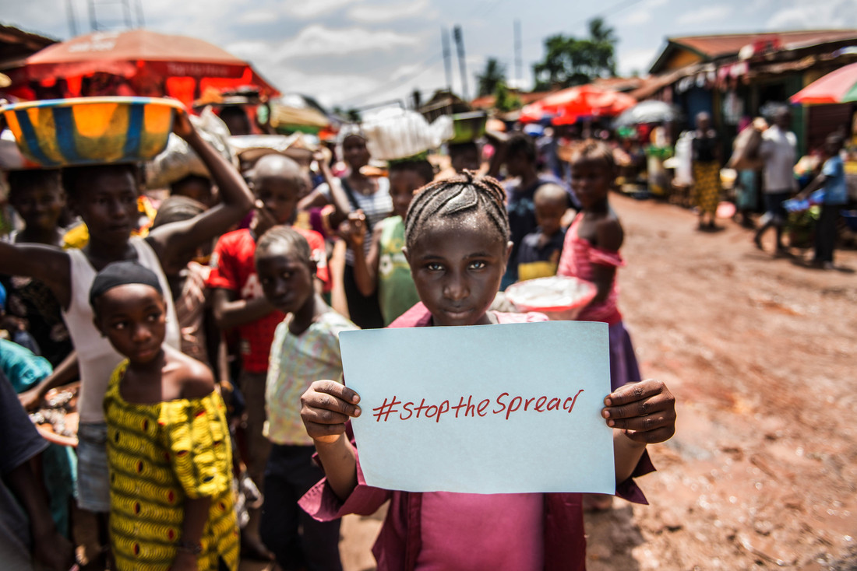
Thank you!
Notes:
Thank you for listening and thank you for thinking about how to ‘stop the spread’
Do not read out
Photo credit: Ramatu Gbla in a busy Freetown market, Sierra Leone (2014)
Bekki Frost/Oxfam

