Slide 1

CHILDREN’S RIGHTS
English resource for 8-11 year olds

Slide 2
CHILDREN’S RIGHTS
Session 1: Needs and wants
English resource for 8-11 year olds

Slide 3

Persuasive phrases
Now is the time to stand up for…
We are all united in our belief that...
We strongly believe that…
We firmly believe that…
Surely you must agree that...

Slide 4
CHILDREN’S RIGHTS
Session 2: Rights of the child
English resource for 8-11 year olds

Slide 5
Article 3: Adults should do what is best for you.
Article 6: You have the right to be alive.
Article 14: You have the right to think what you like and be whatever religion you want to be
Article 15: You have the right to make friends.
Article 17: You have the right to collect information from radios, newspapers, television, books etc., from all around the world.
Article 19: No one should hurt you in any way.
Article 24: You have a right to good health.
Article 27: You have the right to food, clothes, and a place to live.
Article 28: You have a right to education.
Article 30: You have the right to enjoy your own culture, practise your own religion and use your own language.
Article 31: You have the right to play.
Article 37: You should not be put in prison.
Selected articles from the UN Rights of the Child

Slide 6
Persuasive phrases
Now is the time to stand up for…
We are all united in our belief that...
We strongly believe that…
We firmly believe that…
Surely you must agree that...

Slide 7
CHILDREN’S RIGHTS
Session 3: Exploring rights
Children’s Rights

Slide 8
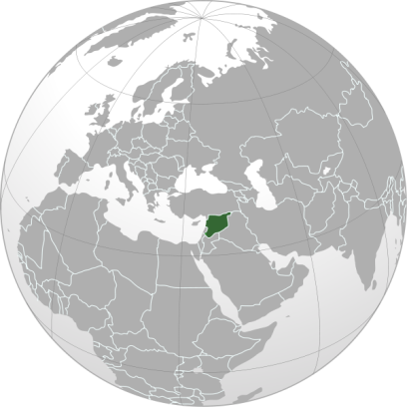
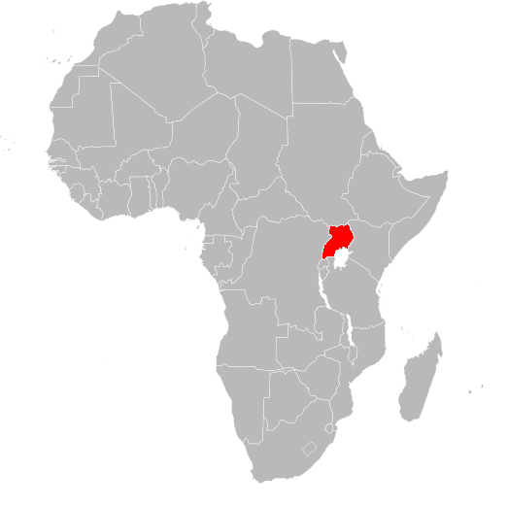
Exploring children’s rights in Syria and Uganda
Notes:
You could ask learners to find Syria and Uganda on a globe or world map.
Image of Syria: Dinamil via Wikimedia Commons
Image of Uganda: Vardion via Wikimedia Commons

Slide 9
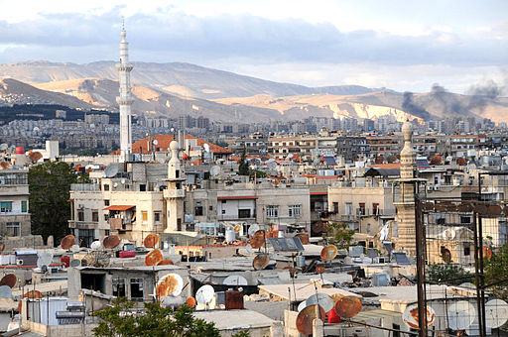
Damascus, Syria
Notes:
Ask learners if they had heard of Syria before this session. It is likely that some will have heard Syria mentioned in the news because of the conflict which began in 2011 (when this photograph was taken).
Ask learners to explain what they can see in this photograph of Syria’s capital city, Damascus. Apart from minarets, they will probably also notice that there are lot of modern buildings and satellite dishes. Make it clear that before the conflict of 2011, Syria was a relatively wealthy and peaceful country.
You might like to share the following information with your learners:
Syria has a population of 23 million people.
Damascus (shown above) was once a major centre for weaving and trading in textiles and “Damask” – an ancient technique for weaving patterns into cloth – derives its name from the city.
All the hamsters kept as pets today are descendants of hamsters from Syria.
Aleppo is one of the oldest cities in the world, with evidence suggesting that people lived there in 6000BC.
Photo credit: Anjči via Wikimedia Commons

Slide 10
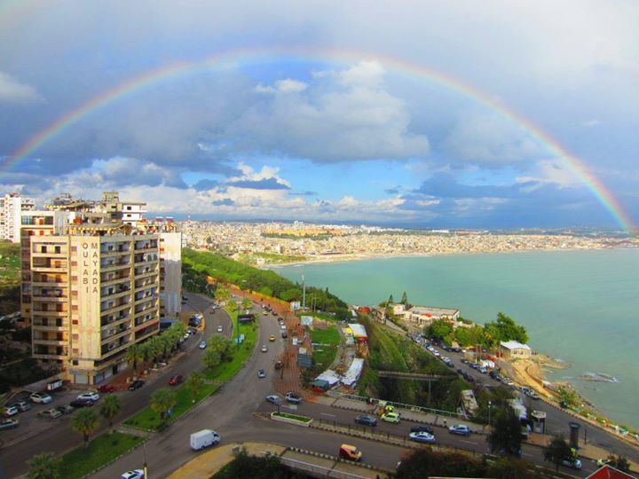
Latakia, Syria
Notes:
Here is another photograph of Syria. This shows part of the city of Latakia, taken in 2013. Is this what learners expected to see? Point out that although we often see images in the news of Syria ‘s buildings being destroyed in conflict, not everywhere has been affected. Since 2011, many millions of internally displaced Syrians have moved to other parts of the country less affected by the fighting.
Tell learners that, like any country, there are richer and poorer people living in Syria. 35% of Syrians live in extreme poverty (which means living under $1.25 a day) but although this means many children do not have all of their human rights met, others live in similar ways to children in the UK.
Photo credit: Ahmad viaWikimedia Commons

Slide 11
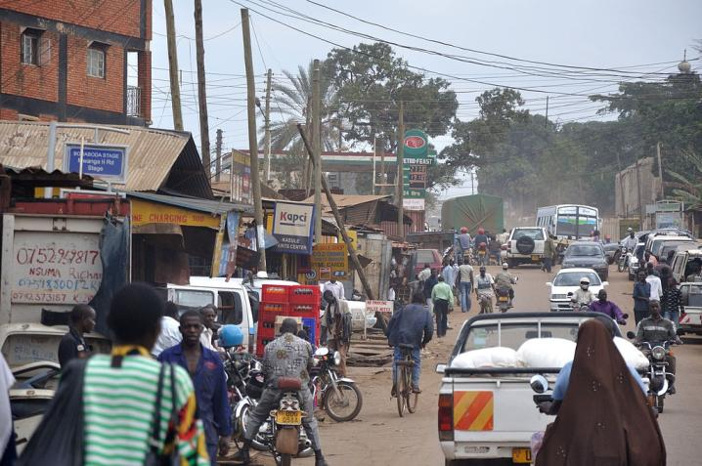
A street in Kampala, Uganda
Notes:
Ask learners if they had heard of Uganda before this session. You might like to share the following information about Uganda:
Uganda has a population of about 38 million.
Uganda shares Africa’s biggest lake – Lake Victoria – with two neighbouring countries, Kenya and Tanzania.
Uganda is quite small compared to neighbouring countries, but it is still about the same size as Great Britain.
Half of the world’s remaining mountain gorillas live in Uganda.
This photograph shows a street in Uganda’s capital city, Kampala.
Photo credit: Simisa via Wikimedia Commons

Slide 12
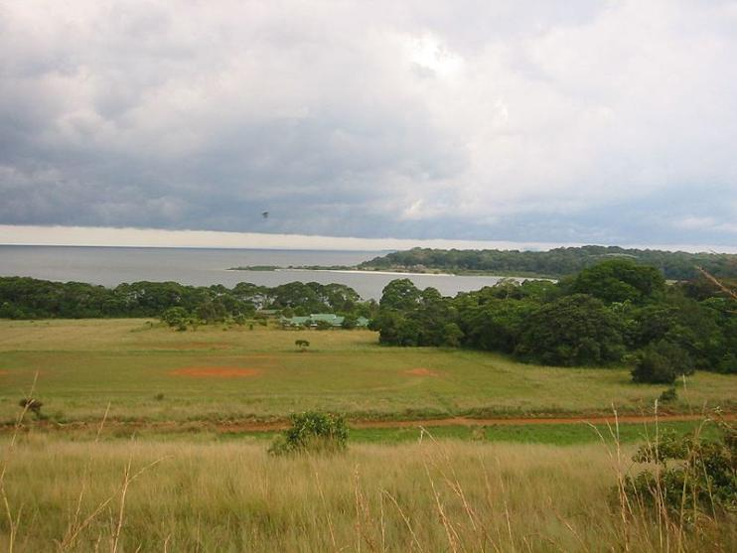
Photo credit: Simisa, Wikimedia Commons
Bugala Island, Uganda
Notes:
Point out that, like any country, there are richer and poorer people living in Uganda. 20% of Ugandans live in extreme poverty (which means living under $1.25 a day) but although this means many children do not have all of their human rights met, others live in similar ways to children in the UK.
Photo credit: http://www.WorldIslandInfo.com via Wikimedia Commons.

Slide 13
CHILDREN’S RIGHTS
Session 4: Right to good health – water and sanitation
Children’s Rights

Slide 14
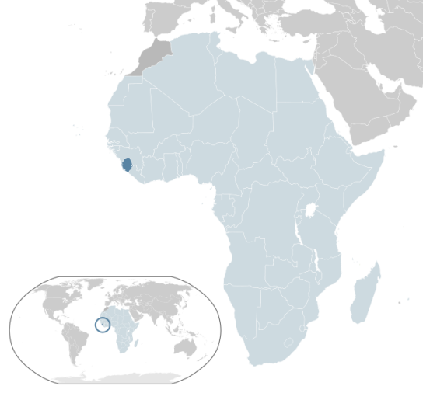
Right to good health: water and sanitation in Sierra Leone
Notes:
You might like to ask learners to find Sierra Leone on a globe or world map.
Image credit: Alvaro via Wikimedia Commons

Slide 15
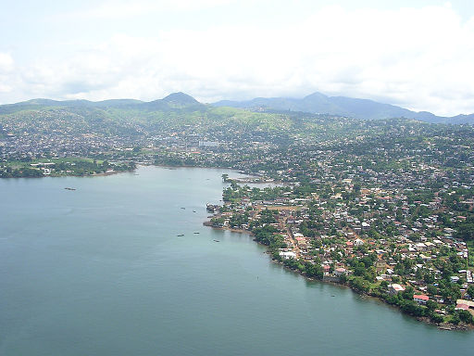
Positive image of SL
Freetown, Sierra Leone
Notes:
You might like to share the following information about Sierra Leone with your learners:
Sierra Leone has a population of about 6 million. About 62% of people live in rural areas and depend on farming for food and income. Major crops include: rice, cassava, maize and ground nuts. Cocoa, coffee and coconuts are also grown.
Sierra Leone is also a major source of the world’s diamonds, gold, titanium and bauxite.
Since the mid-1980s, Sierra Leone has become poorer because of fighting and political unrest.
Poor healthcare facilities made the challenges of managing Sierra Leone’s Ebola epidemic of 2014 worse.
The photograph shows an aerial view of Freetown, Sierra Leone’s capital city.
Image: David Hond via Wikimedia Commons

Slide 16
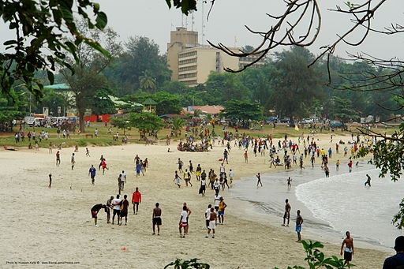
Lumley Beach, Freetown
Notes:
Show learners this photograph of Lumley Beach in Freetown with tower blocks behind. Point out that, like any country, there are richer and poorer people living there. 53% of people in Sierra Leone live in extreme poverty (which means living under $1.25 a day) but although this means many children do not have all of their human rights met, others live in similar ways to children in the UK.
Image:By Hussein Kefel via Wikimedia Commons.

Slide 17
UN Convention on the Rights of the Child
Article 24:
You have the right to good health

Slide 18
What is a water source?
Notes:
Ask learners if they know what a water source might be. Explain that in the UK our main water source is from taps in our homes. Ask learners what they use this water for (drinking, cooking, washing).

Slide 19
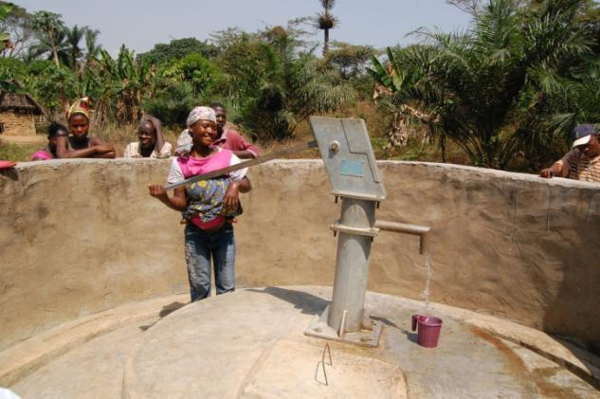
A water source is a place from which people collect water for drinking, cooking or washing. This woman is pumping water up from below the ground.
Notes:
Explain that many people in many countries in the world do not have taps in their homes as a water source. Their water source for drinking, cooking and washing might be from a shared pump like the one in Sierra Leone above, or from a shared well or nearby stream, river, pond or lake.
Explain to learners that they will next be looking at six photographs from Sierra Leone which show challenging situations faced by many people in terms of their water supply and facilities for disposing of waste. Do make it clear that these situations have arisen because Sierra Leone has faced several decades of conflict and the government has lacked the necessary funds to repair water and sanitation systems.
Photo credit: John McLaverty/Oxfam

Slide 20
CHALLENGE 1
There are no pipes to transport human waste away so instead it runs into the streets and makes any nearby water sources dirty.
Which photo shows evidence
of this challenge?

Slide 21
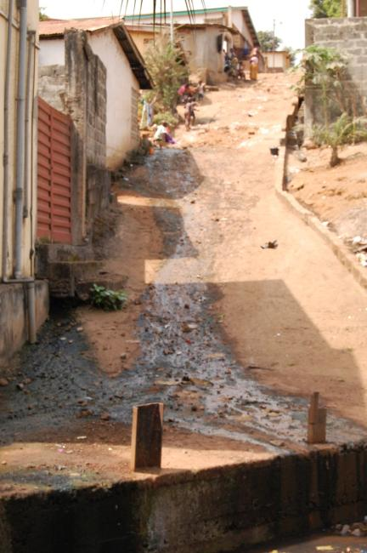
There are no pipes to transport human waste away so instead it runs into the streets and makes any nearby water sources dirty.
Notes:
This photo shows human waste leaking out of an open toilet in the row of houses and running down the street into a water channel below. This open sewer will spread diseases, like cholera, as people use the street and the water in the channel. Cholera is a bacterial infection which can cause dehydration and, if left untreated, death. It is caused by drinking water that is dirty or polluted and therefore dangerous to drink.
Photo credit: John McLaverty/Oxfam

Slide 22
CHALLENGE 2
Toilets are built too close to water sources so waste directly pollutes the water. This leads to diseases like cholera when people drink or wash in it.
Which photo shows evidence
of this challenge?

Slide 23
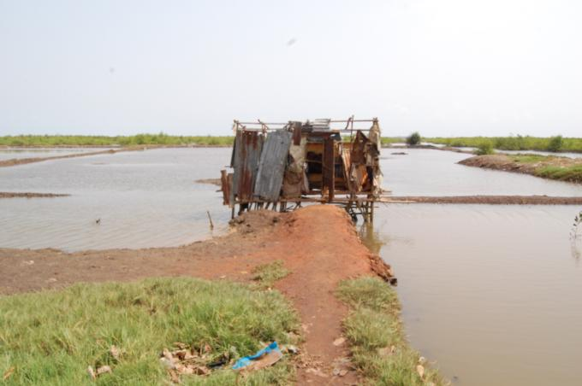
Toilets are built too close to water sources so waste directly pollutes the water. This leads to diseases like cholera when people drink or wash in it.
Notes:
Toilets are often built near to water sources so that waste washes away. Unfortunately, because the same water is used for drinking, washing and cooking, diseases like cholera can easily spread.
Photo credit: John McLaverty/Oxfam

Slide 24
CHALLENGE 3
Wells are not always covered over, so animals are free to defecate in the water.
Which photo shows evidence
of this challenge?

Slide 25
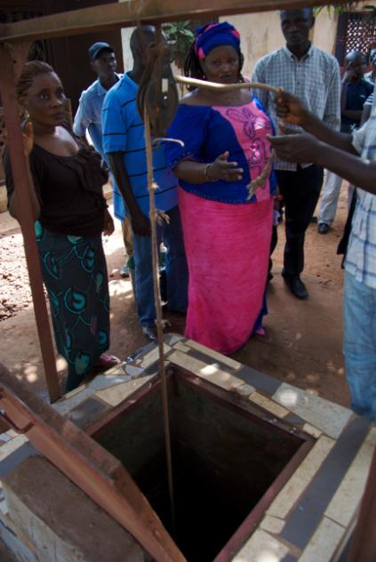
Wells are not always covered over, so animals are free to defecate in the water.
Notes:
Wells are open, which means that water inside can be polluted (or contaminated), for example by animals who wander around the village and defecate nearby. Explain that ‘defecate’ means to poo.
Photo credit: John McLaverty/Oxfam

Slide 26
CHALLENGE 4
Wells are not very deep and each well is used by too many people so they run dry.
Which photo shows evidence
of this challenge?

Slide 27
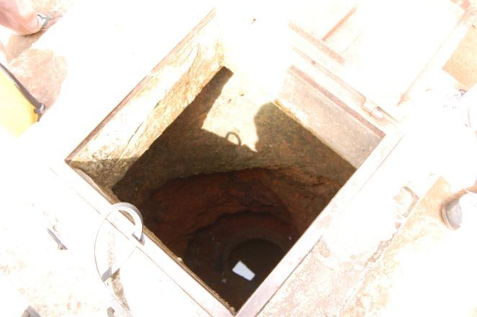
Wells are not very deep and each well is used by too many people so they run dry.
Notes:
Wells are dug by hand and are not very deep so there the water available is not enough for lots of people.
Photo credit: John McLaverty/Oxfam

Slide 28
CHALLENGE 5
Well water is not safe to drink because wells are not dug very deep. This means that water gets contaminated by animals drinking and defecating in it or by humans if there is rubbish, open defecation or a toilet close by.
Which photo shows evidence
of this challenge?
Notes:
Explain to your learners that ‘contaminated’ water means water that is dirty or polluted and ‘open defecation’ means going to the toilet (doing a poo) in the open, with no means of privacy or disposing of waste safely.

Slide 29
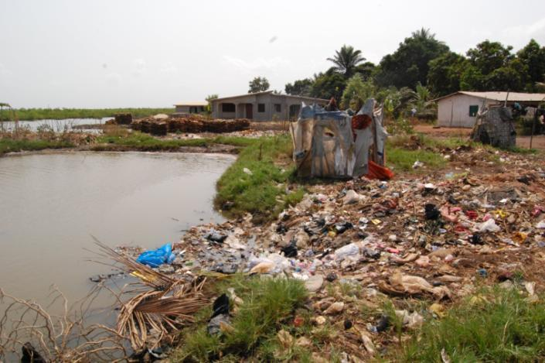
Well water is not safe to drink because wells are not dug very deep. This means that water gets contaminated by animals drinking and defecating in it or by humans if there is rubbish, open defecation or a toilet close by.
Notes:
The toilet here (made from wooden posts and fabric) is very close to the river. All waste from the toilet will go directly into the river. A rubbish heap is also close to the river so this will pollute the water. Animals are free to wander down to the river where they defecate in the water as well as drink it. All of these challenges mean that the water source – a shallow well – will also be polluted and unsafe to drink.
Photo credit: John McLaverty/Oxfam

Slide 30
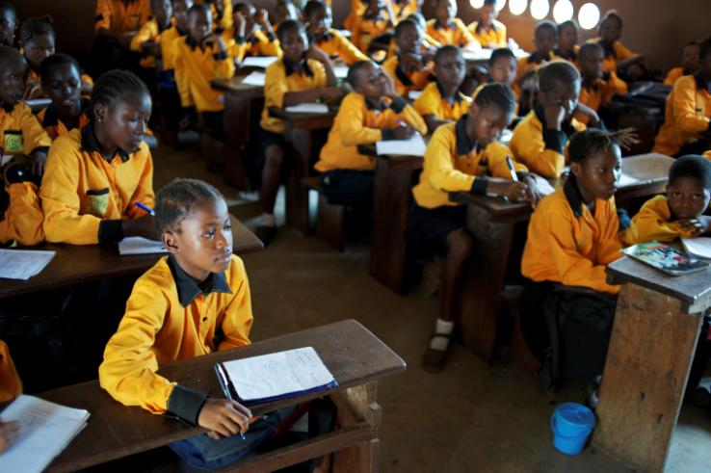

Pamaronko Community Primary School
Notes:
This is the Year 6 class at Pamaronko Community Primary School, just outside Sierra Leone’s capital city Freetown. The school has over 1,000 students who attend in 2 shifts, with one half attending school in the morning and the other half attending school in the afternoon. There are between 60 and 70 students in each class. There are only two toilets for the 1,000 pupils and they are old and unhygienic.
Photo credit: John McLaverty/Oxfam

Slide 31
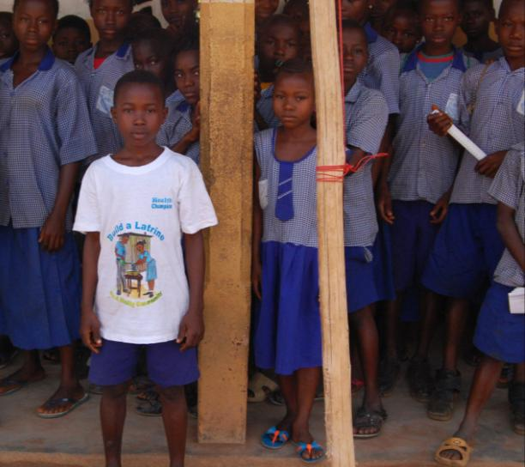
School Health Club
Notes:
Pamaronko Community Primary School has a Health Club as part of a programme (supported by Oxfam) to improve water and sanitation. Explain that ‘sanitation’ means having facilities for disposing of waste safely, in particular waste from toilets. It also means encouraging hygienic practices such as hand washing after using a toilet.
The Health Club has 20 members and meets every week to promote good hygiene in the school and community. There is a teacher with the responsibility of supervising the Health Club. Children are taught that they need to be hygienic by washing their hands properly after using the toilet and before eating to avoid spreading diseases. They are encouraged to share this message with their families. Oxfam has provided the school with soap and buckets for hand washing. A new water pump and pit latrine are going to be built at this school and one of the club’s missions is to persuade other members of the community to build more.
Photo credit: John McLaverty/Oxfam

Slide 32
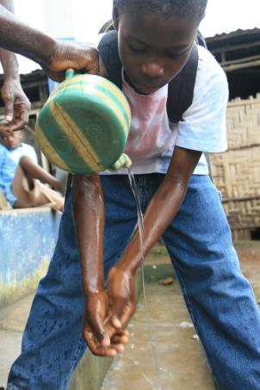

Hand washing
“It’s my responsibility to tell people about how to prevent sicknesses by washing their hands, drinking safe water and other good hygiene.”
Notes:
In 2012, Sierra Leone faced its largest cholera outbreak for over forty years. Poor sanitation and waste management, limited access to safe drinking water, contamination of water resources and the movement of people around the country meant cholera spread around the country very quickly. By the end of September 2012 there had been 20,500 reported cases of cholera and over 270 people had died.
In this photograph, Richard, who is 10, is demonstrating hand washing because he wanted to tell people how to stay safe and healthy.
Photo credit: Jane Beesley/Oxfam

Slide 33
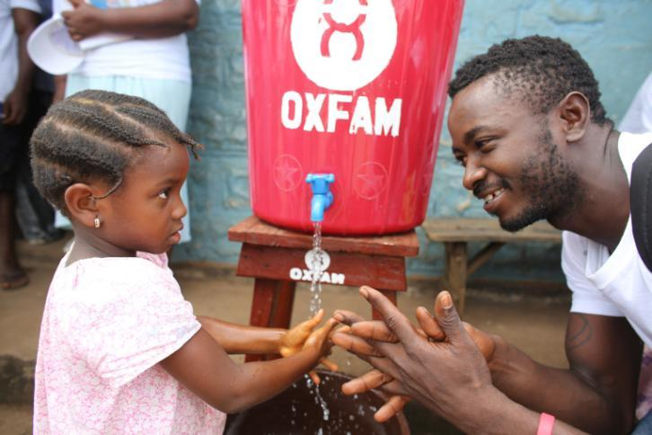

Hand washing
Notes:
During the Ebola crisis of 2014-15, it became even more important to promote good hygiene messages to others. In this photograph, Community Health Worker Alan Beckett Conteh shows Istau how to wash her hands at an Oxfam Hand Washing Point in Tengbeh Town.
For more information about the Ebola crisis which struck Sierra Leone, Liberia and Guinea, see http://www.oxfam.org.uk/education/resources/ebola. One issue during the crisis was that schools were closed to slow down the spread of disease. However, this also meant that teachers and informed pupils like those in health clubs could no longer spread their hygiene messages easily. Oxfam’s hand washing points became a key place for making people aware of the importance of hand washing and good hygiene to help slow the spread of Ebola.
Photo credit: Will Wintercross/ Oxfam

Slide 34
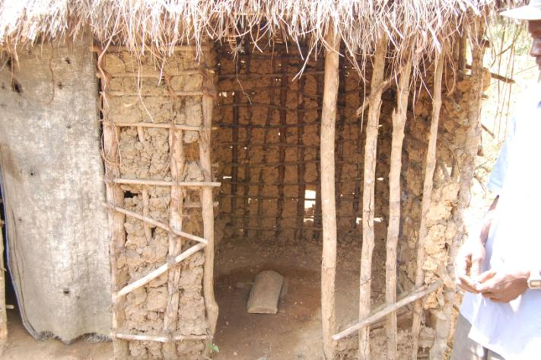
New pit latrine
Notes:
The new pit latrines follow a sanitation methodology called Community Led Total Sanitation (CLTS). The latrine pit is built the correct distance from houses and water sources to avoid polluting (or contaminating) the water source people use for drinking and cooking. Ash is put down the pit after each use and the pit is re-dug every six months to prevent it from over-filling. The latrine walls are built from locally-sourced materials to make them cheap and easy to construct. This encourages communities to build them. Part of CLTS requires the community to agree not to defecate anywhere except in the new latrines.
Photo credit: John McLaverty,/Oxfam

Slide 35

New water pump
Notes:
The new water pump is able to draw up water from far deeper in the ground than the old-style water wells. This means that there is more water available and it is less likely to be polluted or contaminated. The ground around the water pump is covered with concrete so the water is not exposed to further contamination. There is a wall around the water pump to prevent animals from getting close to it. To ensure that the water pumps will last for a long time, the group of families who own the pump contribute a maintenance fee which pays for any necessary repairs as well as for someone to come and test the safety of the water every few weeks.
Photo credit: John McLaverty,/Oxfam

Slide 36
CAN YOU USE THIS
EMOTIVE LANGUAGE
TO DESCRIBE THE BENEFITS OF THE NEW PIT LATRINES AND WATER PUMP?
magnificent
exciting
wonderful
marvellous
superb
unique
thrilling

Slide 37
CHILDREN’S RIGHTS
Session 6: The health club
Children’s Rights

Slide 38


School Health Club
Notes:
Pamaronko Community Primary School has a Health Club as part of a programme (supported by Oxfam) to improve water and sanitation. Explain that ‘sanitation’ means having facilities for disposing of waste safely, in particular waste from toilets. It also means encouraging hygienic practises such as hand washing after using a toilet.
The Health Club has 20 members and meets every week to promote good hygiene in the school and community. There is a teacher with the responsibility of supervising the Health Club. Children are taught that they need to be hygienic by washing their hands properly after using the toilet and before eating to avoid spreading diseases. They are encouraged to share this message with their families. Oxfam has provided the school with soap and buckets for hand washing. A new water pump and pit latrine are going to be built at this school and one of the club’s missions is to persuade other members of the community to build more.
Photo credit: John McLaverty,/Oxfam

Slide 39
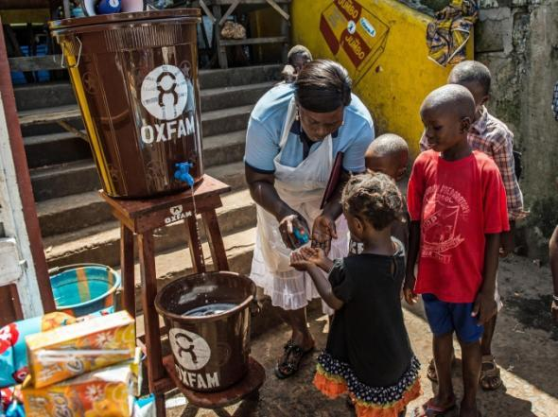
What hygiene messages will you share?
Notes:
Although Ebola and cholera are not diseases which threaten the UK, careful hand washing is still an important way to reduce the spread of other illnesses like colds, ‘flu and stomach bugs.
In this photograph, community health worker Marrion Thomson teaches children how to wash their hands at an Oxfam Hand Washing Point in Freetown, Sierra Leone.
Photo credit: Tommy Trenchard/Oxfam

Slide 40
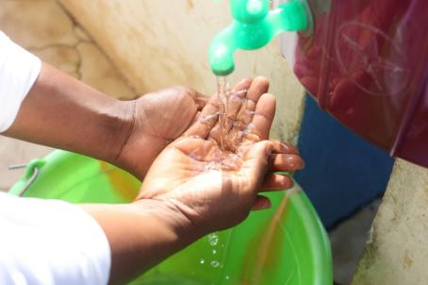

Hand washing song
https://vimeo.com/130732781
Notes:
Watch this video for ideas about how to support your message about hygiene in your school
Photo credit: Will Wintercross/Oxfam

Slide 41
Hand washing demonstration
https://vimeo.com/130733058
Notes:
Watch this video for ideas about how to support your message about hygiene in your school
Photo credit: Will Wintercross/Oxfam

Slide 42
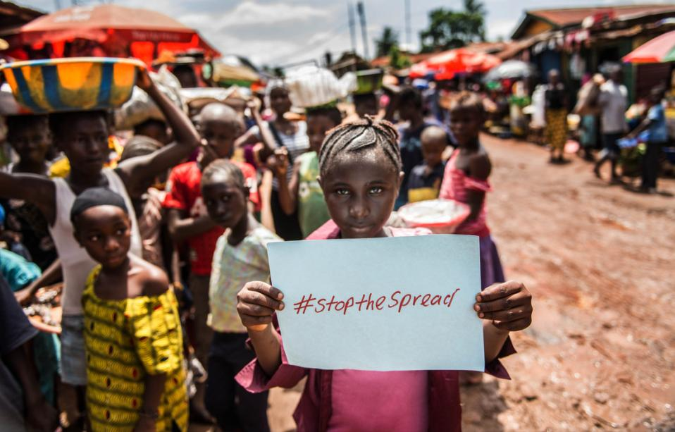
Notes:
Photo credit: Ramatu Gbla in a busy Freetown market, Sierra Leone (2014)
Bekki Frost/Oxfam

