Slide 1

Music CPD
with Dónal Kearney
Thursday 13 January 2022

Slide 2
What will you learn today?
You will learn tools for warming up the body, voice and mind to be used in a musical context
You will learn songwriting approaches to GCE activism
You will learn how advocacy skills can be used in music
Through Global Citizenship Education (GCE), you can take action to change the world as an informed global citizen. GCE equips you with the knowledge, skills and values to act ethically and sustainably in a world that is both complex and highly interconnected.
www.worldwiseschools.ie

Slide 3
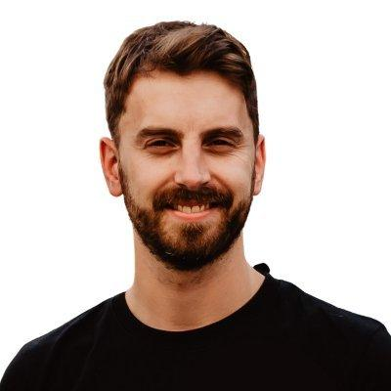
How can I help you? www.donal-kearney.com
Former Human Rights advocate at the United Nations
Studied human rights at the University of Cambridge and the Irish Centre for Human Rights (1st class Master’s)
Worked with human rights organisations in Ireland, the UK, Switzerland and Bolivia
Certified facilitator with Musicians Without Borders
Co-founder of the Irish Institute of Music and Song
Critically-acclaimed songwriter and performer with TRÚ
Building social impact with non-profit, Grow Remote

Slide 4
WARMING UP

Slide 5
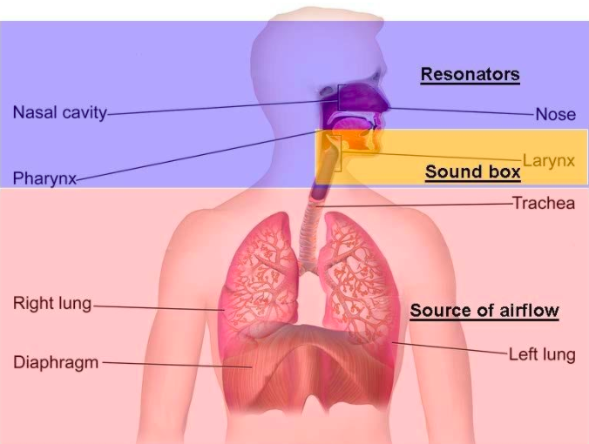
Warming Up 16:10 - 16:30
Stance - balance, get rid of tension
Breath - deep, relaxed
Energy - tongue, lips, face
Mind - focus, creativity

Slide 6
SONGWRITING

Slide 7
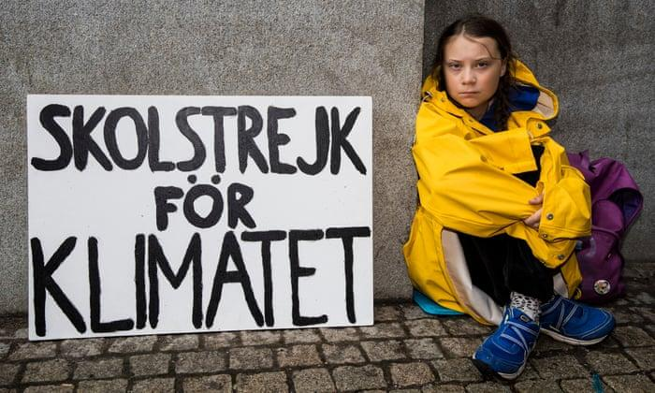

Slide 8
Group Songwriting (LYRICS) 16:45 - 17:15
So what is our THEME for today’s song?
Let’s start with 5 questions
    Who? What? Where? When? Why? (5 mins)
Then we’ll start putting our lyrics together.

Slide 9
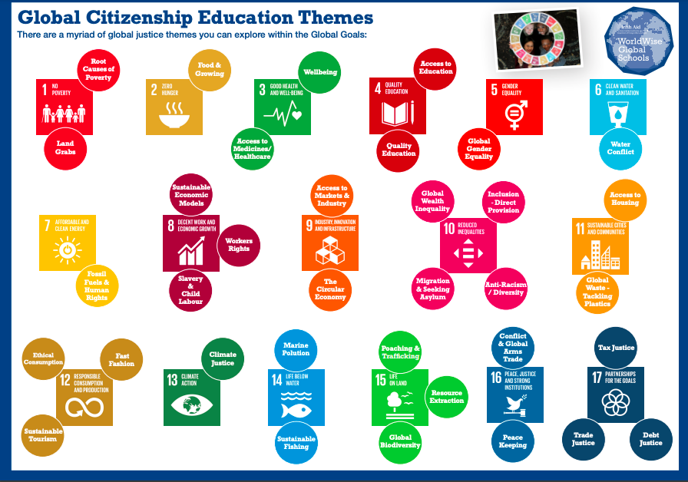

Slide 10
Group Songwriting (MUSIC) 16:45 - 17:15
Now that we have our lyrics, let’s add music.
Is the song fast or slow (tempo)?
Is it happy or sad (major/minor)?
What note (pitch) does it start on?
You can use a tin whistle, guitar, piano, ukulele, or whatever you like!
Students may also like to play along at the songwriting stage.

Slide 11
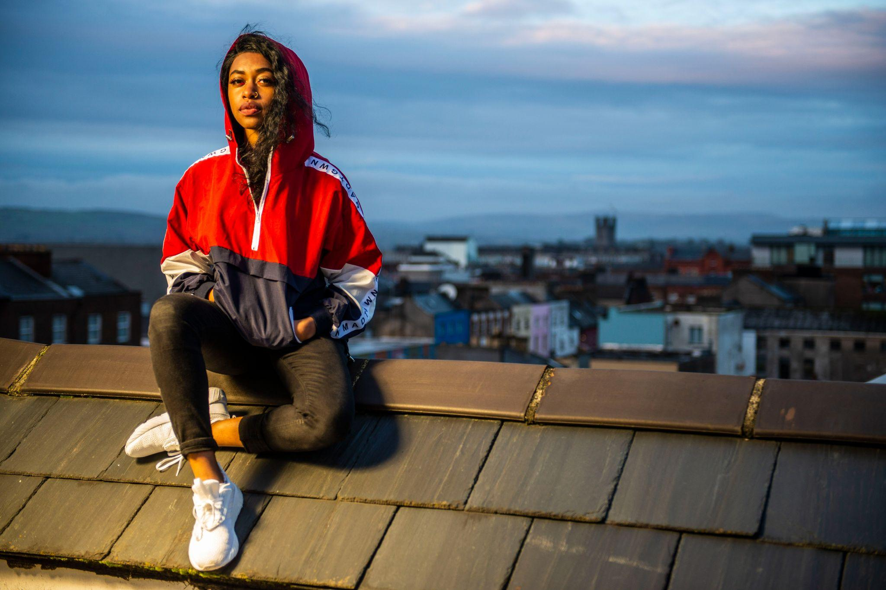

Slide 12
Writing Your Own Rap 16:45 - 17:15
Rap is poetry.
Connect the words to your message.
Then connect your message to your voice.
In class, you can try the same process in smaller groups:
Theme (5 mins) 2) 5 questions (5 mins)
3) Lyrics (15 mins) 4) Add music (15 mins)

Slide 13



Next Steps 16:45 - 17:15
Develop your own rap lyrics
Teach yourself how to produce a track (DAW)
Audacity Garageband Reaper

Slide 14
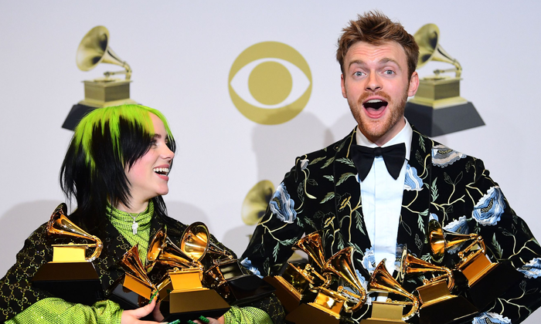

Slide 15
ADVOCACY

Slide 16
Advocacy through Music 17:50 - 18:20
Storytelling
Storytelling is an extremely powerful tool for advocacy.
Today we will share some storytelling techniques and tools.
You can explore these with your classes.

Slide 17
What is Advocacy? 17:50 - 18:20
Please share your personal definition of “advocacy”
    Let’s use the chatbox!
Consider a Human Rights Advocate you know
What are they advocating? How do they do it?
What issue might you class advocate for?

Slide 18
What is Advocacy? 17:50 - 18:20
advocacy
/ˈadvəkəsi/
noun
1. public support for or recommendation of a particular cause or policy.
"his outspoken advocacy of the agreement has won him no friends"
2. the profession or work of a legal advocate.
"solicitors should have a record of advocacy in the lower courts"

Slide 19
What is Advocacy? 17:50 - 18:20
Advocacy is the act of using your voice to summon others to the aid of someone in need

Slide 20
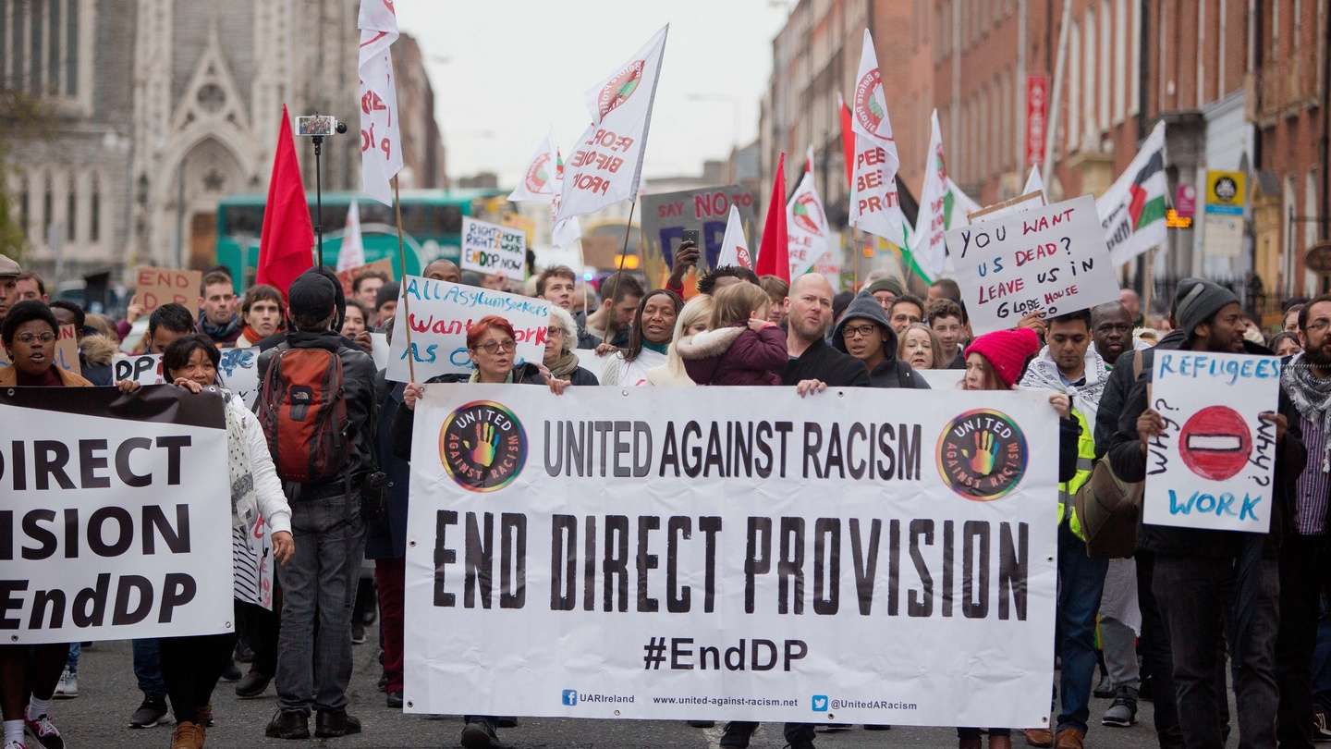

Slide 21
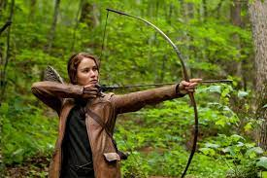
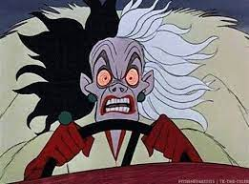
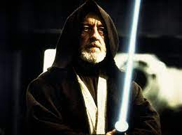
Storytelling 17:50 - 18:20
Characters
Hero (2012) Villain (1961) Guide (1977)

Slide 22
Storytelling 17:50 - 18:20
Characters
Audience Problem Advocate

Slide 23
Storytelling 17:50 - 18:20
Characters
Audience GCE Issue Musician

Slide 24
Storytelling 17:50 - 18:20
Basic Structure
Beginning Middle End
Set-Up Conflict Resolution
Problem 2) Solution 3) Impact
Caused by villain Presented by Guide What has changed?

Slide 25
Forms of storytelling 17:50 - 18:20
In your class, you can encourage various forms of storytelling:
Lyrical - using words and narrative structure
Non-lyrical - just melody, rhythm, harmony
Movement - using the body (solo, ensemble)

Slide 26
What you learned today
You picked up physiological information about the benefits of warming up the body, voice and mind in a musical context
You learned how songwriting / rap can empower GCE activism
You learned some storytelling techniques to empower GCE advocacy through music

Slide 27
Feedback
What was the most interesting part of today?
Would you like to learn more about Global Justice issues?
Would you like to do more similar workshops?
Do you have any questions or comments for Dónal?

Slide 28
Thank You!
www.donal-kearney.com

