Slide 1


Lizzy Noone
WorldWise Global Schools

Slide 2
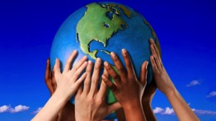



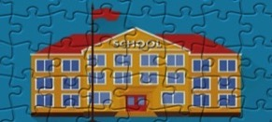

Aims of the WWGS Programme
Notes:
The WWGS programme aims to:
familiarise learners with the concepts of interdependence, development, globalisation and sustainability
enable teachers to move learners from a charity mentality to a social justice mentality
community of practice that stretches across regions and continents. An informal and flexible network that can share experience and resources
stimulate critical thinking about global issues, both at a whole school and learner level help schools promote greater awareness and understanding of global justice issues.

Slide 3
What is Global Citizenship Education?
“an educational process aimed at increasing awareness and understanding of the rapidly changing, interdependent and unequal world in which we live”
By challenging stereotypes and encouraging independent thinking, GCE helps students critically explore the root causes of global justice issues and how they link with our everyday lives
GCE inspires solidarity by supporting people to realise their full rights, responsibilities and potential as global citizens in order to take meaningful action for a just and sustainable world

Slide 4
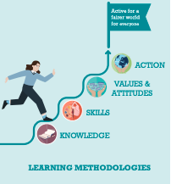
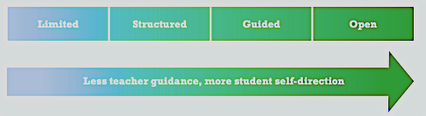
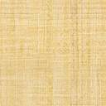

Slide 5



GCE and the Curriculum

Slide 6
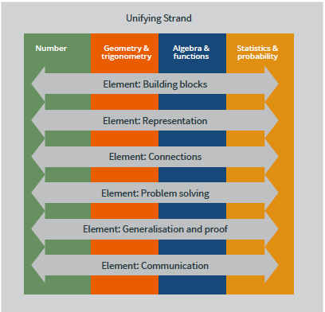
U.6 make connections between mathematics and the real world
Notes:
While the usefulness of mathematics for problem solving is well known, mathematics also has a fundamental role in both enabling and sustaining cultural, social, economic and technological advances and empowering individuals to become critical citizens.
Problem Solving
Students should be able to investigate patterns, formulate conjectures,
and engage in tasks in which the solution is not immediately obvious, in
familiar and unfamiliar contexts.

Slide 7
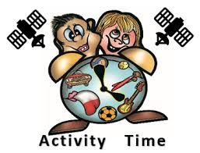
Maths & Global Citizenship Education…what is the link?
What themes? What topics? What skills?
Do a mind map based on the
4 strands of the Junior Cycle
Unifying Strand
Statistics and Probability
Number strand
Geometry and Trigonometry
Algebra and Functions
https://jamboard.google.com/d/1Yqoy2en-qM5JqymNlZdGSbb1hl7s-gWLmtE_ihTNBLo/edit?usp=sharing
Notes:
https://jamboard.google.com/d/1Yqoy2en-qM5JqymNlZdGSbb1hl7s-gWLmtE_ihTNBLo/edit?usp=sharing

Slide 8
In Maths- SDG 13 has been incorporated into looking at statistics of temperature difference over the last 100 years
Davitt College Castlebar
Mathematics- students explore global issues through statistics, probability, percentages and fractions. Data and surveys relating to global injustices and issues are used when exploring particularly statistics and percentages. There is strong link between mathematics class and the development education classes.
Ardscoil Phadraig Granard
Junior cycle maths department have gotten students to calculate their carbon footprint and try to link with the Green Schools committee and CSPE department in the auditing of waste management.
Ballyhaunis CS
Year 8 to 10 registered for the Maths Challenge 2020 for the Children in Crossfire. Completing the quiz allowed pupils to work together to solve mathematic problems in an international development setting; engaging in maths questions whilst thinking about global justice and solidarity.
St Louis Kilkeel

Slide 9

Changing the world through teaching!
Maths educators have an opportunity to communicate the significance of creating and sustaining an improved quality of life for all from a global perspective
Encourage the ability to see the world as an interdependent system and to be aware of one's influence in the interactions of the world's system.
Build ability to perceive the world as a single system→ to be aware of one's involvement in it; to act to influence the system and to recognise the interconnected nature of the planet and all living on it
Information, attitudes, awareness, and skills, which, taken together, can help us understand our world, how we affect it, and how it affects us

Slide 10
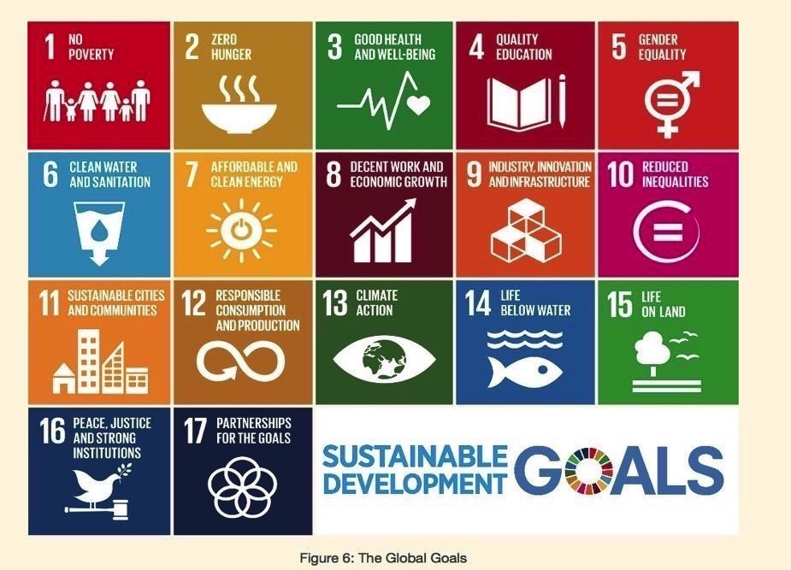

Slide 11
In pairs, discuss what goals are most obvious to explore in Maths?
Take one least obvious and discuss the connection with Science curriculum?
What Systems/Frameworks do we need to consider when exploring Global Citizenship Education in Maths?
What systems within each goal?

Slide 12
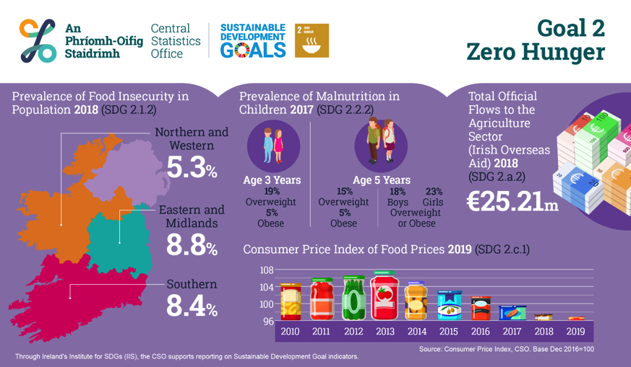
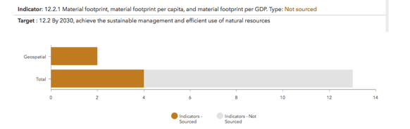
https://irelandsdg.geohive.ie

Slide 13
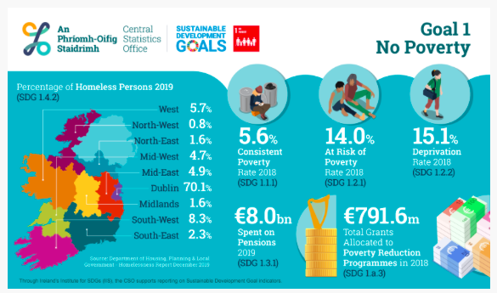

Slide 14
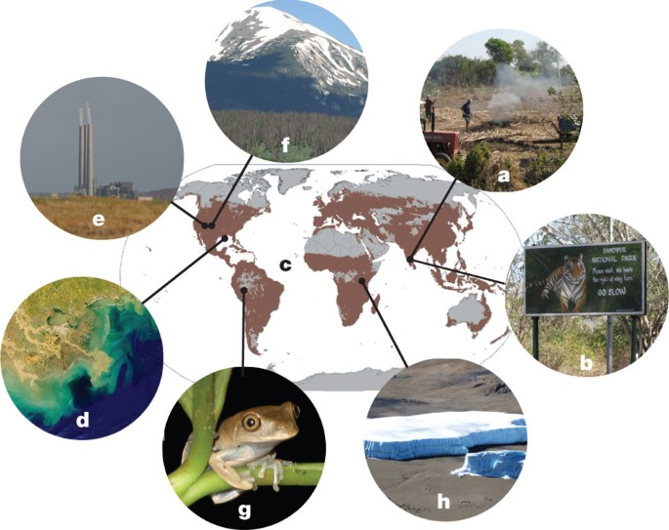

Slide 15
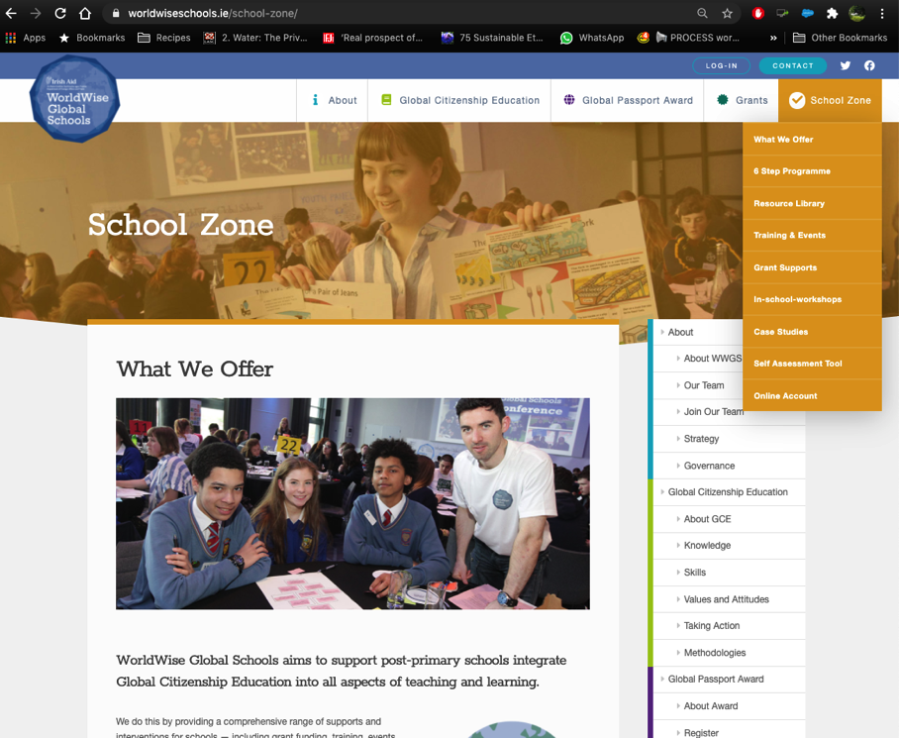

Slide 16
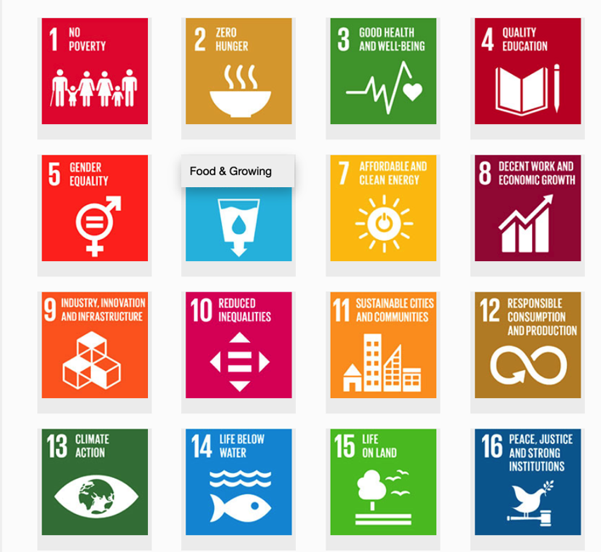


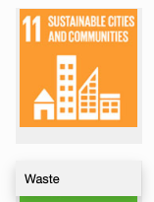

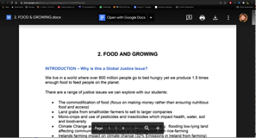
1. Hover over the symbol and a drop down menu appears!
Resource Sheets
– activities, videos, suggested actions etc
2. Click on the theme and the resource sheet will pop up!

Slide 17
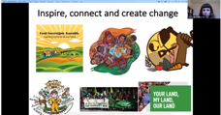
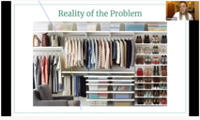
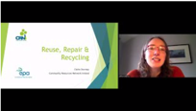
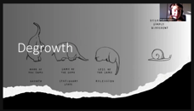
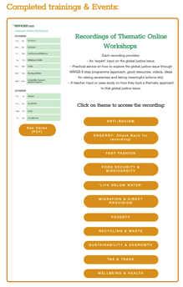
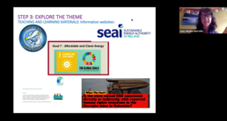
Webinars on relevant Global Justice Themes
Fast Fashion
Food security & Biodiversity
Waste
DeGrowth & Sustainability
Energy

Slide 18

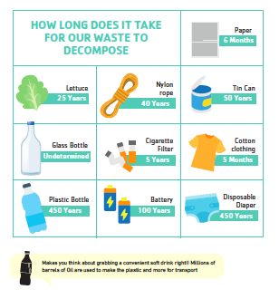
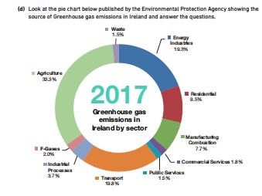
Happiness vs GDP
Debt and Tax
Environmental Sustainability

Slide 19
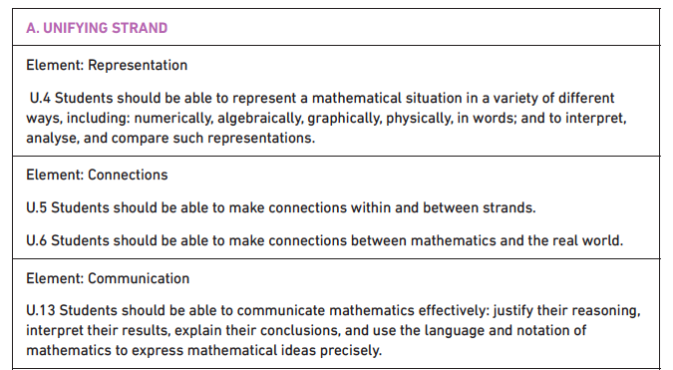
UNIFYING STRAND

Slide 20
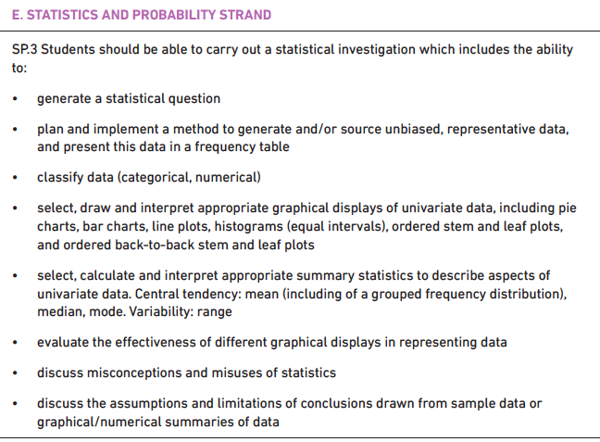
STATISTICS & PROBABILITY STRAND
Notes:
Statistics and probability
This strand focuses on determining probability from random events and generating and investigating data. Students explore the relationship between experimental and theoretical probability as well as completing a data investigation; from formulating a question and designing the investigation through to interpreting their results in context and communicating their findings. Learners use graphical and numerical tools, including summary statistics and the concepts and processes of probability, to explore and analyse patterns in data. Through these activities, learners gain an understanding of data analysis as a tool for learning about the world.

Slide 21
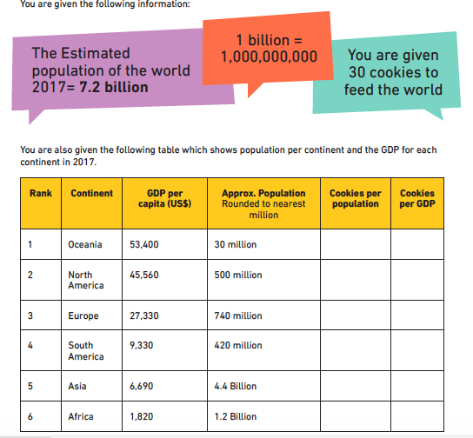
Notes:
https://docs.google.com/document/d/1-mOtSJdUrOY1Pxv3aUXIUxQYMC4eP5XJFoFMt5pGrZo/edit?usp=sharing

Slide 22
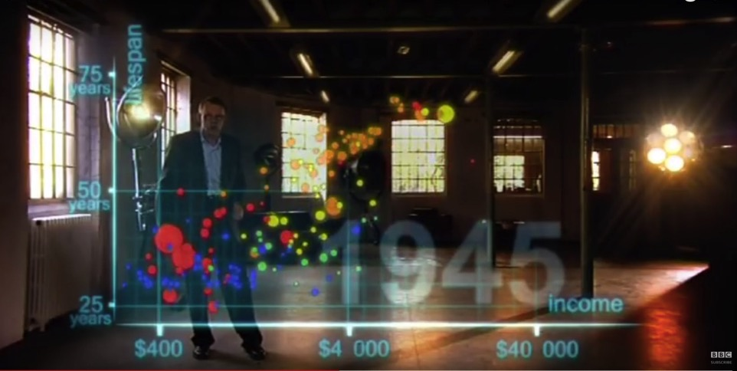
VIDEO: Hans Rosling's 200 Countries, 200 Years, 4 Minutes - The Joy of Stats - BBC Four-
the link to the video is here https://www.youtube.com/watch/jbkSRLYSojo

Slide 23
Task: Examining Global Life Expectancy
Part 1) On your graph, plot the pattern of life expectancy shown in the video. Each group will plot one continent
We will watch the video twice
Part 2) In your group discuss three factors that are affecting life expectancy on your continent?
Part 3) Discuss three ways that global inequality can still have an impact on life expectancy
Notes:
Explain task 1

Slide 24
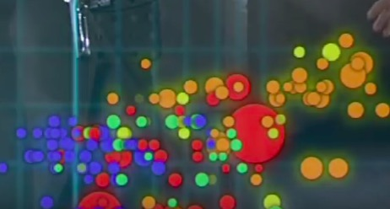
www.gapminder.org
Europe=Brown
Asia=Red
Africa=Blue
Americas=Yellow
Notes:
Different groups will be analysing the trends of various parts of the world-these will be on tables

Slide 25
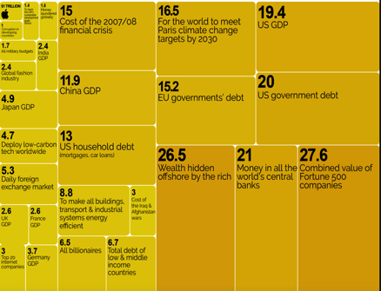
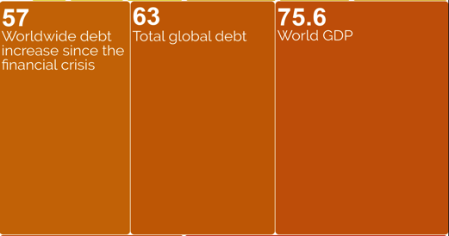
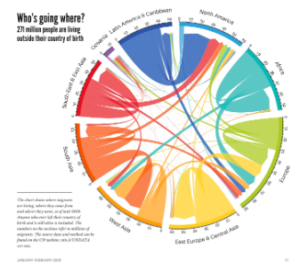
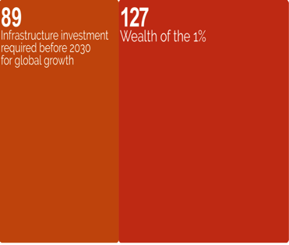
https://informationisbeautiful.net/

Slide 26
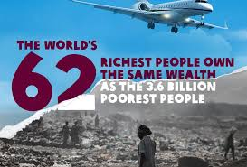
26

Slide 27
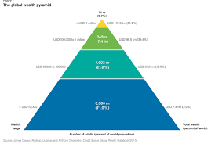

Slide 28
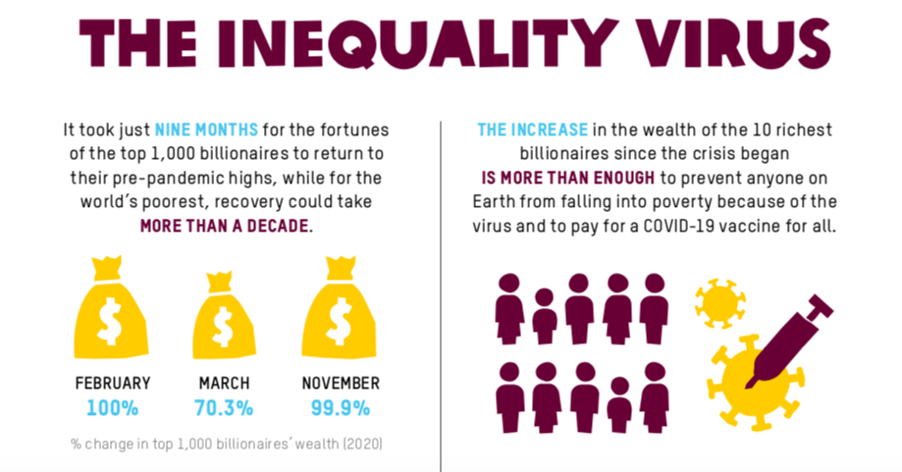
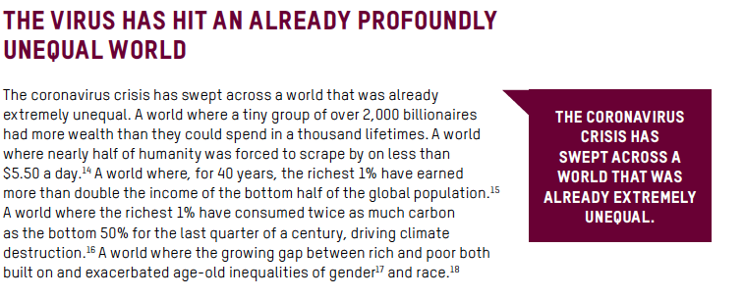

Slide 29
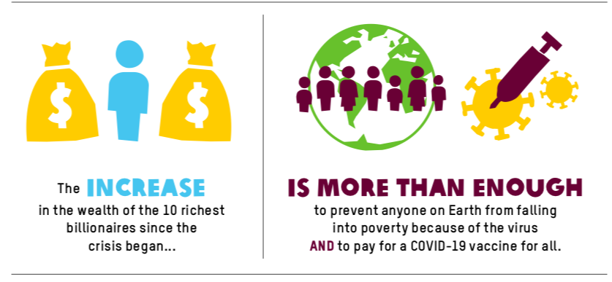
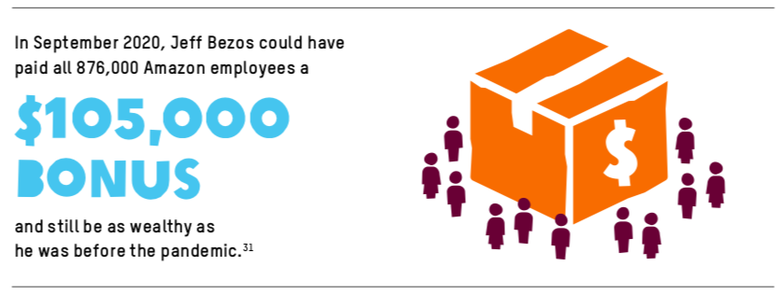

Slide 30
Break & Reflection Time!!
How effective are we at equipping young people with the knowledge and skills that will enable them to make sound decisions as responsible global consumers and citizens?
How well do we cover human rights and global justice issues within our programmes and activities?
How well do we cover environmental issues within our programmes and activities?
How well do we develop young people’s sense of responsibility through taking part in activities which involve the local or wider community?
How effective are we in planning for young people to take part in regular discussion and debate about topical issues related to science?
Let’s Harvest All of Our Examples!
Notes:
https://jamboard.google.com/d/1tmTFXDWNyYQM6mwvL4kDOBNbPBgUkM5UMRy6QUUXDlM/edit?usp=sharing

Slide 31

Our Mind Map
Add in additional global justice issues linked to strands

Slide 32
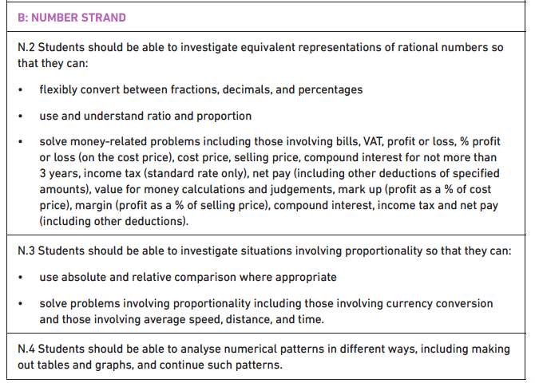
NUMBER STRAND

Slide 33
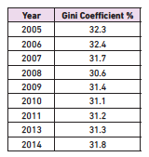
Number Strand
N.2 investigate equivalent representations of rational numbers so that they can:
b. use and understand ratio and proportion
Explore and Calculate the Gini Coefficient and the Palma Ratio
http://shlegeris.com/gini
Oxfam wealth inequality campaign and education

Slide 34
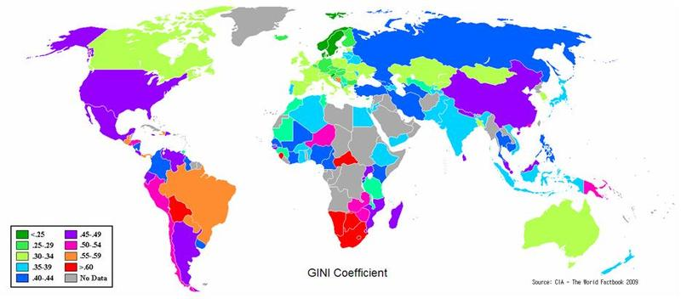
INEQUALITY AROUND THE WORLD
GINI INDEX
Notes:
This world map shows how the countries of the world compare on income inequality according to the GINI index (or coefficient). Countries that are more equal are shaded in green. Countries that are more unequal are shaded in pink, orange and red.
Source: The World Factbook, CIA, 2009: www.cia.gov/library/publications/the-world-factbook/fields/2172.html

Slide 35
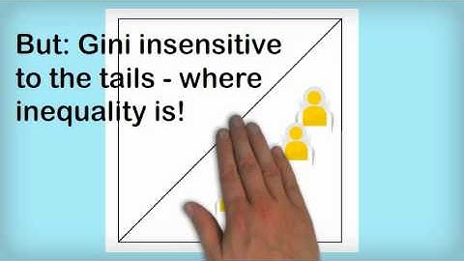
<iframe width="560" height="315" src="https://www.youtube.com/embed/EE0EgIHdGPc" frameborder="0" allow="accelerometer; autoplay; clipboard-write; encrypted-media; gyroscope; picture-in-picture" allowfullscreen></iframe>
https://www.youtube.com/watch?v=EE0EgIHdGPc

Slide 36
WEALTH INEQUALITY
Notes:
Explain that this world map shows the distribution of average wealth per adult (here defined as an individual aged 20 or above) around the world. Average wealth is calculated as the value of a person’s financial assets (for example housing and land) after any debts have been subtracted.
Note: Credit Suisse calculates wealth by looking at the individual net wealth of people aged 20 years or above. Individual net wealth is calculated as the value of a person’s financial assets (primarily housing and land) after any debts have been subtracted. If there is a lack of data in a country, estimates are made by using average figures based on the region and income class the country belongs to. Data may be lacking in a country for a number of reasons. Poorer or more isolated communities may lack the infrastructure for reliable data collection. Very rich people may prefer not to declare all their income.
Source: Global Wealth Databook 2014, Credit Suisse, 2014: www.credit-suisse.com/uk/en/about-us/research/research-institute/publications.html

Slide 37
CALCULATING THE PALMA RATIO
1 10% | 2 10% | 3 10% | 4 10% | 5 10% | 6 10% | 7 10% | 8 10% | 9 10% | 10 10%
Poorest
Richest
Notes:
Explain that we can divide the population of a country into ten equal-sized groups in the same way. We call each group a decile. When Palma did this, he found out that half of a country’s income tends to be shared by the five income groups below the richest decile (the fifth to the ninth deciles shown in white above).
Say that the shares of the richest 10% and the poorest 40% can vary a lot among countries. Palma therefore came up with the Palma ratio to describe how the richest 10% (the tenth group) and the poorest 40% (the first, second, third and fourth groups) share their portion of the country’s total income.

Slide 38
CALCULATING THE PALMA RATIO
Combined income of richest 10% (tenth group)
Combined income of poorest 40% (first to fourth groups)
Notes:
Explain that the Palma ratio is calculated by dividing the combined income of the richest 10% by the combined income of the poorest 40%. In more equal countries this ratio will be one or below. This means that the richest 10% does not receive a larger share of the country’s income than the bottom 40%. In very unequal countries this ratio will be greater than one. This means that the richest 10% receives a larger share of the national income than the bottom 40%. Ask learners to calculate the Palma ratio for their ‘society’.

Slide 39
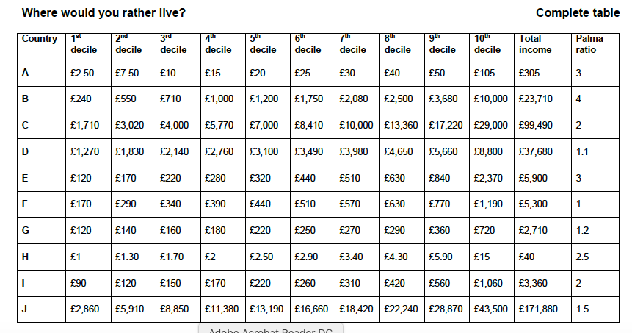

Slide 40
PALMA PROBLEMS TABLE 1
Notes:
Note that the Palma ratios for Ethiopia and Viet Nam differ slightly for Palma problems 1 and 2 as a result of rounding the combined income to the nearest billion.

Slide 41
PALMA PROBLEMS TABLE 2
Notes:
Note that the Palma ratios for Peru and Viet Nam differ slightly for Palma problems 1 and 2 as a result of rounding the combined income to the nearest billion.

Slide 42

WHAT IS INEQUALITY?
Group A
£20
£20
£20
£20
£20
Group B
£87
£10
£1
£1
£1

Slide 43
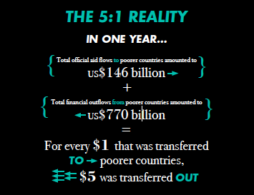
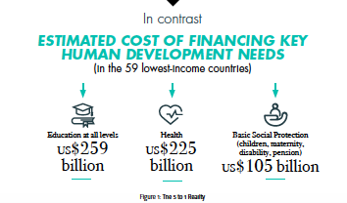
What makes up the $5?

Slide 44
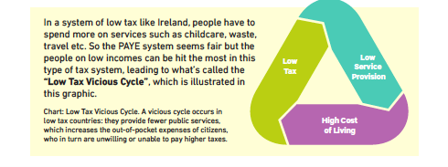
c. solve money-related problems including those involving bills, VAT, profit or loss, % profit or loss (on the cost price), cost price, selling price, compound interest for not more than 3 years, income tax (standard rate only), net pay (including other deductions of specified amounts), value for money calculations and judgements, mark up (profit as a % of cost price), margin (profit as a % of selling price), compound interest, income tax and net pay (including other deductions)
Notes:
-Fairtrade
-Tax Justice
-Trading Game
-Race to the Bottom

Slide 45
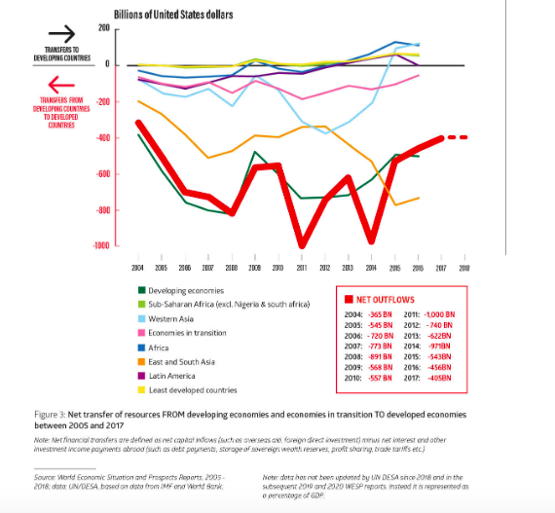
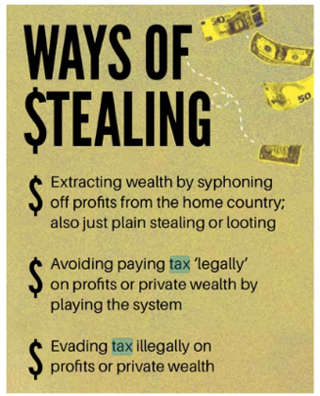

Slide 46
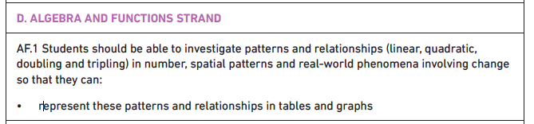


ALGEBRA & FUNCTIONS STRAND

Slide 47


Slide 48



Slide 49



Slide 50


Slide 51


Slide 52

Country Overshoot Day
Notes:
The pandemic gave us a chance to appreciate nature and gave us a glimpse into what a fossil free future might look like offering a break from addictive consumerism (one would hope!)
George Monibot said that’ it [the pandemic] has to be a tipping point. This has to be a point to transform where we move from one system an exploitative political and economic system to a completely different one private sufficiency and public luxury.

Slide 53




Slide 54


Slide 55


Maths and Climate Change
Sort it out Game for Climate change!
https://www.youtube.com/watch?v=bQjVbZQ4T2U
Isotope-Ratio Mass Spectrometer (IRMS)
The Infinite Monkey Cage-Climate Change
-Carbon Footprint calculation
https://www.foe.ie/justoneearth/carboncalculator/
-Sea-level measurement-Bremore

Slide 56


Slide 57

Geometry and Trigonometry STRAND

Slide 58



Slide 59
CLASS BASED ASSESSMENTS (CBAS)
CBA1: Mathematical Investigation-Problem Solving Cycle
-How Happy is Your School?
-How much energy could my school generate through solar power?
-What does debt look like in €20 notes?
CBA2: Statistical Investigation-Statistical enquiry cycle
-On any global theme or goal of the student’s choice.
-Take any of the global issues mentioned here or in the resources to focus your CBA on.

Slide 60
2nd Year students are doing statistics in maths class. We’re currently looking into the votes and seats won in the last general election in Ireland and comparing the percentage of votes to the proportion of the seats they actually got. We’re hoping to continue on and look at the elections in the UK and US and compare them to our system - which is more democratic etc. We’ll then (hopefully) do a project on gerrymandering and dividing constituencies to ‘favour’ some outcomes over others etc, and look at how Trump won despite Clinton getting more votes.
Kate Minnock NWETSS
Our 2nd year Maths students looked at the statistics of elephant deaths in Southern India. During Fairtrade Fortnight they looked at percentages and profit margins for Fairtrade farmers versus market rates.
Colleen Cooney, Moville Community College

Slide 61
Our fifth year Maths students have been involved in the tracking of data and how climate change is affecting our planet and animal populations
Maria Fitzgerald Colaiste na Riochta
Our 2nd year Maths discussed 'what effects a country's wellbeing?' and how to work out a country's wealth by exploring the way GDP per capita is calculated. Students then looked at tables of information displaying the wealth of different countries and the same information in line graphs. The students also practiced doing a line graph on similar information.
Jenny Cooney Ballinamore CS

Slide 62
GCE has been integrated into subjects such as Maths where students are basing their CBAs around global issues and investigating an element of it. The maths department also facilitated a world lesson on the 2nd of December where a statistical investigation was undertaken on climate, water and poverty.
Mullingar Community College
In Maths, economic growth and tax and trade are explored , also we explore a lot of GCE topics through statistics.
Loreto Clonmel

Slide 63


Slide 64
PUT IN CHAT or Chat!
The Resources you have used in your classroom!
Podcasts
Videos
Books
TV programmes/documentaries
People and organisations
Articles
Stories

Slide 65






Useful Links and Resources
http://www.worldwiseschools.ie/resource-item/maths-resources/
www.financialjustice.ie
www.developmenteducation.ie
www.globaldimension.org.uk
https://www.bbc.co.uk/sounds/play/b07142ls
https://views-voices.oxfam.org.uk/the-oxfam-podcast/
https://www.tandfonline.com/doi/full/10.1080/03054985.2017.1331846
Notes:
Afri-They All Had Names: A Survey of Tithe na mBocht and Famine Graveyards in Ireland
Truman on Trial:

Slide 66

Facebook: WorldWise Global Schools

Slide 67

Twitter: WorldWise Schools

Slide 68
Upcoming key dates for your diary
1. Global Passport Award : Apply Online by Feb 26th 2021
2. Subject CPD: various dates- online
3. Annual Student Conference: April 22nd – online
4. Funding application for Schools 2021-2022 school year Opens: April 12th Closes: May 14th
WWGS support for schools: ongoing

Slide 69



THANKS A MILLION!
WE’RE ALL HERE FOR YOU!
TÓG BOG É

