Slide 1


Sinead Hayes & Lizzy Noone
WorldWise Global Schools

Slide 2

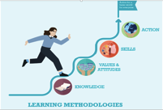




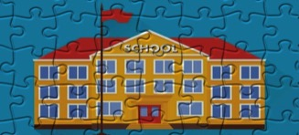

Principals Underpinning GCE
Notes:
The WWGS programme aims to:
familiarise learners with the concepts of interdependence, development, globalisation and sustainability
enable teachers to move learners from a charity mentality to a social justice mentality
community of practice that stretches across regions and continents. An informal and flexible network that can share experience and resources
stimulate critical thinking about global issues, both at a whole school and learner level help schools promote greater awareness and understanding of global justice issues.

Slide 3
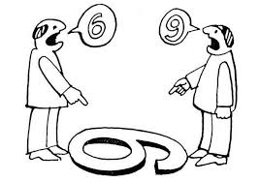
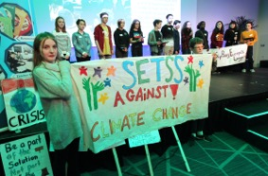
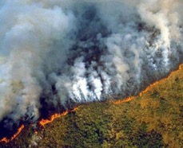
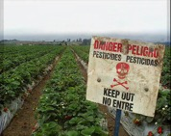
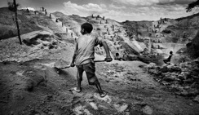

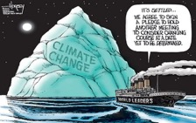
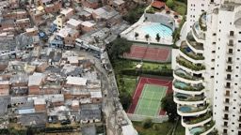
What does GCE mean to you?
Why is it important for you to embed it into Maths?

Slide 4
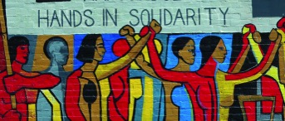
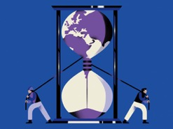


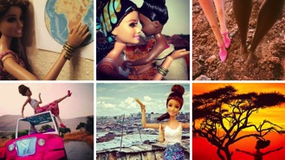
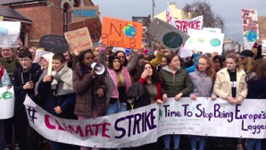
Global Citizenship Education & Art
Global Citizenship Education
Exploring root causes
of inequality & global justice issues
Connects & Inspires Solidarity
Hope
Linking justice issues
with our everyday lives
Challenge stereotypes
Maths for Change

Slide 5

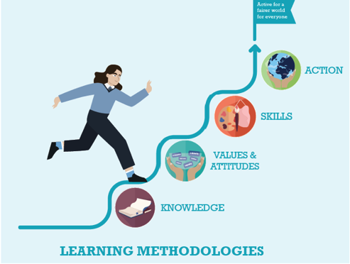
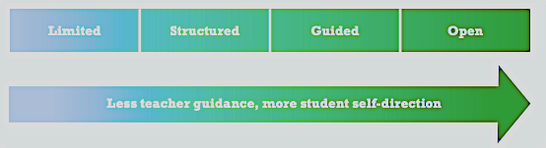
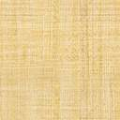
Real world Problem solving & Collaboration
Express ideas, feelings and opinions
Experiment, fail, learn
Critical thinking and responsibility
Multiple Intelligence – expression and empathy

Slide 6





Key Elements To Include In Your Lessons
1. Asking Questions (being critical)
2. Making Connections
3. Exploring viewpoints and attitudes)
4. Responding as Active Global Citizens
5. Assessing Learning (Reflection)

Slide 7



GCE and the Curriculum

Slide 8
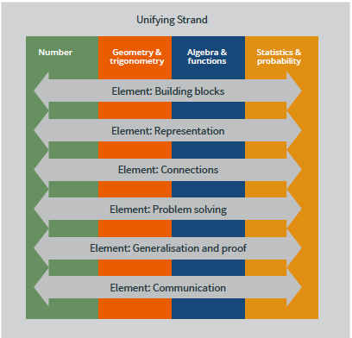
U.6 make connections between mathematics and the real world
Notes:
While the usefulness of mathematics for problem solving is well known, mathematics also has a fundamental role in both enabling and sustaining cultural, social, economic and technological advances and empowering individuals to become critical citizens.
Problem Solving
Students should be able to investigate patterns, formulate conjectures,
and engage in tasks in which the solution is not immediately obvious, in
familiar and unfamiliar contexts.

Slide 9
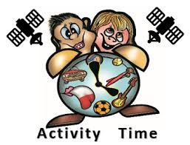
Maths & Global Citizenship Education…what is the link?
What themes? What topics? What skills?
Do a mind map based on the
5 strands of the Junior Cycle
Unifying Strand
Geometry and Trigonometry
Statistics and Probability
Number Strand
Algebra and Functions
Share your Mind Maps in Pairs
Notes:
https://jamboard.google.com/d/1Yqoy2en-qM5JqymNlZdGSbb1hl7s-gWLmtE_ihTNBLo/edit?usp=sharing

Slide 10
In Maths- SDG 13 has been incorporated into looking at statistics of temperature difference over the last 100 years
Davitt College Castlebar
Mathematics- students explore global issues through statistics, probability, percentages and fractions. Data and surveys relating to global injustices and issues are used when exploring particularly statistics and percentages. There is strong link between mathematics class and the development education classes.
Ardscoil Phadraig Granard
Junior cycle maths department have gotten students to calculate their carbon footprint and try to link with the Green Schools committee and CSPE department in the auditing of waste management.
Ballyhaunis CS
Year 8 to 10 registered for the Maths Challenge 2020 for the Children in Crossfire. Completing the quiz allowed pupils to work together to solve mathematic problems in an international development setting; engaging in maths questions whilst thinking about global justice and solidarity.
St Louis Kilkeel

Slide 11
Maths: Changing the world through teaching!
Maths educators have an opportunity to:
communicate the significance of creating and sustaining an improved quality of life for all from a global perspective
Make sense of big numbers!
Explore The World balance sheet.
Encourage the ability to see the world as an interdependent system and to be aware of one's influence in the interactions of the world's system and our interconnected nature of the planet and all living on it.
Information, attitudes, awareness, and skills, which, taken together, can help us understand our world, how we affect it, and how it affects us

Slide 12
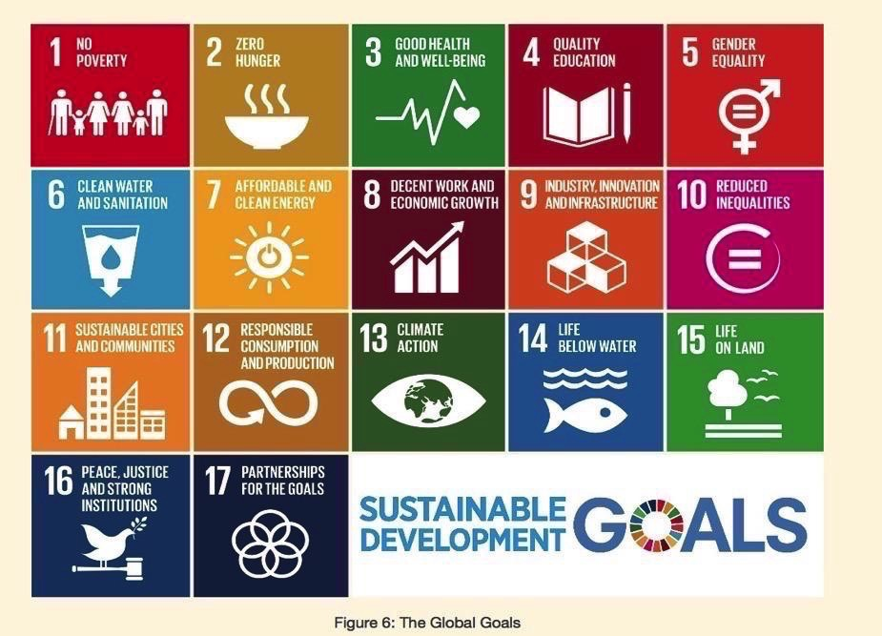

Slide 13
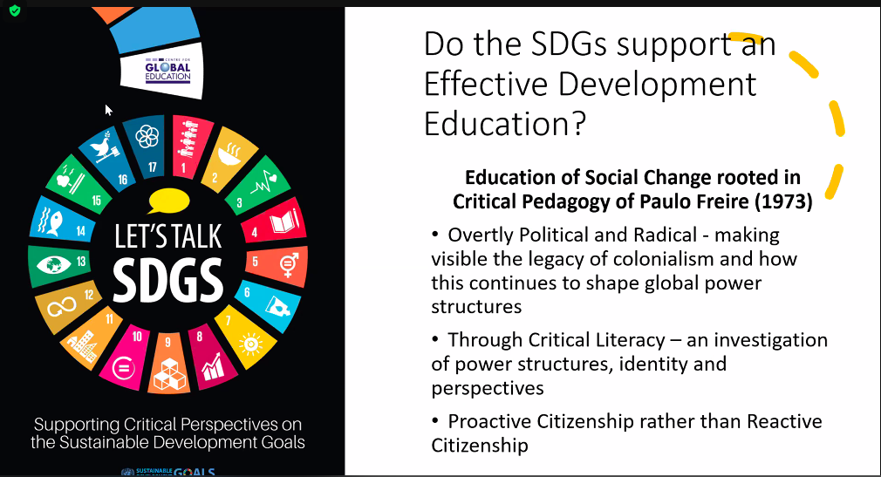

Slide 14
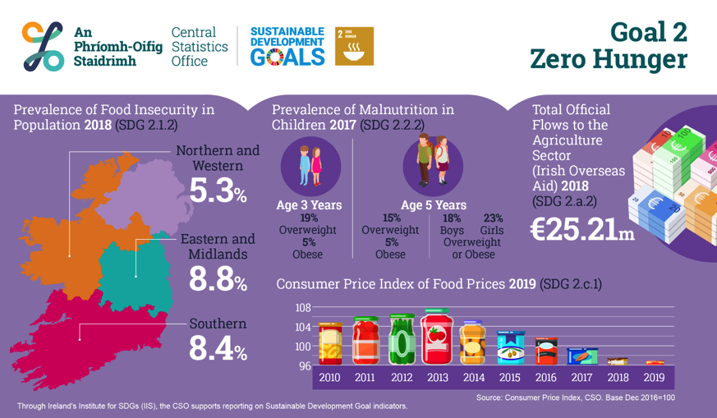
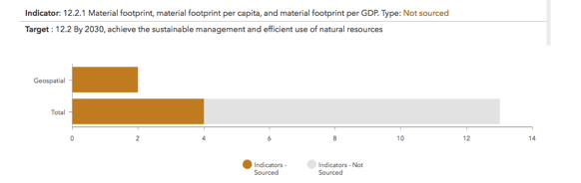
https://irelandsdg.geohive.ie

Slide 15
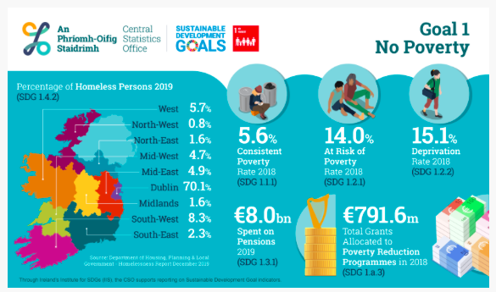

Slide 16
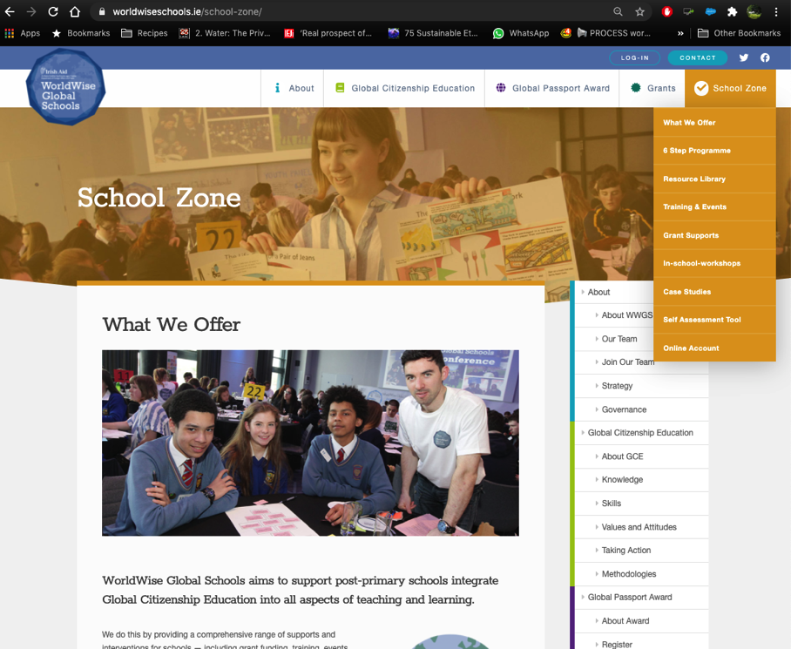

Slide 17
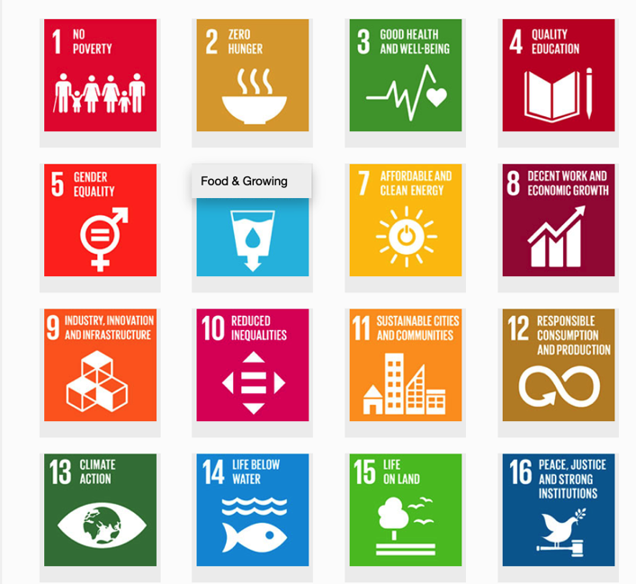


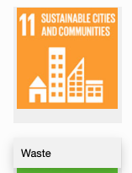

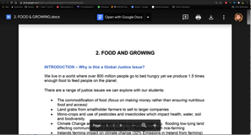
1. Hover over the symbol and a drop down menu appears!
Resource Sheets
– activities, videos, suggested actions etc
2. Click on the theme and the resource sheet will pop up!

Slide 18
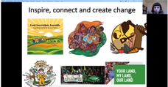
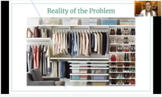

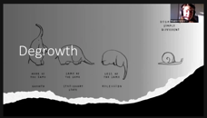
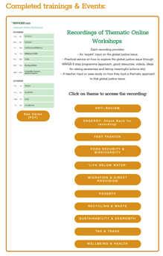
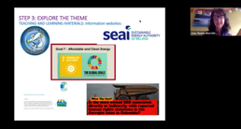
Webinars on relevant Global Justice Themes
Fast Fashion
Food security & Biodiversity
Waste
DeGrowth & Sustainability
Energy

Slide 19
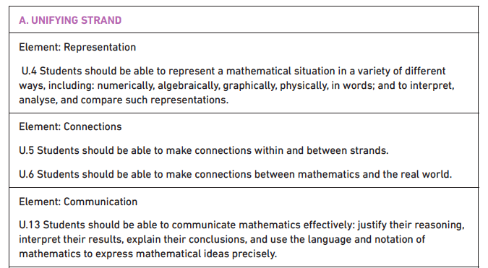
UNIFYING STRAND

Slide 20

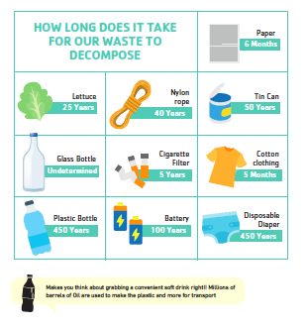
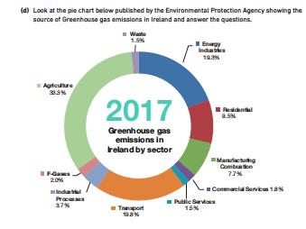
Happiness vs GDP
Debt and Tax
Environmental Sustainability

Slide 21
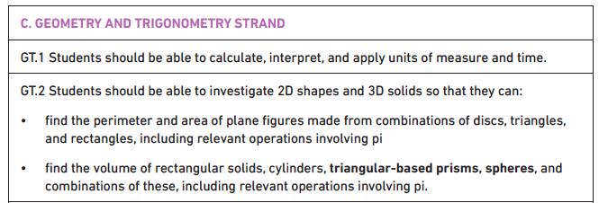
Geometry and Trigonometry STRAND
Mapping the World-Our perspective
Our Footprint on the World
Measuring up for Solutions-Solar Panel
Measuring the Money

Slide 22
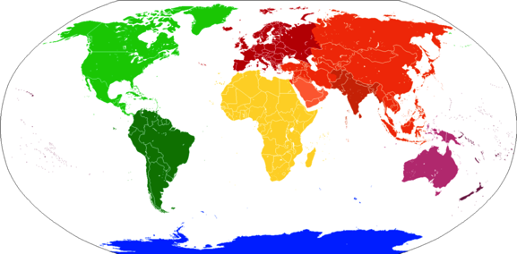
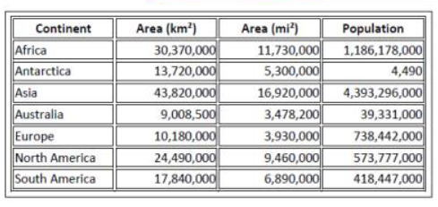
Maps and our view of the world
Notes:
www.thetruesize.com

Slide 23
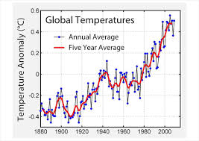
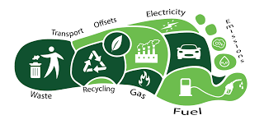
Maths and Climate Change
Simple Maths and Climate Change-brings in probability
Notes:
https://www.youtube.com/watch?v=bQjVbZQ4T2U

Slide 24
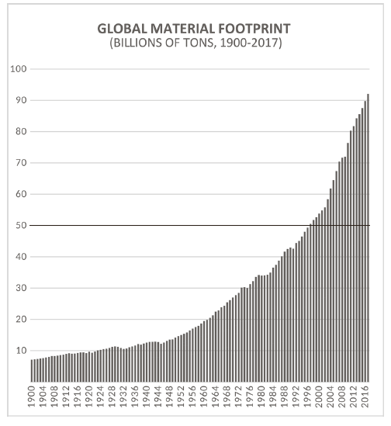

Slide 25

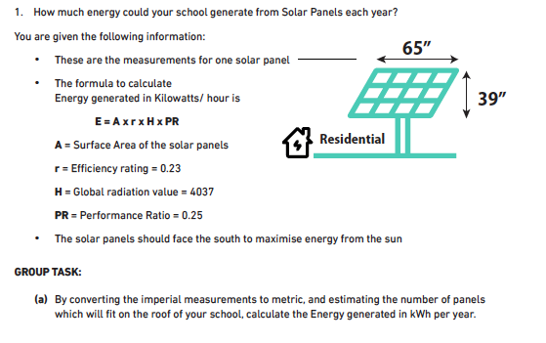
E = A x r x H x PR
Notes:
E = A x r x H x PR

Slide 26
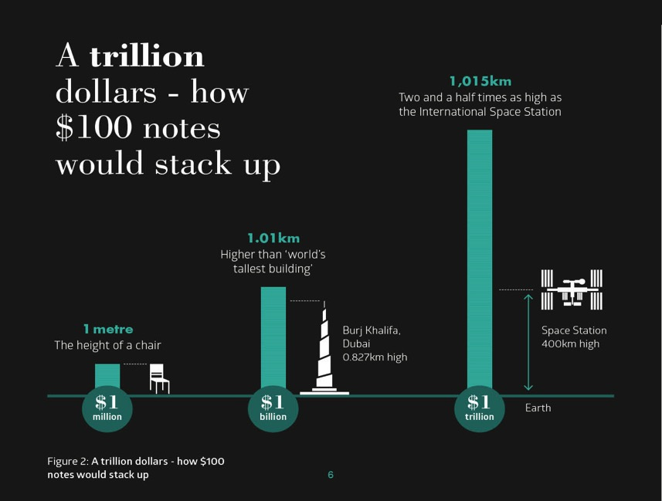

Slide 27
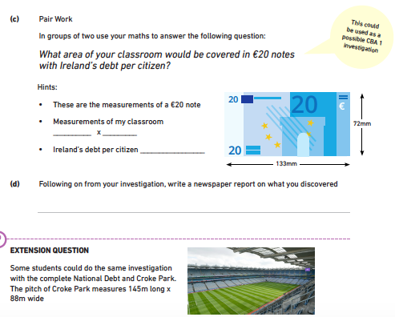

Slide 28
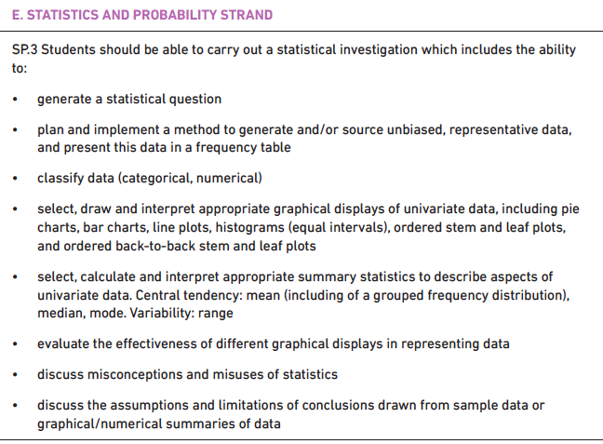
STATISTICS & PROBABILITY STRAND
How statistics are represented
Wealth inequality
Measuring Life Expectancy and Wellbeing
Notes:
Statistics and probability
This strand focuses on determining probability from random events and generating and investigating data. Students explore the relationship between experimental and theoretical probability as well as completing a data investigation; from formulating a question and designing the investigation through to interpreting their results in context and communicating their findings. Learners use graphical and numerical tools, including summary statistics and the concepts and processes of probability, to explore and analyse patterns in data. Through these activities, learners gain an understanding of data analysis as a tool for learning about the world.

Slide 29
What are the Negatives and Positives of Global Statistics and Indicators of Development?
Put in Chat

Slide 30
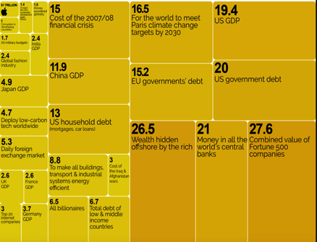
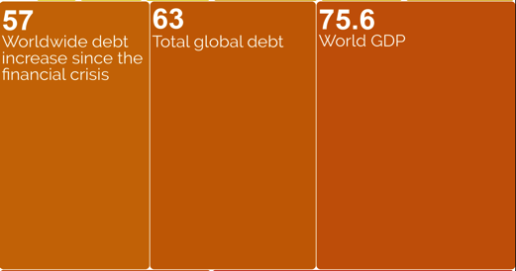
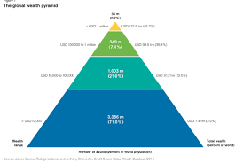
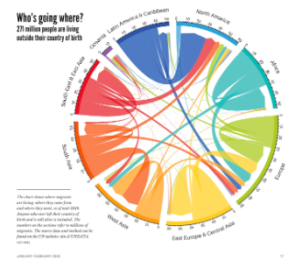
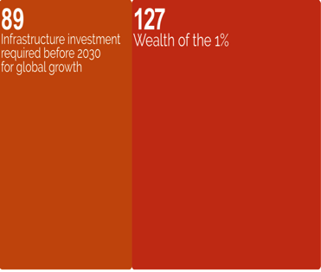
https://informationisbeautiful.net/

Slide 31

Notes:
https://docs.google.com/document/d/1-mOtSJdUrOY1Pxv3aUXIUxQYMC4eP5XJFoFMt5pGrZo/edit?usp=sharing
Warning: Population Growth narrative

Slide 32

26

Slide 33



Slide 34


Notes:
Amazon-time worked + breaks-logistics
Warehouse workers timed by the second-no time for toilet breaks
Campaign in factories in the states trying to form unions.
Decent work agenda
Race to Bottom

Slide 35

Mapping Life Expectancy-The Joy of Stats!
Notes:
VIDEO: Hans Rosling's 200 Countries, 200 Years, 4 Minutes - The Joy of Stats - BBC Four-
the link to the video is here https://www.youtube.com/watch/jbkSRLYSojo

Slide 36

Part 1) On your graph, plot the pattern of life expectancy shown in the video. Each group/student will plot one continent
Part 2) In your group discuss three factors that are affecting life expectancy on your continent?
Part 3) Discuss three ways that global inequality can still have an impact on life expectancy
Examining Global Life Expectancy
www.gapminder.org
Notes:
Explain task 1

Slide 37

What is the happiest country in the world?

Slide 38
2nd Year students are doing statistics in maths class. We’re currently looking into the votes and seats won in the last general election in Ireland and comparing the percentage of votes to the proportion of the seats they actually got. We’re hoping to continue on and look at the elections in the UK and US and compare them to our system - which is more democratic etc. We’ll then (hopefully) do a project on gerrymandering and dividing constituencies to ‘favour’ some outcomes over others etc, and look at how Trump won despite Clinton getting more votes.
Kate Minnock NWETSS
Our 2nd year Maths students looked at the statistics of elephant deaths in Southern India. During Fairtrade Fortnight they looked at percentages and profit margins for Fairtrade farmers versus market rates.
Colleen Cooney, Moville Community College

Slide 39




Slide 40
Our Mind Map
Discuss ideas and activities explored thus far-what ones are you likely to use??
Add additional ideas and activities linked to the Geometry and Statistics strands?
Notes:
How effective are we at equipping young people with the knowledge and skills that will enable them to make sound decisions as responsible global consumers and citizens?
How well do we cover human rights and global justice issues within our programmes and activities?
How well do we cover environmental issues within our programmes and activities?
How well do we develop young people’s sense of responsibility through taking part in activities which involve the local or wider community?
How effective are we in planning for young people to take part in regular discussion and debate about topical issues related to maths?

Slide 41

Notes:
Ragoli

Slide 42

NUMBER STRAND
Using Ratios to look at Climate Change
Wealth Inequality Ratios
Using Ratios to demonstrate systems

Slide 43



Isotope-Ratio Mass Spectrometer
Notes:
https://podcasts.apple.com/no/podcast/climate-change/id343580439?i=1000362970299
Isotope measurement of different neutrons
How the Isotope Ratio changes-higher and lower levels of oxygen-800,000 years old air can be tested in the arctic. Pieces of air trapped in ice. The evidence sudden rise in temperature and carbon dioxide-measuring the pace. The rate of change.

Slide 44


N.2 investigate equivalent representations of rational numbers so that they can:
b. use and understand ratio and proportion
Measuring Wealth Inequality through the
-Gini Coefficient
-Palma Ratio
Notes:
http://shlegeris.com/gini
https://views-voices.oxfam.org.uk/2016/10/real-geek-the-politics-of-inequality-who-is-measuring-what-and-why/

Slide 45

<iframe width="560" height="315" src="https://www.youtube.com/embed/EE0EgIHdGPc" frameborder="0" allow="accelerometer; autoplay; clipboard-write; encrypted-media; gyroscope; picture-in-picture" allowfullscreen></iframe>
https://www.youtube.com/watch?v=EE0EgIHdGPc

Slide 46

INEQUALITY AROUND THE WORLD BY GINI
GINI INDEX
Notes:
This world map shows how the countries of the world compare on income inequality according to the GINI index (or coefficient). Countries that are more equal are shaded in green. Countries that are more unequal are shaded in pink, orange and red.
Source: The World Factbook, CIA, 2009: www.cia.gov/library/publications/the-world-factbook/fields/2172.html

Slide 47
CALCULATING THE PALMA RATIO
1 10% | 2 10% | 3 10% | 4 10% | 5 10% | 6 10% | 7 10% | 8 10% | 9 10% | 10 10%
Poorest
Richest
Notes:
Explain that we can divide the population of a country into ten equal-sized groups in the same way. We call each group a decile. When Palma did this, he found out that half of a country’s income tends to be shared by the five income groups below the richest decile (the fifth to the ninth deciles shown in white above).
Say that the shares of the richest 10% and the poorest 40% can vary a lot among countries. Palma therefore came up with the Palma ratio to describe how the richest 10% (the tenth group) and the poorest 40% (the first, second, third and fourth groups) share their portion of the country’s total income.

Slide 48
CALCULATING THE PALMA RATIO
Combined income of richest 10% (tenth group)
Combined income of poorest 40% (first to fourth groups)
Notes:
Explain that the Palma ratio is calculated by dividing the combined income of the richest 10% by the combined income of the poorest 40%. In more equal countries this ratio will be one or below. This means that the richest 10% does not receive a larger share of the country’s income than the bottom 40%. In very unequal countries this ratio will be greater than one. This means that the richest 10% receives a larger share of the national income than the bottom 40%. Ask learners to calculate the Palma ratio for their ‘society’.

Slide 49

CALCULATING THE PALMA RATIO

Slide 50


What makes up the $5?

Slide 51



N.2. c. solve money-related problems
Tax, Trade, Debt are big issues!
Notes:
including those involving bills, VAT, profit or loss, % profit or loss (on the cost price), cost price, selling price, compound interest for not more than 3 years, income tax (standard rate only), net pay (including other deductions of specified amounts), value for money calculations and judgements, mark up (profit as a % of cost price), margin (profit as a % of selling price), compound interest, income tax and net pay (including other deductions)
-Fairtrade
-Tax Justice
-Trading Game
-Race to the Bottom

Slide 52



Slide 53


ALGEBRA & FUNCTIONS STRAND
Representing patterns of Debt versus Public Services
Planetary Boundaries
Species Extinction

Slide 54



Slide 55



Slide 56


Slide 57


Slide 58

Country Overshoot Day
Notes:
The pandemic gave us a chance to appreciate nature and gave us a glimpse into what a fossil free future might look like offering a break from addictive consumerism (one would hope!)
George Monibot said that’ it [the pandemic] has to be a tipping point. This has to be a point to transform where we move from one system an exploitative political and economic system to a completely different one private sufficiency and public luxury.

Slide 59


Slide 60

Notes:
Moville-extinction

Slide 61
Our Mind Map
Discuss ideas and activities explored thus far-what ones are you likely to use??
Add additional ideas and activities linked to the Number Algebra strands?
Notes:
How effective are we at equipping young people with the knowledge and skills that will enable them to make sound decisions as responsible global consumers and citizens?
How well do we cover human rights and global justice issues within our programmes and activities?
How well do we cover environmental issues within our programmes and activities?
How well do we develop young people’s sense of responsibility through taking part in activities which involve the local or wider community?
How effective are we in planning for young people to take part in regular discussion and debate about topical issues related to maths?

Slide 62
Our fifth year Maths students have been involved in the tracking of data and how climate change is affecting our planet and animal populations
Maria Fitzgerald Colaiste na Riochta
Our 2nd year Maths discussed 'what effects a country's wellbeing?' and how to work out a country's wealth by exploring the way GDP per capita is calculated. Students then looked at tables of information displaying the wealth of different countries and the same information in line graphs. The students also practiced doing a line graph on similar information.
Jenny Cooney Ballinamore CS

Slide 63
CLASS BASED ASSESSMENTS (CBAS)
CBA1: Mathematical Investigation-Problem Solving Cycle
-How Happy is Your School?
-How much energy could my school generate through solar power?
-What does debt look like in €20 notes?
CBA2: Statistical Investigation-Statistical enquiry cycle
-Compare measures GDP, HI, GDI on good measures of wellbeing and happiness.
-On any global theme or goal of the student’s choice.
-Take any of the global issues mentioned here or in the resources to focus your CBA on.

Slide 64


Slide 65
GCE has been integrated into subjects such as Maths where students are basing their CBAs around global issues and investigating an element of it. The maths department also facilitated a world lesson on the 2nd of December where a statistical investigation was undertaken on climate, water and poverty.
Mullingar Community College
In Maths, economic growth and tax and trade are explored , also we explore a lot of GCE topics through statistics.
Loreto Clonmel
in 5th year Maths, students studied exponential graphs focusing on population growth since the Industrial Revolution (SDG11) as well as using bar charts and histograms to compare global wealth inequality (SDG10). Abbey Vocational School

Slide 66
PUT IN CHAT or Chat!
The Resources you have used in your classroom!
Podcasts
Videos
Books
TV programmes/documentaries
People and organisations
Articles
Activity packs

Slide 67






www.financialjustice.ie
http://www.worldwiseschools.ie/resource-item/maths-resources
https://www.oxfam.org.uk/oxfam-in-action/oxfam-blog/5-ideas-for-learning-about-the-world-through-maths/
www.globaldimension.org.uk
https://www.bbc.co.uk/sounds/play/b07142ls
https://views-voices.oxfam.org.uk/the-oxfam-podcast/
https://www.tandfonline.com/doi/full/10.1080/03054985.2017.1331846
Useful Links and Resources
Notes:
Afri-They All Had Names: A Survey of Tithe na mBocht and Famine Graveyards in Ireland
Truman on Trial:

Slide 68

Twitter and Facebook

Slide 69
What’s Next…..
Evaluation: https://forms.gle/mWtjDzxYMuasfuaY6
Share and create a community of practice!
Financial Justice Ireland training 14th of April 7pm: https://us02web.zoom.us/meeting/register/tZMuduiorj4qHtMKgigYjNv-upM97jGBd-ph
Annual Student Conference: April 29th – online
Funding application for Schools 2021-2022 school year: Opens: April 12th Closes: May 14th
WWGS support for schools: ongoing!
Notes:
https://forms.gle/mWtjDzxYMuasfuaY6

Slide 70



THANKS A MILLION!
WE’RE ALL HERE FOR YOU!
TÓG BOG É

