Slide 1
Bringing data to life
-statistical approaches to global issues
14-16 years: Session 3

Slide 2
Pie charts and histograms

Slide 3
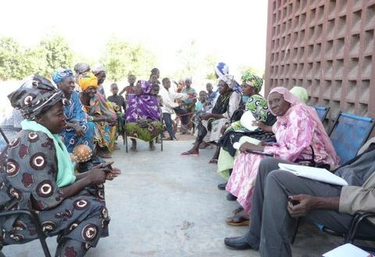
Women’s Collective Action research
Photo Credit: Oxfam
Notes:
These slides will remind learners of the context of the data gathered from Women’s Collective Action groups in Mali and Ethiopia.
Cooperative members meet as part of Oxfam's WCA research project. Credit: Edmond Dembele/Oxfam

Slide 4
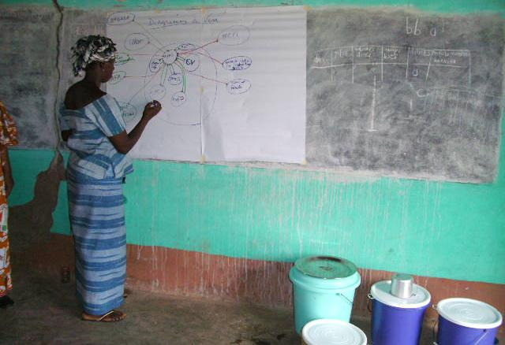
Women’s Collective Action research
Notes:
These slides will remind learners of the context of the data gathered from Women’s Collective Action groups in Mali and Ethiopia.
A cooperative member takes part in Oxfam's WCA research project. Credit: Edmond Dembele/Oxfam

Slide 5
Pie charts
Look at the marital status pie charts for Mali and Ethiopia in front of you. Consider the following questions.
How many people in Ethiopia are married?
How many
are widowed?
Are there more married women in Ethiopia?

Slide 6
Examining Pie charts
Look at the marital status pie charts for Mali and Ethiopia again.
  One of these countries has a life expectancy of 58.
  The other has a life expectancy of 62.
Which life expectancy do you think belongs to each country?
What issues are there with comparing the data from the pie-chart with national statistics?
Notes:
2011-2015 Data from The World Bank - http://data.worldbank.org/indicator/SP.DYN.LE00.FE.IN

Slide 7
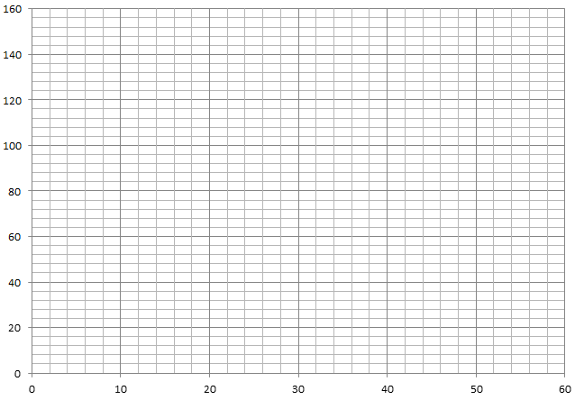
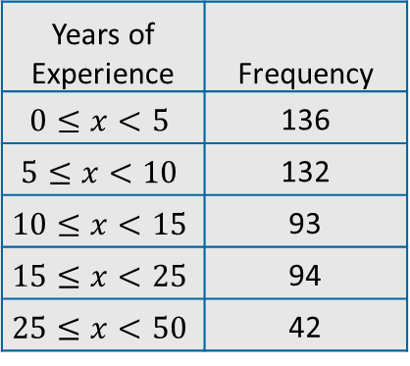
Histograms
Here is a table and histogram showing the years of experience each woman
(non-member) has producing honey in Ethiopia
Frequency
Years of Experience | Frequency
$$0≤x<5$$ | 136
$$5≤x<10$$ | 132
$$10≤x<15$$ | 93
$$15≤x<25$$ | 94
$$25≤x<50$$ | 42
Years of Experience
The bars have been plotted so that the widths match the class intervals but there is a problem! The last class interval now looks as though it should have the most people in it because it has the biggest area!

Slide 8
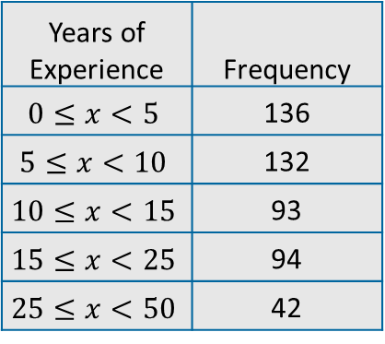
Histograms
In fact, only 42 women out of the 497 asked had over 25 years experience producing honey in Ethiopia.
Frequency
Years of Experience | Frequency
$$0≤x<5$$ | 136
$$5≤x<10$$ | 132
$$10≤x<15$$ | 93
$$15≤x<25$$ | 94
$$25≤x<50$$ | 42
Years of Experience
We need to change the bars so that it is the area of the bar that represents the number of people in it.

Slide 9
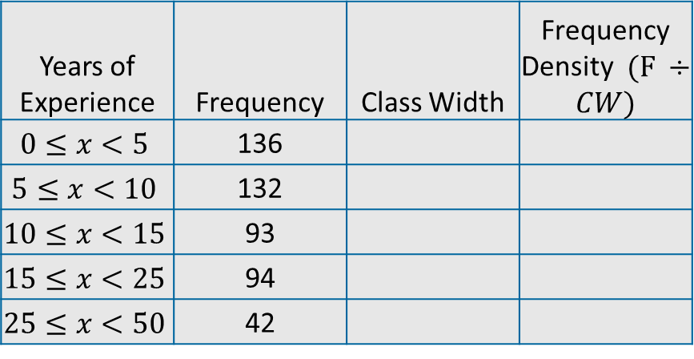
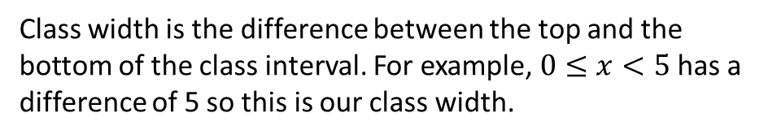
Histograms
To do this, we need to create another column called ‘Frequency Density’. Frequency Density is the Frequency divided by the class width.
Years of Experience | Frequency | Class Width | Frequency Density $(F ÷CW)$
$$0≤x<5$$ | 136
$$5≤x<10$$ | 132
$$10≤x<15$$ | 93
$$15≤x<25$$ | 94
$$25≤x<50$$ | 42
Class width is the difference between the top and the bottom of the class interval. For example, $0≤x<5$ has a difference of 5 so this is our class width.

Slide 10
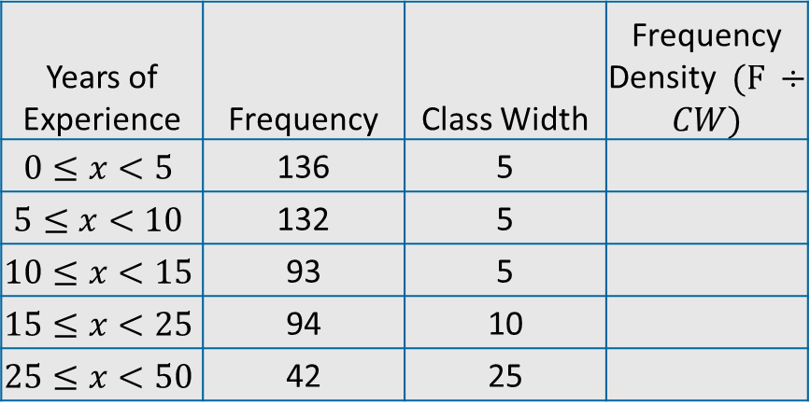
Histograms
To do this, we need to create another column called ‘Frequency Density’. Frequency Density is the Frequency divided by the class width.
Years of Experience | Frequency | Class Width | Frequency Density $(F ÷CW)$
$$0≤x<5$$ | 136 | 5
$$5≤x<10$$ | 132 | 5
$$10≤x<15$$ | 93 | 5
$$15≤x<25$$ | 94 | 10
$$25≤x<50$$ | 42 | 25
Class width is the difference between the top and the bottom of the class interval. For example, $0≤x<5$ has a difference of 5 so this is our class width.

Slide 11
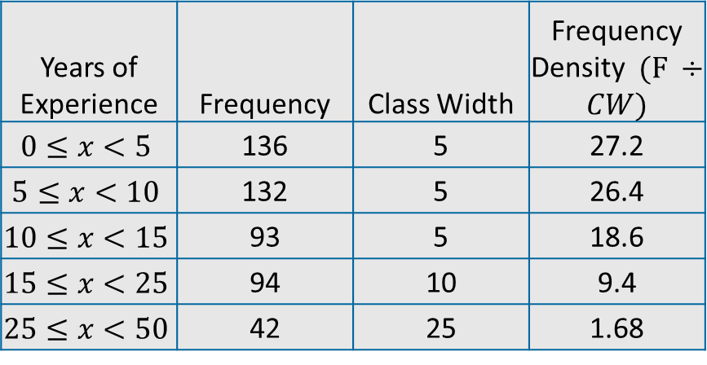
Histograms
To do this, we need to create another column called ‘Frequency Density’. Frequency Density is the Frequency divided by the class width.
Years of Experience | Frequency | Class Width | Frequency Density $(F ÷CW)$
$$0≤x<5$$ | 136 | 5 | 27.2
$$5≤x<10$$ | 132 | 5 | 26.4
$$10≤x<15$$ | 93 | 5 | 18.6
$$15≤x<25$$ | 94 | 10 | 9.4
$$25≤x<50$$ | 42 | 25 | 1.68
Class width is the difference between the top and the bottom of the class interval. For example, $0≤x<5$ has a difference of 5 so this is our class width.

Slide 12
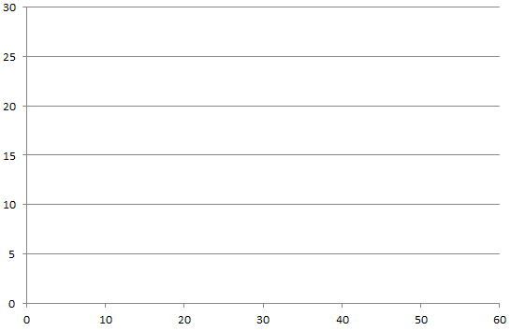
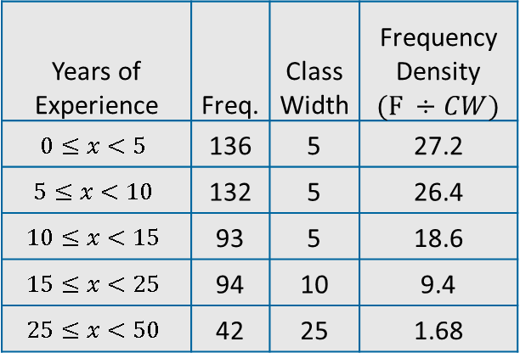
Histograms
Histogram showing years of experience of non-WCA members in Ethiopia
The histogram is ‘right skewed’ towards the lower end. This means most of the data is found closer to zero than fifty.
Frequency
Years of Experience | Freq. | Class Width | Frequency Density $(F ÷CW)$
$$0≤x<5$$ | 136 | 5 | 27.2
$$5≤x<10$$ | 132 | 5 | 26.4
$$10≤x<15$$ | 93 | 5 | 18.6
$$15≤x<25$$ | 94 | 10 | 9.4
$$25≤x<50$$ | 42 | 25 | 1.68
Years of Experience
When we plot our bars, we see that they much better represent the frequencies of the years of experience the women have making honey!

Slide 13
Histograms
Use your worksheet to create your own histogram. Instead of the WCA non-members, you will be looking at the WCA members.
Which group would you expect to have more experience? Why?

Slide 14
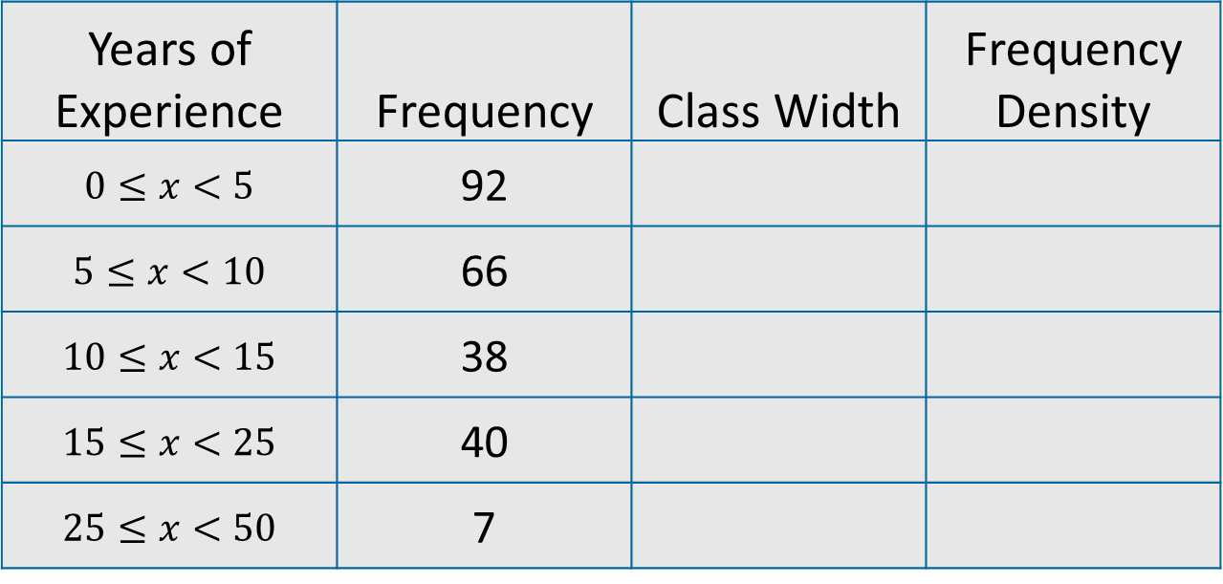
Histograms
This is the table you have on your worksheet. It shows the years of experience each woman (WCA member) has producing honey in Ethiopia.
Years of Experience | Frequency | Class Width | Frequency Density
$$0≤x<5$$ | 92
$$5≤x<10$$ | 66
$$10≤x<15$$ | 38
$$15≤x<25$$ | 40
$$25≤x<50$$ | 7

Slide 15
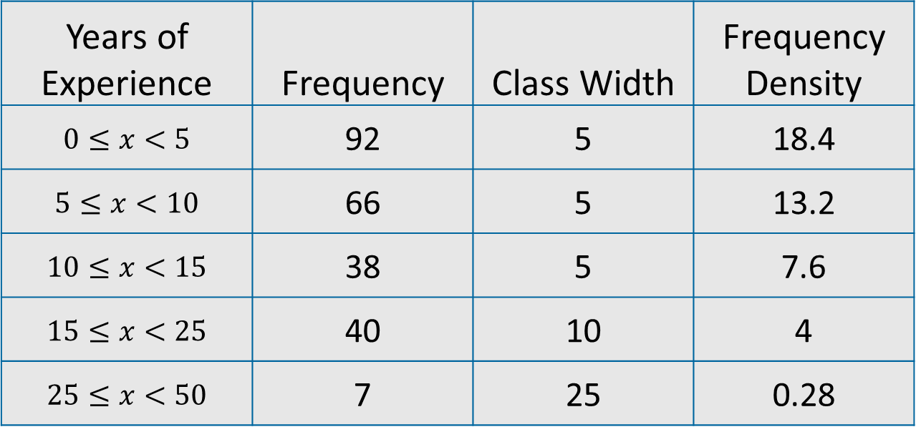
Histograms
This is the table you have on your worksheet. It shows the years of experience each woman (WCA member) has producing honey in Ethiopia. Your table should look like this
Years of Experience | Frequency | Class Width | Frequency Density
$$0≤x<5$$ | 92 | 5 | 18.4
$$5≤x<10$$ | 66 | 5 | 13.2
$$10≤x<15$$ | 38 | 5 | 7.6
$$15≤x<25$$ | 40 | 10 | 4
$$25≤x<50$$ | 7 | 25 | 0.28

Slide 16
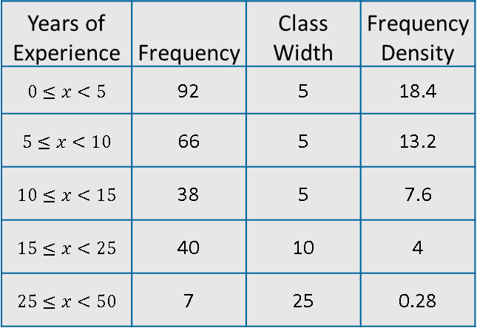
Histograms
Histogram showing years of experience of WCA members in Ethiopia
Years of Experience | Frequency | Class Width | Frequency Density
$$0≤x<5$$ | 92 | 5 | 18.4
$$5≤x<10$$ | 66 | 5 | 13.2
$$10≤x<15$$ | 38 | 5 | 7.6
$$15≤x<25$$ | 40 | 10 | 4
$$25≤x<50$$ | 7 | 25 | 0.28
Frequency Density
Years of Experience

Slide 17
Histograms
What comparisons can you make between the histogram we created as an example (years of experience of non-members in Ethiopia) and the histogram you have drawn on your worksheet (years of experience of WCA members)?
Both of the histograms show a ‘right skewed’ distribution, meaning the data is mostly on the left.
Why is it difficult to make comparisons?

Slide 19
Summary Activity
In front of you are some cards that need grouping together. There is no set number that go together.
Match up as many as you can!

Slide 20
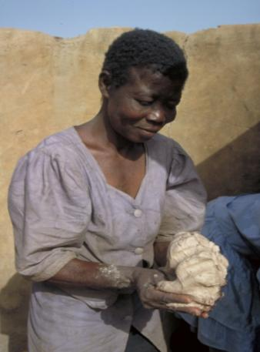
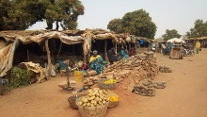
Women’s Collective Action groups
Notes:
Top photo: a market where cooperative members in Ethiopia sell their produce. Credit: Tarekegn Garomsa
Bottom photo: A woman forms shea butter into balls before heating it for a second time as part of the process for making traditional shea butter. Credit: Sarah Errington/Oxfam

