Slide 1
Bringing data to life
-statistical approaches to global issues
14-16 years: Session 2

Slide 2
Cumulative
Frequency Graphs

Slide 3
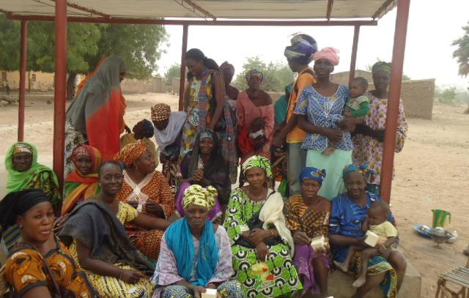
Women’s Collective Action
Notes:
Women from a village where one of the shea butter cooperatives is located. Credit: Edmond Dembele/Oxfam

Slide 4
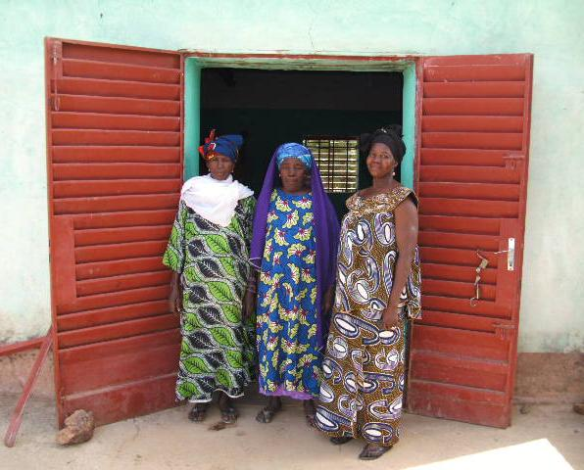
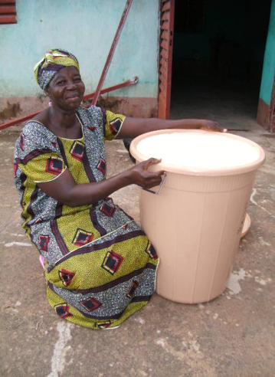
Women’s Collective Action in Mali
Notes:
Photo on the left: Members of a shea butter cooperative. Credit: Edmond Dembele/Oxfam
Photo on the right: A cooperative member shows her group’s finished shea butter, which is ready to be sold.
Credit: Edmond Dembele/OxfamPICT1018

Slide 5
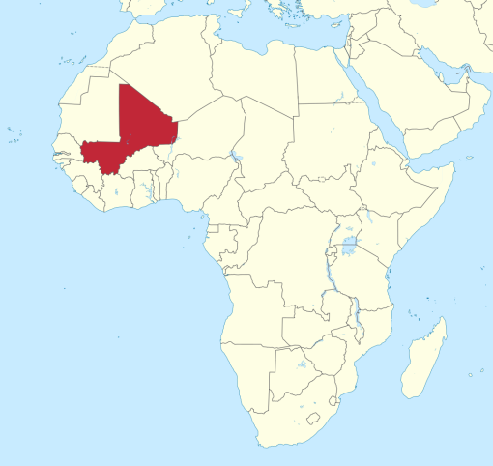
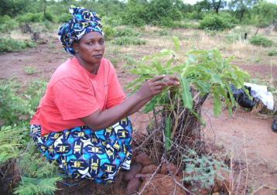
Shea butter production -Mali
Insert map of Mali
Notes:
Map of Mali
Photo on the right: A cooperative member shows a shea tree in her husband’s field.
Credit: Edmond Dembele/Oxfam

Slide 6
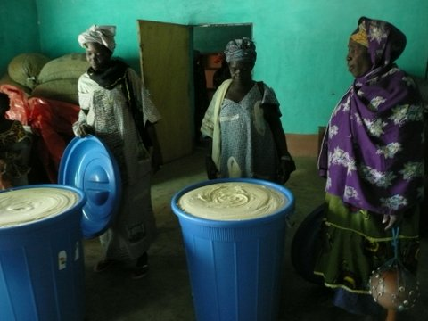
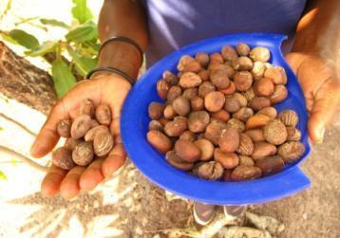
Women’s Collective Action in Mali
Notes:
Photo on the left: Cooperative members check the group’s containers of shea butter, which are waiting to be sold. Credit: Edmond Dembele/Oxfam.
Photo on the right: A member of a women’s group shows collected shea nuts. Photo: Caroline Gluck/Oxfam

Slide 7
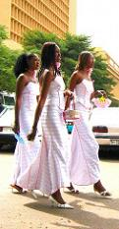
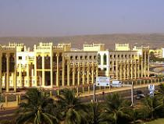
Women’s Collective Action in Mali
Notes:
These photos show a different perspective of Mali to highlight that not everyone lives in the same circumstance as the shea producers featured in this resource.
Photo on the left shows the city of Bamako in Mali, by Michael Panse, used under creative commons licence www.flickr.com/photos/michael-panse-mdl/5399708028/in/photolist-67p5PD-67p42H-9e9V5h-Fw25d7-FEcCMF-qq2pnb-BsCN-2Xs42B-ar8tBH-5zc3Qv-ar97Y6-BsvP-bpsirk-fBzxms-dSVSrP-5EECkz-EGiY9Z-btJ2Yc-cVvAHL-cVvCM7-cVvEoG
Photo on the right shows three bridesmaids in Bamako, Mali by Romel Jacinto, used under creative commons licence www.flickr.com/photos/37degrees/2108740026/in/album-72157603445969212/

Slide 8
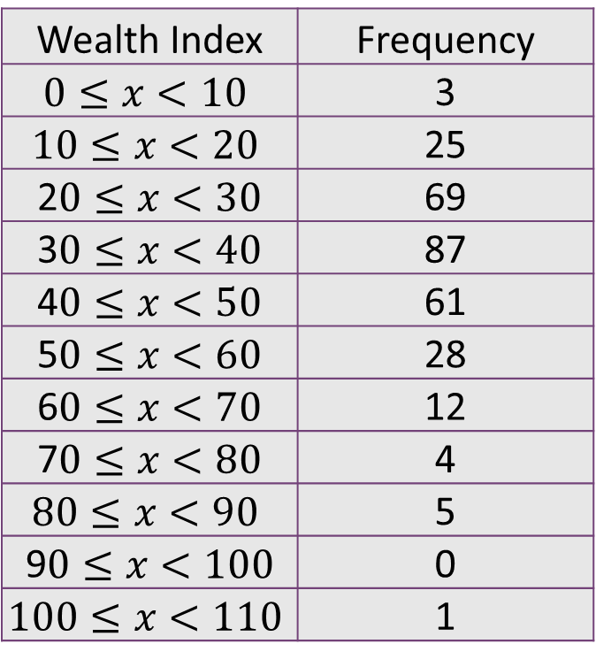
Cumulative Frequency
This table shows the wealth index of 295 WCA group members in Ethiopia.
Wealth Index | Frequency
$$0≤x<10$$ | 3
$$10≤x<20$$ | 25
2$0≤x<30$ | 69
3$0≤x<40$ | 87
4$0≤x<50$ | 61
5$0≤x<60$ | 28
6$0≤x<70$ | 12
7$0≤x<80$ | 4
$$80≤x<90$$ | 5
9$0≤x<100$ | 0
$$100≤x<110$$ | 1
The wealth index is a measure of a household's living standard. The wealth index is calculated using data on a household's possessions, livestock and housing characteristics, such as whether they have a grass or tin roof.

Slide 9
Cumulative Frequency
This table shows the wealth index of 295 WCA group members in Ethiopia.
Wealth Index | Frequency
$$0≤x<10$$ | 3
$$10≤x<20$$ | 25
2$0≤x<30$ | 69
3$0≤x<40$ | 87
4$0≤x<50$ | 61
5$0≤x<60$ | 28
6$0≤x<70$ | 12
7$0≤x<80$ | 4
$$80≤x<90$$ | 5
9$0≤x<100$ | 0
$$100≤x<110$$ | 1
The cumulative frequency is obtained by adding up the frequencies as you go along, to give a 'running total'. You should notice a difference in the class intervals.

Slide 10
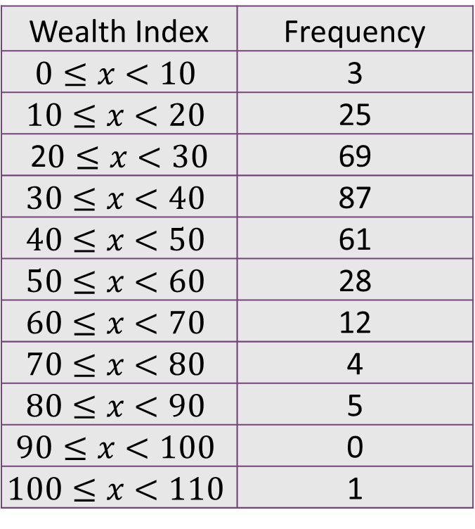
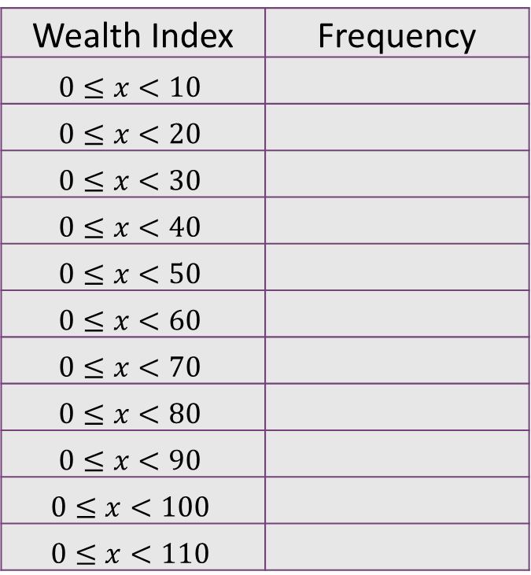
Cumulative Frequency
This table shows the wealth index of 295 WCA group members in Ethiopia.
Wealth Index | Frequency
$$0≤x<10$$ | 3
$$10≤x<20$$ | 25
2$0≤x<30$ | 69
$$30≤x<40$$ | 87
$$40≤x<50$$ | 61
$$50≤x<60$$ | 28
$$60≤x<70$$ | 12
$$70≤x<80$$ | 4
$$80≤x<90$$ | 5
$$90≤x<100$$ | 0
$$100≤x<110$$ | 1
Wealth Index | Frequency
$$0≤x<10$$
$$0≤x<20$$
$$0≤x<30$$
$$0≤x<40$$
$$0≤x<50$$
$$0≤x<60$$
$$0≤x<70$$
$$0≤x<80$$
$$0≤x<90$$
$$0≤x<100$$
$$0≤x<110$$

Slide 11
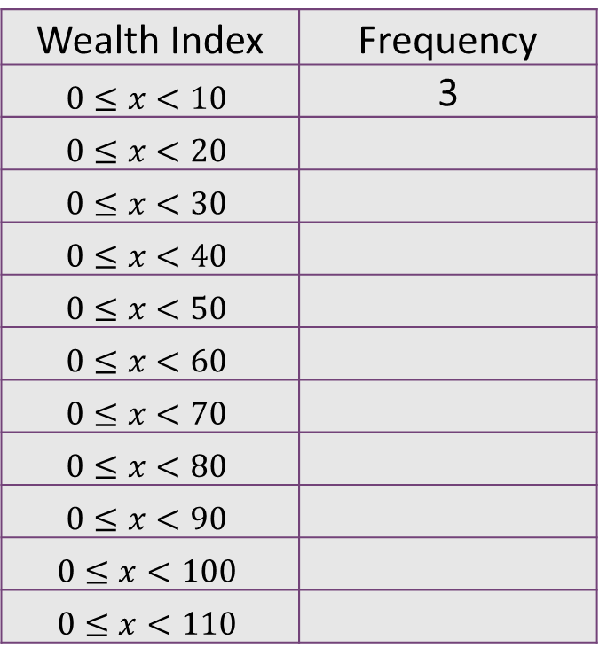
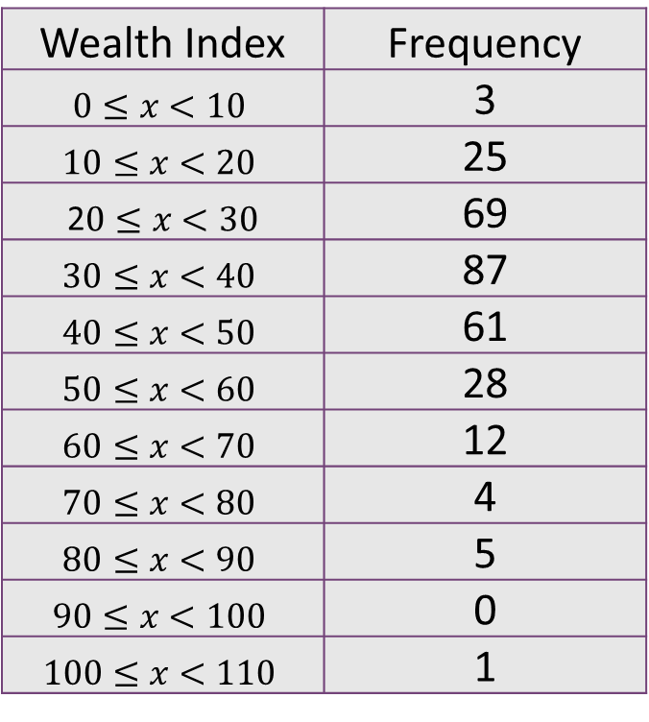
Cumulative Frequency
This table shows the wealth index of 295 WCA group members in Ethiopia.
Wealth Index | Frequency
$$0≤x<10$$ | 3
$$10≤x<20$$ | 25
2$0≤x<30$ | 69
$$30≤x<40$$ | 87
$$40≤x<50$$ | 61
$$50≤x<60$$ | 28
$$60≤x<70$$ | 12
$$70≤x<80$$ | 4
$$80≤x<90$$ | 5
$$90≤x<100$$ | 0
$$100≤x<110$$ | 1
Wealth Index | Frequency
$$0≤x<10$$ | 3
$$0≤x<20$$
$$0≤x<30$$
$$0≤x<40$$
$$0≤x<50$$
$$0≤x<60$$
$$0≤x<70$$
$$0≤x<80$$
$$0≤x<90$$
$$0≤x<100$$
$$0≤x<110$$

Slide 12
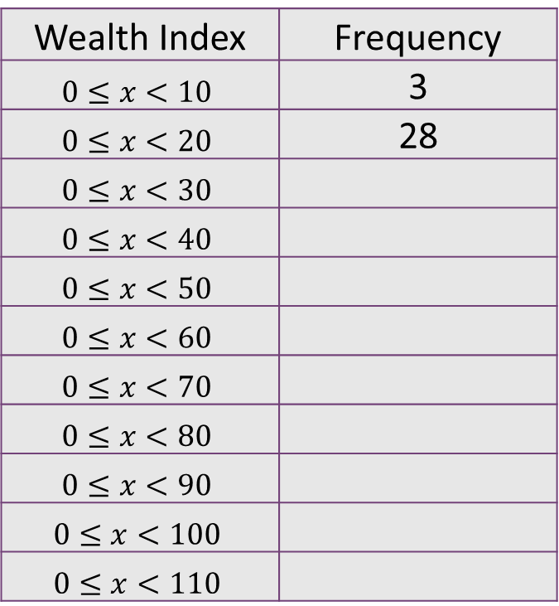
Cumulative Frequency
This table shows the wealth index of 295 WCA group members in Ethiopia.
Wealth Index | Frequency
$$0≤x<10$$ | 3
$$10≤x<20$$ | 25
2$0≤x<30$ | 69
$$30≤x<40$$ | 87
$$40≤x<50$$ | 61
$$50≤x<60$$ | 28
$$60≤x<70$$ | 12
$$70≤x<80$$ | 4
$$80≤x<90$$ | 5
$$90≤x<100$$ | 0
$$100≤x<110$$ | 1
Wealth Index | Frequency
$$0≤x<10$$ | 3
$$0≤x<20$$ | 28
$$0≤x<30$$
$$0≤x<40$$
$$0≤x<50$$
$$0≤x<60$$
$$0≤x<70$$
$$0≤x<80$$
$$0≤x<90$$
$$0≤x<100$$
$$0≤x<110$$

Slide 13
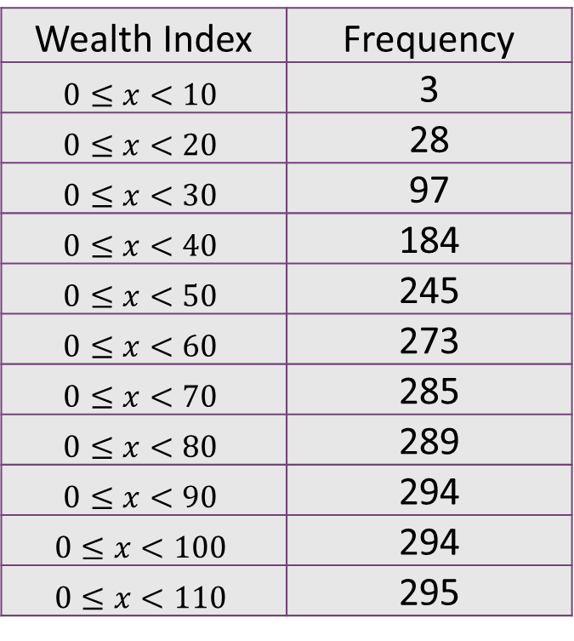
Cumulative Frequency
This table shows the wealth index of 295 WCA group members in Ethiopia.
Wealth Index | Frequency
$$0≤x<10$$ | 3
$$10≤x<20$$ | 25
2$0≤x<30$ | 69
$$30≤x<40$$ | 87
$$40≤x<50$$ | 61
$$50≤x<60$$ | 28
$$60≤x<70$$ | 12
$$70≤x<80$$ | 4
$$80≤x<90$$ | 5
$$90≤x<100$$ | 0
$$100≤x<110$$ | 1
Wealth Index | Frequency
$$0≤x<10$$ | 3
$$0≤x<20$$ | 28
$$0≤x<30$$ | 97
$$0≤x<40$$ | 184
$$0≤x<50$$ | 245
$$0≤x<60$$ | 273
$$0≤x<70$$ | 285
$$0≤x<80$$ | 289
$$0≤x<90$$ | 294
$$0≤x<100$$ | 294
$$0≤x<110$$ | 295

Slide 14
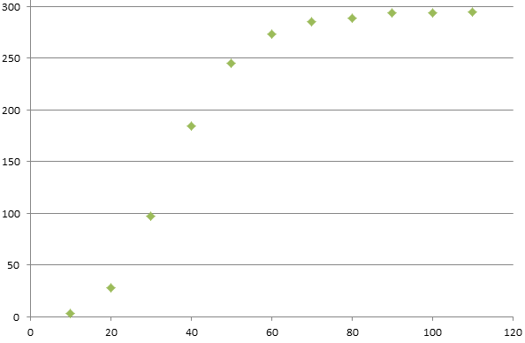
Cumulative Frequency graph to show the wealth index of 295 WCA group members in Ethiopia.
Cumulative Frequency
Wealth Index

Slide 15
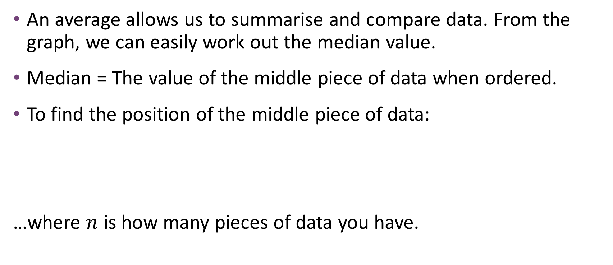
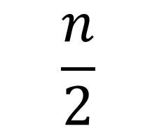
Cumulative Frequency
An average allows us to summarise and compare data. From the graph, we can easily work out the median value.
Median = The value of the middle piece of data when ordered.
To find the position of the middle piece of data:
…where $n$ is how many pieces of data you have.
$$\frac{n}{2}$$

Slide 16
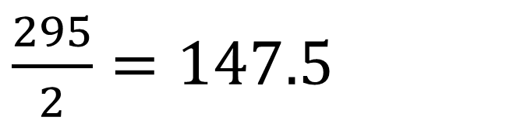
Cumulative Frequency
Median = The value of the middle piece of data when ordered.
Since here we are looking at 295 pieces of data…
Use your graph to read across at this value. At the curve, draw a perpendicular line down to the x-axis to find the median.
$\frac{295}{2}=147.5$

Slide 17
Cumulative Frequency graph to show the wealth index of 295 WCA group members in Ethiopia.
Cumulative Frequency
35
Wealth Index

Slide 18
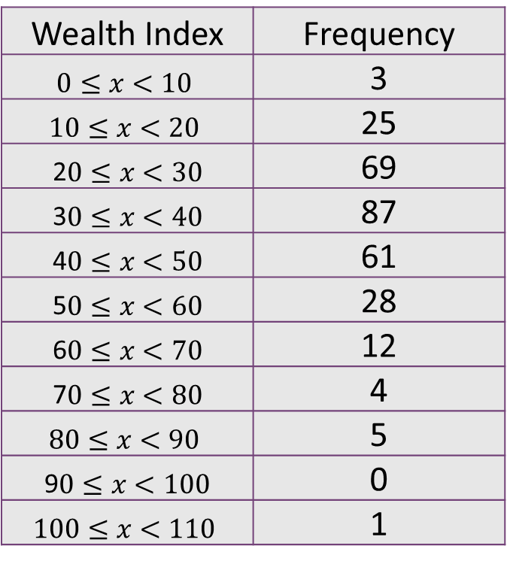
Cumulative Frequency
This table shows the wealth index of 295 WCA group members in Ethiopia.
Wealth Index | Frequency
$$0≤x<10$$ | 3
$$10≤x<20$$ | 25
2$0≤x<30$ | 69
3$0≤x<40$ | 87
4$0≤x<50$ | 61
5$0≤x<60$ | 28
6$0≤x<70$ | 12
7$0≤x<80$ | 4
$$80≤x<90$$ | 5
9$0≤x<100$ | 0
$$100≤x<110$$ | 1
Look at the original data.
An average of 35 seems sensible.

Slide 19
Cumulative Frequency
This table shows the wealth index of 295 WCA group members in Ethiopia.
Wealth Index | Frequency
$$0≤x<10$$ | 3
$$10≤x<20$$ | 25
2$0≤x<30$ | 69
3$0≤x<40$ | 87
4$0≤x<50$ | 61
5$0≤x<60$ | 28
6$0≤x<70$ | 12
7$0≤x<80$ | 4
$$80≤x<90$$ | 5
9$0≤x<100$ | 0
$$100≤x<110$$ | 1
Quartiles
Quartiles divide the data into four sections. This allows us to consider the middle 50% of the data and factors out any outliers that might be in the top 25% or the bottom 25%.

Slide 20

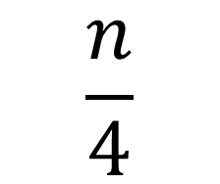
Cumulative Frequency
We want to split the data into four sections.
25%
25%
25%
25%
Lower Quartile
Median
Upper Quartile
To find the position of the lower quartile:
$$\frac{n}{4}$$
…where $n$ is how many pieces of data you have.

Slide 21
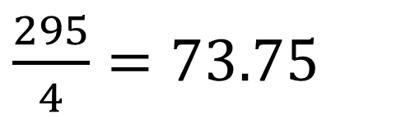
Cumulative Frequency
Since here we are looking at 295 pieces of data…
$\frac{295}{4}=73.75$

Slide 22
Cumulative Frequency
We want to split the data into four sections.
25%
25%
25%
25%
Lower Quartile
Median
Upper Quartile
73.75th piece of data
147.5th piece of data
221.25th piece of data
To get this number, we added 73.75 to 147.5 to find out the position of the piece of data that was three quarters of the way through. (You could also multiply 73.75 by three).

Slide 23
Cumulative Frequency graph to show the wealth index of 295 WCA group members in Ethiopia.
221.25
Cumulative Frequency
Upper Quartile = 46
Median = 35
Lower Quartile = 26
Interquartile range = 20
147.5
73.75
26
35
46
Wealth Index

Slide 24
Cumulative Frequency
What does this mean for honey producers who are members of
the Women’s Collective Action group in Ethiopia?
  The ‘average’ wealth index is 35.
  Half of the women asked are wealthier than this, and half are less wealthy.
  50% of the women have a wealth index of between 26 and 46 – the data before 26 and beyond 46 may include outliers.
Upper Quartile = 46
Median = 35
Lower Quartile = 26
Interquartile range = 20

Slide 25
Cumulative Frequency
Use the data on the learner worksheet B to create your own cumulative frequency graph.
Step 1: Add up the frequencies as you go along to create a ‘running total’.
Step 2: Plot the data at the ‘top’ of the class interval.
Step 3: Join the points up with a smooth curve.

Slide 26
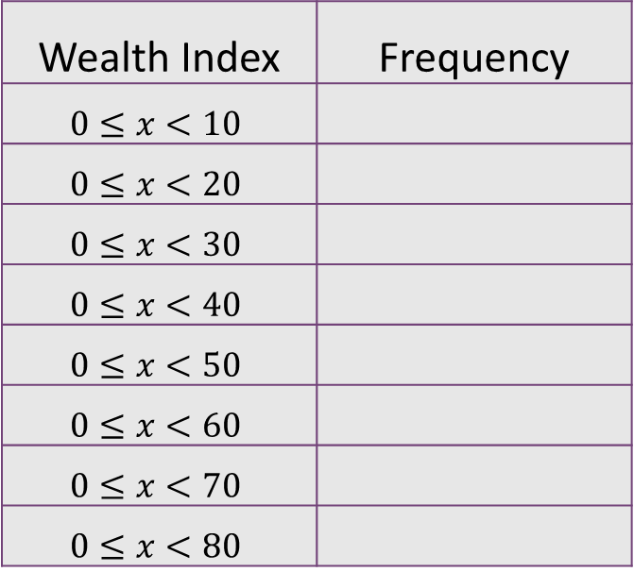
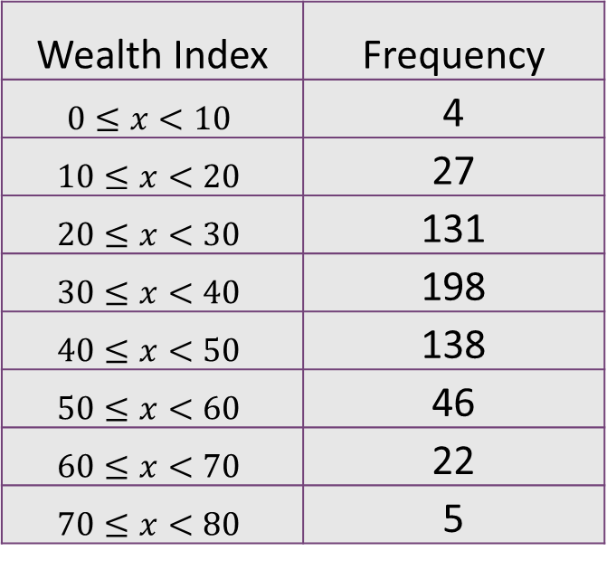
Cumulative Frequency
This table shows the wealth index of 571 non-WCA group members in Ethiopia – this
information is on page two of your learner worksheet .
Wealth Index | Frequency
$$0≤x<10$$ | 4
$$10≤x<20$$ | 27
$$20≤x<30$$ | 131
$$30≤x<40$$ | 198
$$40≤x<50$$ | 138
$$50≤x<60$$ | 46
$$60≤x<70$$ | 22
$$70≤x<80$$ | 5
Wealth Index | Frequency
$$0≤x<10$$
$$0≤x<20$$
$$0≤x<30$$
$$0≤x<40$$
$$0≤x<50$$
$$0≤x<60$$
$$0≤x<70$$
$$0≤x<80$$

Slide 27
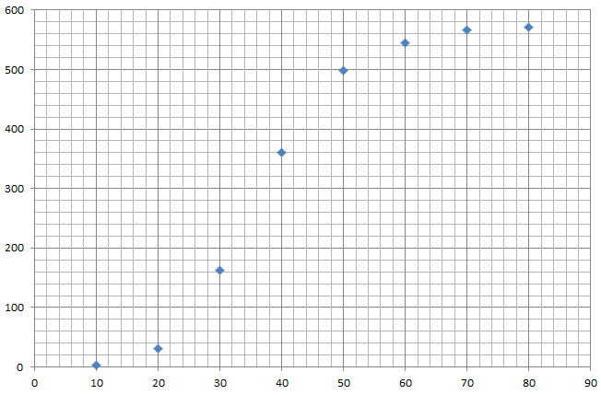
Cumulative Frequency graph to show the wealth index of the 571 non-WCA group members in Ethiopia.
Cumulative Frequency
Cumulative Frequency
35
Wealth Index
Wealth Index

Slide 28
Cumulative Frequency
Generally your median and quartile values may vary as you are reading from a graph.
In an exam question, you would be given a small range of correct answers.

Slide 29
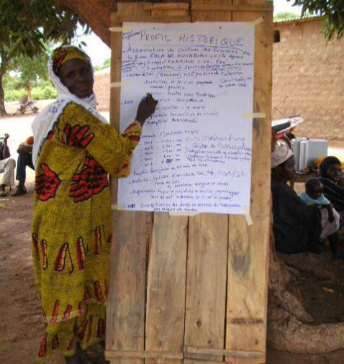
Women’s Collective Action-Mali and Ethiopia
Notes:
A cooperative member taking part in research as part of Oxfam’s WCA project. Credit: Edmond Dembele/Oxfam

Slide 30
Comparing two sets of data
WCA Members - Ethiopia
Lower Quartile | 26
Median | 35
Upper Quartile | 46
IQR | 20
Non-WCA Members - Ethiopia
Lower Quartile
Median
Upper Quartile
IQR
When comparing data from a cumulative frequency graph, we tend to focus on the median and
the interquartile range. This means the person reading your conclusions knows the average for
each and also how spread out the data is.
If the IQR is small, that means the data is closer together and therefore more consistent. If the IQR is large, that means the data is more spread out and therefore less consistent.

Slide 31
Questions to consider
What did you notice about how many people were surveyed? What difference might this have made?
Is it financially beneficial to be a member of a WCA in Mali or Ethiopia?
Did being a member of the WCA make the wealth of the women more or less consistent?
The data in the table is grouped together into ‘categories’ or ‘class intervals’- what are the advantages and disadvantages of this?
These graphs only look at the impact the WCA has on wealth. What other benefits do you think the WCA has on the women of Ethiopia and Mali?

