Slide 1


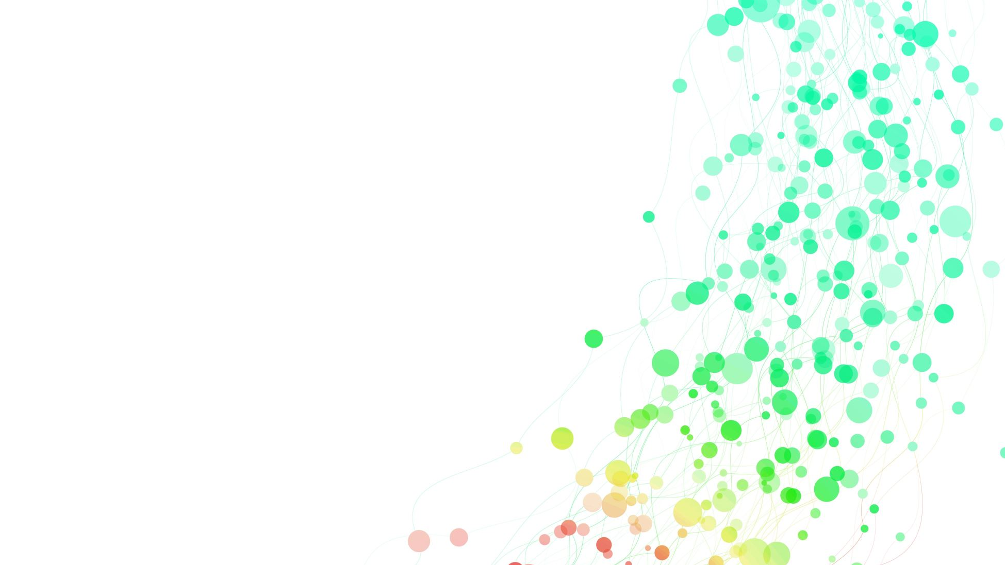

Let’s Talk Trans!
Ailsa Spindler

Slide 2
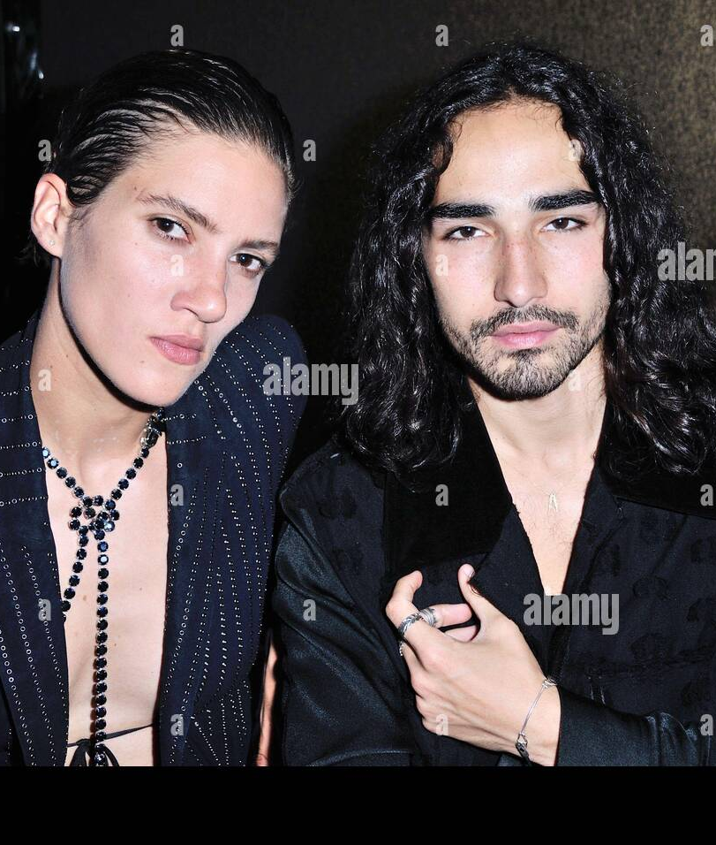
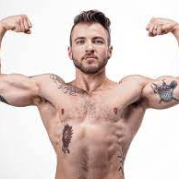
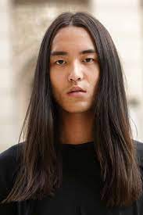
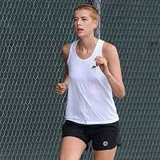


Slide 3

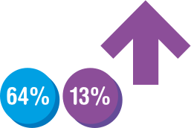






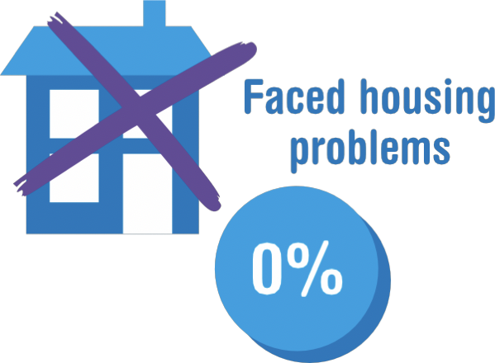







Reported high self-esteem
Based on a 2012 study of 433 individuals. Travers R, Bauer G, Pyne J, Bradley K, for the Trans PULSE Project: Gale L, Papadimitriou M (2012).
Impacts of Strong Parental Support for Trans Youth: a report prepared for Children’s Aid Society of
Toronto and Delisle Youth Services. Based on a resource produced by Trans Student Educational Resources: www.transstudent.org

Slide 4
Why are Trans issues currently causing so much discussion?
Increased Trans visibility
TERF agenda
Right wing backlash
Competing healthcare demands

Slide 5
Trans people are people!
They need friends and allies, just like we all do…
z

