Slide 1



LGBTQI+ and Global Justice

Slide 2
Today’s Session
Input from Ailsa Spindler:
LGBTQI+ terminology
LGBTQI+ and human rights
Discussion, questions and reflection throughout
WWGS – Using the Six-Step Programme to explore LGBTQI+ as your focus
Final Q&A and Evaluation
Talking Trans
Resources and helpful links

Slide 3
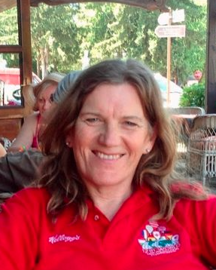
Ailsa Spindler

Slide 4
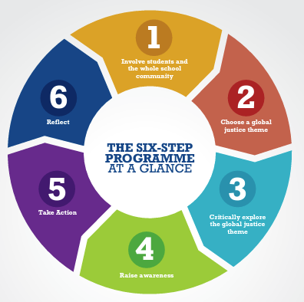
WWGS SIX-STEP PROGRAMME

Slide 5
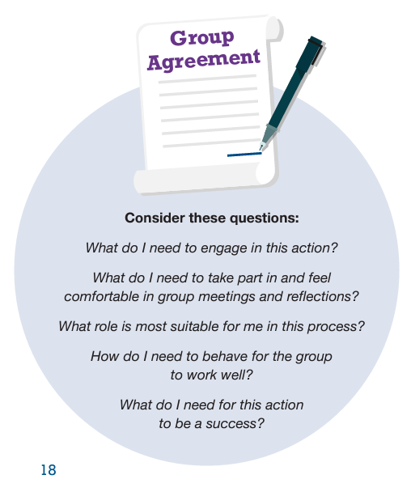
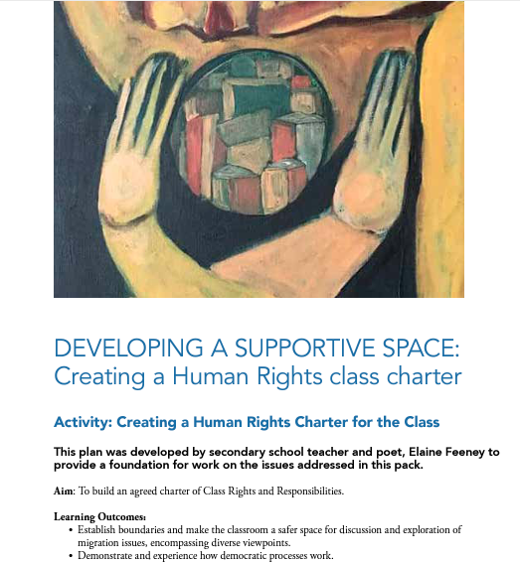
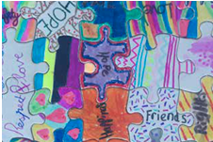
Building a Group Agreement
Notes:
Beyond boarders - https://galwayowc.wordpress.com/beyond-borders/
Tackling controversial issues - https://developmenteducation.ie/media/documents/tackling_controversial_issues.pdf

Slide 6
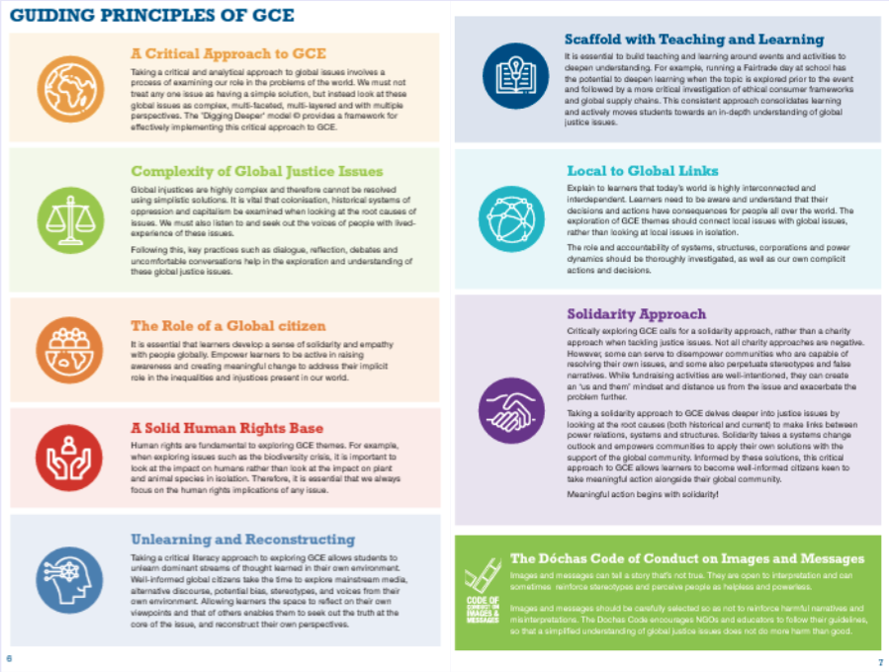
Guiding Principles of GCE

Slide 7
Exploring the Theme
LGBTQIA2S+ Terminology
Gender Identity, Diversity and Expression
LGBTQI+ as a Human Rights Issue
LGBTQI+ Global Justice Issues
LGBTQI+ Representation
LGBTQI+ Inclusion, Diversity and Belonging
LGBTQI+ Discrimination
Creating safe spaces and being an ally
International Days of Solidarity

Slide 8
Curriculum Links
History
History of LGBTQI+ rights, events, people of influence and historical significance, historical patterns of change and chronology, social constructs
Art
Celebrate LGBTQI+ Artists, create LGBTQI+, design ideas for belonging
English and Languages
Voices/narratives of lived experience, gendered language, evolving language, examine LGBTQI+ writers, plays, films, spoken word etc.
SPHE
Links with sexuality, sexual orientation, sexual identity and belonging, social constructs, trans healthcare, HIV/AIDS care, barriers to healthcare
CSPE
LGBTQI+ rights and responsibilities, decision making processes and representation/consultation/involvement, global links, democratic representation, democratic processes, law and voting, media representation
Politics and Society
Rights, equality and responsibilities in Ireland and wider world, power and decision making, social constructs, influence of media, Positive social contributions in Ireland (e.g Panti Bliss and Marriage Equality)
Maths
Using statistics and data to explore LGBTQI+ rights, representation and issues (such as the high percentage of unemployment among trans people)
Geography
LGBTQI+ rights worldwide, LGBTQI+ safe zones, Maps on criminalization of LGBTQI+ people, migration related to LGBTQI+
English and Languages
Voices/narratives of lived experience, gendering and evolving language, examine LGBTQI+ writers, plays, films, spoken word etc.
Music
Music statements, musical storytelling, curiosity and appreciation of LGBTQI+ expression through music
Business
Employment practices, laws, rights, etc. Social impacts on the LGBTQI+ Community by business, representation in workforce, management and senior positions

Slide 9
Using Your Grant
CPD for teachers
Speaker fees
Workshop for students, teachers, school management
Information/learning resources
Planning meetings (substitution, refreshments etc.)
School Policy Meetings
Student action/awareness materials and skills building
*Remember to scaffold events and activities!

Slide 10

International Days of Solidarity, Awareness and Action
International Day Against Homophobia, Transphobia and Biphobia – 17th May
Bisexuality Day – 23rd Sept
Intersex Awareness Day – 26th Oct
National Coming Out Day – 11th Oct
Non-Binary People’s Day – 14th July
Trans day of Visability – 31st March
Lesbian Visability Day – 26th April
International Asexuality Day – 6th April
Irish Marriage Referendum – 22nd May
Pride – Various dates around the world and around Ireland

Slide 11

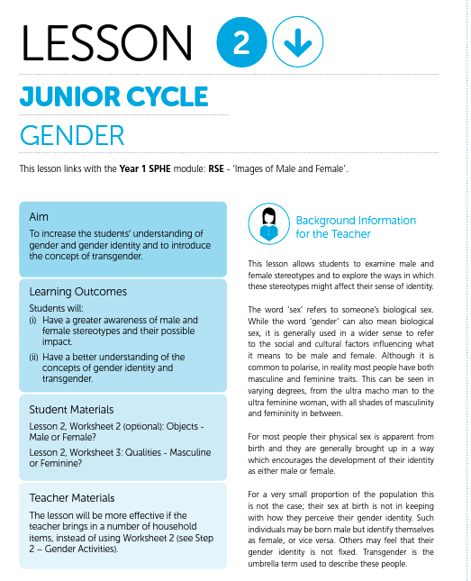
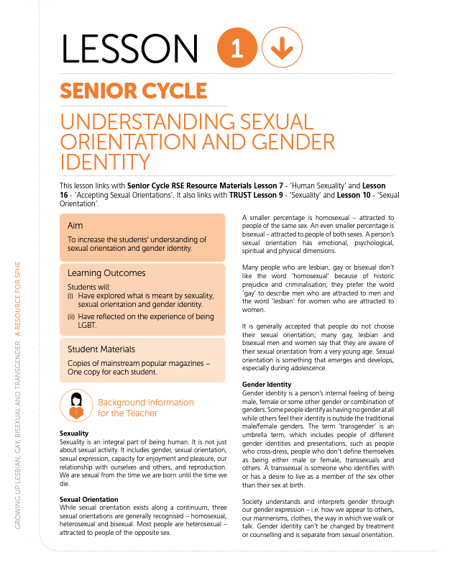
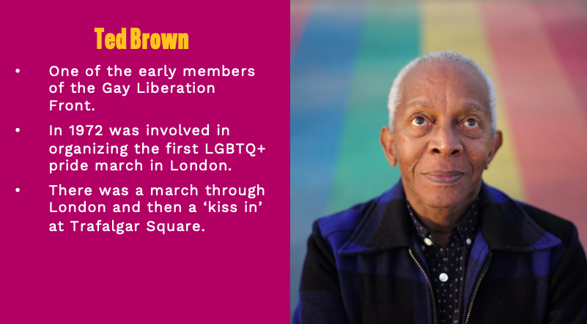

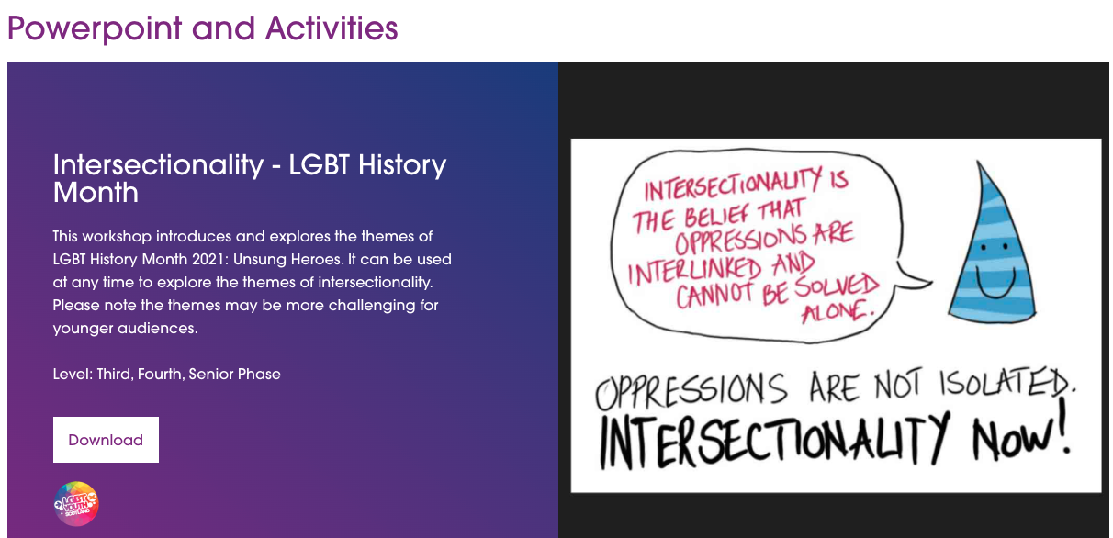

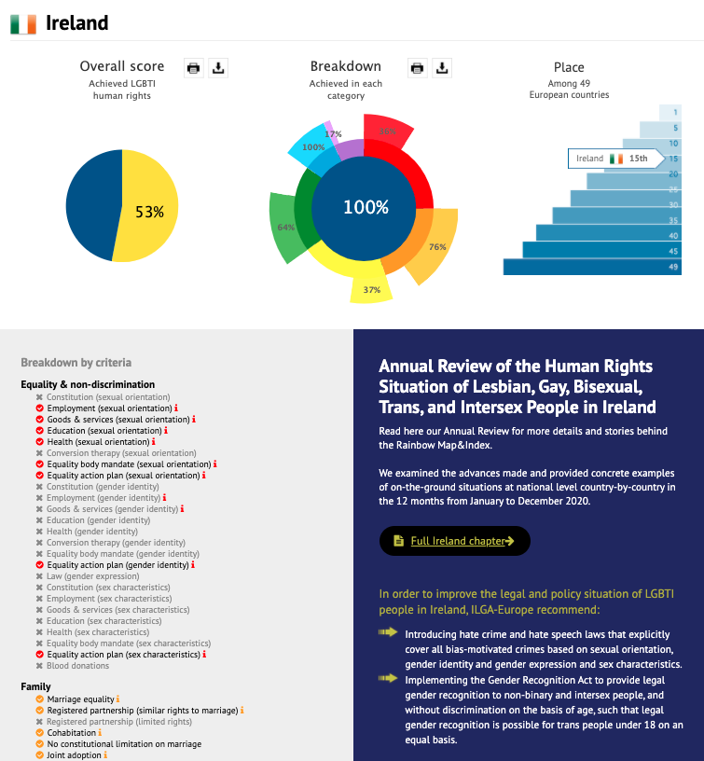

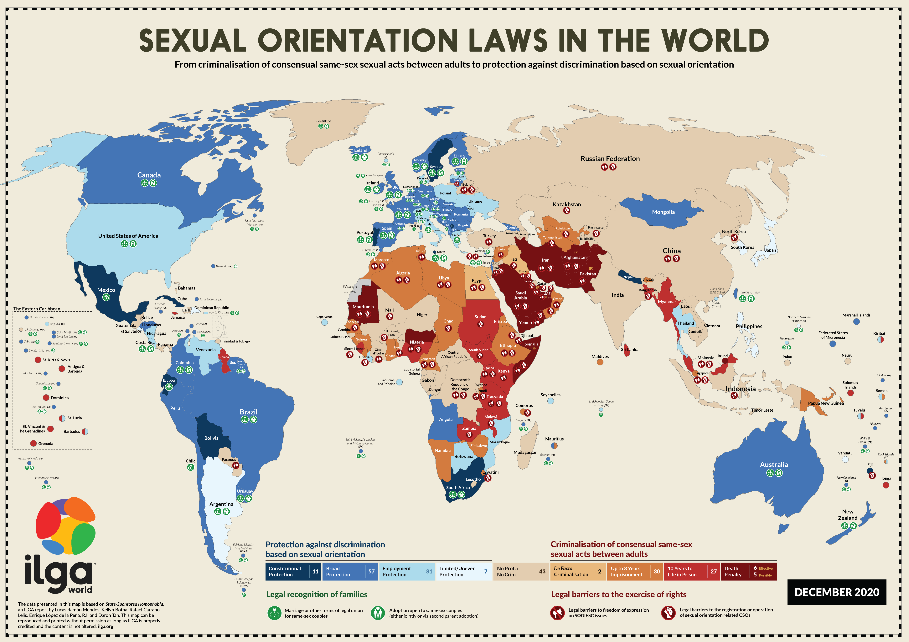
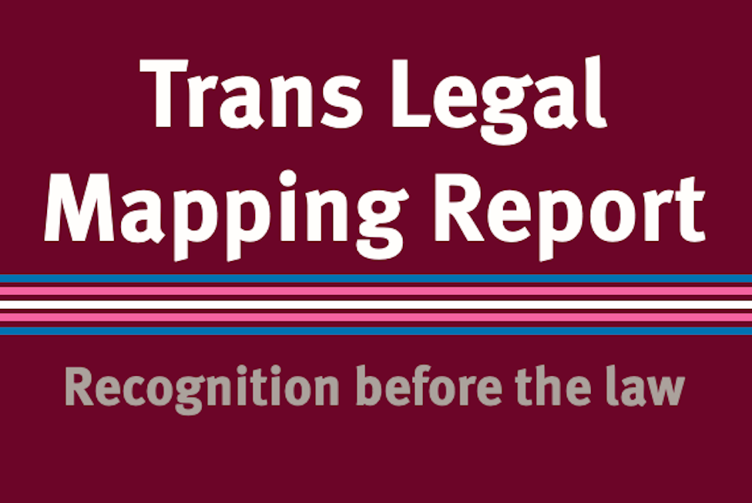
Resources

Slide 12






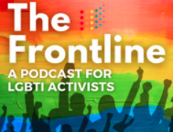



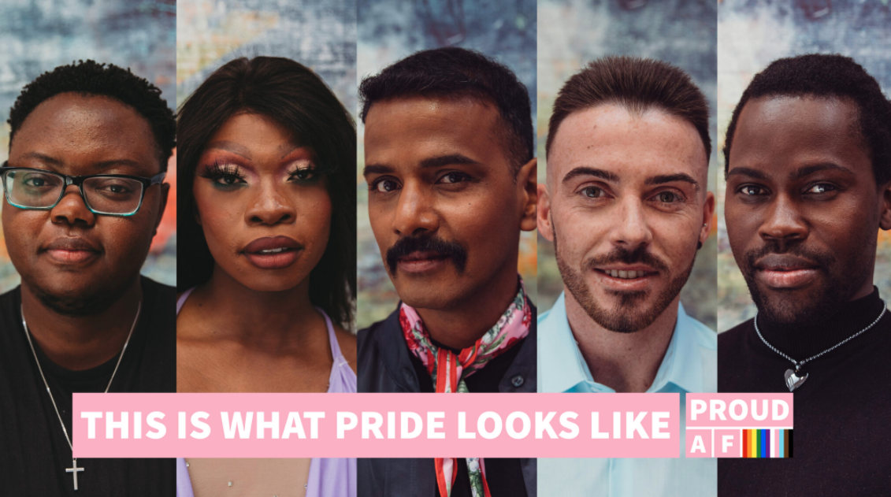
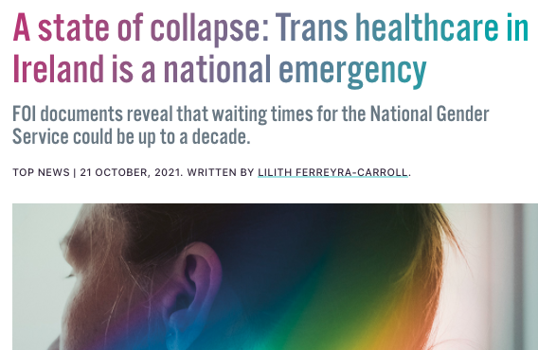

Resources

Slide 13

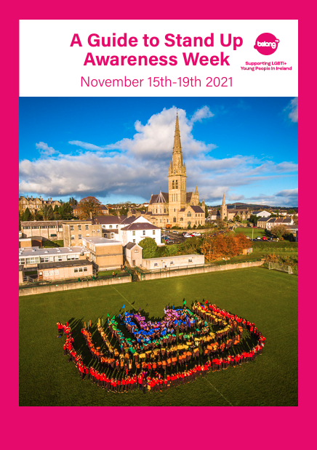
Working with Schools – Belong To
Safe and Supportive Schools (SASS) project – a whole-school, holistic programme covering six key action areas to increase LGBTI+ inclusion in post-primary schools (Second phase beginning Sept 2022)
Providing information and support for school staff in terms of LGBTI+ inclusion on an ad hoc basis through phone and email
Resources – posters, testimonies, teacher resources, free E-learning course available all year (approx. 90 minutes)
Stand Up Awareness Week (15th-19th November) - resources and training to staff in advance of the week.
For young people: one-on-one support as well as youth groups based around the country
Contact – Stephen Cassidy (stephen@belongto.org 01-5826152)
Notes:
More info here: Stand Up Awareness Week - BeLonG To

Slide 14

Working with Schools – ShoutOut
Committed to improving life for LGBTQ+ people by sharing personal stories and educating school students, parents & guardians, teachers, youth workers and workplaces on LGBTQ+ issues
Providing student workshops – a 1 hour session exploring LGBTQ+ terminology, scenarios where students can act as good allies, and ways in which to create a welcoming environment for LGBTQ+ students
Teacher information sessions – a 90 minutes, or up to 3 hours depending on the depth required. This is an information session exploring sexuality, sexual orientation, gender identity and gender expression in order to empower teachers to be allies to their LGBTQ+ students
Contact – Bella (director@shoutout.ie) or use the online booking form here.

Slide 15

Working with Schools – Transgender Equality Network Ireland
Providing one-to-one support and guidance to schools supporting trans and gender diverse students and those who are supporting a social transition and need advice on best practice guidelines around this
Giving support and advice to parents and young people and try to link them into TENI services and support groups: TransParenCI is their parent and family member support group, and Transformers is their young person's support group for age 13-18 (current groups in Dublin, Cork city, Waterford city, Tralee and Cavan/Monaghan)
Online support group for age 18-24 to bridge the gap between the adolescent groups and the adult groups meeting every 6 weeks
Family Support Helpline which runs on Sunday evening and Tuesday morning run by volunteers who are all parents of trans people
Contact: Hannah Solley (hannah@teni.ie 087 0637933)

Slide 16
Useful Websites
Gay Project Ireland – https://gayproject.ie/
LGBT Ireland - https://lgbt.ie/
Belong To Youth Service – https://www.belongto.org/
Transgender Equality Network Ireland - https://www.teni.ie/
BI+ Ireland - http://www.biireland.com/
Full Spectrum Ireland (Disability and LGBT+) - https://www.facebook.com/FullSpectrumIRL/
LGBT Pavee Support Group - http://lgbtpavee.yolasite.com/
Outhouse (LGBT+ Community Resource Centre) - https://outhouse.ie/
Stonewall UK (Resources and e-learning) - https://www.stonewall.org.uk/schools-colleges
GCN (Gay Community Network) - https://gcn.ie/
LGBT Education Scotland - https://lgbteducation.scot/
Supporting Transgender Pupils in Schools (Guidance for Scottish Schools) - https://education.gov.scot/media/xpgo5atb/supporting-transgender-pupils-schools-guidance-scottish-schools_.pdf
Human Rights Explained (Guide to Human Rights Law) - https://www.ihrec.ie/download/pdf/ihrec_human_rights_explained.pdf
European Convention on Human Rights -https://www.echr.coe.int/documents/convention_eng.pdf
Charter of Fundamental Rights of the European Union - https://www.europarl.europa.eu/charter/pdf/text_en.pdf
ILGA-Europe - https://www.ilga-europe.org/

Slide 17
Thank you!

