Slide 1

Diversity and LGBTQI+ Identities
An introduction
Ailsa Spindler

Slide 2
WHAT IS DIVERSITY AND INCLUSION?
Diversity is any dimension that can be used to differentiate groups or people from one another (e.g. gender, age, sexual orientation, family status, religion, ethnicity, and disability).
Inclusion is a state of being valued, respected and supported. It generates a sense of belonging.
Diversity, on its own, is not the answer. A culture of inclusion is essential to harness the power of individual diverse elements.
It's vital to have an inclusive environment where everyone feels able to participate and achieve their full potential.

Slide 3
BELONGING
57% of organisations surveyed by LinkedIn for its Global Recruiting Trends 2018 said that they were moving beyond Diversity and Inclusion to Belonging.
Here’s why: diversity is being invited to the party, inclusion is being asked to dance, and belonging is dancing like no one’s watching.
"Belonging is the feeling of psychological safety that allows employees to be their best selves at work. Even at the most diverse of companies, employees will disengage and leave if they don’t feel included and accepted." - Linkedin

Slide 4
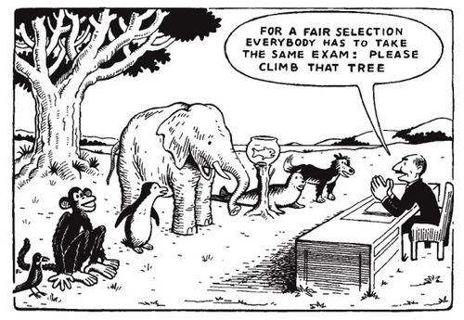
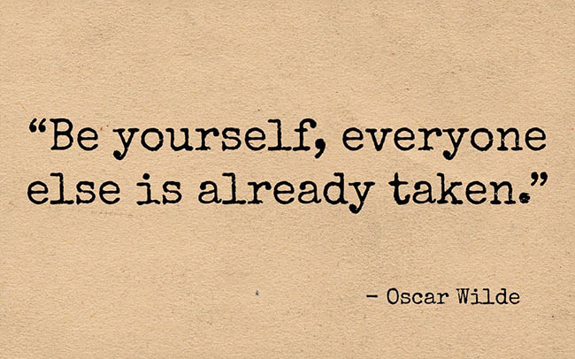

Slide 5
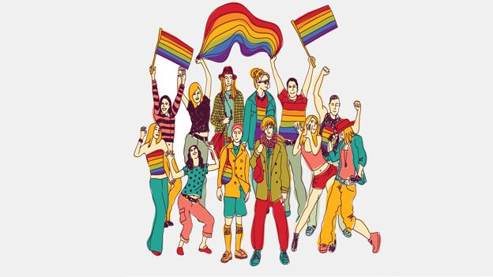
LGBT+ INCLUSION, DIVERSITY AND BELONGING

Slide 6
LGBT+ INCLUSION, DIVERSITY AND BELONGING
Introductions
Terminology
Spectrums
Sexual Orientation
Gender and Sex
Gender Identity
Gender Expression
Minority Stress

Slide 7
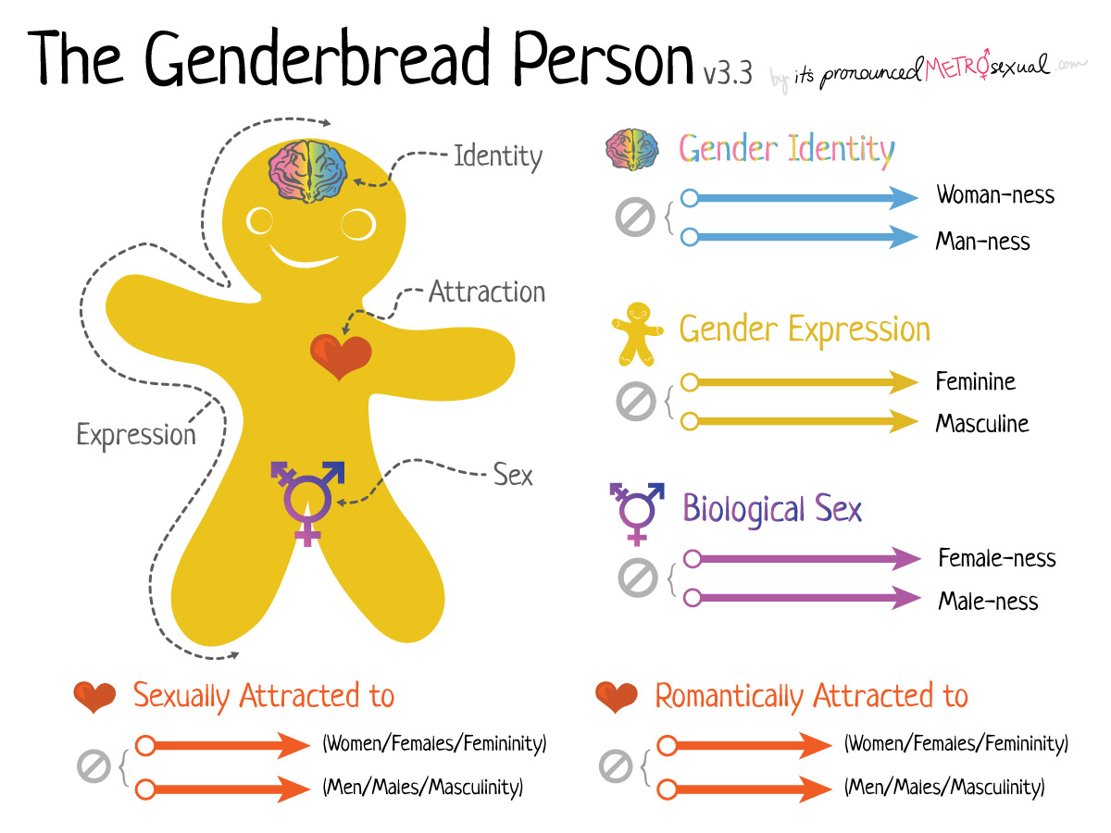

Slide 8
SPECTRUMS
It is useful to think of sexual and gender identities in terms of a spectrum. A spectrum is “used to classify something in terms of its position on a scale between two extreme points”.
Thus people can identify with a sexual or gender identity anywhere on a spectrum ranging from straight to gay OR man to woman and anywhere in between.

Slide 9
WHAT IS SEXUAL ORIENTATION?
Sexual orientation is about who you’re attracted to romantically or sexually and who you want to have relationships with.
Sexual orientations include gay, lesbian, straight, bisexual, and asexual.

Slide 10
Terminology for Sexual Orientation
LESBIAN: A woman who is romantically or sexually attracted to other women.
GAY: A man who is romantically or sexually attracted to other men. Most gay people don’t like to be referred to as homosexual because of the negative historical associations with the word and because the word gay better reflects their identity.
ASEXUAL: Asexual people do not experience sexual attraction. However, many do experience romantic attraction and still take part in non-sexual intimate relationships.
BISEXUAL: A person who is romantically, sexually and/or emotionally attracted to people of both sexes.

Slide 11
More Sexual Orientation stuff......
Pansexual: Sex therapist Dr. Kelly Wise defines pansexual as, “someone who is attracted to people regardless of gender or biological sex. That is irrelevant. Pansexuality holds space for the idea that gender is very fluid.”
Heterosexual: Someone who is sexually or romantically attracted to the opposite sex.

Slide 12
Other terms
MSM – Men who have sex with men
WSW - Women who have sex with women

Slide 13
GENDER AND SEX
SEX is biological and characterised by primary and secondary sex characteristics such as chromosomes, gonads, sex hormones or genitals.
GENDER refers to the socially constructed characteristics of women and men – such as norms, roles and relationships of and between groups of women and men. It varies from society to society and can be changed.

Slide 14
GENDER IDENTITY TERMINOLOGY
GENDER refers to the socially constructed characteristics of women and men – such as norms, roles and relationships of and between groups of women and men. It varies from society to society and can be changed.
QUEER: A historically pejorative term that has been reclaimed by the communities* and used as a term of empowerment. It is an umbrella term that refers to anyone who identifies as anything other that heterosexual or cisgender.
NON-BINARY/GENDER QUEER: This is an umbrella term to describe all gender identities that fall outside of the traditional binary of male and female.
GENDER FLUID: Gender fluid individual experience different gender identities at different time.
INTERSEX: Intersex refers to people born with sex characteristics that do not belong strictly to male or female categories.

Slide 15
Other 'trans' terms
Gender Dysphoria: A medical term used to describe the uncomfortable feeling that a trans person's internal gender experience doesn’t match their body.
Transition: The process of changing genders. This can be social and / or medical. Medical transition may involve hormone replacement therapy and various surgeries. It is important to note that many trans people decide not to transition medically. Carrying out the medical process of transitioning is also not a pre-requisite to identifying as trans.
FTM - female to male trans person - a transman
MTF - male to female trans person – a transwoman

Slide 16
Pronouns
Pronouns are words used to refer to someone or something.
Gender specific pronouns are ‘he’ and ‘she’ which are usually used for men and women respectively. Many non-binary people do not identify with these pronouns and choose to opt for more gender neutral pronouns like ‘they’ or no pronouns at all.
If unsure, it is okay to respectfully and discreetly ask someone which pronoun they prefer to use.

Slide 17
GENDER EXPRESSION
Gender expression is how a person outwardly shows their gender identity. It includes physical expressions such as person’s clothing, hairstyle, makeup, and social expressions such as name and pronoun choice. Some examples of gender expression are masculine, feminine, and androgynous.
However, not everyone who expresses themselves in a way that varies from their assigned sex or gender identity is expressing their particular identity. For example, Drag Kings and Drag Queens are artists and performers who do not necessarily identify with the gender that they are expressing in performance.

Slide 18
Heterosexual and cisgender
Heterosexual/straight: Sexual and romantic attraction to the opposite sex.
Cisgender: Identifying with the gender one was assigned at birth.

Slide 19
A Note on Terminology
Please remember:
Language is fluid and ever-evolving. There is no absolutely correct way to describe identities, although there are ways which are exclusionary and incorrect.
A 'queer' person may use terms about themselves that would be offensive if used by others. If in doubt, check before you use an unfamiliar term.
Lived experience is more valuable than any definition.

Slide 20

COMING OUT

Slide 21
Coming out
Coming Out is the term used to describe "the process of realising one’s LGBT identity and the decision to disclose this to others such as family, friends, classmates and colleagues" (LGBT Ireland).
It is a misconception that coming out is a single event that happens once in an LGBT+ person’s life. In fact, it is a lifelong process. However, the first time this event happens is usually very significant for the individual in question.

Slide 22
“Coming out is probably one of the most extreme and difficult things you can do. Before you come out you have to deal with it all yourself and it took me six years to. And I couldn’t be myself for those six years and it is, again, it’s called in the closet because you are in the closet. No one can see you; they see this door because no one’s ever opened up the closet to look inside” (Gay, Male, 17)

Slide 23
Coming Out statistics
12 years: the most common age that an LGBT person discovers their sexual orientation or gender identity for themselves (average is 14)
17 years: the most common age to start ‘coming out’ to others (average is 21)
5 to 7 years: number of years young LGBT people conceal their identity from others
The period prior to coming out to others is often particularly stressful because of fear of rejection and isolation

Slide 24
BEING AN LGBT+ ALLY
Be inclusive
Listen
Don't assume
Pronouns are personal
Ask questions
Understand terms
Know the law
Challenge
Know your privilege

