Slide 1

Staying Alive!
Ireland 2050
Notes:
Introduce WWGS, what we do and work with schools

Slide 2
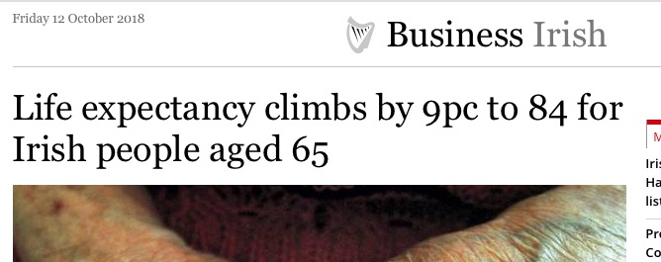
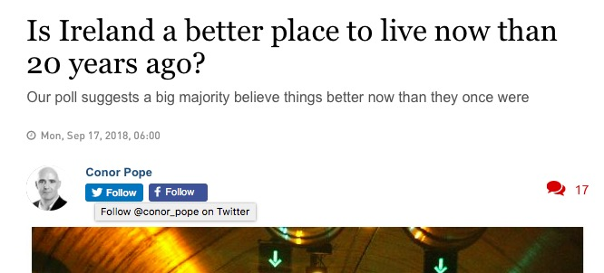
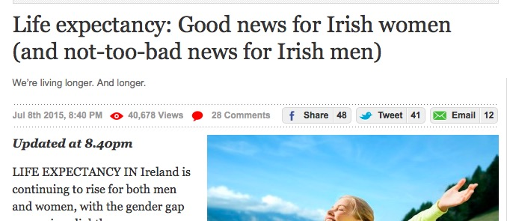
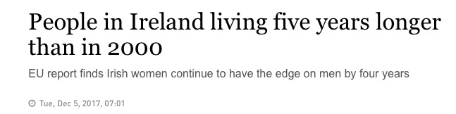
Notes:
Participants to look at headlines and guess the focus of the workshop-what kind of themes might we be exploring in todays workshop? Here are some recent headlines, whats the focus, what might be bring up

Slide 3
Learning Intentions:
Understand the factors influencing global life expectancy
Examine the impact of population change in Ireland 1950-2050
Explore the connections between global goals and life expectancy
Notes:
Share learning intentions with participants

Slide 4
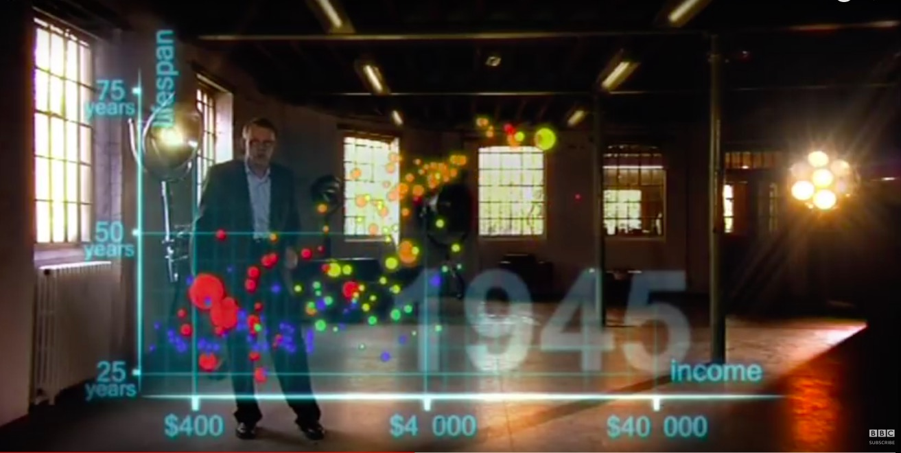
VIDEO: Hans Rosling's 200 Countries, 200 Years, 4 Minutes - The Joy of Stats - BBC Four

Slide 5
Task: Examining Global Life Expectancy
Part 1) On your graph, plot the pattern of life expectancy shown in the video. Each group will plot one continent
We will watch the video twice
Part 2) In your group discuss three factors that are affecting life expectancy on your continent?
Part 3) Discuss three ways that global inequality can still have an impact on life expectancy
Notes:
Explain task 1

Slide 6
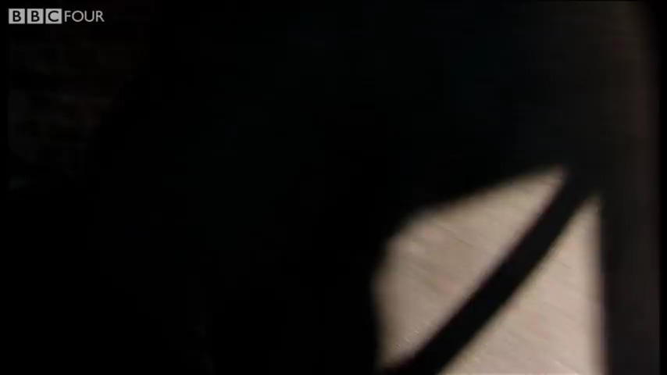
VIDEO: Hans Rosling's 200 Countries, 200 Years, 4 Minutes - The Joy of Stats - BBC Four

Slide 7
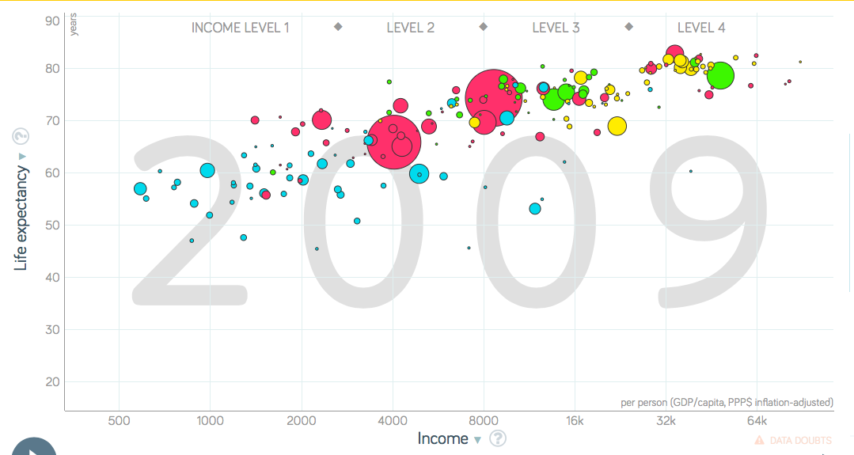
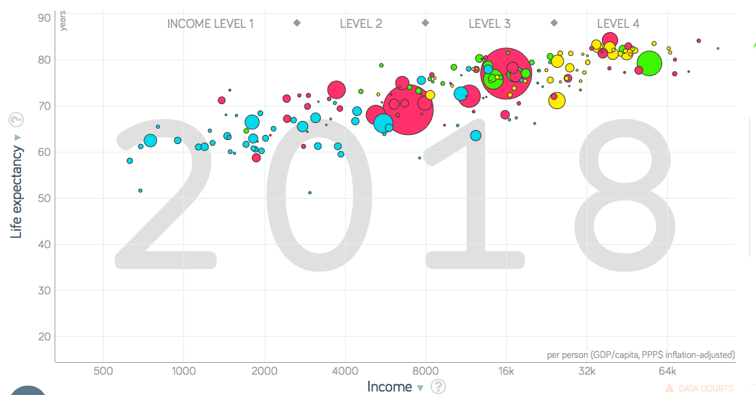
https://www.gapminder.org/tools/

Slide 8
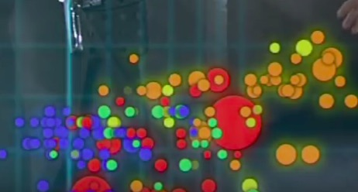
Europe=Brown
Asia=Red
Africa=Blue
Americas=Yellow
Notes:
Different groups will be analysing the trends of various parts of the world-these will be on tables

Slide 9
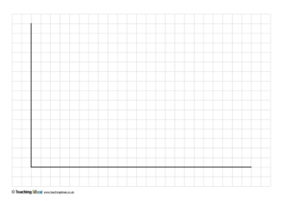
Y axis
LIFE EXPECTANCY
75 Years
50 Years
25 Years
X axis
WEALTH
$400
$4,000
$40,000
Notes:
This is a worksheet which will be shared with groups on tables. Introduce task-participants must plot their continents on the graph to show changes in life expectancy

Slide 10
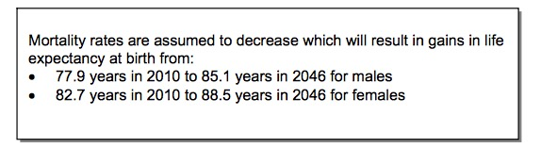
Central Statistics Office, Report 2013
Population and Labour Force Projections 2016-2046
Notes:
Thinking about Ireland 2050-looking to the future-share stats with participants to get them to think about future trends in life expectancy and longevity

Slide 11
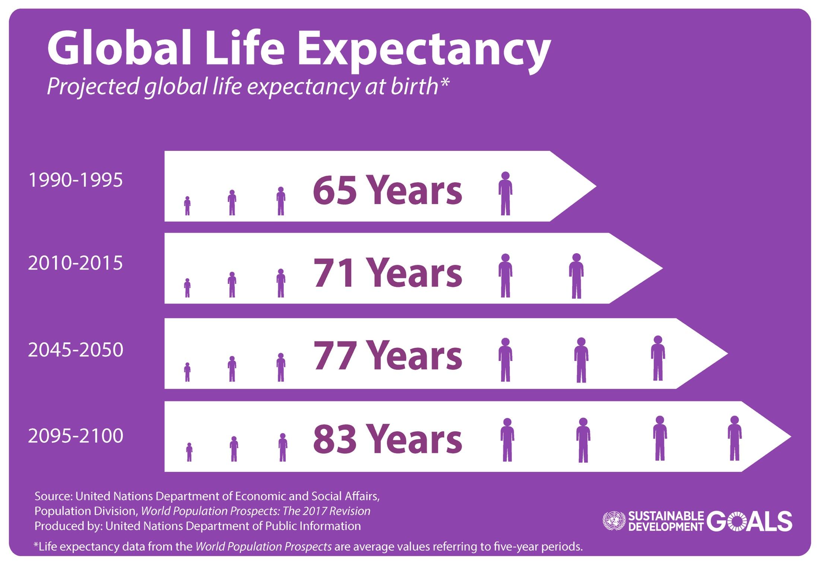
Notes:
Share stats and projections with participants

Slide 12
Why are we living longer? On your table you have a collection of statements. In your groups read through the statements and place them in the categories below:
Science and Technology
Food and Nutrition
Healthy lifestyles
Other (include 3 of your own reasons)
Notes:
Task 2-using the sorting cards provided, groups must decide what category the statements fit into. feedback from group . Participants will be able to add their own reasons in category 4 ‘other’. They will hopefully have gained some insights from the previous workshops also.

Slide 13
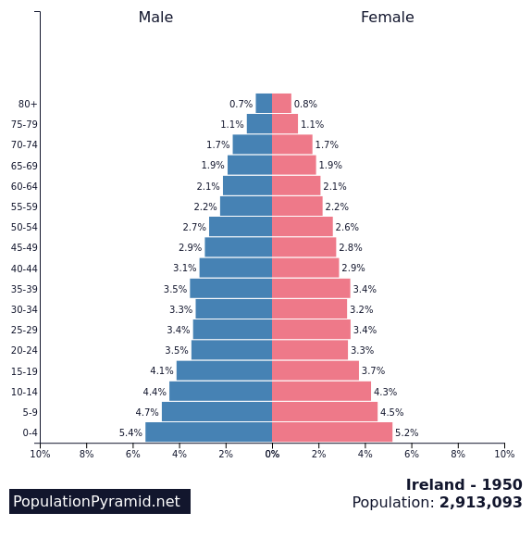
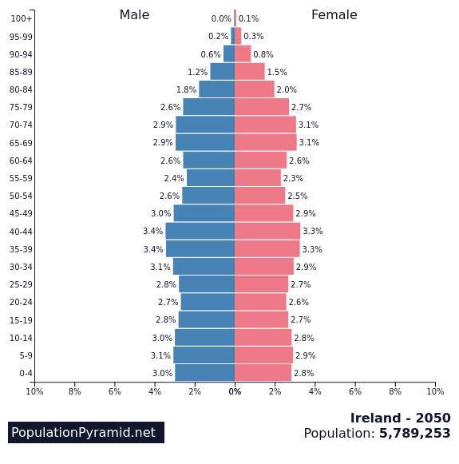
On your table are two Population Pyramids
Ireland 1950 and Ireland 2050
Task Part 1: Describe what you can see in each pyramid. What does the shape tell us. What information does a Population Pyramid give us?
Use some of the words below to help
Gender, wide base, percentage, narrow base, tall, ageing population, birth rate, life expectancy
Task Part 2: Who might use these graphs and why?
Task Part 3: Looking at 1950 and 2050, what would be examples of enablers and disrupters to the life expectancy of people at that time?
Notes:
Task 3-A3 print out of population pyramids provided for groups. Task explained.
Introduce what population pyramids are - A population pyramid is a graphical presentation which shows the distribution of the population by age group and gender. Population pyramids can be created for a county/province/country or region. The base of the pyramid represents the birth rate and the peak represents the death rate.
Time given to look at pop pyramids initially and then 10 minutes provided for group to describe what they see and discuss task 1-4.

Slide 14
What does the shape tell us?
A wide base means there are lots of young people, and suggests a high birth rate.
A narrow base means a smaller proportion of young people, suggesting a low birth rate.
A wide middle, tall pyramid means an ageing population, suggesting that there is a long life expectancy.
Some reasons for high birth rates include:
  need for large families, eg to work in rural areas
  lack of family planning
  people have many children because many infants die
Some reasons for falling death rates include:
  increasing wealth
  better hygiene and improved healthcare
  better farming techniques
Notes:
Not shown to participants-here just in case participants are struggling with population pyramids

Slide 15
Notes:
To print for groups A3- Now let us focus on Ireland in 1950. Looking at the shape and structure of the pyramid what does it tell us about life expectancy in 1950?
(Allow time for groups to discuss and take feedback from the room then ask)
What would be examples of enablers and disrupters to the life expectancy of people at that time?
(give some time for discussion and take feedback)

Slide 16
Notes:
To print for groups A3-Looking to the future and the projected population pyramid for Ireland 2050.
What does this pyramid tell us about life expectancy in the future?
(allow time for discussion and feedback)
Now let us consider the enablers/disrupters impacts and constraints to longevity and life expectancy in Ireland 2050.
You can see that you have a wall space where you can record your thoughts.
(Give time for discussion and posting on wall and ask each group to feedback briefly)

Slide 17

Notes:
SDGs introduced to participants-what do they mean? Why were they introduced?

Slide 18
Identify the goals that are linked to life expectancy and living longer lives
Explain the connection between 2 of the goals you have circled
Notes:
Task 4: A3 print out of SDGs given to groups. Participants must examine the SDGs and Circle the goals that are linked to life expectancy and longevity
Identify or clarify a problem.
Increase creative discussion.
Promote inquiry and challenge preconceived ideas.
Bring out the validity of multiple perspectives.
Make assumptions explicit.
Sift out major issues and factors.
Find the systemic causes of stubborn problems.
Test the viability of previously proposed solutions.
Explore short- and long-term impacts of alternative or newly proposed solutions or actions.
Systems thinking - understanding of a system by examining the linkages and interactions between the elements that comprise the whole of the system.
It encourages us to explore
inter-relationships(context and connections),
perspectives (each actor has their own unique perception of the situation) and
boundaries (agreeing on scope, scale and what might constitute an improvement).
Systems thinking is particularly useful in addressing complex or wicked problem situations. These problems cannot be solved by any one actor, any more than a complex system can be fully understood from only one perspective. Moreover, because complex adaptive systems are continually evolving, systems thinking is oriented towards organizational and social learning – and adaptive management.
When you encounter situations which are complex and messy, then systems thinking can help you understand the situation systemically. This helps us to see the big picture – from which we may identify multiple leverage points that can be addressed to support constructive change.

Slide 19

Making Connections
In your groups discuss what LOs we have touched on today from your subject specifications
Can you see opportunities for cross-curricular development?
Notes:
Task 5: reflection on the workshop-groups to discuss above. In your groups discuss what LOs we have touched on today from your subject specifications
Can you see opportunities for cross-curricular development?
E.g. Science Students should be able to evaluate how human health is affected by: inherited factors and environmental factors including nutritinio; lifestyle choices, examine the role of micro organisms in human health.

Slide 20
Learning Intentions:
Understand the factors influencing global life expectancy
Examine the impact of population change in Ireland 1950-2050
Explore the connections between global goals and life expectancy
Notes:
Share learning intentions with participants.

Slide 21

www.worldwiseschools.ie lizzy.noone@worldwiseschools.ie
Upcoming dates for your diary:
An Chomhdáil Oiliúna do Mhúinteoirí lar-bhunscoile-29th of March, Galway
Annual Conference the 4th of April-Croke Park Dublin
Grant funding: Opens April 8th-Closes May 10th Funding up to €1,500 for schools

