Slide 1
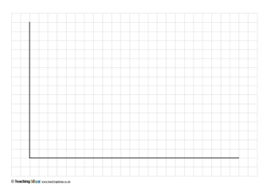
Y axis
LIFE EXPECTANCY
75 Years
Rich and Healthy
50 Years
Poor and Sick
25 Years
X axis
WEALTH
$400
$4,000
$40,000
Follow Europe (Brown Bubbles)
Notes:
This is a worksheet which will be shared with groups on tables. Introduce task-participants must plot their continents on the graph to show changes in life expectancy

Slide 2
Y axis
LIFE EXPECTANCY
75 Years
Rich and Healthy
50 Years
Poor and Sick
25 Years
X axis
WEALTH
$400
$4,000
$40,000
Follow Asia (Red Bubbles)
Notes:
This is a worksheet which will be shared with groups on tables. Introduce task-participants must plot their continents on the graph to show changes in life expectancy

Slide 3
Y axis
LIFE EXPECTANCY
75 Years
Rich and Healthy
50 Years
Poor and Sick
25 Years
X axis
WEALTH
$400
$4,000
$40,000
Follow Africa (Blue Bubbles)
Notes:
This is a worksheet which will be shared with groups on tables. Introduce task-participants must plot their continents on the graph to show changes in life expectancy

Slide 4
Y axis
LIFE EXPECTANCY
75 Years
Rich and Healthy
50 Years
Poor and Sick
25 Years
X axis
WEALTH
$400
$4,000
$40,000
Follow the Americas (Yellow Bubbles)
Notes:
This is a worksheet which will be shared with groups on tables. Introduce task-participants must plot their continents on the graph to show changes in life expectancy

