Slide 1
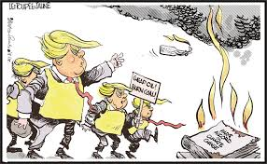
Taking Action on Climate Change
Lizzy Noone
WorldWise Global Schools

Slide 2
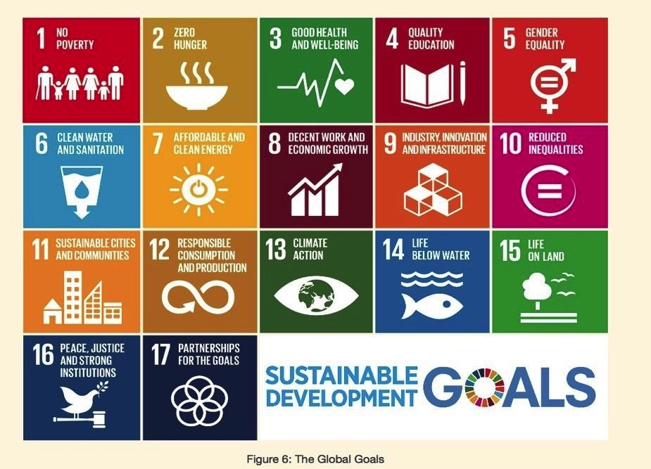

Slide 3
What do you know already!
In groups of 2/3
Write the alphabet
Try write one word on climate change for each letter of the alphabet
Write a C or an E for whether the word is about a cause or an effect
Feedback

Slide 4
Cause and Effect-A Chain Reaction
In groups of 4:
-sort out the cards from Cause to Effect
-what surprised you?
-who has the power?
-what end of the chain would you start?

Slide 5
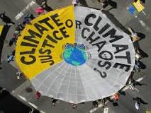
Climate Justice: framing climate change as an ethical & poliitcal issue rather than just an environmental one.
Dirty Energy is at the Root of Climate Justice
What famous ex President runs the Climate Justice Foundation??

Slide 6
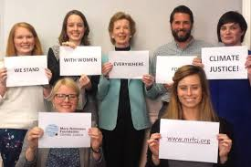
Mothers of Invention podcast

Slide 7
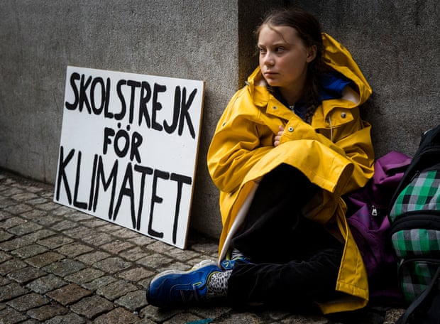

Slide 8
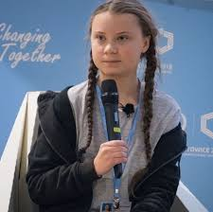
“Some people, some companies, some decision-makers in particular, have known exactly what priceless values they have been sacrificing to continue making unimaginable amounts of money. And I think many of you here today belong to that group of people.”
https://www.youtube.com/watch?v=_17VnmSxcbM

Slide 9
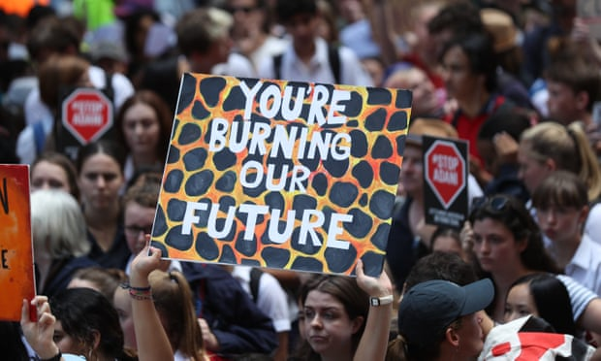

Slide 10
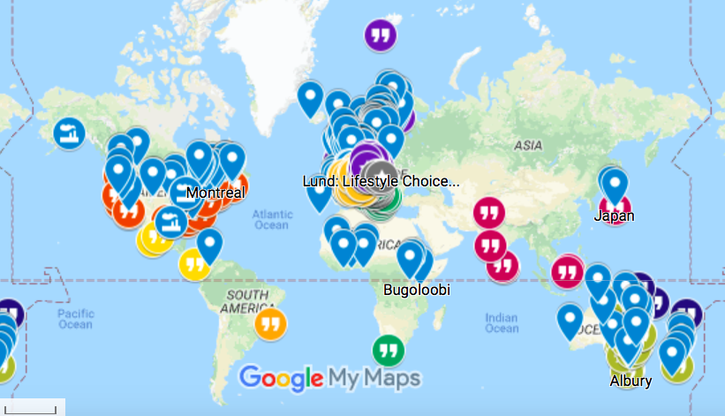

Slide 11
Ireland has the third highest greenhouse gas emissions per person among the EU28
Ireland has the eighth highest greenhouse gas emissions per person among the OCED 35
Ireland is one of only two EU countries that are projected to overshoot their 2013-2020 GHG emissions target
The latest projections from Ireland’s EPA is that on current trends, Ireland’s emissions will still be 13% above 1990 levels in 2030 (2018, EPA).
In the 2018 Climate Performance Index from Germanwatch ranked Ireland as the worst climate performer in the 49th out of 57 countries ranked overall.
The Climate Action Network Europe report Off Target 2018 ranks Ireland second worst in Europe for climate action, ahead only of Poland.

Slide 12
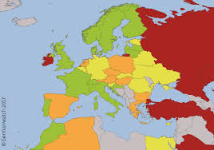

Slide 13
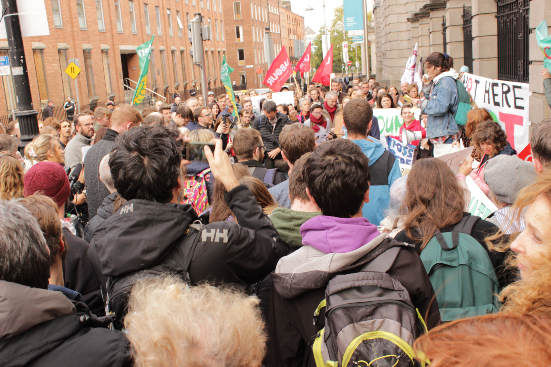
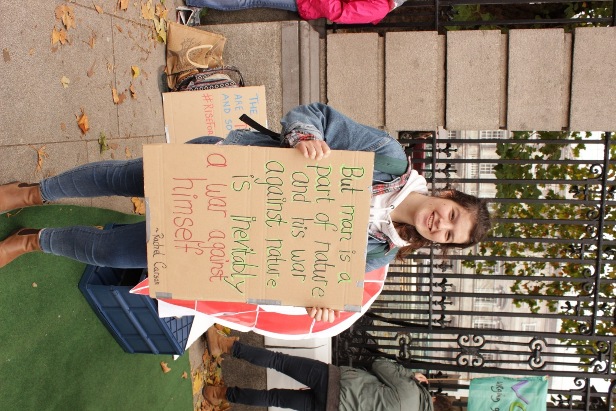
Hannah Fitzpatrick, of Dublin Ecofeminist Collective (DEC), said the latest UN Intergovernmental Panel on Climate Change (IPCC) report had concluded it was only a matter of years before the effects of catastrophic climate change would begin to hit many parts of the world.

Slide 14
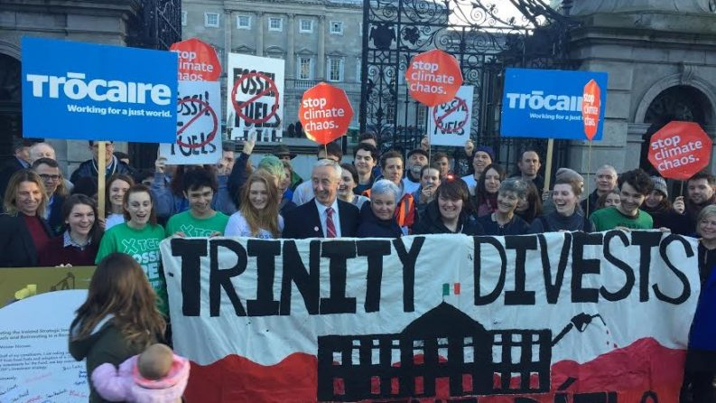

Slide 15
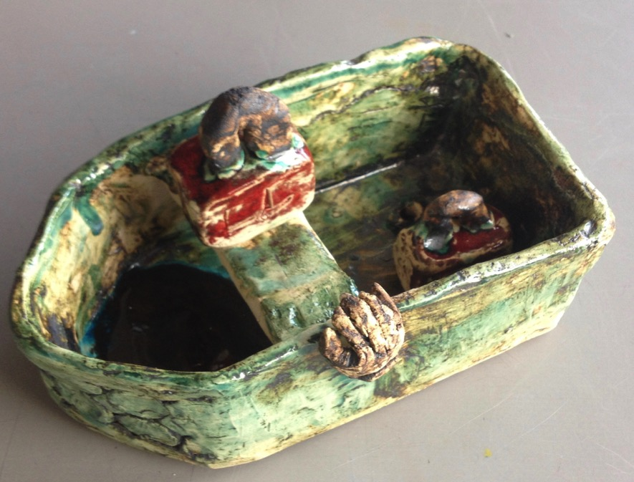

Slide 16
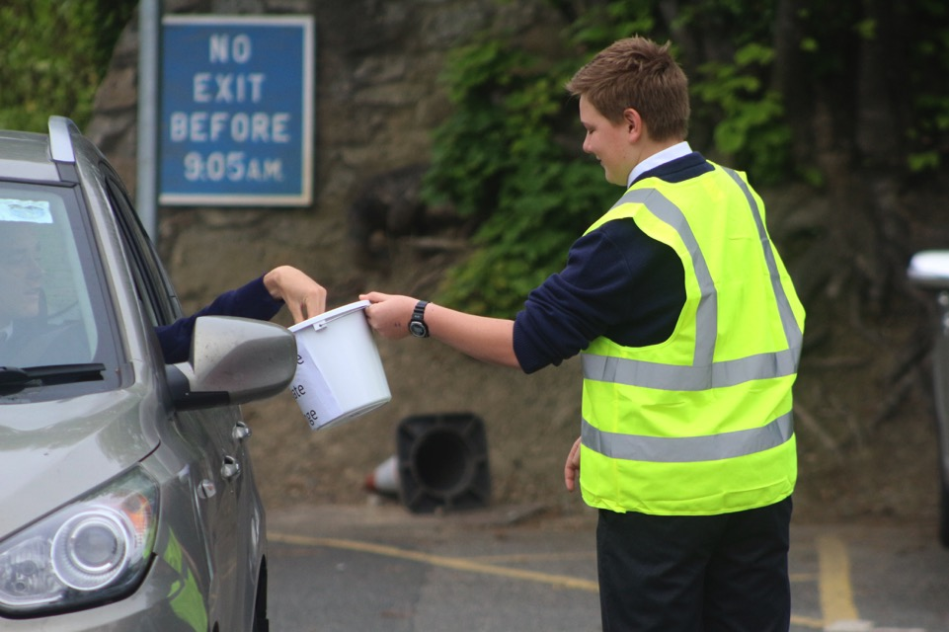

Slide 17
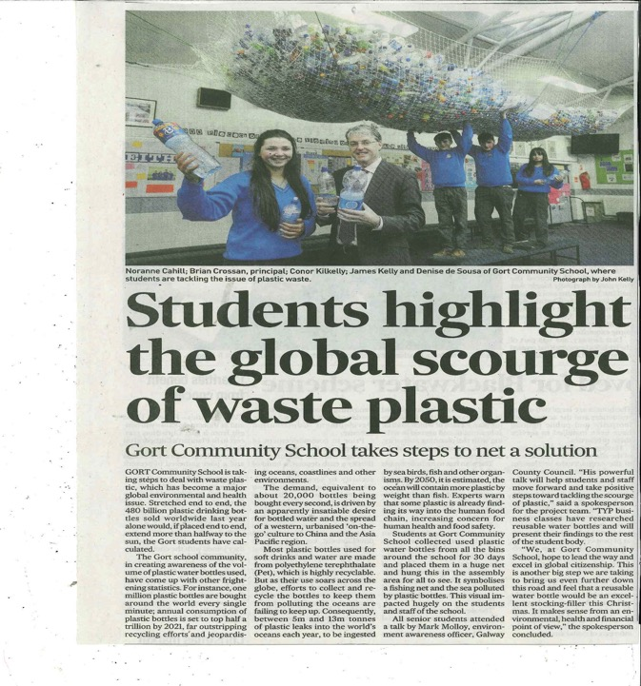

Slide 18
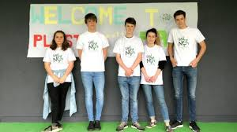

Slide 19
WHAT CAN YOU DO?
-Individual
-School/Community
-National Change

Slide 20
ACTION!
Individual
What can you recycle!!
https://www.irishtimes.com/news/environment/consumer-guide-to-what-s-recyclable-and-what-isn-t-in-household-recycling-bins-1.3425410
Bring your own! Bottle, plate, cutlery, cup
School
Plastic Outta the Park
https://www.youtube.com/watch?v=QCo_vRslipg
Influence National Policy
Ireland’s Strike against Climate Change
https://www.facebook.com/climatecaseire/videos/229823281229640/UzpfSTE0ODkwOTE5MjQzMjM3OToyOTY5ODkxNTc2MjQzODE
Governments need to improve waste management practices and introduce financial incentives to change the habits of consumers, retailers and manufacturers, enacting strong policies that push for a more circular model of design and production of plastics. They must finance more research and development of alternative materials, raise awareness among consumers, fund innovation, ensure plastic products are properly labelled and carefully weigh possible solutions to the current crisis.

