Slide 1

Lizzy Noone
Education Officer
WorldWise Global Schools

Slide 2





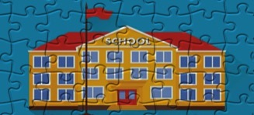
Aims of the WWGS Programme
Notes:
The WWGS programme aims to:
familiarise learners with the concepts of interdependence, development, globalisation and sustainability
enable teachers to move learners from a charity mentality to a social justice mentality
community of practice that stretches across regions and continents. An informal and flexible network that can share experience and resources
stimulate critical thinking about global issues, both at a whole school and learner level help schools promote greater awareness and understanding of global justice issues.

Slide 3

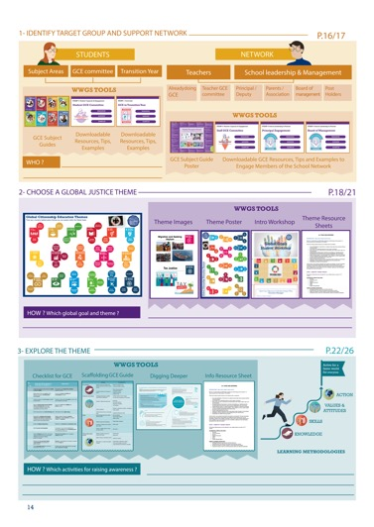
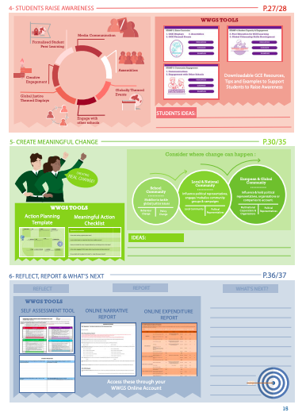
Page
14-15
Notes:
Briefly talk through the 6 steps

Slide 4
What is Global Citizenship Education?
“an educational process aimed at increasing awareness and understanding of the rapidly changing, interdependent and unequal world in which we live”
By challenging stereotypes and encouraging independent thinking, GCE helps students critically explore the root causes of global justice issues and how they link with our everyday lives
GCE inspires solidarity by supporting people to realise their full rights, responsibilities and potential as global citizens in order to take meaningful action for a just and sustainable world

Slide 5
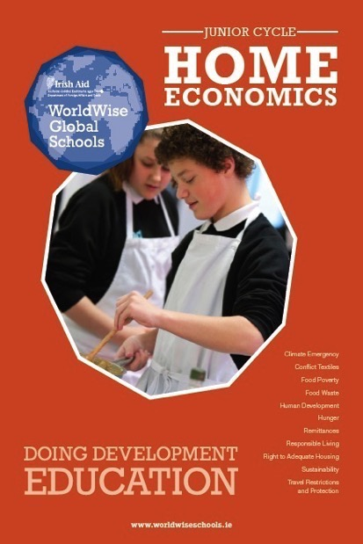


Slide 6
Junior Cycle Home Economics Aim
Home Economics aims to develop students’ knowledge, understanding, skills and competences to achieve optimal, healthy and sustainable living for every person as an individual, and as a member of families and society.
Home Economics aims to develop students’ practical food and health literacy skills so that they are enabled to adopt a healthy lifestyle and make informed decisions that positively impact their health and wellbeing as individuals as well as within their families and society.
It aims to cultivate students who are creative, innovative, adaptable and competent consumers.
Home Economics aims to develop students who are environmentally conscious and dedicated to a sustainable and responsible way of life.

Slide 7
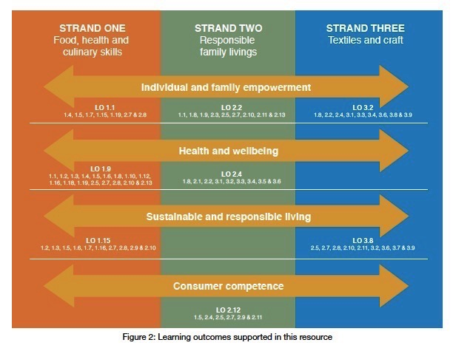

Slide 8
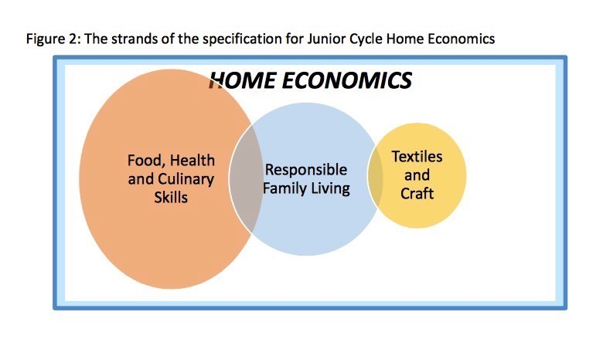
Diet Nutrition Food and health literacy | Role of family in society responsible and sustainable management of resources competent consumers Responsible consumers caring attitude towards other individuals, family members, society and the environment | Textile and craft skills Ethical production Sustainable Consumption Child Labour

Slide 9
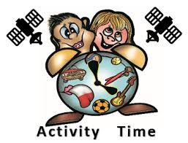
Home Economics & Global Citizenship Education…what is the link?
What themes? What topics? What skills?
Do a mind map based on the
3 strands of the Junior Cycle
Food Family Craft
? ? ?
Notes:
https://www.menti.com/wd9ep9g8bp

Slide 10

Home Economics & Global Citizenship Education…what is the link?
What themes? What strands? What topics? What skills? Write 3 in the Mentimeter
Go to www.menti.com and use the code 77 89 49 4
Notes:
https://www.menti.com/wd9ep9g8bp

Slide 11
Home Economics and Global Citizenship…what is the link?
Home economics play a key role in this ever-changing, interdependent world house, called the global community
Home economics serve a unique bridging role between households and other sectors of society
The purpose of the subject is to empower individuals and families and to equip them in dealing with their world, to cope and to function with given situations
Home economics has a role in contributing to the solutions, not adding to the problems (i.e local or global issues)

Slide 12

Changing the world through teaching!
Home economics educators have an opportunity to communicate the significance of creating and sustaining an improved quality of life for individuals and families from a global perspective
educator have a powerful influence on generations of individuals and families
Basic skills, such as consumer behaviour, decision-making, problem- solving, and group interaction are the content of home economics curriculum, as well as the events and transactions of daily life

Slide 13

Changing the world through teaching!-Systems
Provide the ability to see the world as an interdependent system; to be aware of one's influence in the interactions of the world's system. The ability to perceive
the world as a single system→ to be aware of one's involvement in it; to act to influence the system and to recognise the interconnections.
information, attitudes, awareness, and skills, which, taken together, can help us understand our world, how we affect it, and how it affects us

Slide 14
‘Home economics education uses a systems approach to empower individuals and families with the knowledge and skills to address these real-life concerns
of everyday living’ Home Ec JC Spec

Slide 15
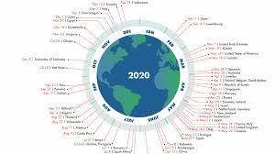
Country Overshoot Day
Notes:
The pandemic gave us a chance to appreciate nature and gave us a glimpse into what a fossil free future might look like offering a break from addictive consumerism (one would hope!)
George Monibot said that’ it [the pandemic] has to be a tipping point. This has to be a point to transform where we move from one system an exploitative political and economic system to a completely different one private sufficiency and public luxury.

Slide 16
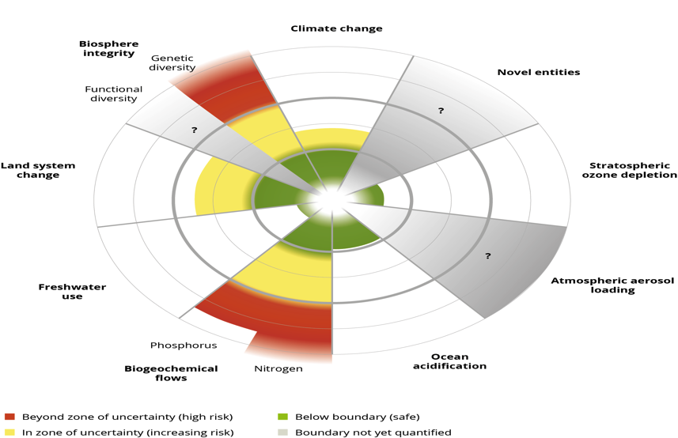
Planetary Boundaries-4 of the 9 have been crossed as a result of human activity-which ones???

Slide 17
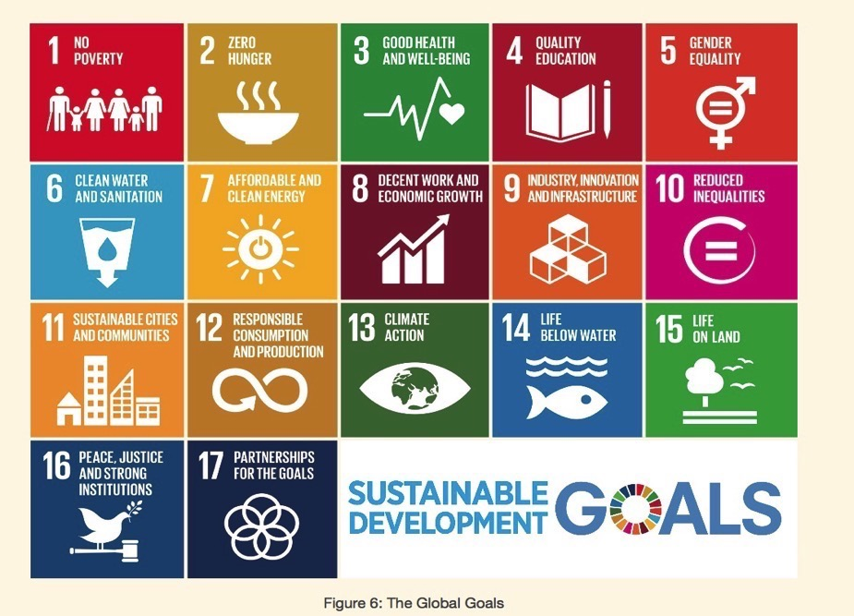

Slide 18
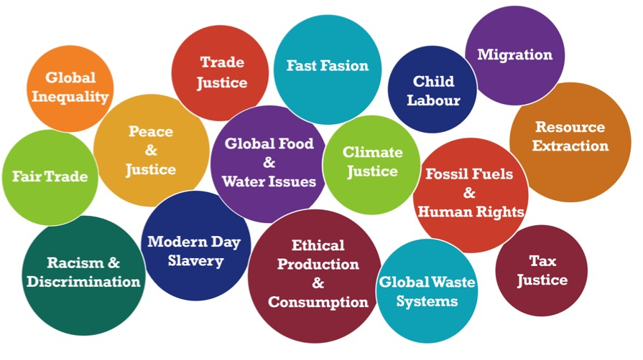
Global Citizenship Education Themes

Slide 19
In pairs, discuss what goals are you most obvious to explore in Home Ec?
-Take one least obvious and discuss the
Connection with the Home Ec curriculum?
What Systems/Frameworks do we need to consider when exploring Global Citizenship Education in Home Economics?
-What systems within each goal?

Slide 20
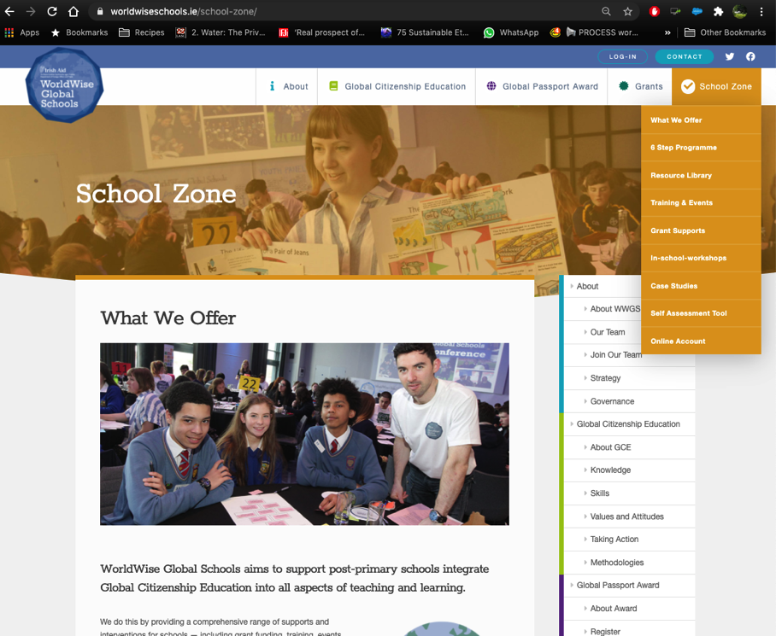

Slide 21
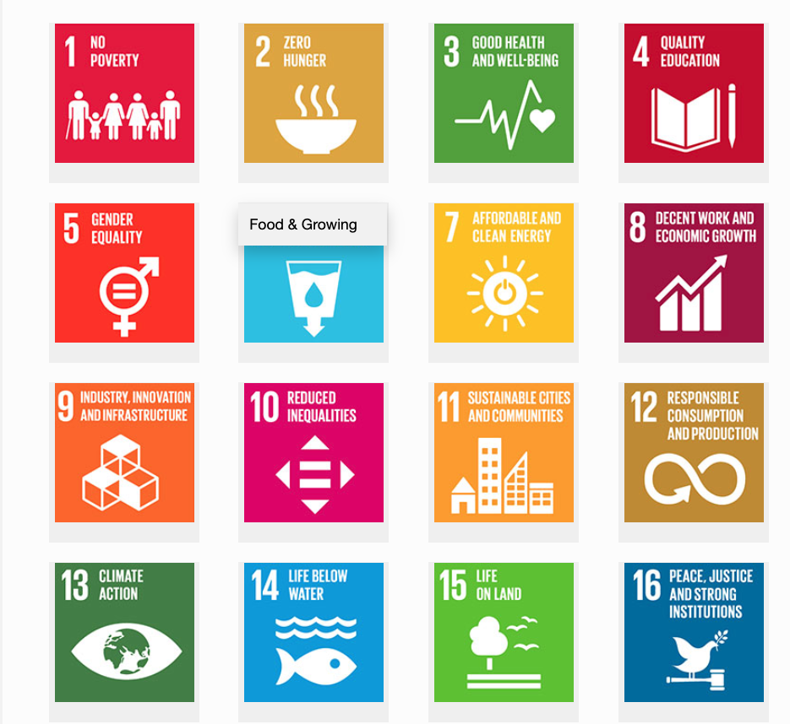

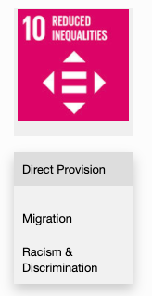
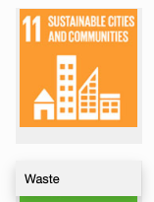
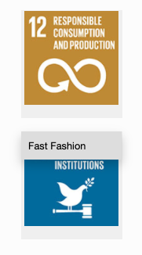
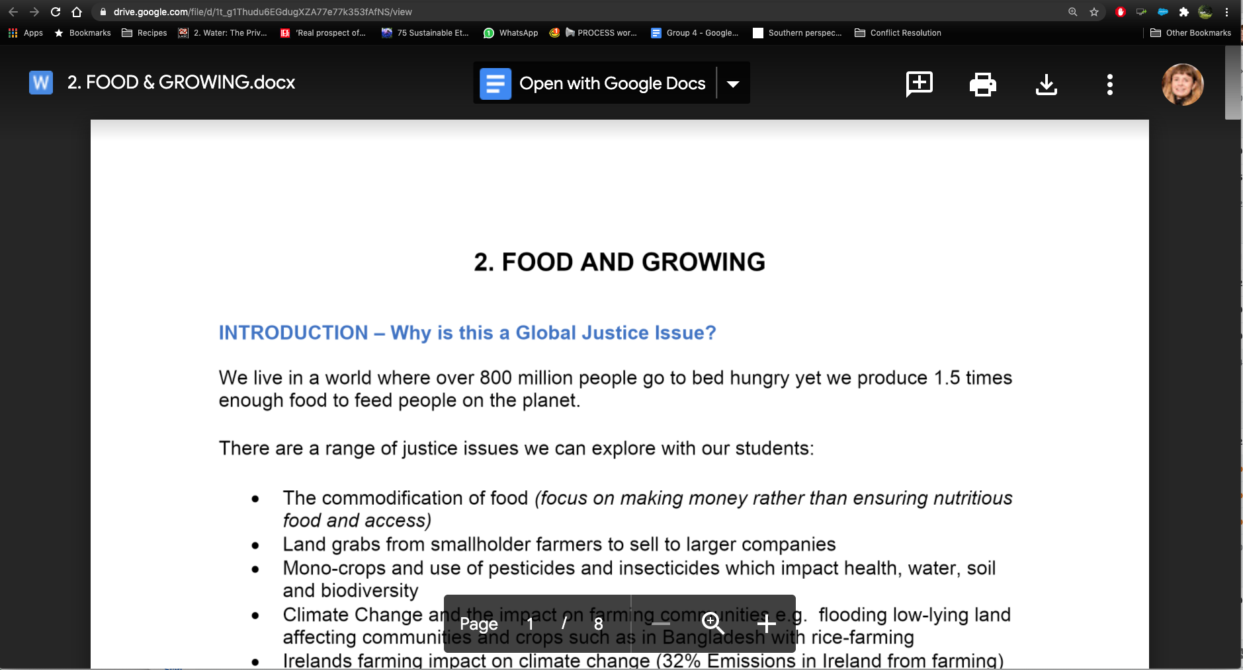
1. Hover over the symbol and a drop down menu appears!
Relevant Resource Sheets
– activities, videos, suggested actions etc
2. Click on the theme and the resource sheet will pop up!

Slide 22
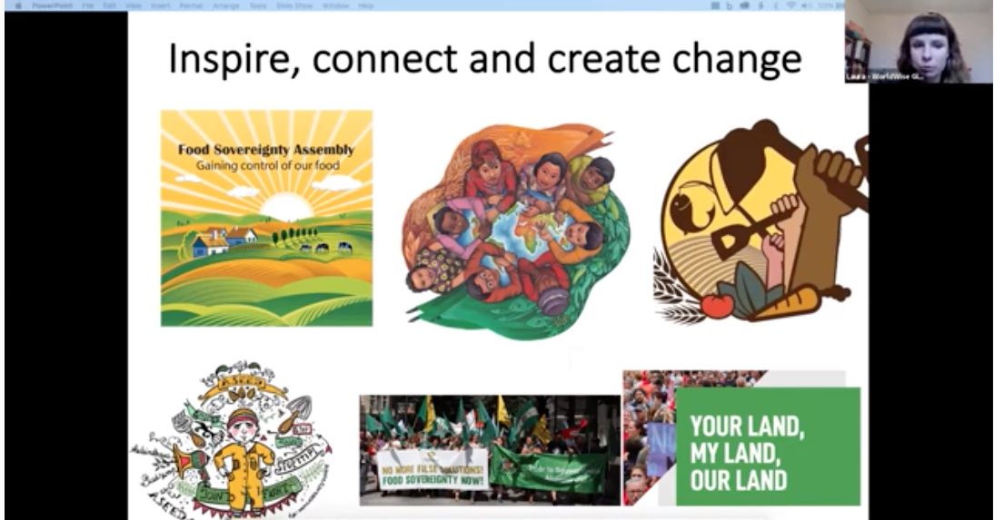
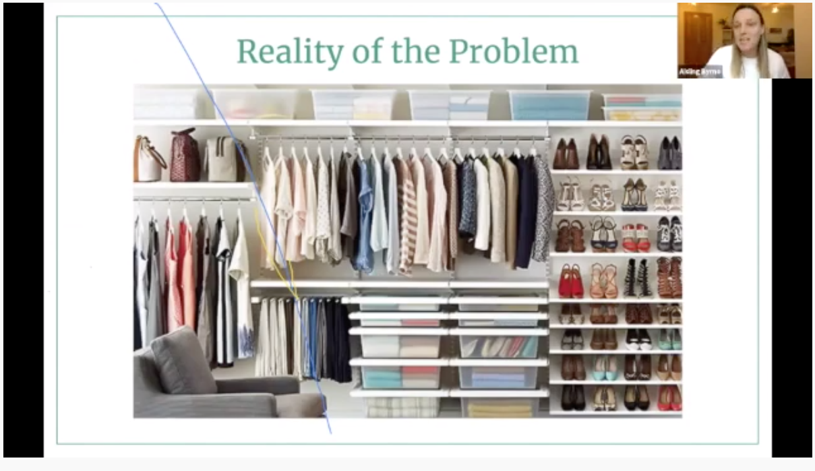

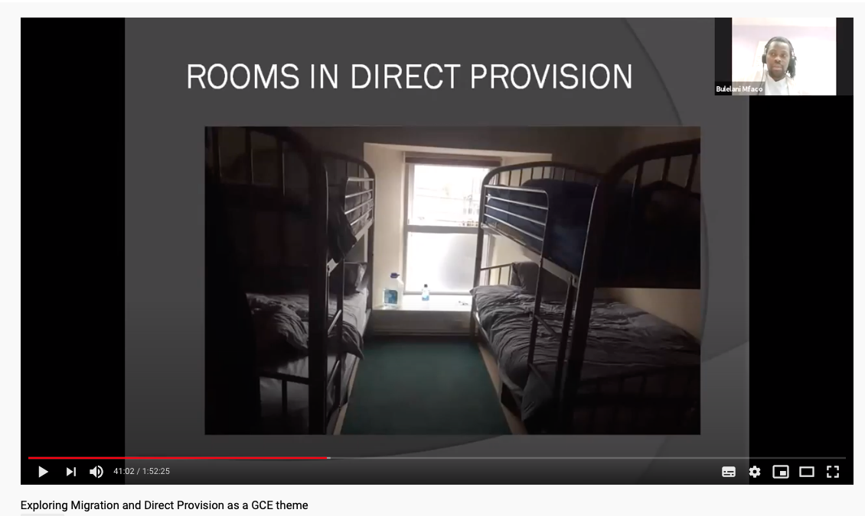
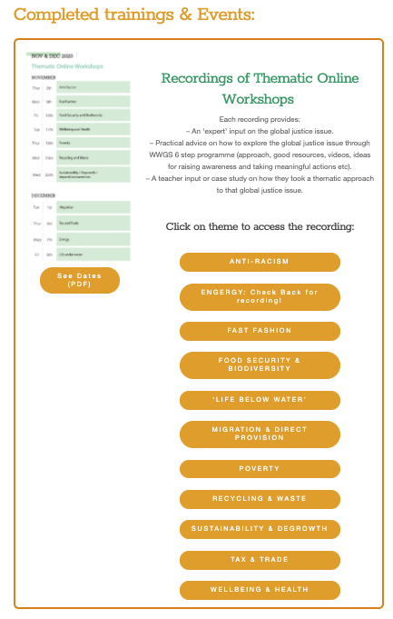
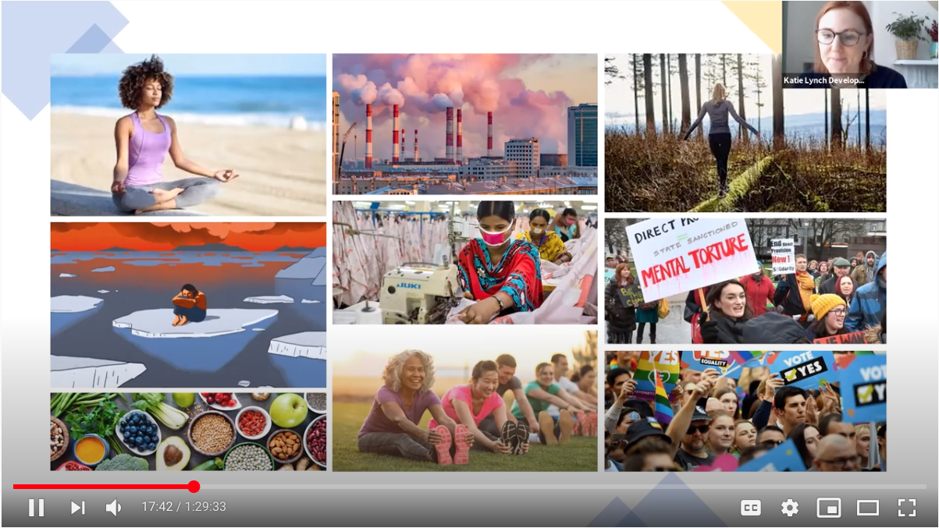
Webinars on relevant Global Justice Themes
Fast Fashion
Food and growing
Waste
Migration &
Direct Provision
Wellbeing

Slide 23

JUNIOR CYCLE

Slide 24
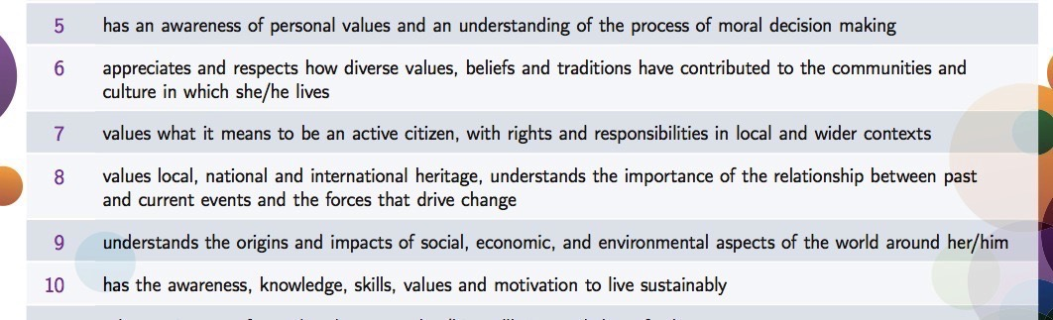
Very Strong DE Links
SOL 5-10
That’s a quarter of all SOL!!

Slide 25
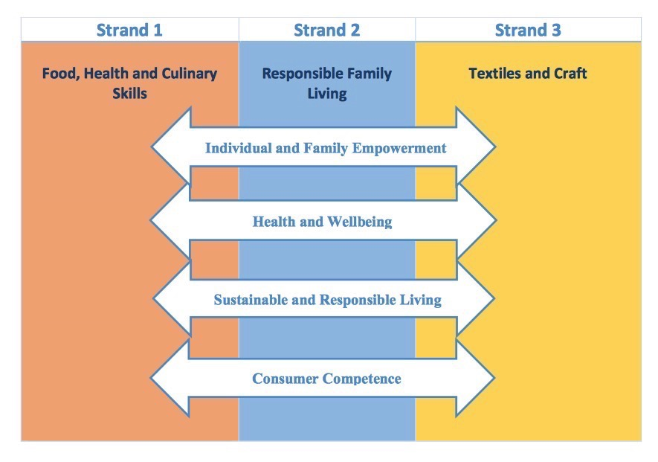
develop as critical, creative thinkers and problem solvers able to make informed decisions to achieve optimal, healthy and sustainable living for individuals, families and society.
decisions that positively impact the health and wellbeing of themselves as individuals as well as within their families.
future- oriented thinkers and environmentally-conscious citizens, committed to a sustainable and responsible way of life
make informed and discerning consumer choices that affect individuals and families in contemporary society.

Slide 26
Learning Outcomes
Food Health and Culinary Skills
1.15 investigate the impact of their food choices from an ecological and ethical perspective
1.16 apply sustainable practices to the selection and management of food and material resources
Responsible Family Living
2.8 identify how individuals and families can contribute to sustainable and responsible living
2.9 describe sustainable everyday practices in the home to include energy efficiency, waste management and water conservation
Textiles and Craft
3.8 discuss the influences of trends and choices on textile and clothing, including ethical and ecological considerations

Slide 27

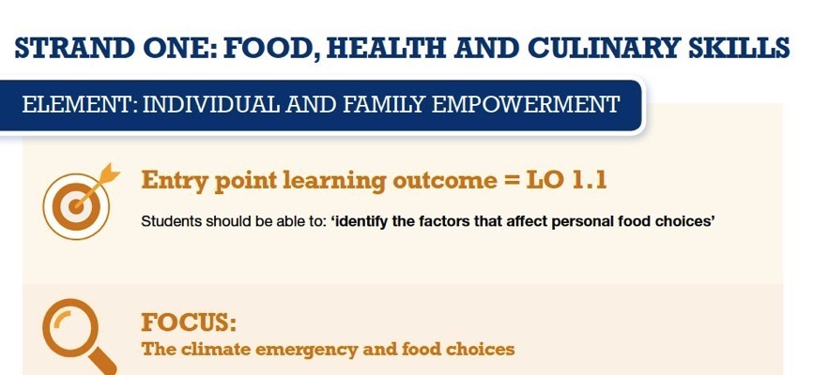

Slide 28
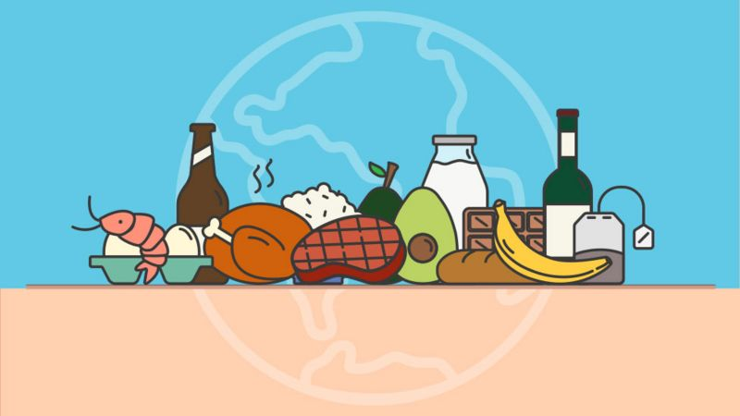
Climate Change Food Calculator
-put a food in the chat!

Slide 29



Slide 30
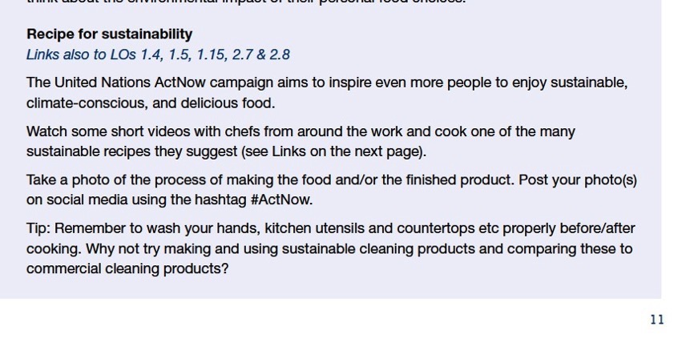
Activity (p.11)

Slide 31
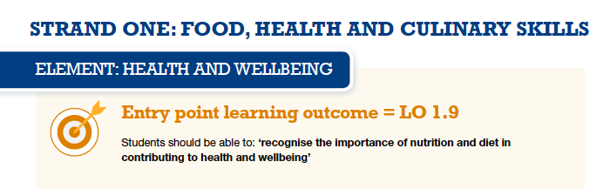
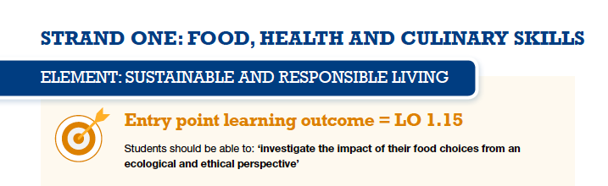

Slide 32

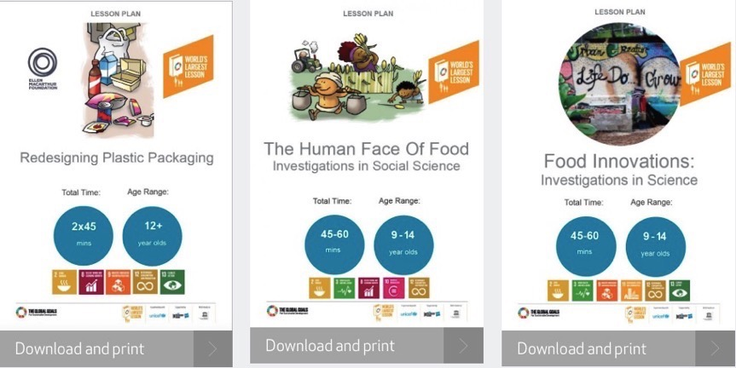

Slide 33
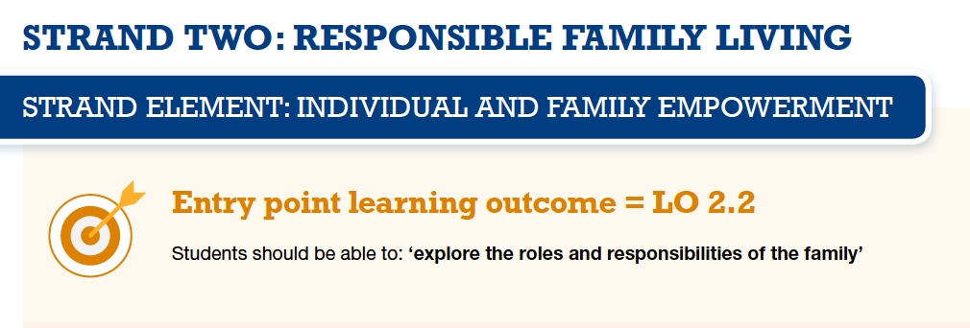
Explores remittances: $551 billion in 2019
Comparison with Aid budget? Looking at Covid 19 context
Movement of people due to climate change.
Financial Justice-structures around sending remittances-how much is lost on either side of the financial transaction.

Slide 34
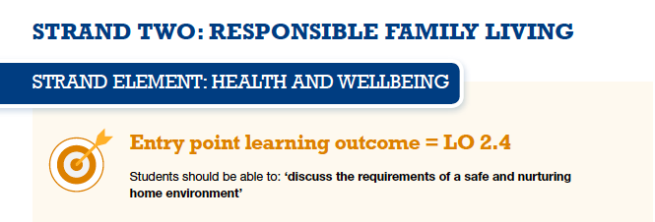
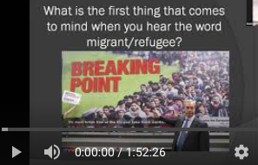
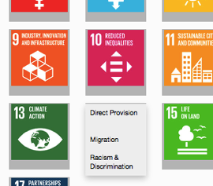
Check out also our information sheet and video of our training on ‘migration and direct provision’.

Slide 35
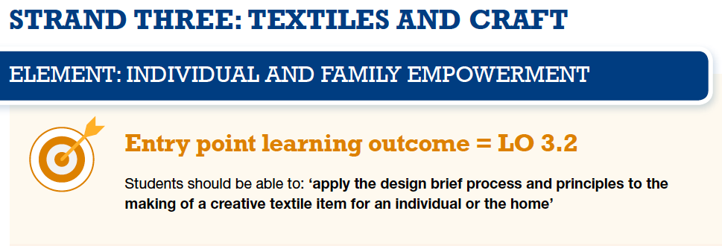
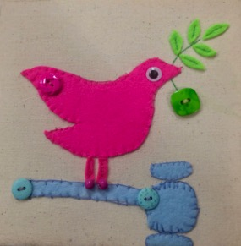
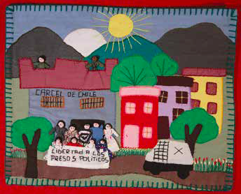

Slide 36
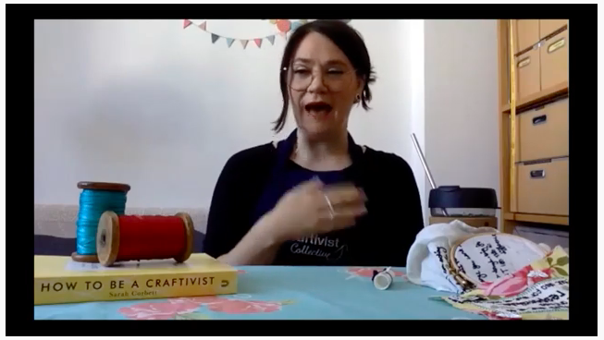
Action ideas: https://craftivist-collective.com/projects
https://www.youtube.com/watch?v=FETY7T-tw40

Slide 37
CBA 1 Creative Textiles
Option 2
Option 2: Recycle or upcycle a textile item for an individual or the home
Applying the design brief process and the principles of design and sustainability, students are asked to recycle or upcycle a textile item for an individual or the home.
As part of the project, students will show evidence of:
    Applying the design brief process
    Applying the principles of design and sustainability
    Using basic hand sewing and/or machine sewing techniques in the making of the product
    Fabric embellishment techniques (where applicable)
    Appropriate textile care and maintenance.

Slide 38
CBA 2 Food literacy Skills
Food Waste
Sustainable Foods
Ethically purchased food

Slide 39

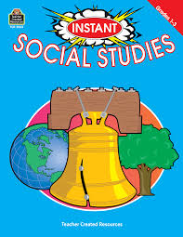

SENIOR CYCLE

Slide 40
Senior Cycle
1. FOOD STUDIES
Food choices: Factors affecting food choices, to include:
culture, eating patterns, sensory aspects, nutritional awareness, health status, availability, finance, marketing and advertising –e.g. Q on LC Why are more people using farmers’ markets.
Food Packaging: Packaging and materials used, to include:
evaluation of their suitability for purpose and environmental impact

Slide 41
2. RESOURCE MANAGEMENT AND CONSUMER STUDIES
Housing: Factors that determine individual and family housing choices, to include:
socio-economic factors, national housing policy, trends in housing development, availability
Consumer Responsibility
Responsibility of the consumer in informed decision-making, with regard to:
consumer information and rights
management of the environment,
to include use of renewable and non-renewable resources, recycling, pollution
3. SOCIAL STUDIES
The family in society
Notes:
Homelessness has come up on past papers to the shhock of students!

Slide 42
Electives
Elective 1: HOME DESIGN AND MANAGEMENT The energy efficient home
Elective 2: TEXTILES, FASHION, AND DESIGN Contemporary clothing and fashion
Elective 3: SOCIAL STUDIES Education : Equality of opportunity in education, with reference to gender inequity, socio-economic status etc. Poverty: The extent and distribution of poverty in Ireland today and identification of those groups at risk of poverty Reasons why poverty continues to be a feature of modern western society

Slide 43
Discussion Time!!
How effective are we at equipping young people with the knowledge and skills that will enable them to make sound decisions as responsible global consumers and citizens?
How well do we cover human rights and global justice issues within our programmes and activities?
How well do we cover environmental issues within our programmes and activities?
How well do we develop young people’s sense of responsibility through taking part in activities which involve the local or wider community?
How effective are we in planning for young people to take part in regular discussion and debate about topical issues related to home economics?
Let’s Harvest All of Our Examples!
https://jamboard.google.com/d/1tmTFXDWNyYQM6mwvL4kDOBNbPBgUkM5UMRy6QUUXDlM/edit?usp=sharing
Notes:
https://jamboard.google.com/d/1tmTFXDWNyYQM6mwvL4kDOBNbPBgUkM5UMRy6QUUXDlM/edit?usp=sharing

Slide 44
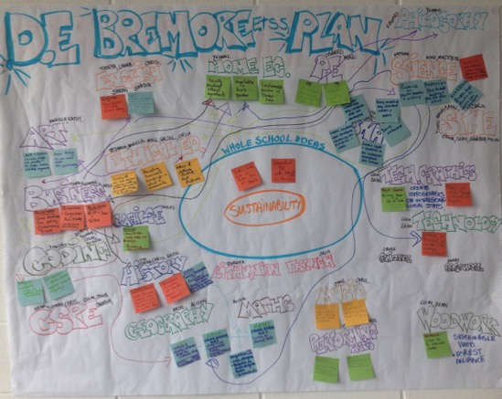
Cross Curricular work

Slide 45
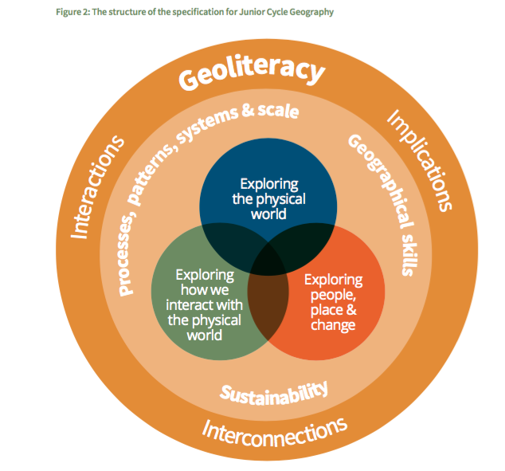

Slide 46
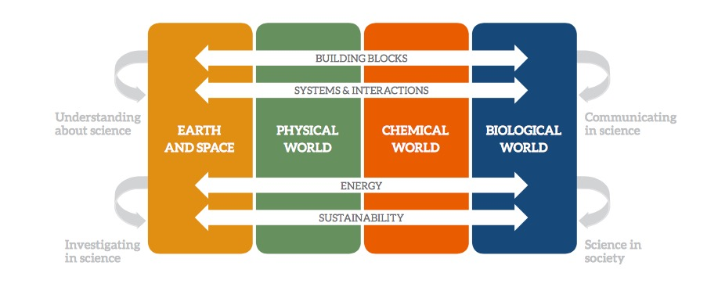
Science-The elements of the contextual strands

Slide 47
Biology
1.3: Nutrition
1.3.1 Function of food
Compare consumption patterns and calorie intake in different regions/countries
Discuss causes of unequal access to health
and nutrition
1.4 Ecology:
1.4.9 Human impact on an ecosystem:
Pollution, Conservation, Waste management - importance of waste minimisation
Pollution: The ecological impact of one human activity
1.4.12 Population dynamics
Movement of populations for food availability to more abundant locations.
The effect on the human population of:
War
Famine
Disease

Slide 48
Economics
Firms: Production & Costs
Appreciation of questions of justice and human rights in relation to the role of MNCs
Identification of impact of MNCs on workers and communities worldwide
Multinational Companies
Investment, Employment & Income Distribution
Identification of causes and consequences
Recognition that income inequalities exist and analyse why this is so
Understand that there are social costs to inequality
Identification of strategies for reducing income inequalities
Unemployment
Income inequality

Slide 49
‘• PE / Home Ec / RE / Ag Science / Art worked together for the ‘Happy Pear Visit, where the focus was on the 5 Ps to Sustainability.
• Geography / Home Ec / RE / CSPE worked together on a Fast Fashion and Sustainability workshop, after we decided to design our own programme and work with a local facilitator.’
Aisling Collins
‘Within Home Economics classes sustainable development regarding food waste and food miles was explored by 1st, 2nd, 3rd Yr and TY students. As a result all tin foil containers, pump action hand washes and cleaning agents were removed from the Home Ec kitchen’.
Philomena Hooban
Home Economics: In all Junior cert cookery classes there is an emphasis on the best disposal of waste /recycling eg. use of the compost bin in class, recycling as many plastic containers as possible either to reuse/refill. Also as far as possible recycled fabric is used in the Junior Cert Craft eg. 2019 crafts largely made form old pillowcases, fabric sample books were donated and these samples can be used for bunting/ quilt-work. For the new Junior Cert Home Ec students (first years 2018) the Global Goals are included in their class notes and integrated into teaching at very opportunity. Colleen Cooney

Slide 50
‘Home Economics -Stop Food Waste, recycling, fair trade and grow your own (in the school garden). Sustainable Fashion - students looked at the harm fast fashion does to the environment and designed a poster campaign in school’.
Mairin Dunne
Home Economics - Students learn about Fair Trade and aim to use Fair Trade products when they are cooking.
Mount Anville
‘We had a cross curricular theme of Water so in Home Ec we explored Water conservation, Water in the production of clothes briefly touched’
St Mary’s Ballina

Slide 51
PUT IN CHAT! The Resources you have used in your classroom!
Podcasts
Videos
Books
TV programmes/documentaries
People and organisations
Articles
Stories

Slide 52













Large community of NGOs involved in Post-Primary Ireland

Slide 53
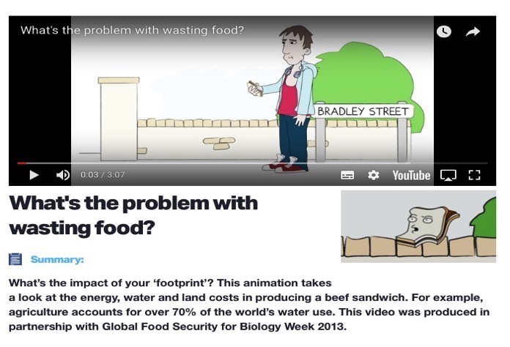
What's the problem with wasting food?
Royal Society of Biology

Slide 54

Practical Action:
Food choice, provenance and sustainability
Food Provenance: Where food comes from
Food life cycles: Social and Environmental impacts of foods throughout their life cycle
Food security and sustainability

Slide 55

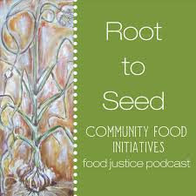
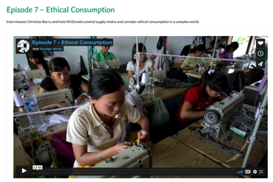
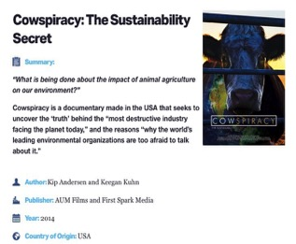

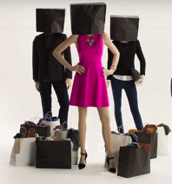
Podcasts/Videos

Slide 56
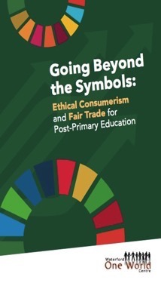

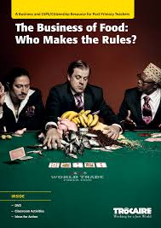
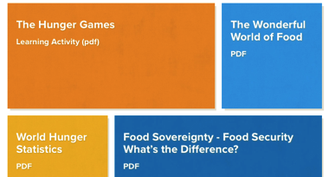


Ethical consumption
Consumer choice
Fair trade
Sustainability
Textiles
Ethical production
Notes:
https://changeforchildren.org/learn-teach/food-security/

Slide 57




Fashion/Textiles

Slide 58


Taking Action!
Craftivism!
Food campaigns
Clothes Campaigns
Consumer Campaigns
Social Justice Campaigns

Slide 59

Facebook: WorldWise Global Schools

Slide 60

Twitter: WorldWise Schools

Slide 61


Upcoming Dates www.worldwiseschools.ie/training-and-events/
Thematic Training Sessions
All recorded and available on our website
Subject Specific Training:
Home Ec-12th of January
Science: 21st of January
National Teacher Training- ‘Working as a community of GCE practice’
28th of January 2021 9.30-12.00
Global Passport Webinar:
Jan 18th 4.30pm
Feb 22nd 4.30pm
Notes:
In terms of the breakdown of trainings, outline the 5 types of training
Purple – starter trainings – (today) for new schools and teachers new to GCE (perhaps their school has been involved longer)
Pink – WWGS approach and adapting to covid-19 – for ALL schools and teachers. Even for schools who have been involved for a while. Updated theory and practice
Green – Thematic areas
Blue – subject specific
Yellow – standard WWGS trainings and events. And deadlines.

Slide 62

SAT!
https://forms.gle/Gy7hr7xR3Ty76NQL8
Notes:
https://docs.google.com/forms/d/1_4FZucTl7k-0QP3bHNYhlJkoSCnfzbJkV2_knSkfKu4/edit?usp=sharing

Slide 63


Slide 64



Thank you!
Everything here:
www.worldwiseschools.ie/resource-item/home-ec/
Lizzy.noone@worldwiseschools.ie
www.worldwiseschools.ie

