Slide 1


An introduction to Global Citizenship Education
Lizzy Noone
St Louis SS Carrickmacross
26th of October, 2018

Slide 2
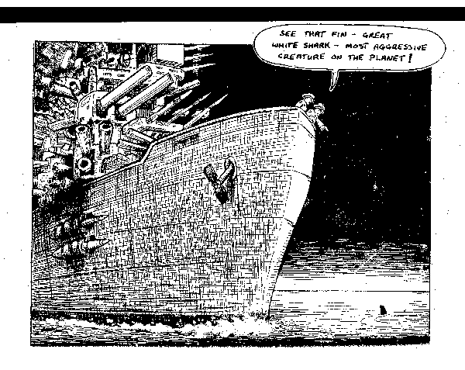
What do you understand by this cartoon?

Slide 3
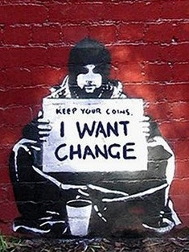

Slide 4
Agree or Disagree
Global Citizenship Education is providing school books for children in poor countries
Global Citizenship Education is fundraising for a project
GCE is about making students understand how lucky they are
Notes:
Many people view DE as simply ‘teaching about far away places’ (e.g. “Saris, steel bands and samosas” stereotype) – but in fact it encompasses a lot more than simply the content of what we teach or facilitate in the classroom. DE is of course partially content-driven, and we need sufficient knowledge in order to engage with it confidently: but it is primarily an approach to education that takes as its starting point the fact that our world is a vastly unequal place.
DE is therefore driven by core values and attitudes (primarily JUSTICE, SOLIDARITY and EMPATHY), and has at its heart a radical and transformative agenda – hence the ACTION component. Therefore, a process cannot be described as DE if it doesn’t contribute to some kind of positive change – be that in myself, in my community, in my behaviour, in my perspective, in our collective narrative of development.
DE also encompasses key skills that we all require in life – namely those of critical thinking and analysis, of being able to question and challenge the messages and information we receive every day.

Slide 5

What is Global Citizenship Education?
Irish Aid define GCE as:
“an educational process aimed at increasing awareness and understanding of the rapidly changing, interdependent and unequal world in which we live”

Slide 6
GCE enables students to move from:
Basic Awareness of Local & Global Issues
Understanding of the Causes & Effects of Global Issues
Personal Involvement & Informed Action

Slide 7
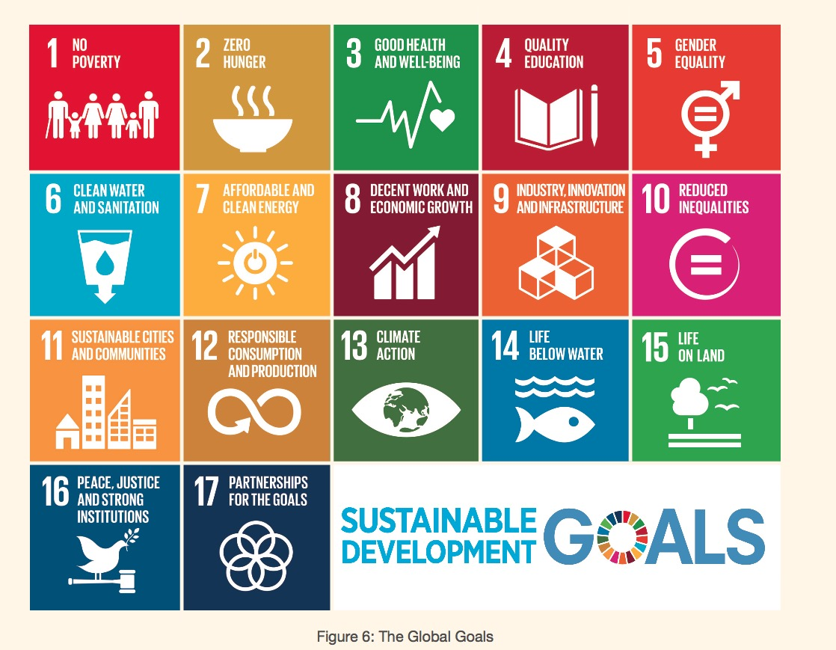
The Global Goals 2015-2030

Slide 8
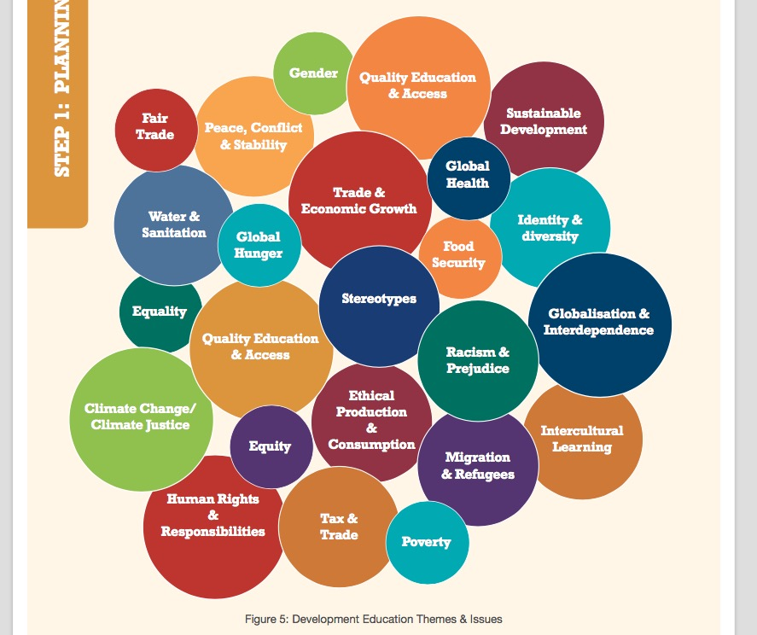
GCE Themes

Slide 9
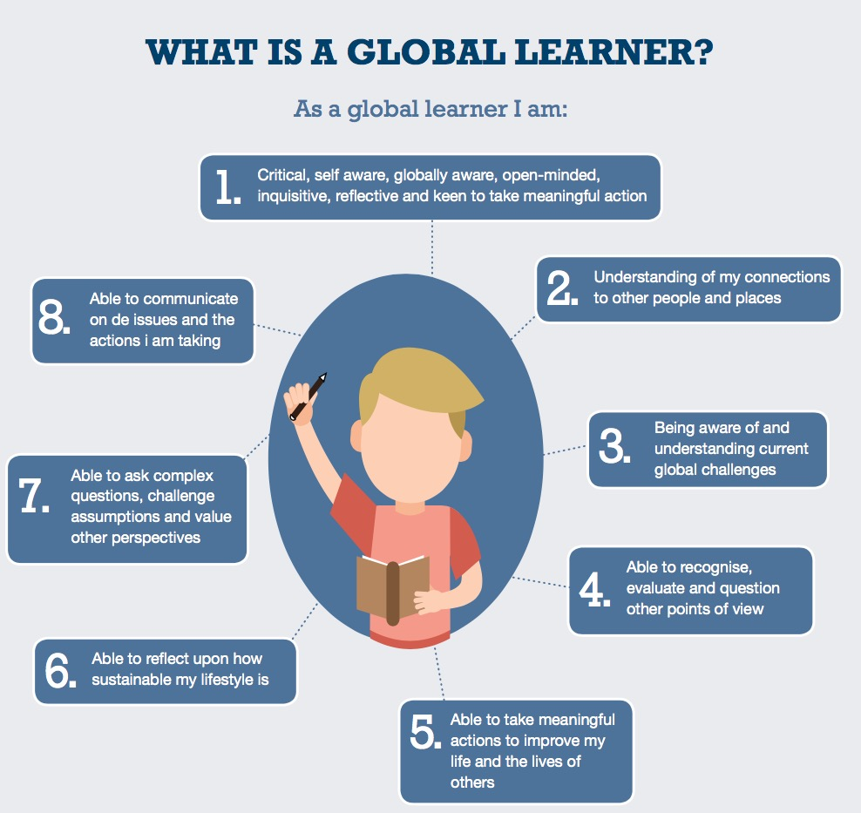

Slide 10
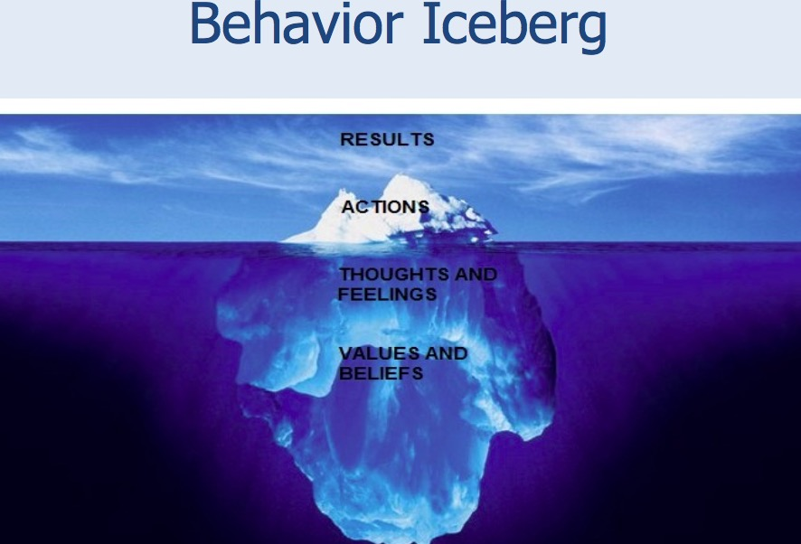

Slide 11
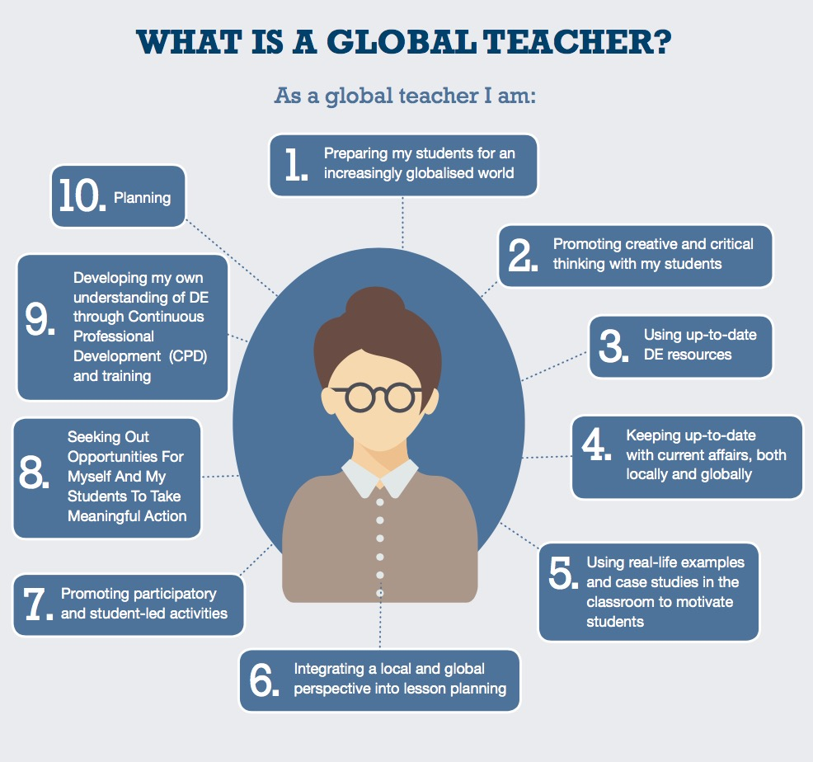

Slide 12
How should I approach GCE theme(s) or issue(s)?
Make connections→ between the local and global. This should be a key focus, regardless of the DE theme(s) you are exploring.
Explore the root causes→ of the theme(s) you have chosen, and examine it from a global justice perspective: Who is a effected by this issue? Who is responsible? Is it fair? What can be done to address it?
Exploring viewpoints and perspectives on the theme(s) →It is vital that time is given to exploring multiple perspectives, as it allows you to acquire a more comprehensive understanding of these theme(s) .
Reflect on your DE work→ For example, what have you learned about yourself, your communities, and the wider world as a result of this process?

Slide 13
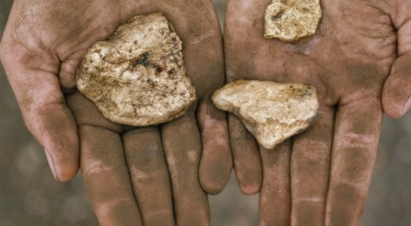
Finding the Global Citizenship Education Nuggets in your Subject
The idea is not to rewrite every lesson that you teach, but simply to be aware of where you can make GCE connections.

Slide 14
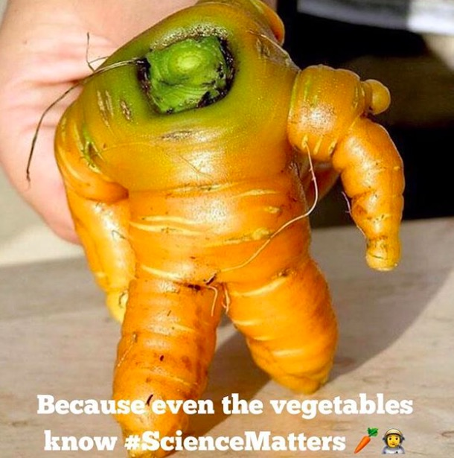
Home Economics & Global Citizenship Education…what is the link?

Slide 15
Home Economics and Global Citizenship…what is the link?
Home economics play a key role in this ever-changing, interdependent world house, called the global community
Home economics serve a unique bridging role between households and other sectors of society
The purpose of the subject is to empower individuals and families and to equip them in dealing with their world, to cope and to function with given situations
Home economics has a role in contributing to the solutions, not adding to the problems (i.e local or global issues)

Slide 16
Home economics educators have an opportunity to communicate the significance of creating and sustaining an improved quality of life for individuals and families from a global perspective
educator have a powerful influence on generations of individuals and families
Basic skills, such as consumer behavior, decision-making, problem- solving, and group interaction are the content of home economics curriculum, as well as the events and transactions of daily life

Slide 17
Provide the ability to see the world as an interdependent system; to be aware of one's influence in the interactions of the world's system. The ability to perceive
the world as a single system→ to be aware of one's involvement in it; to act to influence the system
information, attitudes, awareness, and skills, which, taken together, can help us understand our world, how we affect it, and how it affects us

Slide 19
JUNIOR CYCLE

Slide 20
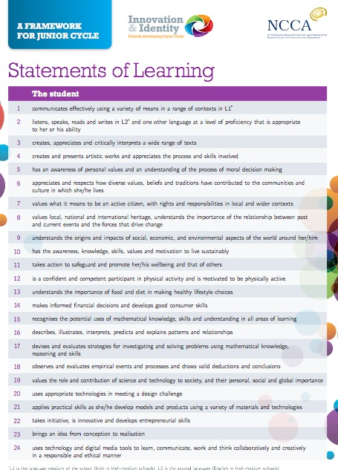
24 Statements of Learning (SOL) for New Junior Cycle
STRONG DE LINKS

Slide 21
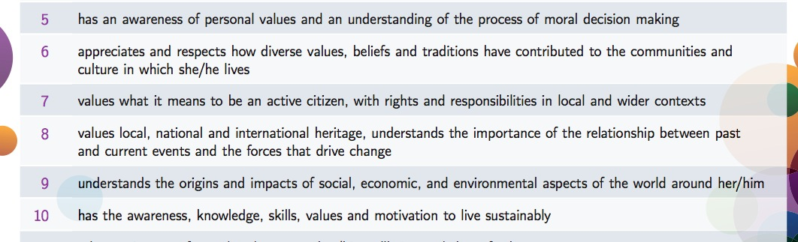
Very Strong DE Links
SOL 5-10
That’s a quarter of all SOL!!

Slide 22
Junior Cycle Home Economics
Aim
Home Economics aims to develop students’ knowledge, understanding, skills and competences to achieve optimal, healthy and sustainable living for every person as an individual, and as a member of families and society.
Home Economics aims to develop students’ practical food and health literacy skills so that they are enabled to adopt a healthy lifestyle and make informed decisions that positively impact their health and wellbeing as individuals as well as within their families and society.
It aims to cultivate students who are creative, innovative, adaptable and competent consumers.
Home Economics aims to develop students who are environmentally conscious and dedicated to a sustainable and responsible way of life.

Slide 23
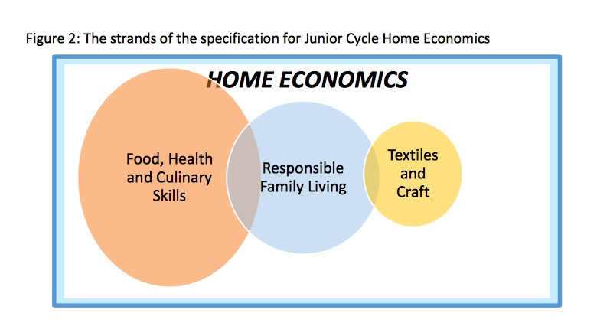
Diet Nutrition Food and health literacy | Role of family in society responsible and sustainable management of resources competent consumers Responsible consumers caring attitude towards other individuals, family members, society and the environment | Textile and craft skills Ethical production Sustainable Consumption Child Labor

Slide 24
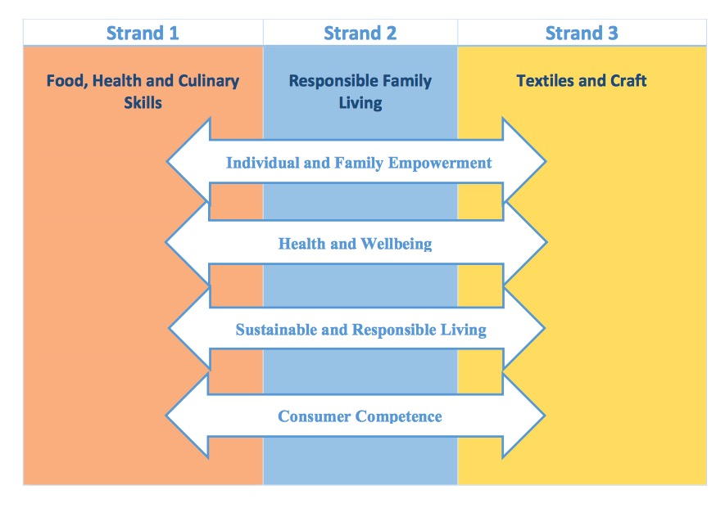
develop as critical, creative thinkers and problem solvers able to make informed decisions to achieve optimal, healthy and sustainable living for individuals, families and society.
decisions that positively impact the health and wellbeing of themselves as individuals as well as within their families.
future- oriented thinkers and environmentally-conscious citizens, committed to a sustainable and responsible way of life
make informed and discerning consumer choices that affect individuals and families in contemporary society.

Slide 25
Learning Outcomes
Food Health and Culinary Skills
1.15 investigate the impact of their food choices from an ecological and ethical perspective
1.16 apply sustainable practices to the selection and management of food and material resources
Responsible Family Living
2.8 identify how individuals and families can contribute to sustainable and responsible living
2.9 describe sustainable everyday practices in the home to include energy efficiency, waste management and water conservation
Textiles and Craft
3.8 discuss the influences of trends and choices on textile and clothing, including ethical and ecological considerations

Slide 26
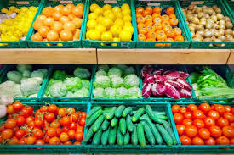
Food Production Cycle Activity

Slide 27
CBA 1 Creative Textiles
Option 2
Option 2: Recycle or upcycle a textile item for an individual or the home
Applying the design brief process and the principles of design and sustainability, students are asked to recycle or up-cycle a textile item for an individual or the home.
As part of the project, students will show evidence of:
    Applying the design brief process
    Applying the principles of design and sustainability
    Using basic hand sewing and/or machine sewing techniques in the making of the product
    Fabric embellishment techniques (where applicable)
    Appropriate textile care and maintenance.

Slide 28
SENIOR CYCLE

Slide 29
Senior Cycle
1. FOOD STUDIES
Food choices: Factors affecting food choices, to include:
• culture, eating patterns, sensory aspects, nutritional awareness, health status, availability, finance, marketing and advertising
Food Packaging: Packaging and materials used, to include:
evaluation of their suitability for
purpose and environmental impact

Slide 30
2. RESOURCE MANAGEMENT AND CONSUMER STUDIES
Housing: Factors that determine individual and family housing choices, to include:
socio-economic factors, national housing policy, trends in housing development, availability
Consumer Responsibility
Responsibility of the consumer in informed decision-making, with regard to:
consumer information and rights
management of the environment,
to include use of renewable and non-renewable resources, recycling, pollution
3. SOCIAL STUDIES
The family in society

Slide 31
Electives
Elective 1: HOME DESIGN AND MANAGEMENT The energy efficient home
Elective 2: TEXTILES, FASHION, AND DESIGN Contemporary clothing and fashion
Elective 3: SOCIAL STUDIES Education : Equality of opportunity in education, with reference to gender inequity, socio-economic status etc. Poverty: The extent and distribution of poverty in Ireland today and identification of those groups at risk of poverty Reasons why poverty continues to be a feature of modern western society

Slide 32
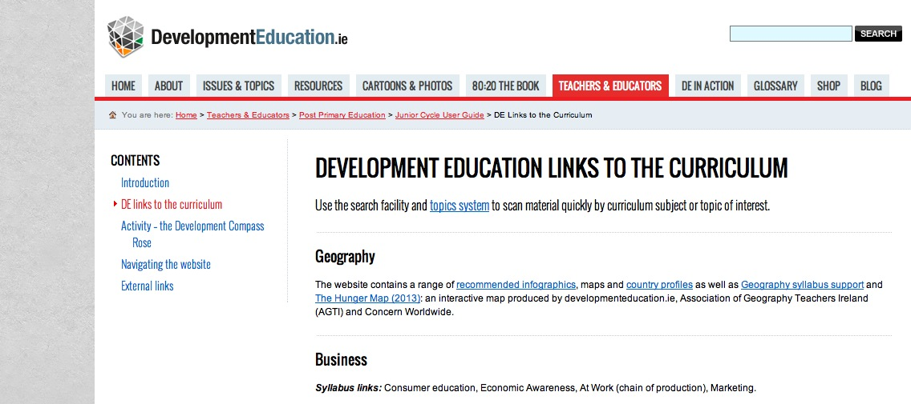
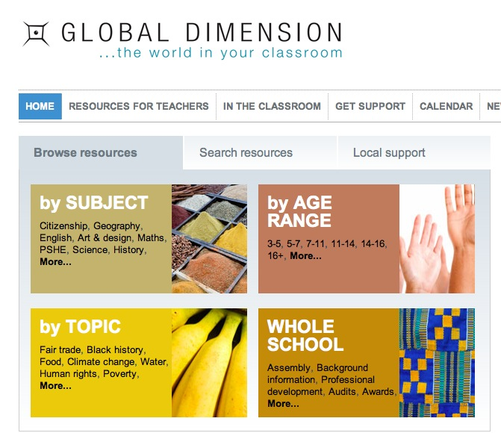
Teaching and learning material
2 websites:
Developmenteducation.ie globaldimension.org.uk

Slide 33
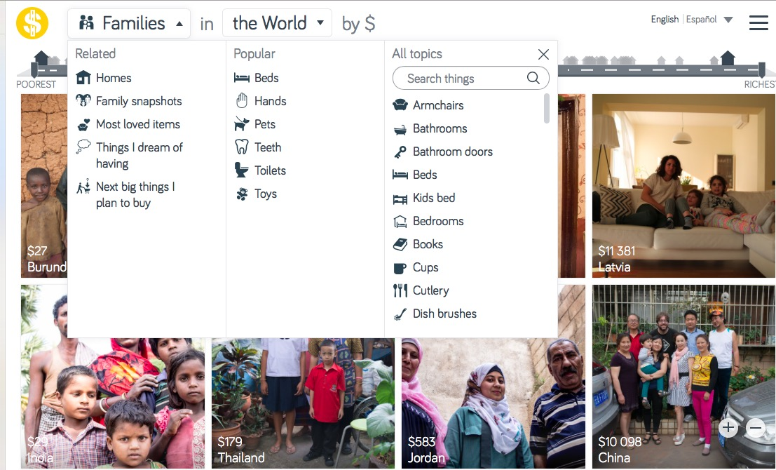
Resources: Dollar Street
264 families in 50 countries and collected 30,000 photos

Slide 34
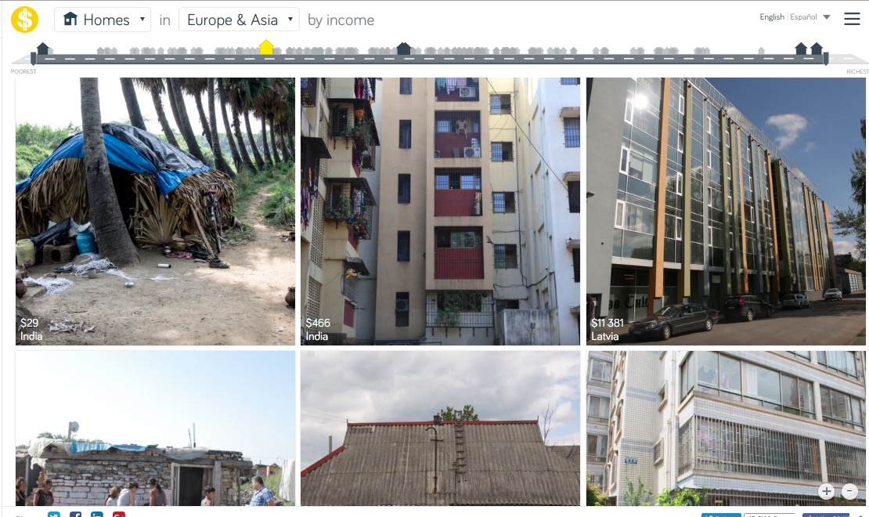
Resources: Dollar Street
264 families in 50 countries and collected 30,000 photos

Slide 35
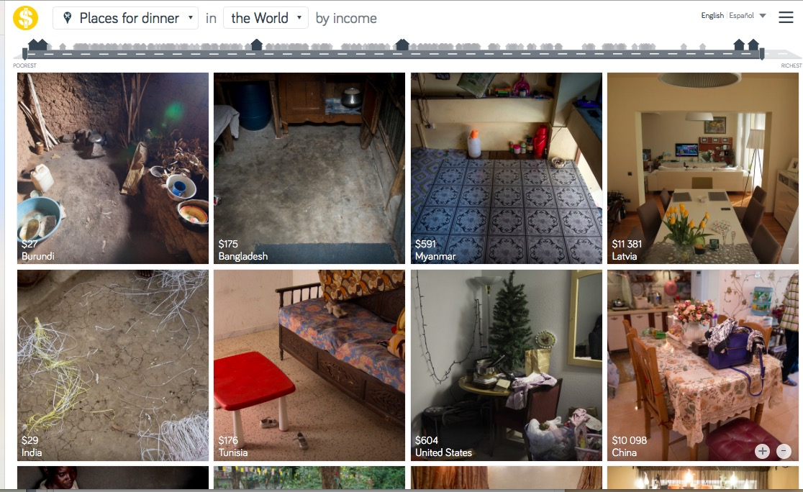
Resources: Dollar Street
264 families in 50 countries and collected 30,000 photos

Slide 36
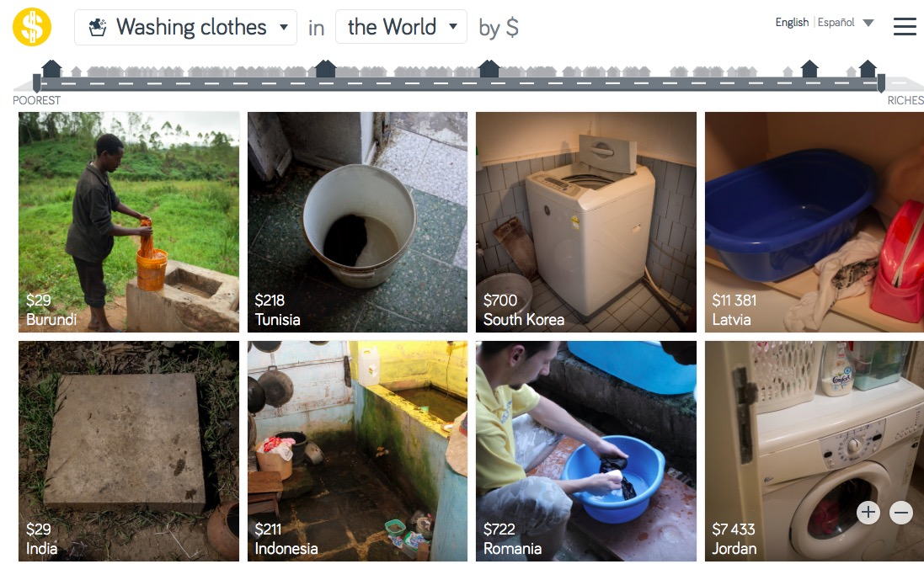
Resources: Dollar Street
264 families in 50 countries and collected 30,000 photos

Slide 37
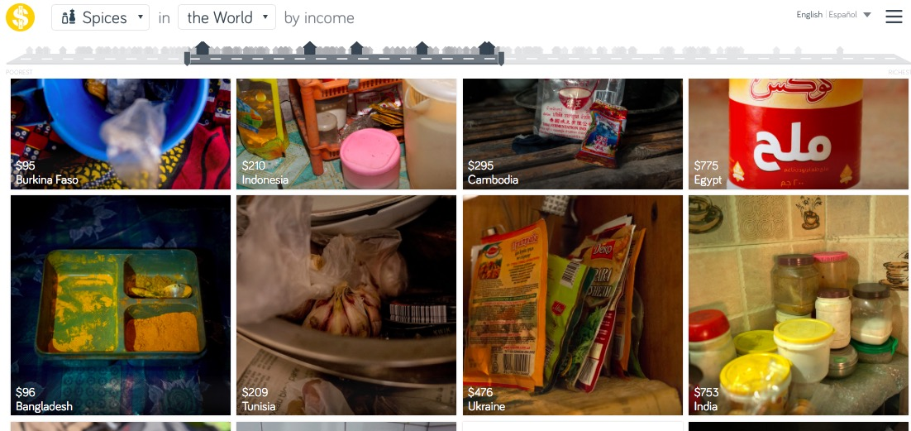
Resources: Dollar Street
264 families in 50 countries and collected 30,000 photos

Slide 38
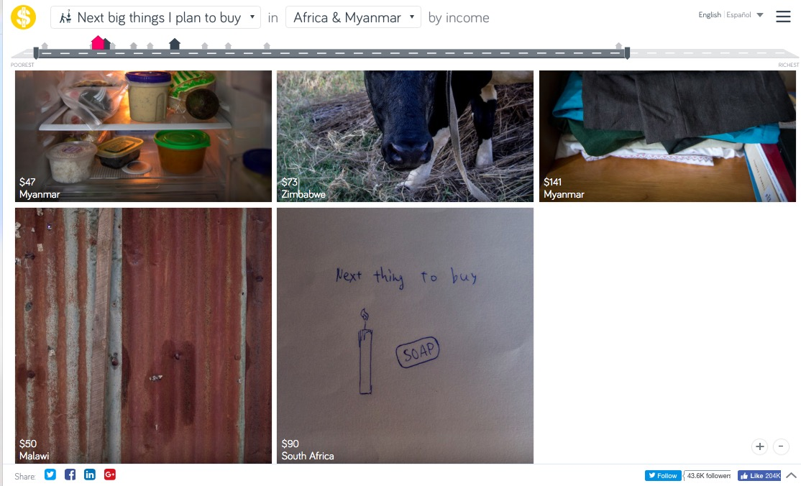
Resources: Dollar Street
264 families in 50 countries and collected 30,000 photos

Slide 39
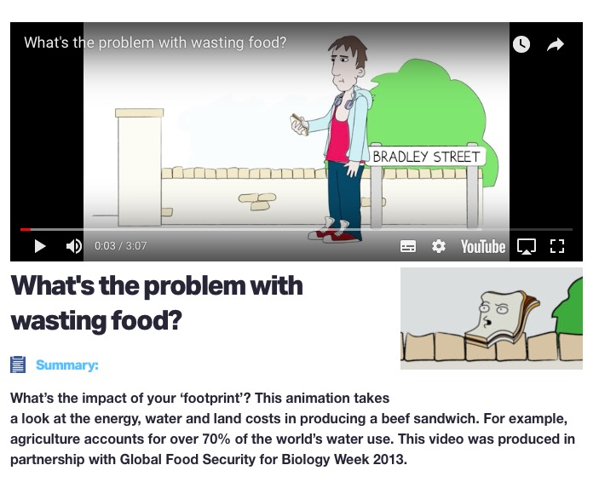
What's the problem with wasting food?
Royal Society of Biology

Slide 40
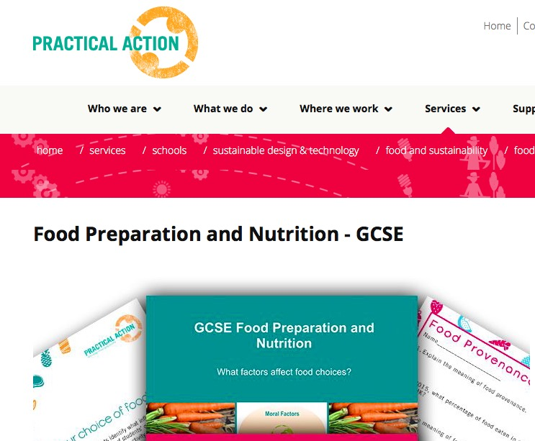
Practical Action:
Food choice, provenance and sustainability
Food Provenance: Where food comes from
Food life cycles: Social and Environmental impacts of foods throughout their life cycle
Food security and sustainability

Slide 41
Taking Action:
Rank the different actions!

Slide 42
The Worlds largest Lesson (Website)

Slide 43
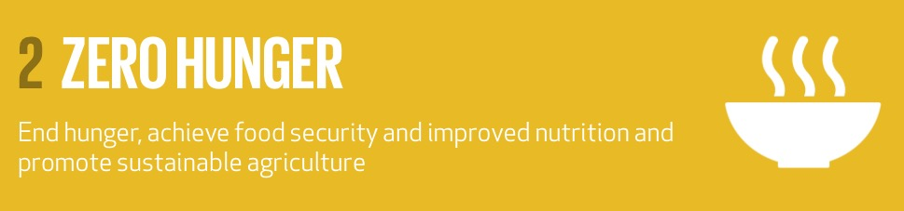
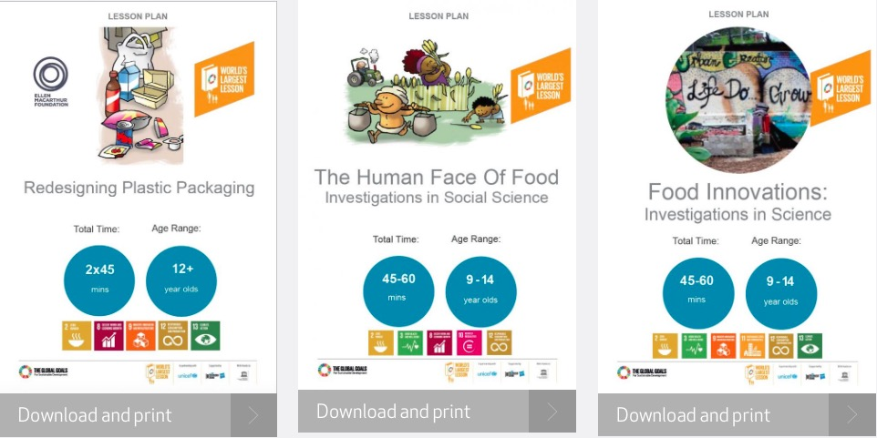

Slide 44
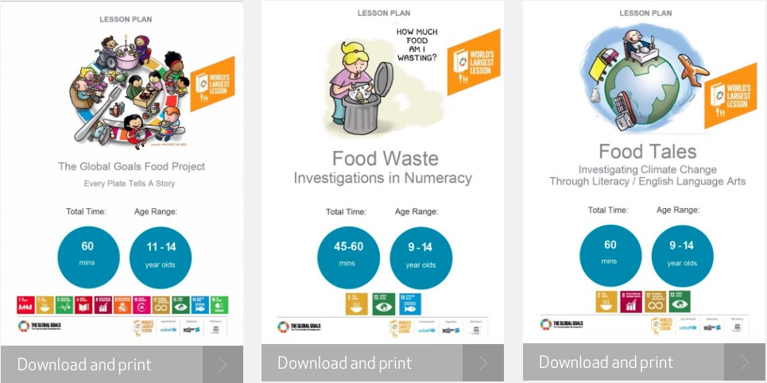

Slide 45
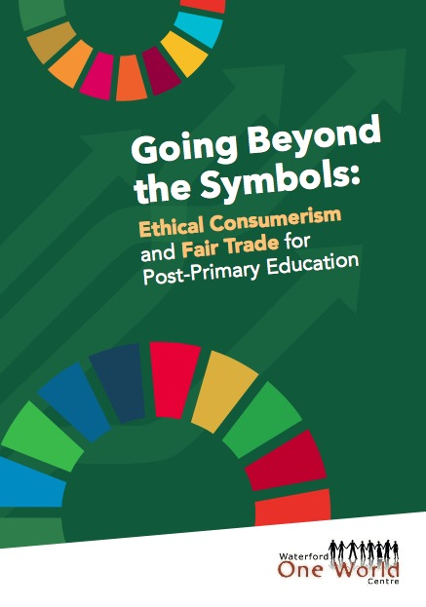
Ethical consumption
Consumer choice
Fair trade
Sustainability
Textiles
Ethical production

Slide 46
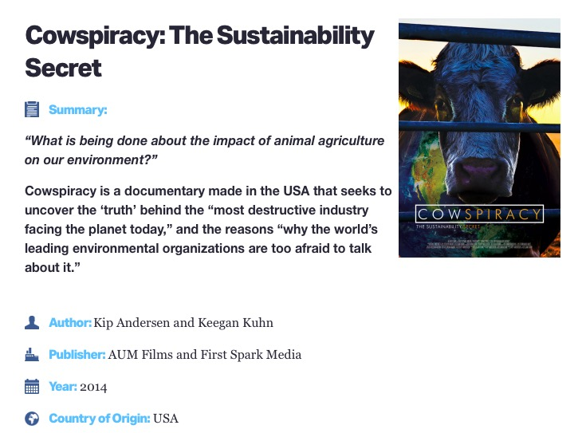

Slide 47
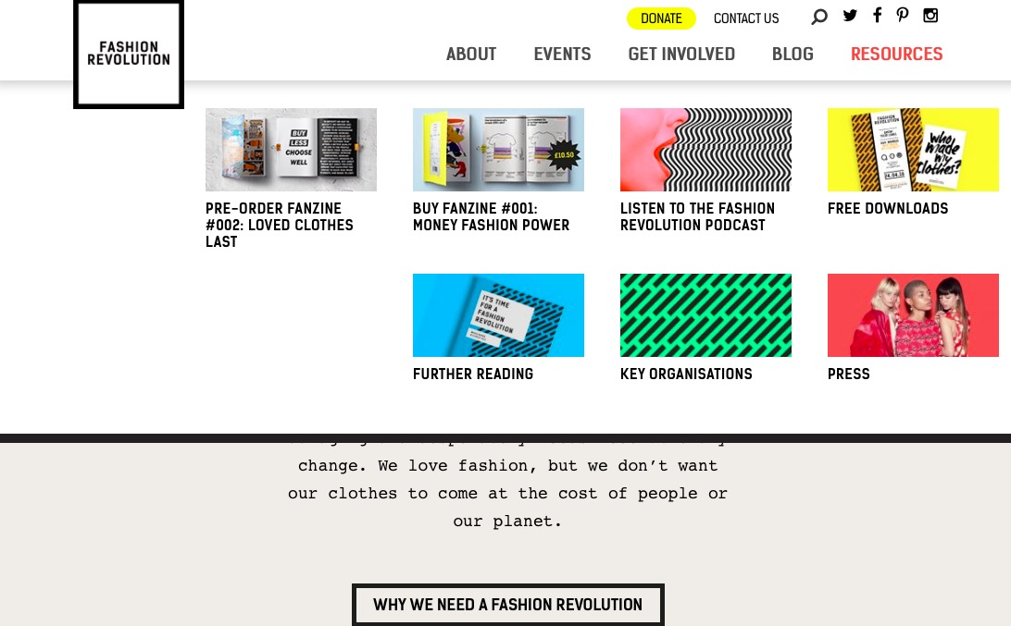
Fashion Revolution fashionrevolution.org

Slide 48
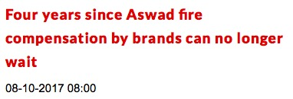
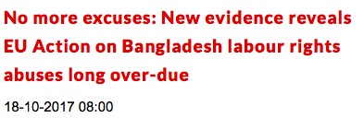
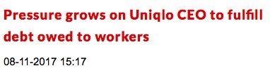
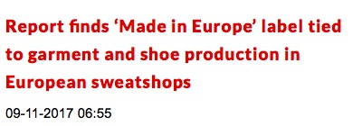

Slide 49



Fashion/Textiles

Slide 50
Biology
1.3: Nutrition
1.3.1 Function of food
Compare consumption patterns and calorie intake in different regions/countries
Discuss causes of unequal access to health
and nutrition
1.4 Ecology:
1.4.9 Human impact on an ecosystem:
Pollution, Conservation, Waste management - importance of waste minimisation
Pollution: The ecological impact of one human activity
1.4.12 Population dynamics
Movement of populations for food availability to more abundant locations.
The effect on the human population of:
War
Famine
Disease

Slide 51













Large community of NGOs involved in Post-Primary GCE in Ireland

Slide 52

Facebook: WorldWise Global Schools

Slide 53
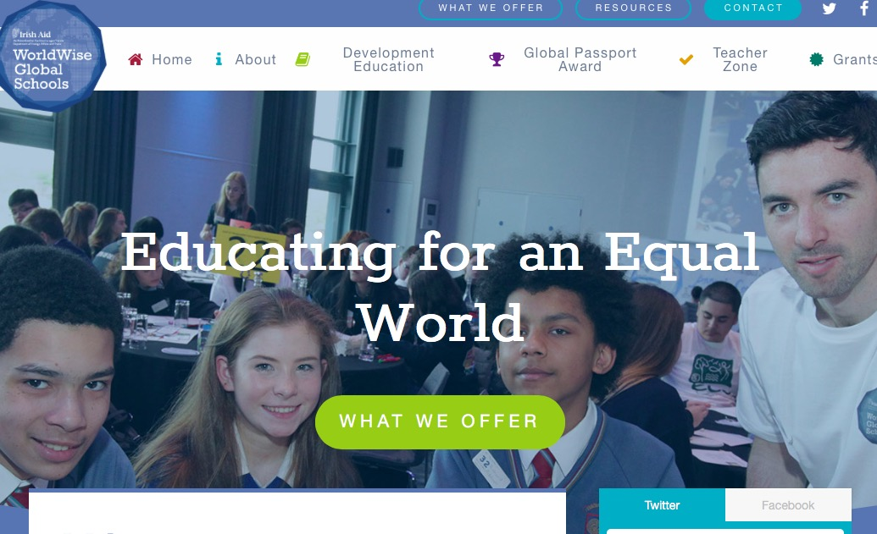
www.worldwiseschools.ie

Slide 54
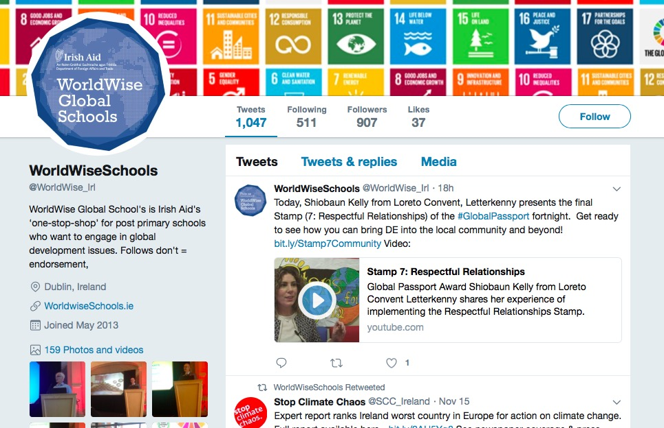
Twitter: WorldWise Schools

Slide 55




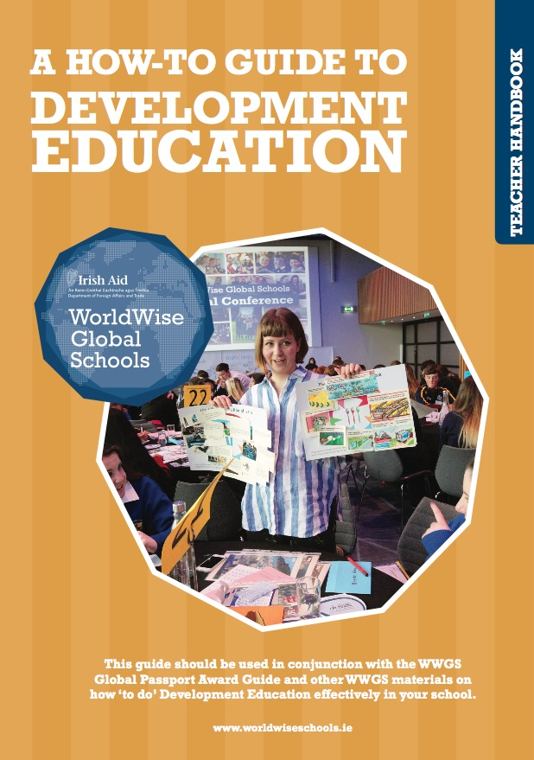

http://www.worldwiseschools.ie

