Slide 1
NOTES FOR THE TEACHER:
This is a suggested slide deck to go with our lesson plan ‘Redesigning Plastics’.
It has two sections:
exploring how plastics are currently produced and designed, its benefits and the challenges that this poses.
supporting students in their own process of rethinking and redesigning.
Please adapt them to your context and needs and let us know how it goes.
On the final page of the accompanying lesson plan, you will find links to further information and contacts.

Slide 2
Redesigning Plastics - PART 1
The New Plastics Economy

Slide 3
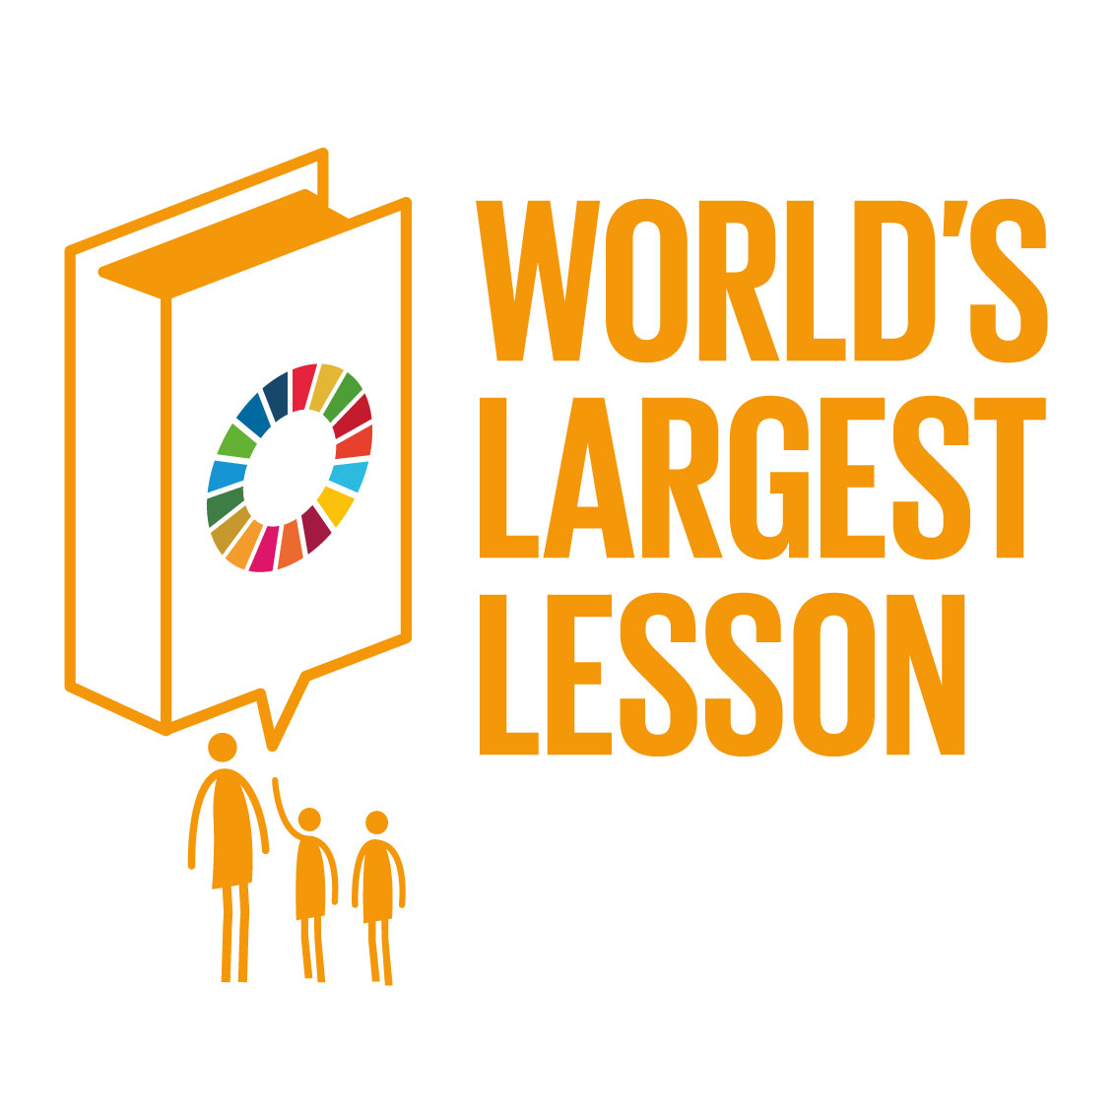
You are joining students in over 100 countries in the
Don’t forget to add your lesson moment to the interactive world map –
and help write the story of the World’s Largest Lesson!
http://worldslargestlesson.globalgoals.org/map

Slide 4

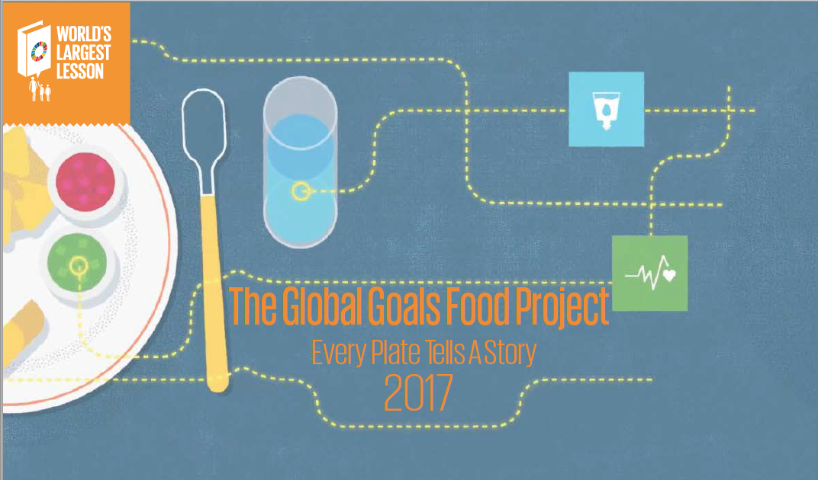
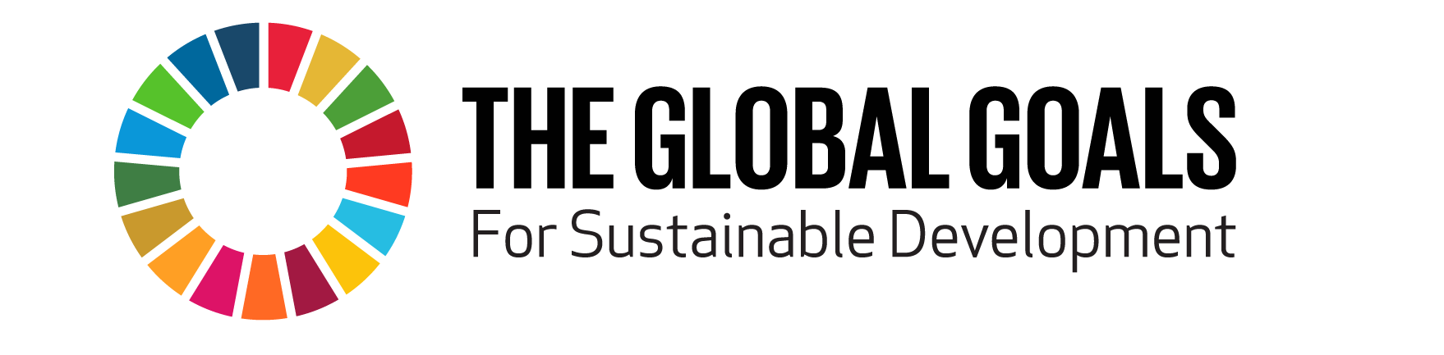
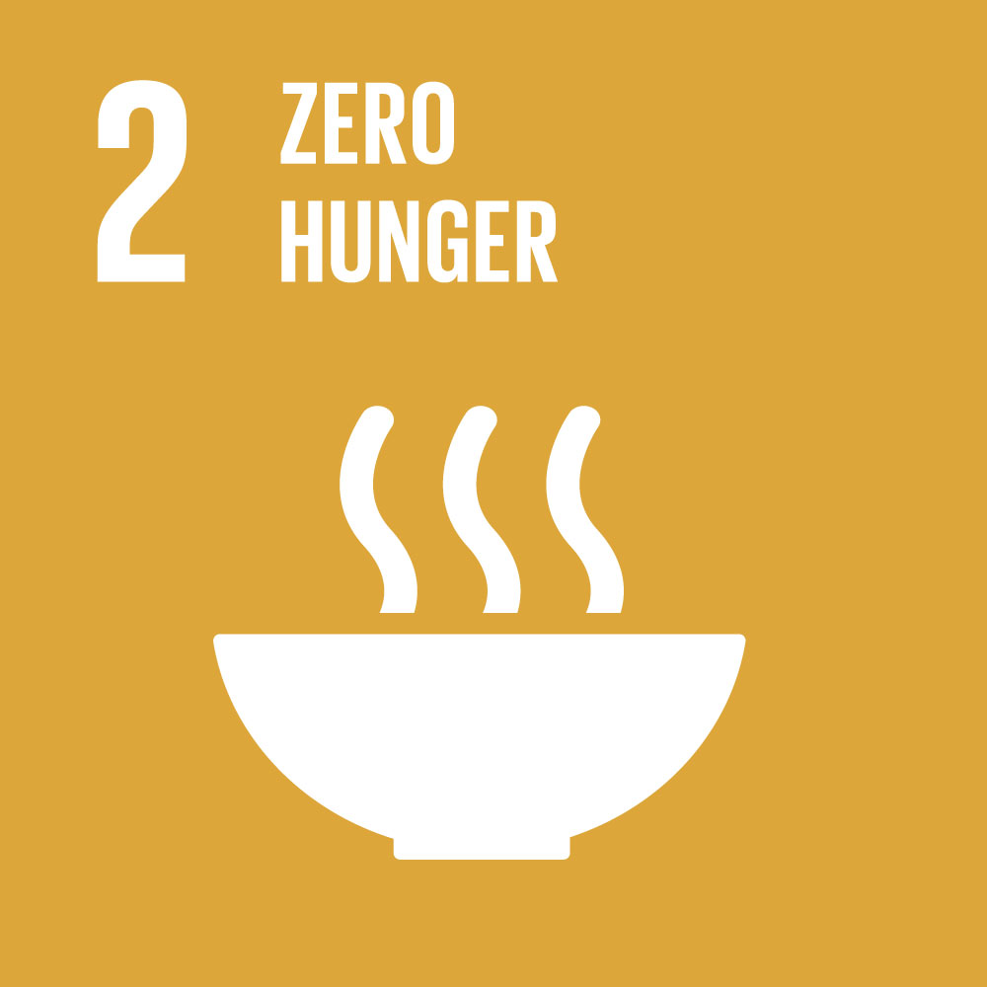
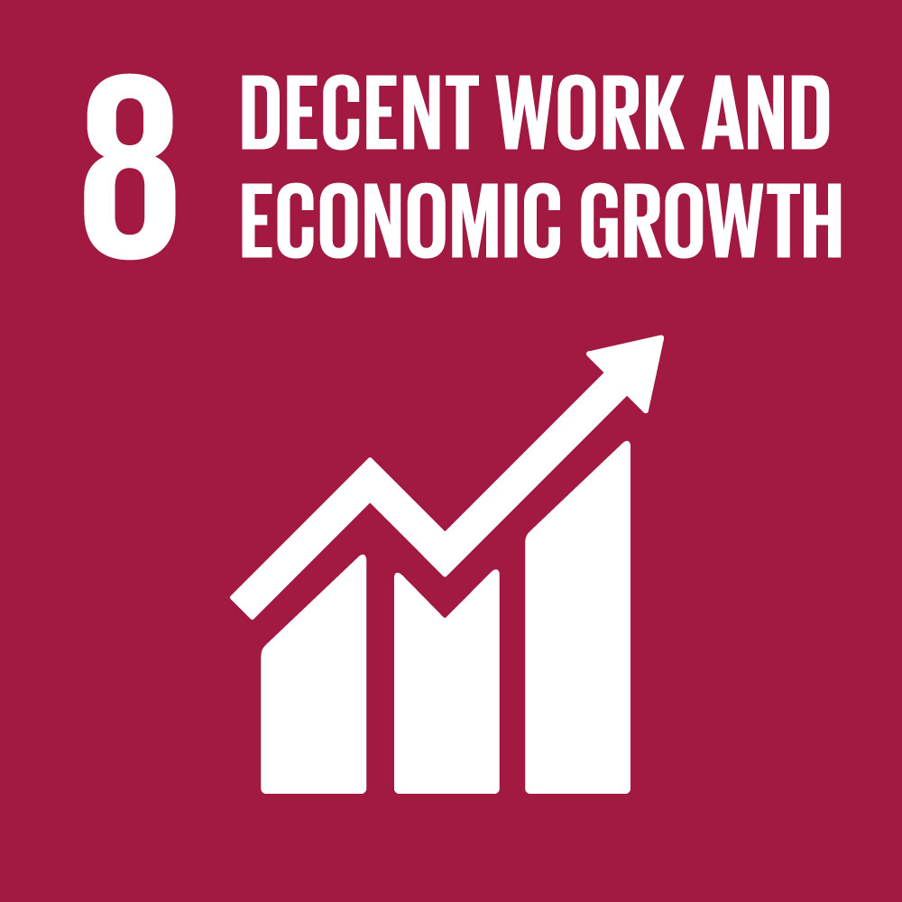
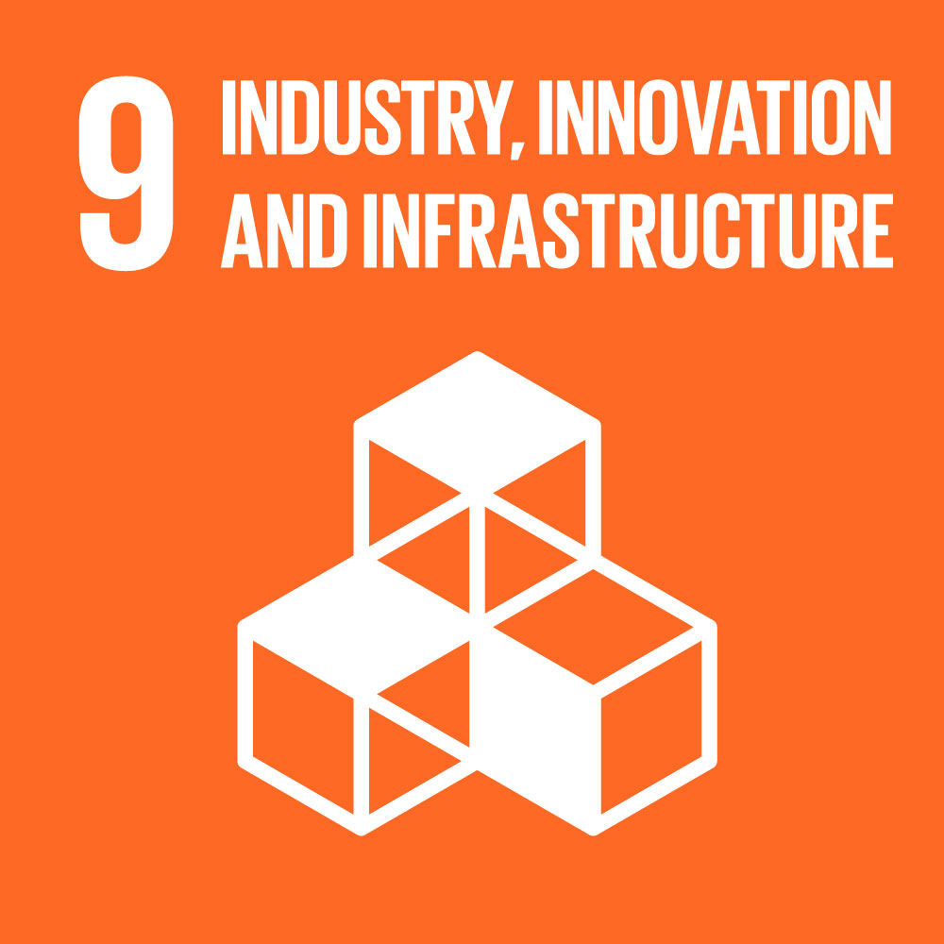
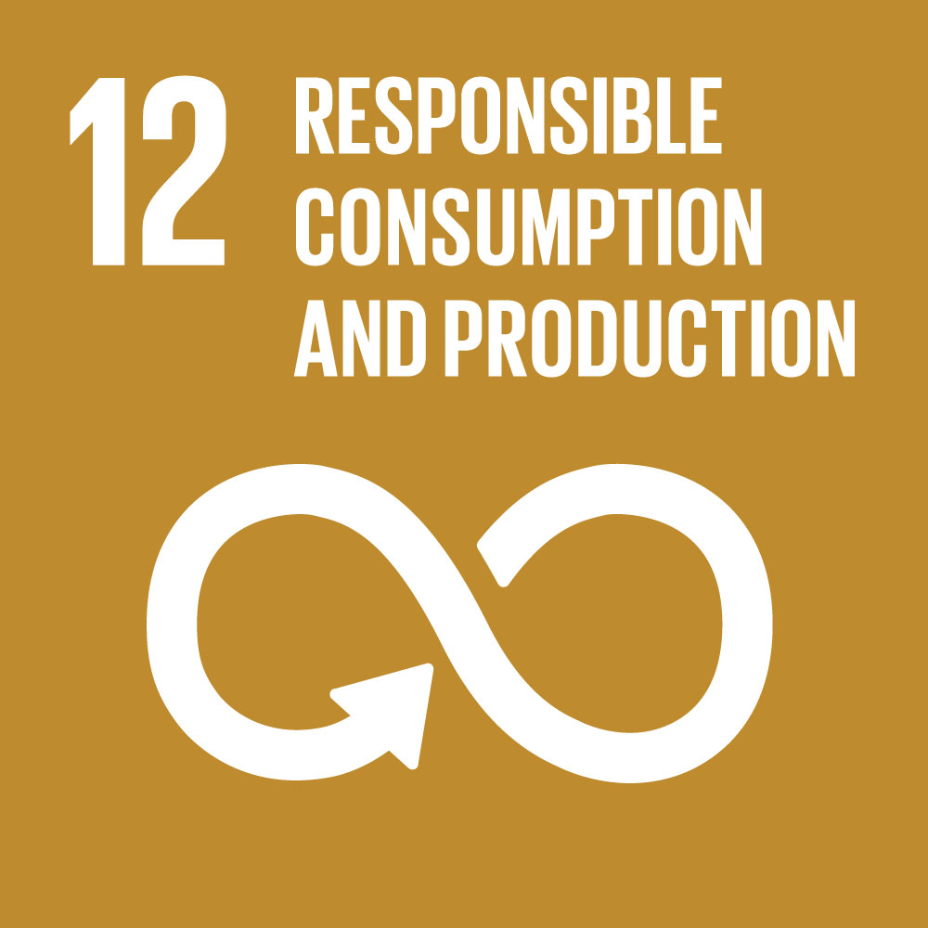
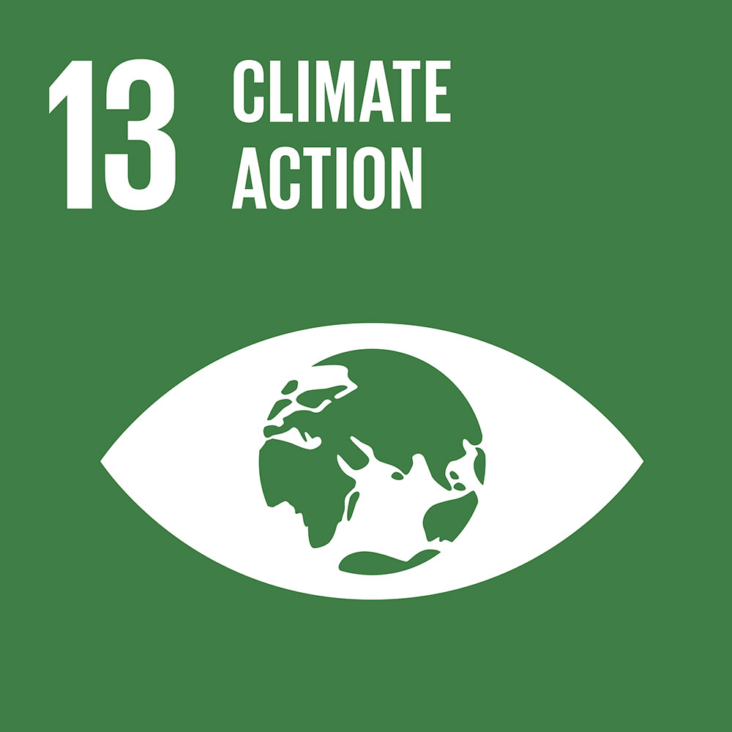
With the
This lesson inspires creative
problem solving towards 5 of the
Notes:
This lesson is part of a series of 6 lessons connecting Food with the Global Goals. Watch the introductory video which shows how you can help achieve the Global Goals through food choices:
https://vimeo.com/220663067

Slide 5

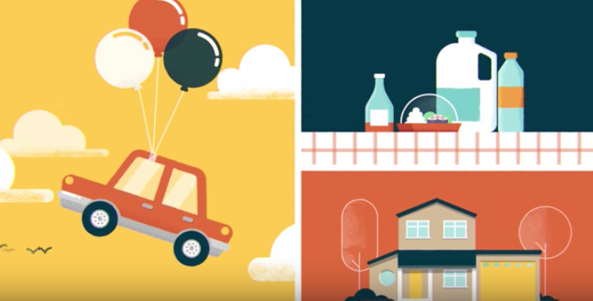
Notes:
https://www.ellenmacarthurfoundation.org/programmes/systemic-initiatives/new-plastics-economy
NOTE: click on the image to reach our webpage where you can access the video.
TEACHER’S GUIDANCE:
This video provides an excellent introduction to plastics – the pros and the cons – and sets students up for the starter activities that follow.
VIDEO TRANSCRIPT:
Plastics are all around us. We all benefit from them. They make our cars lighter, protect our food and insulate our homes. As we use plastics in more and more ways, we’re also creating more. But did you know that just 14% of global plastic packaging is recycled? All the rest, worth 80- 120 billion dollars every year, is lost after just one short use, and that nearly a third of all plastic packaging leaks into ecosystems where it can stay around for hundreds of years. This means that by 2050, there could more plastics than fish in the sea. The New Plastics Economy aims to drive a movement towards a system that works, transforming the current, take-make-dispose economy into one where plastics are designed to be used over and over again. To do that we’re bringing together leading organisations, experts, and entrepreneurs form across the world to innovate, collaborate, and rethink the way we produce, use and recover plastics. We know it’s possible. Join us in creating an effective system that works for everyone. Visit newplasticseconomy.org to learn more and see who is already involved.

Slide 6
WHAT IS MADE OF PLASTIC?
Write down as many things as you can!
GO! - 1min
Notes:
TEACHER’S GUIDANCE:
Ask students to write down as many things they can think of that are made of plastic and then feedback ideas.

Slide 7
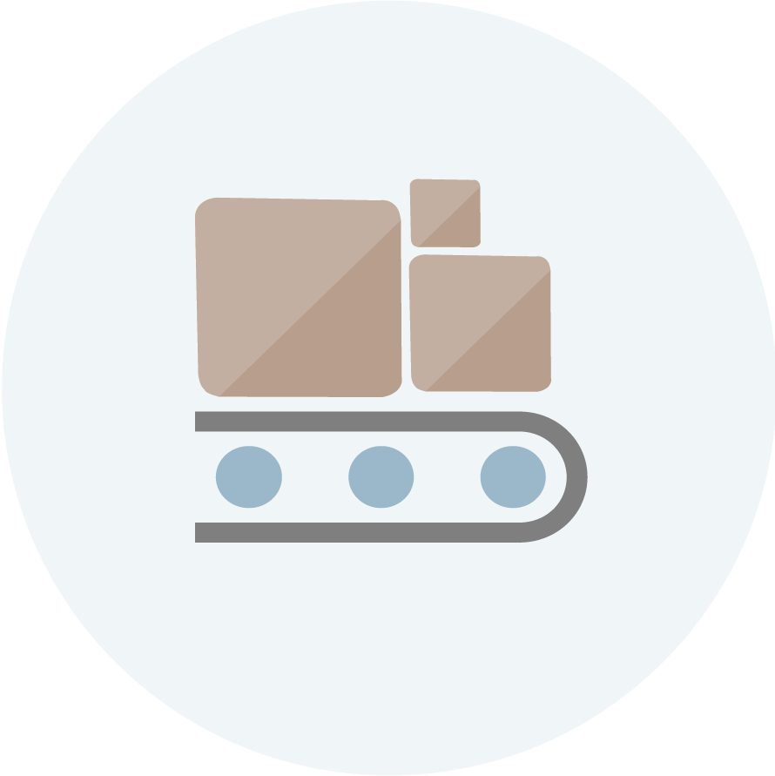
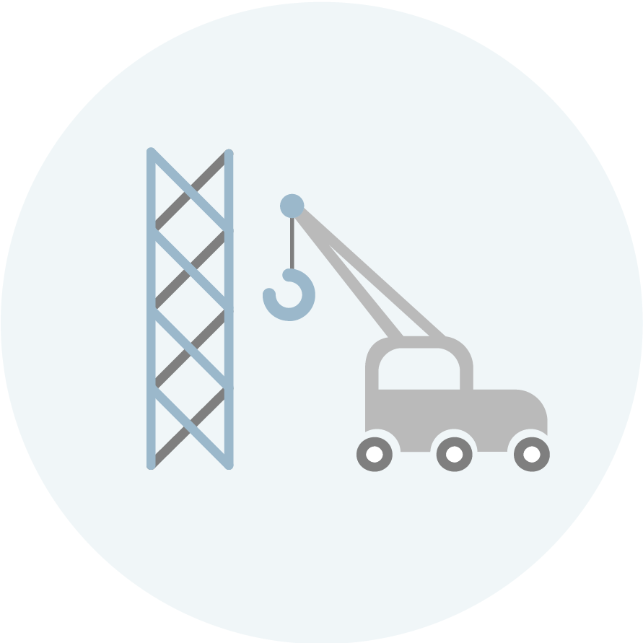
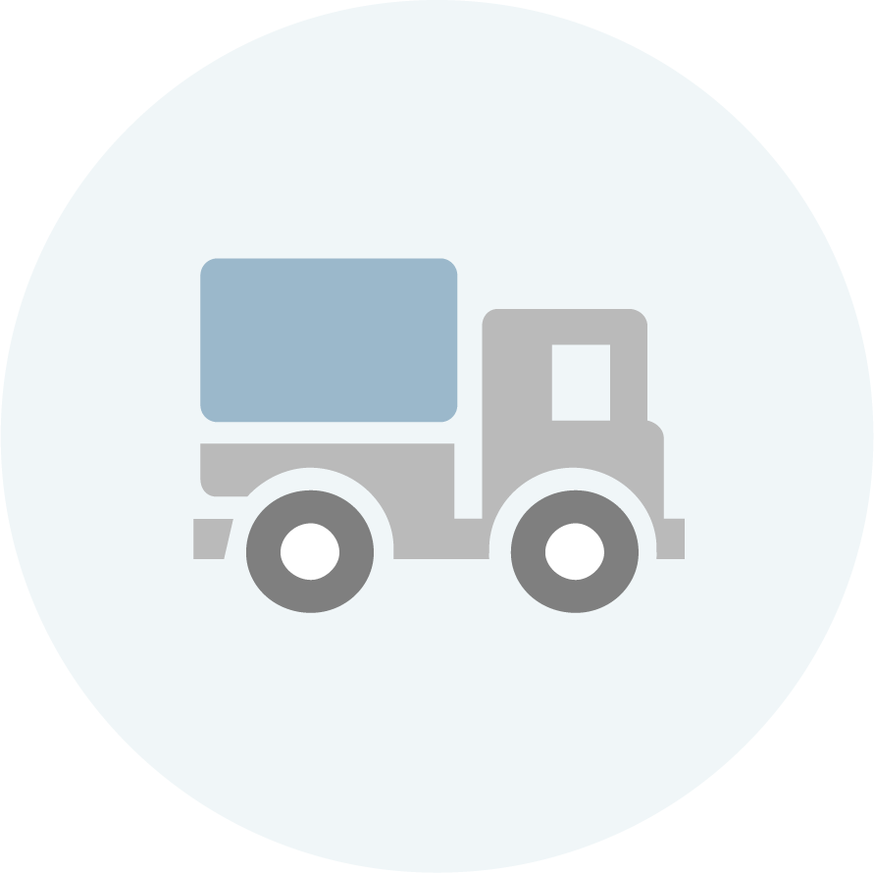

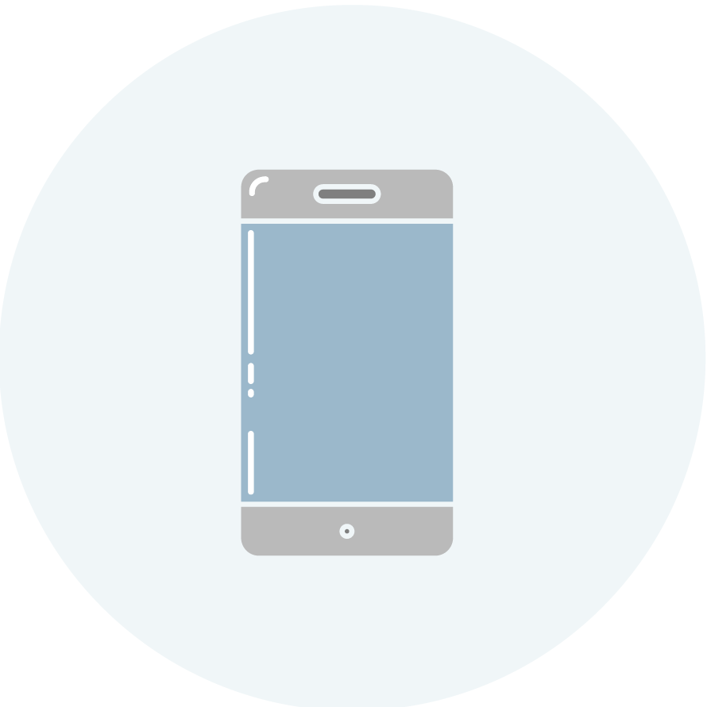
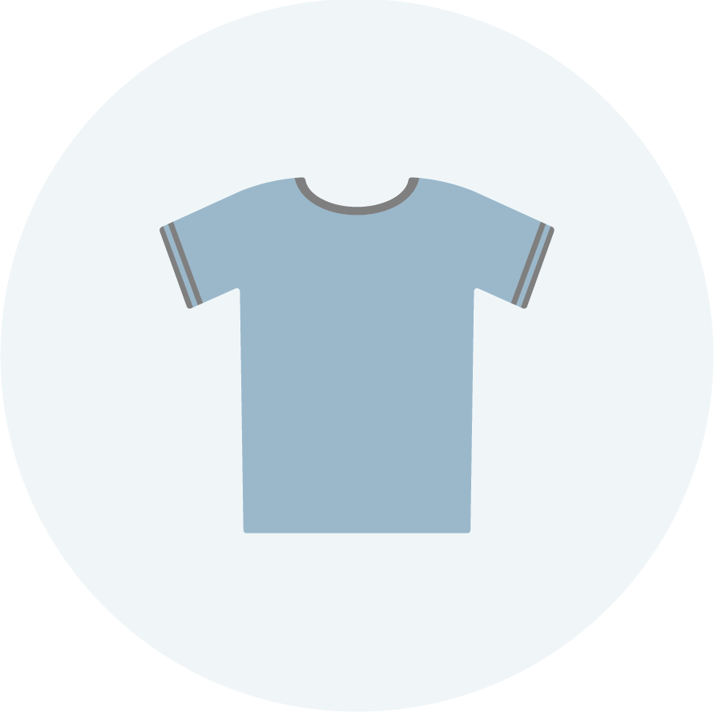
APPLICATIONS
Plastics are everywhere
Notes:
TEACHER’S GUIDANCE:
Explore some applications of plastics in the students’ everyday lives. How many different objects made of plastic do they have on them or can they see right now?
USEFUL INFORMATION:
Packaging materials: Bubble wrap, cling film, food packaging, crisps, endless!
Construction: Modern window frames are made of a plastic called PVC. Many small parts and components are moulded as well.
Transportation: Loads of plastic is built into cars, buses and trains, making them lighter, saving fuel.
Healthcare: Single use plastics like syringes are very hygienic, look around in a hospital and see how many tools and devices are used by doctors and nurses are made of plastic.
Electronics: Playstation, Xbox, laptops, mobile phones, televisions, cameras etc.
Clothes: Synthetic garments, Nylon, recycled PET bottles (see http://www.waste2wear.com/) (watch this video from Patagonia’s recycled clothing line http://www.patagonia.com/recycled-polyester.html

Slide 8
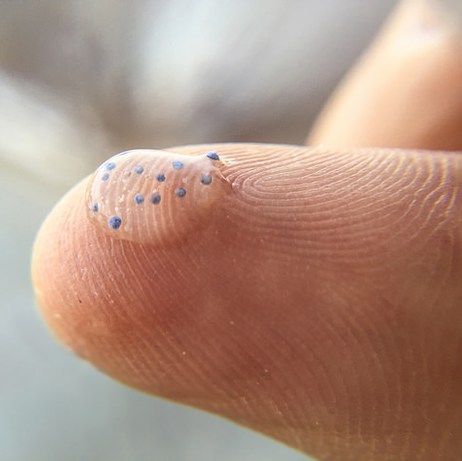
From Football to Make-up
It’s all plastic
Source: CC BY-NC 2.0 Minnesota Pollution Control Agency Photos - microbeads-plastic-particles
Notes:
DID YOU KNOW?
Adidas is creating new Real Madrid and FC Bayern Munich kits from recycled ocean plastic.
Eric Liedtke, Adidas group executive board member responsible for Global Brands:
“We have not only managed to make footwear from recycled ocean plastic, but have also created the first jersey coming 100% out of the ocean. But we won’t stop there. We will make one million pairs of shoes using Parley Ocean Plastic in 2017 – and our ultimate ambition is to eliminate virgin plastic from our supply chain.”
http://www.thedrum.com/news/2016/11/04/adidas-creates-new-real-madrid-and-fc-bayern-munich-kits-recycled-ocean-plastic-part
Plastics in cosmetics
In addition to the obvious packaging role, plastic serves as a film-former in hair gel, hairspray, barrier products, and liquid bandages. Used as polyvinyl alcohol and various other forms, plastics are easily incorporated into many skin and hair care products. Plastic keeps your coif in that perfect Flock of Seagulls swoop, makes your waterproof mascara waterproof, and suspends those little beads in your eye gel. Speaking of beads, tiny polyethylene spheres are frequently used in exfoliating scrubs. The products are generally marketed as "extra gentle," since they are perfectly round and do not damage the skin's surface when used in moderation.
http://mentalfloss.com/article/18876/9-weird-ingredients-hiding-your-makeup-bag

Slide 9
What is it good for?
The Pros and Cons of plastics
On your post-it notes:
Write down all the good things about plastic
Write down all the bad things about plastic
Notes:
TEACHER’S GUIDANCE:
Encourage students to think of all the pros and cons of using plastics. (See ‘Teacher’s notes’ in lesson plan for detailed information)
Previously given by STUDENTS as answers
PRO - you can recycle them, light, easy to make/mould, cheap, useful for packaging
CON - bad for our planet, oceans, animals eat it or get tangled in it, not biodegradable, some are not recyclable

Slide 10
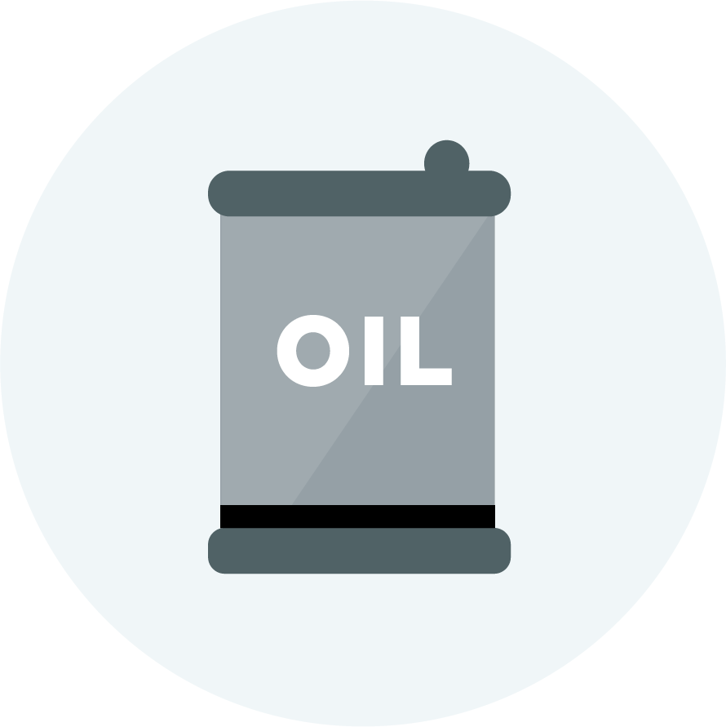

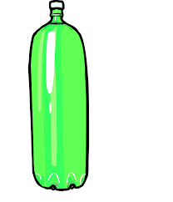
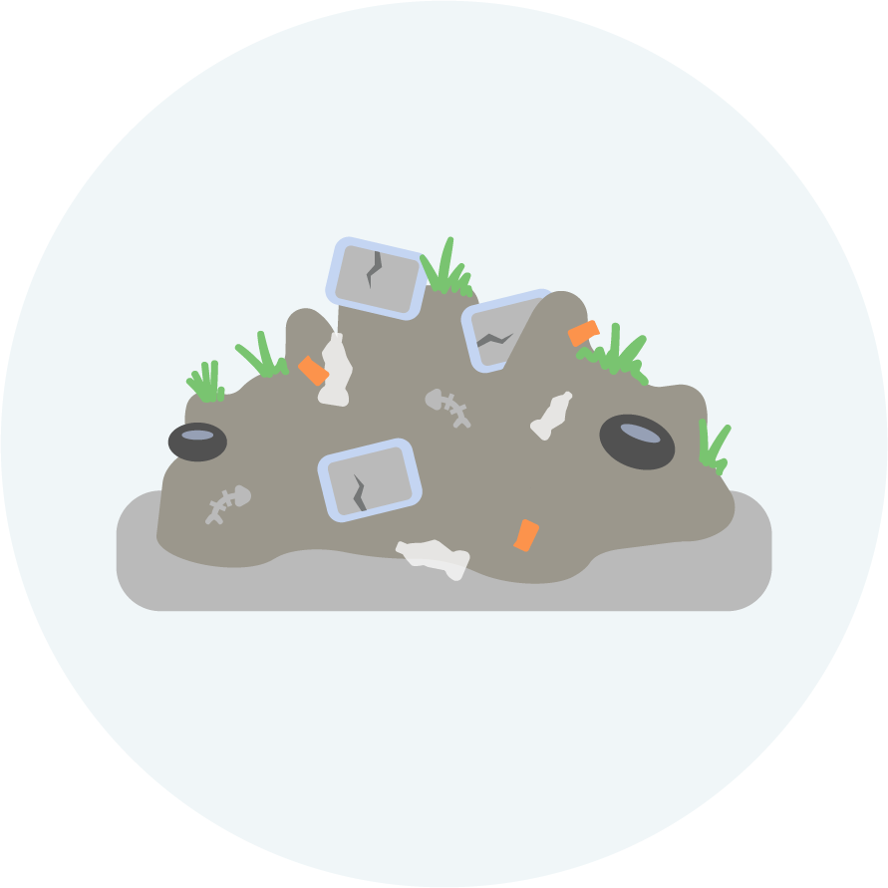
HOW ARE PLASTICS PRODUCED?
A linear system
USE
THROW _AWAY
TAKE
MAKE
Notes:
TEACHER’S GUIDANCE:
Using a plastic bottle as an example, we can see that the process of production runs in a straight line (linear production).
It relies on a non-renewable resource (oil) being taken from the ground, which is used to make the plastic, which is then moulded in a factory to make the bottle. When that bottle is no longer of use it is thrown away, ending up in landfill.
This is what our current plastics economy looks like.
Q: Why is this a problem?
USEFUL INFORMATION:
What is an economy?
noun
1.
the state of a country or region in terms of the production and consumption of goods and services and the supply of money.
A helpful framework for thinking about the economy with students is to consider:
What gets produced, how it is produced, and who gets the benefit.

Slide 11
CIRCULAR ECONOMY
Learning from natural systems
Notes:
TEACHER’S GUIDANCE:
Show students the above animation, which introduces the concept of a circular economy and how it relates to natural systems.
USEFUL QUESTIONS:
What happens to the owl in the video?
What’s so great about carrots?
What happens to the chair?
VIDEO TRANSCRIPT:
Living systems have been around for a few billion years, and will be around for many more. In the living world there’s no landfill, instead materials flow. One species’ waste is another’s food, energy is provided by the sun, things grow, then die, and nutrients return to the soil safely. And it works. Yet, as humans, we’ve adopted a linear approach; we take, we make, and we dispose. A new phone comes out so we ditch the old one. Our washing machine packs up so we buy another. Each time we do this, we’re eating into a finite supply of resources, and often producing toxic waste. It simply can’t work long term. So what can?
If we accept that the living world’s cyclical model works, can we change our way of thinking so that we too operate a circular economy? Let’s start with the biological cycle: How can our waste build capital rather than reduce it? By rethinking and redesigning products and components, and the packaging they come in, we can create safe and compostable materials that help grow more stuff. As they say in the movies – no resources have been lost in the making of this material. So what about the washing machines, mobile phones, fridges – we know they don’t biodegrade. Here we’re talking about another sort of rethink, a way to cycle valuable metals, polymers, and alloys so they maintain their quality and continue to be useful beyond the shelf life of individual products. What if the goods of today, became the resources of tomorrow? It makes commercial sense. Instead of the throw away and replace culture we’ve become used to, we’d adopt a return and renew one where products are designed to be disassembled and regenerated. One solution maybe to rethink the way we view ownership. What if we never owned our technologies, we simply licensed them from the manufacturers.
Now let’s put these two cycles together. Imagine if we could design products to come back to their makers, their technical materials being reused, and their biological parts increasing agricultural value. And imagine that these products are made and transported using renewable energy. Here, we have a model that builds prosperity long term, and the good news is there are already companies out there who are beginning to adopt this way of working. But the circular economy isn’t about one manufacturer changing one product, it’s about all the interconnecting companies that form our infrastructure and economy, coming together. It’s about energy. It’s about rethinking the operating system itself. We have a fantastic opportunity to open new perspectives and new horizons. Instead of remaining trapped in the frustrations of the present, with creativity and innovation, we really can rethink and redesign our future.

Slide 12
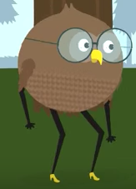
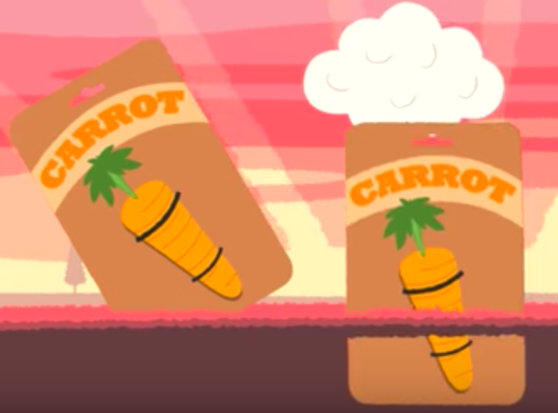
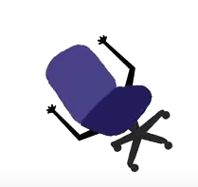
Quick re-cap: What do you understand from the video?

Slide 13
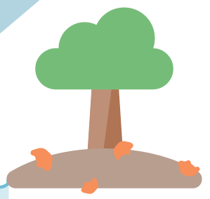

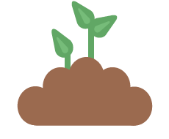

LEARNING FROM NATURE’S CYCLES
Notes:
NOTE: THE NEXT FOUR SLIDES ARE DIFFERENTIATED FOR DIFFERENT AGE GROUPS. THE FIRST TWO ARE SIMPLIFIED VERSIONS OF THE SECOND TWO.
USEFUL INFORMATION:
What does the life cycle of a Mango look like?
After eating, you can throw the leftovers into a compost and new soil can be generated and over time a new tree or other plant could grow out of it. And trees are a little bit like nature’s factories, producing fruit and other valuable products. And the cycle starts again.
USEFUL QUESTION:
Could a similar process be applied to man-made products in order to reduce waste and optimise their value?

Slide 14
LEARNING FROM NATURE
Keep materials in cycles
Nothing becomes ‘waste’
Notes:
TEACHER’S GUIDANCE:
These two principles of the circular economy are important when thinking about design. If we observe how natural cycles work, we see that materials flow in closed loops and nothing becomes waste as materials decompose to release nutrients with then nourish other forms of life (as highlighted in the animation).

Slide 15
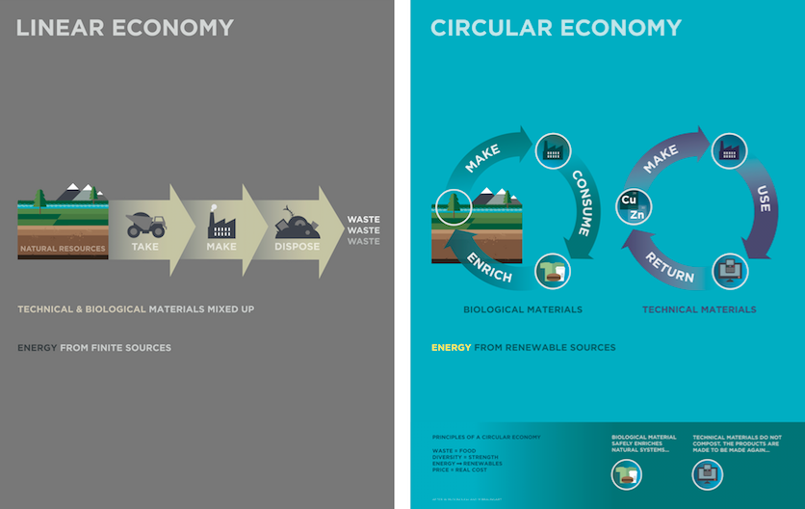
FROM LINEAR TO CIRCULAR
Notes:
TEACHER’S GUIDANCE:
The above diagrams illustrate the fundamental differences between a linear and circular economy.
At this point, you may want to ask students to feedback some of their ideas about the differences between linear and circular and why this shift in the economy might be important.

Slide 16
Notes:
TEACHER’S GUIDANCE:
The above ‘Butterfly Diagram’ illustrates the regenerative cycle of biological materials (green), and the restorative cycle of technical materials (blue). By cycling materials for longer, their value is ‘optimised’, leading to a reduction in negative externalities such as water pollution.
Use the diagram with students to highlight the differences between a linear economy (centre line of diagram) and a circular economy (the outer loops to the left and right). Ask students to think of everyday items or products such as a phone or laptop and decide where they fit (technical or biological cycles) and how these products could be cycled within the different loops.
USEFUL QUESTIONS:
How could these products be redesigned to enable the materials to flow within the system and not become waste?
How might a mobile phone be made to fit the ‘maintain/prolong’ loop in the diagram?
Are there any products that contain a mixture of biological and technical nutrients and how could this create difficulties within a circular economy?

Slide 17
Notes:
WHAT CAN BE DONE TO IMPROVE PLASTICS?
The New Plastics Economy (NPEC) team of the Ellen MacArthur Foundation have identified these three strategic areas to transform the global plastics economy. A $2m New Plastics Economy Innovation Prize was launched in May 2017 to challenge designers, scientists, entrepreneurs and academics to create a plastics system that works.
See the video on this page to find out more: https://newplasticseconomy.org/innovation-prize
Alternatively, you can click on the graphic in the slide.
Show this to your students so they can get a feel for the challenges we are currently facing around plastics and what steps are being taken to improve them.

Slide 18
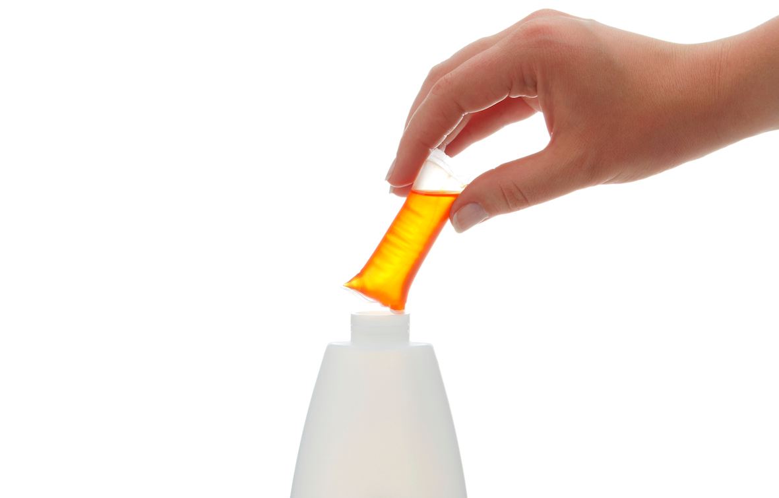
An example combining this
A new way of doing business?
Keep materials in the loop
Nothing becomes ‘waste’
Notes:
USEFUL INFORMATION:
https://www.ellenmacarthurfoundation.org/case-studies/how-re-thinking-the-business-model-for-cleaning-products-can-influence-design
Splosh sells customers a one-off ‘starter box’, containing a range of simply designed bottles. A sachet of concentrated liquid is added to the bottle with warm tap water to create cleaning products. Bottles can be used repeatedly, with refill sachets delivered in boxes through the post.
Angus Grahame set up Splosh in 2012 with the idea that there must be an opportunity to sell household cleaning products outside of the supermarkets using a ‘one time sale’ model.
If the bottle is reused 20 times it means 95% less packaging waste.
One of the design principles of a circular economy is that biological and technical materials should be easily separated. However, in the current model for cleaning products, and elsewhere in the fast-moving consumer goods sector, they are supplied and treated as one. Although something like detergent may only be used for a few months, the plastic bottle in which it comes is in many respects designed to last, yet at best is processed through a traditional recycling route after just one use. In the redesigned Splosh model, the two very different methods employed for the durable plastic bottle and the single-use biological liquid enable more effective end-of-life routes.
Angus says that rethinking the business model and ‘re-writing the rulebook’ on packaging has opened up other opportunities, for instance around marketing. Since they’re not sold on a shelf, Splosh products don’t have be designed to fight for attention with other brands. In addition, the new relationship with the customer opens up a direct marketing channel, an extremely valuable way of communicating with users.
For more information see https://www.splosh.com
TEACHER’S GUIDANCE:
Splosh are an example of thinking differently about product and business design. Use these questions below to get students thinking about the ‘circular’ aspects of the Splosh example.
USEFUL QUESTIONS:
What problems have Splosh solved and what are the potential benefits?
A: Less plastic is used, large quantities of water don’t have to be transported therefore lower carbon footprint, bottle is durable and designed for reuse, as far as possible natural ingredients are used so that the liquid is not harmful to the environment (any others?)
Where does the Splosh example fit on the ‘Butterfly Diagram’? (You may want to print out slide 14 to be used in groups or have slide 14 showing on board for this question.)
A: Note - the plastic bottle fits in the 2nd loop (maintain/prolong) in the technical cycle (blue) but the cleaning product inside the sachet fits in the biological cycle (green) as the liquid can be safely returned to the biosphere because non-toxic ingredients have been used.

Slide 19
Redesigning Plastics - PART 2
The New Plastics Economy
Notes:
This is the end of part 1. You may want to continue with part 2 or insert your own plenary activity here and return to the design challenge later.

Slide 20
DESIGN CHALLENGE
Small groups, big change
What process did they go through to get to you?
PHOTO
Ketchup
Snacks nuts
…
Notes:
TEACHER’S GUIDANCE:
Ask students to write up the journey they see crisps going through before showing the next slide. Students could map this out on paper in groups or pairs.

Slide 21
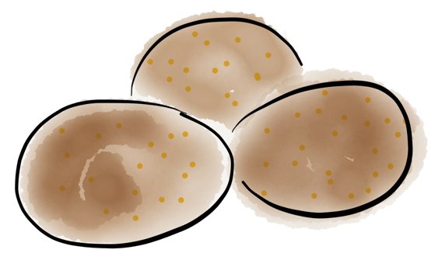
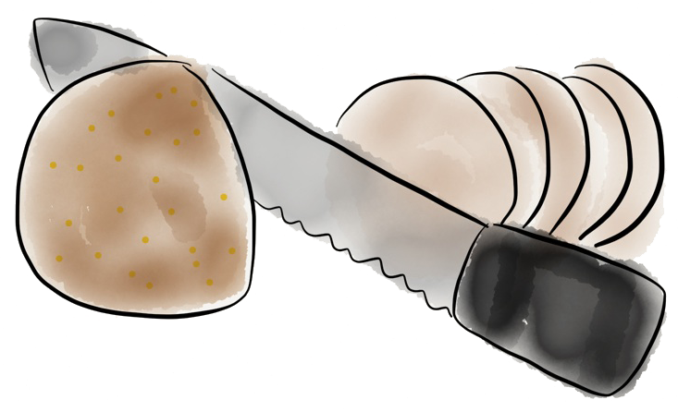
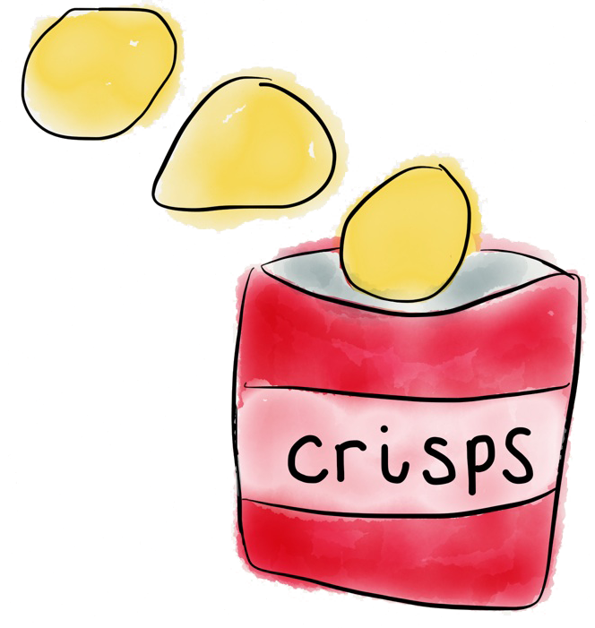
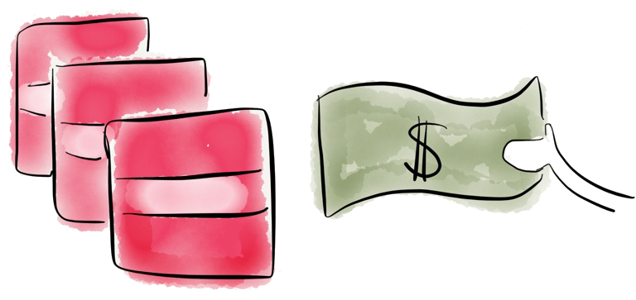
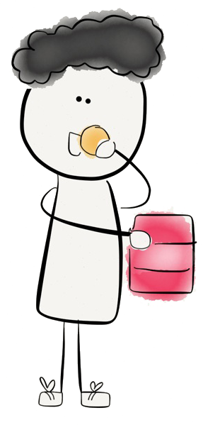
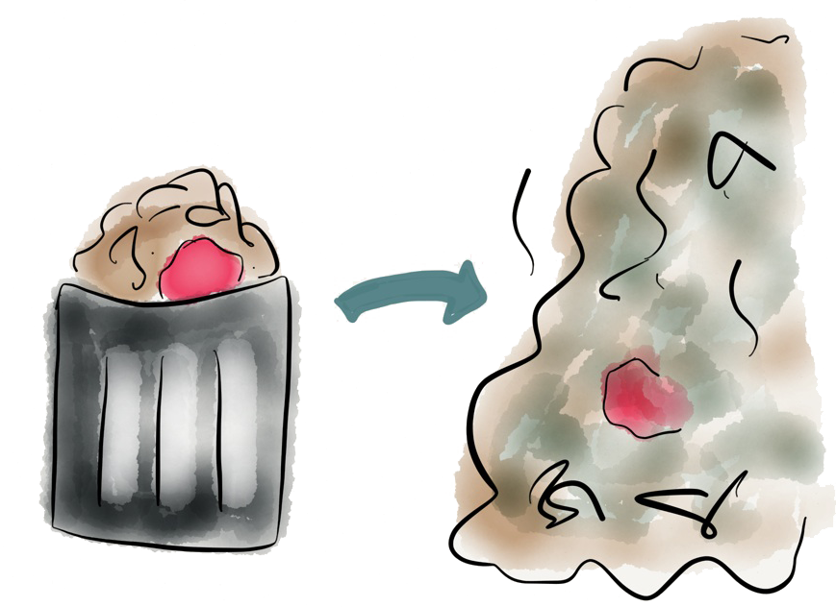
DESIGN CHALLENGE
The potato journey
1
Potatoes were grown,
then harvested
2
They were taken to a factory where they were baked, sliced and processed.
3
The crisps were baked then put into a bag
4
I bought them at the shop
5
6
The packet will go to the dump
Then I ate them
Notes:
TEACHER’S GUIDANCE:
Use this slide to illustrate the journey that a packet of crisps goes through.
USEFUL QUESTIONS:
What other products follow a similar journey to crisps?
What important parts of the journey are left out? (Transportation!)

Slide 22
DESIGN CHALLENGE
The linear story
Notes:
The linear process in action.

Slide 23
DESIGN CHALLENGE
Small groups, big change
How might we re-design packaging?
Packaging
Notes:
USEFUL INFORMATION:
Crisp packets are an example of multi-layered packaging which is difficult to recycle. Each layer adds a certain property; for example, one layer may be good at keeping out moisture while another may add strength and flexibility.
Typically, this type of packaging is designed for single rather than repeated use.

Slide 24
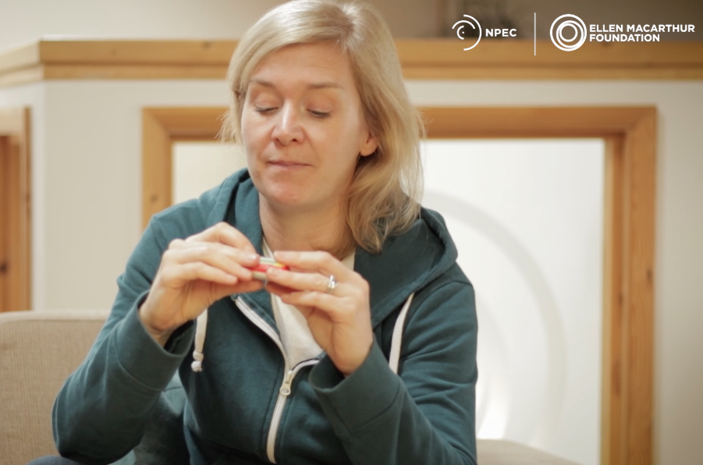
LET’S REDESIGN
Here’s an example from real life
Notes:
(Click on above photo to watch video)
A team member of the Ellen MacArthur Foundation explains the challenges around multi-layered packaging.
VIDEO TRANSCRIPT:
Hello, I’m Phillipa, And I work for the New Plastics Economy team here at the Ellen MacArthur Foundation. One of the things we’ve been thinking about that could do with a bit of a redesign, are these things: plastic sachets. Let’s have a look at them. They are small, lightweight, cheap, and they enable us to get a single serving of any product that we want, when we want, and also saves us carrying around a big bottle of ketchup in our pockets.
But there’s a problem with these sachets, and that problem is that they are made of multiple layers of plastic, which are currently unrecyclable. More often than not, they also have a tear off strip on them, which doesn’t even make it to the bin let alone the recycling system half the time. Which means that these things often end up in our environment.
And here’s your design challenge for today: How can we design a new system of getting a single serving of a product to the consumer when they want it, where they want it, without damaging the environment. And it’s over to you.

Slide 25
DESIGN CHALLENGE
Let’s use the item
2
Select someone in your group and let them use the item.
How do they use it? What do you notice?
Notes:
TEACHER’S GUIDANCE:
In groups or pairs, ask students to decide on a type of plastic packaging that needs redesigning e.g.crisp packets, plastics sachets or plastic packaging with tear-offs (such as the little plastic pull tags found on some drinks bottles that release the cap).

Slide 26
DESIGN CHALLENGE
What’s great about the packaging?
3
Ask that person to choose one thing
…they like most about the packaging? ____________________________
…that could be better? ____________________________

Slide 27
DESIGN CHALLENGE
Create your own material features checklist
Write a list of the things your packaging needs to do:
3
4
Ask that person to choose one thing
…they like most about the sachet? Write it down.
…that could be better? Write it down.
____________________________________
____________________________________
____________________________________
____________________________________
Notes:
SOME IDEAS:
Keep product fresh
Maintain flavour
Air and water tight
Protect from germs
Light
Easy to open
Show ingredients
Aesthetically pleasing
Inexpensive

Slide 28
DESIGN CHALLENGE
Remember these principles?
Keep materials in cycles
Nothing becomes ‘waste’
Notes:
TEACHER’S GUIDANCE:
Remind students of these two key principles of the circular economy. Encourage their ‘how might we’ questions (on next slide) to address these principles.

Slide 29
DESIGN CHALLENGE
Let’s work through the Design Game Sheet
5
Write down your ‘how might
we’ question in the following format.
“How might we design a ________ so that ___________________________________
___________________________________
and is fit for the circular economy?”
“How might we design a ________ so that _______________________
___________________________
and is fit for the circular economy?”
“How might we design a ________ so that _______________________
___________________________
and is fit for the circular economy?”
“How might we design a ________ so that _______________________
___________________________
and is fit for the circular economy?”
Notes:
EXAMPLE QUESTION:
How might we design a sachet so that it protects the ketchup hygienically, but is fully compostable and is fit for the circular economy?”
Note: Remind students to address the two principles when designing for a circular economy.

Slide 30
DESIGN CHALLENGE
Let’s work through the Design Game Sheet
6
Use post-its and write or draw as many ideas as possible to answer your ‘how might we…’ question from number 5.

Slide 31
DESIGN CHALLENGE
Let’s work through the Design Game Sheet
7
Select one idea that you want to explore further and prototype.

Slide 32
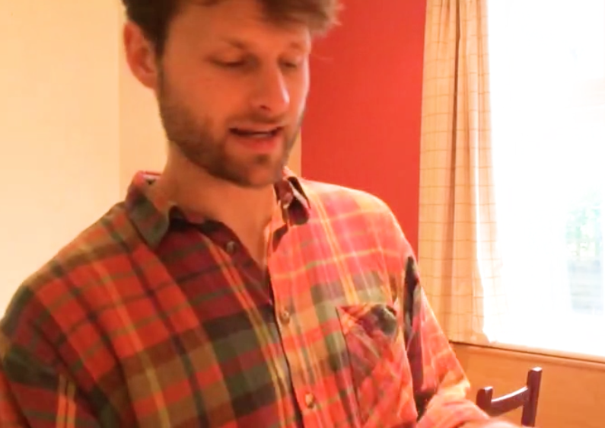
SOME PROTOTYPING INSPIRATION
Notes:
(Click on above photo to watch video)
Remind students that the prototyping process is just a way of giving life to an idea in order to demonstrate the essential workings; it does not have to look pretty or use the same materials that you would want to use to create your design for real. It’s about having fun and being creative!

Slide 33
DESIGN CHALLENGE
Let’s work through the Design Game Sheet
8
Now, it is time to prototype! Create a prototype that communicates the key idea of your design.

Slide 34
DESIGN CHALLENGE
Let’s work through the Design Game Sheet
9
Share your idea! Prepare to present to the class:
1) What is great about your packaging?
2) Present your prototype

Slide 35
DESIGN CHALLENGE
Let’s work through the Design Game Sheet
10
Congratulations, you are now a designer! What did you learn today?

Slide 36

What can be done to make the circular economy a reality for plastics?
Now that you have learned about plastics, list all the steps that can be taken to improve the plastics system…
Notes:
USEFUL INFORMATION:
Reuse. Make secondary markets more economically attractive
Sorting and collection. Develop adoption of collection and sorting guidelines
Recycling. Drastically increasing the economics, uptake and quality
Business models. Adopt a business model that allows home users to reuse plastics (like Splosh.com, for example)
Service-based models. Sell the service rather than the product, and eliminate packaging in the process (Netflix, for example)
Design. Create a global standard for plastic design
Compostable packaging. Return nutrients to the soil
Materials. Use materials that don’t harm natural systems (example: dissolvable packaging)

Slide 37



Share your design with the world!
#WorldsLargestLesson
@TheWorldsLargestLesson @TheWorldsLesson @theworldslesson
@EllenMacArthurFoundation @circulareconomy
Add your idea to the interactive world map –
and help write the story of the World’s Largest Lesson!
http://worldslargestlesson.globalgoals.org/map

Slide 38
Notes:
Thank you for teaching this important topic with your students. For more information on resources, content and all things circular economy, please see the final page of the lesson plan that accompanies this Powerpoint.
We welcome any feedback so please feel free to email harrison.wavell@ellenmacarthurfoundation.org or fill in the short questionnaire found on the final page of the lesson plan PDF.

