Slide 1
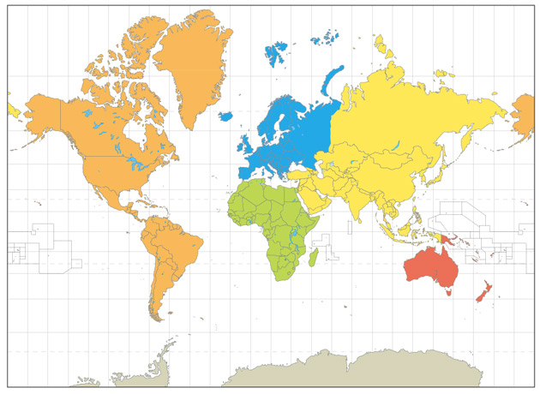
Mercator Map

Slide 2
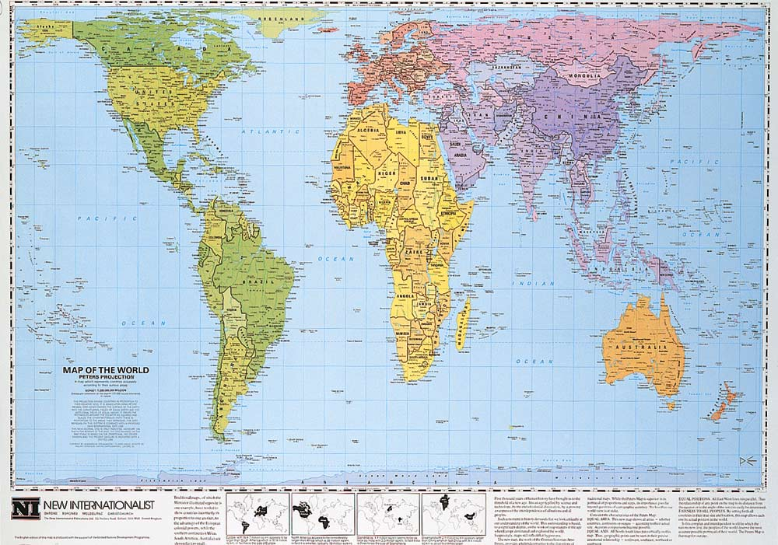
Peter’s Projection Map
HOW THE WORLD WORKS
Mapping our world

Slide 3
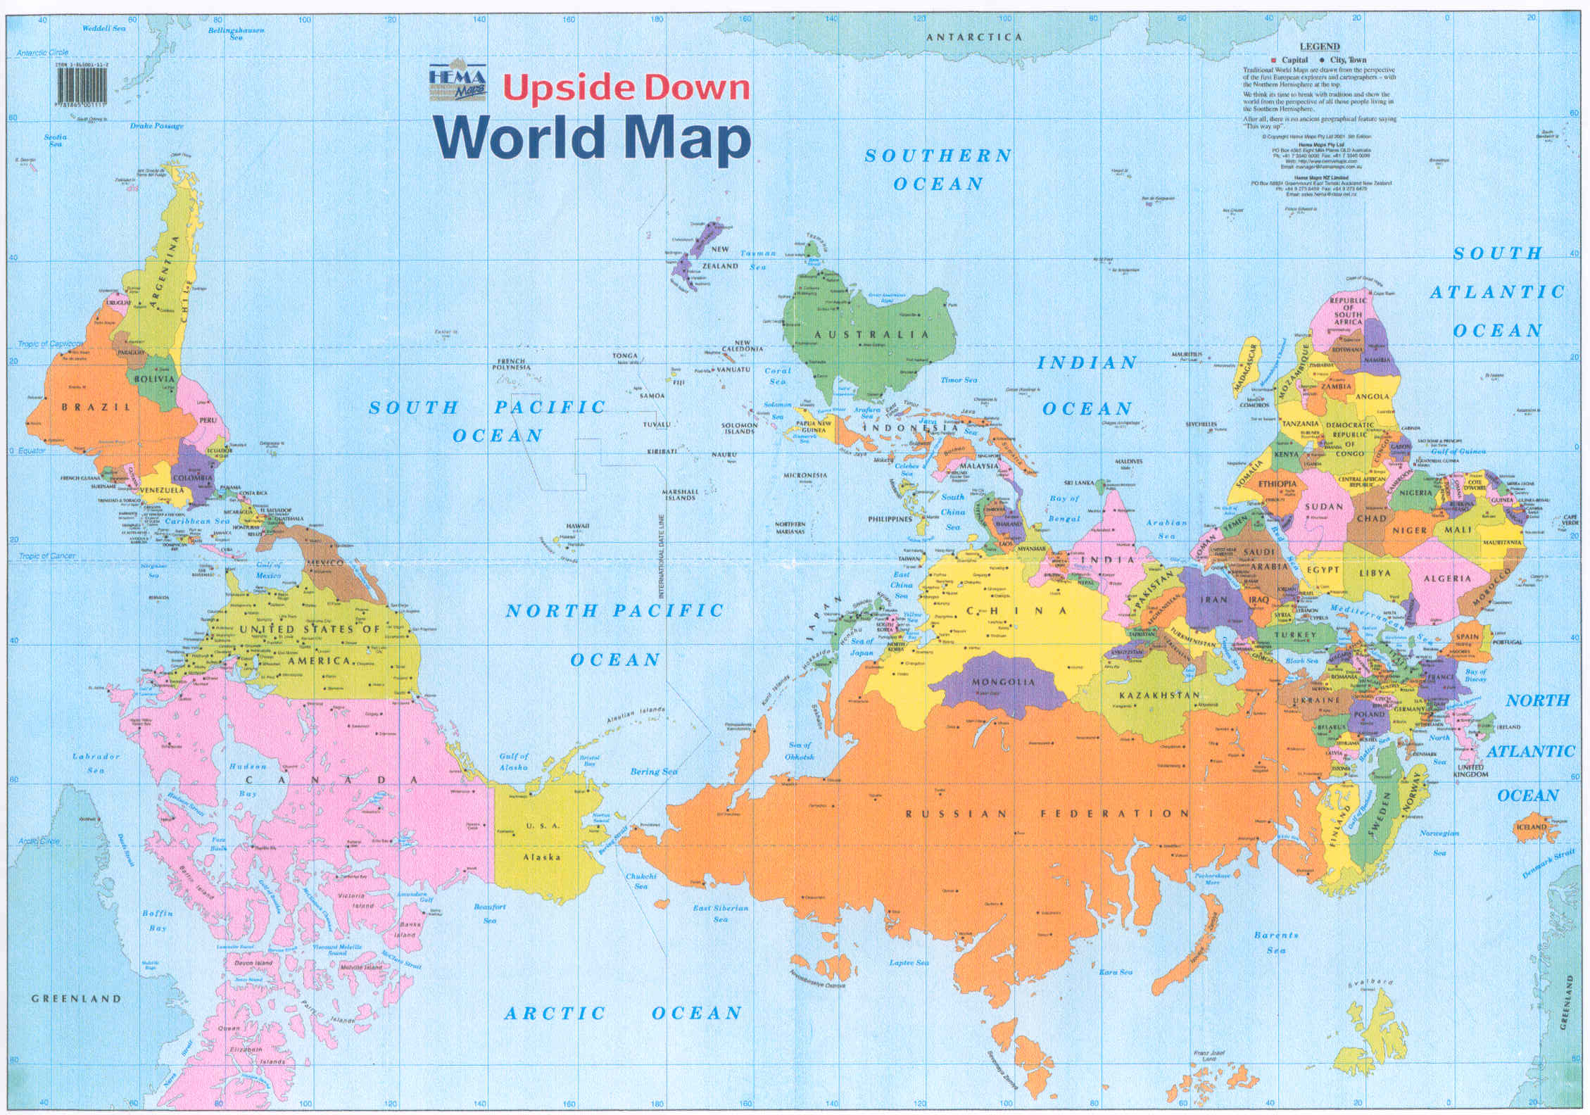

Slide 4
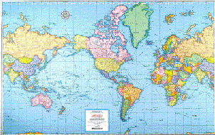
What’s different here?

Slide 5


